Slide 1
Programming memory safe OVS in Rust
December 10-11, 2019 | Westford, MA
William Tu, Yi-Hung Wei VMWare Inc.

Slide 2
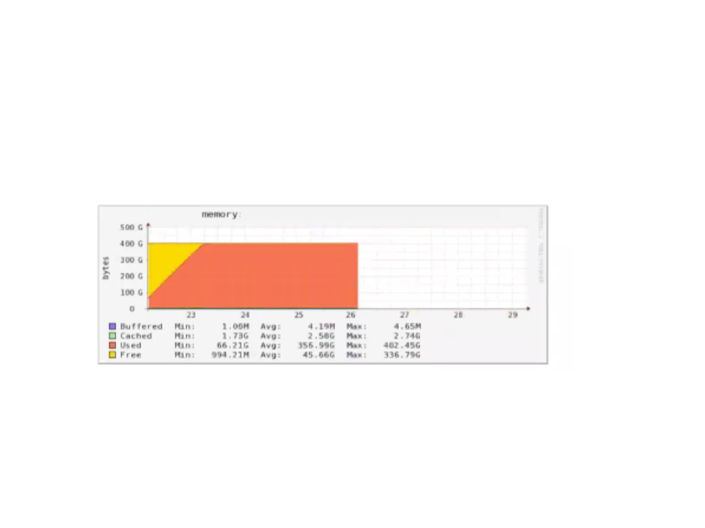
Motivation
C provides great freedom and control in the use of memory
C introduce memory safety problems easily
Accesses of uninitialized memory
Access of deallocated memory
Dangling pointers
Memory leakage
Buffer and stack overflows
The memory issue may lead to security hole^{[*1]} and system crash.
[1] https://mail.openvswitch.org/pipermail/ovs-announce/2016-March/000082.html

Slide 3
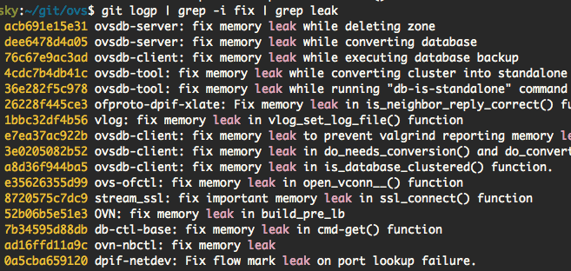
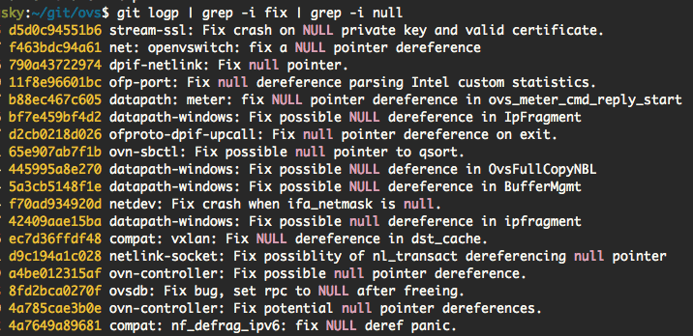

Slide 4
Address memory issues
Current approach
Tools that reduce memory issues
Address Sanitizer, Undefined Behavior Sanitizer, Valgrind, etc...
Alternatives
Automatic memory management
A runtime keeps track of all of the references to the objects
Example: Java, Python
Slower and less predictable performance
Less control over low-level memory details
Rust
Provide memory safety without compromising performance

Slide 5
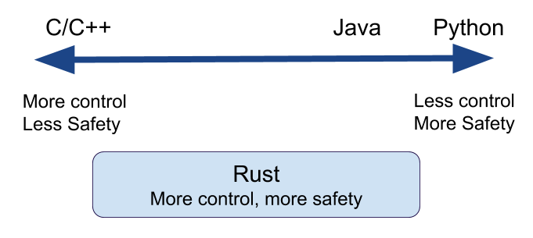
Rust programming language
A system programming language
Memory and thread safety
Rich type system and ownership model
Guarantee memory-safety and thread-safety
Eliminate many classes of bugs at compile-time
High performance
No runtime or garbage collector
Powerful compiler
Easily integrate with C
Package management

Slide 6
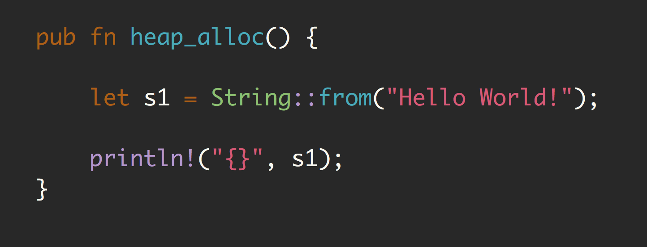
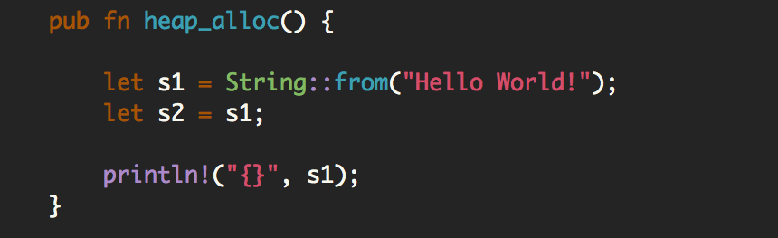
Ownership
Each value in Rust has a variable that’s called its owner.
There can only be one owner at a time.
When the owner goes out of scope, the value will be dropped.
Memory is freed after owner goes out of scope.
No more memory leak
error[E0382]: borrow of moved value: `s1`

Slide 7
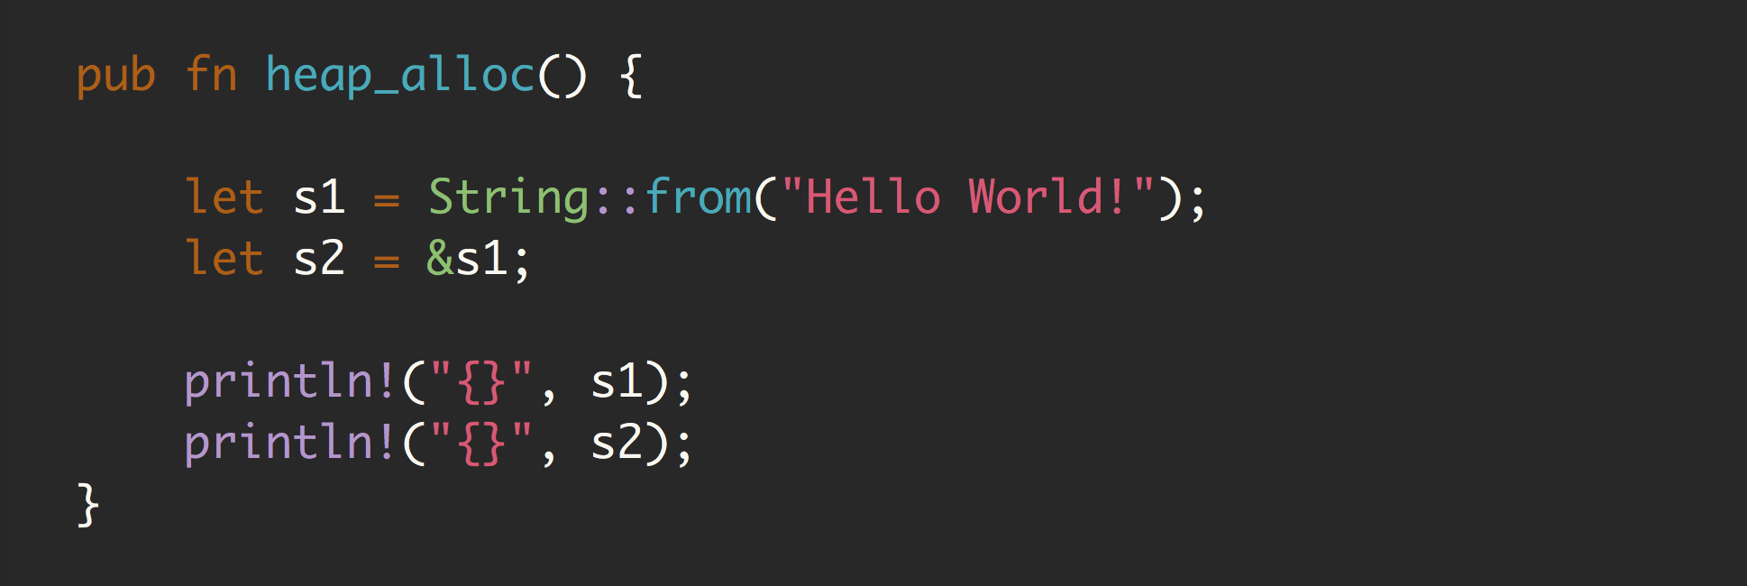
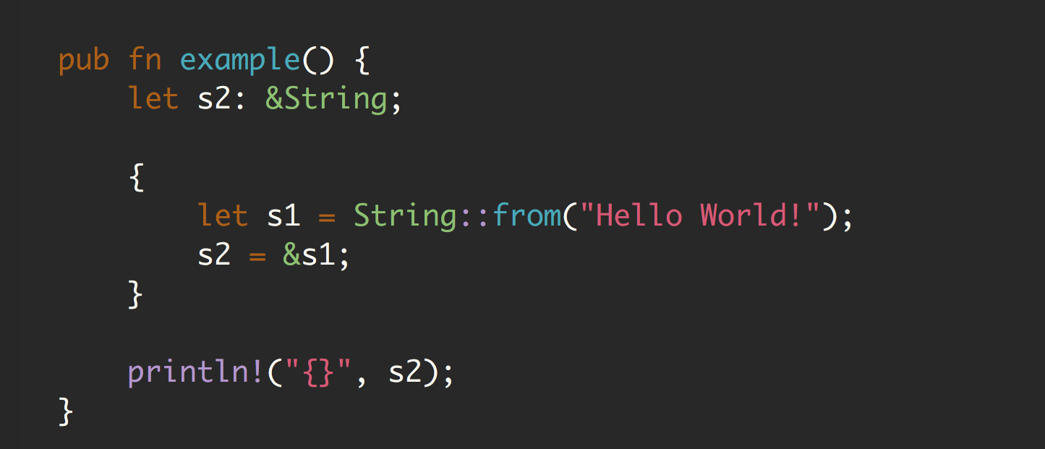
Reference & Borrowing
At any given time, either have
one mutable reference
any number of immutable references
References must always be valid
Immutable borrow
error[E0597], borrowed value does not live long enough. Avoid use after free.

Slide 8
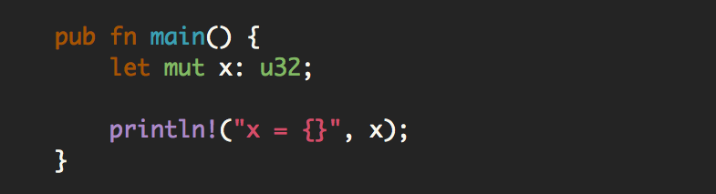
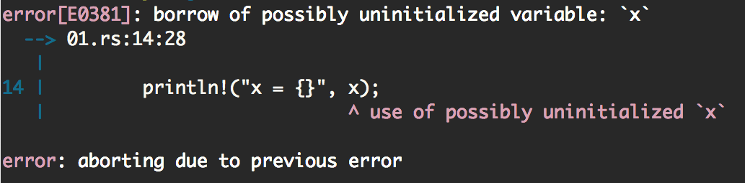
Avoid uninitialized variables

Slide 9
Flow Rust Project
Goal
Rewrite miniflow_extract() by Rust
Why?
This logic is executed in fast path for every packets
Memory bug in this area can lead to serious bugs
CVE-2016-2074: MPLS buffer overflow vulnerabilities in Open vSwitch
Implementation
Build rust implementation as a shared library
Link the shared library with ovs-vswitchd

Slide 10
Performance Evaluation
Testbed
Two servers
Intel Xeon E5 2240 v2 1.9GHz
Intel X540-AT2 10Gbps NIC
One server runs traffic generator using DPDK, 64-byte UDP traffic
DUT runs OVS with simple port forwarding
Measure single core performance
10
AF_XDP datapath | AF_XDP + Flow Rust
6 MPPS | 4.5 MPPS

Slide 11
Conclusion and Future Works
Rust is a memory safe system programming language
Implement flow extract function with Rust and integrate it with ovs-vswitchd
Future work
Rust other OVS code / New feature with Rust
Using Rust’s thread safety feature in OVS
Writing OVS kernel datapath module using Rust
Reduce unsafe code
Performance tuning
Try it out
https://github.com/williamtu/flow-rust

Slide 12
Thank you!

Slide 13
Backup Slides

Slide 14
Rust Safety Model
At any given time, you can have either
one mutable reference
any number of immutable references.
References must always be valid.
No null pointer, only Option type
Out-of-bounds access
At runtime, program stops
Ownership rules apply across multiple threads

Slide 15
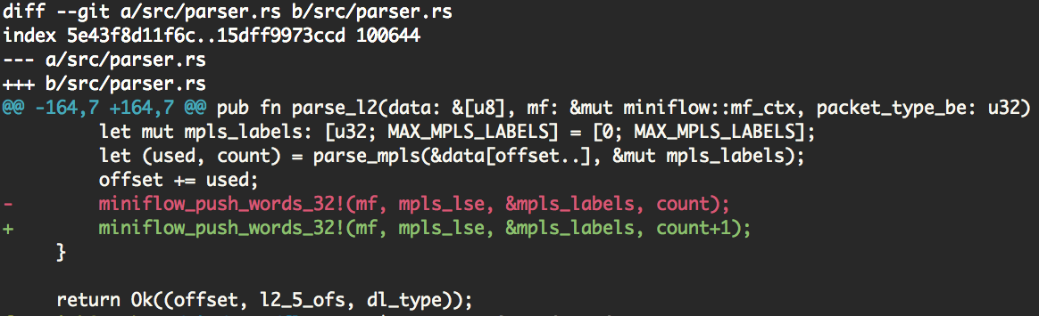
How Rust avoid buffer overflow?
$ cargo test
---- parser::tests::l2_mpls stdout ----
thread 'parser::tests::l2_mpls' panicked at 'index out of bounds: the len is 1 but the index is 1', src/miniflow.rs:223:36
stack backtrace:
……….
13: rust_begin_unwind
at src/libstd/panicking.rs:303
14: core::panicking::panic_fmt
at src/libcore/panicking.rs:84
15: core::panicking::panic_bounds_check
at src/libcore/panicking.rs:61
16: ovsflowrust::miniflow::mf_ctx::miniflow_push_words_32_
at src/miniflow.rs:223
17: ovsflowrust::parser::parse_l2
at src/parser.rs:167
18: ovsflowrust::parser::tests::l2_mpls
at src/parser.rs:792

Slide 16
Perf result
Current C implementation
34.15% pmd-c06/id:6 ovs-vswitchd [.] dp_netdev_process_rxq_port
27.42% pmd-c06/id:6 [unknown] [k] 0000000000000000
16.34% pmd-c06/id:6 ovs-vswitchd [.] miniflow_hash_5tuple
14.98% pmd-c06/id:6 ovs-vswitchd [.] miniflow_extract
14.49% pmd-c06/id:6 ovs-vswitchd [.] __netdev_afxdp_batch_send
11.86% pmd-c06/id:6 ovs-vswitchd [.] netdev_afxdp_rxq_recv
11.75% pmd-c06/id:6 ovs-vswitchd [.] dp_packet_use_afxdp

Slide 17
Perf result
miniflow_extract in Rust implementation
9.99% pmd-c06/id:6 libovsflowrust.so [.] ovsflowrust::miniflow::mf_ctx::miniflow_assert_in_map
7.70% pmd-c06/id:6 libovsflowrust.so [.] ovsflowrust::parser::parse_l2
6.51% pmd-c06/id:6 libovsflowrust.so [.] ovsflowrust::parser::parse_l3
4.15% pmd-c06/id:6 libovsflowrust.so [.] ovsflowrust::parser::parse_metadata
3.58% pmd-c06/id:6 libovsflowrust.so [.] ovsflowrust::parser::parse_l4
2.01% pmd-c06/id:6 libovsflowrust.so [.] ovsflowrust::miniflow::mf_ctx::miniflow_push_words_
Around 32% CPU time in doing Rust version of miniflow_extract()

Slide 18
Miscellaneous
Rust-VMM project
https://github.com/rust-vmm
https://opensource.com/article/19/3/rust-virtual-machine
Firecracker Project – VMM in Rust
https://firecracker-microvm.github.io/
A Rust API for libsrvg
https://people.gnome.org/~federico/blog/a-rust-api-for-librsvg.html
C2Rust: https://c2rust.com/
Writing Kernel Module in Rust
https://ldpreload.com/p/kernel-modules-in-rust-lssna2019.pdf
Is It Time to Rewrite the Operating System in Rust?
https://www.youtube.com/watch?v=HgtRAbE1nBM&t=3222s
Rust Out Your C by Carol (Nichols || Goulding)
https://www.youtube.com/watch?v=SKGVItFlK3w

