Slide 1
Antrea Open Source Kubernetes Networking Based on OVS
December 10-11, 2019 | Westford, MA
Jianjun Shen shenj@vmware.com, Antonin Bas abas@vmware.com

Slide 2
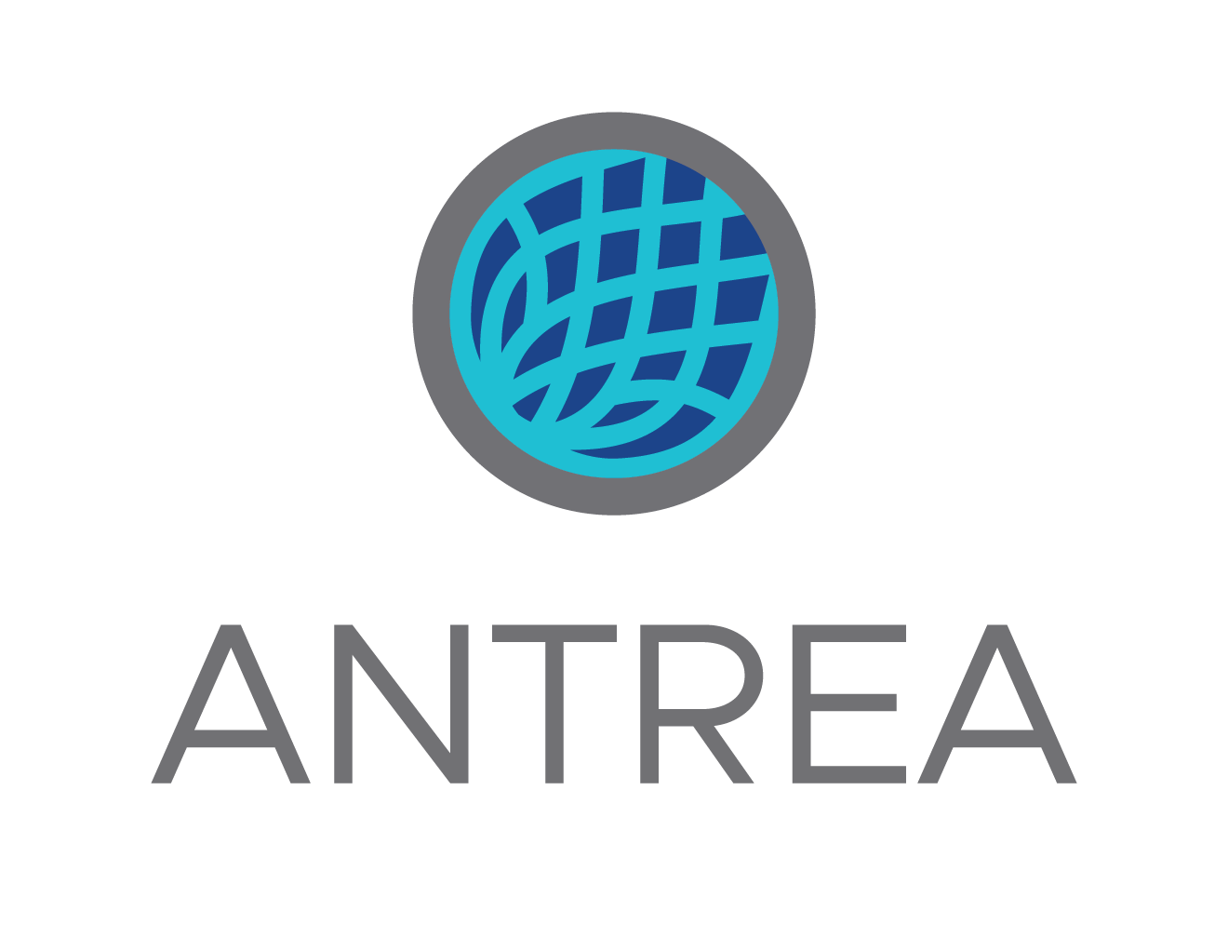
What is Antrea
Kubernetes Cluster Networking
Open vSwitch as Data Plane
Open Source
Built with K8s technologies. K8s’ way to operate.
Supports all OSes and compute platforms K8s runs on.
Focuses on and optimized for K8s networking
Flexible; enables fast feature development
Leverages existing open source
Supports Linux and Windows
Good performance
Rich set of troubleshooting mechanisms
Strong community support
Public on Nov 18, 2019 https://github.com/vmware-tanzu/antrea Apache 2.0 license
Open governance

Slide 3
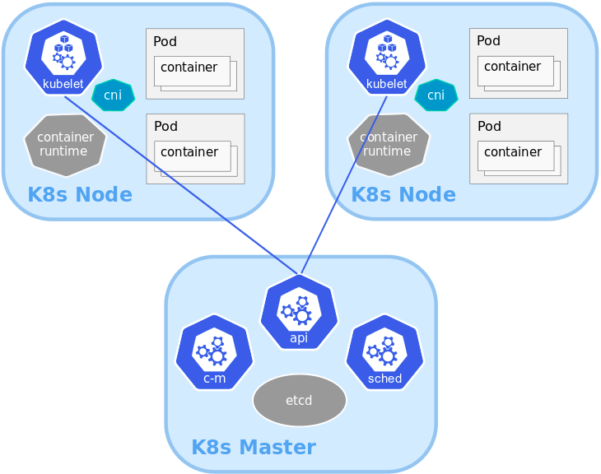
Kubernetes Networking Introduction
Pod
"The basic execution unit of a Kubernetes application"
Each Pod has its own IP address.
CNI (Container Network Interface) plugin is responsible for allocating Pod IPs and configuring network interfaces.
Network connectivity assumptions
“pods on a node can communicate with all pods on all nodes without NAT”

Slide 4
Kubernetes Networking Introduction (cont.)
NetworkPolicy
"a specification of how groups of pods are allowed to communicate with each other and other network endpoints".
Service
"An abstract to expose an application running on a set of Pods"
Inside the Cluster exposed via a ClusterIP (VIP allocated by K8s).
kube-proxy implements the VIP and distributes the traffic to the Service's backend Pods.
kube-proxy has implementations with: iptables, IPVS, and a userspace proxy.

Slide 5
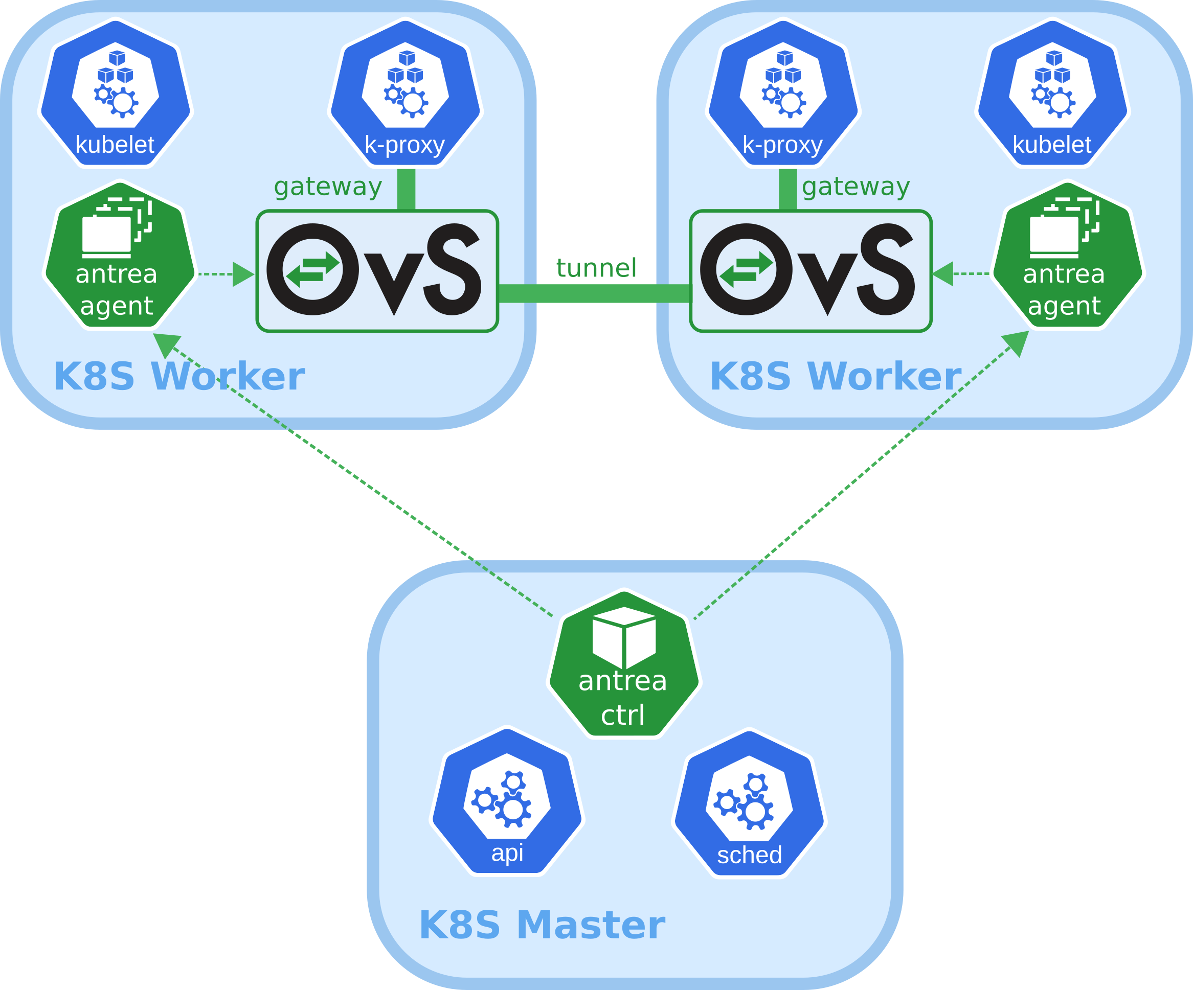
Antrea Technical Overview
Kubernetes Native Networking and Security Solution
Supports K8s cluster networking:
Pod network, NetworkPolicy, Service ClusterIP.
Open vSwitch as data plane.
Built with K8s technologies:
Leverages K8s and K8s solutions for API, UI, deployment, control plane, CLI.
Antrea Controller and Agent are based on K8s controller and apiserver libs.
All components are deployed using K8s manifests.
Multi-platforms
VM, bare metal, public clouds
Windows

Slide 6
Antrea Roadmap
Standard K8s Networking
Upcoming Features
Open Interfaces to External Policy Manager and Analyzer
Pod overlay network
VXLAN or Geneve
K8s Network Policy
Octant UI plugin
CLI for debugging (under development)
Windows Node
IPv6 and dual stack
OVS and NetworkPolicy troubleshooting
Data plane extensions
No encapsulation mode
IPSec encryption
K8s on public clouds
Global policy and visibilty
Exporting flow information to a flow/policy analyzer

Slide 7
Antrea Components
Antrea Controller
Computes K8s NetworkPolicies, and publishes the results to Antrea Agents.
Antrea Agent
Manages Pod network interfaces and OVS bridge.
Creates overlay tunnels across Nodes.
Implements NetworkPolicies with OVS.
Antrea CNI plugin
Interface to kubelet. Calls to Antrea Agent for Pod network interface configuration.
Octant UI plugin
Shows Antrea runtime information.
antctl – CLI for debugging
Can be exectued through kubectl as a plugin.
All bits (inc. OVS daemons) in a Docker image.
Super simple to deploy: kubectl apply -f antrea.yml

Slide 8
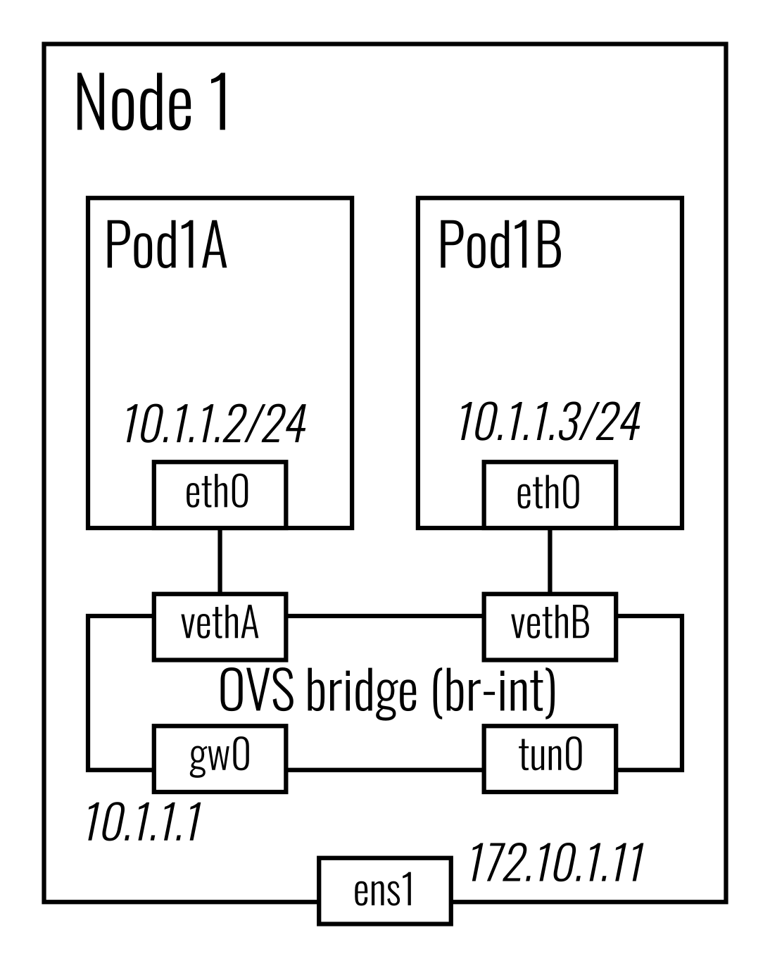
Pod Network on a Node
Each Node has an OVS bridge and is allocated with a single subnet (by K8s NodeIPAM controller).
The subnet's gateway IP is configured to the "gw0" interface on the bridge.
A tunnel interface - "tun0" - is created on the bridge too.
Each Pod's gets an IP from the Node's subnet.
The Pod network interface is connected to the OVS bridge using the veth devices.

Slide 9
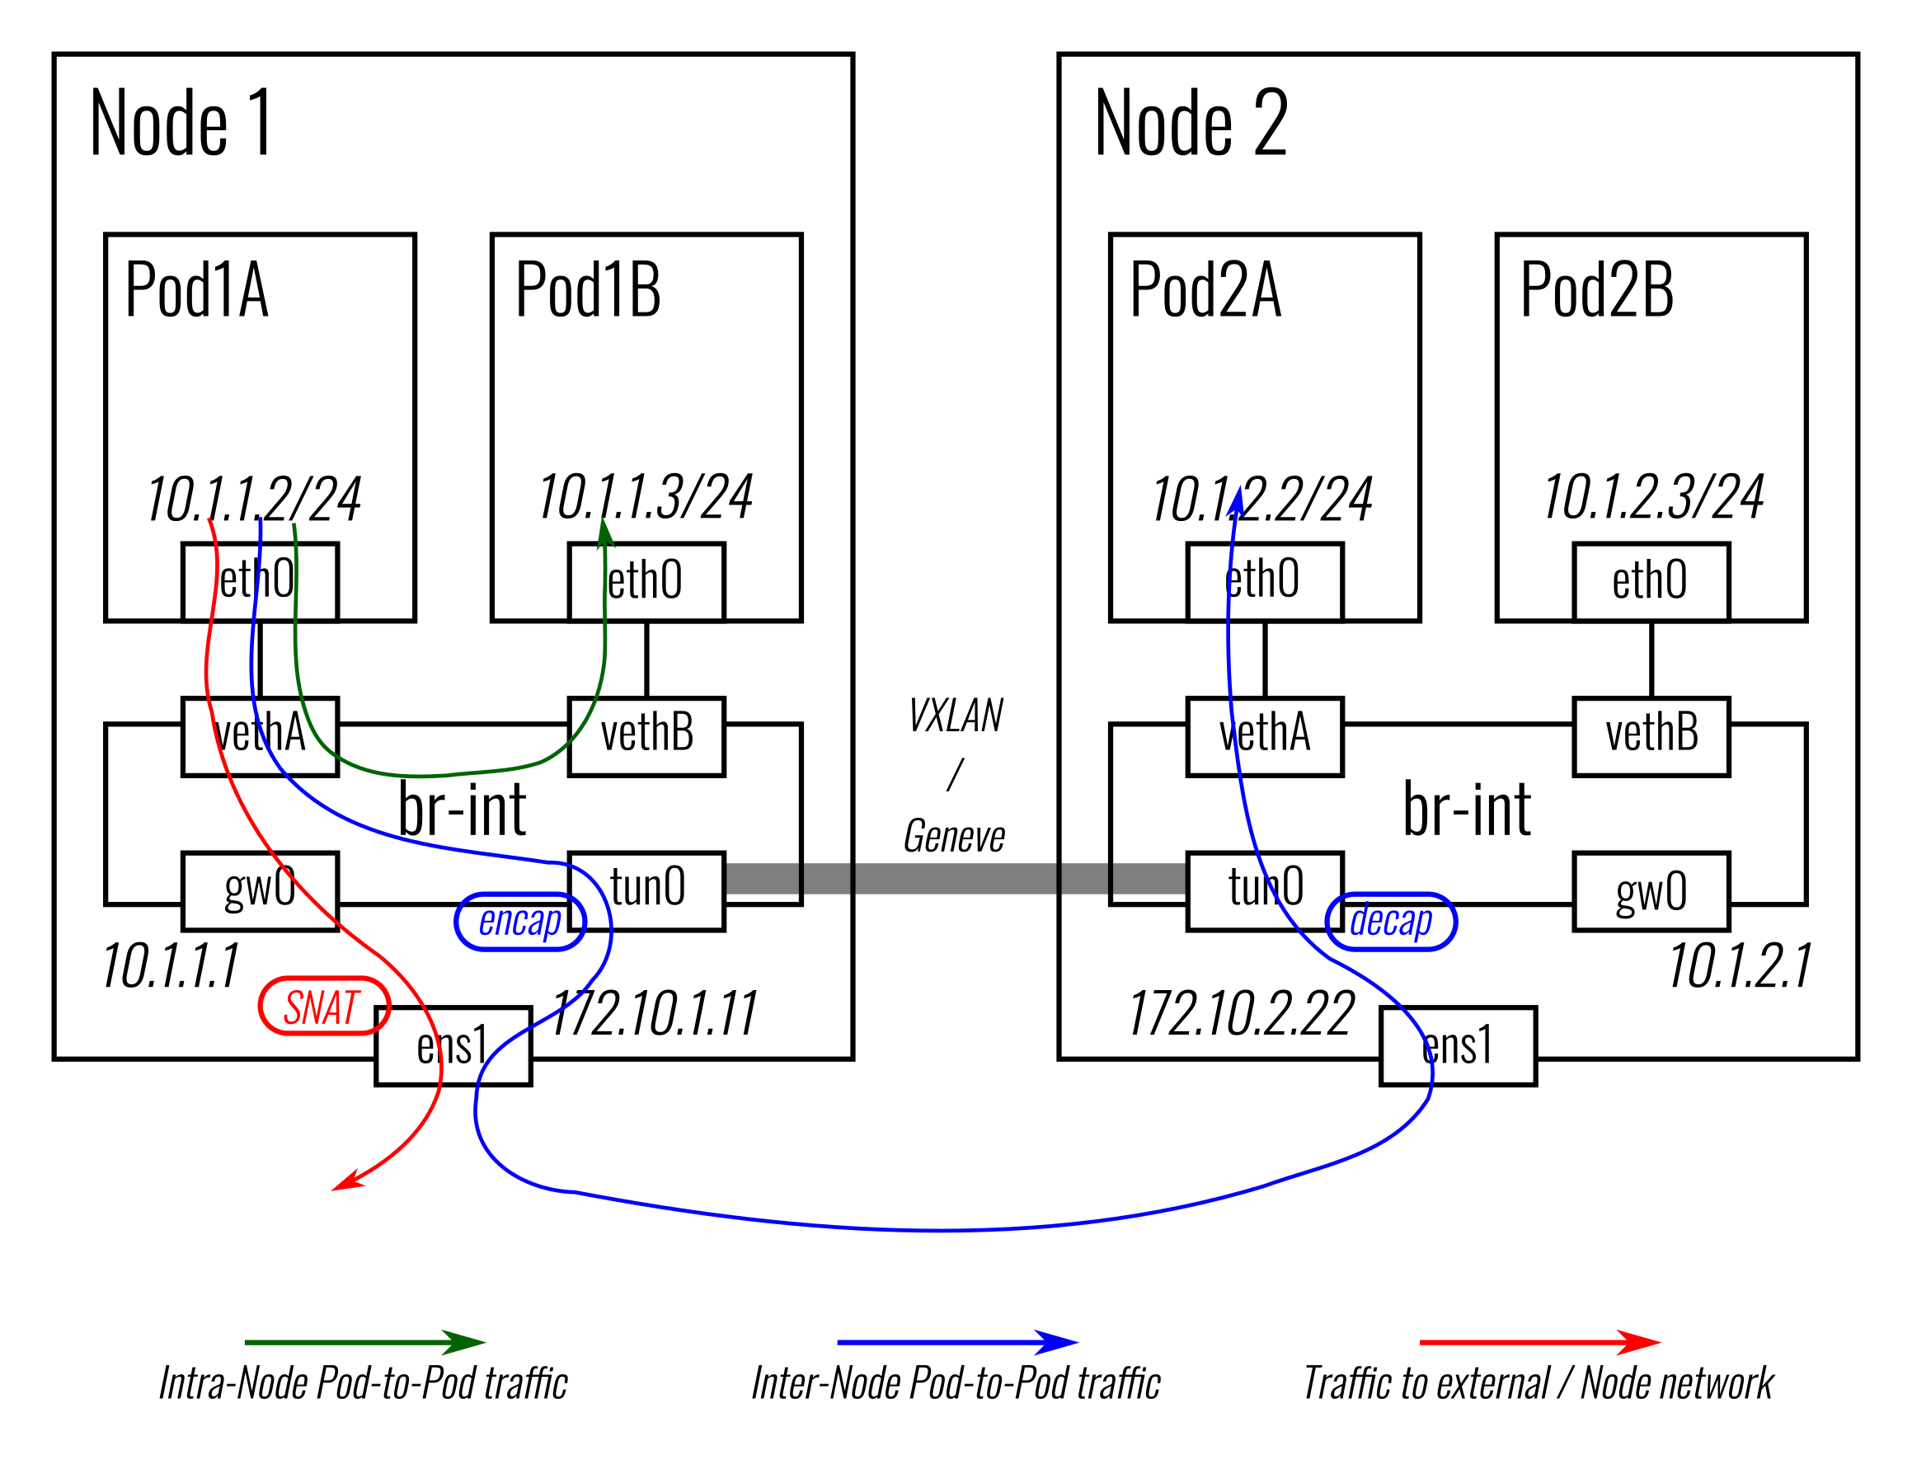
Traffic Walk
Intra-Node traffic
Does not leave the OVS bridge.
Inter-Node traffic
Transmitted to the destination Node via overlay tunnels.
OVS flow based tunneling.
Traffic from a Pod to external network or another Node
SNAT to the Node IP (by an iptables rule).

Slide 10
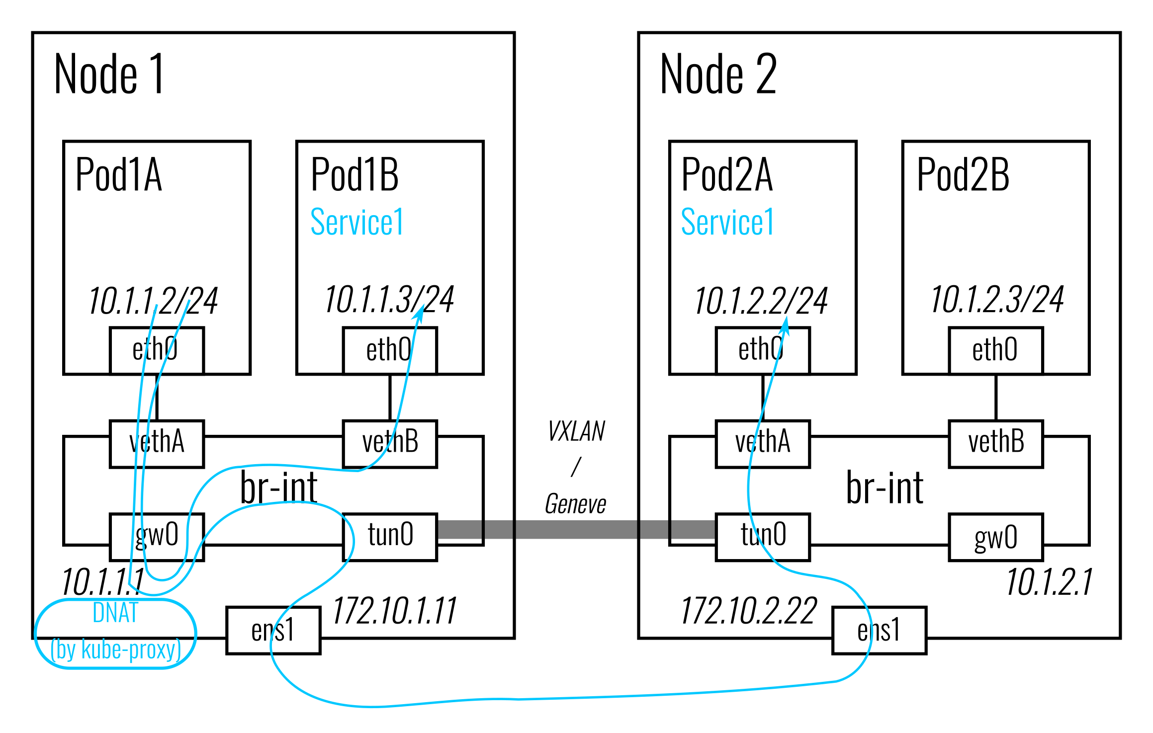
ClusterIP Service Traffic
Antrea now leverages kube-proxy for Service traffic.
Packets to the Service ClusterIP CIDR will be forwarded to “gw0” (in the default network namespace).
Then kube-proxy is able to intercept the packets.
kube-proxy can work in any of the iptables, or IPVS, or userspace proxy modes.
Will also support ClusterIP Service with OVS (group and DNAT actions) in future.

Slide 11
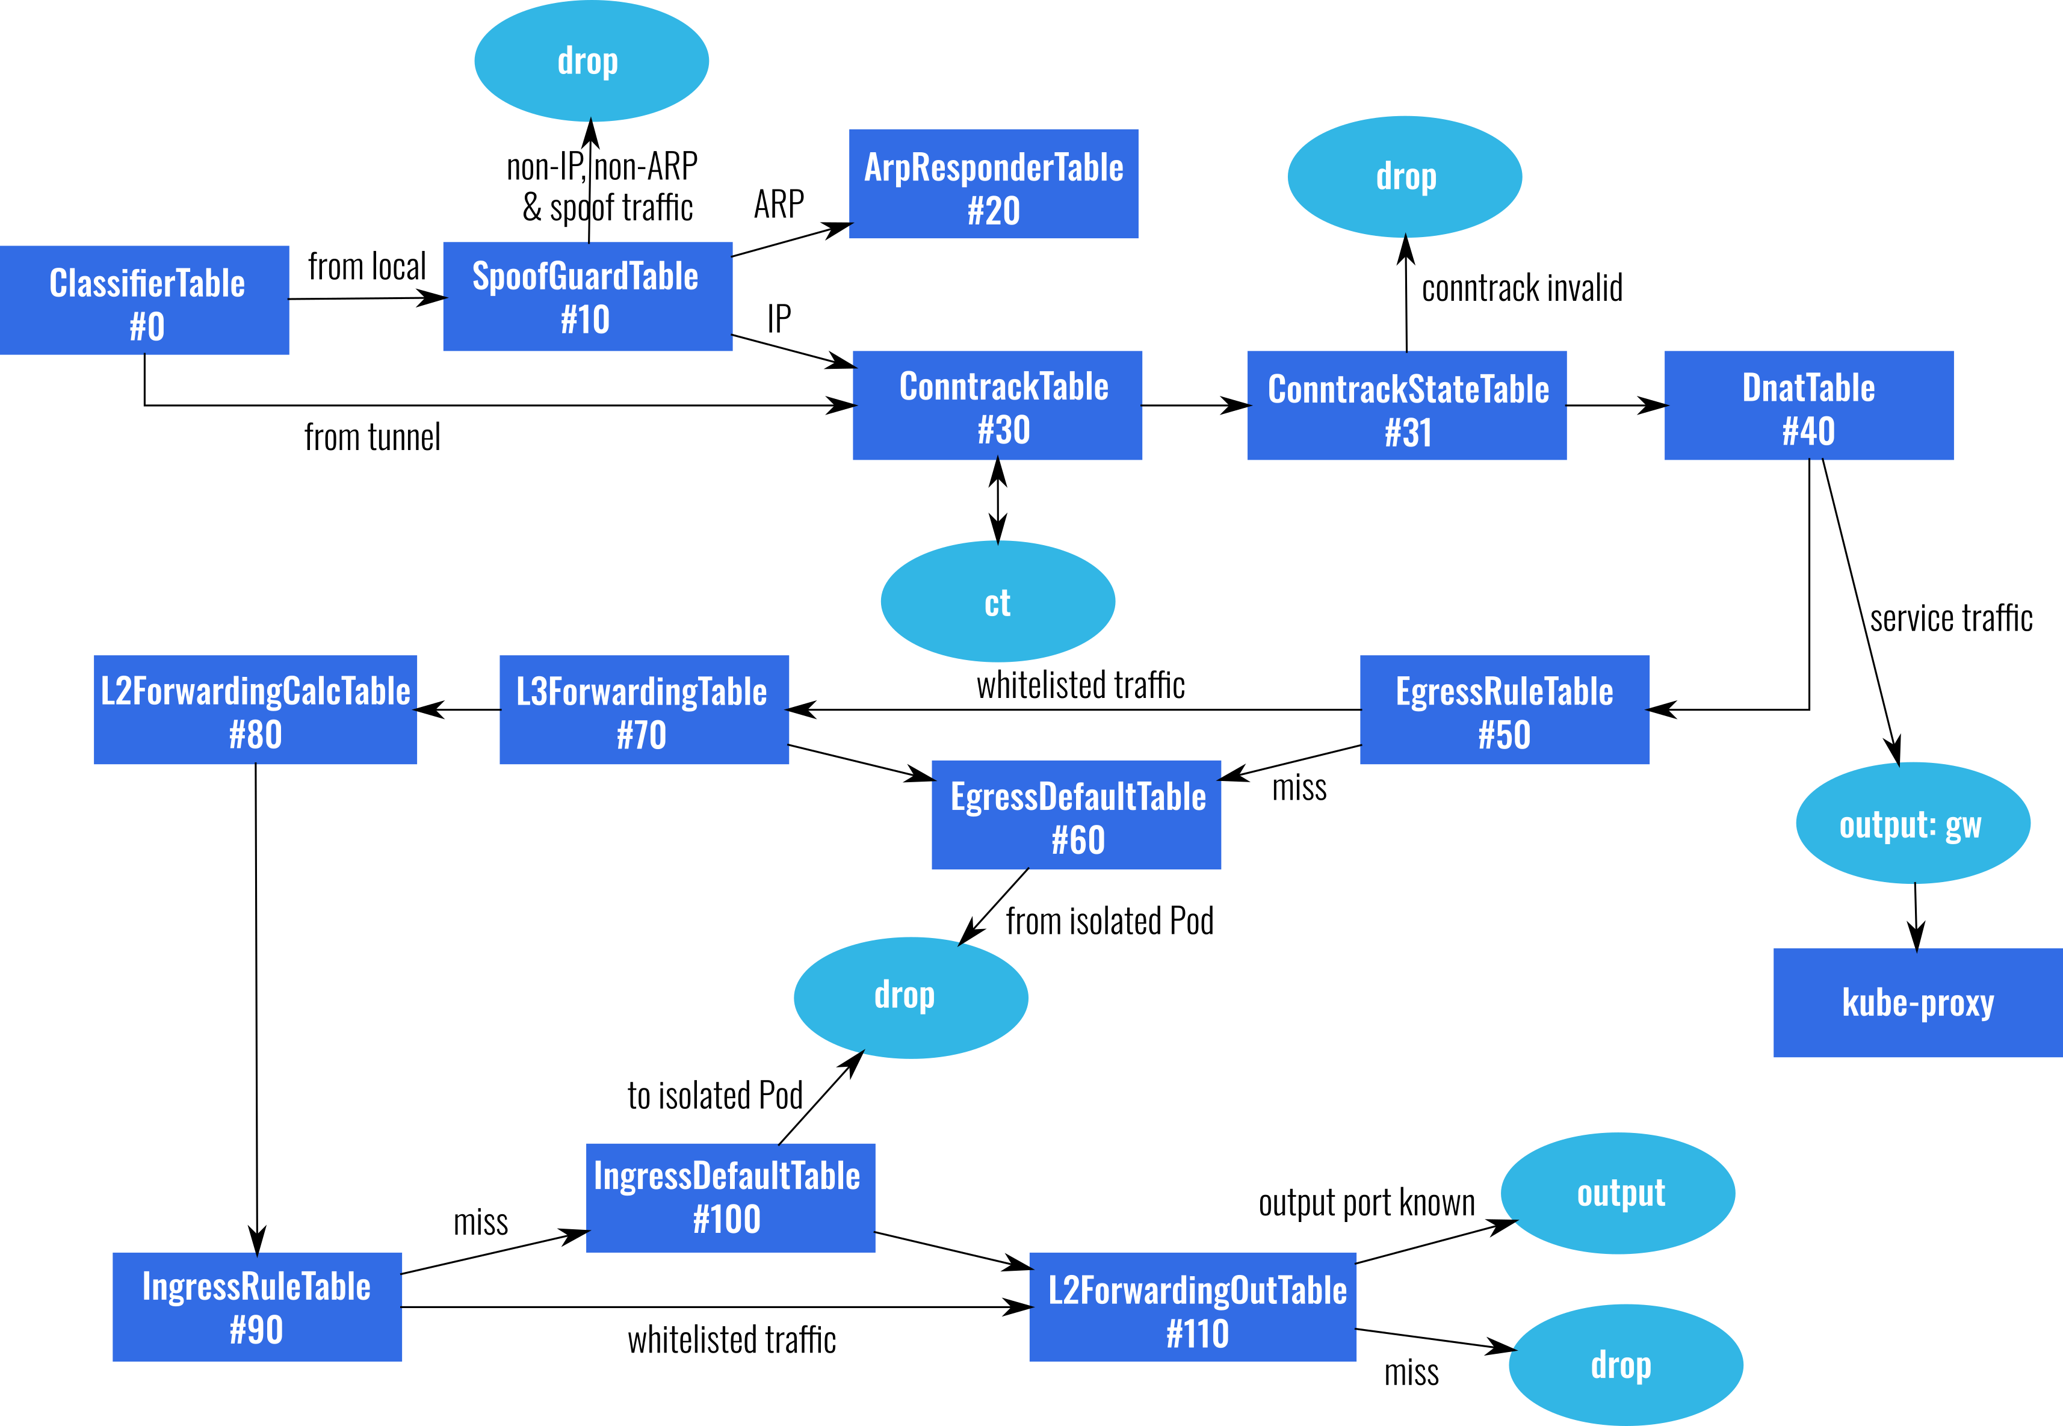
OVS Pipeline
Notes:
ClassifierTable: marks the traffic as coming from a local Pod, the local gateway or a tunnel -> used for subsequent matches
SpoofGuardTable: prevent IP & ARP spoofing from local Pod
ArpResponderTable: responds to ARP requests for remote gateways (with global virtual mac) and rest of ARP traffic is handled by normal action. Each Node has an "onlink" route to every other Node's Pod subnet via the appropriate remote gateway. When a vSwitch receives traffic with the global virtual mac as the destination mac, it is forwarded directly to the appropriate Node.
ConntractTable & ConntrackStateTable:
- commit all connections
- ensures correct reverse path for reply trafiic coming from a backend service Pod
DnatTable: at the moment, just bypasses rest of table (especially egress policy rules) for service traffic
EgressRuleTable: accepts all whitelisted traffic
EgressDefaultTable: drops non-whitelisted traffic from isolated Pod (in K8s a Pod becomes isolated when at least one policy is applied to it)
L3ForwardingTable:
- handles tunnelled traffic destined to local Pods or gateway
- forwards traffic to remote destination on appropriate tunnel (we use flow-based tunneling, add a new flow every time a Node joins the cluster)
L2ForwarindCalcTable: plain dmac table, determines the output port based on the MAC but does not call output action yet, port is stored in register
IngressRuleTable / IngressDefaultTable: same as their ingress counterparts, but this time for ingress rules in network policies
L2ForwardingOutTable: outputs packet to correct port based on register content (set by L2FowardingCalcTable)
The entire pipeline is well-documented in the Antrea github repository.

Slide 12
Network Policy Implementation
apiVersion: networking.k8s.io/v1 kind: NetworkPolicy metadata: name: test-network-policy namespace: default spec: podSelector: matchLabels: app: nginx policyTypes: - Ingress - Egress ingress: - from: - podSelector: matchLabels: app: nginx ports: - protocol: TCP port: 80 egress: ... | IngressRuleTable 1. table=90, priority=210,ct_state=-new+est,ip actions=resubmit(,110) 2. table=90, priority=210,ip,nw_src=10.10.1.1 actions=resubmit(,110) 3. table=90, priority=200,ip,nw_src=10.10.1.2 actions=conjunction(1,1/3) 4. table=90, priority=200,ip,nw_src=10.10.1.3 actions=conjunction(1,1/3) 5. table=90, priority=200,ip,reg1=0x3 actions=conjunction(1,2/3) 6. table=90, priority=200,ip,reg1=0x4 actions=conjunction(1,2/3) 7. table=90, priority=200,tcp,tp_dst=80 actions=conjunction(1,3/3) 8. table=90, priority=190,conj_id=1,ip actions=resubmit(,110) 9. table=90, priority=80,ip actions=resubmit(,100) IngressDefaultTable 1. table=100, priority=200,ip,reg1=0x3 actions=drop 2. table=100, priority=200,ip,reg1=0x4 actions=drop 3. table=100, priority=80,ip actions=resubmit(,110)
Notes:
Pods (target, source, destination) are selected with labels, ip blocks
With conjunctive match fields to avoid an explosion in the number of rules: 3 dimensions (traffic source, egress port == pods the policy is applied to, transport port)
Default table then drops all non-whitelisted traffic for isolated pods
K8s network policies also support exceptions, which are also enforce in this table by dropping traffic
Enforce these policies after forwarding (so we can use the port), egress is before
Same for egress, but we use the IP address and not the port (because rules are enforced when traffic comes back through gateway after dnat)
Connection tracking: once a connection is established we accept all traffic -> performance advantage?

Slide 13
Challenges
Daemon removes all kernel flows on exit
Rolling update re-creates Antrea Agent Pod, daemon is restarted
OVS datapath and vswitchd capability query
Troubleshooting
Few people in K8s community are familiar with OVS
Antrea will provide tools to map flows to higher-level K8s objects
Openflow Go binding
Support for OVS fields & actions and OF bundle added to contiv libraries (contiv/libOpenflow, contiv/ofnet)
Official Go library for OVS?
Flow exporting
Add context to map individual flows back to high-level K8s objects
Notes:
OVS datapath and vswitchd capability query:
- Antrea relies on some recent features, like IPSec support
- Would like to have a reliable way to check if the available OVS kernel module can be used for Antrea, across distributions including RedHat Enterprise Linux
Troubleshooting:
- antrea CLI to run OVS commands easily (right now you need to figure out which container to exec into)
- integration with Octant to expose debugging / monitoring information about each vSwitch
- packet tracing tool: can PodA talk to PodB and if not why? If traffic is getting dropped because of a Network Policy, which one?
LibOpenflow:
- Openflow 1.3 message marshalling / unmarshalling
- add support for Nicira OpenFlow extensions, bundle
Ofnet:
- Openflow agent implementation
- Distributed Openflow controller, with a router implementation
- Minor changes for agent, e.g. support for Unix Domain Socket
Flow exporting:
- Need the ability to map individual flows to the Network Policy / CRD -> use cookie to do that easily & statelessly

Slide 14
Using Antrea & OVS in Kind clusters
What is Kind?
Tool for running local K8s clusters using Docker container Nodes
Kind == K8s in Docker
Can create a 3-Node cluster in 1 minute
Used by K8s project for CI and to run conformance tests
Why do we care?
Pleasant developer UX for projects using K8s
Automation for e2e testing
Use many clusters to run CI tests in parallel
Supports public CI (TravisCI, …) - no nested virtualization
Low infrastructure cost

Slide 15
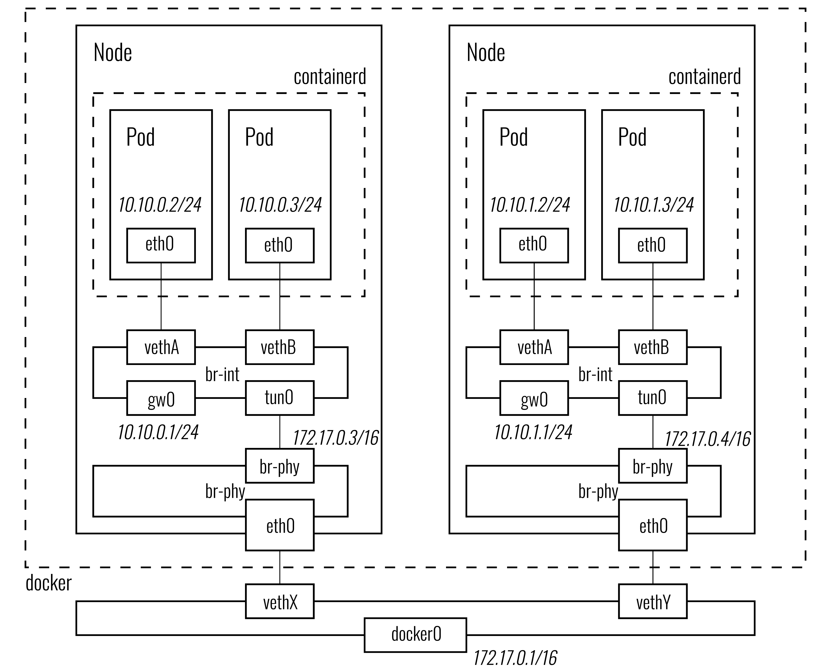
Using Antrea & OVS in Kind clusters
Cannot use kernel datapath
Requires "br-phy" bridge to allow use of the kernel network stack for routing and ARP resolution of encapsulated packet
Netdev datapath does not support TX checksum offloading
Disable it in Pods (easy)
Disable it on host for each Node's veth
Does not work on macOS

Slide 16
Using Antrea & OVS in Kind clusters
Running Antrea in Kind clusters requires some script modifications / YAML manifest customizations
But no changes to the code -> valuable for CI
We run Antrea e2e tests on an ephemeral Kind cluster using Github public CI service (~10mins)
Developers can run e2e tests locally without VMs
Kind can be used to qualify Antrea by running K8s community tests rapidly
Run tests in parallel across several clusters on beefy server

Slide 17
Next steps
Run scale tests to detect performance bottlenecks
Improve performance by using AF_XDP / DPDK?
kube-proxy with OVS
Run performance comparisons with iptables-based solutions
Use OpenFlow bundle
Metrics and monitoring
L2 / L3 / L4
Application monitoring (HTTP / DNS)?
Integration with Grafana / Prometheus
Notes:
Scale tests:
- scale Pods on Node
- scale number of Nodes
- scale number of Policies
Improve performance by using AF_XDP / DPDK:
- how much does it help with container networking
- plan on investigating some work by William Tu and Toshiaki Makita that was presented at Netdev earlier this year about using XDP / AF_XDP for veth (https://www.youtube.com/watch?v=q3gjNe6LKDI)
Kube-proxy with OVS:
- load-balance service traffic with DNAT, SNAT with external traffic
- avoid going through gateway for such traffic originating from Pods
Iptables comparison: e.g. Calico which implements K8s Network Policy with iptables – iptables got much better in recent years so how do we compare against that? OF bundle: can simply error handling / rollback in Antrea OF client
Metrics and monitoring:
- in OVS: packet drops, spoofing alerts, unanswered SYNs?
- app monitoring: http error responses / DNS issues; how do we do this efficiently in the fast path; ebpf filters with TC hook point; what kind of assumptions regarding packets (message cannot span multiple packets)?
- UI tools to visualize these metrics, such as integration with Grafana / Prometheus

Slide 18
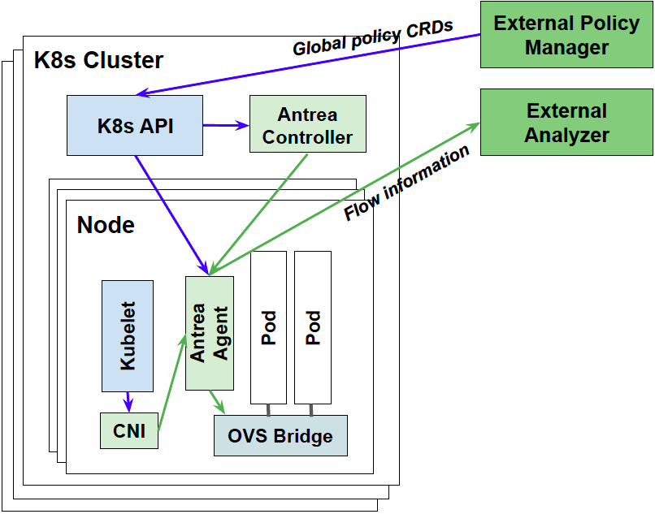
Interfaces to External Policy Manager / Flow Analyzer
Global policy
Defined in K8s API using Antrea policy CRDs (CustomResourceDefinition).
Computed by Antrea Controller and realized by Antrea data plane.
Antrea reports the realization status in the policy CRDs.
Flow and policy analytics
Antrea exports OVS flow information with K8s and policy contexts.
Using standard protocols like IPFix.
Notes:
Global policy:
- K8s policies are specific to a namespace
- Global policy spanning all namespaces
- try to standardize CRD format to promote integration with open and proprietary policy managers
Flow export:
- can export flow information directly from OVS, but not very useful K8s cluster operators

Slide 19

Community
Github: https://github.com/vmware-tanzu/antrea
Slack: #antrea channel in K8s workspace
Mailing list
projectantrea-announce
projectantrea
projectantrea-dev
Community meeting: every Wednesday at 9AM PST

