Slide 1
Extending OVS packet processing pipeline at runtime using P4
December 10-11, 2019 | Westford, MA
Tomasz Osiński, Orange Labs, Warsaw University of Technology, Poland
Notes:
Hello, my name is Tomasz Osiński, I’m a R&D Expert at Orange Labs Poland and also a PhD Student at Warsaw University of Technology.
Today I would like to present you our last-year effort around „extending OVS packet processing pipeline at runtime using P4”.

Slide 2
Main contributions
Design and implementation of programmable actions as BPF programs inside Open vSwitch (based on Oko [1])
P4c-uBPF – a new P4 compiler’s backend
[1] Paul Chaignon et al. 2018. Oko: Extending Open vSwitch with Stateful Filters. In Proceedings of the Symposium on SDN Research (SOSR ’18). 13:1–13:13.
Notes:
In particular, In this talk I’m gonna talk about two contributions that we made around Open vSwitch. The first one is partially based on the Oko switch, which was presented in the previous year by Paul Chaignong. Thanks to userspace BPF implementation we were able to enhance Open vSwitch with programmable actions, which can effectively extend the packet processing pipeline at runtime.
The second contribution is made totally by my team at Orange Labs Poland. We have designed and implemented the userspace BPF backend for P4 compiler, which provides the easy way to implement new network features or protocols for Open vSwitch using the P4 language.

Slide 3

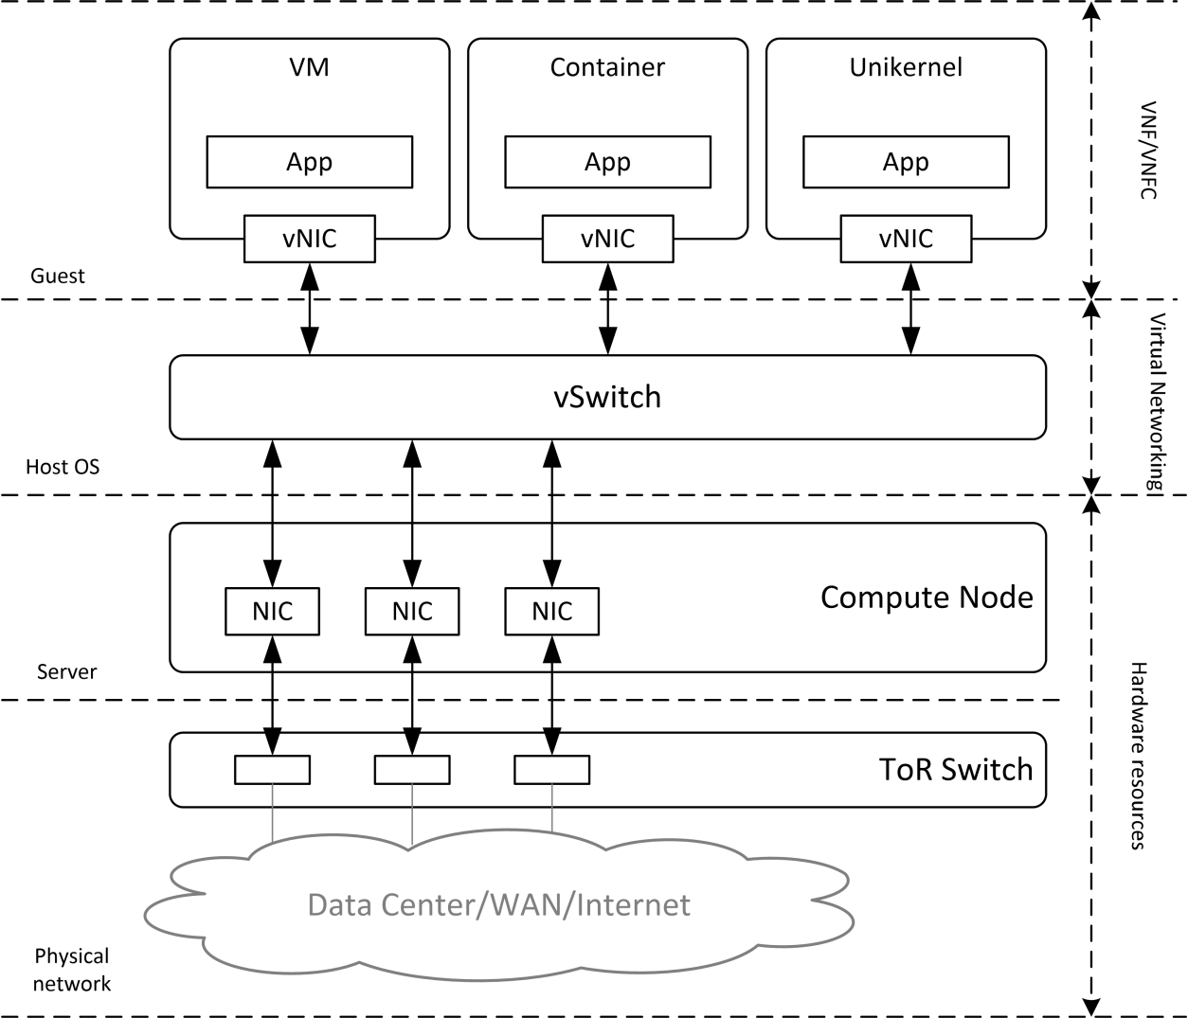
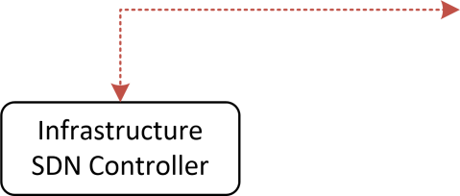


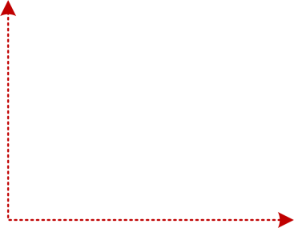
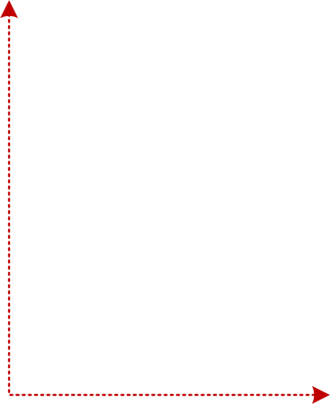

Motivation – VNF offloading using P4
P4 high-level programming language for network data plane
expressivness
protocol-independence
target-independence
VNF’s data plane can be effectively described in P4 and offloaded to the high-performance targets
The need for runtime programmability!
Notes:
Before going to the implementation details I would like to emphasize why we started to work on the runtime extensions for Open vSwitch.
As you may already know, P4 is a high-level programming language to describe a data plane of network devices. It provides three main features, which are expressivness, protocol-independence and target-independence.
These features of P4 are especially interesting for service providers as they can take advantage of the expressivnes and high-level of language and re-design and implement the data plane of the VNF on their own. Then, those programs can be executed on a high-performance targets inside the telco cloud.
However, the first step is to offload the data plane onto the virtual switch, such as Open vSwitch. However, in order to make it possible the virtual switch needs to consume the P4 programs at runtime, without re-compilation. And it was our goal to build such a solution for our use cases.
As P4 gives the expressivness for its users to develop an arbitrary network features it is considered to be used in the Telco world to offload the network-intensive data plane network functions from virtual machines or containers to the high-performance packet processing engines.

Slide 4
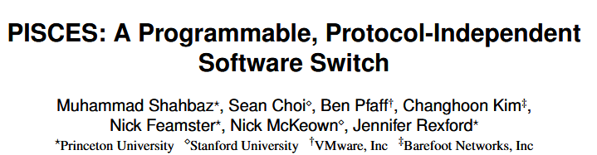
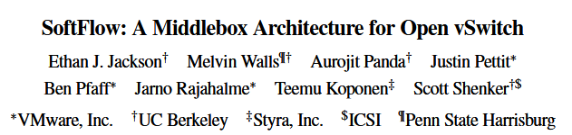
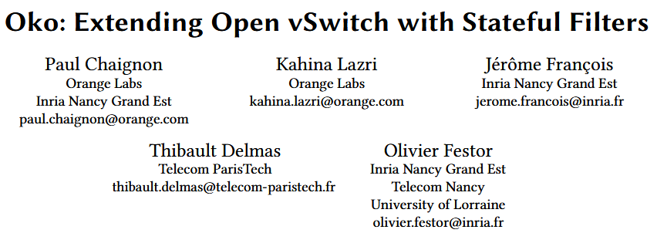
Related work
Notes:
We started from analyzing the related work and it is worth to distinguish here three solutions. First one is PISCES, which is really the first implementation of P4-capable Open vSwitch, but it requires re-compilation every time the P4 program is changed.
There is also the SoftFlow solution, which doesn’t support P4, but allows to develop custom vendor-specific network functions and inject them into the Open vSwitch forwarding pipeline.
And finally, we have Oko switch, which was presented last year by Paul Chaignon, and it provides stateful packet filers and runtime extensibility to Open vSwitch by integrating the userspace BPF subsystem with OVS forwarding pipeline. It also doesn’t support P4, but it was a good starting point for us as it provides runtime extensibility mechanism for Open vSwitch. Therefore, we based our work on Oko significantly.

Slide 5
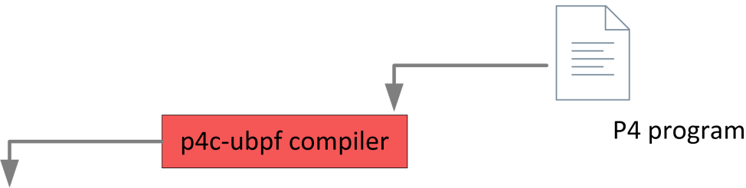
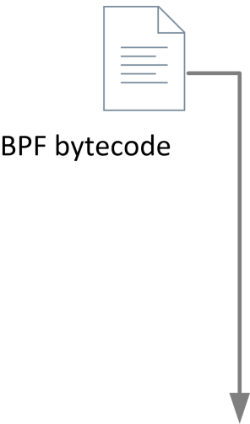
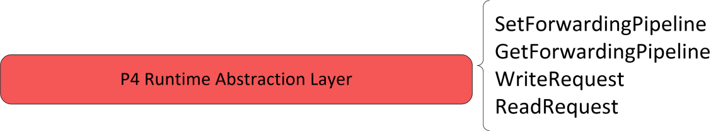
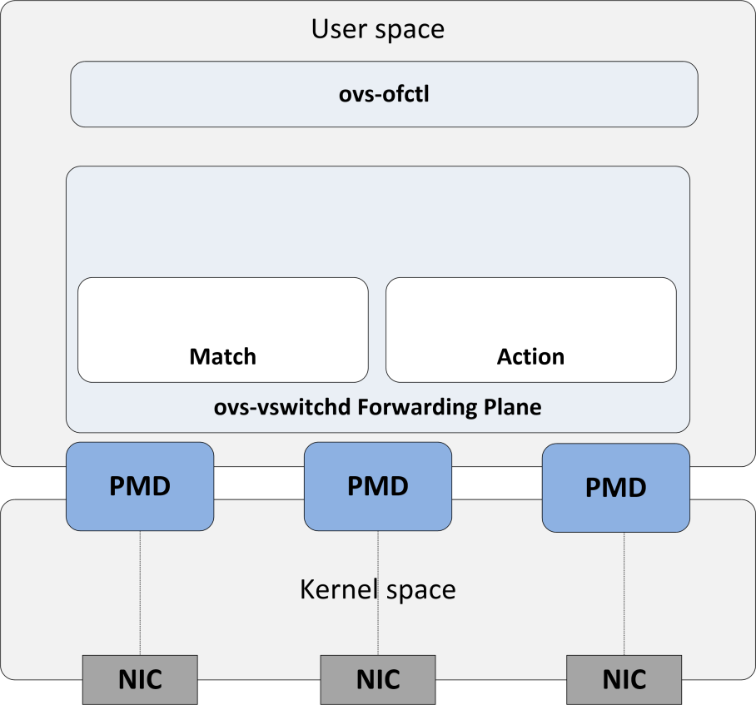



From programmable filters to programmable actions..
Oko implements stateful packets filters..
uBPF integrated with userspace datapath
Integrated with flow caching architecture
BPF verifier
Re-design of Oko:
BPF verifier modified to allow for packet writes
BPF program as separate OVS action
Programmable actions:
New functionality logically isolated
Flow caching not affected
Minimal impact on the OVS forwarding pipeline
Notes:
As I said Oko implements stateful packet filters by utlilizing the userspace BPF infrstructure integrated with the DPDK datapath. It integrates the userspace BPF virtual machine to inject arbitrary packet filtering programs at runtime. The new subsystem is integrated with flow caching architecture. Moreover, the Oko switch provides the BPF verifier that to ensure the correctness of the program and its safe execution and successful termination.
However, as we wanted to do much more with Open vSwitch than only perform packet filtering. Therefore, we made the significant change in the design of Oko. We decided to place BPF program as an additional OVS action instead of the match field. Thanks to that a new functionality is well-isolated from the rest of the packet processing pipeline, the flow caching mechanism is not affected and, in general, it has really a minimal impact on the forwarding pipeline. And at the same time we keep the features provided by BPF, which is extensibility, support for runtime programming and safe execution of programs.
Having the extensibility mechanism ready we then built the P4 layer on top. It provides the expressivness of the P4 language to a user, so that user can use P4 to define any data plane extension. It is also worth to mention that using P4 is not mandatory and user can simply use the C language if he or she feels comfortable with this language.

Slide 6
p4c-ubpf compiler
Notes:
Now, I would like to jump into how the BPF programs are structured and generated from the P4 language and then we will come back to how they can be injected into the OVS forwarding pipeline.

Slide 7
Introduction to p4c-ubpf
Generates BPF bytecode: P4₁₆ -> C -> uBPF [1]
Based on p4c-ebpf (similar to p4c-xdp)
uBPF vs. eBPF
Userspace vs. Kernel
Apache 2.0 vs. GPL license
uBPF implements „thin” BPF VM (e.g. no tail calls)
BPF maps used to implemented P4 tables, registers, etc.
[1] Paul Chaignon et al. 2018. Oko: Extending Open vSwitch with Stateful Filters. In Proceedings of the Symposium on SDN Research (SOSR ’18). 13:1–13:13.
Notes:
The main goal of the P4 to uBPF compiler is to generate BPF bytecode comaptible with user space BPF virtual machine. Our compiler backend inherits from eBPF backend for the P4 compiler. It is also similar to the p4c-xdp compiler. As both these solutions we use an intermediate step to generate C code, which is further compiled by clang to the BPF bytecode.
Quick word on the differences between in-kernel BPF and userspace BPF. Of course, the main difference is the location where the BPF bytecode is executed and, as we use userspace Open vSwitch datapath, we decided to use userspace BPF implementation. We didn’t test it yet, but it could be potentially integrated with a new userspace datapath implementation, which is AF_XDP.
The second different is the open-source license and here the userspace BPF can be easily used based on the Apache 2 license. Finally, the userspace version implements a „thin” virtual machine and therefore, it less compilcated.
Our compiler makes heavy use of the BPF map construct, which is a persistent key-value store and allows to share the data across packets. In our case BPF maps are used to implement various P4 objects such as tables, registers and othes.

Slide 8
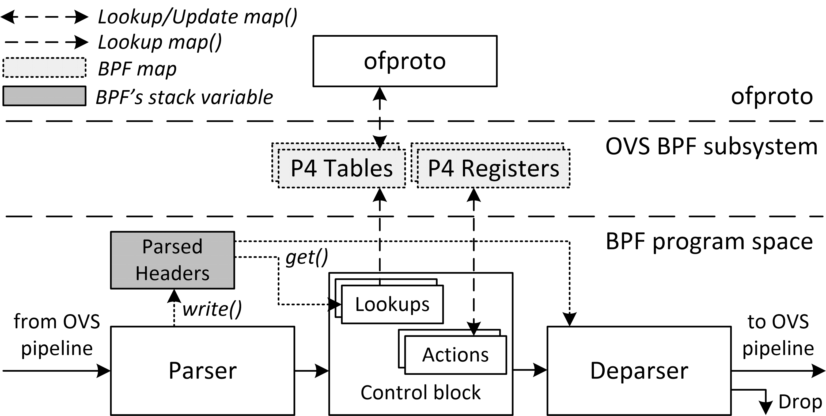
p4c-ubpf: architecture model
Tailored to Open vSwitch
No packet forwarding!
No access to ingress / egress port
Simple PASS/DROP
Support for P4 registers
Stateful operations
Notes:
First, what we did is the design of the architecture model for our compiler. This model is really tailored to Open vSwitch. The generated BPF program is a part of the Open vSwitch pipeline and is composed of three blocks: the parser, control block with set of Match-Action tables and Deparser. What really differs our design from the ebpf or xdp is that we disabled packet forwarding inside the BPF program, so this is still the Open vSwitch responsibility to determine the output port for packet. What BPF/P4 program can do is to modify packet and drop it or send back to the OVS pipeline.
As you can see, the P4 tables are implemented as BPF maps. Moreover, we implemented support for the only stateful object in the P4 language, which are P4 registers. By using P4 registers a programmer can implement stateful network functions such as stateful firewall, for instance.

Slide 9
Basic uBPF program structure
static inline bpf_result
ubpf_handle_packet(struct ubpf_vm *vm, struct dp_packet *packet)
{
…
uint64_t ret = vm->jitted(packet, pkt_len);
return (ret == 1)? BPF_MATCH // pass
: BPF_NO_MATCH; // drop
}
uint64_t entry(struct dp_packet *ctx, uint64_t pkt_len) {
uint8_t pass = 1;
void *pkt = ubpf_packet_data(ctx);
/* Packet processing logic */
/* Parser */
/* Control block (Match+Action) */
/* Deparser */
return pass;
}
void *
ubpf_packet_data(void *ctx)
{
struct dp_packet *packet = (struct dp_packet *) ctx;
return dp_packet_data(packet);
}
Notes:
The basic structure of uBPF program for Open vSwitch looks as follows.
It consists of only one function called entry, which takes two arguments. The first one is a point to the context, which in fact is a point to the dp_packet structure, which represents the actual packet inside the userspace datapath. The second argument here is the packet length. To retrieve pointer to actual packet’s data we implemented an additional helper, which retrieves packet data from the dp_packet structure. The dp_packet structure will be also necessary in the encapsulation use cases.
This function returns the decision whether the datapath should drop the packet or send it for further processing by the OVS pipeline.
Finally, the packet processing logic is generated by our P4 to userspace BPF compiler. I will quickly show how to write a simple P4 program for Open vSwitch and how the compiler generates the C code from P4 language.

Slide 10
P4 Headers
header Ethernet_h
{
bit<48> dstAddr;
bit<48> srcAddr;
bit<16> etherType;
}
header mpls_h {
bit<20> label;
bit<3> tc;
bit<1> stack;
bit<8> ttl;
}
struct Ethernet_h {
uint64_t dstAddr; /* bit<48> */
uint64_t srcAddr; /* bit<48> */
uint16_t etherType; /* bit<16> */
uint8_t ebpf_valid;
};
struct mpls_h {
uint32_t label; /* bit<20> */
uint8_t tc; /* bit<3> */
uint8_t stack; /* bit<1> */
uint8_t ttl; /* bit<8> */
uint8_t ebpf_valid;
};
p4c-ubpf
Notes:
First of all, in the P4 program we need to define packet headers for our P4 program. In P4 it is really simple and the compiler translates headers defined in P4 into the set of C structures. For every header there is one additional field added, which stores the validity bit. It will determine if the header for packet is valid or not.

Slide 11
P4 Parser
parser prs(…) {
state start {
packet.extract(headers.ethernet);
transition select(headers.ethernet.etherType) {
16w0x800 : parse_ipv4;
0x8847 : parse_mpls;
default : accept;
}
}
state parse_mpls {
packet.extract(headers.mpls);
transition ipv4; // simplified
}
state parse_ipv4 {
packet.extract(headers.ipv4);
transition accept;
}
}
struct Headers_t headers = {
.ethernet = { .ebpf_valid = 0 },
.mpls = { .ebpf_valid = 0 },
.ipv4 = { .ebpf_valid = 0 },
};
goto start;
start: {
headers.ethernet.dstAddr = load_dword(pkt, …);
…
headers.ethernet.ebpf_valid = 1;
switch (headers.ethernet.etherType) {
case 0x0800: goto ipv4;
case 0x8847: goto mpls;
default: goto accept;
}
}
accept: { /* Control block */ }
p4c-ubpf
Notes:
Next step is to define a packet parser. In our example we will parse Ethernet, MPLS and IP headers. It is translated to C as follows. Firstly, compiler defines field, which will store all fields of the packet’s headers. Next, the actual parser logic is generated by using a set of blocks and goto statements. The load_ functions are used to fill the headers structure. Here we have load double word, because ethernet destination address is stored in the 64-bit field. For shorter fields the corresponding load_ functions are used.

Slide 12
Match-Action Tables
action ipv4_decrementl_ttl() {
headers.ipv4.ttl = headers.ivp4.ttl - 1;
}
table downstream_tbl {
key = { headers.ipv4.dstAddr : exact; }
actions = { ipv4_decrement_ttl;
NoAction; }
}
apply {
downstream_tbl.apply();
}
/* construct key */
struct pipe_downstream_tbl_key key = {};
key.headers_ipv4_dstAddr = headers.ipv4.dstAddr;
/* value */
struct pipe_downstream_tbl_value *value = NULL;
/* perform lookup */
value = ubpf_map_lookup(&pipe_downstream_tbl, &key);
if (value != NULL) {
/* run action */
switch (value->action) {
case pipe_ipv4_decrement_ttl:
{
headers.ipv4.ttl = (headers.ipv4.ttl + 255);
}
}
}
p4c-ubpf
Notes:
If the parser is defined, we can go to the defintion of the control block, which in fact is composed of the set of Match-Action tables. In P4 we need to define the table key and the list of possible actions. In C they are translated to the corresponding C structures. When a table is applied, the C program uses ubpf_map_lookup helper, which looks for the matching entry inside the BPF map. If found, the switch-case statement is used to find an appropriate action.

Slide 13
P4 Registers
Register<bit<32>, bit<32>>(1) count_r;
apply {
bit<32> index = 0;
bit<32> last_count = count_r.read(index);
count_r.write(index, last_count + 1);
}
// map definition
struct ubpf_map_def count_r_0 = {
.type = UBPF_MAP_TYPE_HASHMAP,
.key_size = sizeof(uint32_t),
.value_size = sizeof(uint32_t),
.max_entries = 1,
.nb_hash_functions = 0,
};
…
uint32_t idx = 0;
uint32_t* tmp = ubpf_map_lookup(&count_r_0, &idx);
if (tmp != NULL) {
uint32_t tmp_value = (*tmp + 1);
ubpf_map_update(&count_r_0, &idx, &tmp_value);
}
p4c-ubpf
Notes:
Inside control block, a programmer can also use registers, which allows to write and read some data. This feature is really unique for our compiler and allows users to write stateful network functions.
In P4, register is defined as addtional object. The user needs to define the width of the key and width of value of register. Then, the read and write functions can be used to manage the content of the register.
In C program, the register is translated to the BPF map. Moreover, the ubpf_map_lookup helper is used to implement the read operation, and , likewise, the ubpf_map_update is used to implemente the write operation.
As the result, the design is really simple and user-friendly.

Slide 14
P4 Deparser
control dprs(packet_out packet, in Headers_t headers) {
apply {
packet.emit(headers.ethernet);
packet.emit(headers.ipv4);
}
}
int packetOffsetInBits = 0;
if (headers.ethernet.ebpf_valid) {
ebpf_byte = ((char*)(&headers.ethernet.dstAddr))[0];
write_byte(pkt, BYTES(packetOffsetInBits) + 0,
(ebpf_byte));
…
packetOffsetInBits += 48;
}
if (headers.ipv4.ebpf_valid) {
…
}
return pass;
p4c-ubpf
Notes:
Finally, the packet needs to be send back to the OVS pipeline. For this function, the deparser is responsible. In P4 deparser specifies the order of outgoing packets’ headers.
In C, the compiler generates set of blocks for each packet header. Firstly, the validty bit is check. If valid, the packet header is appended to the head of the packet byte by byte by using write_byte function.

Slide 15
Arbitrary packet encapsulation
void * ubpf_adjust_head(void* ctx, int offset) {
struct dp_packet *packet =
(struct dp_packet *) ctx;
void *pkt = NULL;
if (offset >= 0) // encapsulation
pkt = dp_packet_push_zeros(packet, offset);
else { // decapsulation
dp_packet_reset_packet(packet, abs(offset));
pkt = dp_packet_data(packet);
}
return pkt;
}
action mpls_encap() {
headers.mpls.setValid();
headers.ethernet.etherType = 0x8847;
headers.mpls.label = 20;
headers.mpls.tc = 5;
headers.mpls.stack = 1;
headers.mpls.ttl = 64;
}
action mpls_decap() {
headers.mpls.setInvalid();
}
control dprs(packet_out packet, in Headers_t headers) {
apply {
packet.emit(headers.ethernet);
packet.emit(headers.mpls);
packet.emit(headers.ipv4);
}
}
/* control block */
case pipe_mpls_encap: {
head_len += 4; // sizeof(mpls_h)
headers.mpls.ebpf_valid = true;
…
}
case pipe_mpls_decap: {
head_len -= 4; // sizeof(mpls_h)
headers.mpls.ebpf_valid = false;
}
…
/* deparser */
pkt = ubpf_adjust_head(ctx, head_len);
if (headers.mpls.ebpf_valid) {
write_byte(…);
…
}
return pass;
p4c-ubpf
Notes:
When deparsing, the compiler needs also to handle arbitrary packet encapsulation or decapsulation.
In P4, encapsulation is performed by validating the encapsulation header, for instance, the MPLS header. On the other hand, decapsulation is made by invalidating the header.
In C, we have implemented the ubpf_adjust_head helper, which provides the method to change the packet size, accordingly. Firstly, when validating or invalidating the bit, the header offset is calculated. If the offset is negative, the ubpf_adjust_head helper removes bytes from the head of the packet. Otherwise, it put zero bytes in the front of the packet.

Slide 16
Programming workflow for OVS
Notes:
Now, let’s come back to the Open vSwitch and how to inject a new BPF program in the OVS pipeline.

Slide 17
Programming workflow
#include <ubpf_model.p4>
…
parser Parser() { … } control pipe() {
action NoAction() { … }
action rewrite_ipv4(bit<32> srcAddr)
{ hdr.ipv4.srcAddr = srcAddr };
table nat_tbl {
key = { hdr.ipv4.srcAddr : exact }
actions = { NoAction; rewrite_ipv4; }
apply { nat_tbl.apply() }
}
}
control Deparser() { … }
ubpf(Parser(), pipe(), Deparser()) main;
p4c-ubpf -o prog.c nat.p4
clang -O2 –target bpf -c prog.c -o prog.o
ovs-ofctl load-bpf-prog br0 <prog-id> prog.o
ovs-ofctl add-flow br0 in_port=1,actions=prog:<prog-id>, \ output:2
ovs-ofctl update-bpf-map br0 <prog-id> <map-id> \ key 16 0 12 172 value 0 0 0 1 192 168 1 1
ovs-ofctl dump-bpf-map br0 <prog-id> <map-id>
…
ovs-ofctl delete-bpf-map br0 <prog-id> <map-id> key 16 0 12 172
ovs-ofctl unload-bpf-map br0 <prog-id>
SDE
Open vSwitch
nat.p4
Notes:
Let’s assume we have a simple Source NAT P4 program with one P4 table responsible for re-writing the source IP address.
Firstly, we need to compile this program by our P4c-ubpf compiler and clang respectively. This step is made, let say, outside of OVS.
The next steps are made by using the OVS CLI. Firstly, we should load new BPF program by using load-bpf-prog command and set the program id. The argument of this function is the bytecode generated by the compiler.
Then if program is already installed in the OVS BPF subsystem, we can use it inside the add-flow command as a normal OVS action. What we just need to do is pass the program identifier to the prog action.
As the BPF program can have a number of BPF maps the update-bpf-map command is provided to manipulate the content of the map. This method is little bit more complicated. It takes the map identifier as argument, which corresponds to the name of the table, but here it should be the index of map. Map are numbered in the order, in which they occur in the P4 program. The key value corrensponds to the match key and value corresponds to the action for packet matching the key. The value is composed of two parts, the first part identifies the action from the list and the second part is the action data passed to the action as argument. In this example it is the source address that should be set for the packet.

Slide 18
Programming workflow
#include <ubpf_model.p4>
…
parser Parser() { … } control pipe() {
action NoAction() { … }
action rewrite_ipv4(bit<32> srcAddr)
{ hdr.ipv4.srcAddr = srcAddr };
table nat_tbl {
key = { hdr.ipv4.srcAddr : exact }
actions = { NoAction; rewrite_ipv4; }
apply { nat_tbl.apply() }
}
}
control Deparser() { … }
ubpf(Parser(), pipe(), Deparser()) main;
p4c-ubpf -o prog.c nat.p4
clang -O2 –target bpf -c prog.c -o prog.o
ovs-ofctl load-bpf-prog br0 <prog-id> prog.o
ovs-ofctl add-flow br0 in_port=1,actions=prog:<prog-id>, \ output:2
ovs-ofctl update-bpf-map br0 <prog-id> <map-id> \ key 16 0 12 172 value 0 0 0 1 192 168 1 1
ovs-ofctl dump-bpf-map br0 <prog-id> <map-id>
…
ovs-ofctl delete-bpf-map br0 <prog-id> <map-id> key 16 0 12 172
ovs-ofctl unload-bpf-map br0 <prog-id>
SDE
Open vSwitch
nat.p4

Slide 19
Programming workflow
#include <ubpf_model.p4>
…
parser Parser() { … } control pipe() {
action NoAction() { … }
action rewrite_ipv4(bit<32> srcAddr)
{ hdr.ipv4.srcAddr = srcAddr };
table nat_tbl {
key = { hdr.ipv4.srcAddr : exact }
actions = { NoAction; rewrite_ipv4; }
apply { nat_tbl.apply() }
}
}
control Deparser() { … }
ubpf(Parser(), pipe(), Deparser()) main;
p4c-ubpf -o prog.c nat.p4
clang -O2 –target bpf -c prog.c -o prog.o
ovs-ofctl load-bpf-prog br0 <prog-id> prog.o
ovs-ofctl add-flow br0 in_port=1,actions=prog:<prog-id>, \ output:2
ovs-ofctl update-bpf-map br0 <prog-id> <map-id> \ key 16 0 12 172 value 0 0 0 1 192 168 1 1
ovs-ofctl dump-bpf-map br0 <prog-id> <map-id>
…
ovs-ofctl delete-bpf-map br0 <prog-id> <map-id> key 16 0 12 172
ovs-ofctl unload-bpf-map br0 <prog-id>
SDE
Open vSwitch
nat.p4

Slide 20
Programming workflow
#include <ubpf_model.p4>
…
parser Parser() { … } control pipe() {
action NoAction() { … }
action rewrite_ipv4(bit<32> srcAddr)
{ hdr.ipv4.srcAddr = srcAddr };
table nat_tbl {
key = { hdr.ipv4.srcAddr : exact }
actions = { NoAction; // index 0 rewrite_ipv4; } // index 1
apply { nat_tbl.apply() }
}
}
control Deparser() { … }
ubpf(Parser(), pipe(), Deparser()) main;
p4c-ubpf -o prog.c nat.p4
clang -O2 –target bpf -c prog.c -o prog.o
ovs-ofctl load-bpf-prog br0 <prog-id> prog.o
ovs-ofctl add-flow br0 in_port=1,actions=prog:<prog-id>, \ output:2
ovs-ofctl update-bpf-map br0 <prog-id> <map-id> \ key 16 0 12 172 value 0 0 0 1 192 168 1 1
ovs-ofctl dump-bpf-map br0 <prog-id> <map-id>
…
ovs-ofctl delete-bpf-map br0 <prog-id> <map-id> key 16 0 12 172
ovs-ofctl unload-bpf-map br0 <prog-id>
SDE
Open vSwitch
nat.p4

Slide 21
Programming workflow
#include <ubpf_model.p4>
…
parser Parser() { … } control pipe() {
action NoAction() { … }
action rewrite_ipv4(bit<32> srcAddr)
{ hdr.ipv4.srcAddr = srcAddr };
table nat_tbl {
key = { hdr.ipv4.srcAddr : exact }
actions = { NoAction; // index 0 rewrite_ipv4; } // index 1
apply { nat_tbl.apply() }
}
}
control Deparser() { … }
ubpf(Parser(), pipe(), Deparser()) main;
p4c-ubpf -o prog.c nat.p4
clang -O2 –target bpf -c prog.c -o prog.o
ovs-ofctl load-bpf-prog br0 <prog-id> prog.o
ovs-ofctl add-flow br0 in_port=1,actions=prog:<prog-id>, \ output:2
ovs-ofctl update-bpf-map br0 <prog-id> <map-id> \ key 16 0 12 172 value 0 0 0 1 192 168 1 1
ovs-ofctl dump-bpf-map br0 <prog-id> <map-id>
…
ovs-ofctl delete-bpf-map br0 <prog-id> <map-id> key 16 0 12 172
ovs-ofctl unload-bpf-map br0 <prog-id>
SDE
Open vSwitch
nat.p4
Notes:
We provide also the method to dump the content of the map…

Slide 22
Programming workflow
#include <ubpf_model.p4>
…
parser Parser() { … } control pipe() {
action NoAction() { … }
action rewrite_ipv4(bit<32> srcAddr)
{ hdr.ipv4.srcAddr = srcAddr };
table nat_tbl {
key = { hdr.ipv4.srcAddr : exact }
actions = { NoAction; // index 0 rewrite_ipv4; } // index 1
apply { nat_tbl.apply() }
}
}
control Deparser() { … }
ubpf(Parser(), pipe(), Deparser()) main;
p4c-ubpf -o prog.c nat.p4
clang -O2 –target bpf -c prog.c -o prog.o
ovs-ofctl load-bpf-prog br0 <prog-id> prog.o
ovs-ofctl add-flow br0 in_port=1,actions=prog:<prog-id>, \ output:2
ovs-ofctl update-bpf-map br0 <prog-id> <map-id> \ key 16 0 12 172 value 0 0 0 1 192 168 1 1
ovs-ofctl dump-bpf-map br0 <prog-id> <map-id>
…
ovs-ofctl delete-bpf-map br0 <prog-id> <map-id> \ key 16 0 12 172
ovs-ofctl unload-bpf-map br0 <prog-id>
SDE
Open vSwitch
nat.p4
Notes:
Delete entry from map..

Slide 23
Programming workflow
#include <ubpf_model.p4>
…
parser Parser() { … } control pipe() {
action NoAction() { … }
action rewrite_ipv4(bit<32> srcAddr)
{ hdr.ipv4.srcAddr = srcAddr };
table nat_tbl {
key = { hdr.ipv4.srcAddr : exact }
actions = { NoAction; // index 0 rewrite_ipv4; } // index 1
apply { nat_tbl.apply() }
}
}
control Deparser() { … }
ubpf(Parser(), pipe(), Deparser()) main;
p4c-ubpf -o prog.c nat.p4
clang -O2 –target bpf -c prog.c -o prog.o
ovs-ofctl load-bpf-prog br0 <prog-id> prog.o
ovs-ofctl add-flow br0 in_port=1,actions=prog:<prog-id>, \ output:2
ovs-ofctl update-bpf-map br0 <prog-id> <map-id> \ key 16 0 12 172 value 0 0 0 1 192 168 1 1
ovs-ofctl dump-bpf-map br0 <prog-id> <map-id>
…
ovs-ofctl delete-bpf-map br0 <prog-id> <map-id> \ key 16 0 12 172
ovs-ofctl unload-bpf-prog br0 <prog-id>
SDE
Open vSwitch
nat.p4
Notes:
And finally remove the program from the OVS subsystem.
Of course, all these commands can be invoked are OpenFlow messages and can be invoked by the external OpenFlow controller.

Slide 24
Use cases
Notes:
With such a new functionality an OVS user can implement a bunch of new use cases.

Slide 25
Use cases
Domain-specific network protocols
GPRS Tunnelling Protocol (GTP)*
Point-to-Point Protocol over Ethernet (PPPoE)
In-Band Network Telemetry (INT)
Stateful data plane programs
Stateful firewall
In-Network DDoS mitigation
Many others.. creativity is the limit!
* PoC ~200 lines of P4 code
Notes:
To list few of them, the first group of potential extensions are domain-spefific network protocols. For instance, we have implemented the support for the GTP tunneling in just a two hundreds lines of the P4 code. Similarily, we can implement the PPPoE tunneling, which is used in the fixed-access networks or the In-Band Network Telemetry.
Moreover, as the compiler provides support for registers a range of stateful data plane programs can also be implemented, like for example stateful firewall or In-Network DDoS mitigation.
And many others, I think that there are number of use cases that I don’t see, but also can be implemented using our framework.

Slide 26
Summary
We propose a hybrid approach
Keep well-known features and backward compatibility of OVS
Add BPF as OVS action and P4-based programmability
Many new, exciting use cases for OVS!
The p4c-ubpf compiler to be merged with p4c
Work in progress:
Enhancements to BPF verifier
Checksum computation
Performance optimizations
We plan to open-source OVS modifications soon!
Notes:
To summarize, we propose a BPF extension to the Open vSwitch, which results in a hybrid approach, becuase:
We keep a well-known features and backward compatibility of Open vSwitch, but we enable a runtime programmability thanks to the BPF and we give the users the feasibility to write their program using the high-level P4 language.
Thanks to our extension the community can implement many new and exiciting use cases.
We are going to merge our userspace BPF backend with the main branch of the official P4 compiler.
Of course, there is still work in progrss, as we need to implement some enhancements to the BPF verifier. Our implementation of P4 compiler does not compute checksums and we also need to optimize the performance.
Nevertheless, we plan to open-source the OVS extensions soon. Of course, we would be happy if the OVS community will be interested in this work and we could contribute the solution to the OVS codebase.
Also, I didn’t show a demo, but if you are interested please come to me, we can sit together and I can make you a quick demo for you.

Slide 27
Thank you!
osinstom@gmail.com / tomasz.osinski2@orange.com

Slide 28
BACKUP

Slide 29
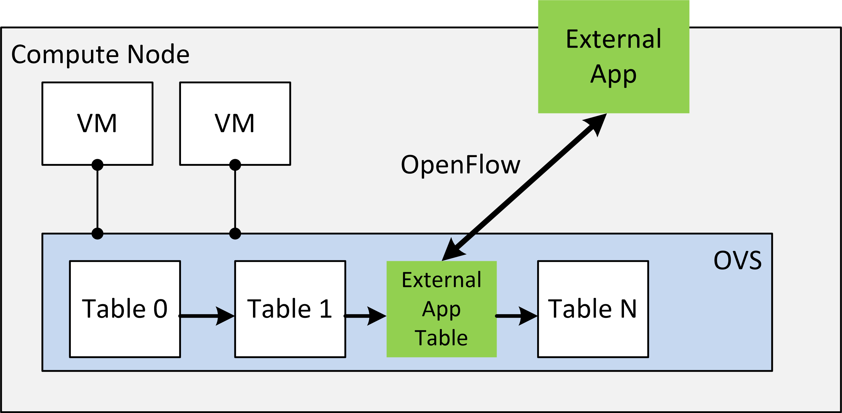
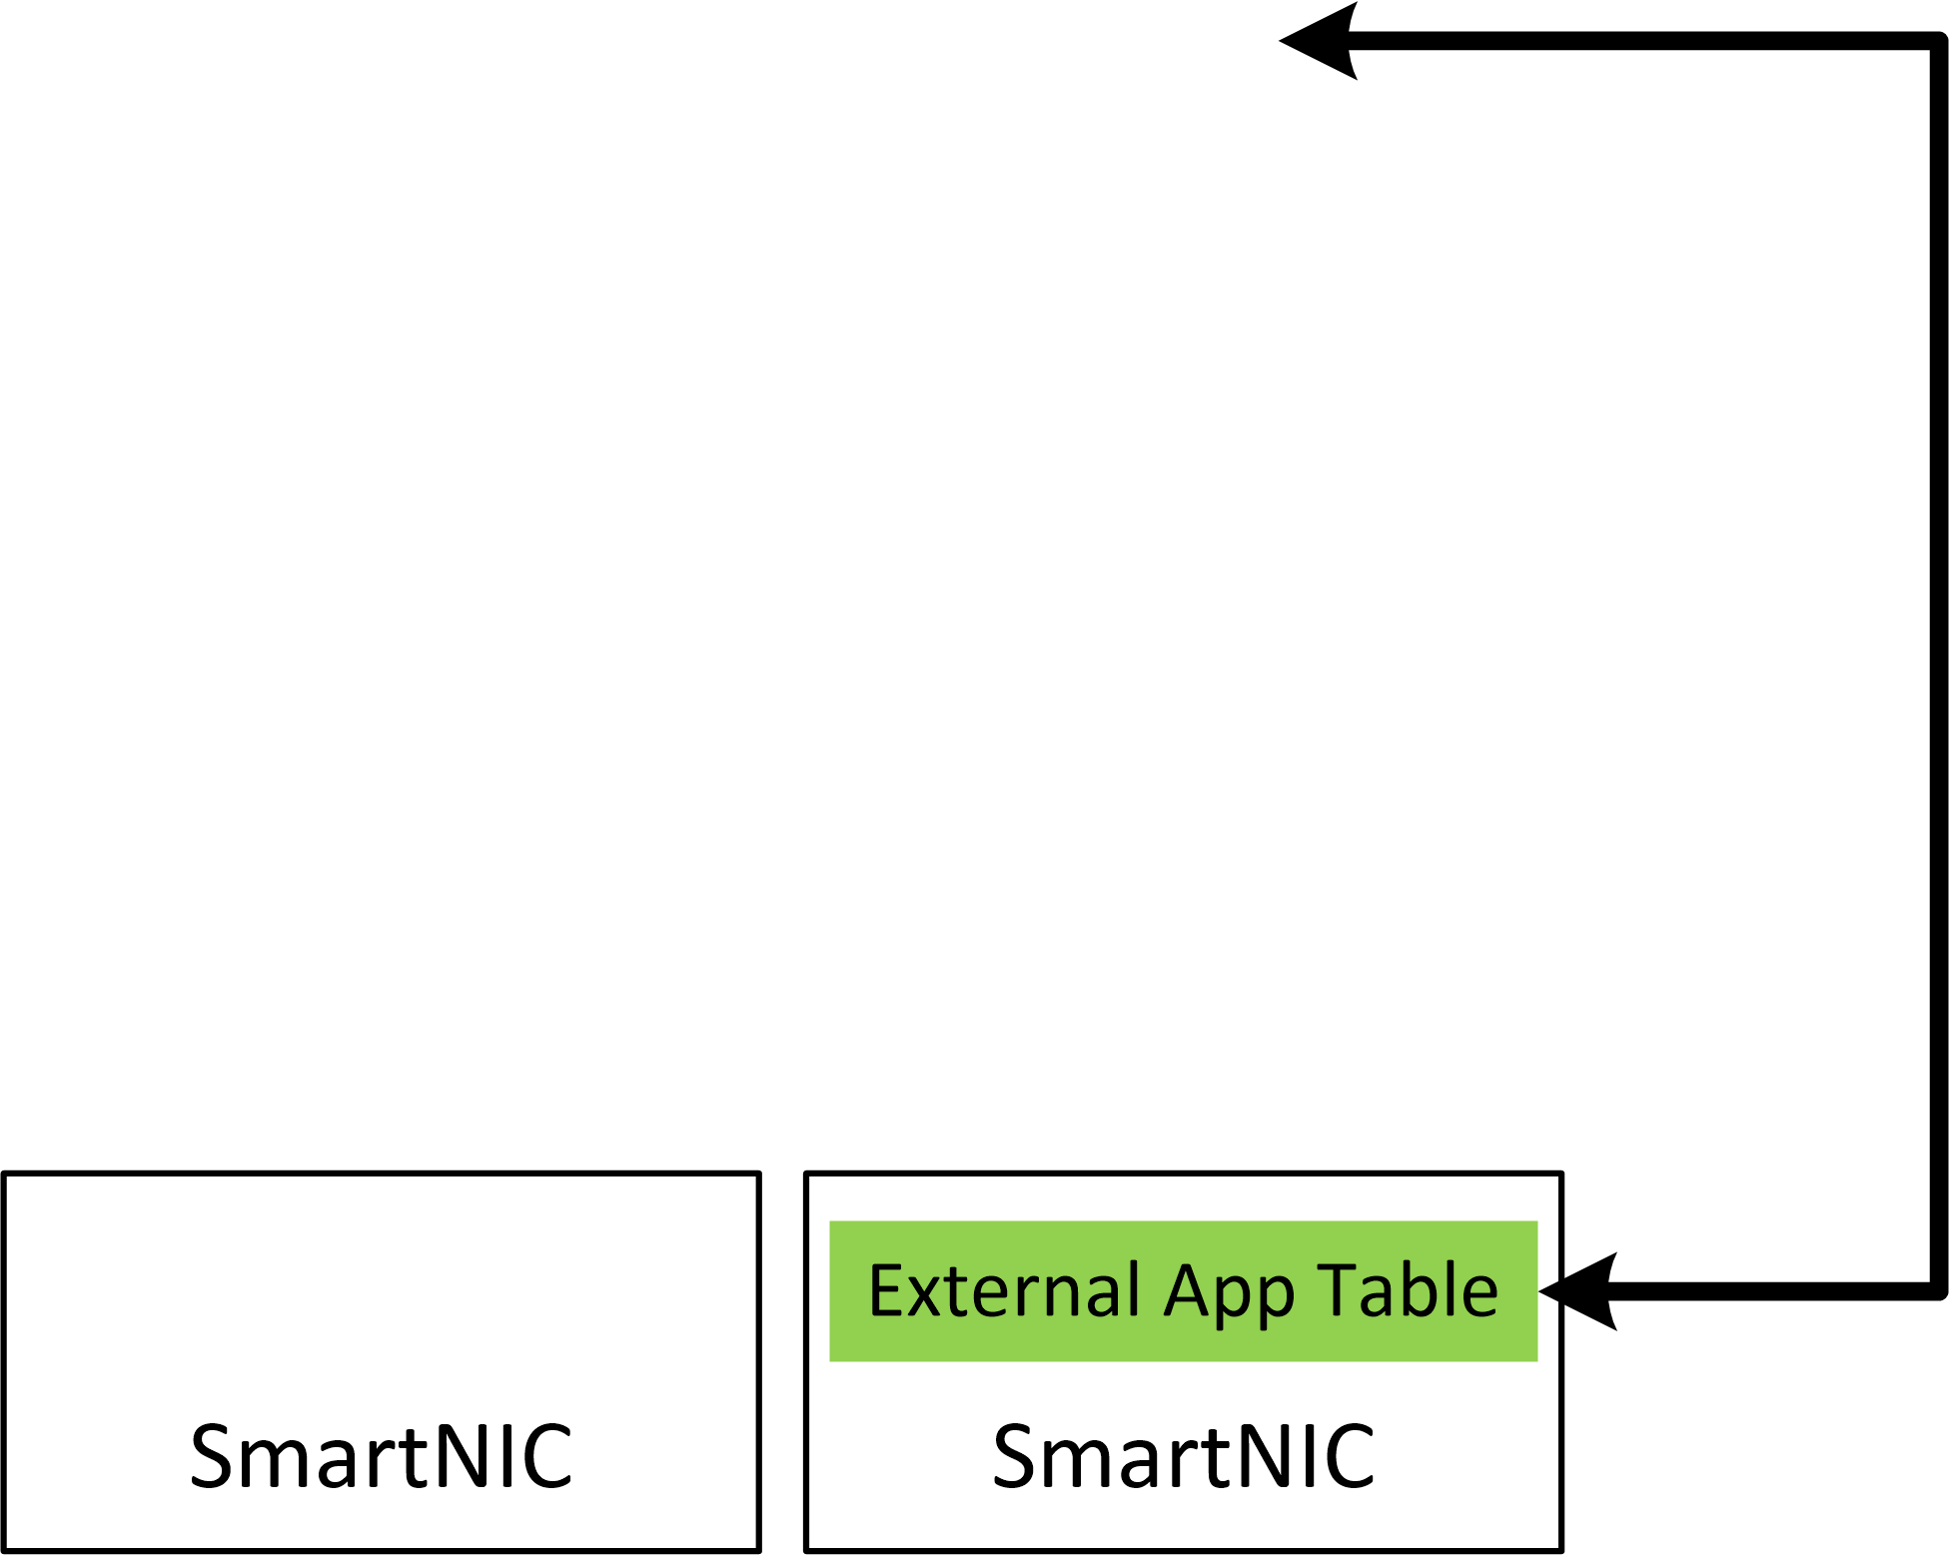
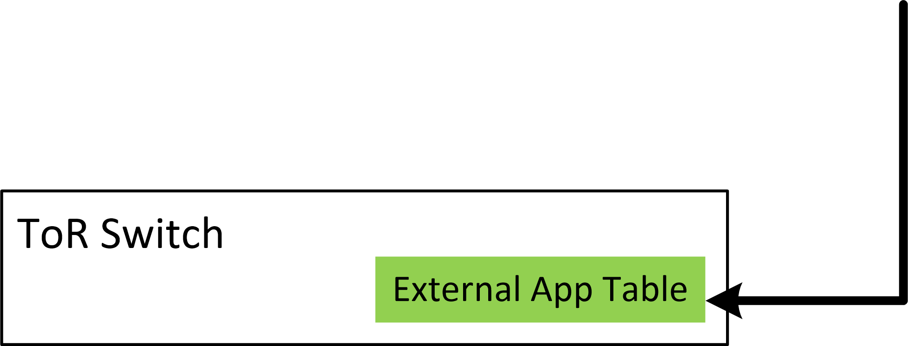
Topology Service Injection 2.0
The plugin for OpenStack Neutron proposed a few years ago..
Goal:
allow users/tenants to inject vendor-specific network functions in the virtual networking layer of OpenStack
TSI 2.0:
P4 & P4Runtime as a default southbound interface
Enhance programmability to SmartNiCs and ToR switches

Slide 30
Open issues
Stack size limit (512 bytes):
Complex parsers are rejected by the verifier due to small stack size!
Solution: As we’re in userspace -> change stack size (needed modifications to clang)
Recirculate or not to recirculate?
Refer to: P. Chaignon, „Open vSwitch Extensions with BPF”, Open vSwitch 2018 Fall Conference
Notes:
Nevertheless, the implementation is not completed yet. We have faced several issues during design and implementation phase and they are not solved yet. First problem is related to the BPF verifier. For longer and more complex parsers the program is rejected by the verifier, because the program exceeds the stack size limit. The solution is to use the BPF maps, but it can effectively impract the performance. Thankfully, we are in userspace and we could just simply adjust the stack size limit, but it may not be the optimal solution. Certaintly, it requires modifications to clang compiler to pass the stack size option.
The second problem is more about the design. As BPF programs can modify packets and subsequent can match against the modified fields the packets should be recirculated. The question is when to recirculate packets? This has been deeply analyzed by Paul in the last-year presentation, so I send you to this presentation. Our current implemenation assumes that BPF programs are executed at the end of the pipeline.

Slide 31
p4c-ubpf: architecture model
No packet forwarding!
No access to ingress / egress port
Simple PASS/DROP
Support for P4 registers
Stateful operations
parser parse<H, M>(packet_in packet, out H headers,inout M meta); control pipe<H, M>(inout H headers, inout M meta);
@deparser control deparser<H>(packet_out b, in H headers); package ubpf<H, M>(parse<H, M> prs, pipe<H, M> p, deparser<H> dprs); extern void mark_to_drop(); extern void mark_to_pass(); extern Register<T, S> { Register(bit<32> size); T read (in S index); void write (in S index, in T value); }
Notes:
The architecture model is similar to ebpf or xdp backends, but we decided not to expose packet forwarding capabilities to the BPF program, Therefore, the BPF program does not decided how to forward the packet, this is still the responsibility of the Open vSwitch. What the BPF program can do is to pass or drop the packet (and of course modify headers).
Moreover, we implemented support for the only stateful object in the P4 language, which are P4 registers. By using P4 registers a programmer can implement stateful network functions such as stateful firewall, for instance.

