Slide 1
OVN operationalization at scale @eBay
Aliasgar Ginwala (aginwala@ebay.com)

Slide 2
Agenda
Why ovn as a preferred sdn provider?
Challenges/migration from legacy vendor overlay to ovn
Moving control plane to raft cluster
Operational challenges for current ovn AZ
OVN/OVS upgrades, monitoring and lessons learned

Slide 3
OVN as preferred SDN solution!
Scale testing helped gain confidence using 1.
No vendor dependency.
Open-Source software is a preferred approach for eBay.
Minimize control/data plane impacts as we can control the version/release.
Awesome support from the community.
[1]. https://github.com/ovn-org/ovn-scale-test

Slide 4

OVS/OVN use cases at eBay
Overlay
OpenStack VMs
Kubernetes on openStack
Distributed load balancer
Non-overlay
L4 ACL enforcement
No scale challenges, no gateways as OVN is local to the computes
Acl enforcement is done leveraging go-ovn (https://github.com/eBay/go-ovn).

Slide 5
Typical OVN availability zone at eBay
Router count: 25+
Size /21.
lport count: 10k+.
SB DB Mac binding: 35k+ due to nested workloads (kubernetes on openstack VMs).
GW count: 8 per az.
HV count: 1k+.
Single OpenStack with multiple k8s cluster.
Ubuntu

Slide 6
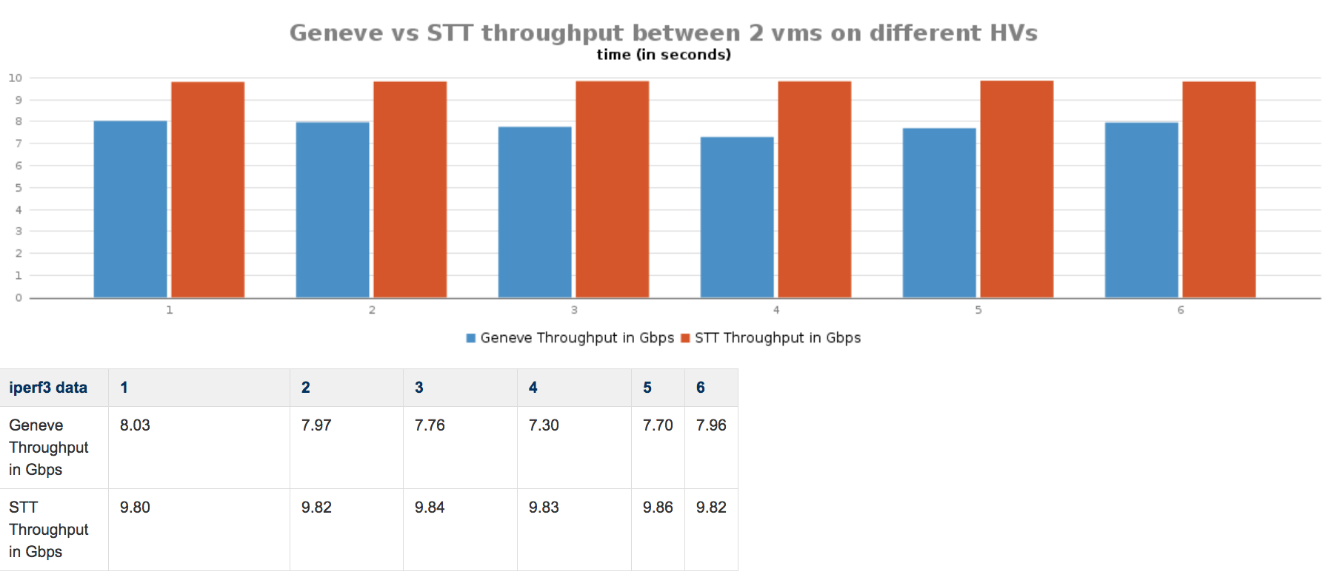
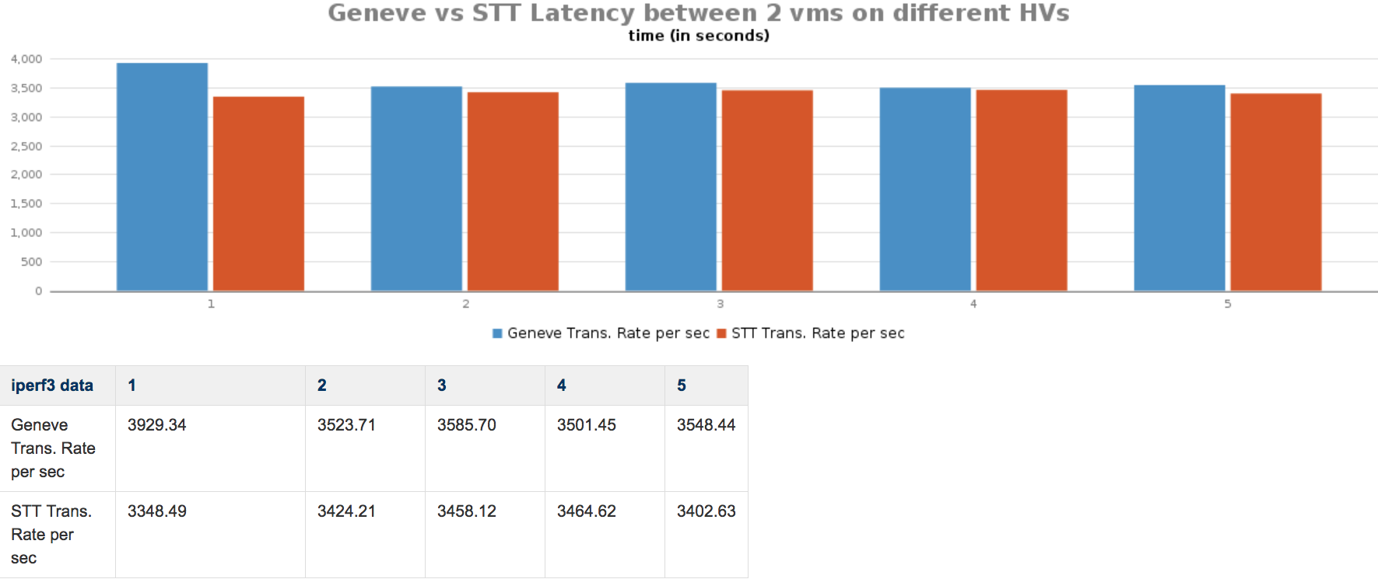
Choosing STT
Legacy SDN using STT was tried and tested in production already.
No other performance issues noted when using STT.

Slide 7
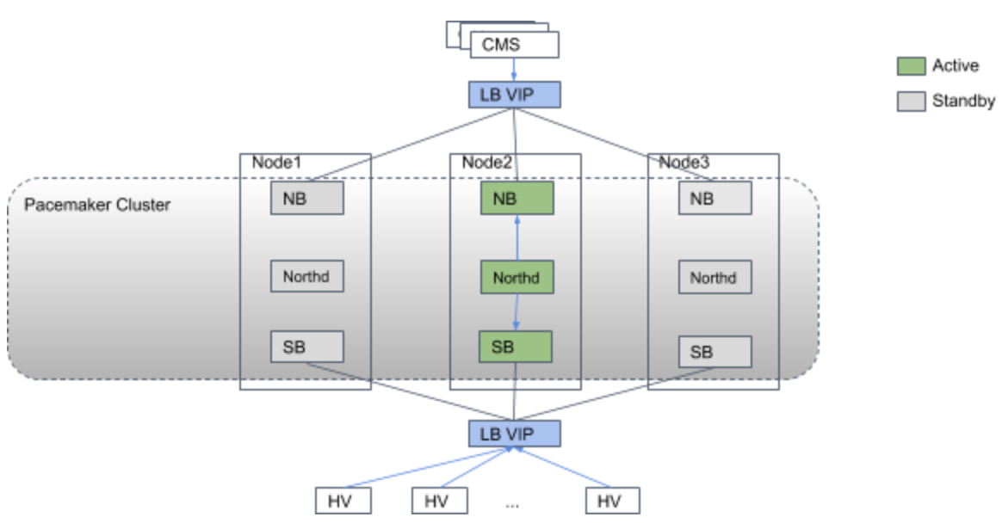
Go-live with active-standby control plane
3 Nodes with one active and 2 standby nodes that sync from active node
Probe interval set to 0 on central nodes
Probe interval set to 3 min on clients (HVs).

Slide 8
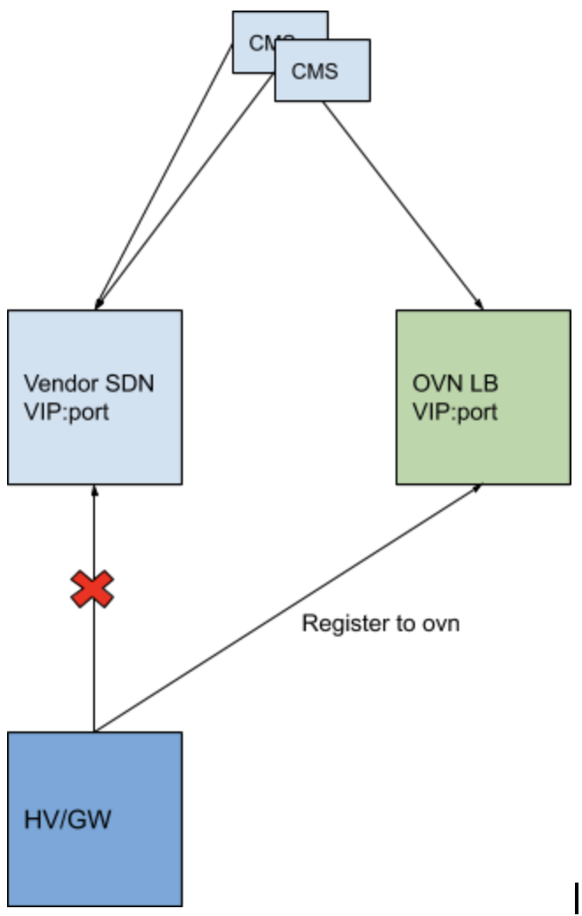
Migration to ovn
Migration of OpenStack VMs
No security groups
No floating IPs
Migration of K8s workloads

Slide 9

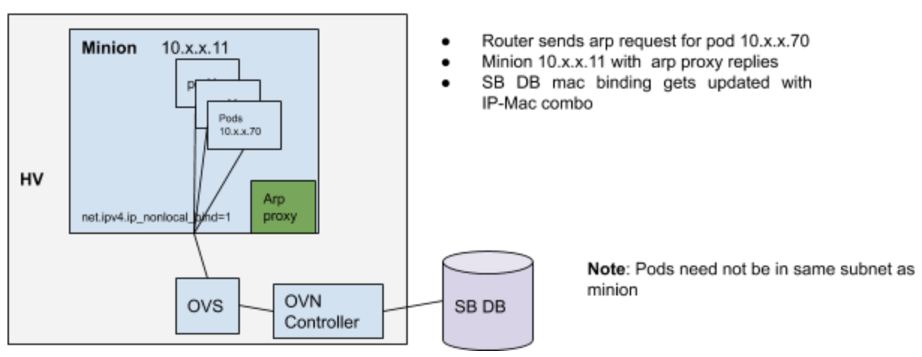
Seamless migration for k8s workloads to OVN
No down time
Spin up minions + k8s control plane nodes in new ovn computes
Create new nodepool object with appropriate minion flavors/size
Release new IP capacity
Drain pods from existing minions in legacy SDN to land on
OVN minions
With down time
Migration per HV in batches
Enable periodic garp from minions so that south bound mac-binding is
up-to date.
Neutron Port update address-pair since there is no mac learning in ovn.
Node life cycle health check disabled for k8s clusters to avoid reclaiming computes due to no connectivity

Slide 10
Migration for OpenStack VMs to ovn
Retain IP/dns for VMs
Changes in openstack nova to use ovn with hints instead of default sdn provider in case we have to rollback.
networking-ovn sync tool to sync data from neutron to ovn 1.
Compute audits for ovs/ovn and kernel version.
Ansible to migrate computes in batches.
[1] https://github.com/openstack/networking-ovn

Slide 11
Some surprises during/post migration
Wrong MTU on computes caused service degradation like download failures for VMs, etc.
Max open file limits exceeded for sb db process which failed to start ovn services
DefaultLimitNOFILE=4096
Fixed in 4992e00

Slide 12
Some pain points when using active-standby mode
OVS/OVN upgrades always needs planned maintenance by notifying customer
Takes ~30+ mins for active sb db to resync data for all clients.
Active node failure causes control plane outage to resync data for all clients.
No workload distribution:
All clients(HVs) connect to single active node
Not only OpenStack provisioning but K8s control plane gets impacted:
New pods created during this time will not ping as mac binding cannot be updated due to SB DB running hot.

Slide 13
Active-active improved to handle scale issues
Scale test results were promising and major issues addressed in upstream master
100% CPU utilization when preprocessing at followers to reduce leader load.
Follower update latency; reduced to 500 ms from 30 sec
Leader flapped due to heartbeat timeout which triggered re-election which can now be controlled by election time out.
SB DB uses fast re-sync for db re-connect for which time reduced from ~30 min+ to 1 min.

Slide 14
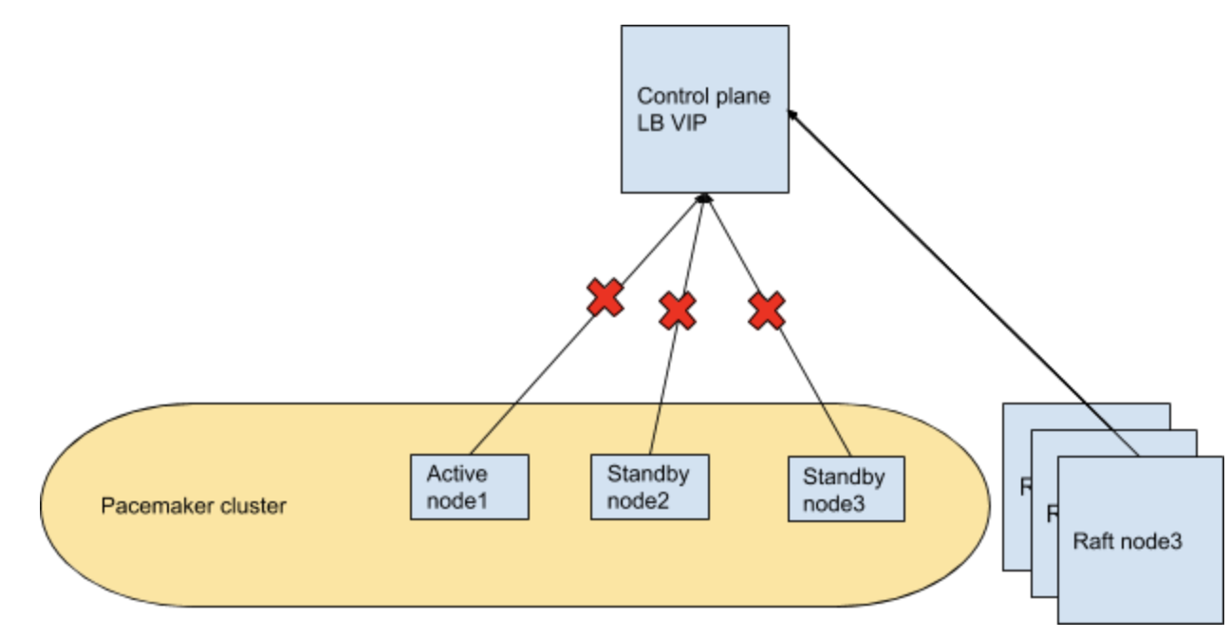
Migrating to raft cluster
3 Nodes raft cluster
Copy standalone db from active pacemaker node
Conversion to clustered db from standalone already addressed by
ovn-ctl
Increase election timeout to 10 sec after starting ovn on first node..
Use cluster/change-election-timer ; start with 2k upto 10k (10 seconds)
Start ovn services on rest 2 cluster nodes using join cluster using remote-addr
/usr/share/openvswitch/scripts/ovn-ctl --db-nb-cluster-remote-addr=10.x.x.x --db-sb-cluster-remote-addr=10.x.x.x

Slide 15
Raft control plane upgrade
Graceful
Start upgrading ovs/ovn node by node by node stopping ovn services
Upgrade and restart ovn services
Ungraceful
Kill ovn/ovs services on all three nodes
Upgrade ovs/ovn on all 3 nodes
Restart the last leader first
Follow the same on rest 2 nodes

Slide 16
Raft backup
Periodic db backups on all control plane nodes
ovsdb-client backup

Slide 17
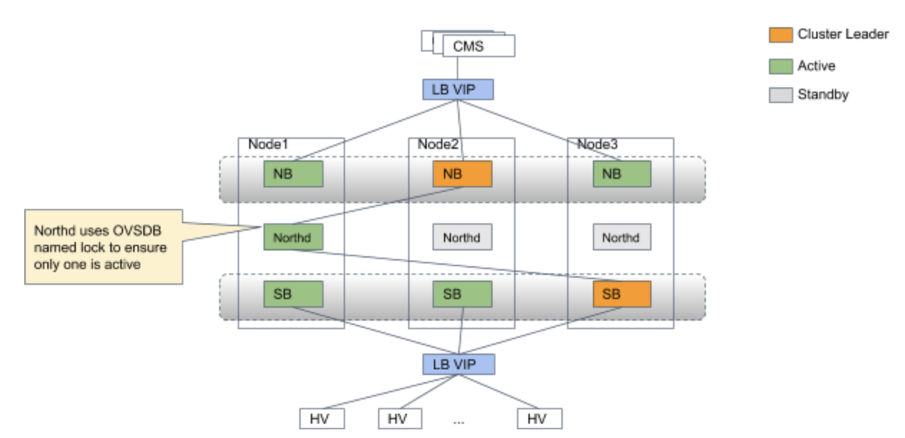
Recovery in raft cluster
Nodes down but recoverable
Impact: Control plane outage
Recovery: Recover 2 out of 3 nodes asap to complete election and restore cluster.
Data lost
All nodes are ok but some some data is deleted/lost
Impact: Data plane outage
Recovery: Use ovsdb-client restore and neutron-ovn sync tool
Nodes down but not recoverable
Kick out node using cluster/kick.
Join cluster with --db-nb-cluster-remote-addr and --db-sb-cluster-remote-addr.

Slide 18
SSL & RBAC
Centralized cert management for all AZ
Cert generation and setting ssl permissions done via puppet modules.
No rbac for northd in upstream yet
northd listen on different port
Secure the new port with iptable rules to restrict access only from central nodes.

Slide 19
Puppet for managing computes
Compute registration which includes setting up of nova/ovs/ovn/networking settings on the node.
Probe-interval 180000 seconds for connecting to south bound.

Slide 20
Ansible for OVS/OVN upgrades on computes
Always with planned maintenance notifying customers
Ansible playbook for installing new ovs/ovn versions in batches in parallel
Small data plane blip for workloads per compute when restarting OVS using force reload with new version
Upstream in talks to handle live upgrades for ovs without data plane impact.
For ovn-controller, use graceful exit to avoid deleting flows
# The --restart option is supported from 2.10.
ovs-appctl -t ovn-controller exit --restart
# Before 2.10, use:
kill `cat /var/run/openvswitch/ovn-controller.pid`
OVN/OVS still in same code base.

Slide 21
How to monitor OVN nodes?
Zabbix: https://www.zabbix.com/
Zabbix agent on control plane, computes and gateways to pump data
Monitoring scripts running in the background collects ovs/ovn/system stats

Slide 22
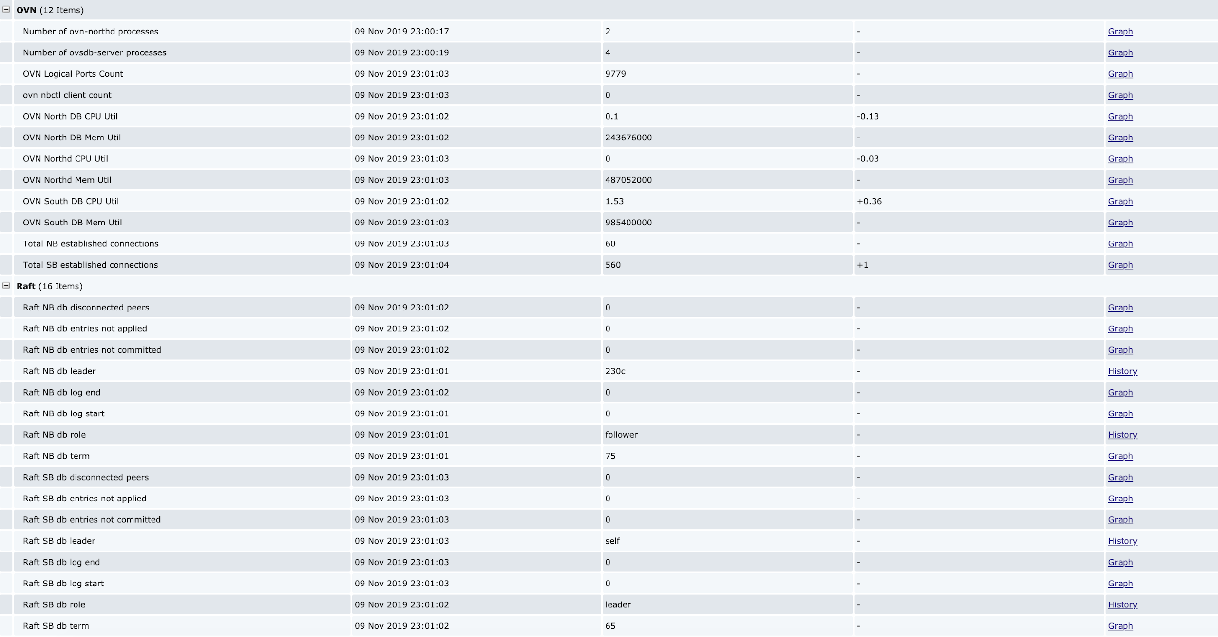
Central node stats

Slide 23
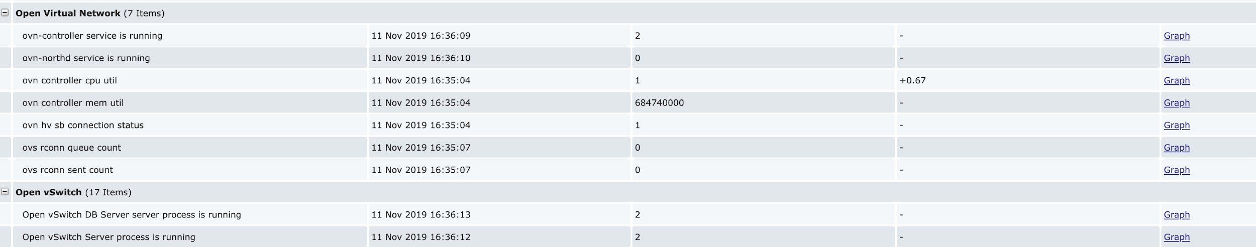
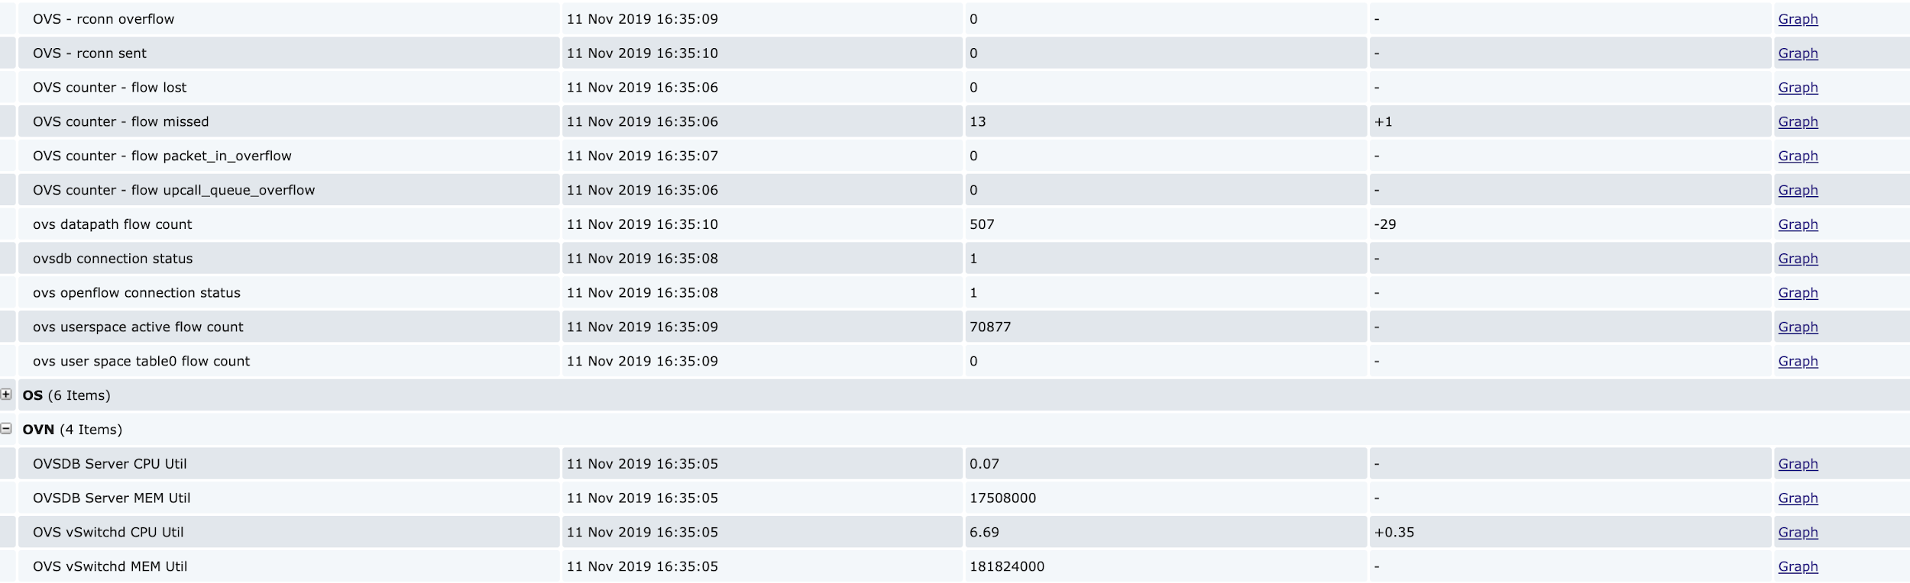
Hypervisor ovs/ovn stats

Slide 24
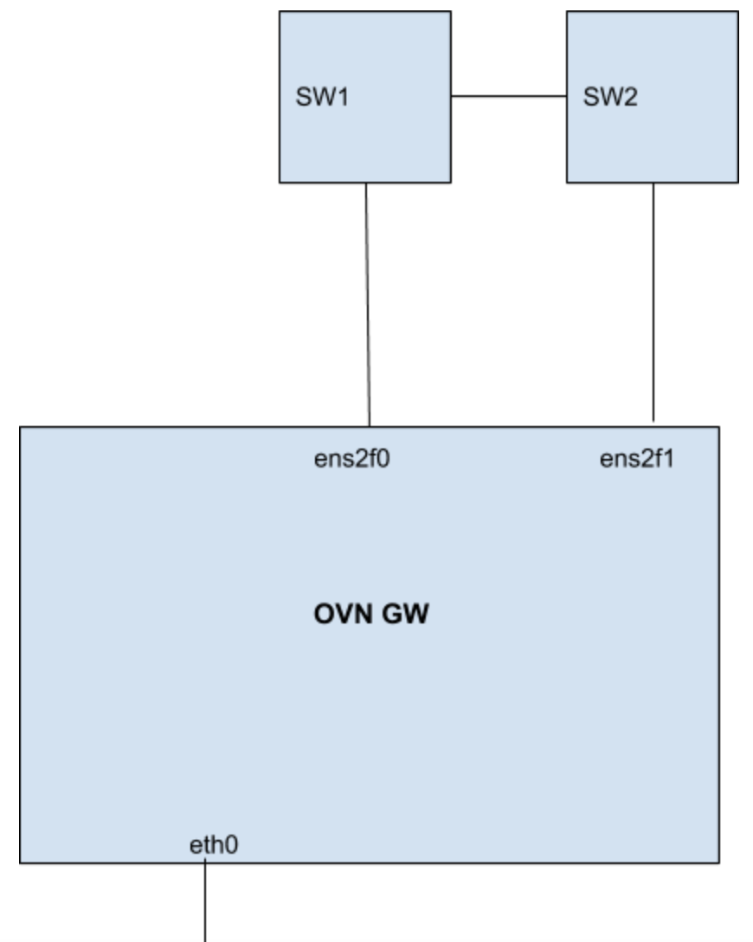
Managing Gateways
MTU
Uplink, ens2f0: 1500
Downlink, tunnel to HVs (tunnel interface, e.g. eth0): 9000
Bridge-mappings
ovn-bridge-mappings=providernet:brens2f0
Disable conntrack to avoid confusion with STT
iptables -t raw -A PREROUTING -j NOTRACK
iptables -t raw -A OUTPUT -j NOTRACK

Slide 25
GW b/w & service degradation detection
Current l3 GW HA model which multiple logical outer per gw.
K8s workload behind a service can choke entire gw band-width.
We use hsflow to identify top talkers https://sflow.net/downloads.php
No in built monitoring for uplink gw interface
If down, there is no failover triggered
custom script to mark the interface up if marked down.

Slide 26
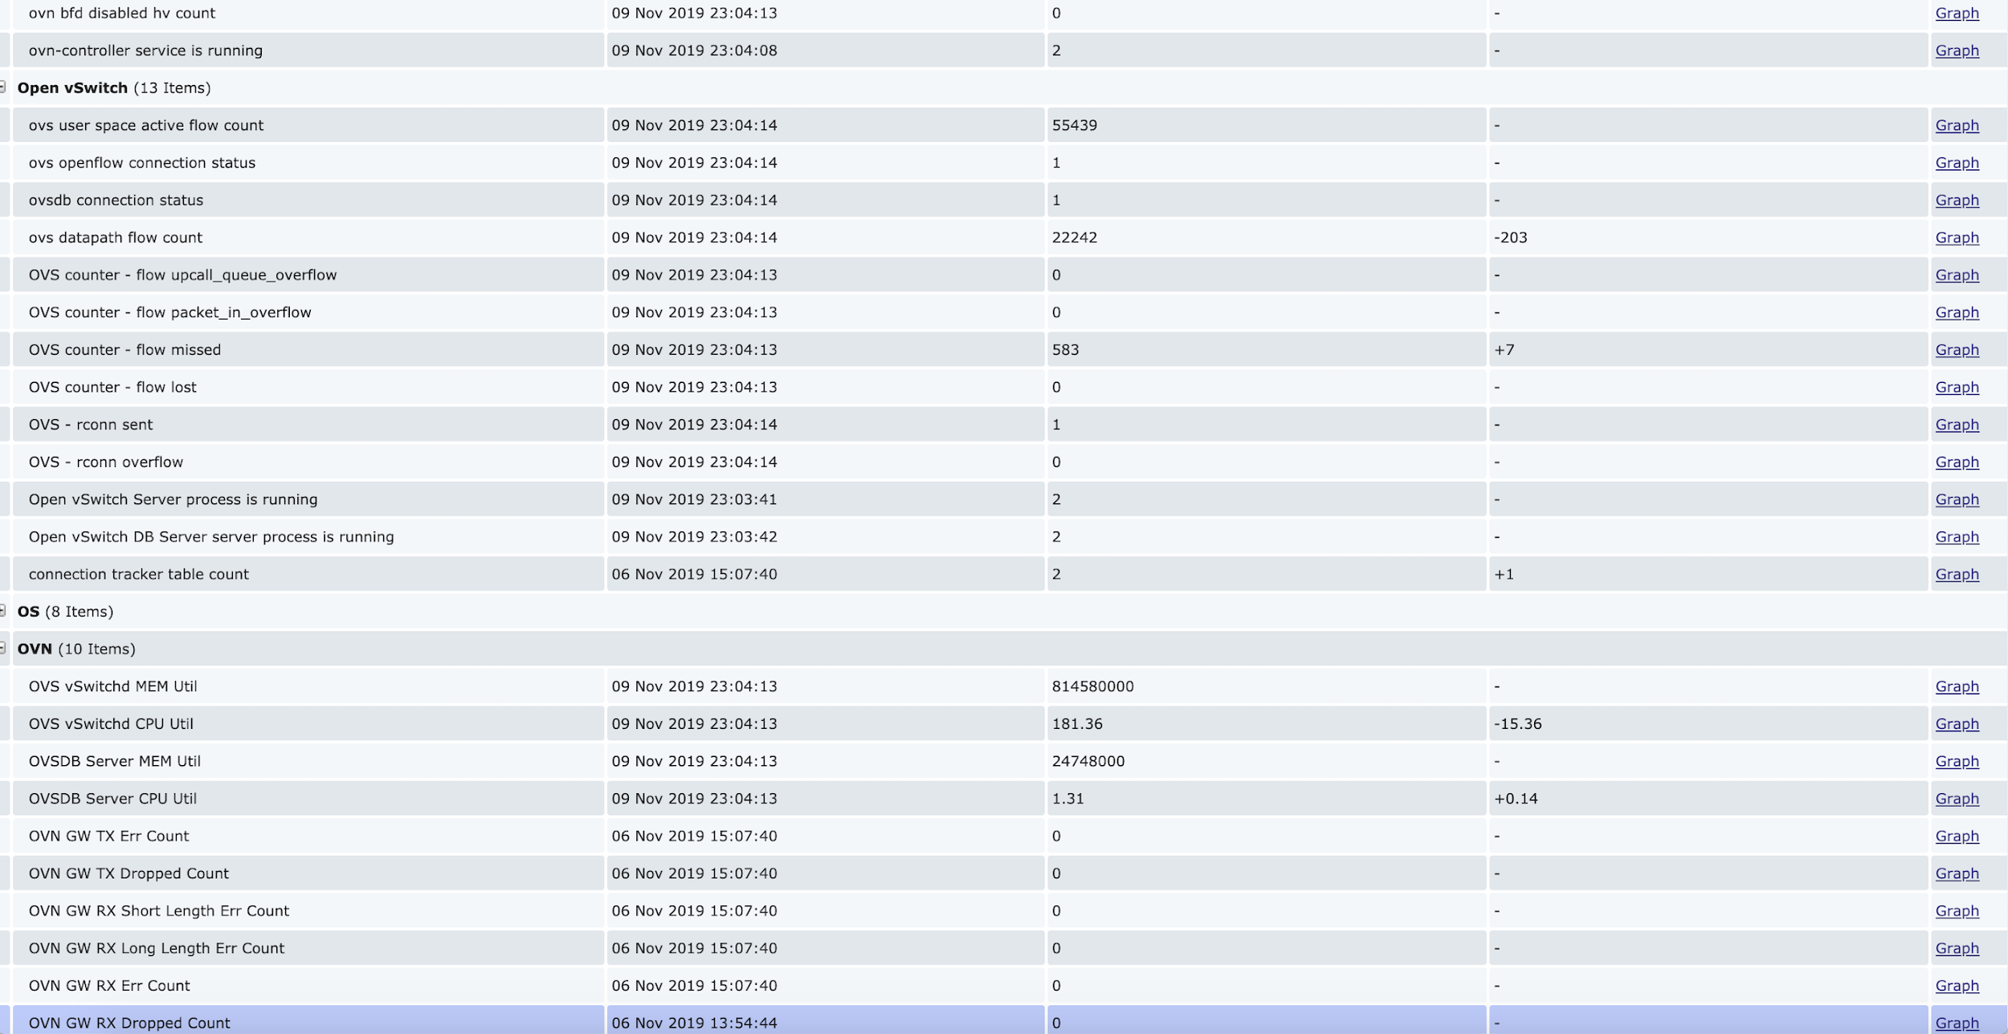
Gateway ovs/ovn stats

Slide 27
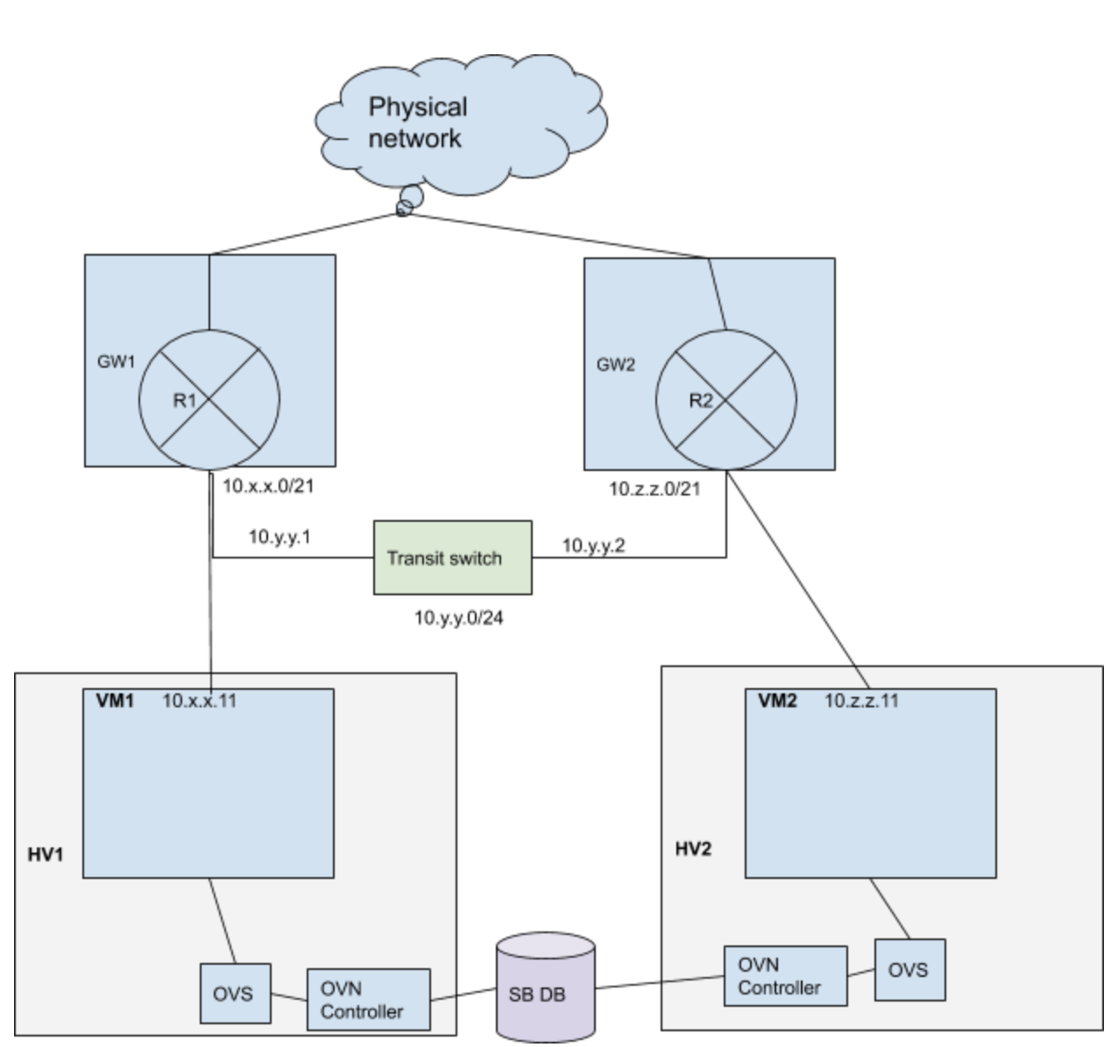
Transit switch is cool!
Different routers for same VPC
connected using transit switch.
Pods can also use static routes
to configure per minion subnet.
Join automated using internal config tool
as manual commands by operator can
cause outages.

Slide 28
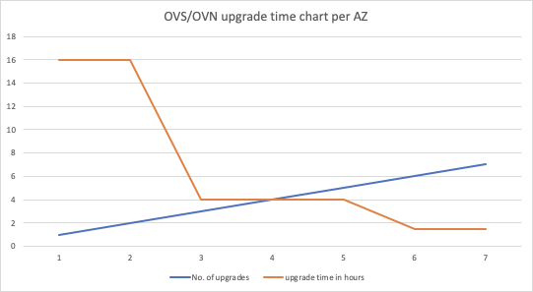

Faster upgrades….
Most recent: 1.5 hours per az
Multiple ansible machines
Automated most of the upgrade steps to push on computes.
Experience with multiple upgrades helped gain confidence.

Slide 29

Encountered major dataplane impacts
Race conditions in promoting active node using pacemaker that wiped out entire nb db
Impact: All openstack VMs + kube pods
Action: Used neutron-ovn-sync tool to sync back the data along with backup db
Fix: Addressed already (ecf44dd)
2. A node with stale data got promoted due to human error
Impact: Only few pods as IP moves when pod dies and new promoted node had stale mac binding entries in the south bound db
Action: Move to active-active cluster.
Fix: Send periodic garp from minions so that mac binding is updated frequently
3. Shared ovn external network range for a vpc use case with load balancer vips caused IP conflict
Impact: Data plane impact for VIP range
Action: Deleted conflicting ports from neutron and ovn.
Fix: Black listed those IPs in neutron to avoid getting picked up.

Slide 30
Future goals
Move all OVS/OVN components to kubernetes ecosystem driven by pods specs in containers.
Further scale improvements for OVN to handle more computes and lports in a single availability zone.
Cross az multi-tenant DC interconnect.
Ecmp for routers.

Slide 31
Thank You.

