Slide 1
COOKING OVS WITH P4 SPICE!
Debashis Chatterjee and Namrata Limaye, Intel
Intel P4-OVS Team: Dan Daly, Anjali Singhai, James Choi, P. Venkata Suresh Kumar, Namrata Limaye, Debashis Chatterjee

Slide 2
Notices & Disclaimers
Performance varies by use, configuration and other factors. Learn more at www.Intel.com/PerformanceIndex.
Performance results are based on testing as of dates shown in configurations and may not reflect all publicly available updates. See backup for configuration details. No product or component can be absolutely secure.
Your costs and results may vary.
Intel technologies may require enabled hardware, software or service activation.
© Intel Corporation. Intel, the Intel logo, and other Intel marks are trademarks of Intel Corporation or its subsidiaries. Other names and brands may be claimed as the property of others.

Slide 3
Agenda
Networking’s next great innovation
Prior work
OVS HW offload challenges
P4-driven vswitch platform
P4-Proto
What is P4 runtime?
OVS to P4 mapping
Example P4 table: Antrea L3 fwding table(Tunnels)
Example Config: Mirror
Example CT, Conjunctions
Summary
Contacts
Q&A

Slide 4



Networking’s next great innovation
First release in 2009
Opensource multilayer virtual switch
Support for ACL, QoS policies
OpenFlow integration for SDN controllers
Support for LAG/LACP, tunneling, port bonding and other networking features
Widespread adoption
Linux kernel and user space support
Introduced in 2014
Protocol-independent, platform-independent domain-specific language for packet processing
Support for match-action pipeline and associated metadata
Allows the network to be described top down, instead of a vendor-centric bottoms up view
Six years later, still waiting for the next major innovation
P4 faces challenges in coding more complex networking features such as connection tracking
OVS needs more programmability in the ingress and egress pipeline
We need integration of the two - an OVS cooked with P4 spice!

Slide 5
Prior work
PISCES
Muhammad Shahbaz et al
https://github.com/P4-vSwitch/P4-vSwitch.github.io
Modified OVS code, P4-to-OVS compiler, many SW optimization for performance
P4vSwitch Library
Sander Tolsma
https://www.tolsma.net/blog/an-open-p4-based-virtual-network-switch
Run both ingress and egress pipeline on an eBPF VM
P4-OVS
Tomaz Osinski
https://github.com/osinstom/P4-OvS
Userspace BPF(ubpf) as pocket processing engine, and a ubpf backend for P4 compiler
PISCES seemed to focus more on using P4 to describe what the OVS data plane was doing. The other two approaches are mostly SW-centric, but what we are planning to do aligns closely with Tomaz’ work.
Our focus is on running OVS on a P4-defined data path- which could be implemented in many different ways based on the P4 compiler backend used.

Slide 6




OVS HW offload challenges
OVS Megaflow cache - great SW optimization idea, can be slow, potential of DDOS attack
The reactive behavior requires high slow path performance; maintaining high flow set up rate is a challenge
The aggregation followed by disaggregation -> the intent is lost
Better -> skip the caches and offload directly to the HW tables
Solves the other associated problems
Generic Flow
Optimized Flow
SDN Controller
Offload
Offload
SDN Controller
Application Pipeline DB
Application Pipeline DB
(
Clear intent for
L
L
2
2
L
L
3
3
(
each table is known)
ACL
LKUP
LKUP
ACL
LKUP
LKUP
Clear intent for
each table is known)
OVS Slow
-
Path
OpenFlow Tables
T
OpenFlow Tables
2
/
T
3
T
/
1
(
/
Intent for each
L
2
w
/
P
L
4
annotations
T
3
T
2
1
T
table is lost)
3
ACL
LKUP
LKUP
(
Intent is preserved)
P
4
API
OVS SW Fast
-
Path
Megaflow Cache
(
Generic flows are
Offloaded)
HW Data
-
Plane
Specialized HW Blocks
Specialized HW Blocks
(
Non
-
optimal usage
(
Non
-
TCAM
EM
LPM
TCAM
EM
LPM
optimal usage
of HW blocks)
of HW blocks)

Slide 7

P4-driven vSwitch platform
ACLs
Security Groups
As HW vendor, we need to support many platforms
Switch, NIC, FPGA, SW
As HW vendor, we need to support many vSwitches
Custom vSwitches not upstreamed
Windows GFT, Vmware NSX-T, VPP
and many others
P4-driven vSwitch platform
Is common, extensible, and programmable
Any specific vSwitch can be supported
by simply adding a thin shim layer
Next speaker, Namrata Limaye will now present the technology details
L2
L2
L2
L2
L2
L2
LB
L2
L3
SDN Controller / Agent
P4
Runtime
vswitch.p4*
L2
L3
Ports*
Disks*
FDB
Team
BGP*
ECMP*
Tunnel*
ILA*
vSwitch*
P4 RT
Intel P4-driven vSwitch Platform
P4 Compiler
Switch
Pipeline
NIC
Pipeline*
FPGA
Pipeline*
DPDK
Pipeline*
Pipeline
C Model
Unified Pipeline Driver
Unified Pipeline Driver
Switch
Pipeline
NIC
Pipeline
FPGA
Pipeline
DPDK
Pipeline
Pipeline
C Model

Slide 8
P4Proto
P4 pipeline within P4proto
OpenFlow to P4 mappings using enhanced CLI for P4
Tables
Fields
Actions
Configs
Counters
Enables explicit encoding the underlay functions
P4-DPDK Software Datapath
HW offloads on P4 capable devices
Microflow/Megaflow caches disabled/unused for offload to P4 datapath
Enables proactive programming along with pre-existing reactive programming
Exception Path Support on ofproto and p4proto
Interface to P4 Controllers, SAI, SONIC using grpc within OVS
P4 Controller
OF Controller
ovs-p4ctl
ovs-ofctl
ovs-vswitchd
Map OF->P4 Tables/Fields/Actions
p4proto
ofproto
p4proto-dpif/API
netdev
ofproto-dpif
Netdev provider
dpif
P4-ubpf
dpif-provider
userspace
P4-dpdk
kernel
openvswitch.ko
P4-ebpf
external devices
P4 NICs
NIC device
New
Exists
Unused

Slide 9
What is P4 runtime?
P4Runtime API is a standard, open and silicon-independent
Protobuf for data model - P4Info
P4Runtime has grpc client and server interfaces
P4Runtime API (https://github.com/p4lang/PI) – Reference implementation for P4Runtime API. Provides grpc server capability.
BFRT (Barefoot (now Intel) Runtime) – Based on P4Runtime API. Offers more features and capabilities. To be Open-sourced Soon.
Features: Master Arbitration, Rule provisioning, DP re-configurablity, Packet IO, Batching, Error/Stats reporting, Extensible
Grpc client examples – SONIC

Slide 10
OVS + P4Runtime
OF Controllers
Rules/Configs
ovs-ofctl map br0 table ….
ofproto
Match Action pipeline
Reactive Programming
Classifier/Spoofguard
Tunnel Mgmt
Security Group
L3 Fwding
Mirror
P4 Controllers
Proactive Programming (Tables/Fields/Actions/Configs)
Rules/Configs
Stats
ovs-p4ctl add_table ….
p4proto
P4 API
JSON
Classifier/Spoofguard
Tunnel Mgmt
Security Group
L3 Fwding
Mirror
P4
Runtime/BFRuntime
p4c
P4 Tables
P4 FIle
P4Info
Target Dataplanes
P4-ubpf/ebpf target
P4 NIC libs
RTE-Flow
P4-DPDK target
P4 NIC Pipeline
Exception Packets
Classifier/Spoofguard
Tunnel Mgmt
Security Group
L3 Fwding
Mirror

Slide 11
OVS to P4 Mapping
OVS Bridge to P4-device
OVS tables mapped 1:1 or Many:1 (Antrea) into P4 control tables –
OVS Exact Match, Bit mask or wild card -> P4, Exact Match, Ternary (wild card/bit mask ) or LPM – Static Map
OVS priority to P4 action ‘set_priority’
ovs-ofctl map-table br0 <OVS_table_#> <P4_table_name>
ovs-ofctl add-flow <OVS_table_#> map-table <P4_table_name> br0 <OVS_fields>:<OVS actions> map-action <P4-action-macro>
OVS Actions to P4 Macros for actions –
OVS default action to P4 default action
Per table action or control block via static mapping
RECIRC and RESUB as P4 metadata
Tunnel actions from OVS into P4 action
Metadata to P4 Metadata
ovs-ofctl map-action br0 <OVS_action> <P4_Action>
Mirroring, Sampling
mapped to config tables in P4
Action mapping from OVS flow to P4
LAG, ECMP – Applied as config tables in P4
Counters, Meters and Registers applied directly to P4 direct/indirect counters and meters

Slide 12
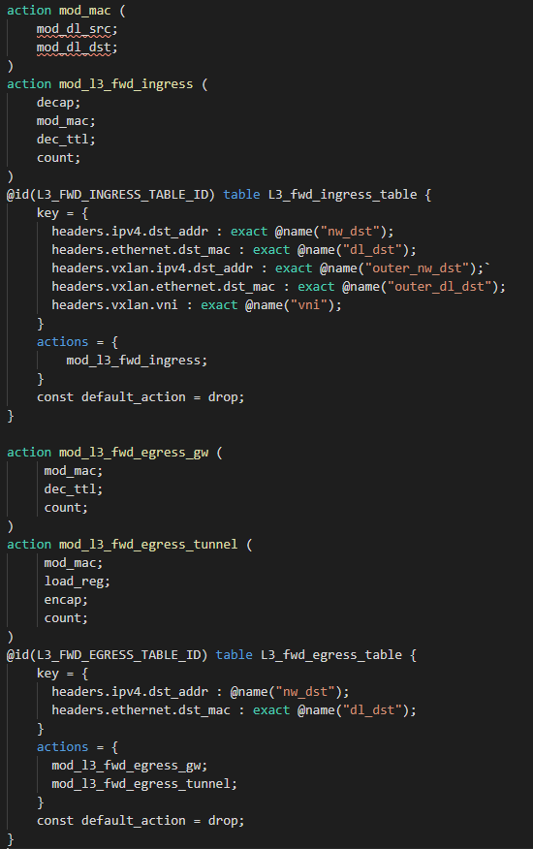
Example P4 table: Antrea L3 Fwding table (Tunnels)
Ingress:
Tunneled traffic coming in from peer node:
table=70, priority=200,ip,dl_dst=aa:bb:cc:dd:ee:ff,nw_dst=10.10.0.2 actions=mod_dl_src:e2:e5:a4:9b:1c:b1,mod_dl_dst:12:9e:a6:47:d0:70,dec_ttl,goto_table:80
Egress:
Tunneled traffic destined to local gateway:
table=70, priority=200,ip,dl_dst=aa:bb:cc:dd:ee:ff,nw_dst=10.10.0.1 actions=mod_dl_dst:e2:e5:a4:9b:1c:b1,goto_table:80
Traffic destined to remote Pod via tunnel:
table=70, priority=200,ip,nw_dst=10.10.1.0/24 actions=mod_dl_src:e2:e5:a4:9b:1c:b1,mod_dl_dst:aa:bb:cc:dd:ee:ff,load:0x1->NXM_NX_REG1[],load:0x1->NXM_NX_REG0[16],load:0xc0a84d65->NXM_NX_TUN_IPV4_DST[],goto_table:71
Default:
table=70, priority=0 actions=drop

Slide 13
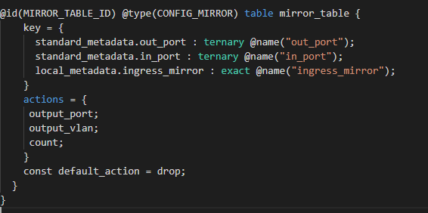
Example Config: Mirror
OVS Mirror Table Fields –
_uuid,
external_ids,
name,
output_port,
output_vlan,
select_all,
select_dst_port,
select_src_port,
select_vlan,
snaplen,
statistics

Slide 14
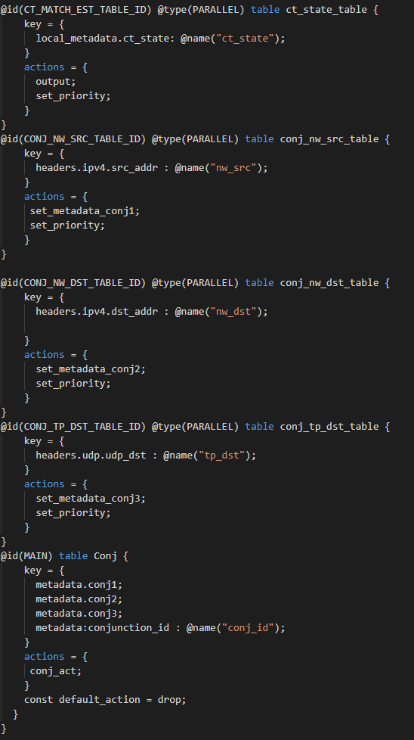
1
Example: CT, Conjunctions
table=45, priority=64990,ct_state=-new+est,ip actions=resubmit(,61)
table=45, priority=14000,conj_id=1,ip actions=load:0x1->NXM_NX_REG5[],ct(commit,table=61,zone=65520,exec(load:0x1->NXM_NX_CT_LABEL[32..63]))
table=45, priority=14000,ip,nw_src=10.10.1.6 actions=conjunction(1,1/3)
table=45, priority=14000,ip,nw_dst=10.10.1.8 actions=conjunction(1,2/3)
table=45, priority=14000,udp,tp_dst=53 actions=conjunction(1,3/3)
table=45, priority=0 actions=resubmit(,50)

Slide 15
Summary
Create P4Proto (P4Runtime) parallel to Ofproto. Interface to P4 controllers. Entire pipeline in P4.
Map Openflow (OVS) pipeline to P4 pipeline for flow rules and configurations using OVS Command line.
Program dataplane from Openflow tables, skip Microflow and Megaflow caches for HW offloads
Re-validator updates both ofproto and p4proto
Open issues:
Supporting multiple dataplanes
Single binary with Ofproto and P4proto, or a different P4Proto?
Propagating Changes (OVS pipeline, P4 file, Ofproto->P4proto mapping)

Slide 16
Contacts
Code will be uploaded on Github. Please email for more info…
Contacts: Debashis Chatterjee (Debashis.Chatterjee@intel.com)
Namrata Limaye (Namrata.Limaye@intel.com)
Intel P4-OVS Team: Dan Daly, Anjali Singhai, James Choi, P. Venkata Suresh Kumar, Namrata Limaye, Debashis Chatterjee

