Slide 1
vswitch.p4: Why OVS Needs P4
Open vSwitch and OVN 2020 Fall Conference
Presenter: Dan Daly
Intel P4-OVS Team: Dan Daly, Anjali Singhai, James Choi, P. Venkata Suresh Kumar, Namrata Limaye, Debashis Chatterjee

Slide 2
Notices & Disclaimers
Performance varies by use, configuration and other factors. Learn more at www.Intel.com/PerformanceIndex.
Performance results are based on testing as of dates shown in configurations and may not reflect all publicly available updates. See backup for configuration details. No product or component can be absolutely secure.
Your costs and results may vary.
Intel technologies may require enabled hardware, software or service activation.
© Intel Corporation. Intel, the Intel logo, and other Intel marks are trademarks of Intel Corporation or its subsidiaries. Other names and brands may be claimed as the property of others.

Slide 3
Why P4 in OVS? Information Encoding
Notes:
- Why P4 in a host? Why P4 in OVS?
- Encoding More Information than OpenFlow
- - Explicit match types, actions and control flow
- - Enable dataplane optimizations
- - Better constrained random testing (define the combos you need, nothing you don’t, and test them)
- No More Priority Based If-Clauses
- - OpenFlow conditionals using priority (yuck)
- - Explicit control flow between matches and action (yay)
- Whole Datapath Approach
- - Encode the underlying network structures
- - - Ports, Teams, Routes, Tunnels
- - Encode the translation tables
- - - iptables NAT, VLAN tagging, netdev tagging
- - Preserve the existing control planes
- Enable a full dataplane offload
- Yes, Connection Tracking Too
- - I can keep this brief if someone else is going deep on this
- Kernel Control Planes, SDN vSwitch, Hardware Datapath
- - Outline the Kernel - SAI connection used in SONiC
- - Netlink socket listeners
- Summary
- - P4 encodes more information than OpenFlow
- - - Better for optimization, easier to validate
- - New! P4 can now encode the whole datapath
- - - Explicit Connection Tracking
- - - IPSec Tunnels
- - One Datapath definition of everything that processes packets
- - - Provides a complete ‘spec’ that can be targeted to different data planes, including hardware
- - - Provides customization path where it is clear what goes where in what order

Slide 4
What Information to Encode?
Specific instead of generic →
Better optimized pipeline implementations
Auto-generated testing of what matters
Kernel operations in the datapath →
Enables an optimized kernel path w/out bypassing
Program more operations →
Cambrian explosion of networking applications
Network as a programmable platform →
Programs to measure, validate, & re-program the network
Notes:
- Why P4 in a host? Why P4 in OVS?
- Encoding More Information than OpenFlow
- - Explicit match types, actions and control flow
- - Enable dataplane optimizations
- - Better constrained random testing (define the combos you need, nothing you don’t, and test them)
- No More Priority Based If-Clauses
- - OpenFlow conditionals using priority (yuck)
- - Explicit control flow between matches and action (yay)
- Whole Datapath Approach
- - Encode the underlying network structures
- - - Ports, Teams, Routes, Tunnels
- - Encode the translation tables
- - - iptables NAT, VLAN tagging, netdev tagging
- - Preserve the existing control planes
- Enable a full dataplane offload
- Yes, Connection Tracking Too
- - I can keep this brief if someone else is going deep on this
- Kernel Control Planes, SDN vSwitch, Hardware Datapath
- - Outline the Kernel - SAI connection used in SONiC
- - Netlink socket listeners
- Summary
- - P4 encodes more information than OpenFlow
- - - Better for optimization, easier to validate
- - New! P4 can now encode the whole datapath
- - - Explicit Connection Tracking
- - - IPSec Tunnels
- - One Datapath definition of everything that processes packets
- - - Provides a complete ‘spec’ that can be targeted to different data planes, including hardware
- - - Provides customization path where it is clear what goes where in what orde

Slide 5

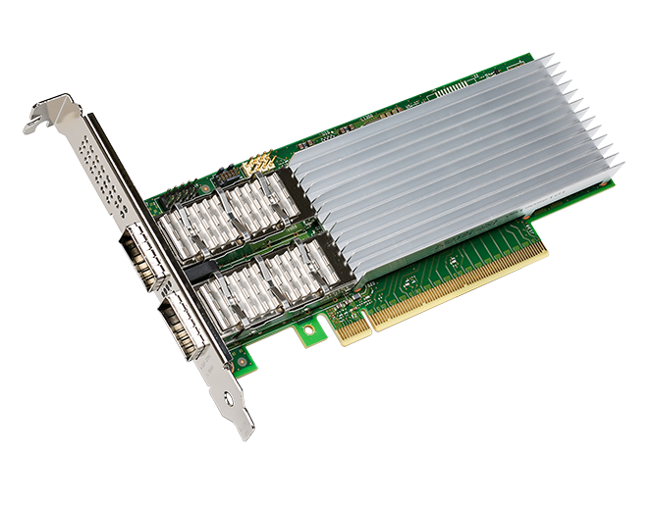
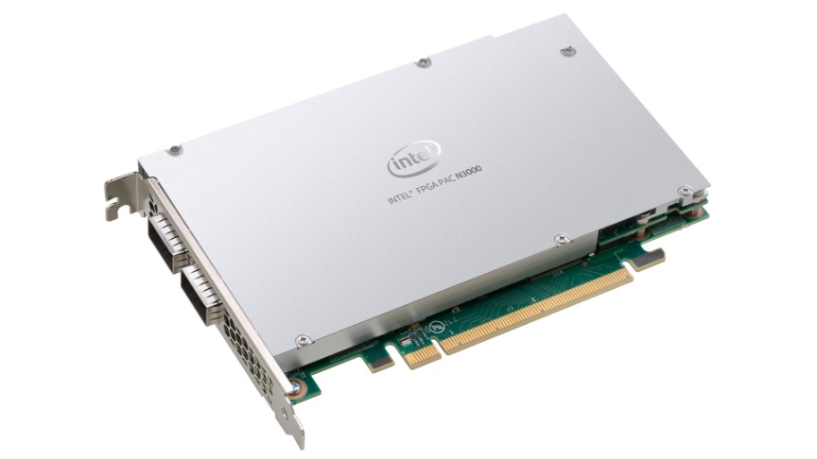
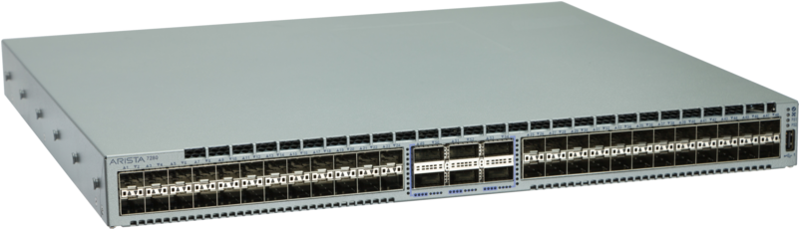

1. Be Specific
P4 Encodes:
Control Flow: Order of Operations
Match Types: Not Everything Has to Be Ternary
Specific Actions: Specify the actions needed
Enables a Compiler to Target Dataplanes ↓
P4 Program
table routing {
key = { ipv4.dstAddr : lpm; }
actions = { drop; route; }
size : 2048; }
control ingress() {
apply {
routing.apply(); }
}
P4 Studio
P4 Compiler Front-end
P4 Visualization
Switch Back-end
NIC Back-end
FPGA Back-end
Software Back-end
SDK
Pipeline
SDK
Pipeline
SDK
Hardware
SDK
Pipeline
C Model
C Model
C Model
Platform
Switch
SmartNIC
FPGA
Software
More info: Converting OpenFlow to P4

Slide 6
2. Kernel Powered
New! P4 can encode the supporting kernel operations
Tunnels, Routes, Conntrack, IPSec Tunnels, iptables
PNA – Portable NIC Architecture
Portable across different targets
New constructs for Connection Tracking, IPSec, Message Handling
Kernel configuration relayed to P4 dataplane via SAI
See SONiC synchronization msgs (https://github.com/Azure/SONiC/)
Whole Datapath Approach
More info: Container Networking w/ OVS
Notes:
- Why P4 in a host? Why P4 in OVS?
- Encoding More Information than OpenFlow
- - Explicit match types, actions and control flow
- - Enable dataplane optimizations
- - Better constrained random testing (define the combos you need, nothing you don’t, and test them)
- No More Priority Based If-Clauses
- - OpenFlow conditionals using priority (yuck)
- - Explicit control flow between matches and action (yay)
- Whole Datapath Approach
- - Encode the underlying network structures
- - - Ports, Teams, Routes, Tunnels
- - Encode the translation tables
- - - iptables NAT, VLAN tagging, netdev tagging
- - Preserve the existing control planes
- Enable a full dataplane offload
- Yes, Connection Tracking Too
- - I can keep this brief if someone else is going deep on this
- Kernel Control Planes, SDN vSwitch, Hardware Datapath
- - Outline the Kernel - SAI connection used in SONiC
- - Netlink socket listeners
- Summary
- - P4 encodes more information than OpenFlow
- - - Better for optimization, easier to validate
- - New! P4 can now encode the whole datapath
- - - Explicit Connection Tracking
- - - IPSec Tunnels
- - One Datapath definition of everything that processes packets
- - - Provides a complete ‘spec’ that can be targeted to different data planes, including hardware
- - - Provides customization path where it is clear what goes where in what orde

Slide 7
P4 Referencing Kernel Objects via SAI
P4 match/action w/ Kernel (SAI) objects
SAI+P4 Table Entries Populated via P4Runtime:
Match on { Header, Virtual Port Metadata } → Set VNI / Geneve.{source,dest} Metadata, Encap( SAI Tunnel Handle, VNI, Geneve.{source,dest} )
Remaining pipeline logic is populated through the kernel (via SAI):
Match on { VRF : exact, Metadata Dest IP : LPM } → Route
Action Selector for NextHop, Interface
vSwitch
Pipeline
Kernel
(via SAI)
(Tunnel,
Route,
Forward)
VMs
Ports
Transmit Flow Example

Slide 8



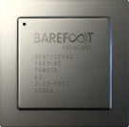
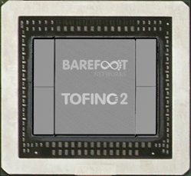
3. Program More = Explosion of Accelerated Workloads
More…
Storage Interconnect
Networking
Microservices Acceleration
Machine Learning Fabrics
P4
DNS Cache
Compiler
Key Value Caching & Replication
Extremely-Accurate Time Synchronization
Pattern Matching & Stream Processing
Consensus Acceleration
Network Packet Broker
Firewall & DDoS
Accelerated VNFs
Programmable
Data Planes
Adv Congestion Control
Programmable Data Planes
E2E Telemetry & Analytics (INT)
Enterprise/Telco/SP Switching
Cloud Switching
Notes:
#1: If you’re a just fixed-function switch, there are only two things you can do: telco and cloud switching (in blue boxes). But with P4 programmability, it opens pandoras box on what types of applications you can create and implement.
1a) The different colors illustrated above are grouping the different types of new apps together.
#2: What can you do with P4 beyond Tofino? Combining Tofino with other programmable devices like NIC, FPGA, CPU, you can create richer applications to further expand the market applicability.
*On the next slide, we will focus on end-to-end telemetry and analytics

Slide 9


4. Network as a Programmable Platform
Control App
Control App
Control App
Control App
Control state/code
Generation & Verification
Control Plane
Contract
Runtime Contract
Dataplane state/code
vswitch.p4
-OVS
-OVS
Switch OS
Switch OS
Switch OS
DPDK
XDP
NIC
NIC
NIC
switch
switch
switch
NIC
Fine-grained Per-packet Measurement (e.g. INT)

Slide 10
vSwitch Programmable Platform
Use P4 to Encode Network Intent
Current: OpenFlow + OVSDB
OpenFlow ordered tables w/ priority-based ‘jumps’
Escapes to kernel functions Conntrack, tunnels, iptables
Proposal: P4 + OVSDB
P4 control flow w/ typed matches & actions Converting OpenFlow to P4
Explicit dataplane functions Conntrack, tunnels, iptables Container Networking w/ OVS

Slide 11
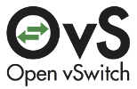
vswitch.p4
Jumpstart Your.p4
Reflected Kernel Datapath
Ports, Teams, Routes, Tunnels, NAT, load balancing, conntrack
OpenStack Neutron Feature Set
vL2, vL3, Security Groups, vLB
OVN & Antrea examples
ACLs
Security Groups
L2
L2
L2
L2
L2
L2
LB
L2
L3
SDN Controller / Agent
ovsdb
P4
Runtime
L2
L3
+
Ports
FDB
team
BGP
ECMP
Tunnel
ILA
Config
RPC
P4 RT
Re-usable
tests

Slide 12
vswitch.p4
How it comes together
vswitch.p4 → Your.p4 Customize, Optimize
Compile for Target(s) Capabilities, Scale, Fit
Dataplane Load Population w/ P4 APIs
(Optional) Dataplane Update
Open Source Project
P4.org
vswitch.p4
PSA Specification
PNA Specification
P4_16 Specification

Slide 13
Why P4 in OVS?
P4 encodes more information than OpenFlow
Better for optimization, validation & re-programming
New! P4 can now encode the Whole Datapath
P4 in OVS : More programmable, flexible & multi-target
vswitch.p4 encodes common functionality to get started
What Will You Do With This Added Programmability?

Slide 14
Contacts
Code will be uploaded on Github. Please email for more info…​
Contacts: Debashis Chatterjee (Debashis.Chatterjee@intel.com)​
Dan Daly (dan.daly@intel.com)​
Intel P4-OVS Team: Dan Daly, Anjali Singhai, James Choi, P. Venkata Suresh Kumar, Namrata Limaye, Debashis Chatterjee

