Slide 1
OVS DPDK Community Auto Validation
December 7th-8th, 2021
Michael Phelan, Ian Stokes, Aaron Conole
Intel/Red Hat

Slide 2





Problem Statement
Patches for OVS are validated by a variety of means.
OVS features that use technology such as Intel® AVX-512 require specific hardware/platform capabilities.
Developers submitting patches to OVS do not always have the means to test these features.
Patches submitted may break existing features without the developer’s knowledge.
Notes:
Previously, patches for OVS have been validated by a variety of means such as GitHub, Appveyor and Travis etc.
New patches can break existing functionality without the developer being aware.
Features in OVS such as AVX512 support require specific platform capabilities to be tested properly.
Not all developers working on OVS have access to these platforms and thus have no way to test their code extensively

Slide 3
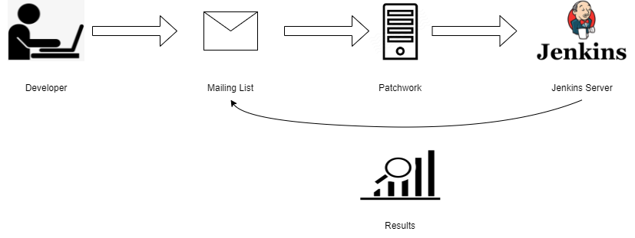
Solution
Use scripts from the OVS 0-day robot to retrieve patches and launch Jenkins build jobs.
Currently validating OVS features that use Intel® AVX-512 i.e. compilation and OVS DPDK unit tests.
Results of jobs sent to mailing list via e-mail.
Notes:
Deploy a Jenkins instance with access to the required platforms for building jobs which perform OVS AVX512 compilation and unit testing.
Use the scripts from the OVS robot designed by Aaron Conole and Michael Santana to download new patch series from patchwork and send it to a Jenkins job for testing.
Once testing is complete the results will be sent via email to the mailing list for review and any necessary changes can be made.
call out specific features e.g. what unit tests being run
Work based on the 0-day robot done by Aaron Conole and Michael Santana

Slide 4
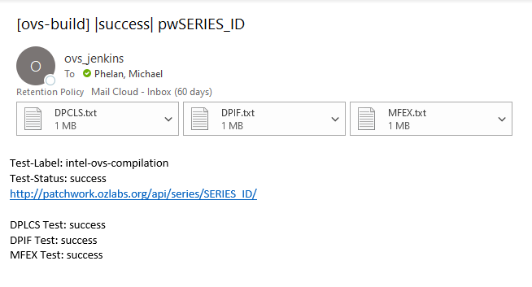
Sample Result E-Mail
Key Information:
Build Result
Series ID
Patchwork Link
Test Logs
More information at: http://patchwork.ozlabs.org/project/openvswitch/patch/20210628180028.581283-1-aconole@redhat.com/
Notes:
Result E-mail will look something like this, should contain the results, series ID, link to patchwork and log files for each of the tests

Slide 5
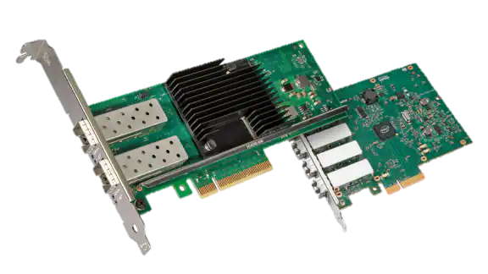
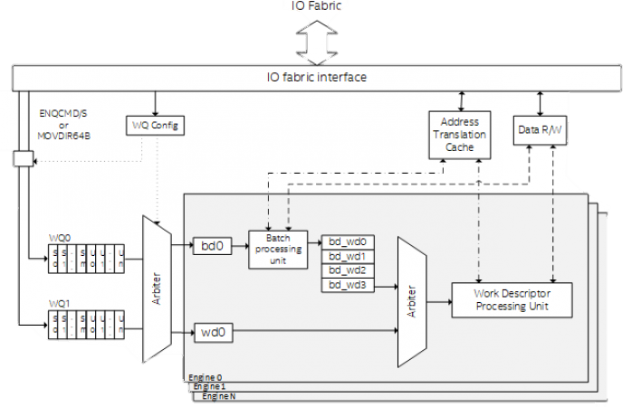
Future Work
Include testing for other proprietary capabilities.
Include jobs which test performance.
Handle corner cases such as code being targeted for branches other than master (will require email header keywords for parsing).
Hardware Offload
Intel® Data Streaming Accelerator
Notes:
Integrate testing frameworks for other capabilities such as Hardware offload or Intel Data Streaming Accelerator
Could also implement regression testing to measure performance of patches
Also need to allow for and catch corner cases such as patches being targeted for different branches

Slide 6
? Questions ? Michael Phelan michael.phelan@intel.com Ian Stokes ian.stokes@intel.com Aaron Conole aconole@redhat.com

