Slide 1
P4 Control Plane with OVS
Namrata Limaye, Derek Foster, Nupur Uttarwar - Intel
Intel P4 Control Plane Team: Deb Chatterjee, Dan Daly, Namrata Limaye, Derek Foster, Nupur Uttarwar, P. Venkata Suresh Kumar

Slide 2
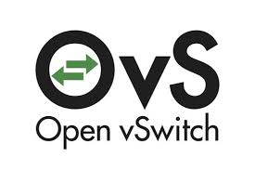
Notices & Disclaimers
Performance varies by use, configuration and other factors. Learn more at www.Intel.com/PerformanceIndex.
Performance results are based on testing as of dates shown in configurations and may not reflect all publicly available updates. See backup for configuration details. No product or component can be absolutely secure.
Your costs and results may vary.
Intel technologies may require enabled hardware, software or service activation.
© Intel Corporation. Intel, the Intel logo, and other Intel marks are trademarks of Intel Corporation or its subsidiaries. Other names and brands may be claimed as the property of others.

Slide 3
Agenda
History
P4 Control Plane (Split Arch) Components
OVS P4Runtime library
Implementation and patches
Conclusion
Resources
Q&A

Slide 4
Moving from Integrated to Split Architecture
In 2020, we created monolithic P4-OVS implementation and open-sourced on ipdk-io
Integrated architecture components
Stratum was integrated within OVS to support P4Runtime and Openconfig
Linux kernel offload function using SAI was integrated
Program pipeline like OVS slowpath via P4
The new P4 Control Plane or Split Architecture separates all functions into different components
OVS Patches will contain minimal changes to OVS and expected by end of the year

Slide 5
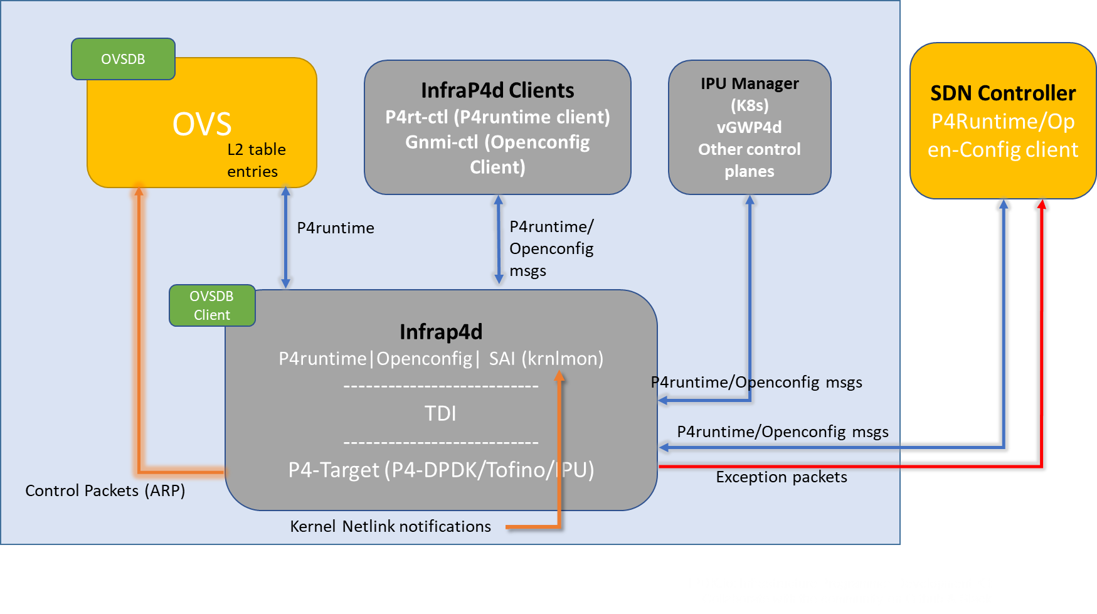
P4 Control Plane (Split Architecture)

Slide 6
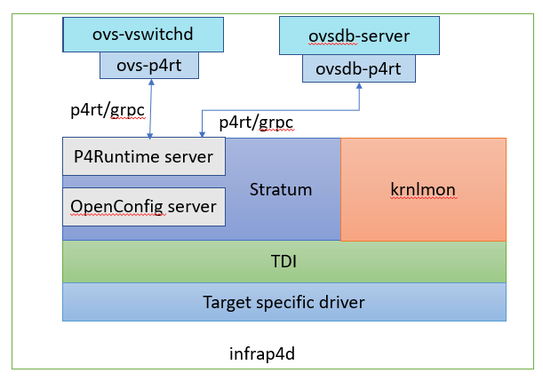
OVS P4Runtime library
ovs-p4rt is a library (C++ with a C interface) that allows ovs-vswitchd to communicate with the P4Runtime Server in infrap4d via gRPC.
ovsdb-p4rt library communicates with infrap4d and is used to subscribe to tables in ovsdb-server for port notifications to program P4 tables.
Uses for ovs-p4rt and ovsdb-p4rt::
Forwarding tables based on MAC learning in OVS (ovs-p4rt)
Tunnel encapsulation/decapsulation tables based on tunnel configuration using ovs-vsctl (ovsdb-p4rt/ovs-p4rt)
Any port add/updates

Slide 7
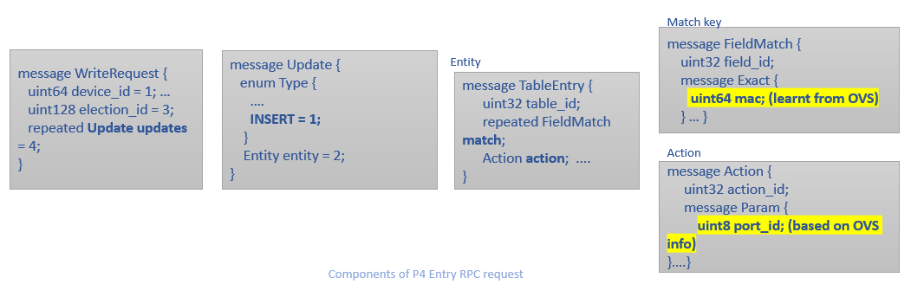
ovs-p4rt Implementation
OVS “sidecars” called ovs-p4rt and ovsdb-p4rt created for minimal change to OVS
ovs-p4rt library will be managed by the networking recipe within ipdk-io.
OVS on enabling P4 links this library to perform P4Runtime operations.
ovs-p4rt transfers Mac learning and L2 information to infrap4d via P4Runtime.
For multiple P4Runtime controllers, master arbitration is handled by ovs-p4rt

Slide 8
In Conclusion
New architecture:
Is modular
Easier to update and upstream
Only makes necessary changes in OVS
Introduces OVS P4Runtime library for P4 to integrate with infrap4d

Slide 9
Resources
Infrap4d - https://github.com/ipdk-io/networking-recipe
OVS - https://github.com/ipdk-io/ovs/tree/split-arch
P4-OVS - “Why OVS Needs P4” https://www.youtube.com/watch?v=Hpb-OipXLqQ

Slide 10
Thank You

