Slide 1
OVS DPDK Practice in Real Public Cloud
2022
Cheng Li, Ding Han
Chinatelecom Cloud

Slide 2
Meter lock
Scenario: User VM pps and bps are both limited by meter action.
Problem: meter lock becomes expensive when PMD number increases(Multiple PMDs process pkts for the same VM).
Solution: introduce per PMD bucket pool to reduce meter lock frequency.

Slide 3
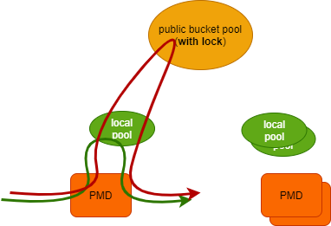
Solution: per PMD bucket pool
Each PMD has its local bucket pool.
Cost from local pool if satisfies(no lock).
If local pool can’t cover the cost, then: 1. Feed the public bucket pool 2. Move at most X times this batch cost from public pool to local pool (with lock). 3. Cost local pool
Thoughts:
How to decide the local pool size(X)? Larger local pool(X), less lock times. Lower accuracy. (20% improvement.)
What if public pool doesn’t have enough bucket? Lock every meter action? Yes, but it’s not a problem.

Slide 4
Conntrack performance improvement
Scenario: Conntrack is used to ensure reply pkts can arrive VMs.
Problem: conn timeout update for each pkt is not necessary for most scenarios.
Solution: instead of making timeout update for each pkt, we can update in interval.

Slide 5
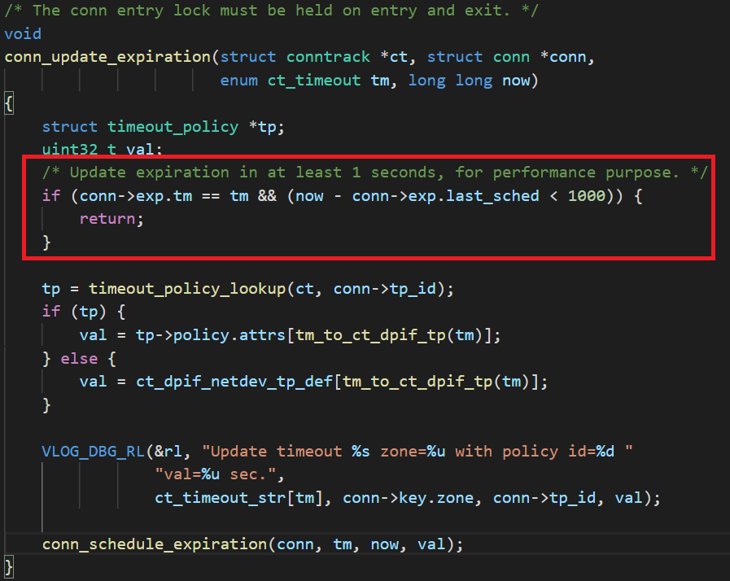
Solution: not make update for every pkt
The rule is simple: do not make timeout update if no conn state change and last update happened within 1 second.
If we run at 1,000,000 pkt/s, we saves 999,999 times of update. At the cost of 1 second timeout floating.
Most time, we are not sensitive about the 1 second floating.
About 5% performance improment.
(The sample code was based on an old version,
latest ovs version may has some changes.)

Slide 6
Flow based CT limitation
Scenario: One host may run multiple VMs from difference users, one VM may cost all CT resource if no limitation.
Problem: OVS currently supports zone based CT limit
Solution: we have developed flow based CT limit, to achieve CT limitation for every single VM.

Slide 7
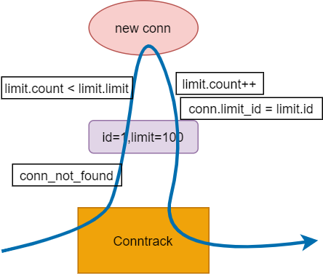
Solution: flow based CT limit
Openflow changes:
ovs-ofctl add-ct-limit <bridge_name> "id=<limit_id>,limit=<limit_size>“
ovs-ofctl add-flow <bridge_name> \ "in_port=1,action=ct(commit[,limit=<id>],xxx)”
Check conn count when creating new conn.
When a conn expires, limit.count minus 1.
Deleting ct-limit triggers ct flow delete. (just like how meter works)
With this implementation, we can:
Limit ct entry for every single VM.
No performance drop as limit happened only for new conn(not lookup).
Notes:
likewise, when a conn expires, the limit.count will minus 1.

Slide 8
Thank you! Cheng Li lic121@chinatelecom.cn Ding Han handing@chinatelecom.cn

