Slide 1
Face Emotion Recognition and mapping to Emojis
Name : Amit Agarwal
Roll No. : 18EEBCS006
Branch : CSE
Year : 3rd

Slide 2
Contents
Problem Description
Objective
Steps Involved in Model
Data Collection
Data Preparation
Data Visualization
Model Selection
Training Methodology
Model Evaluation
Implementation Details
Predicting Output
Hyperparameter tuning
Future Scope

Slide 3
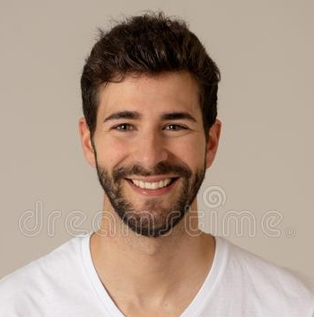

Problem Description
Trying to get emoji from face emotion
Which Facial Expressions
???

Slide 4
Objective
The objective is to identify emotions of a human.
The emotion can be captured from facial expressions.
Facial emotion recognition is one of the useful task and can be used as a base for many real-time applications.

Slide 5
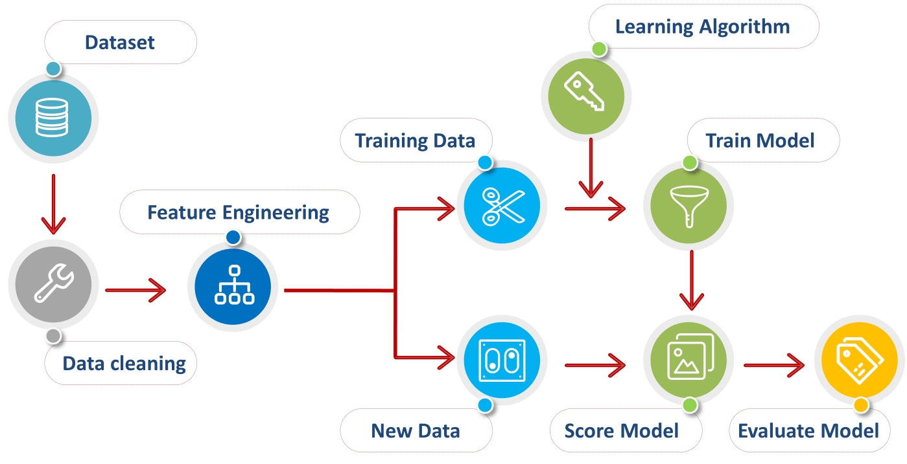
Steps involved in model
To build a deep machine learning model to predict facial expression

Slide 6
Data Collection
In this model, we are using online data science websites datasets to train our model. Example: Kaggle, Socrata, Github, etc.
We have collected raw data from the kaggle.com - fer2013 dataset
https://www.kaggle.com/msambare/fer2013
Our data is in form of images each of size 48x48 (Gray Scale) pixels.
Images are grouped into 7 different facial expression groups
Classes: (angry, disgust, fear, happy, sad, surprise, neutral)
There are total 28,709 images in training dataset and 7,178 images for testing

Slide 7
Data Preparation
Since our dataset has images and we need it to convert into some numerical type values, to be processed by our model.
We use ImageDataGenerator function of keras-preprocessing library to convert these images to tensor images (multi-dimensional numeric array).
This function rescales the images pixel range between 0 and 1.
Since our data is grouped into different directories, we use ImageDataGenerator function using another function flow_from_directory to process each image.

Slide 8







Data Visualization
0 - Anger
1 - Disgust
2 - Fear
3 - Neutral
4 - Happy
5 - Surprise
6 - Sad

Slide 9
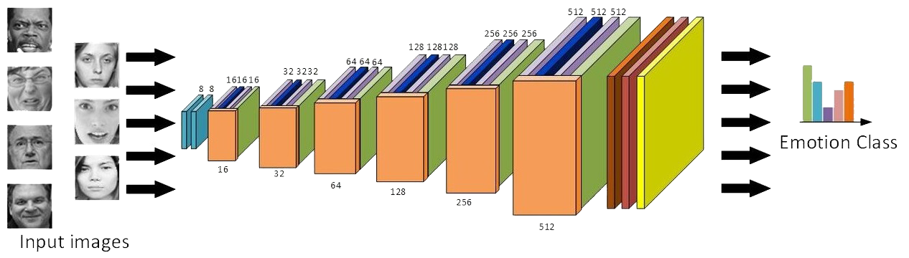
Model Selection
We are using Convolutional Neural Network Model (CNN Model) because of its high accuracy in image Classification.
The CNN follows a hierarchical model which works on building a network, like a funnel, and finally gives out a fully-connected layer where all the neurons are connected to each other and the output is processed.

Slide 10
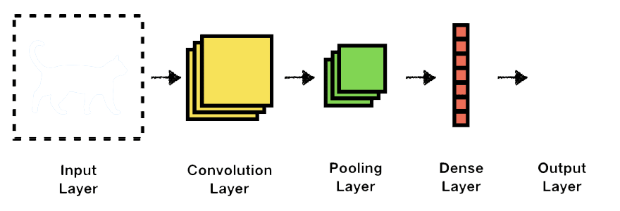
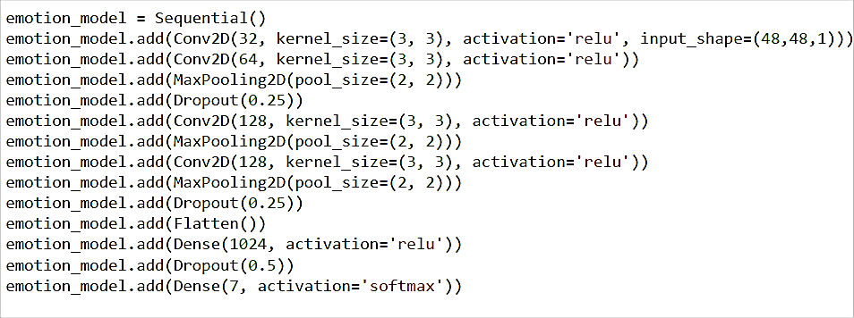
Training Methodology
4 :
Happy

Slide 11


Model Evaluation
We have completed our model architecture, now we have compiled with hyperparameters.
Evaluating our model using accuracy metrics gives accuracy score as 61.59%
Accuracy Score is the accuracy of the model.

Slide 12
Implementation Details
NumPy
OpenCV
Keras-Models - Sequential
Keras-Layers – Conv2D, Dense, Dropout, Flatten, MaxPooling2D
Keras-Optimizers - Adam
Keras-Image Processing
Tkinter

Slide 13
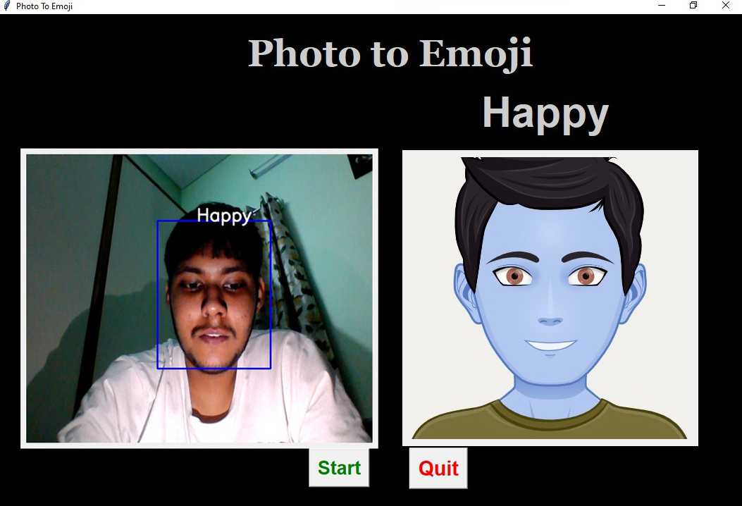
Predicting Output

Slide 14
Hyperparameter Tuning
Loss Function – Categorical_crossEntropy
Optimizer - Adam
Epoch – 50 epoches
Batch Size – 448 images for training and 120 images for testing

Slide 15
Future Scope
Deepfake Detection - Identify videos with facial or voice manipulations.
Medical Research into Autism - Where sufferers have developmental and long-term difficulties in evaluating facial emotions.
Automotive Safety and Research Systems - Expression recognition is included as part of automotive car systems.
Recruitment – Solve challenge of the subject's face being occluded by a mask and thus hindering intelligent video analysis.

Slide 16
Thank You

