Slide 1
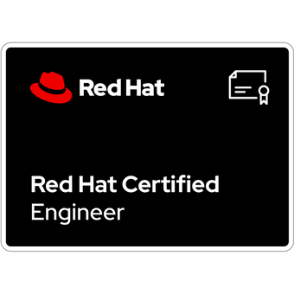
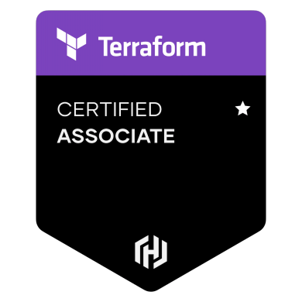
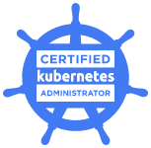
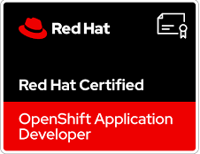
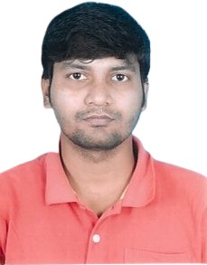
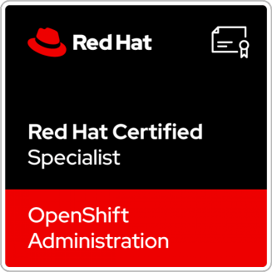
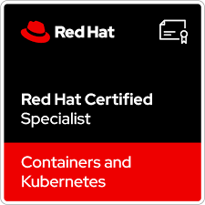
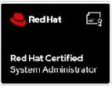
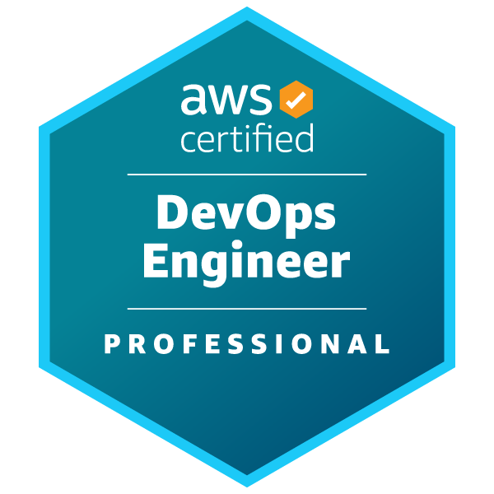

Raju Das
Senior Technical Lead
Mobile : 7002358450
Email : raju.das@gds.ey.com
Background
Middleware: IBM WAS, JBoss, Tomcat
Patching - Red Hat Satellite server, RHN, AWS SSM, BigFix
Storage:- IBM V7k, Dell SC4020, DS4700/3400, SAN Switch.
Monitoring: Tivoli Monitoring tool, ManageEngine, CloudWatch.
Projects
over 11 years of experience in Banking and Auction platforms, I specialize in developing architectures and building highly scalable applications. My expertise includes designing/optimizing, implementing, and migrating AWS Cloud Infrastructure, as well as proficiency in Automation, DevOps, and Legacy Application-based technologies.
Hands on experience in GitHub, AWS DevOps, Docker, EKS, Kubernetes, Jenkins, Terraform, Ansible, AWS Cloud.
Certification: RHCSA, RHCE(Ansible), Red Hat Certified Specialist in OpenShift Administration, Red Hat Certified Specialist in Containers, Red Hat Certified Specialist in OpenShift Developer and Certified Kubernetes Administrator and Certified in terraform
Holds a Bachelor degree in Computer Science from Calcutta University. MCA from SGVU.
US Based Banking Project: Project involved cloud infrastructure automation design and implementation of bank application using AWS API gateway, Cognito, ECS, RDS, GitHub workflow etc.
UK Based Banking API Gateway Project: Project involved cloud infrastructure automation design and implementation of Akana API Gateway. He worked as a Senior Consultant working with team advising on designing and implementation throughout migration process from On premise OpenShift to AWS EKS project. Includes AWS, EKS, CI/CD, SCM, Image Repo and Security management.
India-based Auction and Support Project: This Company is India’s top e-Auction platform provider. He has worked in this firm as a Senior Officer for On-prem & Cloud Infrastructure Management, Automation using Configuration Management tool, IaC and CI/CD pipeline implementation. Worked on POCs on various Project. Providing client support and managing end to end security of product on three tier architecture which also includes internal and external audit.
Leading US Support Company: This company is America’s Support provider. He has worked as Unix & Storage L2 administrator. Providing support on three tier architecture on On-prem virtualization, Private and public cloud. Which includes OpenStack, IBM PAAS, HP Helium cloud, IBM Power server, RedHat/Debian/Ubuntu, IBM/Dell storage, SAN switch, RedHat Satellite, DB, Webserver and Middleware support.
Experience
Design and implementation of Continuous Integration, Continuous Deployment pipelines & Security Testing using AWS DevOps and Jenkins.
Implementation of CI/CD and automated deployments for Web Services and API programmes.
Design and automated Infrastructure provisioning on Cloud using Terraform, Ansible, CloudFormation Template.
Containerization using Docker, OpenShift and EKS
Implementation of Zero Downtime Deployment using Blue-Green deployment strategy
Worked on migration from On-premise to IAAS cloud, IAAS Cloud to PAAS Cloud
Design of Branching strategy for scrum-based development
Worked on architects for cloud infrastructure design, Security cost estimation and management, cloud administration.
Reviewed the technical deliverables and worked with the client for approval process.
SME for performance optimization and improving the application performance by identifying and resolving all the bottlenecking issues.
Skills
Languages: YAML, Shell Scripting and Python
Public Cloud Platform: AWS , Azure
Virtualization[RHEV & VMware] & OpenStack
Tools: GIT, Jenkins, , GITLAB, GitHub, CloudFormation Templates, Terraform, Ansible, Docker, SonarQube, Maven, NEXUS repo and NEXUS image repo, Prisma Scan.
Domain : Banking, Auction Platform
Build Tools: Maven, Gradle
Containerization/Orchestration: Docker, Kubernetes, EKS, ECS, OpenShift.
RDBMS Tools: MySQL, DB2,Postgresql, RDS (Storage & Managed Instances)
Security - OpenVAS, Tenable, OS Hardening , RedHat Insights, AWS security.

