Slide 1
Docker
Anshul Pathneja

Slide 2
Chroot
chroot command in Linux/Unix system is used to change the root directory.
It changes the root directory for currently running processes as well as its child processes.
It cannot access files outside the root directory.

Slide 3
Control Groups(cgroups)
Cgroup is group of process.
With the help of Cgroup we can apply cpu and memory limits on group of process.
It also track memory and cpu usage.
/sys/fs/cgroup
systemd-cgls cpu/memory
https://www.monetdb.org/blog/limit_memory_usage_on_linux_with_cgroups

Slide 4
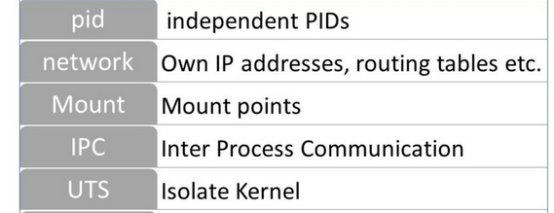
NameSpace
Linux provides namespaces that allows a process to see only resources that are part of that namespaces.

Slide 5
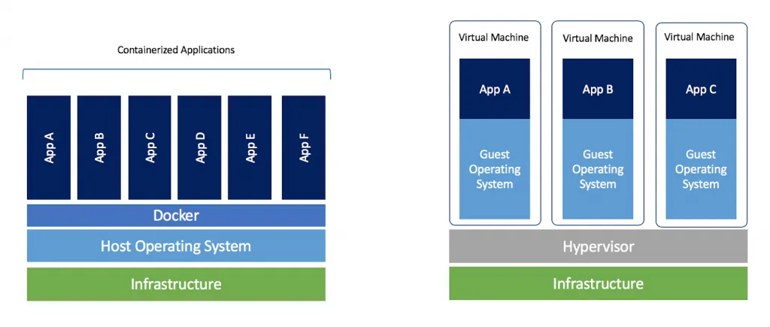
Docker vs VM
Notes:
Hypervisor : is a software or hardware that creates and run different virtual machine.

Slide 6
Container VS VM
Each container can share OS.
Boots in seconds.
Containers are of few KBs/MBS.
Containers can be created in seconds.
Less resource usage.
Containers are destroyed and re-created rather than moving
Each VM has a separate OS.
Boots in minutes.
VMs are of few GBs.
Creating VM takes a relatively longer time.
More resource usage.
VMs can move to new host easily

Slide 7
What is Docker?
Docker is an open platform for developing, shipping, and running applications. Docker enables you to separate your applications from your infrastructure so you can deliver software quickly.

Slide 8
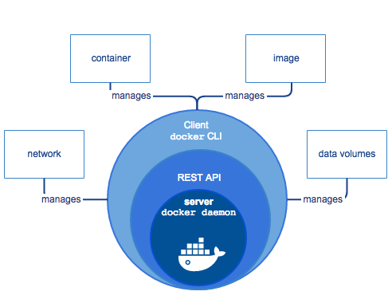
Client Server Architecture (sudo docker version)

Slide 9
Container
Image
Volume
Docker-Compose

Slide 10
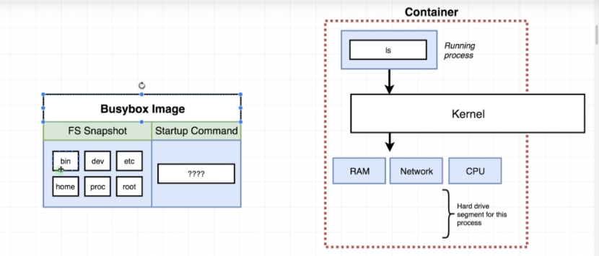

Slide 11
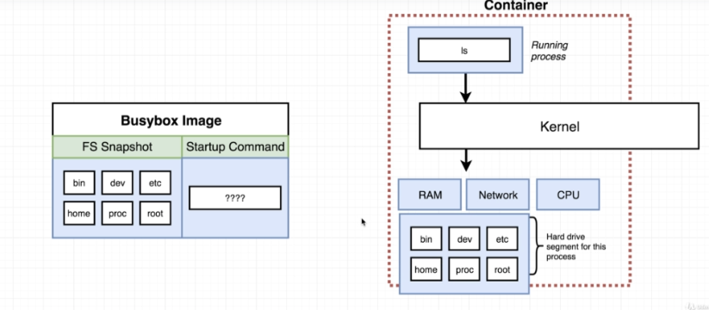

Slide 12
Container
Creating and Running container from an Image:
sudo docker container run hello-world / sudo docker run hello-world
Creating and Running container from an Image with command
docker container run busy-box echo This is Docker session by anshul
docker container run busy-box ls
Listing the running containers
sudo docker container ls / sudo docker ps
sudo docker container run busy-box sleep 40

Slide 13
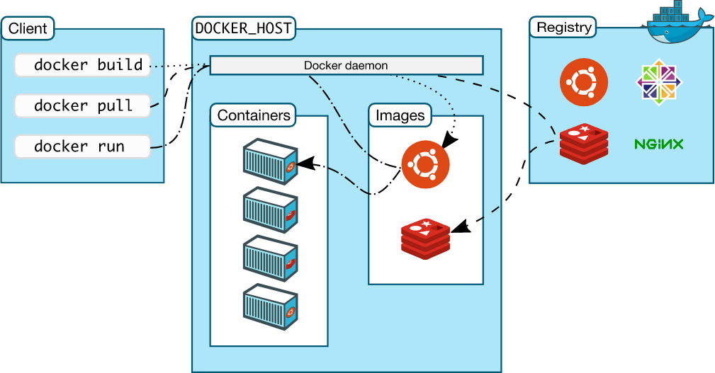

Slide 14
Continue on Container
Restarting an existing container:
sudo docker container start <container-id>
sudo docker container start -a <container-id>
sudo docker start <container-id>
sudo docker start -a <container-id>
Check the log of a container
sudo docker logs <continae-id>
sudo docker container logs <container-id>
Removing stopped container
sudo docker system prune
sudo docker container prune

Slide 15
Continue on Container
Stop an running container:
sudo docker container stop <container-id>
sudo docker container kill <container-id>
Execute a command inside running container
sudo docker container exec -it <container-id> <command>
sudo docker exec -it <container-id> <command>
Getting a command prompt inside a container
sudo docker container exec -it <container-id> /bin/bash
Listing out all container
sudo docker container ls -a
sudo docker container ps --all

Slide 16
Port Mapping and Environment Variable
Port Mapping
sudo docker container run -p 3600:80 -d nginx
Environment Variable
sudo docker container run -it -e abc=anshul ubuntu /bin/bash
Copy local files to container
sudo docker container cp /home/wm/cop/ <conttainer_id>:/tmp/
Inspect changes to files of a container
sudo docker container diff <conttainer_id>
Export a running container
sudo docker container export <container_id> > myfile1.tar

Slide 17
Image
Search an Image: docker search nginx
Pull an image from docker hub: docker image pull nginx
List all the Image: docker image ls
List all the Inactive Image: docker image ls -a
Remove unused image: docker image prune
History of an Image: docker image history <image_name>
Inspect an Image: docker image inspect <container-id>

Slide 18
Create Custom Image
Import from a tar file
sudo docker import abc.tar <image-name>:<tag-name>
By using commit:
sudo docker commit -c ‘CMD [“redis-server”]’ -m "ubuntu" <container-id> <image-tag-name>:<tag-name>

Slide 19
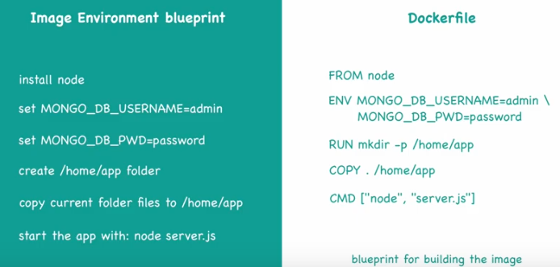
Custom Image from DockerFile

Slide 20
Docker-Volume
It is the mechanism for persisting data generated by and used by the container.
We can attach a volume to the container.
We can share a volume among multiple container.
On deleting a container volume does not delete.

Slide 21
Docker Volume Types
Anonymous Volume
docker run -v /data01 <image_name>
Named Volume
docker run -v <volume-name>:/data01 <image_name>
Bind Volume or Host Volume
docker run -v /opt/data01:/data1 <image_name>

Slide 22
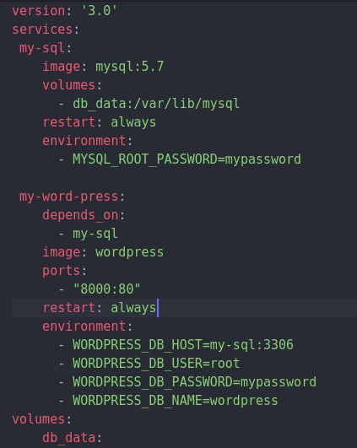
Docker-compose Multi Tier
DB layer
sudo docker container run --name=mysql -e MYSQL_ROOT_PASSWORD=mypassword -d mysql:5.7
Presentation layer
sudo docker container run --name=mywordpress -e WORDPRESS_DB_HOST=172.17.0.2:3306 -e WORDPRESS_DB_USER=root -e WORDPRESS_DB_PASSWORD=mypassword -d wordpress

Slide 23


Slide 24


