Slide 1

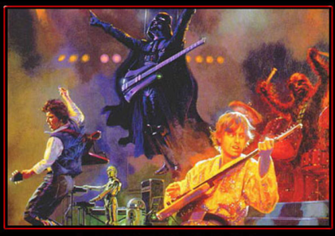
Team Awesome
It is comforting to know that no matter how hard other teams try, they will never be as awesome as TEAM AWESOME!

Slide 2
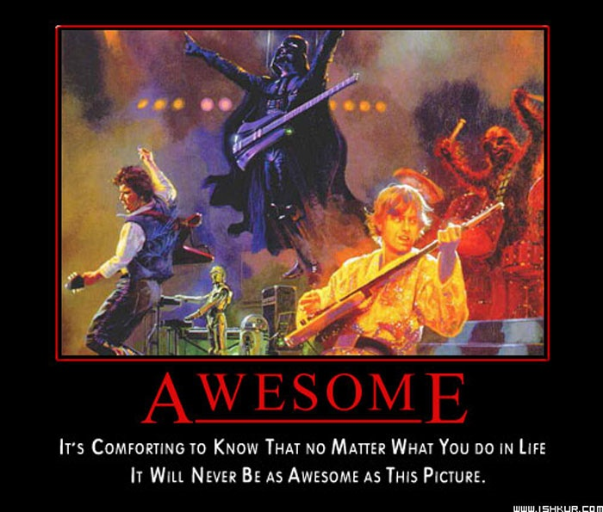

Slide 3



Member Profiles
Meeting schedule & minutes
Source code
Assignments

Slide 4
4 Requirements Document
5 Design Document
6 Quality Assurance Document
3 Research iPhone SDK
2 Research Application Frameworks
1 Learn Objective-C

Slide 5
