Slide 1

Aka: Group 11

Slide 2





Who is Team Awesome?
Meiko Li
Cley Tang
Ariel Lorenzo-Luaces
Tony Yang
Daniel Chappell
For more info, go to our website!!
http://code.google.com/p/cmpt275group11/

Slide 3



What are we doing here?
To present:
Hey Kids, its…
Quiz Monkey
…you’ll go BANANAS!

Slide 4
What is Quiz Monkey?
Quiz Monkey is:
- an educational iPhone game for kids _aged 7-8
- A game that tests vocabulary and grammar
- A fun way for kids to learn
-for more info, check out our website!

Slide 5

Overview
There will be many game question types, such as:
-Find the Nouns/Verbs/Adjectives; a game where you touch the correct word types in the sentence
-Fill in the Blank; select the best word for the given sentence
-Find the Misspelled Word; touch all the errors

Slide 6
Version 1
Version 1 will include:
-the main menu screen
-a working game engine utilizing the first 3
question types:
-Find the Word Type
-Fill in the Blank
-Find the Misspelled Word
-the XML parser (and question builder)

Slide 7
Version 1
Version 1 will not include:
-a way to enter your info for the leaderboard(V. 2)
-an online score database(V.2) or an online
progress tracker for teachers(V.3)
-state saving for continuation of game play upon
reopening (V.2)

Slide 8
Unit Testing
A series of unit tests using the OCUnit framework were implemented to test the parsing of xml questions.
These test cases include:
Ensuring correctly formatted questions will be loaded
Ensuring that invalid questions from xml will not be loaded and filtered from the program Note: The program must have an xml file loaded in order to function correctly

Slide 9
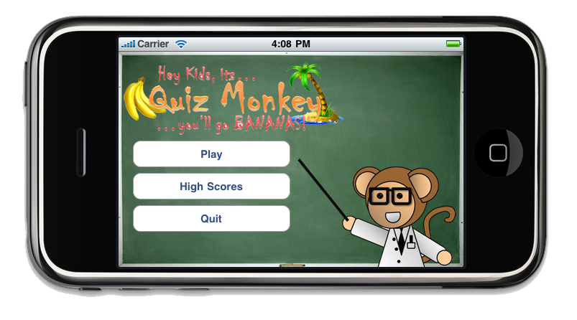
Main Menu Screen

Slide 10
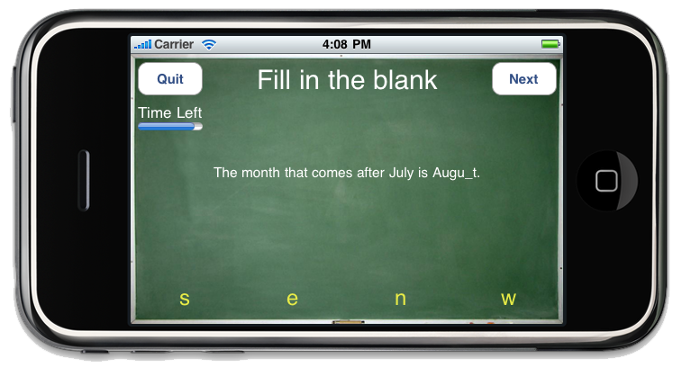
Game Play

Slide 11
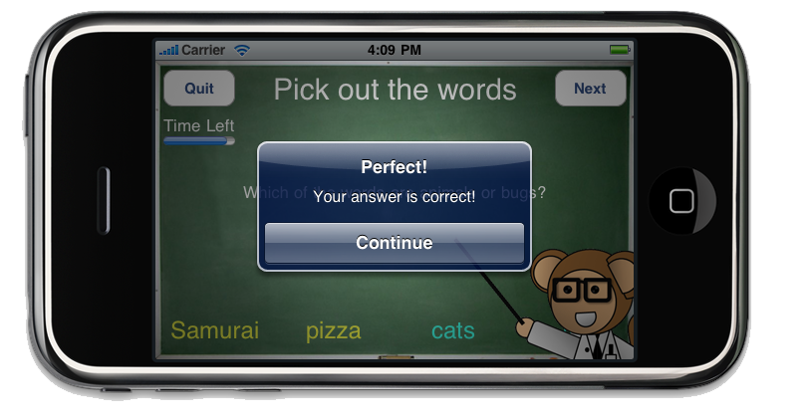
Answer correctly…

Slide 12
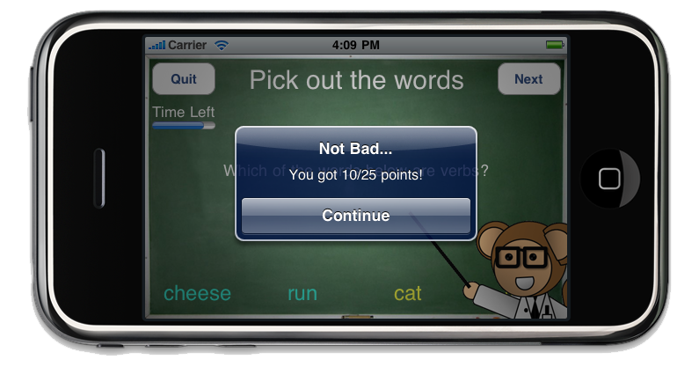
Partial Credit

Slide 13
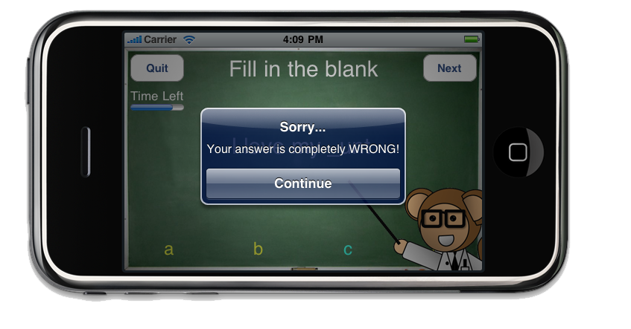
Needs significant improvement

Slide 14
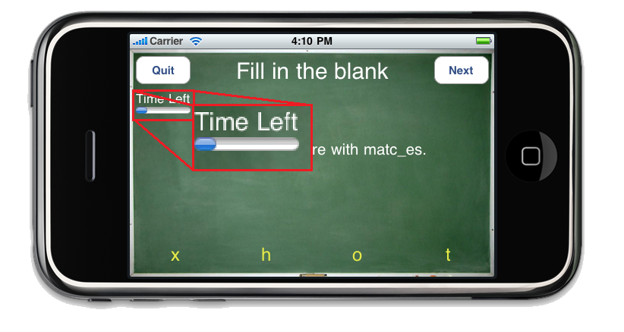
But don’t take too long…

Slide 15
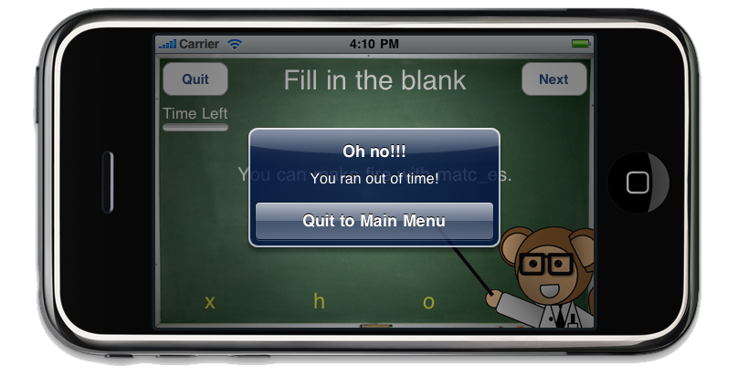
…or else you fail!

Slide 16
We hope you buy our program…
Any questions?

