Slide 1
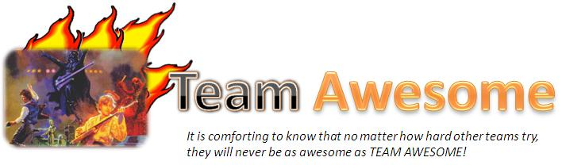
Aka: Group 11

Slide 2

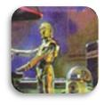

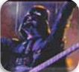

Who is Team Awesome?
Meiko Li
Cley Tang
Ariel Lorenzo-Luaces
Tony Yang
Daniel Chappell
For more info, go to our website!!
http://code.google.com/p/cmpt275group11/

Slide 3



We are here to present:
Hey Kids, its…
Quiz Monkey
…you’ll go BANANAS!

Slide 4
What is Quiz Monkey?
Quiz Monkey is an educational iPhone application that quizzes young students on their basic understanding of English
- An educational iPhone game for kids aged 7-8
- A game that quizzes the user on vocabulary and grammar
- A fun quiz environment

Slide 5

Overview
The game asks a set of random questions and gives the user a limited time to answer them, similar to a quiz in a classroom.
The types of questions include:
-Find the Nouns/Verbs/Adjectives: select all the specified word types in a given sentence
-Fill in the Blank: select the best letter/word out of 4 choices to complete the given sentence
-Find the Misspelled Word: select all the misspelled words out of 4 choices

Slide 6
Video

Slide 7
Features
Version 1 features:
-Main menu
-A working game engine:
Able to load questions from an xml file
Able to display multiple choice questions
Version 2 features:
-An online score database
-An online progress tracker for teachers
-High score submission and viewing
Version 3 features:
-An award system
-Personal high score viewing with username and password

Slide 8
Interesting Aspects
Virtually any type of multiple choice question can be loaded, as long as it has 4 choices
Achievements are rewarded to the student

Slide 9
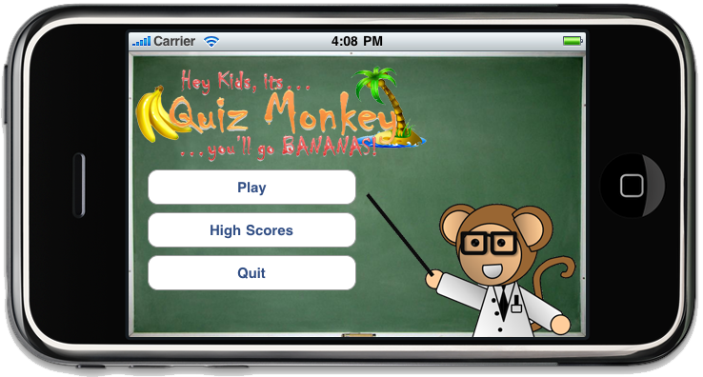
Architectural diagram
Scores.xml
Retrieving high scores
iPhone
Score submission
Database
Questions.xml

Slide 10
Testing
The OCUnit framework was used to test our custom xml quiz question parser
This test includes:
-Ensuring correctly formatted questions will be loaded -Ensuring that invalid questions from xml will be filtered instead
Manual Testing:
-Ensuring that questions were loaded properly
-Finishing a Quiz with the correct final score
-Quitting a quiz midway
-Submitting a score to the database
-Ensuring that high scores were being loaded properly
-Trying to submit a score with an invalid username/password
-Trying to load score with an invalid username/password

Slide 11
Bugs and un-implemented Fearures
Bugs:
No internet connection is not handled
Features that were not implemented:
state saving (unnecessary)

Slide 12
Feedback
No formal, real user testing was done
Only informal presentation to family and friends was done

Slide 13
Post-mortem
Project management techniques:
Major technical problems
Major “human” problems
Advice

