Slide 1



Hey Kids, its…
Quiz Monkey
…you’ll go BANANAS!
Play Game Quit

Slide 2
Fill in the blank
C_T
←
A B C D

Slide 3
Find the misspelled word
Cook Fun
Leter Yellow
←

Slide 4
Find the adjectives
Sally is a very special person
←

Slide 5
Find the verbs
Billy eats grass
←

Slide 6
Fill in the blank
Quit game now?
Yes No
C_T
←
A B C D

Slide 7
Fill in the blank
Correct!
√
C_T
Next
←
A B C D

Slide 8
Fill in the blank
WRONG!
×
C_T
Next
←
A B C D

Slide 9
Congratulations! You got 3 / 10 questions!
Submit score

Slide 10
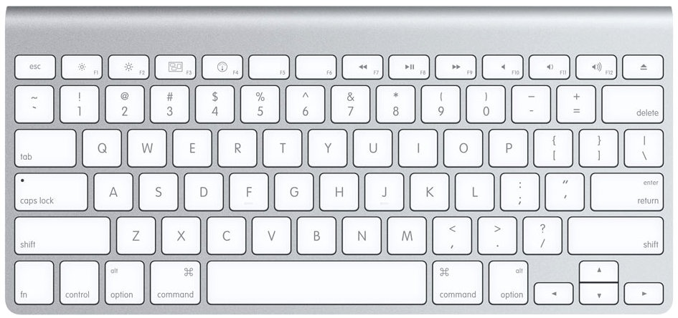
Name:
Mike Hawke
OK

Slide 11
ID:
420
OK

Slide 12
Your score has been submitted!
OK

Slide 14
Hey Kids, its…
Quiz Monkey
…you’ll go BANANAS!
Student Progress Monitoring System Teacher’s Login Page
User Name: Password:
Login

Slide 15
Hey Kids, its…
Quiz Monkey
…you’ll go BANANAS!
Student Progress Monitoring System
Student Name: Mike Hawke
Student ID: 420 Scores:
Game 1: 3/10
Game 2: 4/10
Student Name: Suzy Smarterthanmike
Student ID: 123 Scores:
Game 1: 9/10
Game 2: 10/10

