Slide 1
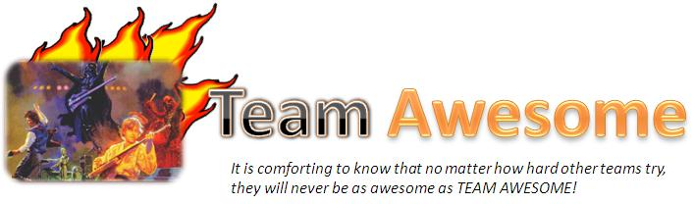
Aka: Group 11

Slide 2





Who is Team Awesome?
Meiko Li
Cley Tang
Ariel Lorenzo-Luaces
Tony Yang
Daniel Chappell
For more info, go to our website!!
http://code.google.com/p/cmpt275group11/

Slide 3



What are we doing here?
To present:
Hey Kids, its…
Quiz Monkey
…you’ll go BANANAS!

Slide 4
Overview
Quiz Monkey is:
-an educational iPhone game for kids aged 7-8
-a quiz game of vocabulary and grammar
-a way for teachers to track students performance
-for more info, check out our website!

Slide 5

Overview
There will be many game question types, such as:
-Find the Nouns/Verbs/Adjectives; a game where you touch the correct word types in the sentence
-Fill in the Blank; select the best word for the given sentence
-Find the Misspelled Word; touch all the errors

Slide 6
Version 1
Version 1 will include:
-the main menu screen
-a working game engine utilizing the first 3
question types:
-Find the Word Type
-Fill in the Blank
-Find the Misspelled Word
-the XML parser (and question builder)

Slide 7
Version 1
Version 1 will not include:
-a way to enter your info for the leaderboard(V. 2)
-an online score database(V.2) or an online
progress tracker for teachers(V.3)
-state saving for continuation of game play upon
reopening (V.2)

Slide 8
Testing
Note:
We used an iterative process, so testing was
more or less ongoing.
In addition:
-many unit tests:
-integration test

Slide 9
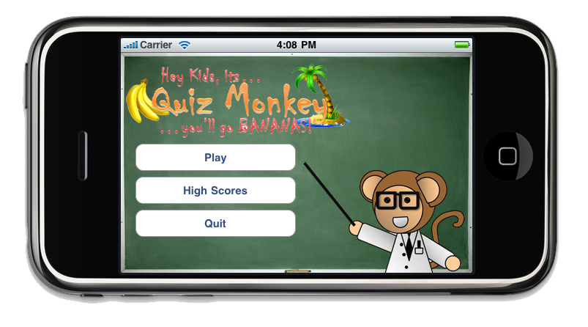
Demonstration

Slide 10
Demonstration

Slide 11
Demonstration

Slide 12
Title
-STUFF written on a chalkboard

Slide 13
