Slide 1
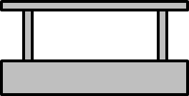
Track
Station
Train
Station Stop Sensor
Train Doors
Nearing Station Sensor

