Slide 1
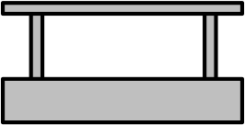
Track
Station
Train
Station Stop Sensor
Train Doors
Slow Down Sensors
Nearing/Leaving Station Sensor

