Slide 1
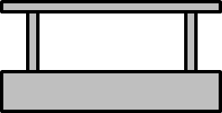
Track
“Man on Track” Sensor
Station
Train
Station Stop Sensor
Train Doors
Nearing Station Sensor

