Slide 1
AZ-900T00
Learning path 04:
Apply Azure Skills in Guided Projects
Notes:
Learn URL: https://learn.microsoft.com/training/paths/introduction-cloud-infrastructure-apply-azure-skills-guided-projects/
Welcome to Learning Path 4: Apply Azure Skills in Guided Projects.
This learning path provides hands-on, real-world practice through eight guided projects covering storage, serverless computing, identity and access, cost governance, monitoring, and command-line management.
Each project walks through a realistic scenario step by step using the Azure portal or Cloud Shell.

Slide 2
Notice and Intent
This guided project set is provided to provide OPTIONS for practical activities during class. It is NOT expected that you complete all guided projects during a delivery. Given the breadth of content, the goal should be to complete 1, or maybe 2 if timing allows, of the guided projects during a delivery.
The students can complete the additional guided projects using a Bring Your Own Subscription model from Microsoft Learn at any time.

Slide 3
Guided project: Deploy a static website with Azure Blob Storage
Notes:
Learn URL: https://learn.microsoft.com/training/modules/guided-project-deploy-static-website-blob-storage/1-introduction
This guided project focuses on deploying a static website using Azure Blob Storage.
Learners will create a storage account, enable static website hosting, upload HTML content, and update the site, all through the Azure portal.

Slide 4
Learning Objectives
After completing this module, you will be able to:
1
Create a storage account and enable static website hosting
2
Upload HTML content and verify the public endpoint
3
Update site content and confirm the change is live
Notes:
Learn URL: https://learn.microsoft.com/training/modules/guided-project-deploy-static-website-blob-storage/1-introduction
After completing this project, learners will be able to create a storage account with static website hosting enabled, upload and verify HTML content at the public endpoint, and update the site to confirm changes appear live.

Slide 5
Project: Static website on Blob Storage objectives
Scenario: Publish a product landing page without provisioning VMs or web servers
Enable static website hosting on a storage account to create a public endpoint
Azure automatically creates a $web container to serve HTML, CSS, and image files
Exercise 1: Create a storage account and enable static website hosting
Exercise 2: Upload HTML content and verify the live site
Exercise 3: Update the site content and confirm the change
Notes:
Learn URL: https://learn.microsoft.com/training/modules/guided-project-deploy-static-website-blob-storage/1-introduction
Azure Blob Storage can serve HTML, CSS, and image files directly to browsers without a web server.
When you enable static website hosting, Azure creates a public endpoint and a special container named dollar-sign-web where you upload your site files.
In this project, the marketing team needs to publish a product landing page quickly. They upload content, verify it is live, push an update, and confirm the change.
This is a cost-effective approach for simple websites that do not require server-side processing.

Slide 6
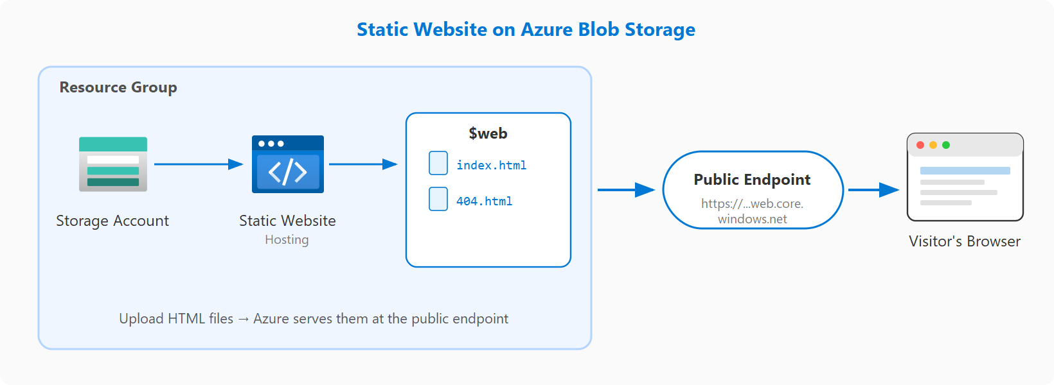
Project: Static website on Blob Storage diagram
Notes:
Learn URL: https://learn.microsoft.com/training/modules/guided-project-deploy-static-website-blob-storage/1-introduction
Azure Blob Storage can serve HTML, CSS, and image files directly to browsers without a web server.
When you enable static website hosting, Azure creates a public endpoint and a special container named dollar-sign-web where you upload your site files.
In this project, the marketing team needs to publish a product landing page quickly. They upload content, verify it is live, push an update, and confirm the change.
This is a cost-effective approach for simple websites that do not require server-side processing.

Slide 7
Knowledge check
1
What must you enable on a storage account before it can serve static website content?
Blob versioning
Static website hosting
Azure CDN integration
2
Where does Azure store the files for a static website hosted in Blob Storage?
A container named blob-website
The root of the storage account
A container named $web
3
What happens when you upload an updated file to the $web container?
You must redeploy the storage account
The updated content is available without redeployment
The previous version enters a staging state
Notes:
Learn URL: https://learn.microsoft.com/training/modules/guided-project-deploy-static-website-blob-storage/7knowledge-check
Let us check your understanding of static website hosting with Blob Storage.
Question 1: You must enable Static website hosting in the storage account settings before Azure will serve web content from the dollar-sign-web container.
Question 2: Azure automatically creates a dollar-sign-web container when static website hosting is enabled.
Question 3: Uploading an updated file to the dollar-sign-web container replaces the existing file and the change is reflected immediately at the public endpoint.

Slide 8
Guided project: Organize and protect resources with tags and locks
Notes:
Learn URL: https://learn.microsoft.com/training/modules/guided-project-organize-resources-tags-locks/1-introduction
This guided project focuses on organizing and protecting Azure resources using tags and resource locks.
Learners will apply tags for cost tracking and governance, configure locks to prevent accidental changes, and test the full lock lifecycle.

Slide 9
Learning Objectives
After completing this module, you will be able to:
1
Create resources and apply tags for organization and cost tracking
2
Apply a delete lock to prevent accidental resource removal
3
Test lock enforcement and then remove the lock
Notes:
Learn URL: https://learn.microsoft.com/training/modules/guided-project-organize-resources-tags-locks/1-introduction
After completing this project, learners will be able to create resources and apply tags for organization and cost tracking, apply delete locks to prevent accidental resource removal, and test that locks enforce restrictions properly.

Slide 10
Project: Tags and locks for governance objectives
Scenario: Set up a shared Azure environment with organized and protected resources
Tags are key-value pairs for cost reporting, ownership tracking, and governance
Locks prevent accidental modification or deletion, even for users with full permissions
Exercise 1: Create resources and apply organizational tags
Exercise 2: Apply resource locks to prevent accidental changes
Exercise 3: Test lock enforcement and confirm the full lock lifecycle
Notes:
Learn URL: https://learn.microsoft.com/training/modules/guided-project-organize-resources-tags-locks/1-introduction
Tags are key-value pairs that you attach to resources and resource groups. They help categorize resources for cost reporting, ownership tracking, and governance.
Locks add a layer of protection that prevents accidental modification or deletion, even for users with full permissions.
In this project, the development team sets up a shared environment and needs to keep resources organized with tags and protected with locks.
A read-only lock prevents both modifications and deletion. A delete lock only prevents deletion. Both must be explicitly removed before the blocked action can proceed.

Slide 11
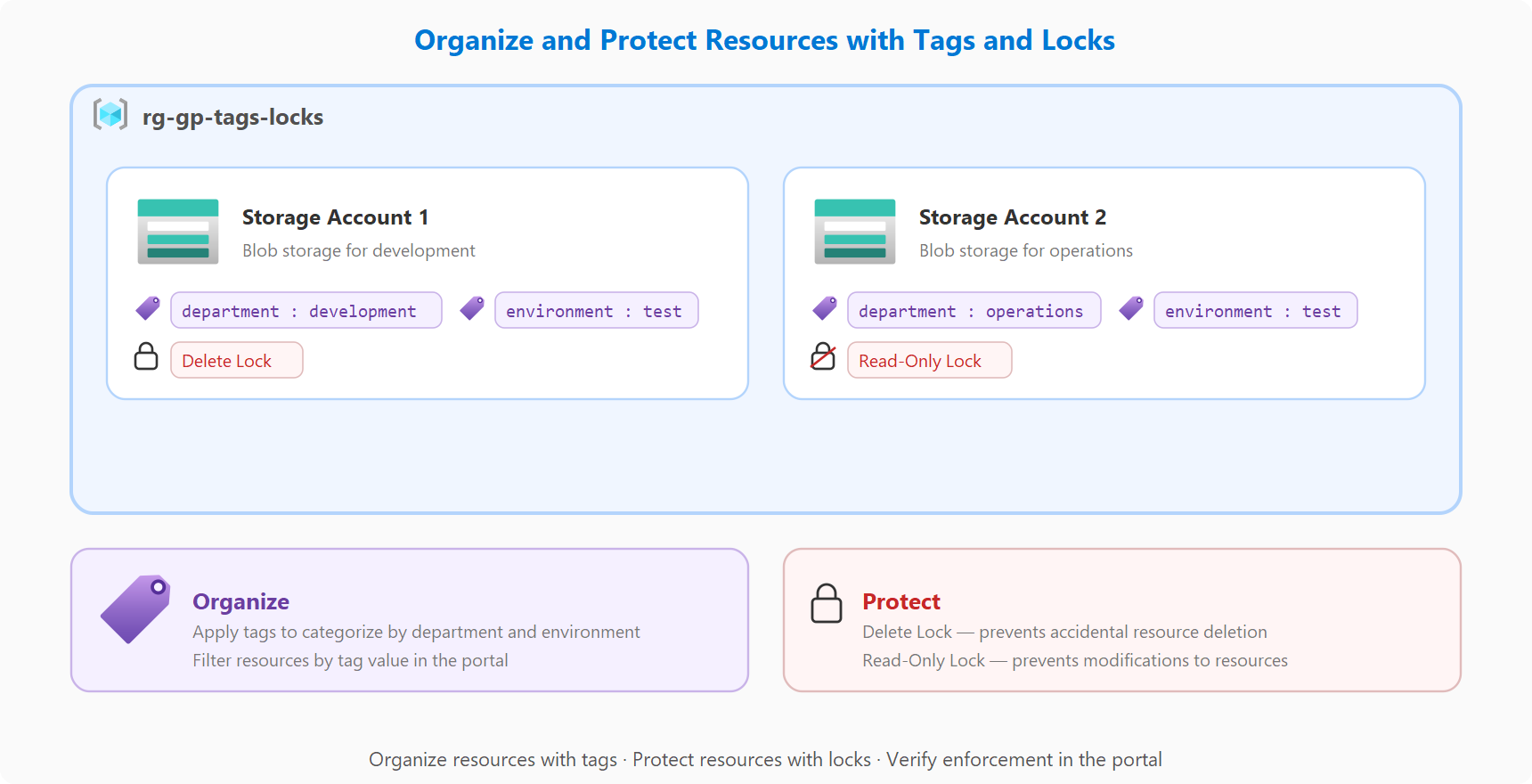
Project: Tags and locks for governance diagram
Notes:
Learn URL: https://learn.microsoft.com/training/modules/guided-project-organize-resources-tags-locks/1-introduction
Tags are key-value pairs that you attach to resources and resource groups. They help categorize resources for cost reporting, ownership tracking, and governance.
Locks add a layer of protection that prevents accidental modification or deletion, even for users with full permissions.
In this project, the development team sets up a shared environment and needs to keep resources organized with tags and protected with locks.
A read-only lock prevents both modifications and deletion. A delete lock only prevents deletion. Both must be explicitly removed before the blocked action can proceed.

Slide 12
Knowledge check
1
What is the primary purpose of applying resource tags in Azure?
To restrict who can access a resource
To organize resources for cost tracking and management
To prevent resources from being deleted
2
What does a read-only resource lock prevent?
Only deletion of the resource
Modifications and deletion of the resource
All access to the resource including viewing
3
What must you do before you can delete a resource that has a delete lock?
Disable the lock using Azure Policy
Contact Azure Support to override the lock
Remove the lock first
Notes:
Learn URL: https://learn.microsoft.com/training/modules/guided-project-organize-resources-tags-locks/7-knowledge-check
Let us check your understanding of tags and locks.
Question 1: Tags organize resources for cost tracking and management using key-value pairs.
Question 2: A read-only lock prevents both modifications and deletion of the resource.
Question 3: You must explicitly remove the lock first before you can delete a resource with a delete lock.

Slide 13
Guided project: Build a simple website endpoint with Azure Functions
Notes:
Learn URL: https://learn.microsoft.com/training/modules/guided-project-build-basic-website-endpoint-with-functions/1-introduction
This guided project introduces serverless hosting by creating a function endpoint and validating responses.
Learners will create a Function App, deploy an HTTP-triggered function from Cloud Shell, and test, secure, and monitor the endpoint.

Slide 14
Learning Objectives
After completing this module, you will be able to:
1
Create a Function App in a Flex Consumption plan
2
Deploy an HTTP-triggered function from Cloud Shell
3
Test endpoint behavior, add security, and review logs
Notes:
Learn URL: https://learn.microsoft.com/training/modules/guided-project-build-basic-website-endpoint-with-functions/1-introduction
After completing this project, learners will be able to create a Function App in a Flex Consumption plan, deploy an HTTP-triggered function from Cloud Shell, and test endpoint behavior with security and execution logs.

Slide 15
Project: Serverless endpoint with Azure Functions objectives
Scenario: Create a lightweight contact page endpoint without maintaining servers
Azure Functions is a serverless compute service that runs code in response to events
An HTTP trigger gives your function its own URL callable from any browser
Exercise 1: Create a Function App with the Flex Consumption plan
Exercise 2: Deploy an HTTP-trigger function from Cloud Shell
Exercise 3: Test the endpoint, add security, and review logs
Notes:
Learn URL: https://learn.microsoft.com/training/modules/guided-project-build-basic-website-endpoint-with-functions/1-introduction
Azure Functions is a serverless compute service that runs code in response to events without managing infrastructure.
With an HTTP trigger, your function gets its own URL that anyone can call from a browser.
In this project, the team needs a lightweight contact page endpoint. They create a Function App, deploy an HTTP-triggered function using Cloud Shell, and then test, secure, and monitor the endpoint.
Application Insights provides detailed telemetry including invocation logs, response codes, and execution times.

Slide 16
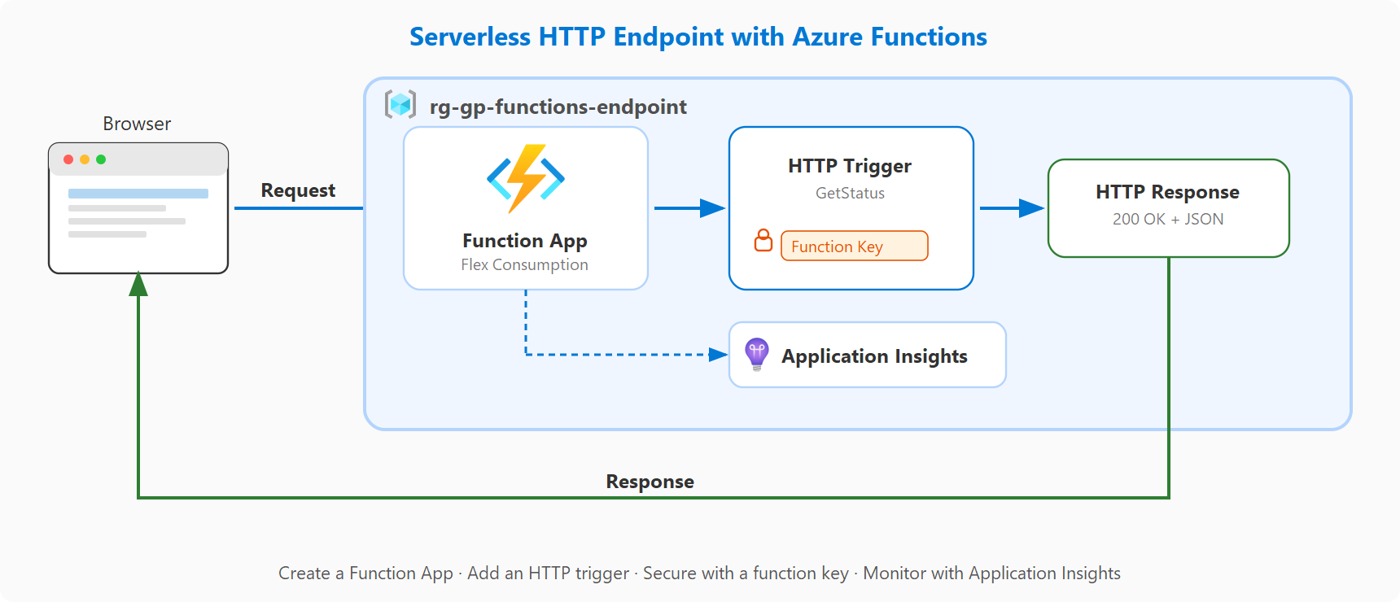
Project: Serverless endpoint with Azure Functions diagram
Notes:
Learn URL: https://learn.microsoft.com/training/modules/guided-project-build-basic-website-endpoint-with-functions/1-introduction
Azure Functions is a serverless compute service that runs code in response to events without managing infrastructure.
With an HTTP trigger, your function gets its own URL that anyone can call from a browser.
In this project, the team needs a lightweight contact page endpoint. They create a Function App, deploy an HTTP-triggered function using Cloud Shell, and then test, secure, and monitor the endpoint.
Application Insights provides detailed telemetry including invocation logs, response codes, and execution times.

Slide 17
Knowledge check
1
What type of trigger allows an Azure Function to respond to web requests?
Timer trigger
HTTP trigger
Blob trigger
2
What is the main advantage of using Azure Functions for a simple endpoint?
It provides a dedicated virtual machine
You do not need to manage any infrastructure
It automatically creates a custom domain
3
What Azure service lets you monitor function invocations and view execution logs?
Azure Monitor metrics
Azure Activity Log
Application Insights
Notes:
Learn URL: https://learn.microsoft.com/training/modules/guided-project-build-basic-website-endpoint-with-functions/7-knowledge-check
Let us check your understanding of Azure Functions.
Question 1: An HTTP trigger runs the function when it receives an HTTP request, making it suitable for web endpoints.
Question 2: Azure Functions is serverless, meaning you do not need to manage any infrastructure.
Question 3: Application Insights provides detailed telemetry for monitoring function invocations and viewing execution logs.

Slide 18
Guided project: Set up new employee access (Entra ID and RBAC)
Notes:
Learn URL: https://learn.microsoft.com/training/modules/guided-project-new-employee-access/1-introduction
This guided project focuses on setting up identity and access for a new employee using Microsoft Entra ID and Azure RBAC.
Learners will create users and groups, assign roles, and verify least-privilege access.

Slide 19
Learning Objectives
After completing this module, you will be able to:
1
Create a user and security group in Microsoft Entra ID
2
Assign group-based Azure RBAC at resource group scope
3
Validate expected access at the correct scope
Notes:
Learn URL: https://learn.microsoft.com/training/modules/guided-project-new-employee-access/1-introduction
After completing this project, learners will be able to create a user and security group in Microsoft Entra ID, assign group-based RBAC at resource group scope, and validate that the expected access works at the correct scope.

Slide 20
Project: Identity and RBAC onboarding objectives
Scenario: A new support analyst needs read-only access to a development resource group
Microsoft Entra ID manages users and groups; RBAC assigns specific permissions at a scope
Together they implement the principle of least privilege
Exercise 1: Create a user account and security group in Entra ID
Exercise 2: Assign the Reader role to the group at resource group scope
Exercise 3: Verify read access is granted and write access is denied
Notes:
Learn URL: https://learn.microsoft.com/training/modules/guided-project-new-employee-access/1-introduction
Microsoft Entra ID is the identity service that manages users and groups. RBAC assigns specific permissions at a specific scope.
Together they implement the principle of least privilege, giving users exactly the access they need and nothing more.
In this project, a new support analyst needs read-only access to a development resource group. You create the user account, add them to a security group, assign the Reader role at resource group scope, and verify the access works.
Assigning roles to groups instead of individuals simplifies access management when team members change.

Slide 21
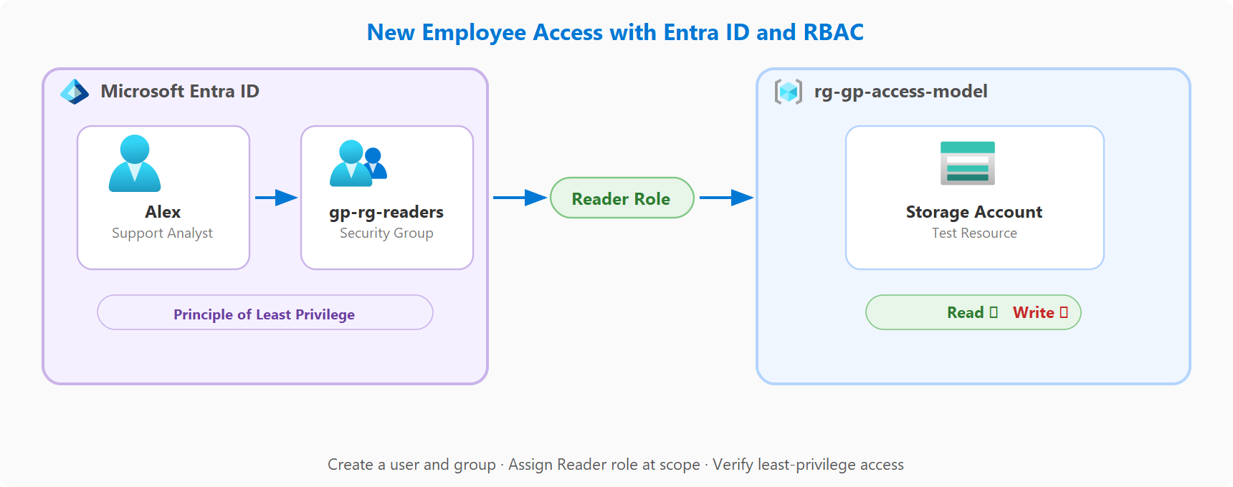
Project: Identity and RBAC onboarding diagram
Notes:
Learn URL: https://learn.microsoft.com/training/modules/guided-project-new-employee-access/1-introduction
Microsoft Entra ID is the identity service that manages users and groups. RBAC assigns specific permissions at a specific scope.
Together they implement the principle of least privilege, giving users exactly the access they need and nothing more.
In this project, a new support analyst needs read-only access to a development resource group. You create the user account, add them to a security group, assign the Reader role at resource group scope, and verify the access works.
Assigning roles to groups instead of individuals simplifies access management when team members change.

Slide 22
Knowledge check
1
What is the benefit of assigning RBAC roles to a group instead of individual users?
Groups automatically inherit subscription permissions
It simplifies access management when users join or leave
Groups can hold more permissions than individual users
2
What RBAC role provides view-only access to Azure resources?
Contributor
Owner
Reader
3
At what scope level was the RBAC role assigned in this guided project?
Subscription
Resource group
Individual resource
Notes:
Learn URL: https://learn.microsoft.com/training/modules/guided-project-new-employee-access/7-knowledge-check
Let us check your understanding of identity and RBAC.
Question 1: Assigning RBAC roles to a group simplifies access management because new members automatically get the role and removed members automatically lose it.
Question 2: The Reader role provides view-only access to Azure resources without allowing changes.
Question 3: The RBAC role was assigned at the resource group scope to follow least-privilege principles.

Slide 23
Guided project: Share files securely
Notes:
Learn URL: https://learn.microsoft.com/training/modules/guided-project-share-files-securely/1-introduction
This guided project teaches secure, temporary file sharing using blob storage, stored access policies, and SAS tokens.
Learners will configure private storage, generate policy-based SAS links, test access, revoke access, and set up lifecycle management.

Slide 24
Learning Objectives
After completing this module, you will be able to:
1
Create blob storage and generate policy-based SAS links for secure sharing
2
Validate SAS access and revoke it instantly by deleting a stored access policy
3
Configure lifecycle management rules to auto-delete shared files
Notes:
Learn URL: https://learn.microsoft.com/training/modules/guided-project-share-files-securely/1-introduction
After completing this project, learners will be able to create blob storage and generate policy-based SAS links, validate and revoke SAS access by deleting a stored access policy, and configure lifecycle management rules for automatic cleanup.

Slide 25
Project: Secure file sharing with SAS objectives
Scenario: Share monthly reports with an external partner for a short review window
Stored access policies let you centrally manage and revoke SAS tokens instantly
Exercise 1: Create a storage account, private container, and upload a file
Exercise 2: Create a stored access policy and generate a SAS link
Exercise 3: Test SAS access and verify direct access is blocked
Exercise 4: Revoke access by deleting the stored access policy
Exercise 5: Configure lifecycle management for automatic cleanup
Notes:
Learn URL: https://learn.microsoft.com/training/modules/guided-project-share-files-securely/1-introduction
A shared access signature is a token that grants temporary, scoped access to a blob or container without sharing your storage account keys.
When you generate a SAS from a stored access policy, the policy acts as a central control point. You can revoke all linked tokens instantly by deleting the policy.
In this project, the finance team shares monthly reports with an external partner. They upload to a private container, create a stored access policy, generate a SAS link, test access, revoke it, and configure lifecycle management.
This project has five exercises, covering the complete lifecycle of secure file sharing.

Slide 26
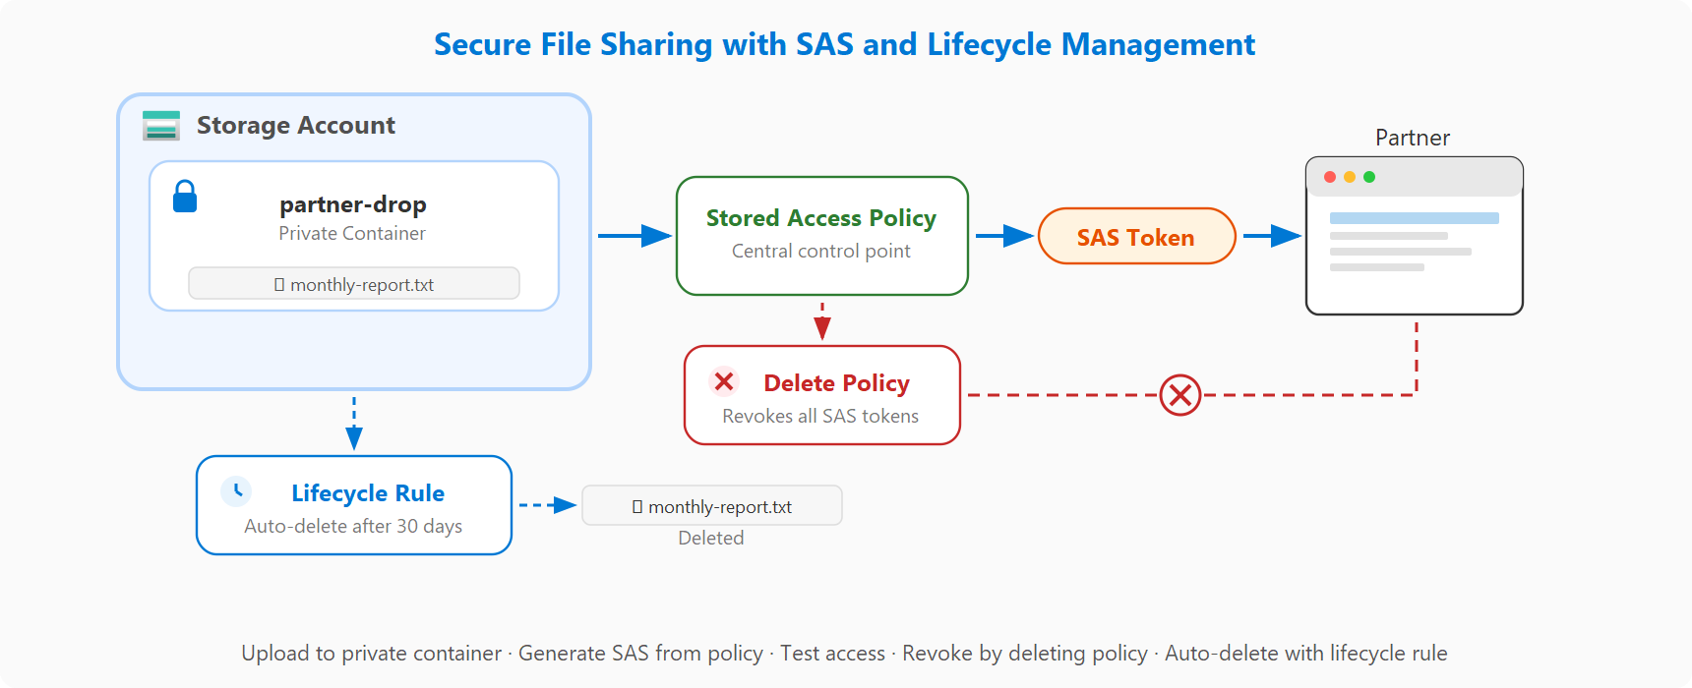
Project: Secure file sharing with SAS diagram
Notes:
Learn URL: https://learn.microsoft.com/training/modules/guided-project-share-files-securely/1-introduction
A shared access signature is a token that grants temporary, scoped access to a blob or container without sharing your storage account keys.
When you generate a SAS from a stored access policy, the policy acts as a central control point. You can revoke all linked tokens instantly by deleting the policy.
In this project, the finance team shares monthly reports with an external partner. They upload to a private container, create a stored access policy, generate a SAS link, test access, revoke it, and configure lifecycle management.
This project has five exercises, covering the complete lifecycle of secure file sharing.

Slide 27
Knowledge check
1
How can you instantly revoke all SAS tokens generated from a stored access policy?
Regenerate the storage account access keys
Delete the stored access policy
Set the SAS token expiry to a past date
2
What determines the permissions and expiry of a policy-based SAS token?
The storage account access tier
The stored access policy
The container public access level
3
What does a lifecycle management rule do for blob storage?
Moves blobs between storage accounts
Backs up blobs to a secondary region
Automatically deletes or moves blobs based on age
Notes:
Learn URL: https://learn.microsoft.com/training/modules/guided-project-share-files-securely/9-knowledge-check
Let us check your understanding of secure file sharing.
Question 1: Deleting the stored access policy immediately invalidates all SAS tokens that reference it, providing targeted revocation.
Question 2: The stored access policy defines the permissions, start time, and expiry for all SAS tokens generated from it.
Question 3: Lifecycle management rules can automatically delete or move blobs based on age or other conditions.

Slide 28
Guided project: Set up cost guardrails in Azure
Notes:
Learn URL: https://learn.microsoft.com/training/modules/guided-project-cost-guardrails/1-introduction
This guided project helps reduce spend risk by implementing cost guardrails in Azure.
Learners will apply resource tags, create budget alerts, and assign Azure Policy to enforce compliance.

Slide 29
Learning Objectives
After completing this module, you will be able to:
1
Apply consistent resource tags for cost tracking
2
Create budget alerts for early spend visibility
3
Assign and test a policy control for resource compliance
Notes:
Learn URL: https://learn.microsoft.com/training/modules/guided-project-cost-guardrails/1-introduction
After completing this project, learners will be able to apply consistent resource tags for cost tracking, create budget alerts for early spend visibility, and assign and test a policy control for resource compliance.

Slide 30
Project: Cost guardrails with tags, budgets, and policy objectives
Scenario: A pilot team needs clear cost controls before a broader cloud rollout
Tags categorize resources for cost reporting; budgets alert when spending reaches thresholds
Azure Policy enforces organizational rules like restricting deployment regions
Exercise 1: Apply organizational tags for cost tracking
Exercise 2: Create a budget with alert thresholds
Exercise 3: Assign and test an Azure Policy for region compliance
Notes:
Learn URL: https://learn.microsoft.com/training/modules/guided-project-cost-guardrails/1-introduction
Azure provides several tools to control cloud spending. Tags categorize resources for cost reporting. Budgets send alerts when spending approaches a threshold. Azure Policy enforces organizational rules automatically.
In this project, a pilot team has a limited monthly budget and needs clear controls before a broader rollout.
Budget alerts send email notifications when spending reaches configured percentage thresholds. They provide visibility but do not automatically stop resources.
A policy with a deny effect actively blocks noncompliant deployments, such as preventing resource creation in unapproved regions.

Slide 31
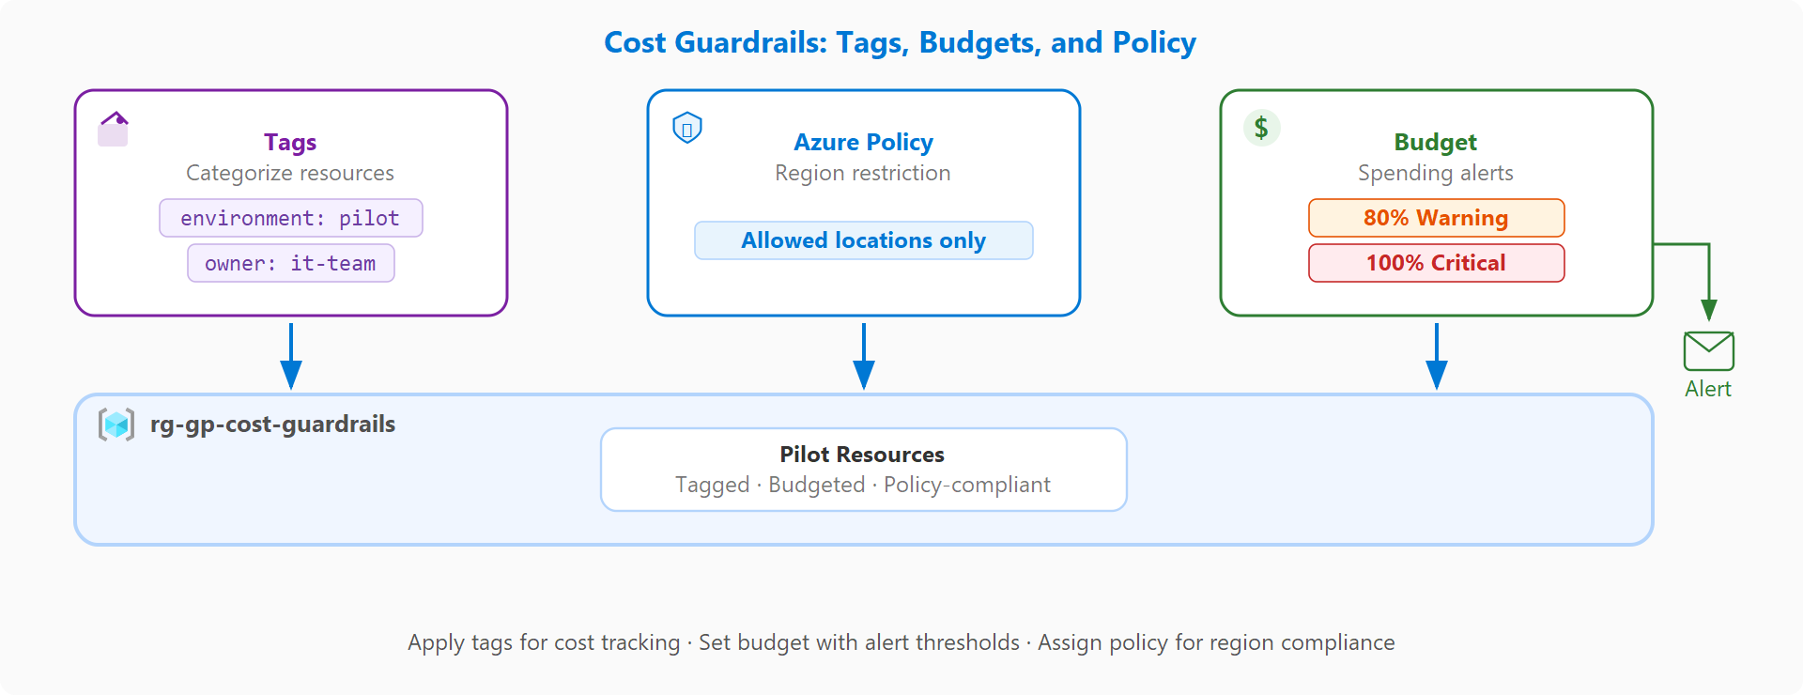
Project: Cost guardrails with tags, budgets, and policy diagram
Notes:
Learn URL: https://learn.microsoft.com/training/modules/guided-project-cost-guardrails/1-introduction
Azure provides several tools to control cloud spending. Tags categorize resources for cost reporting. Budgets send alerts when spending approaches a threshold. Azure Policy enforces organizational rules automatically.
In this project, a pilot team has a limited monthly budget and needs clear controls before a broader rollout.
Budget alerts send email notifications when spending reaches configured percentage thresholds. They provide visibility but do not automatically stop resources.
A policy with a deny effect actively blocks noncompliant deployments, such as preventing resource creation in unapproved regions.

Slide 32
Knowledge check
1
What happens when a resource deployment violates an Azure Policy with a deny effect?
The deployment succeeds but is flagged as noncompliant
The deployment is blocked
The resource is deployed and then automatically deleted
2
What is the purpose of a budget alert in Azure?
To automatically stop all running resources
To notify you when spending approaches a defined threshold
To enforce a hard spending cap
3
Why should you apply consistent tags to Azure resources?
Tags are required before you can deploy resources
Tags automatically reduce the cost of resources
To track and allocate costs by team, environment, or project
Notes:
Learn URL: https://learn.microsoft.com/training/modules/guided-project-cost-guardrails/7-knowledge-check
Let us check your understanding of cost guardrails.
Question 1: A policy assignment with a deny effect prevents any deployment that does not meet the policy conditions. The deployment is blocked.
Question 2: Budget alerts notify you when spending approaches or exceeds defined thresholds. They send email notifications but do not stop resources.
Question 3: Consistent tags help you track and allocate costs by team, environment, or project.

Slide 33
Guided project: Monitor Azure with Service Health and Activity Log alerts
Notes:
Learn URL: https://learn.microsoft.com/training/modules/guided-project-monitor-service-health-activity-alerts/1-introduction
This guided project builds a starter monitoring baseline using free Azure alerting services.
Learners will create action groups, Service Health alerts, and Activity Log alerts.

Slide 34
Learning Objectives
After completing this module, you will be able to:
1
Create an action group with email notifications
2
Create a Service Health alert for platform incidents and maintenance
3
Create an Activity Log alert for resource deletion events
Notes:
Learn URL: https://learn.microsoft.com/training/modules/guided-project-monitor-service-health-activity-alerts/1-introduction
After completing this project, learners will be able to create an action group with email notifications, configure a Service Health alert for platform incidents and maintenance, and create an Activity Log alert for resource deletion events.

Slide 35
Project: Monitoring with alerts and action groups objectives
Scenario: Notify the operations team when Azure platform issues occur or resources are deleted
Action groups define who gets notified and how when an alert fires
Service Health alerts watch for platform-level incidents and planned maintenance
Activity Log alerts fire when management operations like resource deletion occur
Exercise 1: Create an action group and verify email delivery
Exercise 2: Create a Service Health alert for platform incidents
Exercise 3: Create an Activity Log alert for resource deletions
Notes:
Learn URL: https://learn.microsoft.com/training/modules/guided-project-monitor-service-health-activity-alerts/1-introduction
Azure Monitor provides several alert types that work without paid compute resources.
Service Health alerts watch for platform-level incidents and planned maintenance. Activity Log alerts fire when management operations, like resource deletion, occur. Action groups define who gets notified and how.
In this project, the operations team sets up a notification pipeline for both platform issues and unexpected infrastructure changes.
Together, these three components give the team proactive visibility into events that affect their Azure environment.

Slide 36
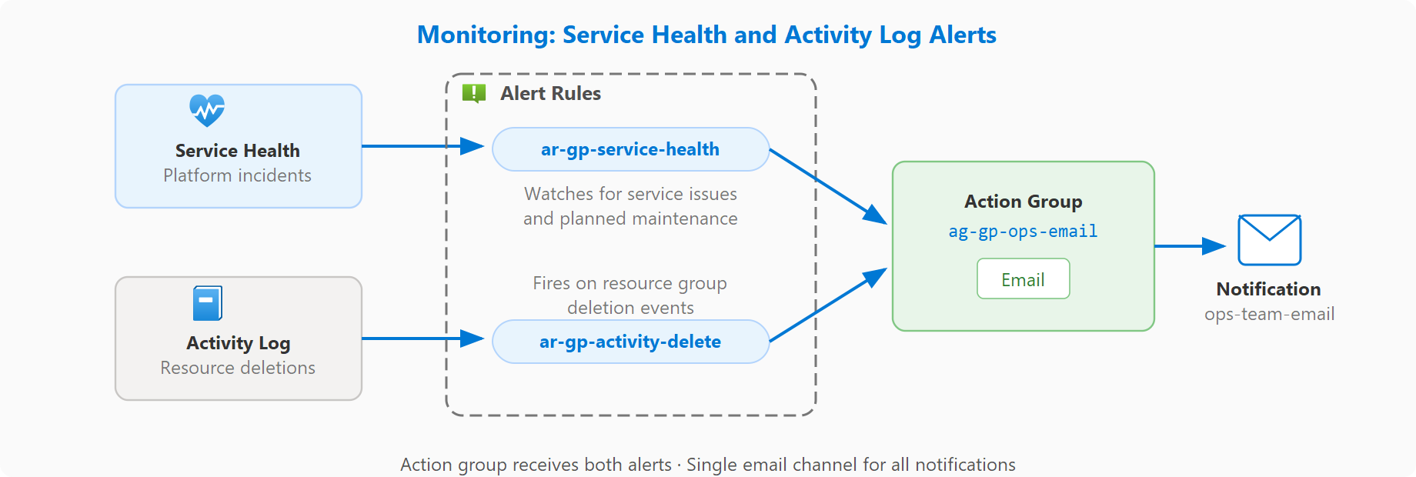
Project: Monitoring with alerts and action groups diagram
Notes:
Learn URL: https://learn.microsoft.com/training/modules/guided-project-monitor-service-health-activity-alerts/1-introduction
Azure Monitor provides several alert types that work without paid compute resources.
Service Health alerts watch for platform-level incidents and planned maintenance. Activity Log alerts fire when management operations, like resource deletion, occur. Action groups define who gets notified and how.
In this project, the operations team sets up a notification pipeline for both platform issues and unexpected infrastructure changes.
Together, these three components give the team proactive visibility into events that affect their Azure environment.

Slide 37
Knowledge check
1
What is the purpose of an action group in Azure Monitor?
To define which metrics are collected
To define who gets notified and how when an alert fires
To group related alert rules into a dashboard
2
What type of alert monitors Azure platform incidents and planned maintenance?
Activity Log alert
Metric alert
Service Health alert
3
What type of event does an Activity Log alert detect?
Changes in resource performance metrics
Management operations such as resource creation or deletion
User sign-in attempts to the Azure portal
Notes:
Learn URL: https://learn.microsoft.com/training/modules/guided-project-monitor-service-health-activity-alerts/7-knowledge-check
Let us check your understanding of monitoring alerts.
Question 1: An action group specifies notification targets such as email addresses, SMS numbers, or webhook endpoints that trigger when an alert fires.
Question 2: Service Health alerts notify you about Azure platform incidents, planned maintenance, and health advisories.
Question 3: Activity Log alerts fire when specific management operations occur, such as deleting a resource group or modifying a resource.

Slide 38
Guided project: Manage Azure resources with Cloud Shell and the Azure CLI
Notes:
Learn URL: https://learn.microsoft.com/training/modules/guided-project-manage-resources-cloud-shell-cli/1-introduction
This guided project introduces Cloud Shell and the Azure CLI as tools for creating and managing Azure resources from the command line.
Learners will navigate the Bash environment, create resources, and use queries to filter output.

Slide 39
Learning Objectives
After completing this module, you will be able to:
1
Open Cloud Shell and navigate the Bash environment
2
Create and list Azure resources using CLI commands
3
Tag and query resources with filters and output formatting
Notes:
Learn URL: https://learn.microsoft.com/training/modules/guided-project-manage-resources-cloud-shell-cli/1-introduction
After completing this project, learners will be able to open Cloud Shell and navigate the Bash environment, create and list Azure resources using CLI commands, and tag and query resources with filters and output formatting.

Slide 40
Project: Resource management with Cloud Shell and CLI objectives
Scenario: Manage resources efficiently from the command line instead of navigating the portal
Cloud Shell is a browser-based terminal with the Azure CLI preinstalled
The CLI is useful when performing the same operations across multiple resources quickly
Exercise 1: Open Cloud Shell and explore the environment
Exercise 2: Create and list resources with CLI commands
Exercise 3: Tag, query, and clean up resources from the command line
Notes:
Learn URL: https://learn.microsoft.com/training/modules/guided-project-manage-resources-cloud-shell-cli/1-introduction
Azure Cloud Shell is a browser-based terminal built into the Azure portal. It comes preinstalled with the Azure CLI, so you can manage resources from the command line without installing anything locally.
The CLI is especially useful when performing the same operations across multiple resources quickly.
In this project, the IT administrator creates and manages resources efficiently from the command line. They open Cloud Shell, create a resource group and storage accounts, apply tags, query resources with JMESPath filters, and delete everything when done.
JMESPath is the built-in query language for filtering and reshaping JSON output from CLI commands.

Slide 41
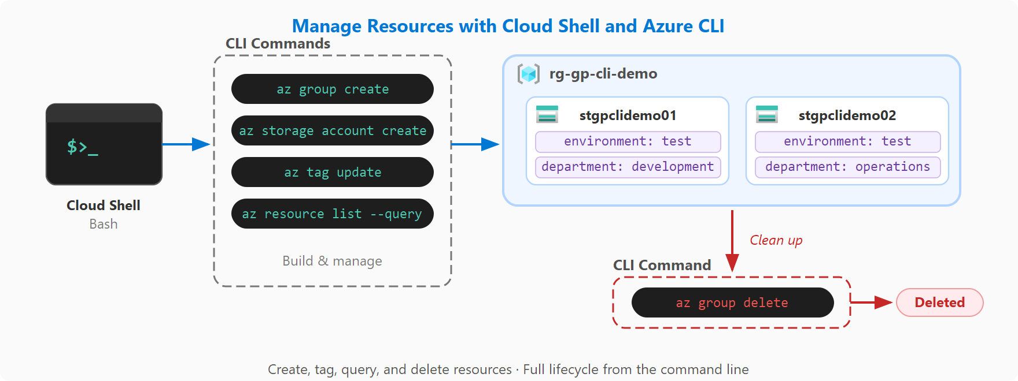
Project: Resource management with Cloud Shell and CLI diagram
Notes:
Learn URL: https://learn.microsoft.com/training/modules/guided-project-manage-resources-cloud-shell-cli/1-introduction
Azure Cloud Shell is a browser-based terminal built into the Azure portal. It comes preinstalled with the Azure CLI, so you can manage resources from the command line without installing anything locally.
The CLI is especially useful when performing the same operations across multiple resources quickly.
In this project, the IT administrator creates and manages resources efficiently from the command line. They open Cloud Shell, create a resource group and storage accounts, apply tags, query resources with JMESPath filters, and delete everything when done.
JMESPath is the built-in query language for filtering and reshaping JSON output from CLI commands.

Slide 42
Knowledge check
1
What query language does the Azure CLI use to filter and shape JSON output?
SQL
JMESPath
KQL (Kusto Query Language)
2
What happens when you delete a resource group using the Azure CLI?
Only the resource group is deleted
All resources inside the resource group are also deleted
Resources are moved to a default resource group
3
What shell environment does Cloud Shell use by default for Azure CLI commands?
PowerShell
Command Prompt
Bash
Notes:
Learn URL: https://learn.microsoft.com/training/modules/guided-project-manage-resources-cloud-shell-cli/7-knowledge-check
Let us check your understanding of Cloud Shell and CLI.
Question 1: The Azure CLI uses JMESPath, a built-in query language for filtering and reshaping JSON results.
Question 2: Deleting a resource group is a cascading operation that removes the group and every resource it contains.
Question 3: Cloud Shell defaults to a Bash environment for Azure CLI commands, providing a Linux-based shell experience.

