Slide 1
4483/8995 CAPSTONE PROJECT PRESENTATION
AUSTRALIAN VEHICLE PRICES
INSERT STUDENT NAMES/IDs: u3280729
TUTORIAL GROUP – WEEK DAY/TIME: Wednesday 15:30

Slide 2
Table of Contents (Agenda)
Introduction / Problem Statement
Dataset Details
EDA (Exploratory Data Analysis) Outcomes
AI/ML/PDA (Predictive Data Analytics) Outcomes
Implementation and Deployment (TkInter / Flask / Streamlit) Outcomes
Project Demo
Reflection
References/Bibliography

Slide 3
Introduction / Problem Statement
Various factors potentially influence vehicle prices
Problem: use machine learning on a variety of different data to accurately predict a vehicle's selling price

Slide 4
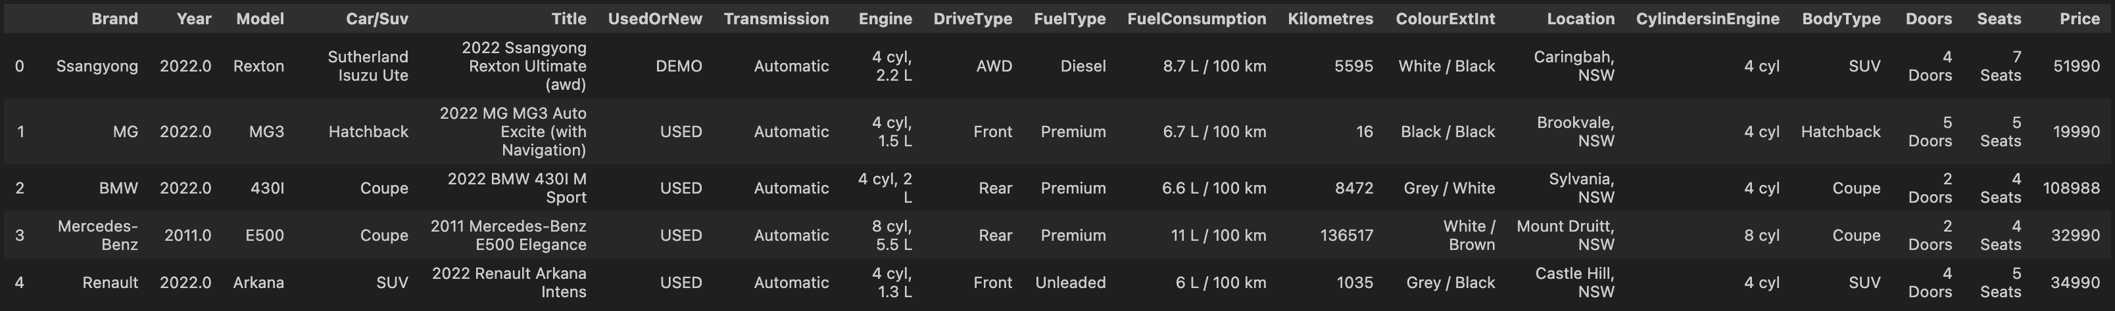
2. Dataset Details
Australian Vehicle Prices
Model data (‘Brand’, ‘Model’, ‘Year’)
Selling details (‘UsedOrNew’, ‘Kilometres’, ‘Location’)
Engine, internal and cosmetic details (‘Transmission’, ‘DriveType’, ‘FuelType’, ‘FuelConsumption’, ‘ColourExtInt’, ‘CylindersinEngine’, ‘BodyType’, ‘Doors’, ‘Seats’)
Price (a perfect dependant variable)

Slide 5
2. Dataset Details
Australian Vehicle Prices
16,734 entries in total
Variety of different data sources
781 unique car models across 76 different brands, and ranging from 1940 to 2023
Very unclean

Slide 6
3. EDA (Exploratory Data Analysis) Outcomes
Data had lots of issues caused by different data sources
Variably missing data
Sometimes most of the row was empty; for one row all of it was
Every columns’ type was wrong
Some fields sometimes had the wrong data
Some data mis-transcribed

Slide 7
3. EDA (Exploratory Data Analysis) Outcomes
Cleaning data was required
Remove unsalvageable nulls (null row, Price)
Convert Year (float) to an integer and Price (a string, but now purely numeric in value) to float
Convert other columns
Replace effectively null values to be actually null
For any numeric fields that remain unconvertable after this step, investigate
Look for data that doesn’t belong there and address accordingly
If the data has a string format, de-format
If column stores two sets of data in each cell, either split into two columns or combine into one
Fill in missing data
Combine or transfer cases of columns repeating other columns’ data
Group by model
Manually fill in or correct notable cases
Either separate nulls into their own field if they could provide informative value or drop rows with nulls if they hinder the data
Drop unprocessed/un-processable columns

Slide 8
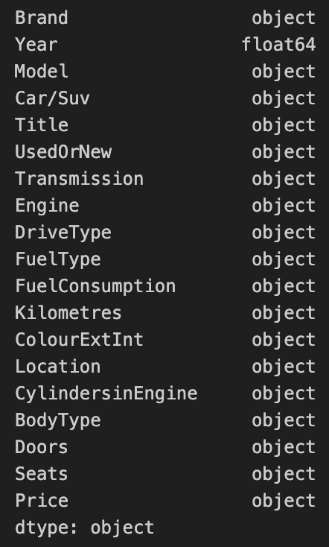
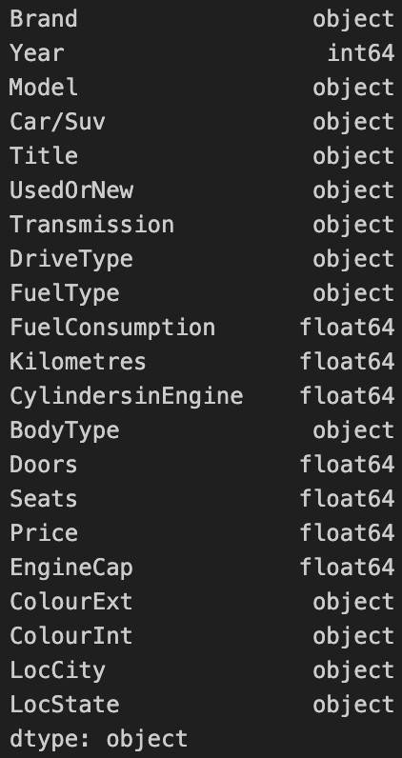
3. EDA (Exploratory Data Analysis) Outcomes
Dataset as read in
Dataset after EDA (before column rejection)

Slide 9
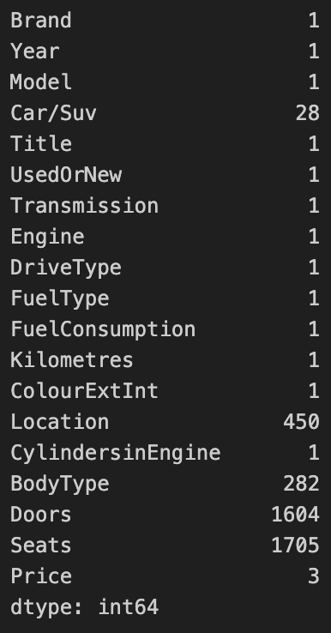
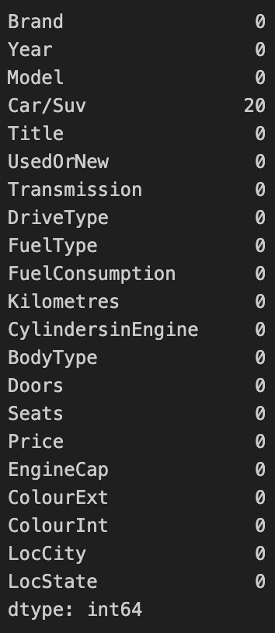
3. EDA (Exploratory Data Analysis) Outcomes
Dataset as read in
Dataset after EDA (before column rejection)

Slide 10
4. AI/ML/PDA (Predictive Data Analysis) Outcomes
Every used row needed to be numeric
Split the values of remaining string columns into separate Boolean columns
Brand/Model turned into numeric index sorted by each model’s mean price
15,935 entries remaining by the end
5 models, 2 methods tested – basic and k-fold cross validation
Best model is Random Forest
Basic process explains 92% of the proportion of total variation in the dependent variable that is explained by independent variables
10-fold cross validation improved effectiveness to 96%

Slide 11
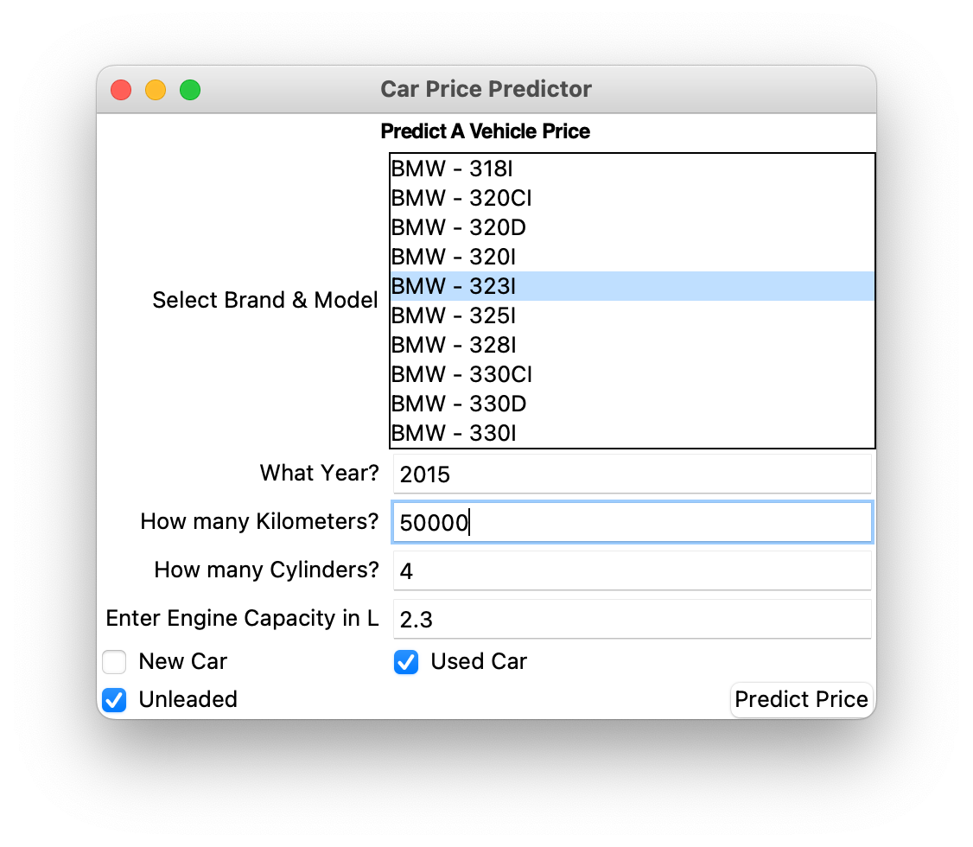
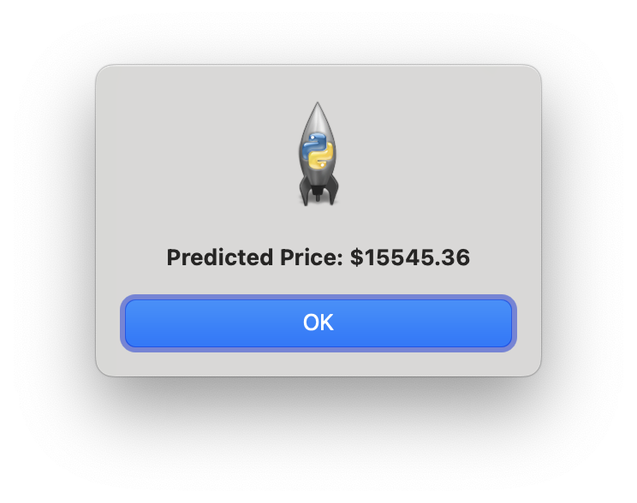
5. Implementation and Deployment (TkInter/Flask/Streamlit) Outcomes
Tkinter program
Loads training model, brand-model index lookup and normalised parameters
Input via 8 widgets in a window, each representing a column
Chosen based on correlation positive/negative over 20%
Ensures input values are valid – numeric values >0; Booleans restricted to checkboxes; brands and models restricted to what is in dataset via list box
Outputs an estimated price based on the data provided in a message box

Slide 12
PROJECT DEMO
WORKING/LIVE PROJECT
DEMONSTRATION

Slide 13
REFLECTION
Solo project
Tutorials and guidance was necessary to understand topic
Workflow severely interrupted by broken computer and several other ongoing assignments

Slide 14
References /Bibliography
[1] Australian Vehicle Prices, N. Elgiriyewithana, Nov. 27, 2023. [Online]. Available: https://www.kaggle.com/datasets/nelgiriyewithana/australian-vehicle-prices
[2] N. Renotte. Pandas for Data Science in 20 Minutes | Python Crash Course (Aug. 21, 2020). Accessed Apr. 7, 2024 [Online Video]. Available: https://youtu.be/tRKeLrwfUgU
[3] Programming with Mosh. Python Machine Learning Tutorial (Data Science) (Sep. 17, 2020). Accessed Apr. 7, 2024 [Online Video]. Available: https://youtu.be/7eh4d6sabA0
[4] NeuralNine. House Price Prediction in Python - Full Machine Learning Project (Nov. 26, 2022). Accessed Apr. 7, 2024 [Online Video]. Available: https://youtu.be/Wqmtf9SA_kk
[5] G. Hogg. Machine Learning Project in Python: Predicting California Housing Prices (Sep. 22, 2021). Accessed Apr. 7, 2024 [Online Video]. Available: https://youtu.be/_- UCcuB8nbw
[6] A. Kumar, “K-Fold Cross Validation in Machine Learning – Python Example,” Analytics Yogi, Jan. 3, 2024. [Accessed May 11, 2024].

