Slide 1
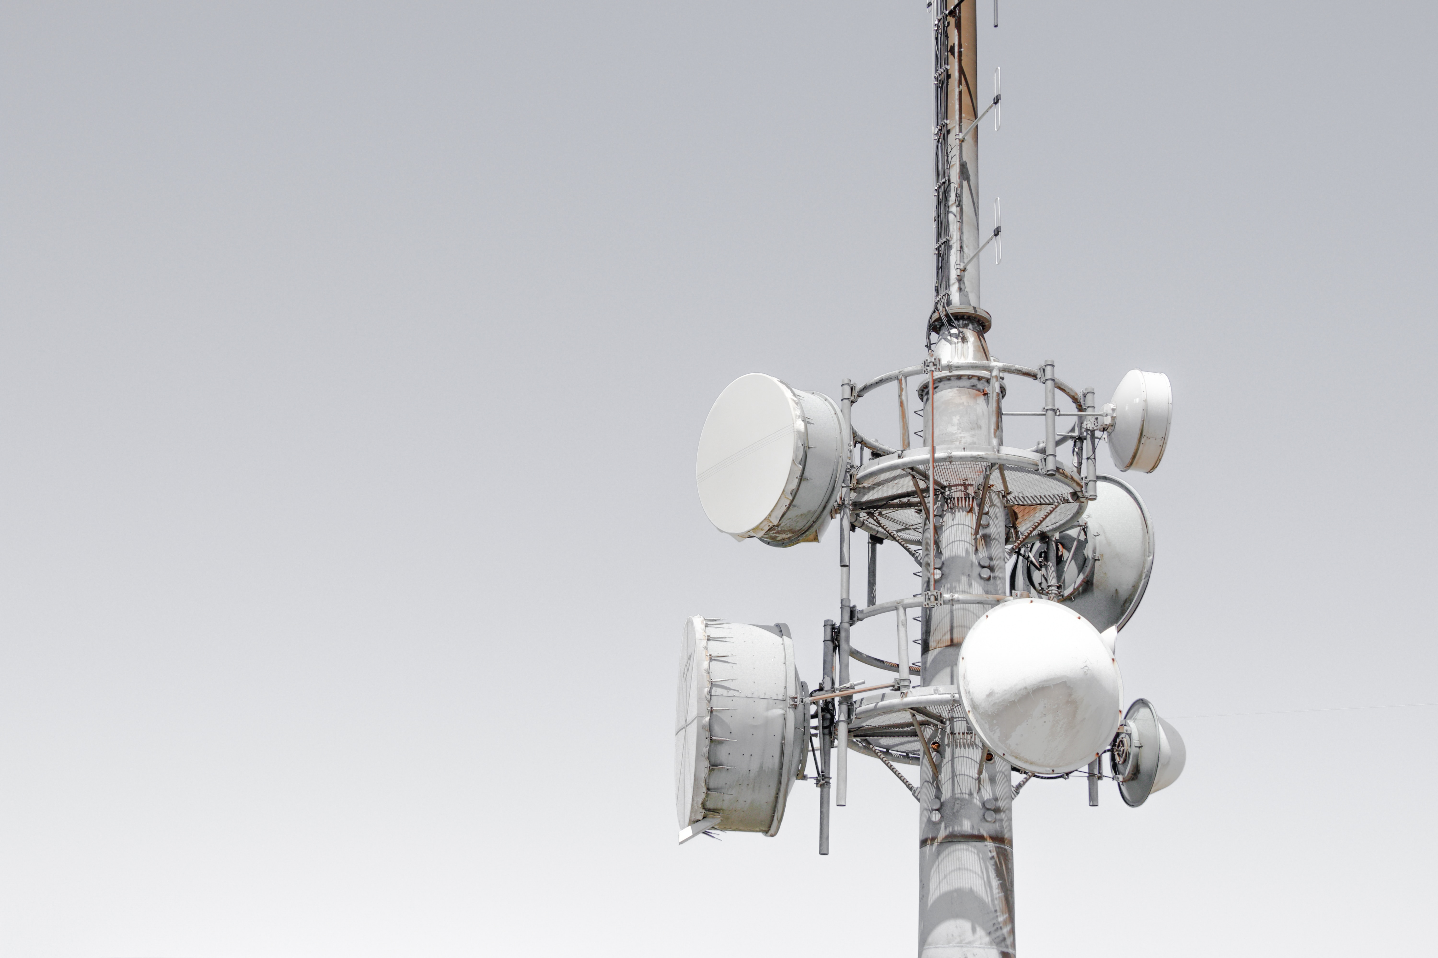
Cellular
Networks
MAHARSHI BHAVSAR - 11
MIHIR DARJI - 13

Slide 2
Why?
Communication
Over long distances
Mobility

Slide 3
What does it provide?
Hierarchical structure
Large geographical coverage area
Reduced interference
Transparent handovers
Roaming

Slide 4
How does it work?

Slide 5
Capitalize.
Leverage.
Innovate.
Efficiently unleash cross-media information without cross-media value. Quickly maximize timely deliverables for real-time schemas.
Bring to the table win-win survival strategies to ensure proactive domination.
Podcasting operational change management inside of workflows to establish a framework.
Education.
Progress.
Productivity.
Collaboratively administrate empowered markets via plug-and-play networks.
Objectively innovate empowered manufactured products whereas parallel platforms.
Proactively envisioned multimedia based expertise and cross-media growth strategies.

