Slide 1

Medical Appointment No Shows
Team 4 Project
Arthur Sowinski
Ibrahim Abu Nameh
Michel Tayzon
Vishal Valentine
Type to enter a caption.

Slide 2
Introduction
What is No-Show ?
No-Shows cost the healthcare industry more than $150 billion annually
Dataset source (https://www.kaggle.com/joniarroba/noshowappointments/data)
110527 rows x 14 columns

Slide 3
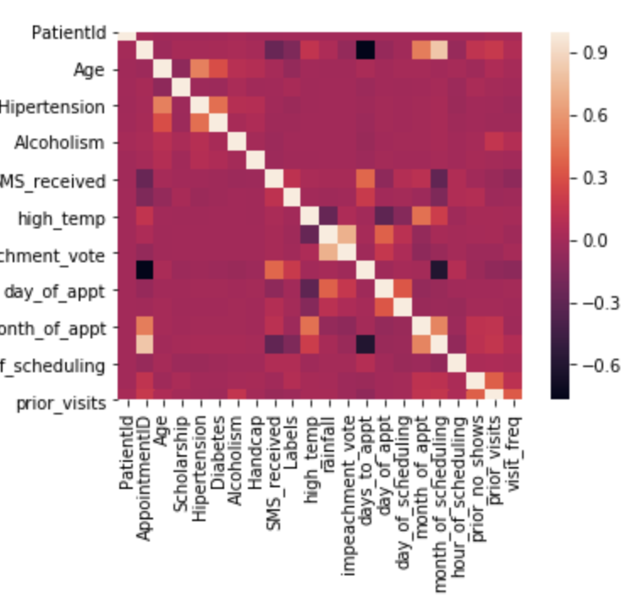
Feature Engineering
Patient Gender
ScheduledDay
AppointmentDay
Patient Age
Neighbourhood
Scholarship
Hipertension, Diabetes & Alchoholism
Handicap
Sms_received
No-show
Heat

Slide 4
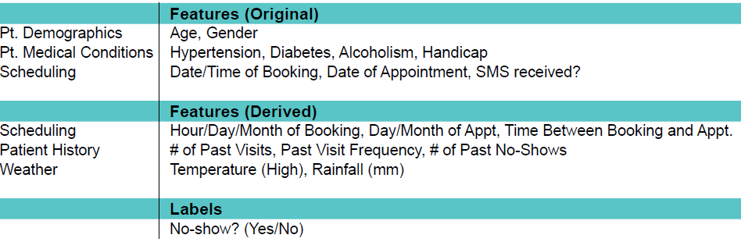
Feature Labels Table
Feature Labels Table

Slide 5
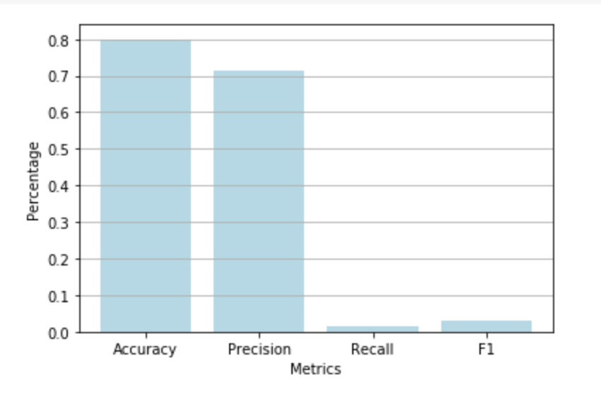
Current Model
Type to enter a caption.

Slide 6

Conclusion
Best model has a accuracy of 80% & precision of 70%.
Additional variables that would have helped in model prediction:
Appointment Time
Type of reminders issued
Distance between patient’s house to clinic
Type to enter a caption.

Slide 7
Conclusion (Contd….)
Remedial Measures:
More booking: Using the predictive model, schedule more appointments
No-Show fees: Charging fees for a no-show appointment
Incentives: by collecting fees upfront might provide an incentive fo a patient to show-up

