Slide 1

Medical Appointment No Shows
Team 4 Project
Arthur Sowinski
Ibrahim Abu Nameh
Michel Tayzon
Vishal Valentine
Type to enter a caption.

Slide 2
Introduction
What is a No-Show ?
No-Shows cost the healthcare industry more than $150 billion annually
Dataset source (https://www.kaggle.com/joniarroba/noshowappointments/data)
110527 rows x 14 columns

Slide 3
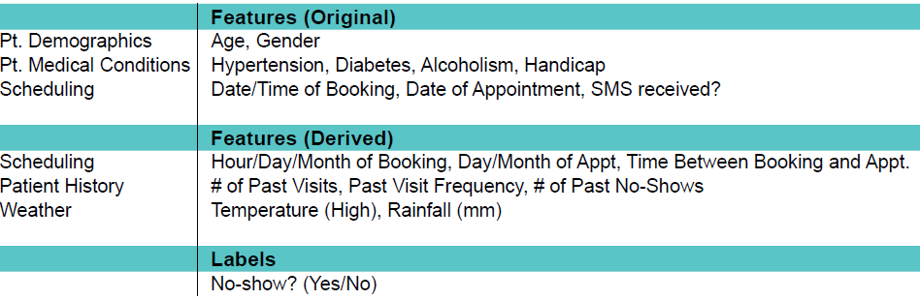
Feature Engineering
Feature Labels Table

Slide 4
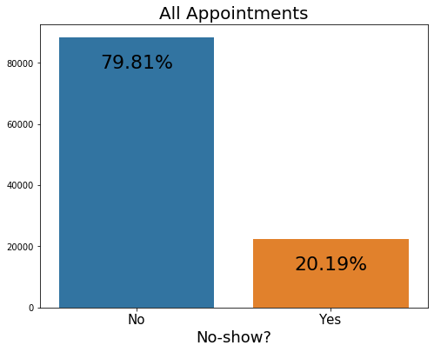
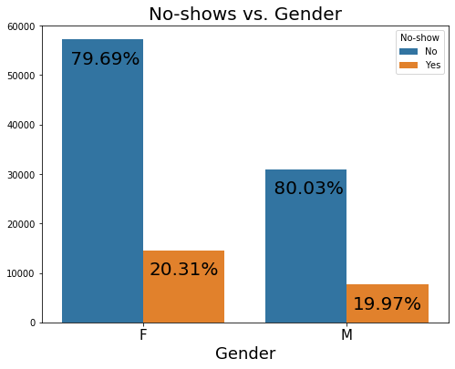
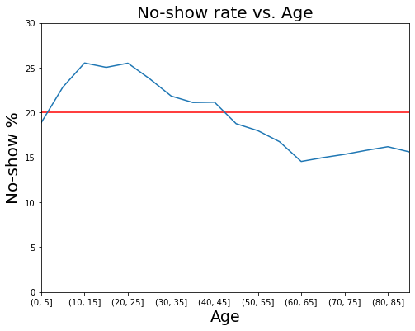
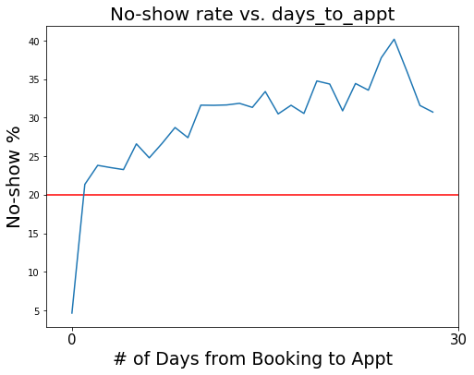
Analysis

Slide 5
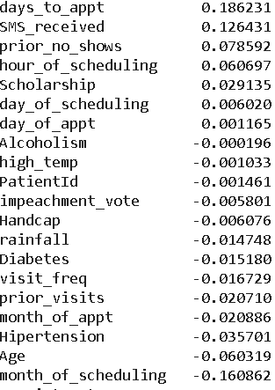
Analysis
Very poor correlations versus label

Slide 6
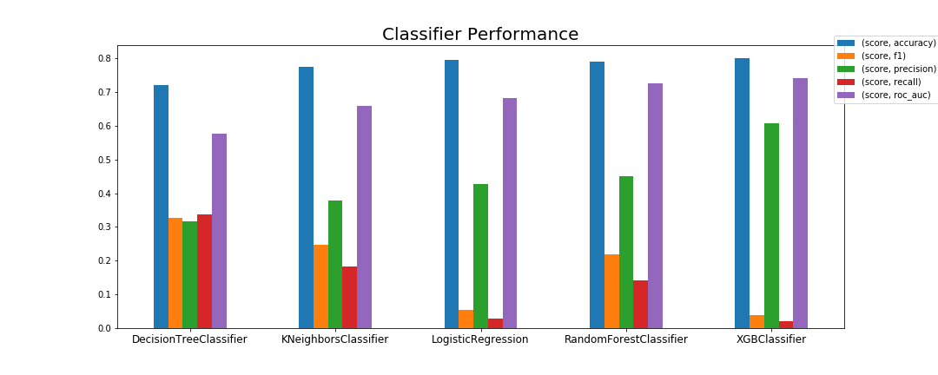
Model Selection

Slide 7
Model Selection
Individual models - LOG,DTC,RFC,KNN,XGB, SGD,SVC
Best individual model - XGBoost
Accuracy: 0.80
Precision: 0.61
Recall: 0.02
Best model - Voting Classifier (LOG, KNN,XGB,RFC)
Scores
Accuracy: 0.80
Precision: 0.75
Recall: 0.01

Slide 8
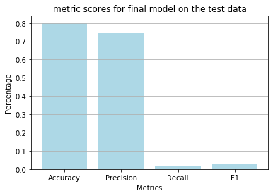
Current Model

Slide 9
Implementation
Send extra reminders to the predicted no shows.
Potential Savings
Every 2 months the model predicts 150 no shows
Assume $50 per visit
These extra reminders could save up to 150*50 = $7500 per quarter

Slide 10

Conclusion
Best model has a accuracy of 80% & precision of 70%.
Additional variables that would have helped in model prediction:
Appointment Time
Type of reminders issued
Distance between patient’s house to clinic
Type to enter a caption.

Slide 11
Conclusion
Remedial Measures:
More booking: Using the predictive model, schedule more appointments
No-Show fees: Charging fees for a no-show appointment
Incentives: by collecting fees upfront might provide an incentive fo a patient to show-up

