Slide 1
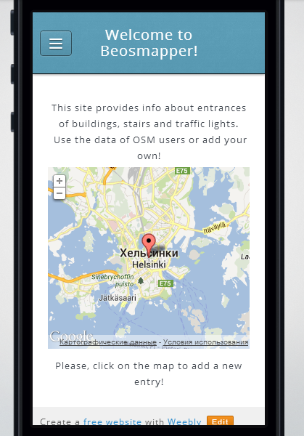
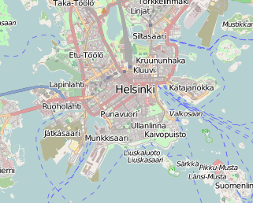
Welcome to Beosmapper!
This suite provides information about entrances of the buildings, stairs and traffic lights.
You can use the data of OSM users or add your own!
Ѵ
Entrance
Traffic lights
Stairs
Please, click on the map to add a new entry!
Login
Some info about us

