Slide 1
BALL COLLECTOR
Syed Raza Ahmed (62952) Shaikh Bilal Ahmed (63004) Aarij Hassan (61654) Qasim Hassan (62357)

Slide 2

INTRODUCTION
Nostalgia from subway surf.
We build quite a similar game but different concept game.

Slide 3
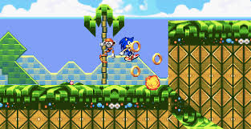
Scope Of Project
The scope of project is that we have to build the project like Sonic in the future.
We will make more compatible for all the device.

Slide 4
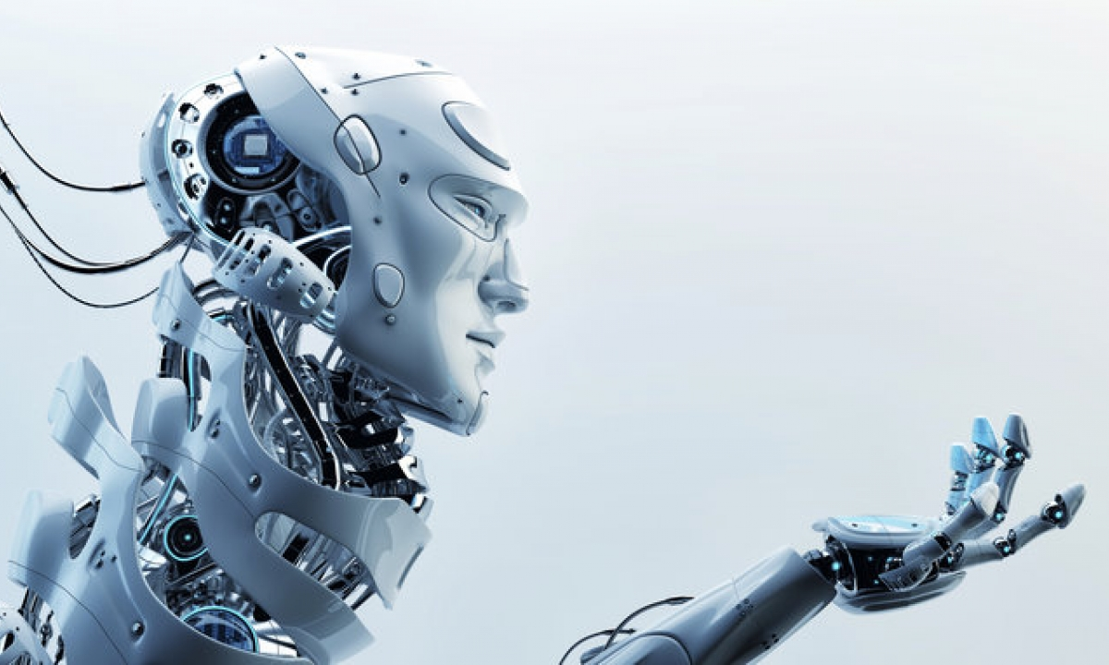
Technology
Unity 3D
Visual Studio 2012

Slide 5
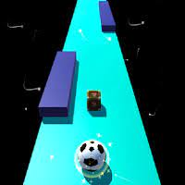
Assets
Coins
Ball
Wall
Jumper
Score Board
Sound
Texture

Slide 6
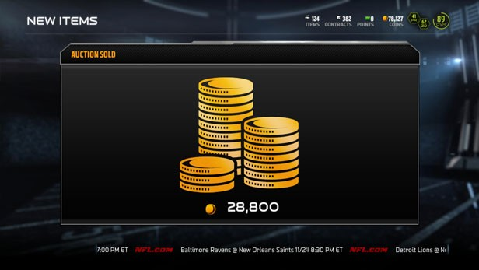
COINS
Box Collider
Coins Script
Cylinder(Mesh)
Total 252 Coins

Slide 7
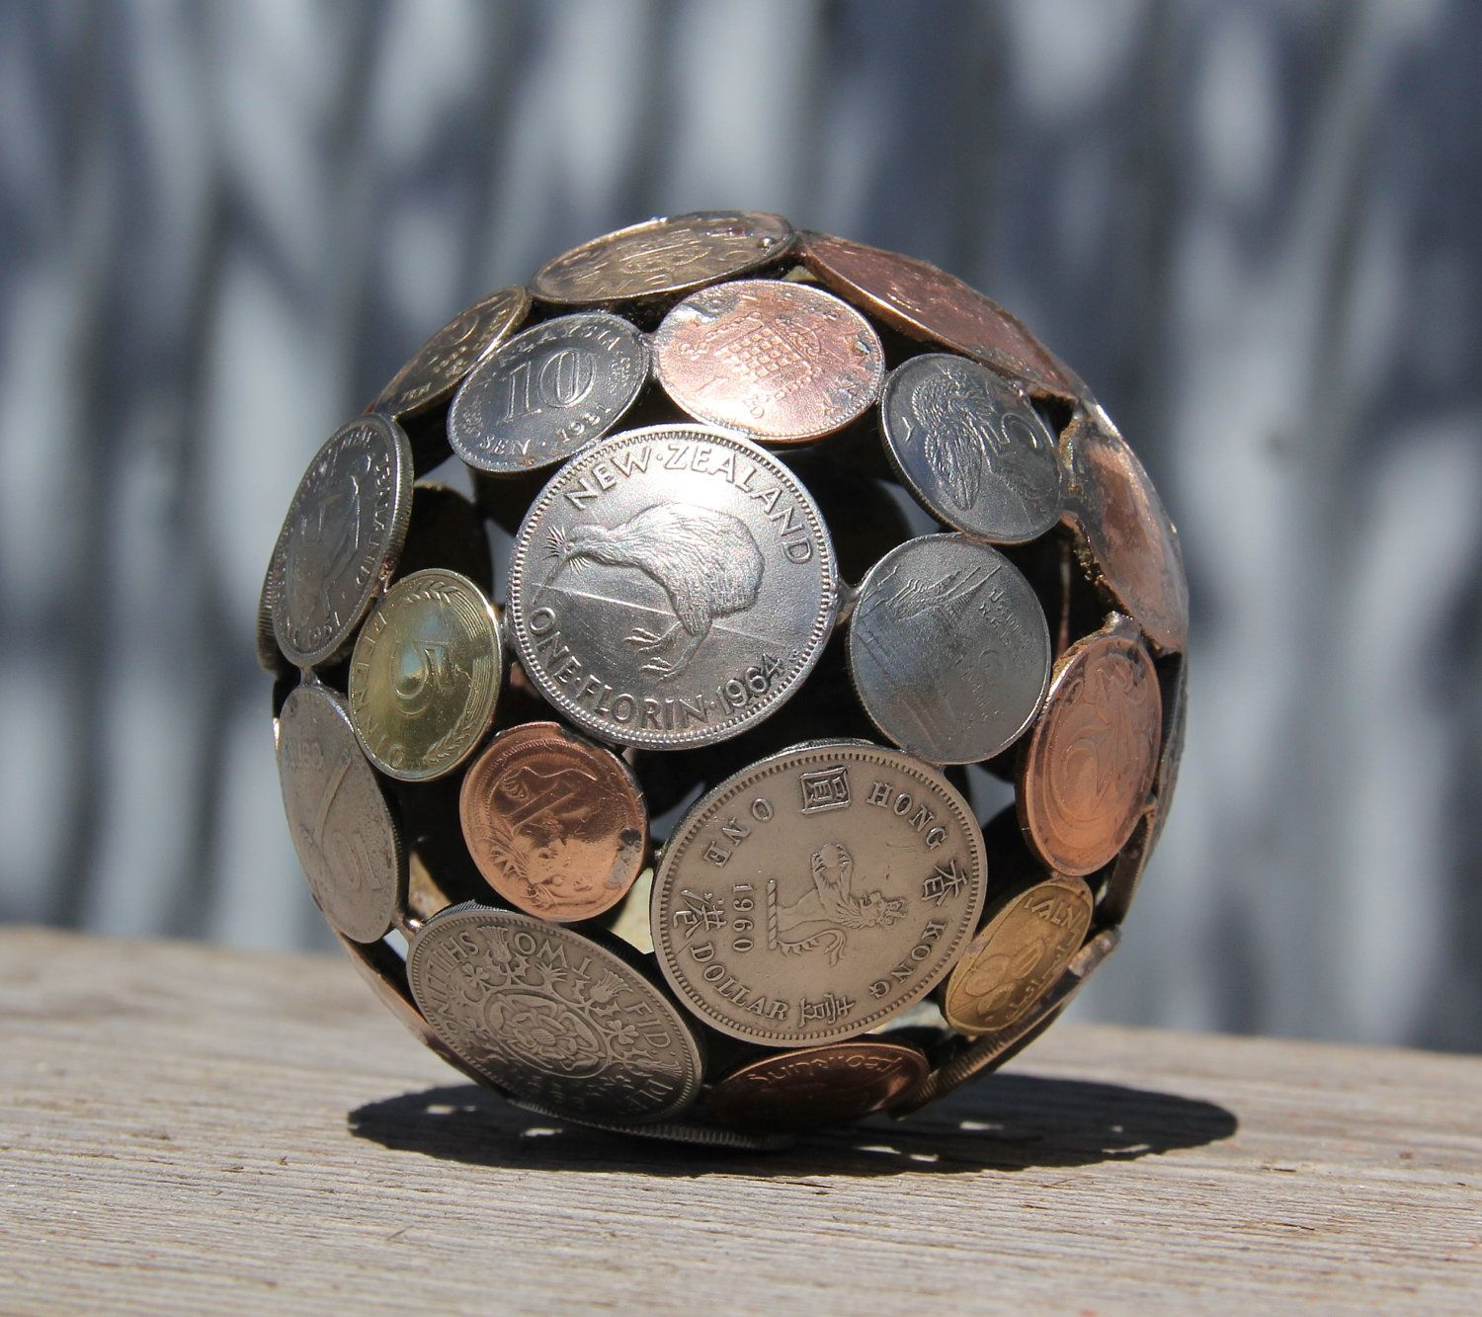
BALL
Rigid Body
Sphere Collider
Script (Player Movement)

Slide 8
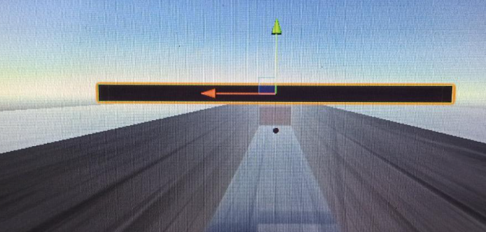
ROOF
Box Collider
Mesh Filter (Cube)

Slide 9
Thankue

