Slide 1

Machine Learning
Session Two: An Introduction
to Machine Learning
Algorithms &
Approaches
Instructors: Multiple
Hosted by: Brian Lofy, PhD
Source Graphic: tech.com

Slide 2
Course Description
Machine Learning
This introductory course reviews machine learning approaches in use across our industry, commercial companies, and academia. Insight from this course will enable you to make better decisions on ML approaches to fit the problem domain. Whether you are developing your own software solution or leveraging commercial software packages to solve your project’s problem, this course aims to demystify machine learning and describe what is within the ML “Black Box”. This course is a multi-part series which includes ML techniques like:
Regression
Decision Trees
Instance-based and Kernel methods-based Learning
Bayesian Learning
Neural Networks
Deep Learning
During the series we will be joined by guest speakers to describe how they applied machine learning techniques to projects here at BAE systems. After each session you should have an appreciation for the inner workings of ML techniques.
…demystify machine learning and describe what is within the ML “Black Box”…

Slide 3
Course Objectives
Intent of this ML course
Give the student an appreciation for what is under the hood of the ML algorithms, if applying COTS or opensource tools, SW packages, etc.
Provide the student a basis to research, develop, and apply a ML algorithm and the intuition into how it will perform on their data set and conditions as they apply to BAE Systems’ projects and examples
Course Book Selection:
Collective Intelligence – Toby Segaran
“comprehensive collection of computational methods for relating vast amounts of data”
“practical, easy-to-understand examples”

Slide 4

Course Dates
October 11: Regression
October 18: Decision Trees
October 25:
Instance-based Learning
Kernel methods-based Learning
2017
Bayesian Learning
Neural Networks
Deep Learning

Slide 5
Machine Learning (ML)
ML is a subfield of AI that provides computers with the ability to learn without being explicitly programmed. (1959, Arthur Samuel)
“What this means, in most cases, is that an algorithm is given a set of data and infers information about the properties of the data
– and that information allows it to make predictions about other data that it might see in the future.
This possible because almost all nonrandom data contains patterns, and these patterns allow the machine to generalize.
In order to generalize, it trains a model with what it determines are the important aspects of the data” (i.e., features). (Toby Segaran)

Slide 6
ML Representations (i.e. Algorithms)

Slide 7
Decision Trees
Decision Trees (DT):
are a popular tool in ML as a decision support tool for both
Classification Trees (discrete valued)
Regression Trees (continuous valued)
DT use a tree-like graph or model of decisions and their possible consequences
→ Decisions fork in the tree structure until a decision is made for a given record
Available in:
Apache Mahout
R
Julia
Apache Spark
Python
And many more

Slide 8
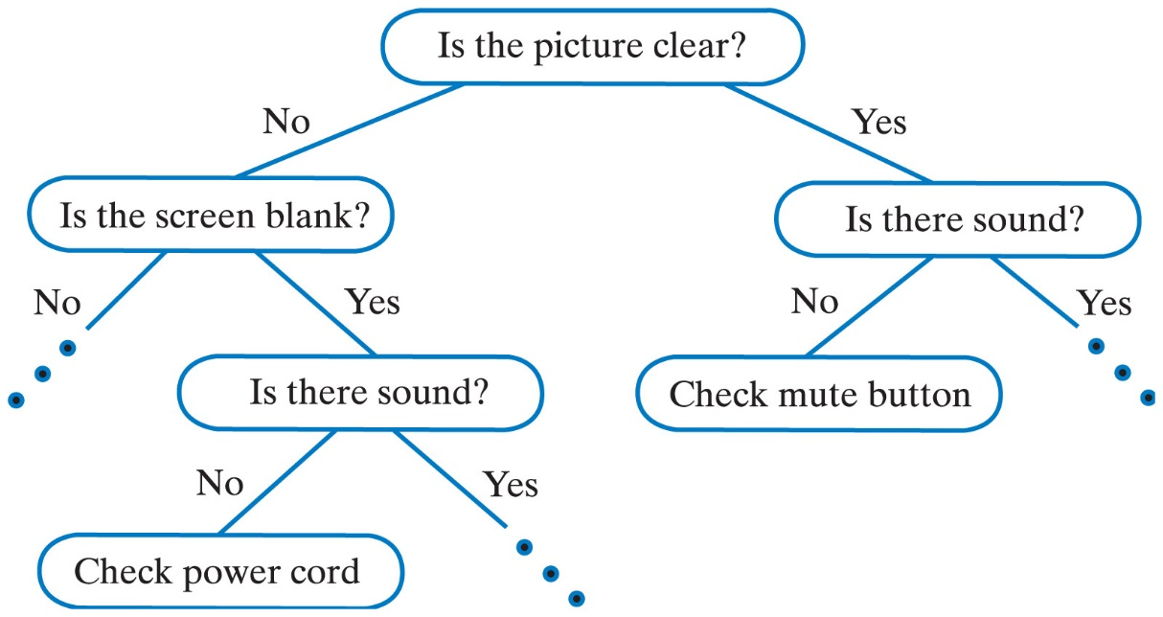
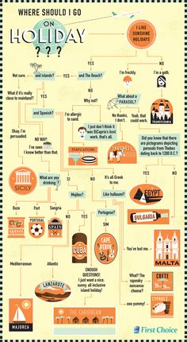
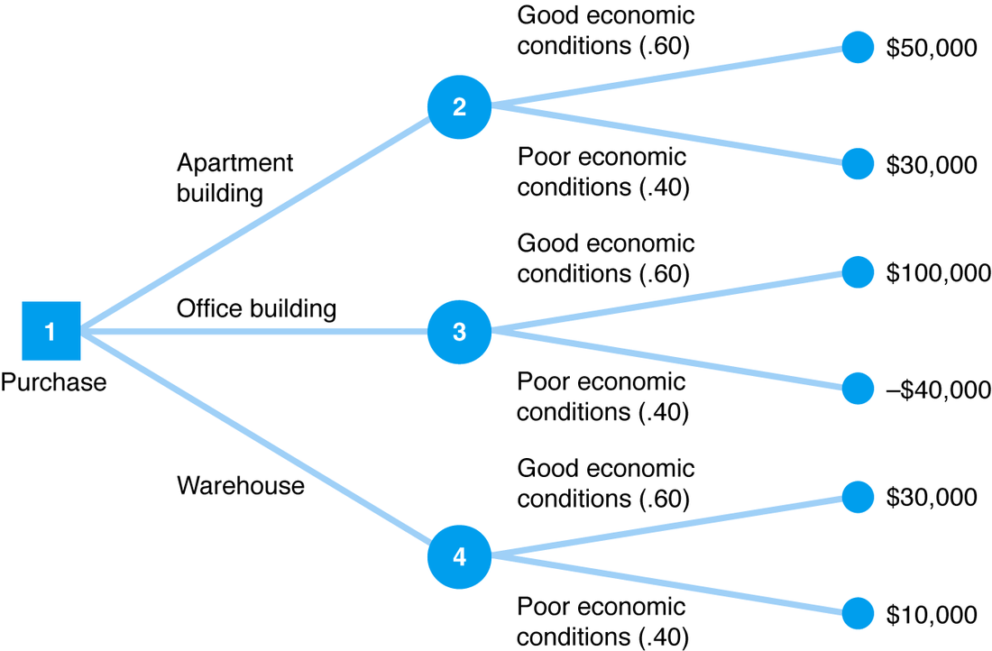
Decision Trees
Have you seen or used decision trees before?
What comes to mind when DT are mentioned?

Slide 9
Decision Tree
Example of a Decision Tree Classifier
Attribute Day Outlook Humidity Wind |  |  |  | Play
D1 | Sunny | High | Weak | No
D2 | Sunny | High | Strong | No
D3 | Overcast | High | Weak | Yes
D4 | Rain | High | Weak | Yes
D5 | Rain | Normal | Weak | Yes
D6 | Rain | Normal | Strong | No
D7 | Overcast | Normal | Strong | Yes
D8 | Sunny | High | Weak | No
D9 | Sunny | Normal | Weak | Yes
D10 | Rain | Normal | Weak | Yes
D11 | Sunny | Normal | Strong | Yes
D12 | Overcast | High | Strong | Yes
D13 | Overcast | Normal | Weak | Yes
D14 | Rain | High | Strong | No
Build a classifier to predict whether Bob will play a game of outdoor tennis, based on the observations (i.e., training set) over a 14 day period.
A decision tree classifier attempts to make the best inference from the available attributes:
Outlook (e.g., Forecast)
Humidity
Wind
Attribute Day Outlook Humidity Wind |  |  |  | Play
D1 | Sunny | High | Weak | No
D2 | Sunny | High | Strong | No
D3 | Overcast | High | Weak | Yes
D4 | Rain | High | Weak | Yes
D5 | Rain | Normal | Weak | Yes
D6 | Rain | Normal | Strong | No
D7 | Overcast | Normal | Strong | Yes
D8 | Sunny | High | Weak | No
D9 | Sunny | Normal | Weak | Yes
D10 | Rain | Normal | Weak | Yes
D11 | Sunny | Normal | Strong | Yes
D12 | Overcast | High | Strong | Yes
D13 | Overcast | Normal | Weak | Yes
D14 | Rain | High | Strong | No
Training Examples:
9 yes / 5 no
9 yes / 5 no
Attribute Day Outlook Humidity Wind |  |  |  | Play
D15 | Rain | High | Weak | ?
New Data:
Source: Victor Lavrenko – School of Informatics University of Edinburgh UK
Notes:
Let’s start simple, by hand constructing a decision tree. By doing so you will have a better understanding of how and why SW kits automate the creation of a decision tree for provided data.
My goal with all these sessions is to teach and the best way I know how to achieve that is to clearly illustrate the concept. Perhaps this will inspire you all to jump into programming a classifier to solve a particular problem on your program.

Slide 10
Decision Tree
Example of a Decision Tree Classifier
9 yes / 5 no
Training Examples:
Decision Trees are “greedy” algorithm, in the first sense, in selecting the root node. Root node can be any of the attributes. (e.g., Outlook, Humidity, or Wind)
STEPS TO CREATE DT:
Select the “best” attribute
Create child nodes
Split the training examples into child nodes
At each child node, stop if data subset is pure, otherwise repeat the splitting procedure
Attribute Day Outlook Humidity Wind |  |  |  | Play
D1 | Sunny | High | Weak | No
D2 | Sunny | High | Strong | No
D3 | Overcast | High | Weak | Yes
D4 | Rain | High | Weak | Yes
D5 | Rain | Normal | Weak | Yes
D6 | Rain | Normal | Strong | No
D7 | Overcast | Normal | Strong | Yes
D8 | Sunny | High | Weak | No
D9 | Sunny | Normal | Weak | Yes
D10 | Rain | Normal | Weak | Yes
D11 | Sunny | Normal | Strong | Yes
D12 | Overcast | High | Strong | Yes
D13 | Overcast | Normal | Weak | Yes
D14 | Rain | High | Strong | No
Ross_Quinlan
and ID3 & C4.5 approaches to DT
Breiman et. al. 1984
and DT
Source: Victor Lavrenko – School of Informatics University of Edinburgh UK

Slide 11
Decision Tree
Example of a Decision Tree Classifier
STEP 1:
Attribute Day Outlook Humidity Wind |  |  |  | Play
D1 | Sunny | High | Weak | No
D2 | Sunny | High | Strong | No
D3 | Overcast | High | Weak | Yes
D4 | Rain | High | Weak | Yes
D5 | Rain | Normal | Weak | Yes
D6 | Rain | Normal | Strong | No
D7 | Overcast | Normal | Strong | Yes
D8 | Sunny | High | Weak | No
D9 | Sunny | Normal | Weak | Yes
D10 | Rain | Normal | Weak | Yes
D11 | Sunny | Normal | Strong | Yes
D12 | Overcast | High | Strong | Yes
D13 | Overcast | Normal | Weak | Yes
D14 | Rain | High | Strong | No
Option #1
Option #2
Option #3
Outlook
Humidity
Wind
Sunny
Overcast
Rain
Normal
High
Weak
Strong
STEP 2: Create Child Nodes
Source: Victor Lavrenko – School of Informatics University of Edinburgh UK

Slide 12
Decision Trees
Question ?:
In the first step, Select the “best” attribute, how do you know you are selecting the right attribute to assign to the root node?
In the following procedure we will begin a DT with the attribute “Outlook” as the root node.
Homework: Construct all DTs for each of the remaining attributes as the root node and child node variants.

Slide 13
Decision Tree
Example of a Decision Tree Classifier
STEP 1: Option #1
9 yes / 5 no
STEP 2: Create Child Nodes
Outlook
STEP 3: Split
STEP 4: Pure or not?
Sunny
2 yes / 3 no
Overcast
4 yes / 0 no
Rain
3 yes / 2 no
Attribute Day Outlook Humidity Wind |  |  |  | Play
D1 | Sunny | High | Weak | No
D2 | Sunny | High | Strong | No
D8 | Sunny | High | Weak | No
D9 | Sunny | Normal | Weak | Yes
D11 | Sunny | Normal | Strong | Yes
Attribute Day Outlook Humidity Wind |  |  |  | Play
D3 | Overcast | High | Weak | Yes
D7 | Overcast | Normal | Strong | Yes
D12 | Overcast | High | Strong | Yes
D13 | Overcast | Normal | Weak | Yes
Attribute Day Outlook Humidity Wind |  |  |  | Play
D4 | Rain | High | Weak | Yes
D5 | Rain | Normal | Weak | Yes
D6 | Rain | Normal | Strong | No
D10 | Rain | Normal | Weak | Yes
D14 | Rain | High | Strong | No
SPLIT FURTHER
PURE SUBSET → STOP
SPLIT FURTHER
Source: Victor Lavrenko – School of Informatics University of Edinburgh UK

Slide 14
Decision Tree
Example of a Decision Tree Classifier
STEP 1: Option #1
9 yes / 5 no
STEP 2: Create Child Nodes
Outlook
STEP 3: Split
STEP 4: Pure or not?
Sunny
2 yes / 3 no
Overcast
4 yes / 0 no
Rain
3 yes / 2 no
Day Outlook Humid Wind
D3 | Overcast | High | Weak
D7 | Overcast | Normal | Strong
D12 | Overcast | High | Strong
D13 | Overcast | Normal | Weak
Humid
Wind
Normal
High
Weak
Strong
Day Outlook Humid Wind
D9 | Sunny | Normal | Weak
D11 | Sunny | Normal | Strong
Day Outlook Humid Wind
D1 | Sunny | High | Weak
D2 | Sunny | High | Strong
D8 | Sunny | High | Weak
Day Outlook Humid Wind
D4 | Rain | High | Weak
D5 | Rain | Normal | Weak
D10 | Rain | Normal | Weak
Day Outlook Humid Wind
D6 | Rain | Normal | Strong
D14 | Rain | High | Strong
PURE SUBSETS → STOP
PURE SUBSETS → STOP
Source: Victor Lavrenko – School of Informatics University of Edinburgh UK

Slide 15
Decision Tree
Example of a Decision Tree Classifier
DT Classifier is trained and ready for test and/or production. Recall Day 15, does Bob play tennis or not?
9 / 5
Outlook
Sunny
2 / 3
Overcast
4 / 0
Rain
3 / 2
YES
Humid
Wind
0 / 3
3 / 0
0 / 2
2 / 0
Normal
High
Weak
Strong
YES
NO
YES
NO
Attribute Day Outlook Humidity Wind |  |  |  | Play
D15 | Rain | High | Weak | ?
New Data:
→ YES
Bob is predicted to play tennis on Day 15
Source: Victor Lavrenko – School of Informatics University of Edinburgh UK
Notes:
Now that the classifier is trained …
Lastly, the numbers at each node is a confidence metric

Slide 16
Demystifying the ML “Black Box”
Putting the learning algorithm into perspective
Attribute Day Outlook Humidity Wind |  |  |  | Play
D1 | Sunny | High | Weak | No
D2 | Sunny | High | Strong | No
D3 | Overcast | High | Weak | Yes
D4 | Rain | High | Weak | Yes
D5 | Rain | Normal | Weak | Yes
D6 | Rain | Normal | Strong | No
D7 | Overcast | Normal | Strong | Yes
D8 | Sunny | High | Weak | No
D9 | Sunny | Normal | Weak | Yes
D10 | Rain | Normal | Weak | Yes
D11 | Sunny | Normal | Strong | Yes
D12 | Overcast | High | Strong | Yes
D13 | Overcast | Normal | Weak | Yes
D14 | Rain | High | Strong | No
Supervised Learning Model
LABELS
LABELS
MACHINE LEARNING
ALGORITHM
LABELS
y(i)
m = 14
n = 4
INPUT DATA
“Train the Model”
INPUT DATA
x(i)
x = Day, Outlook,
Humidity, Wind
INPUT DATA
y = Play
(Train)
Creates
x(i)
CLASSIFIER MODEL
x
y
Decision Tree
Classifier
Predicted“y”
Instance (i) | Input x(i) | Output y(i)
1 | x(1) | y(1)
2 | x(2) | y(2)
3 | x(3) | y(3)
: | : | :
m | x(m) | y(m)
TERMINOLOGY
m = number of training samples
n = number of features
m
x = input variables / features
y = output variables / “target” variables
(x,y) = single training example
(x^{i},y^{i}) = specific example (i^{th} training example) where “i”
is an index into to the training set
Notes:
Recall this supervised learning model to train a ML algorithm

Slide 17
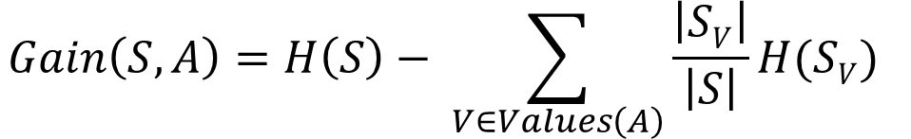
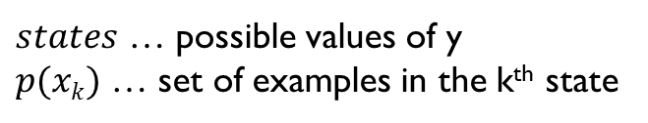
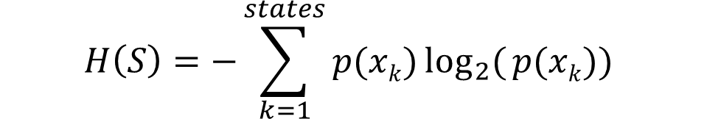
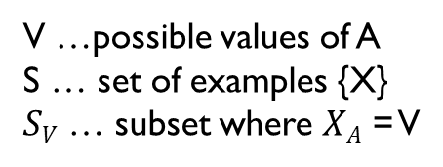
Decision Tree
Creating a Decision Tree Classifier
Recall the 4 steps to implementing a DT:
Select the BEST attribute
Define child nodes
Split attributes at child nodes
Stop if data subset is pure, otherwise continue splitting
Select the BEST attribute at a node (including the root)
Loop through the attributes and calculate the information gain one step down in the tree.
Compare information gain values and set the node to the attribute with the highest information gain
For each of the child nodes check the “purity” (i.e., confidence metric). (stop if pure, otherwise continue to next step)
Remove the winning attribute from the list and repeat steps a through c.
Information Gain:
V …possible values of A
S … set of examples {X}
$SV$ … subset where $XA$ = V
$$Gain\left(S,A\right)=H\left(S\right)− \sum_{V∈Values\left(A\right)}{\frac{\left|SV\right|}{\left|S\right|}}H(SV)$$
Entropy:
$$H\left(S\right)=−\sum_{k=1}^{states}{p(xk)\log_{2}({p(xk))}}$$
$states$ … possible values of y
$p(xk)$ … set of examples in the k^{th} state
Source: https://en.wikipedia.org/wiki/Entropy
Notes:
Entropy is borrowed from the world of information theory, and essentially is the expected value of the amount of information that conveyed in a message.

Slide 18
Decision Tree
Understanding Entropy
DT uses entropy to measure the confidence at a node.
Attribute Day Outlook Humidity Wind |  |  |  | Play
D1 | Sunny | High | Weak | No
D2 | Sunny | High | Strong | No
D3 | Overcast | High | Weak | Yes
D4 | Rain | High | Weak | Yes
D5 | Rain | Normal | Weak | Yes
D6 | Rain | Normal | Strong | No
D7 | Overcast | Normal | Strong | Yes
D8 | Sunny | High | Weak | No
D9 | Sunny | Normal | Weak | Yes
D10 | Rain | Normal | Weak | Yes
D11 | Sunny | Normal | Strong | Yes
D12 | Overcast | High | Strong | Yes
D13 | Overcast | Normal | Weak | Yes
D14 | Rain | High | Strong | No
Option #1
Option #2
Option #3
9 yes / 5 no
9 yes / 5 no
9 yes / 5 no
Outlook
Humidity
Wind
Sunny
Overcast
Rain
Normal
High
Weak
Strong
2 / 3
4 / 0
3 / 2
6 / 1
3 / 4
6 / 2
3 / 3
Examples of confidence:
- The (4 / 0) set is “pure” and we are completely certain (100%)
- The (3 / 3) set is “impure” and we are completely uncertain (50%)
- The remaining sets are also “impure” and we are again uncertain

Slide 19
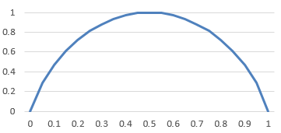
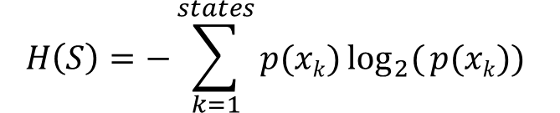


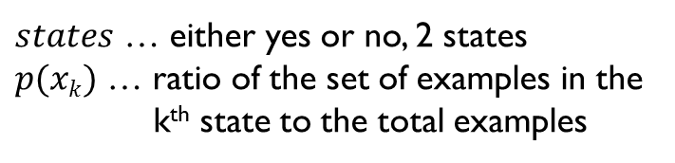
Decision Tree
Understanding Entropy
DT uses entropy to measure the confidence at a node.
Entropy:
$$H\left(S\right)=−\sum_{k=1}^{states}{p(xk)\log_{2}({p(xk))}}$$
Option #1
Option #2
Option #3
9 yes / 5 no
9 yes / 5 no
9 yes / 5 no
$states$ … either yes or no, 2 states
$p(xk)$ … ratio of the set of examples in the
k^{th} state to the total examples
Outlook
Humidity
Wind
Sunny
Overcast
Rain
Normal
High
Weak
Strong
2 / 3
4 / 0
3 / 2
6 / 1
3 / 4
6 / 2
3 / 3
$$H\left(S\right)=−\frac{4}{4}\log_{2}({\frac{4}{4})−\frac{0}{4}\log_{2}({\frac{0}{4}) } }$$
$$H\left(S\right)=−\frac{3}{6}\log_{2}({\frac{3}{6})−\frac{3}{6}\log_{2}({\frac{3}{6}) } }$$
H(S)
$$H\left(S\right)=0$$
$$H\left(S\right)=1$$
p(+) = ½
p(+) = 0
p(+) = 1

Slide 20

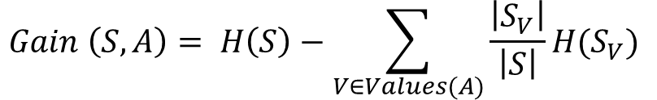




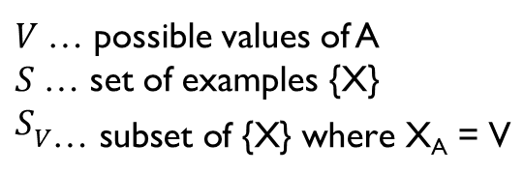

Decision Tree
Using Information Gain
Option #1
Option #2
Option #3
9 yes / 5 no
9 yes / 5 no
9 yes / 5 no
Outlook
Humidity
Wind
Sunny
Overcast
Rain
Normal
High
Weak
Strong
2 / 3
4 / 0
3 / 2
6 / 1
3 / 4
6 / 2
3 / 3
$$H\left(S\right)=$$
$$0.971$$
$$0$$
$$0.971$$
$$0.5917$$
$$0.9852$$
$$0.8113$$
1
Information Gain:
$V$… possible values of A
$S$… set of examples {X}
$$S_{V\text{… }\text{sub}\text{set} \text{of}\text{ \{}\text{X}\text{\} }\text{where} \text{X}\text{A}\text{ = }\text{V}}$$
$$Gain \left(S,A\right)= H\left(S\right)−\sum_{V∈Values(A)}{\frac{\left|S_{V}\right|}{\left|S\right|}H(S_{V})}$$
Mutual Information: between attribute A and class labels of S
Source: https://en.wikipedia.org/wiki/Information_gain_in_decision_trees
Source: https://en.wikipedia.org/wiki/Mutual_information
Notes:
Information Gain is a measure of how much more certain I am after the split compared to how certain I was before the split.
From a mathematical background, Information Gain is called Mutual Information … between attribute A and a class of labels of S

Slide 21


Decision Tree
Using Information Gain
Option #1
9 yes / 5 no
$$H\left(S\right)=0.94$$
Outlook
$$Gain \left(S, Outlook\right)$$
$$=H\left(S\right)− \frac{5}{14}H\left(Sunny\right)−\frac{4}{14}H\left(Overcast\right)−\frac{5}{14}H\left(Rain\right)$$
Sunny
Overcast
Rain
$=0.94 −\frac{5}{14}∗0.971 − \frac{4}{14}∗0$ $−\frac{5}{14}∗0.971$
2 / 3
4 / 0
3 / 2
$$H\left(Sunny\right)=0.971$$
$$=0.2464$$
More certain by 0.2464
$$H\left(Overcast\right)=0$$
$$H\left(Rain\right)=0.971$$
$V$… possible values of A
$S$… set of examples {X}
$$S_{V\text{… }\text{sub}\text{set} \text{of}\text{ \{}\text{X}\text{\} }\text{where} \text{X}\text{A}\text{ = }\text{V}}$$
$$Gain \left(S,A\right)= H\left(S\right)−\sum_{V∈Values(A)}{\frac{\left|S_{V}\right|}{\left|S\right|}H(S_{V})}$$
Entropy before the split
Entropy after the split

Slide 22






Decision Tree
Using Information Gain
Option #2
$$H\left(S\right)=0.94$$
9 yes / 5 no
Humidity
$$Gain \left(S, Humidity\right)$$
$$=H\left(S\right)− \frac{7}{14}H\left(Normal\right)−\frac{7}{14}H\left(High\right)$$
Normal
High
$$=0.94 −\frac{7}{14}∗0.5917 −\frac{7}{14}∗0.09852$$
6 / 1
3 / 4
$H\left(High\right)=$0.9852
$$=0.15155$$
$$H\left(Normal\right)=0.5917$$
$V$… possible values of A
$S$… set of examples {X}
$$S_{V\text{… }\text{sub}\text{set} \text{of}\text{ \{}\text{X}\text{\} }\text{where} \text{X}\text{A}\text{ = }\text{V}}$$
$$Gain \left(S,A\right)= H\left(S\right)−\sum_{V∈Values(A)}{\frac{\left|S_{V}\right|}{\left|S\right|}H(S_{V})}$$

Slide 23






Decision Tree
Using Information Gain
Option #3
$$H\left(S\right)=0.94$$
9 yes / 5 no
$$Gain \left(S, Wind\right)$$
Wind
$$=H\left(S\right)− \frac{8}{14}H\left(Weak\right)−\frac{6}{14}H\left(Strong\right)$$
$$=0.94 −\frac{8}{14}∗0.8113−\frac{6}{14}∗1$$
Weak
Strong
6 / 2
3 / 3
$$=0.049$$
$H\left(Strong\right)=$1
$$H\left(Weak\right)=0.8113$$
$V$… possible values of A
$S$… set of examples {X}
$$S_{V\text{… }\text{sub}\text{set} \text{of}\text{ \{}\text{X}\text{\} }\text{where} \text{X}\text{A}\text{ = }\text{V}}$$
$$Gain \left(S,A\right)= H\left(S\right)−\sum_{V∈Values(A)}{\frac{\left|S_{V}\right|}{\left|S\right|}H(S_{V})}$$

Slide 24
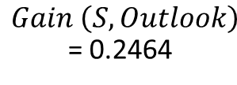
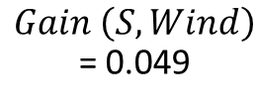
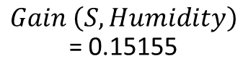
Decision Tree
Using Information Gain
Option #1
Option #2
Option #3
9 yes / 5 no
9 yes / 5 no
9 yes / 5 no
Outlook
Humidity
Wind
Sunny
Overcast
Rain
Normal
High
Weak
Strong
2 / 3
4 / 0
3 / 2
6 / 1
3 / 4
6 / 2
3 / 3
$Gain \left(S, Outlook\right)$ = 0.2464
$Gain \left(S, Humidity\right)$ = 0.15155
$Gain \left(S, Wind\right)$ = 0.049
The information gain for Outlook is highest and should be selected as the root node.
Follow the same process for child nodes.

Slide 25
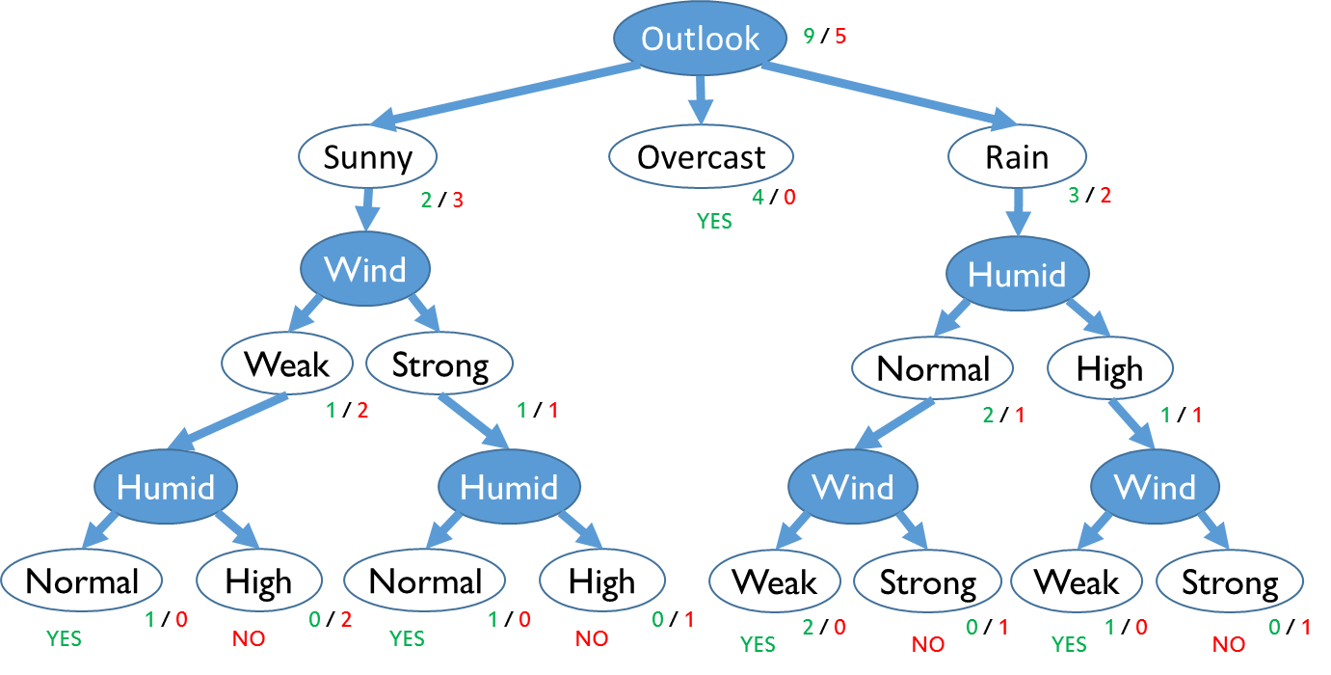
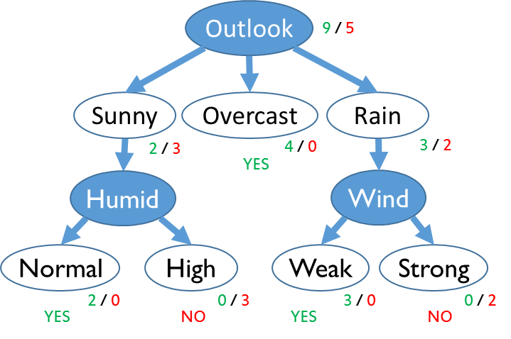
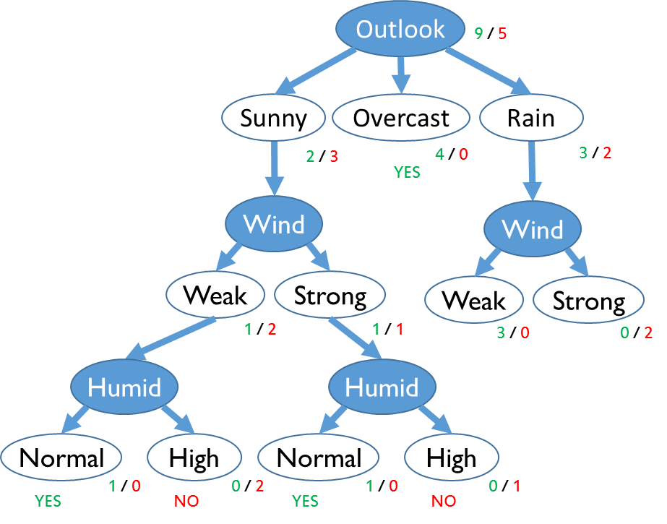
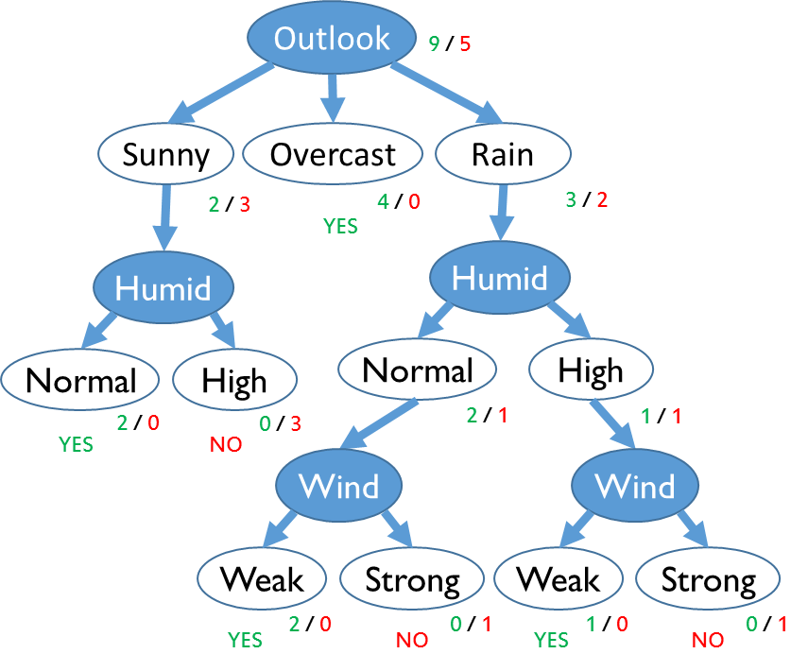
Decision Trees
Outlook
Question ?:
What makes one DT better than other DTs?
Depth
Breadth
9 / 5
Outlook
9 / 5
Sunny
Overcast
Rain
2 / 3
4 / 0
3 / 2
Sunny
Overcast
Rain
Humid
YES
Wind
2 / 3
4 / 0
3 / 2
YES
Humid
Humid
Normal
High
Weak
Strong
2 / 0
0 / 3
3 / 0
0 / 2
Normal
High
Normal
High
YES
NO
YES
NO
Homework Reminder: Construct all DTs for each attribute as root node and the child node variants.
2 / 0
0 / 3
2 / 1
1 / 1
YES
NO
Wind
Wind
Weak
Strong
Weak
Strong
YES
2 / 0
NO
0 / 1
YES
1 / 0
NO
0 / 1
Outlook
9 / 5
Outlook
Sunny
Overcast
Rain
9 / 5
2 / 3
4 / 0
3 / 2
YES
Sunny
Overcast
Rain
Wind
Wind
2 / 3
4 / 0
3 / 2
Wind
YES
Weak
Strong
Humid
Weak
Strong
1 / 2
1 / 1
3 / 0
0 / 2
Weak
Strong
Normal
High
Humid
Humid
1 / 2
1 / 1
2 / 1
1 / 1
Humid
Humid
Wind
Wind
Normal
High
Normal
High
YES
1 / 0
NO
0 / 2
YES
1 / 0
NO
0 / 1
Normal
High
Normal
High
Weak
Strong
Weak
Strong
YES
1 / 0
NO
0 / 2
YES
1 / 0
NO
0 / 1
2 / 0
0 / 1
1 / 0
0 / 1
YES
NO
YES
NO

Slide 26
Decision Tree
Issues
DT is a Deterministic Classifier (not stochastic) – identical input results in identical output. If two identical samples have different labels, then there is either an error in labeling or an issue with an insufficient set of features/attributes describing the data
Accuracy – a DT will continue splitting the training data until each node is “pure”, the DT will increase in depth, the accuracy on the training data increases, but the classifiers’ ability to generalize on new/unseen data decreases in accuracy. This is called overfitting.
Splitting Condition – stop splitting a branch when the node has reached a statistically significant threshold to avoid overfitting. Overfitting will result for node’s with one sample (i.e., singleton subset) and the result is a classification accuracy of 100%.
DT Pruning – grow the full depth DT and post prune the tree. Divide the training set into two sets; one for training and one for test. Remove a branch and using the test set calculate the classification improvement. Calculate the improvement for each removed branch. After testing, remove the node with the highest improvement to avoid overfitting.

Slide 27

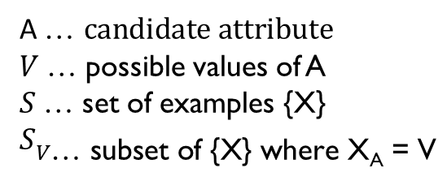
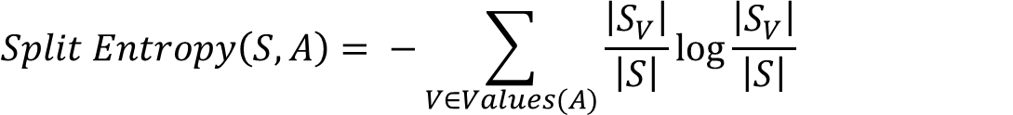
Decision Tree
Using Split Entropy
Day
9 yes / 5 no
NOTE: All subsets perfectly pure → Optimal Split
ISSUES:
Biased towards attributes with many values
Won’t work for new data → D15 “Rain High Weak”; Play?
D1
D2
D3
D4
D14
0/1
0/1
1/0
1/0
0/1
A$\text{… }candidate attribute$
$V$… possible values of A
$S$… set of examples {X}
$$S_{V\text{… }\text{sub}\text{set} \text{of}\text{ \{}\text{X}\text{\} }\text{where} \text{X}\text{A}\text{ = }\text{V}}$$
$$Split Entropy\left(S,A\right)= −\sum_{V∈Values(A)}{\frac{\left|S_{V}\right|}{\left|S\right|}\log{\frac{\left|S_{V}\right|}{\left|S\right|}}}$$
Split Entropy favors few number of subsets with many values → SplitEntropy is small
Split Entropy downplays many subsets with small values → SplitEntropy is large
$$GainRatio\left(S,A\right)=\frac{Gain(S,A)}{Split Entropy\left(S,A\right)}$$
GainRatio is one method to fix the problem of overfitting to the training data. HOW: GainRatio penalizes attributes with many values

Slide 28








Decision Tree
Continuous Values Attributes
Thresholds:
axis aligned values to create a True, False condition to build a DT
Thresholds can be optimized
x₂
E
X₁ $>θ_{1}$
$$θ_{3}$$
B
X₂ $≤θ_{2}$
C
D
X₂ $>θ_{3}$
X₁ $≤θ_{4}$
$$θ_{2}$$
A
$$θ_{1}$$
$$θ_{4}$$
x₁
A
B
C
D
E
Notes:
When the attributes are numeric, then think of a decision tree as a tresholding on values on each axis.

Slide 29
Decision Tree
Pros and Cons
Applicable to multi-class classification
Can be used for regression
LEGEND:
regression
C.V. DT
Pros
Very fast at testing time: O(depth)
Compact: #nodes << depth (after pruning)
Robust to missing data
Gracefully handles irrelevant data (Gain = 0)
Interpretable by humans → can understand decisions
Cons
Relegated to axis-aligned splits of C.V. data
Greedy (may not find best tree) exponentially many possible trees
x₂
x₁
Notes:
Fastest ML algorithm out there … to test
Regression might find a diagonal line shown here. However DT considers each attribute in turn, one at a time, and thresholds repeatedly until each split is pure. This is good since classification accuracy on the training data improves …. This is bad for the reason of overfitting to the data. So pruning is the method for not overfitting the data, but the accuracy decreases.

Slide 30
Decision Tree
Ensemble Methods: Random Forests
Train: Grow “K” different DTs
Divide training data into “K” equal, randomly selected, data sets → S_{r}
Grow full DT_{r} without pruning
CATCH: when splitting randomly pick “a” << “A” attributes
COMPUTE: gain based on S_{r} instead of full set of attributes
Repeat for r = 1 …K
Test: given a new data point X
Classify X using each of the trees DT_{1 …}DT_{K}
Use majority vote: class predicted most often
Notes:
It is a strange method, but it turns out to be the state of the art approach for DT in several different problem domains.

Slide 31
Decision Tree
Ensemble Methods: Random Forests
DT₁
DT₂
DT₃
DT_{K}
yes
yes
no
yes
Train: Grow “K” different DTs
Test: given a new data point X
Classify X using each of the trees DT_{1 …}DT_{K}
Use majority vote: class predicted most often
Notes:
So now that you all have seen what DT are, are you believe ML is daunting or inviting? This is yet another example of ML using simple techniques with tremendous application.

Slide 32
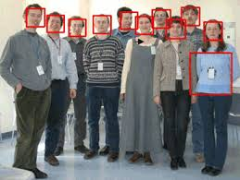
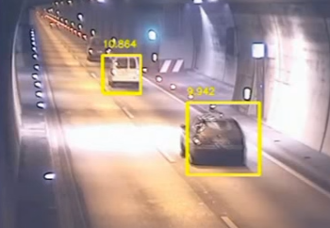
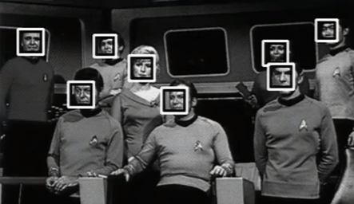

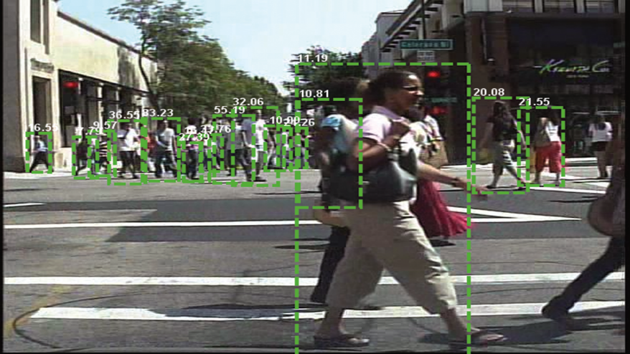
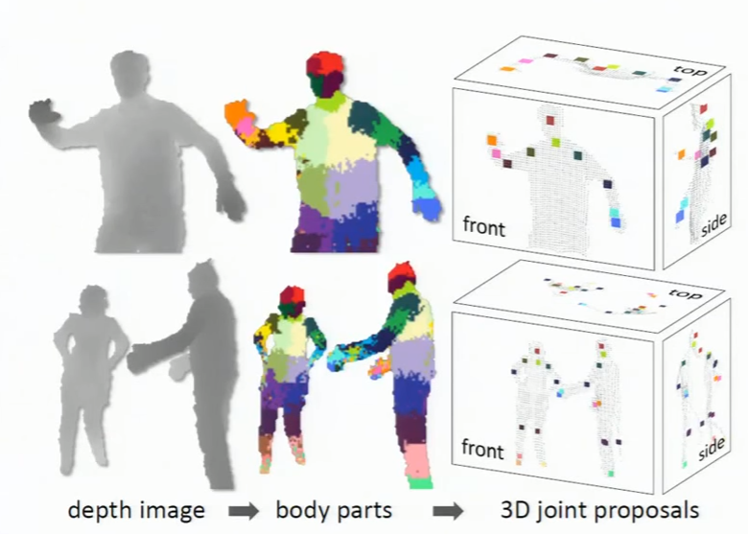
Decision Tree
DT has been used for decades, lost some steam due to its lack of ability at generalizing (i.e., lack of good prediction and high variance).
When Random Forests (aka, Decision Forests) came along, the averaging of several DT minimized the variance to build the most powerful classifiers today.
Today’s smart phones’ cameras utilize DT approaches to detect faces in photographs for autofocusing
Object Detection – DT to detect pedestrians (for avoidance) in automated driving cars
Kinect – DT to detect stance
Web Page Classification – DT used to classify billions of webpages (text classification)

Slide 33
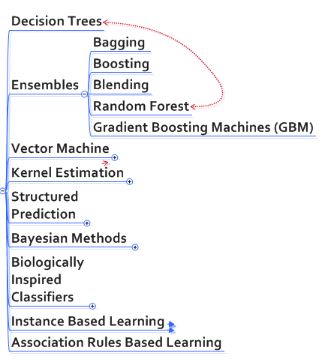
ML Representations (i.e. Algorithms)

Slide 34

Additional Resources for offline learning
For additional information on Decision Trees and Random Forest please view/read:
- Wikipedia: Decision Trees
Victor Lavrenko – School of Informatics University of Edinburgh UK
Decision Tree 1: How it works
Decision Tree 2: ID3 algorithm
Decision Tree 3: Which attribute to split on?
Decision Tree 4: Information Gain
Decision Tree 5: Overfitting and pruning
Decision Tree 6: Degenerate splits and gain ratio
Decision Tree 7: Continuous, multi-class, regression
Decision Tree 8: Random Forests
Decision Tree – Boosting, Bagging
Text Classification - Decision Trees & Random Forests in WEKA
Linda Uruchurtu - A Beginner's Guide to Random Forests - R vs Python
What is Random Forest Algorithm? - A graphical tutorial on how Random Forest algorithm works.
Source:
Victor Lavrenko –
School of Informatics University of Edinburgh UK

Slide 35
Recap of this Session on Decision Trees
You might have a newfound appreciation of:
Decision trees ability to make predictions about other data that it might see in the future
How easy of a job humans have in interpreting the decision a DT makes
How fast and compact the production DT classifiers are.
How to improve DT predictions using Random Forest Decision Trees
Notes:
Whether you are developing your ML algorithm yourself or applying existing SW tools and libraries to your problem set, I hope you have a better understanding of this category of ML algorithms and understand what is happening in the ML Black Box. A better understanding of the ML approach will assist in your development or integration effort, and guide you selection of optimization techniques, performance evaluation, and ML approaches.

Slide 36
Next Sessions
Intend to cover the following:
K-NN family of classifiers (logical classifier)
More topics starting in 2017
Bayes – Guest Speakers (from ES/TS and/or GXP-SIG)
NN & Deep Learning – Guest Speakers (from ES and/or GXP)
BE BOLD, INNOVATIVE, and MENTOR your programs

