Slide 1
Library Management System
CHITKARA UNIVERSITY
Library Management made easy.
Presented by: Group 8

Slide 2

Language and Software
Language used:
Python
Modules used:
Random and Time
Software used:
Visual Studio Code

Slide 3

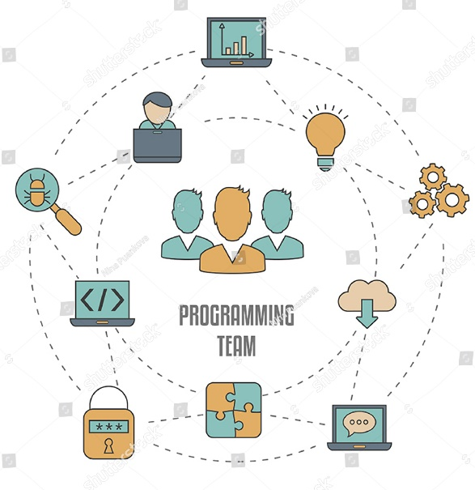
Work Division
Rydhampreet Singh Gindra
Logic Implementation
Coding
Rupesh Singla
Logic Implementation
Coding
Sanchit Prashar
Logic Implementation
Innovation
Proof Reading
Coding
Proof Reading

Slide 4
Higher Level Approach
The system contains multiple lists to store required data entered by user and access whenever needed.
After you exit the code, the data stored in lists is transferred to a text file which can be reused upon recalling the code.

Slide 5


Lower Level Approach
User Case 1:To add a new member and take input of their information required for Account creation and issue a book
The code will first ask user for the operation he/she wants to perform.
In User Case 1, Our goal is to add a new member and issue a book.
The entered information is added in lists which further resides in a single dictionary named “allinone.”
After the information is entered, a unique id is generated and assigned to the user for logging in later.

Slide 6


Lower Level Approach
User Case 2:To add Employees and take input of their information required for Employee account creation and mark their attendance.
The code will first ask user for the operation he/she wants to perform.
In User Case 2, Our goal is to add a new Employee and mark his/her attendance.
The entered information is added in lists which further resides in a single dictionary named “allinone.”
After the information is entered, a unique Employee id is generated and assigned to the Employee for marking his/her attendance.

Slide 7


Lower Level Approach
User Case 3:To perform various tasks designed for users and show library rules.
The code will first ask user for the operation he/she wants to perform.
In User Case 3, Our goal is to perform various tasks designed for users and show rules which are to be followed in library.
These various tasks use data entered in lists to show and verify certain things which increase credibility.
After a task is completed. System automatically reaches the start menu and ends only when user commands.

Slide 8
ADVANTAGES
Library management made easier.
It provides users a friendly interface to work.
It provides easier access to data.

Slide 9
Future Scope
To provide libraries a simpler and an efficient way to work with their Members and Employees.
This code can also be modified for the development of new management ideas.
To implement this code in an application to make it even more accessible and User Friendly.
This code is designed to automate tasks and reduce human effort.

Slide 10

Special Thanks to our mentor
Dr. Teena Narang for guidance and helping us to tackle various problems.

