Slide 1
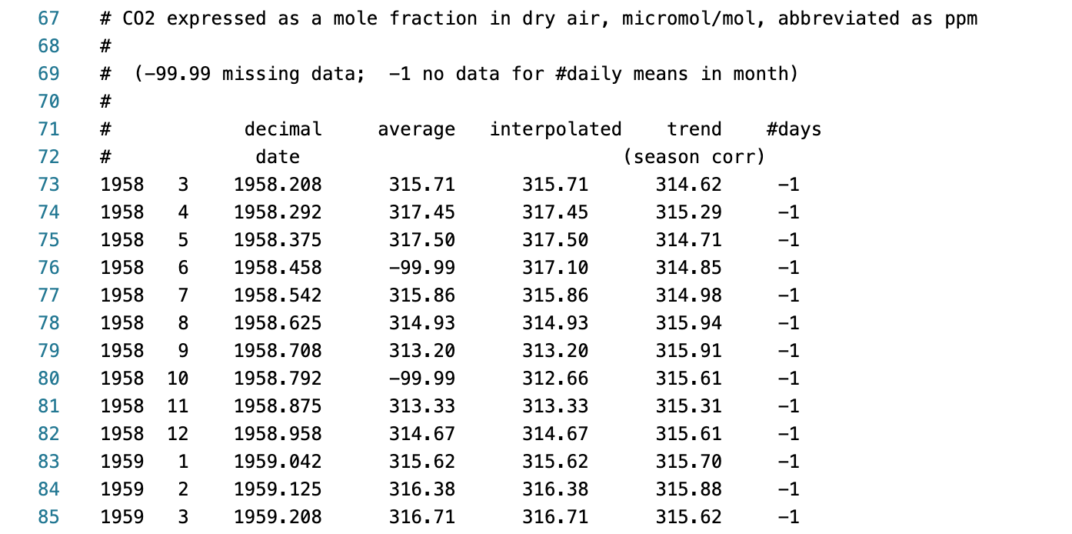
time series data values in file

Slide 2
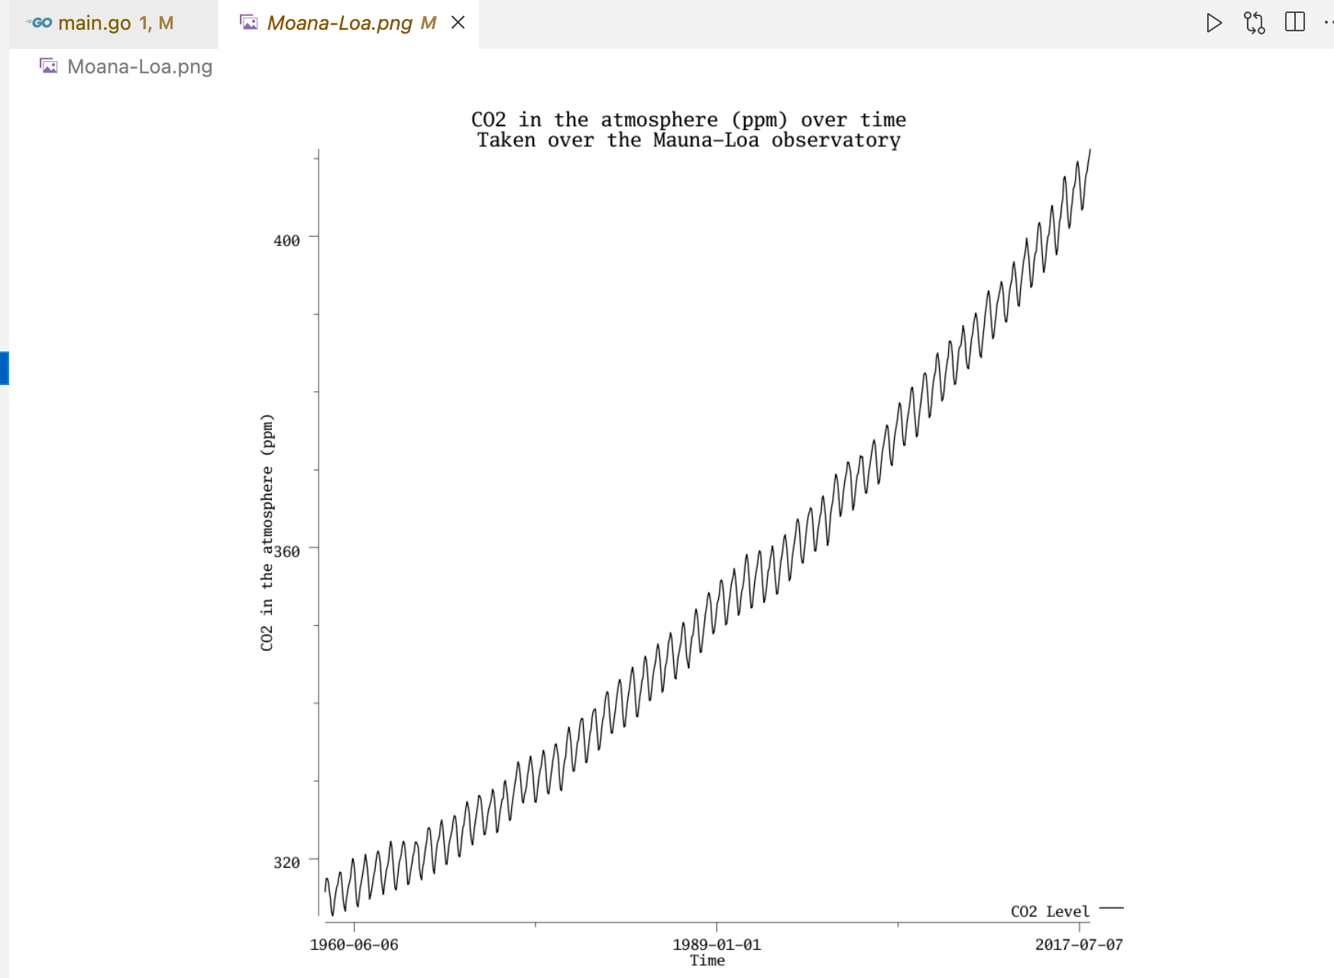
plot time series data

Slide 3
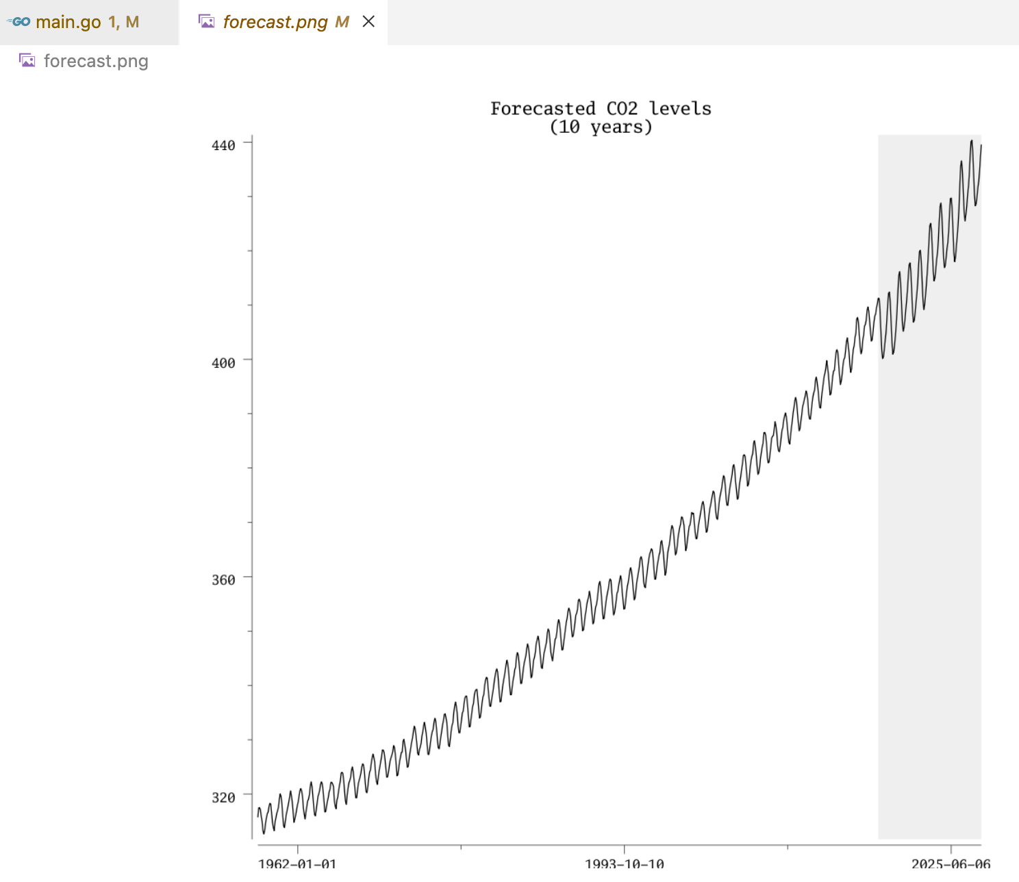
time series data forecast

Slide 4
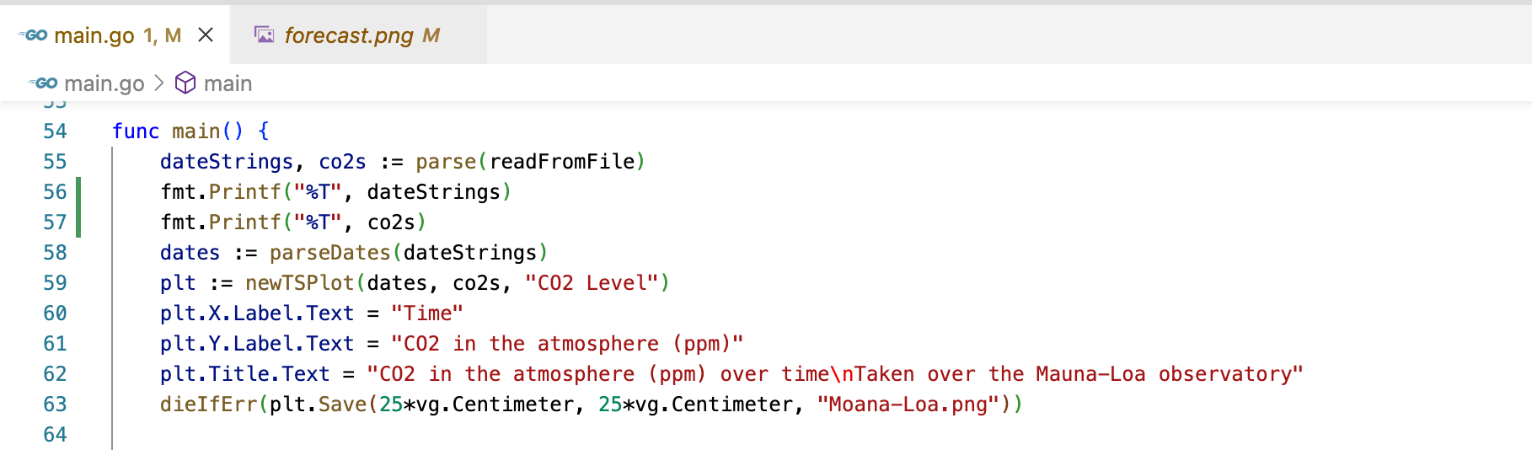
time series data plot go code

Slide 5
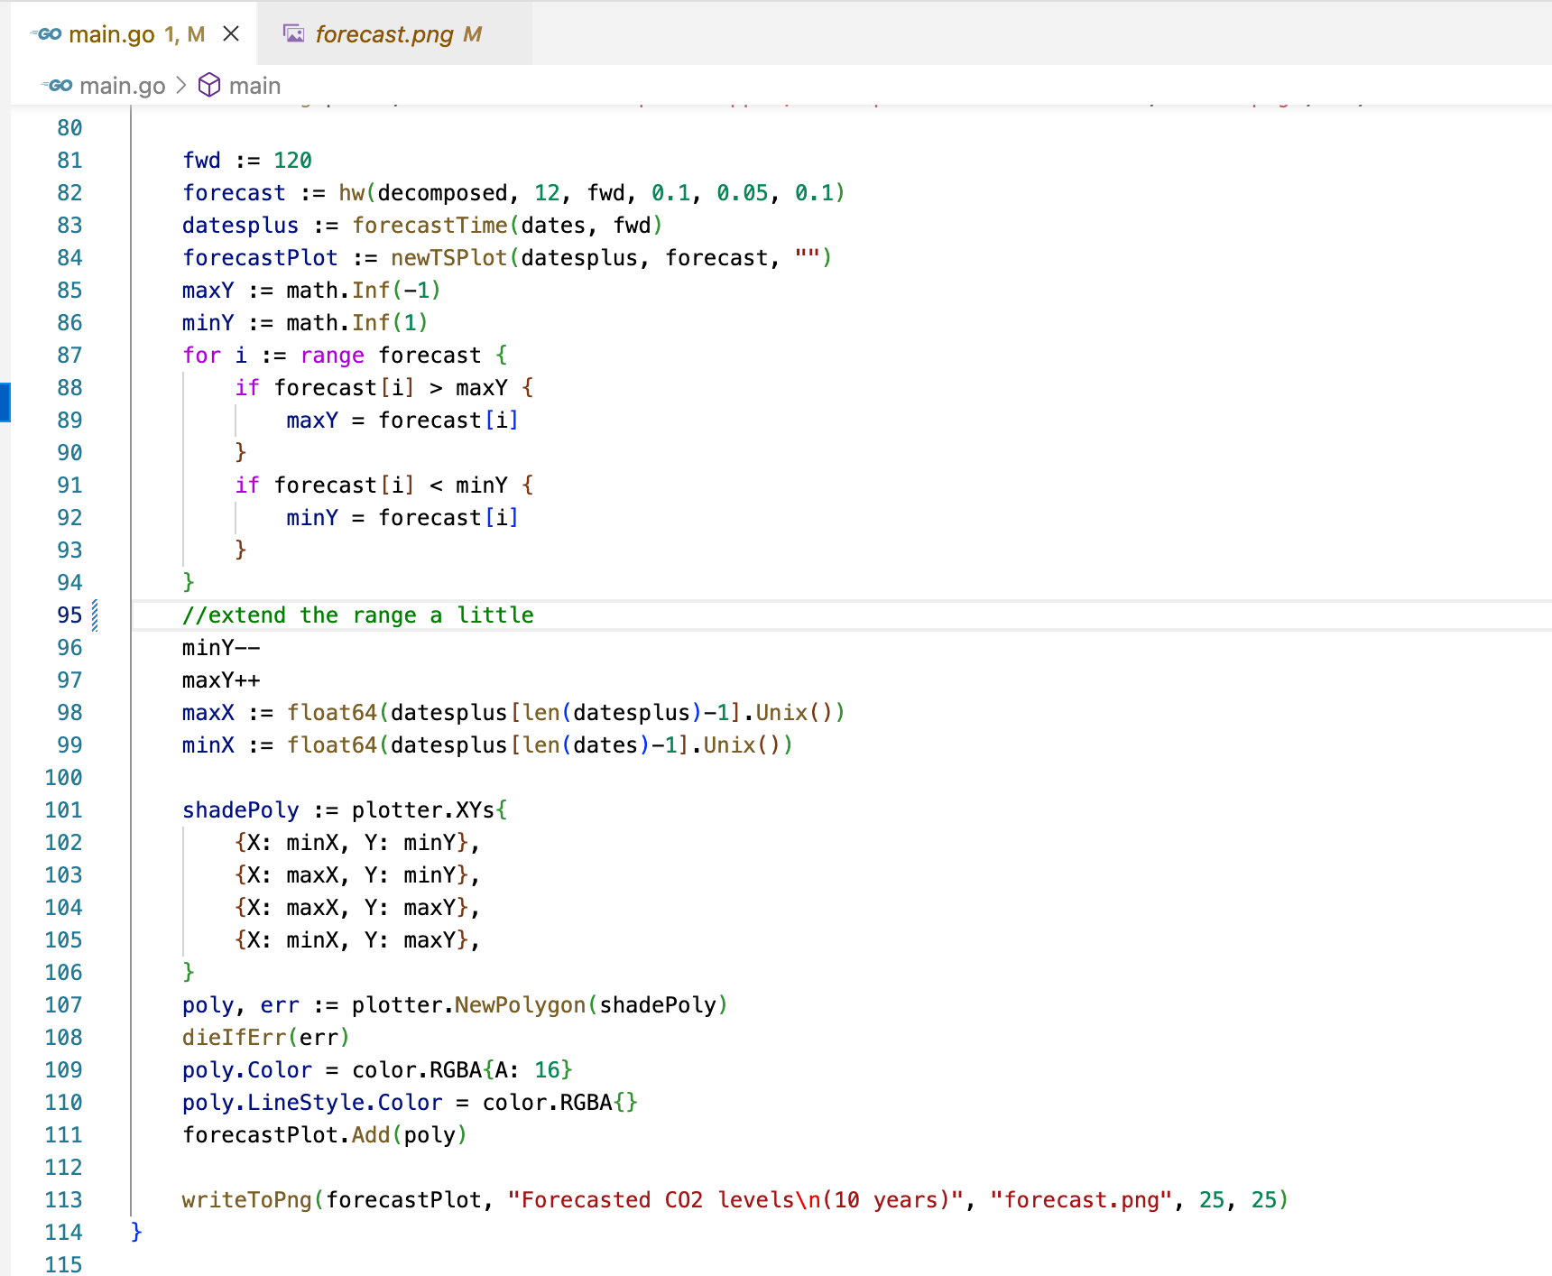
time series data forecast go code

Slide 7
A text to speech using go, docker, grpc, and kubernetes,

Slide 8
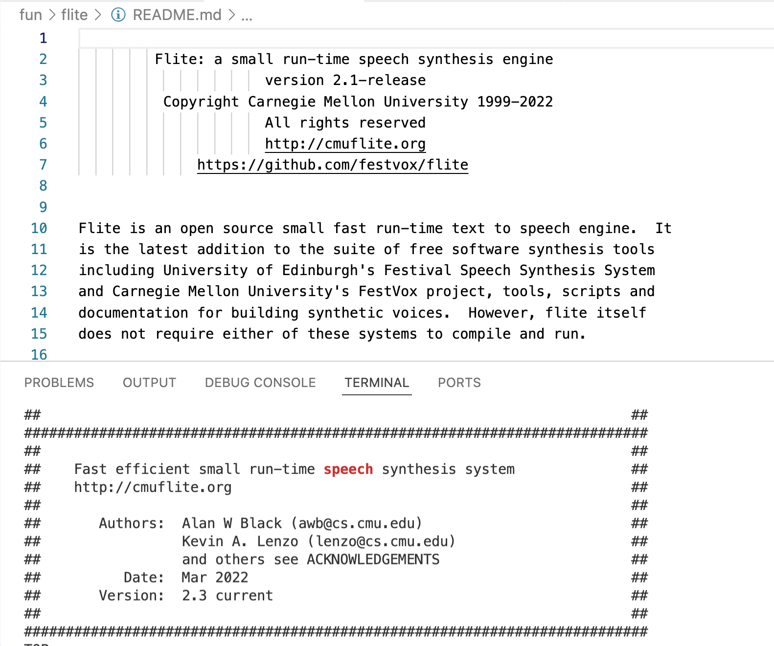
A text to speech grpc server – speech engine

Slide 9
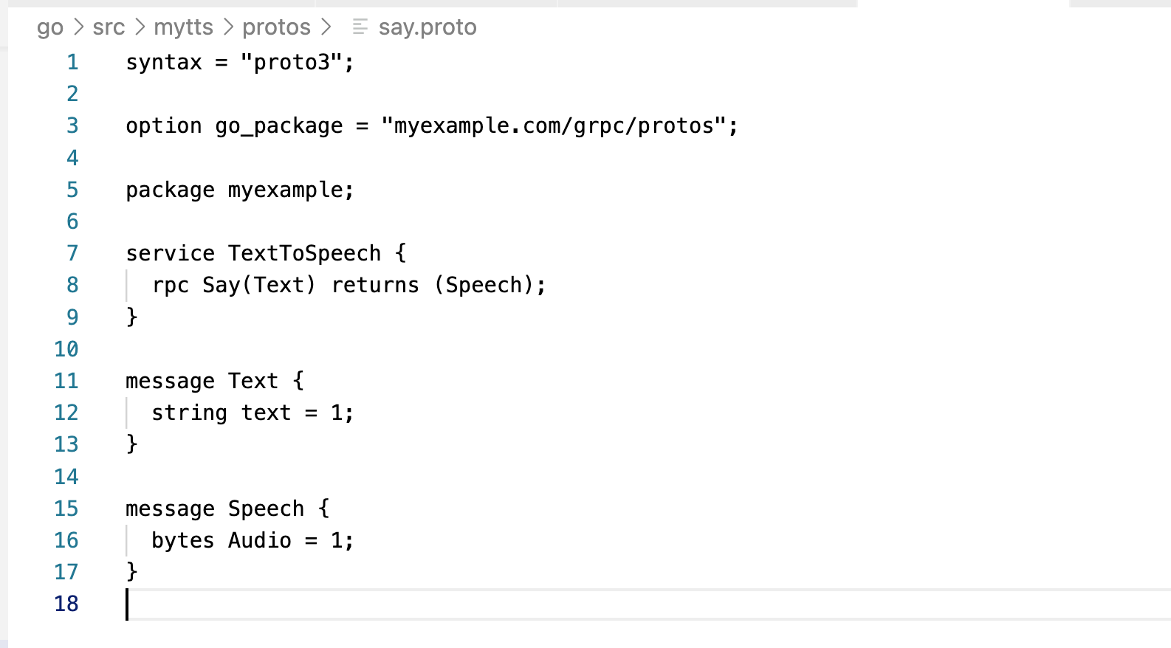
A text to speech grpc server - proto

Slide 10
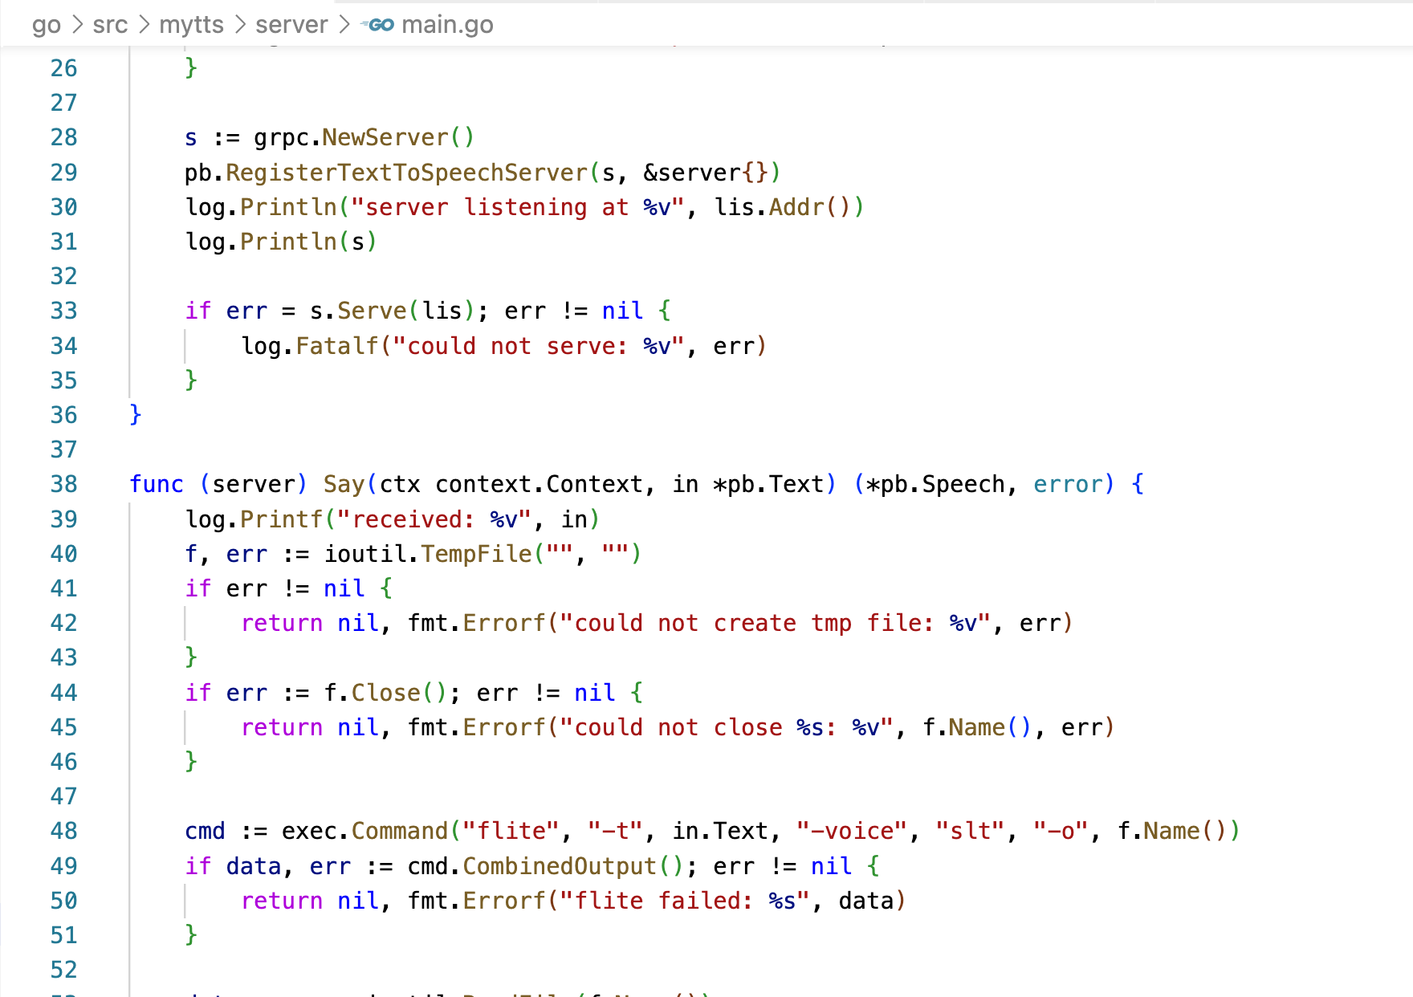
A text to speech grpc server - server

Slide 11
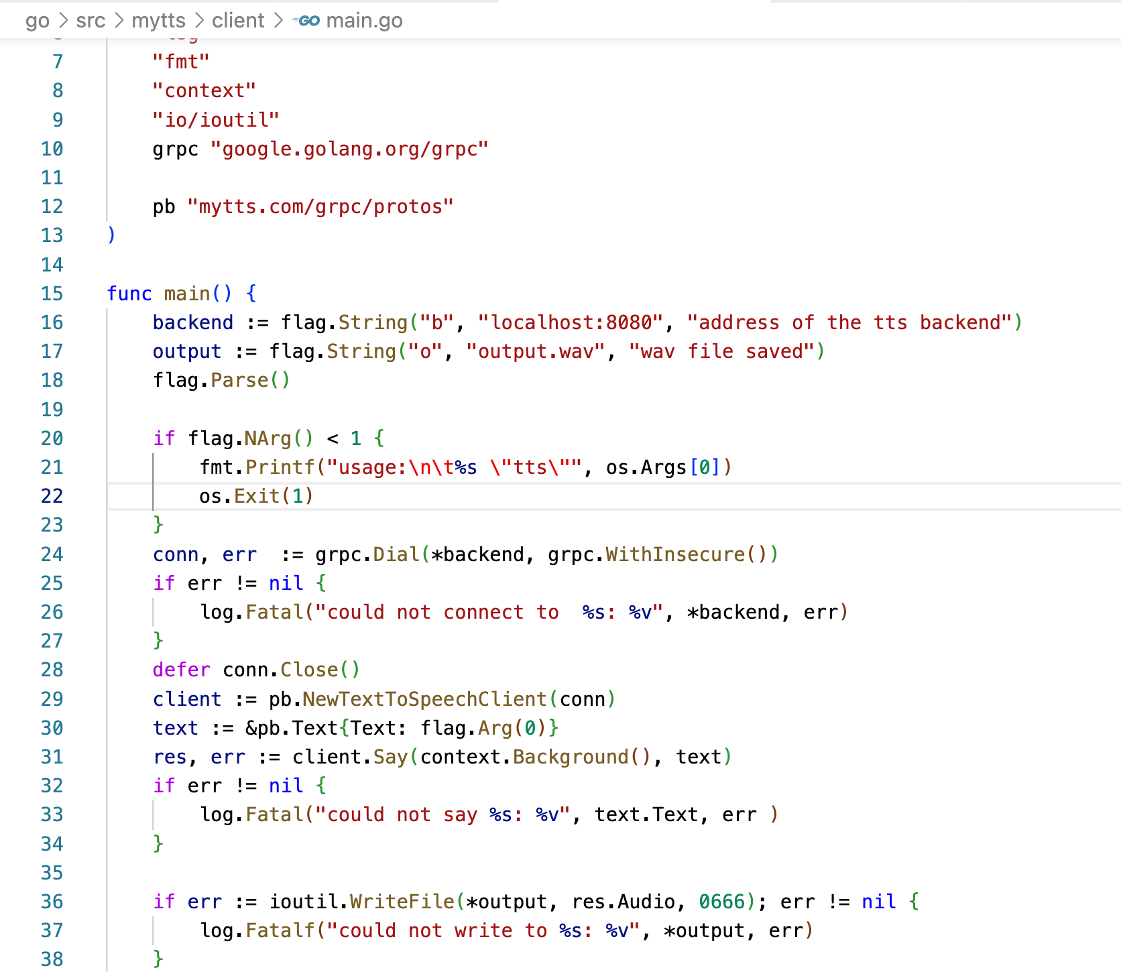
A text to speech grpc server - client

Slide 12
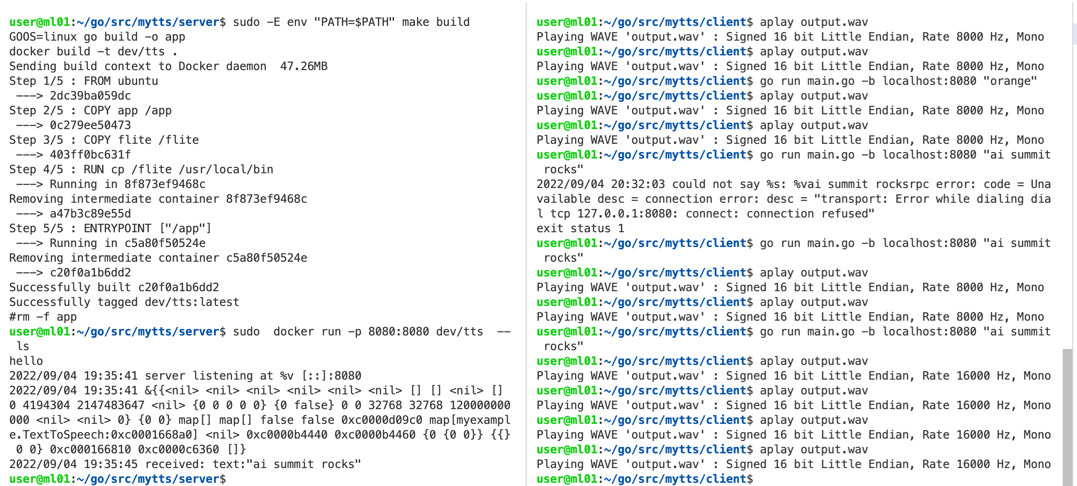
A text to speech grpc server - test results

