Slide 1
& C
D V P
Engineering

Slide 2
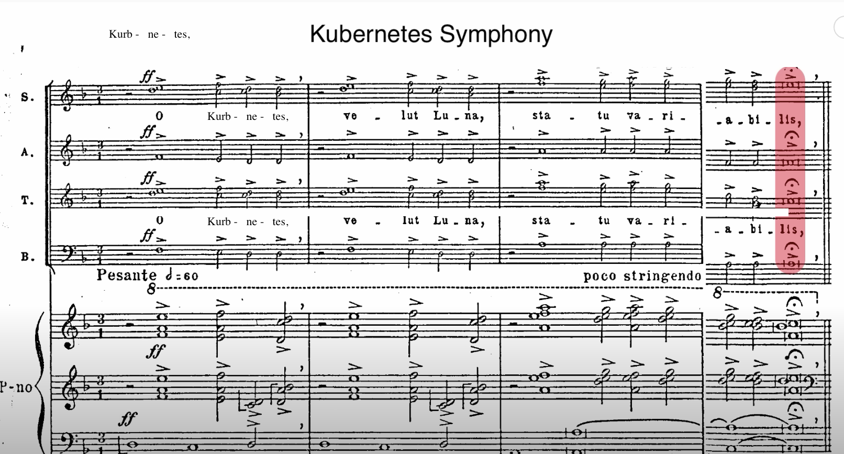
Kubernetes symphony
O κυβε - ρνή - της , Ve - lut Lu – na , sta – tu va – ri - a - bi - lis ,
O Kuber – ne - tes , Like the moon, You are changing unpredictably

Slide 3
intro
Kubernetes securities
from built-in features to open source tools
By .c, .e, .s

Slide 4
Contents
About k8s
k8s security
Demos
Notes:
It is difficult to overstate the impact k8s has had on the world of devops, over the years since it was open sourced by google in 2014, k8s has experienced a meteoric rise in popularity, becoming a preeminent solution for orchestrating cloud native container work load, in just 8 years, this technology reshaped the thinking and design of container, vm, data center, cloud native, and linux kernel, and even observability, networking, and security.

Slide 5
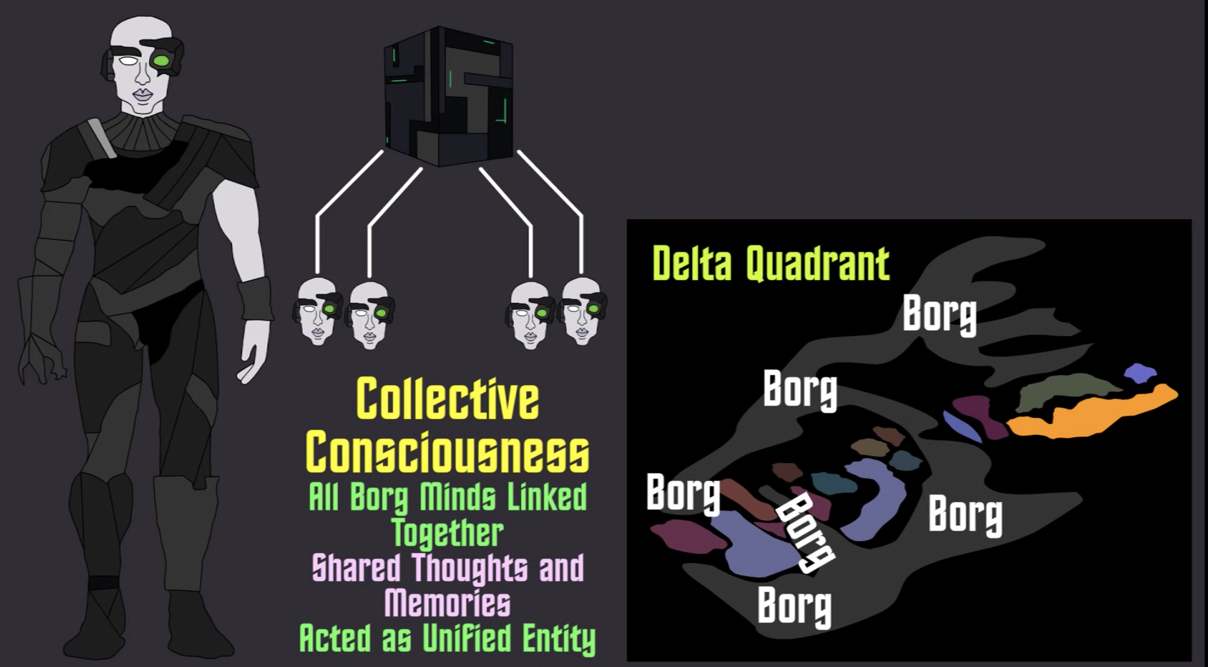
borg
Notes:
We like to start with a star trek story, the borg, which located primarily throughout the delta quadrant, was a species of cybernetic humanoids, by sharing information and thoughts through collective consciousness, allowing them to act as a singular unified entity, obsessed with achieving a state of perfection and pursuit of efficiency, resulting in the conquest of countless worlds and systems

Slide 6
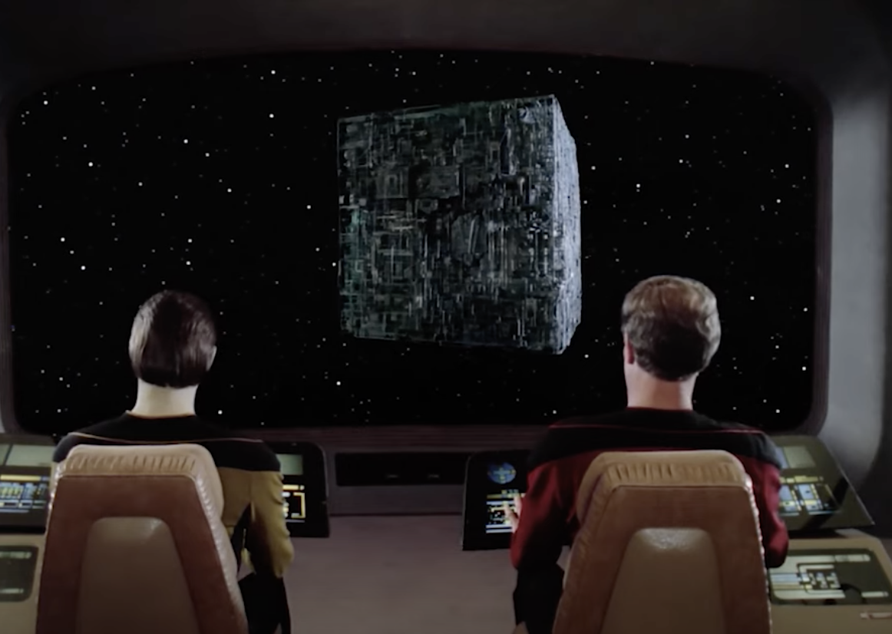
borg
Notes:
Borg is strangely in generalized design, no bridge, no command center, no engineering section, no living quarter, no shield, no weapon of any known design, but is powerful.

Slide 7
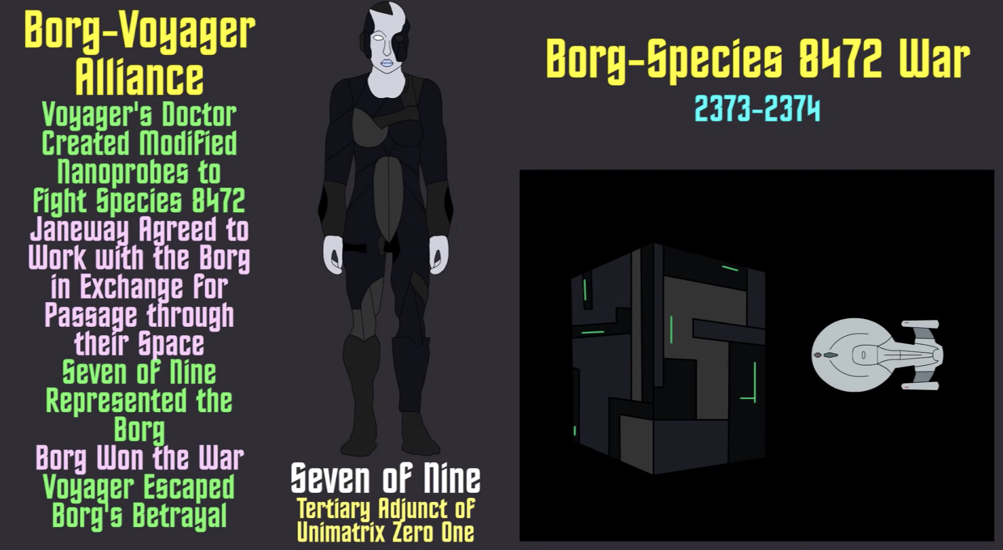
borg
Notes:
Seven of nine, is a voyager’s character, lived in tertiary adjunct of unimatrix zero one, was a former drone, and represented the borg.

Slide 8
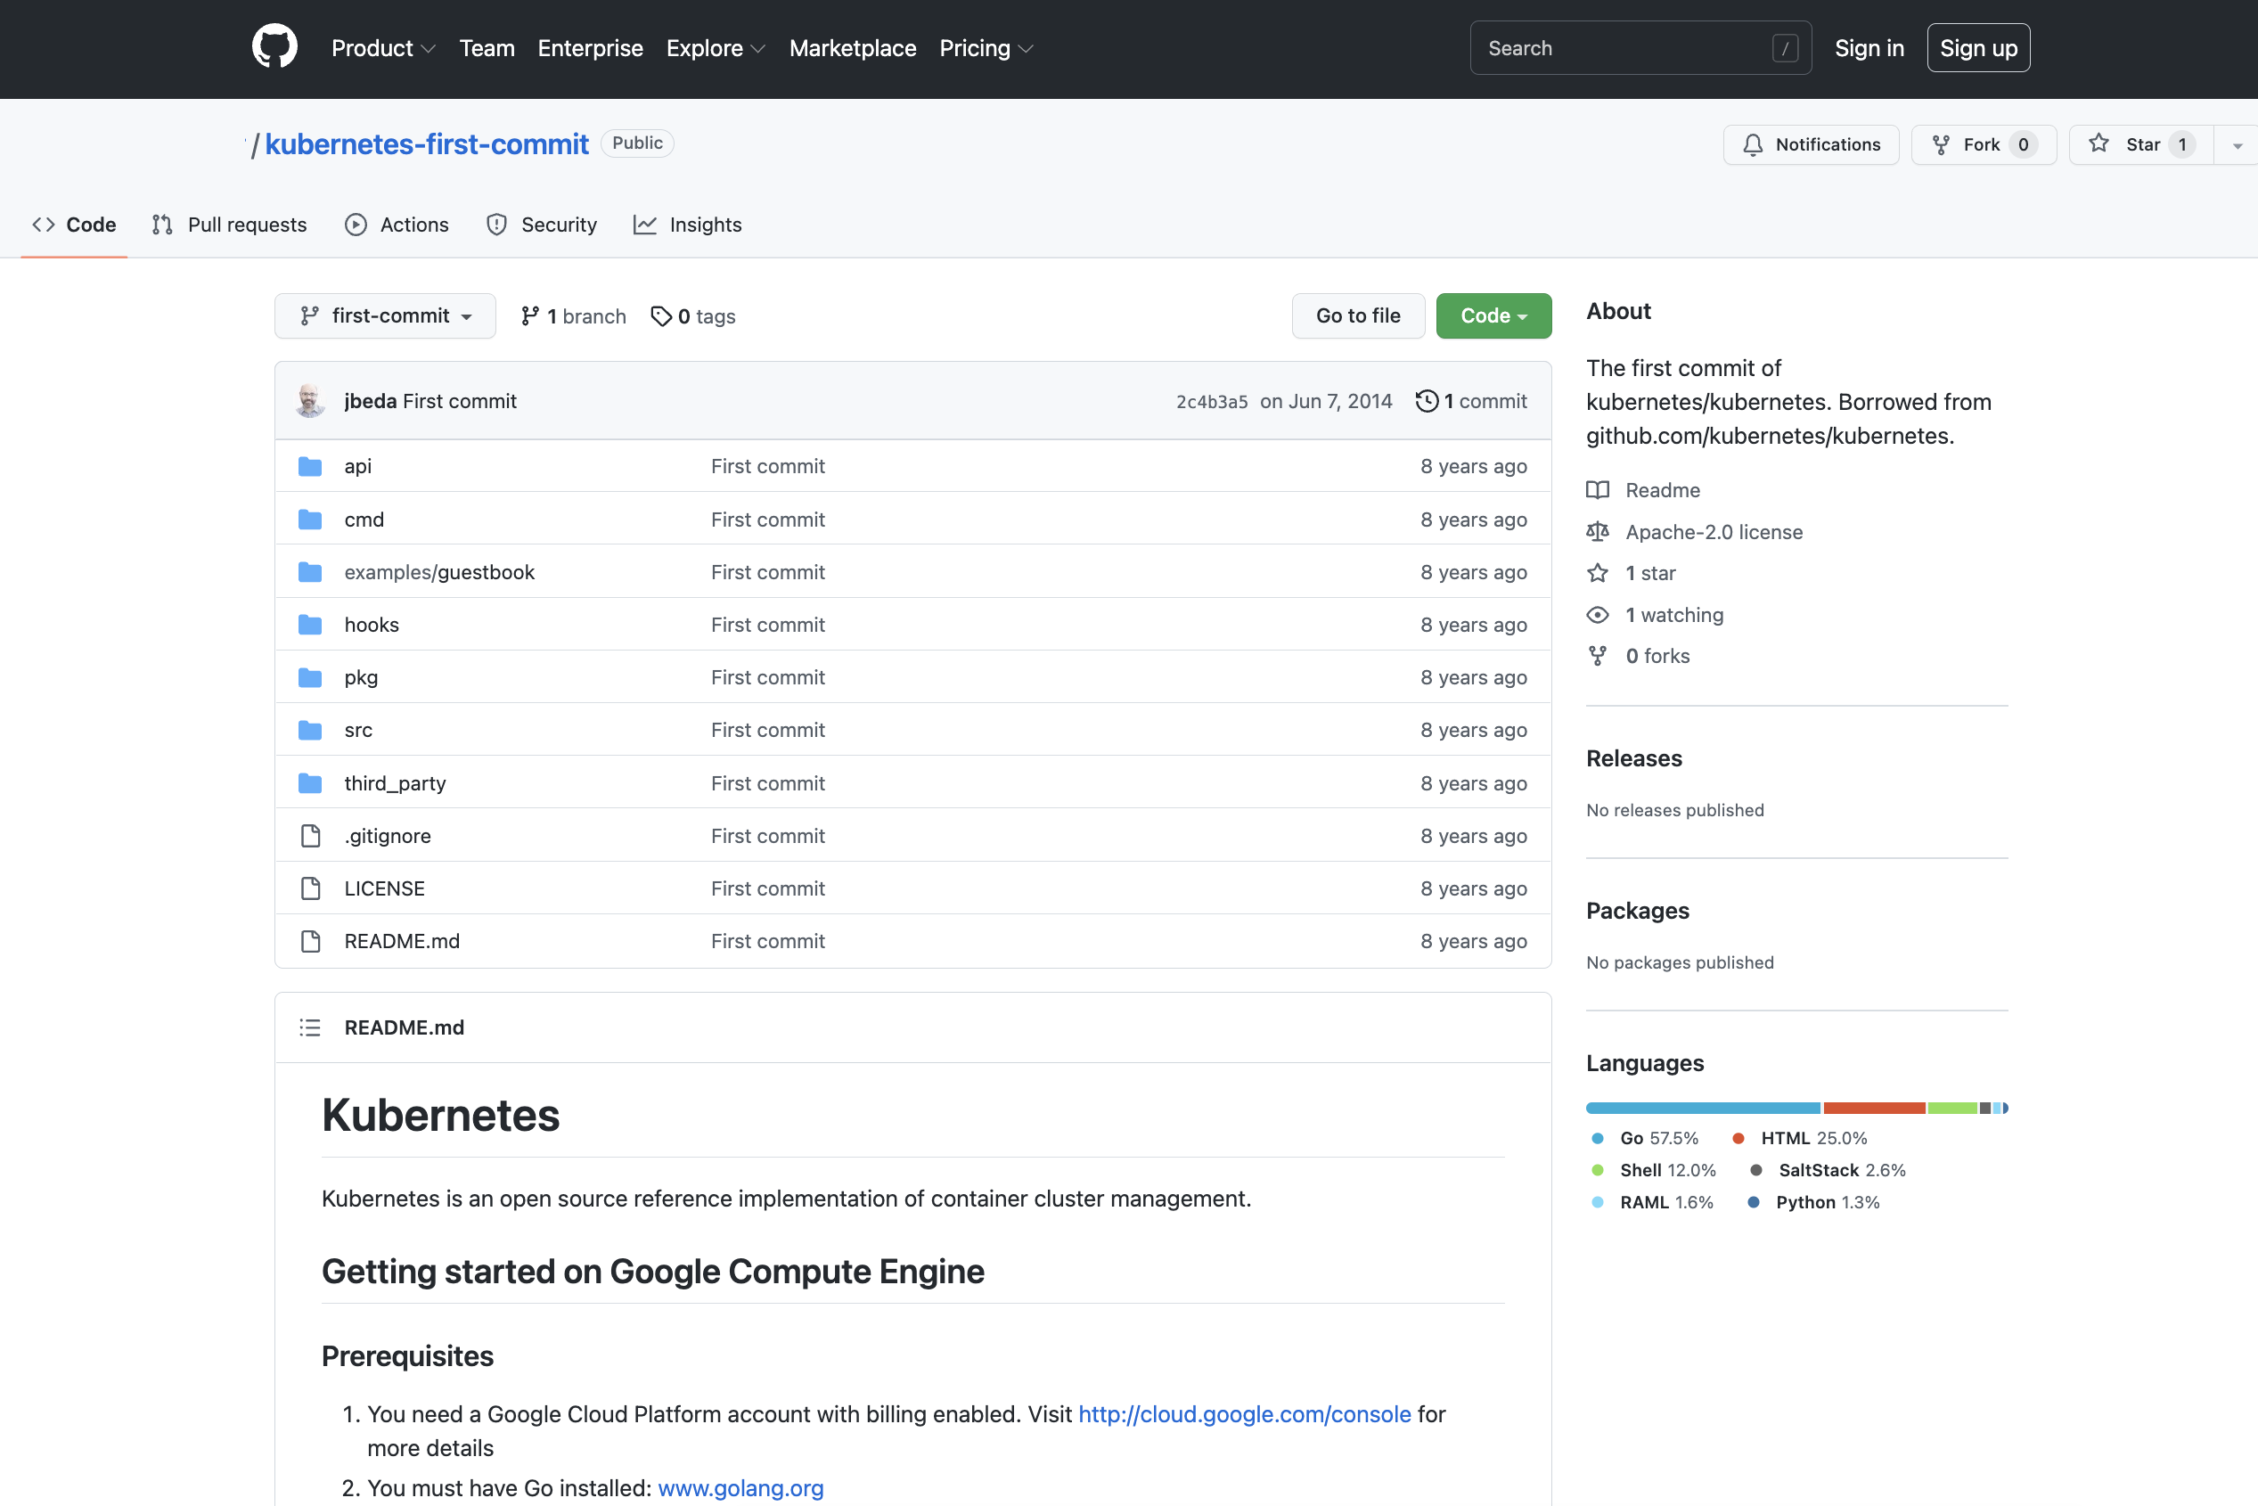
k8s first commit on June 7 2014

Slide 9
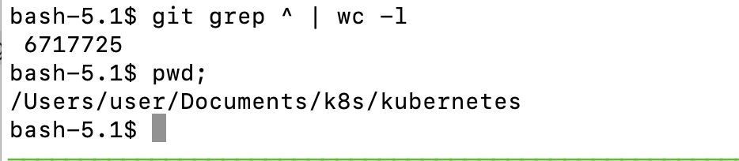
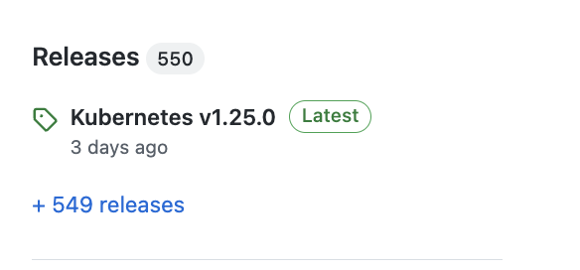
6.7 millions loc
Notes:
After 8 years 2 months (2982 days), k8s had 549 releases, which is about a release in 5.4 days based on 24x7, or averaged 3.7 days per release after excluding annual 52 weekends and 10 public holidays, it is getting interesting

Slide 10
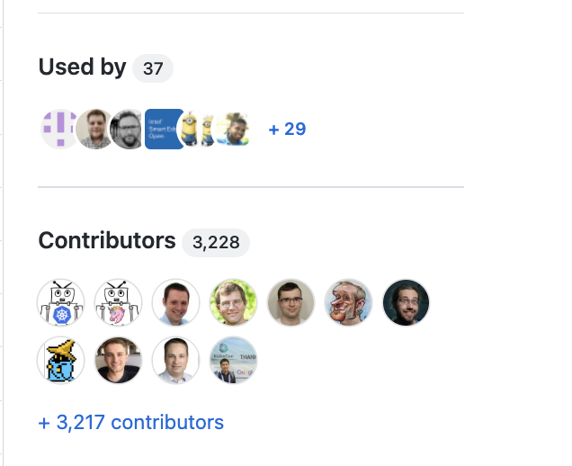
k8s first commit on June 7 2014

Slide 11
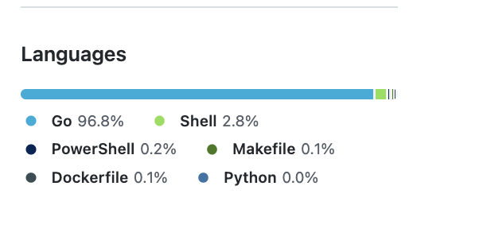
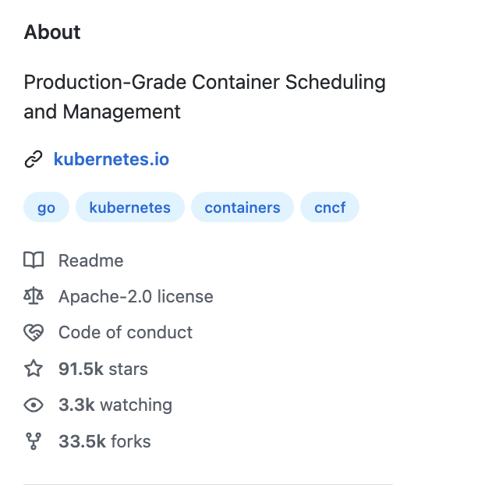
k8s first commit on June 7 2014

Slide 12
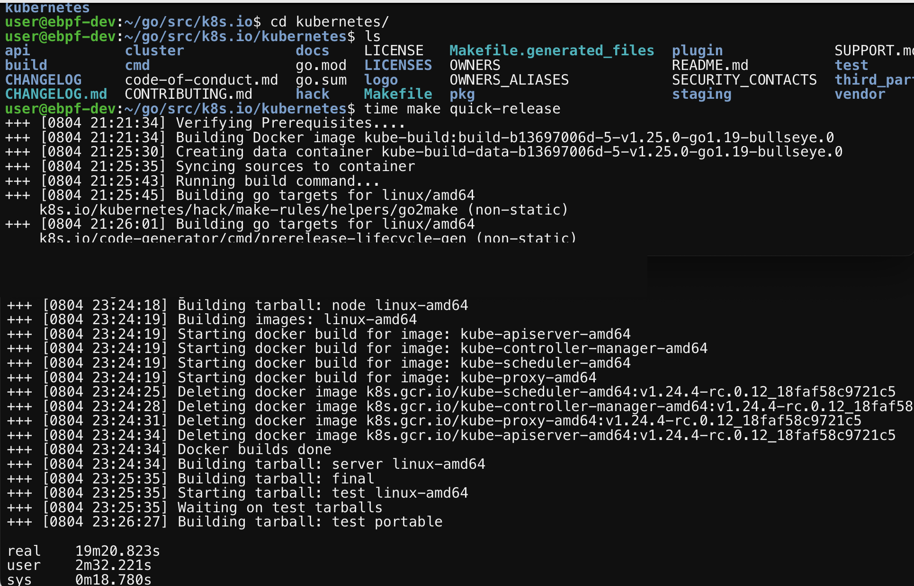
k8s source build

Slide 13
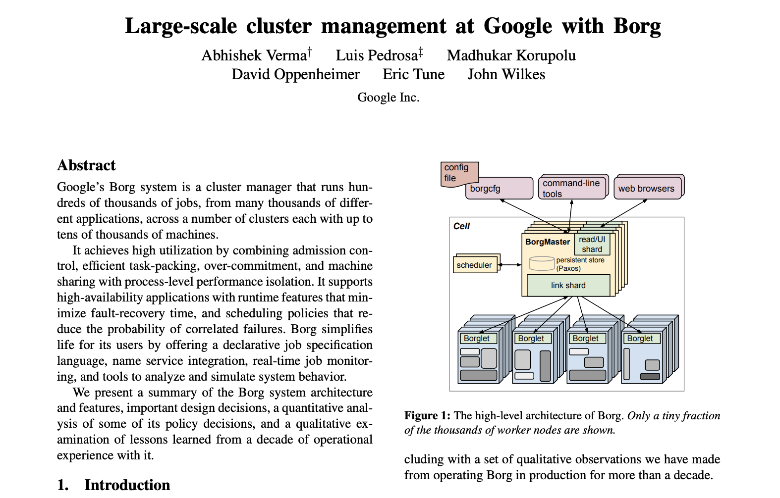
10 years borg
Notes:
K8s start at google, the internal project borg is around efficiency, getting more out of every machine in a light way, when docker hit the scene, google was thinking how to make this esoteric product more consumable, they put together borg api with container images into k8s, and convinced leadership team a nd open sourced it, none nor google had expected to what quite what it has happened. It is a result of borg, container image, startup mentality, community owner, and attract 3000 contributors.

Slide 14
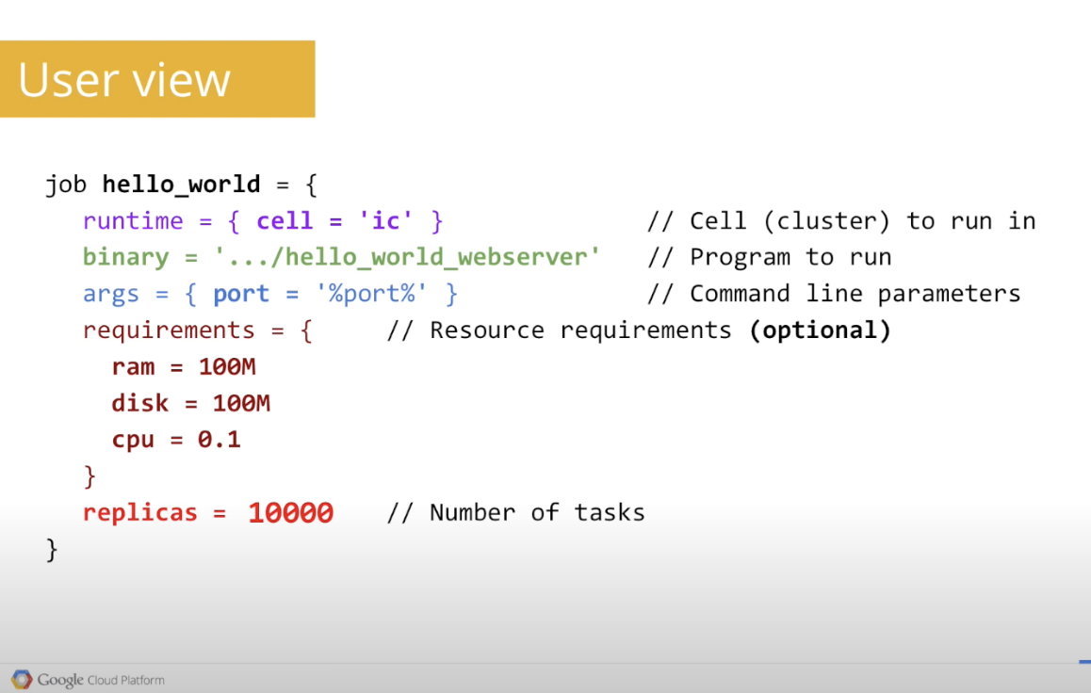
10 years borg
Notes:
Borg is the internal project that runs search, apps, and ads, it is a totally geek culture.

Slide 15
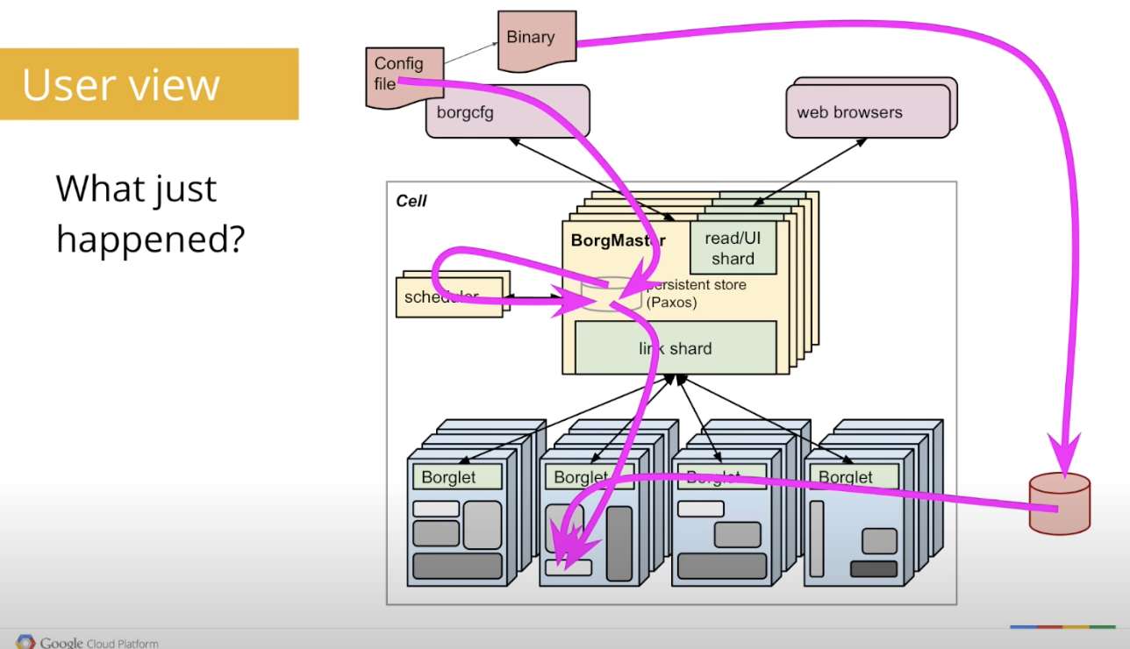
10 years borg

Slide 16
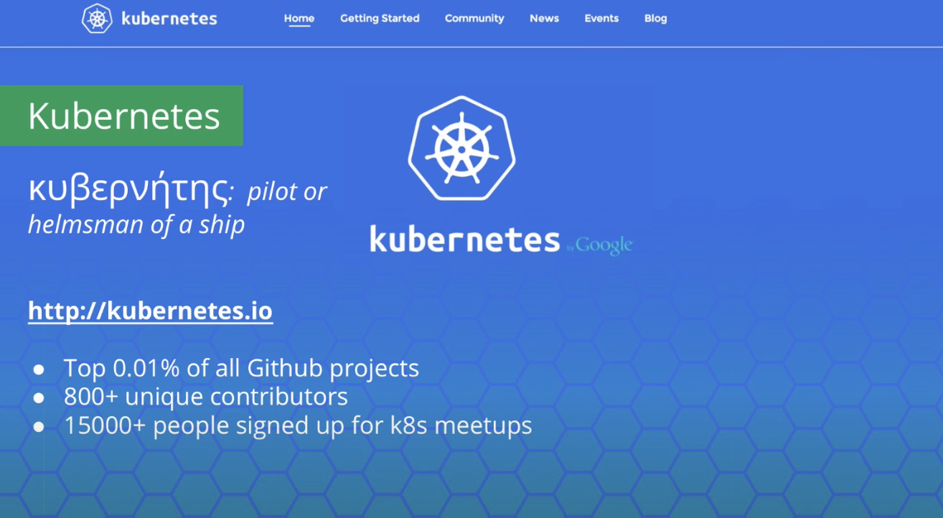
10 years borg
Notes:
To make k8s a friendlier borg, the name turned into project seven, when it went to public, they don’t want to lose track of the seven, and the logo has seven sides, it is a way to pull the seven through.

Slide 17
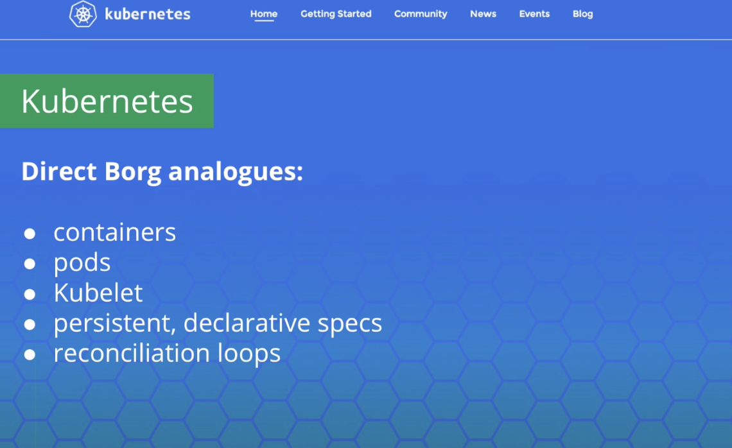
10 years borg

Slide 18
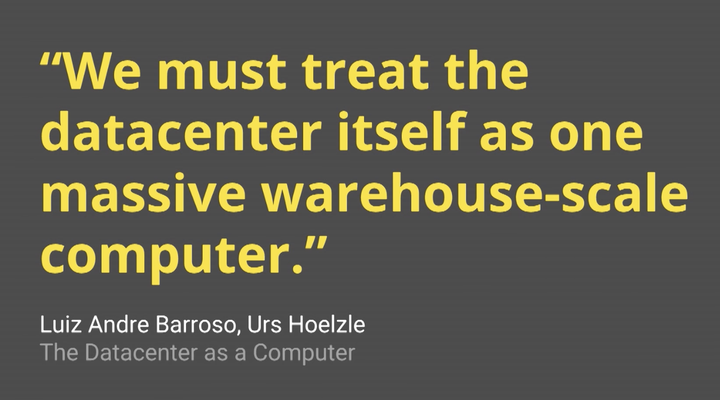
One computer

Slide 19
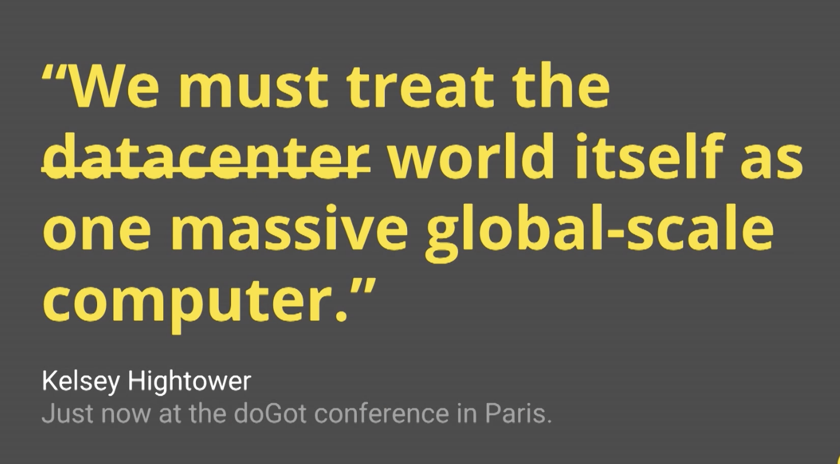
One computer

Slide 20
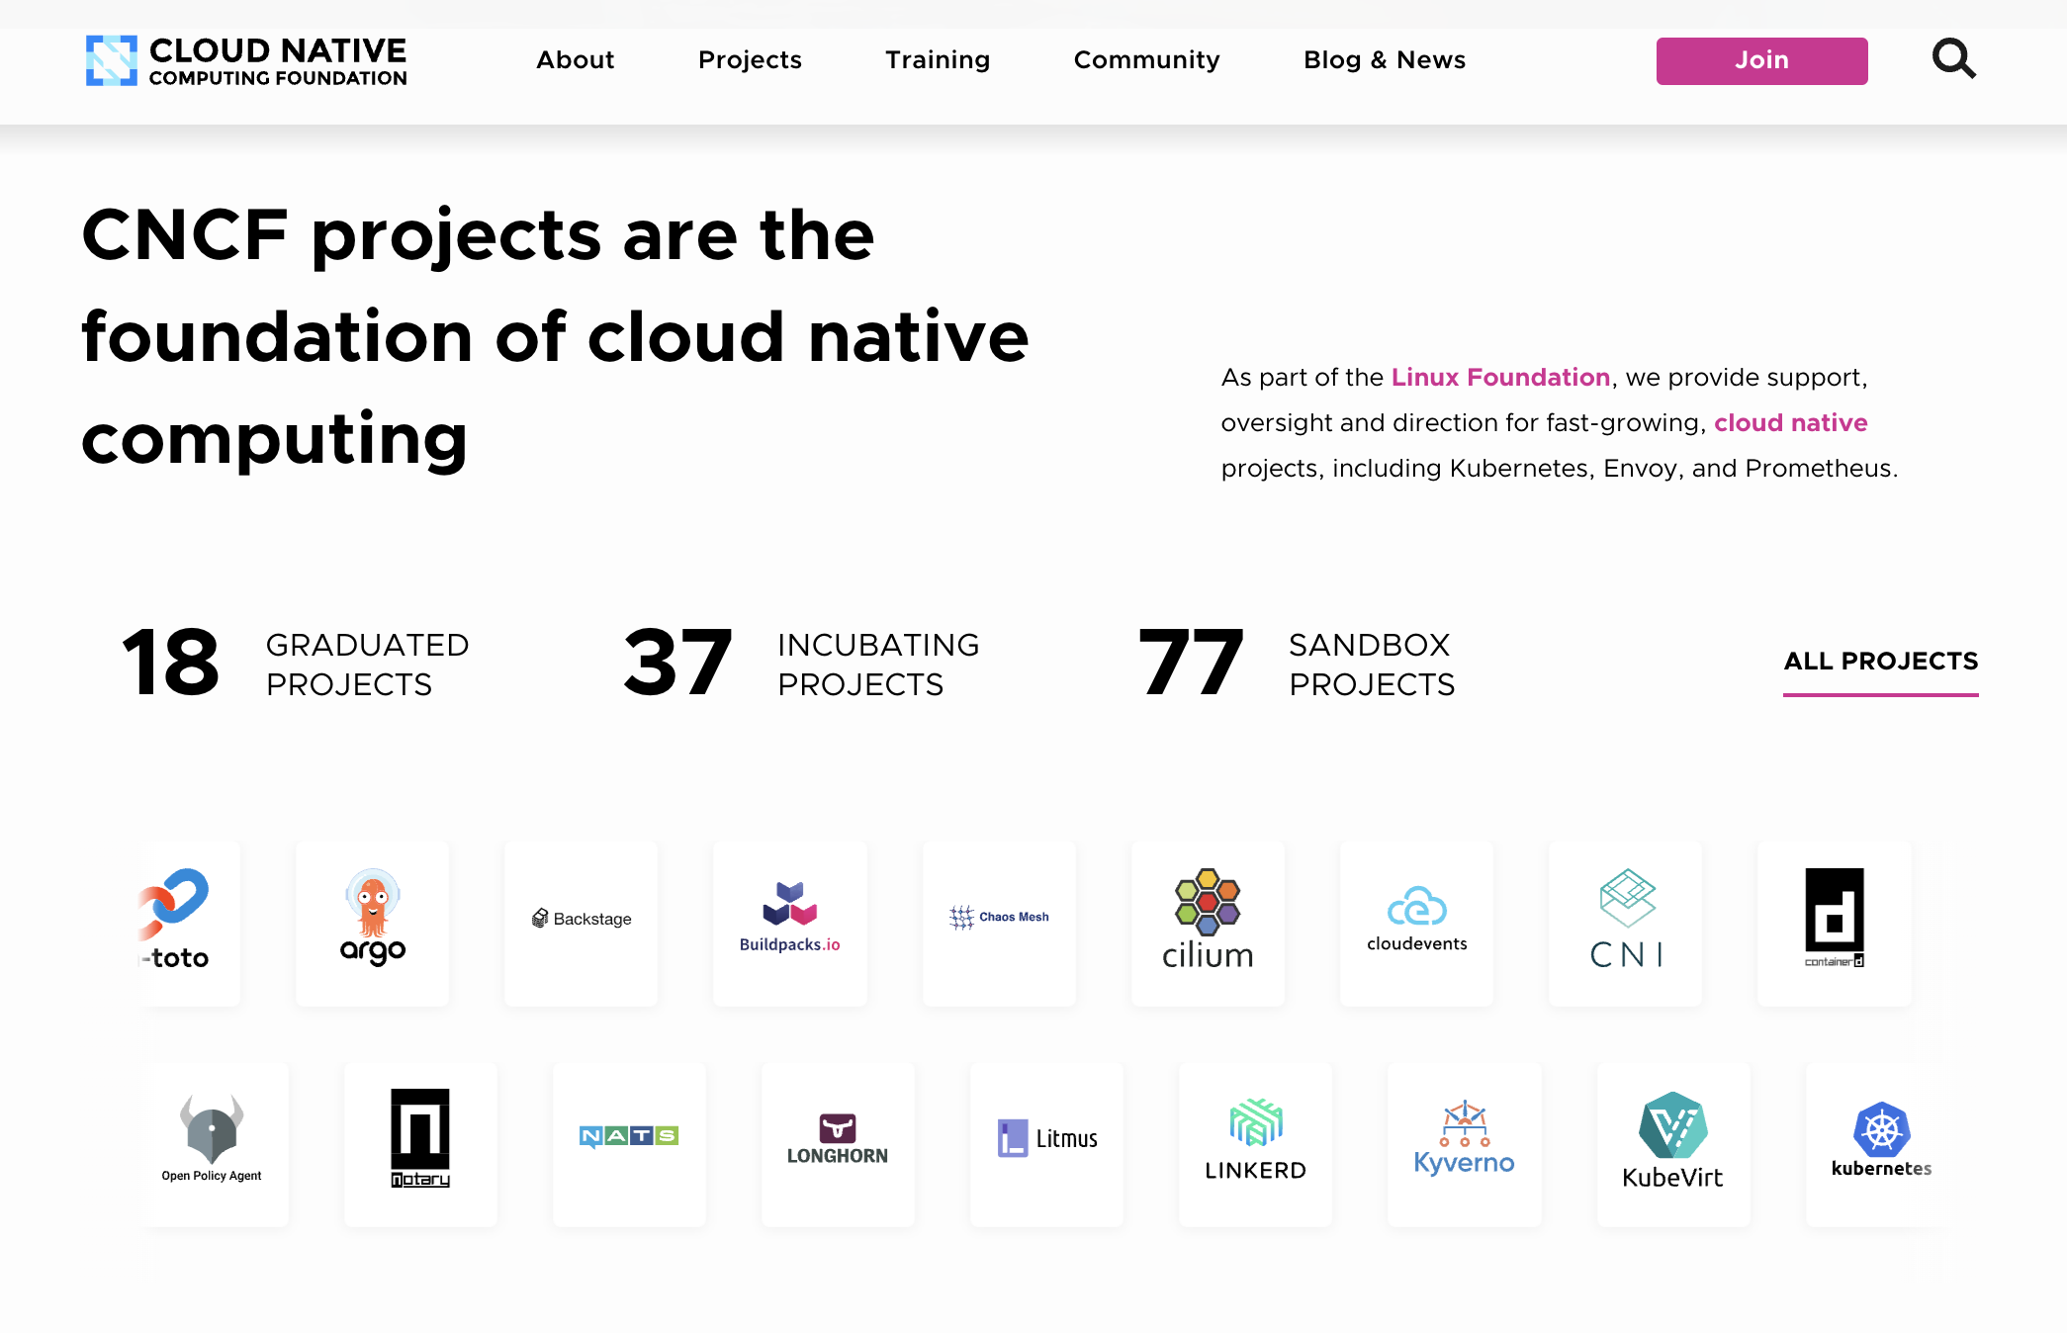
One computer
Notes:
To have a healthy open source community ownership model and governance model, cncf is the center of cloud native initiatives, k8s is one of the 18 graduated project.

Slide 21
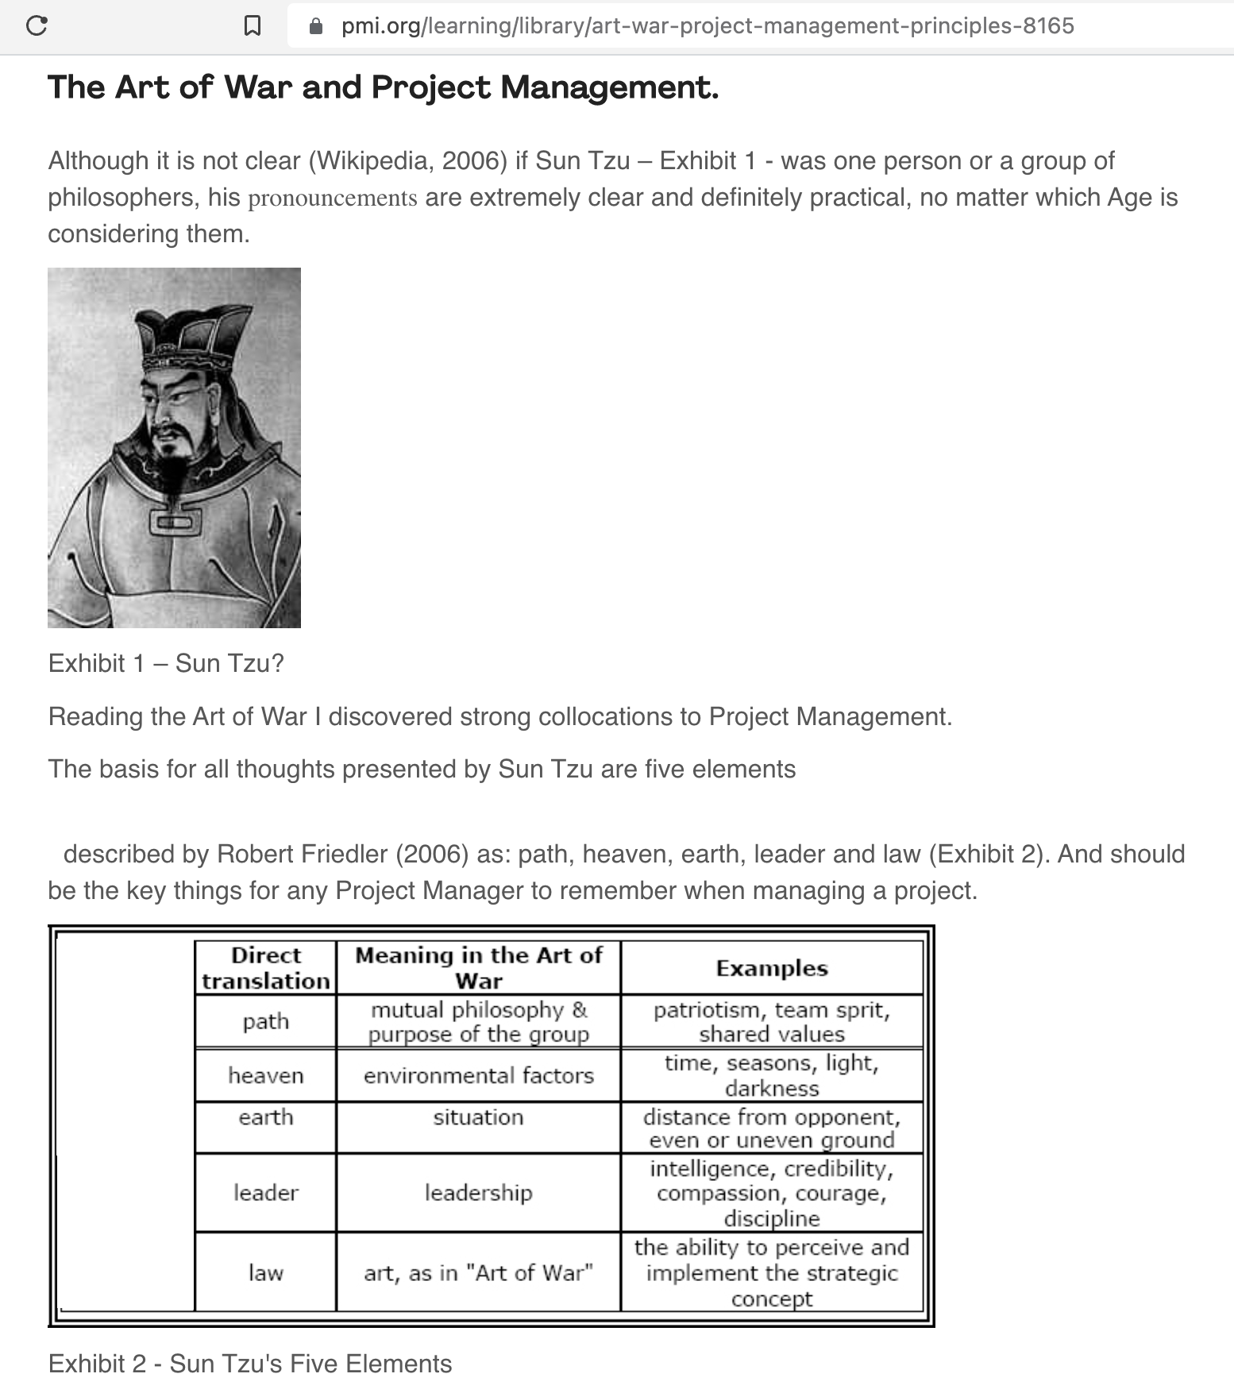
pmi
Notes:
Many military, political, business leader have drawn inspirations from this book, including general douglas macarthur, quoted from project management institution, the art of war has a strong collocation to project management, for any project manager, the key 5 elements of winning should be remembered when managing a project, we will look at them around k8 security also.

Slide 22
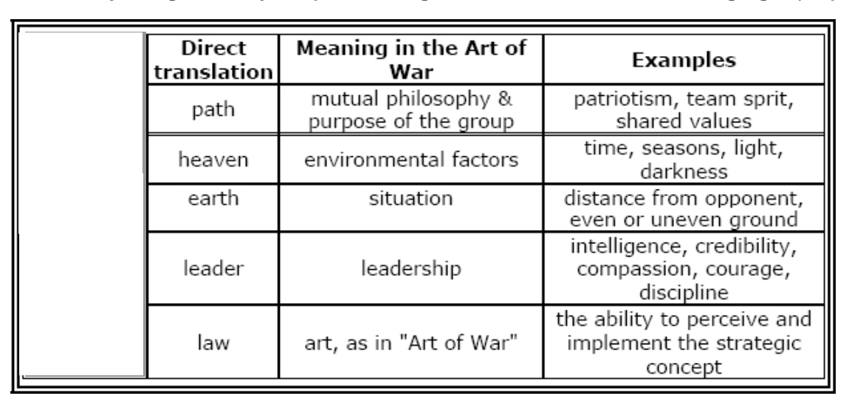
5 elements

Slide 23
k8s benefits
Crazy delicious
You can enjoy doing your job

Slide 24
Contents
k8s security

Slide 25
4c
k8s is not a security system
Sec wasn’t built in natively
k8s sec improving (1.22+)
Notes:
K8s is a component in cloud native environment, it is a self contained, independent, with a single, well-defined purpose, with high cohesion.

Slide 26
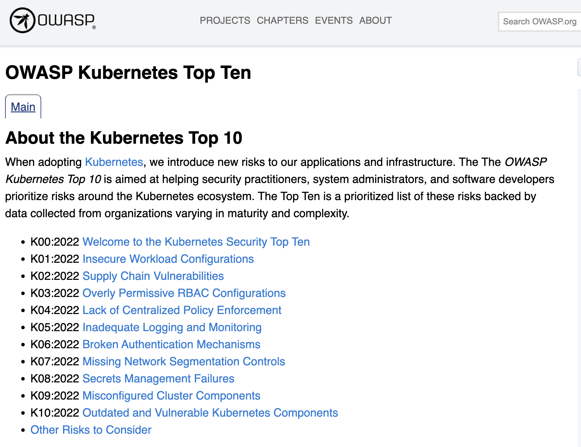
K8s sec

Slide 27
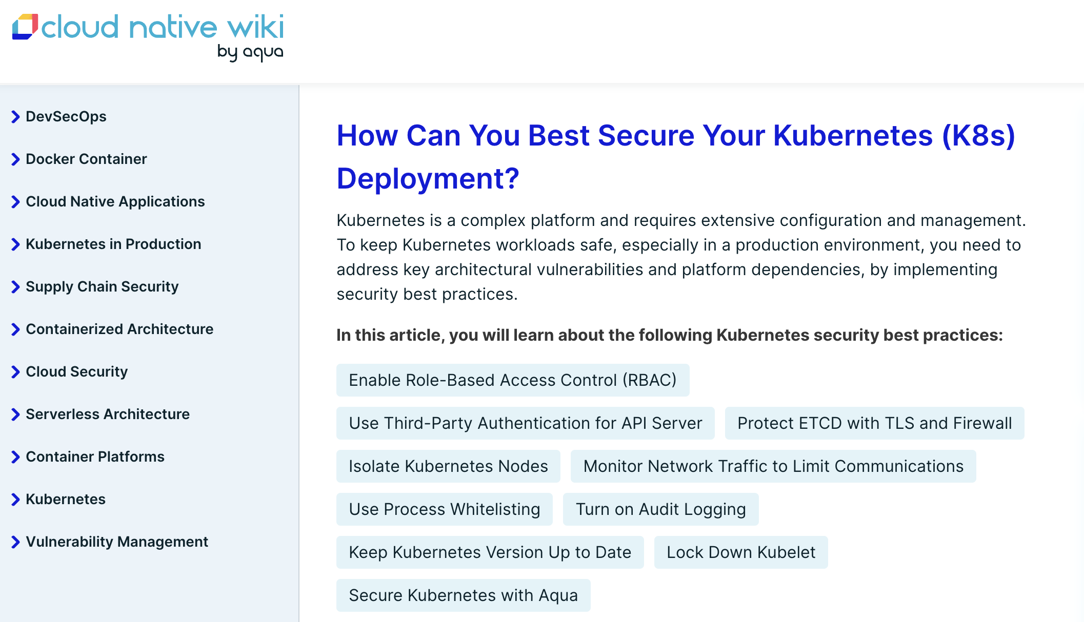
K8s sec

Slide 28
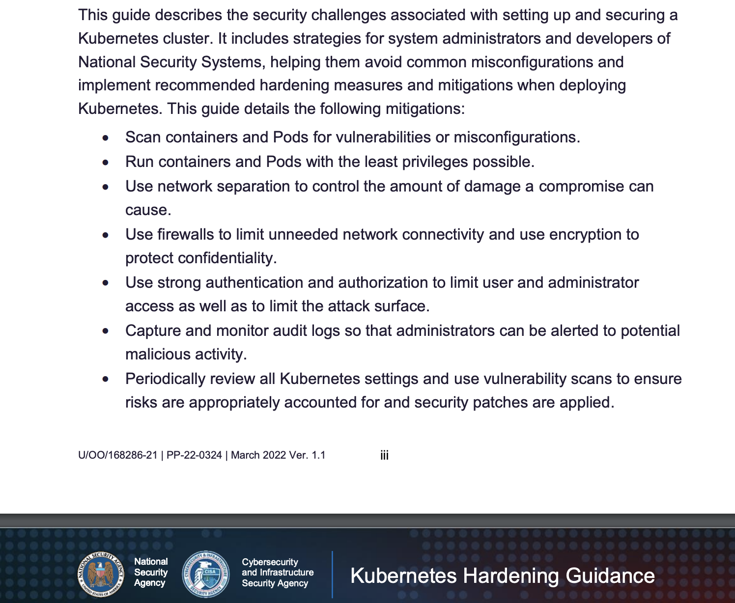
K8s sec

Slide 29
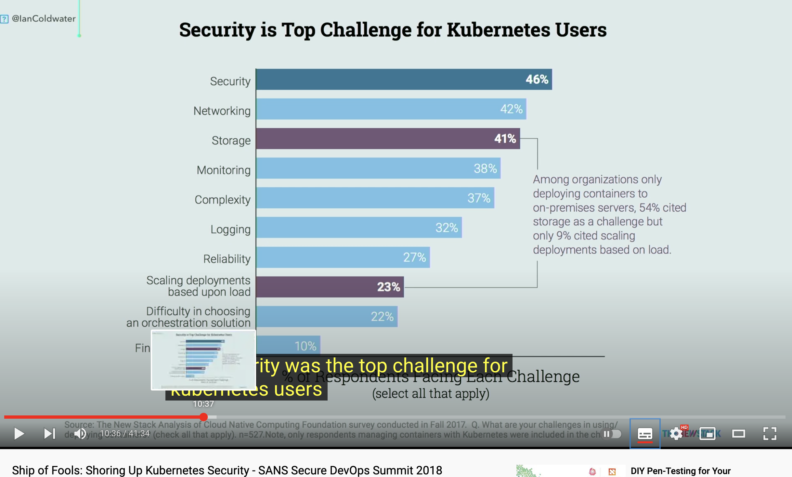
K8s sec

Slide 30
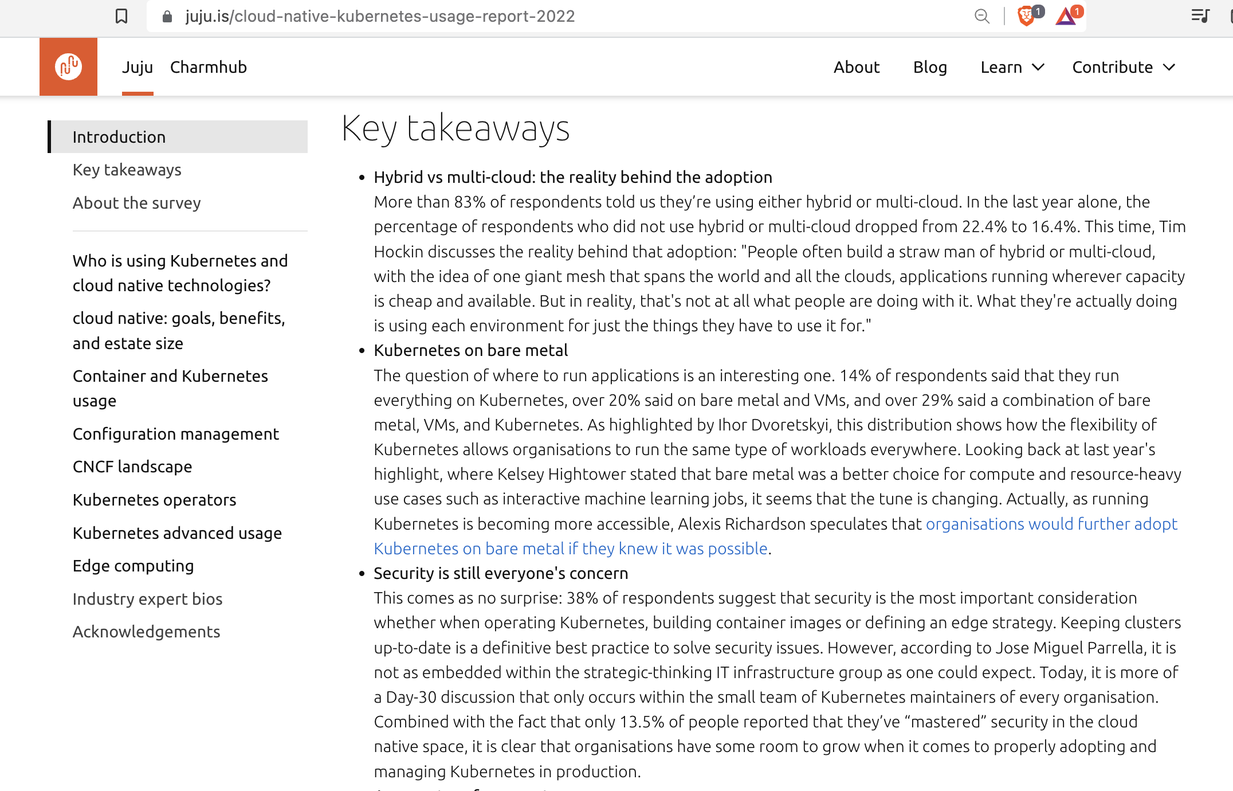
K8s sec

Slide 31
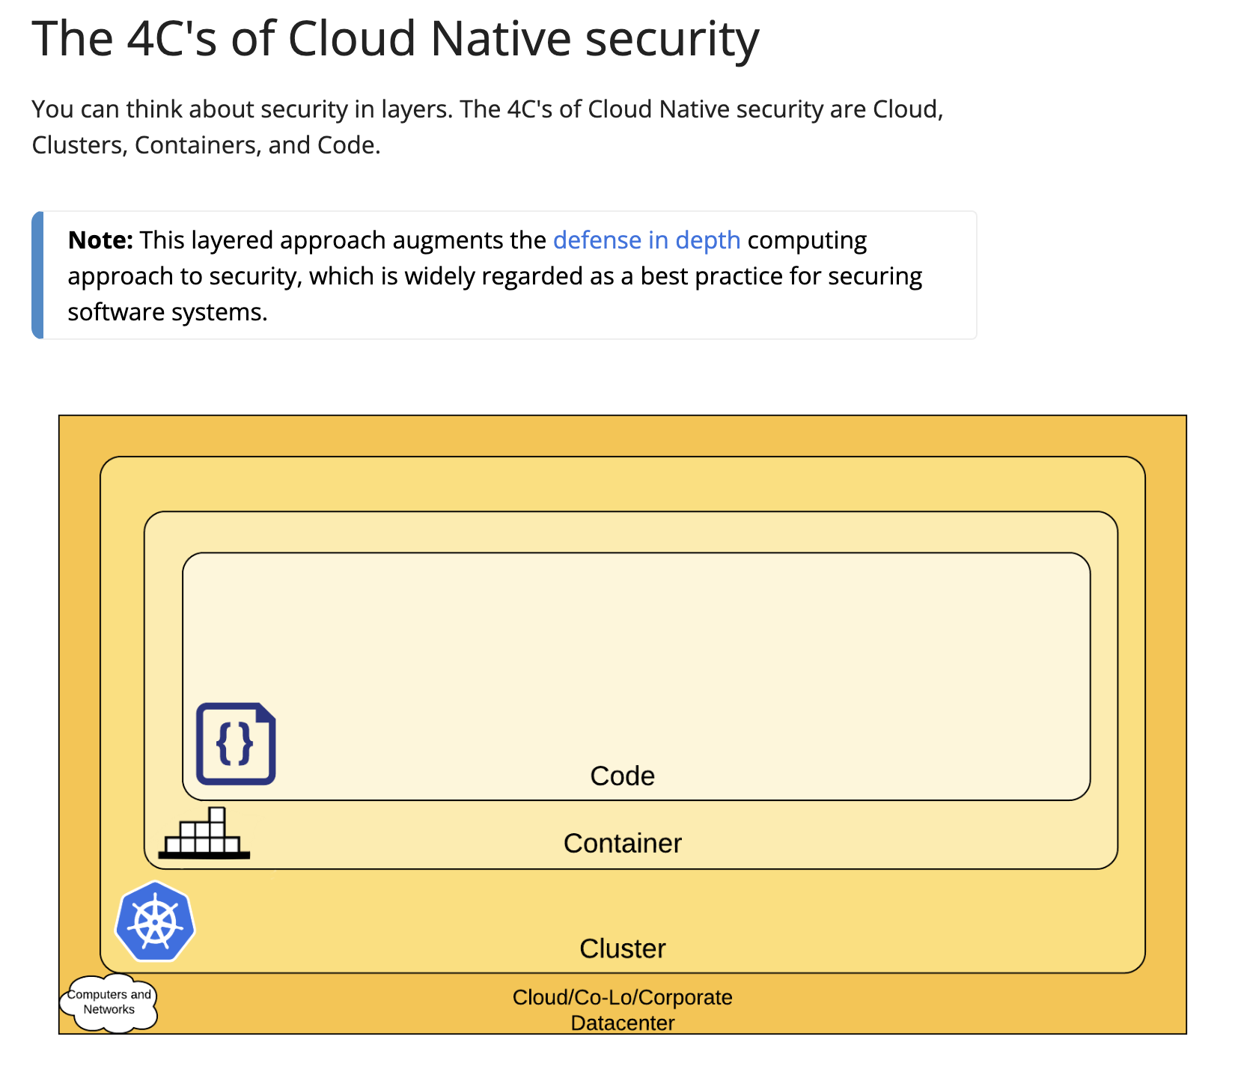
4c

Slide 32
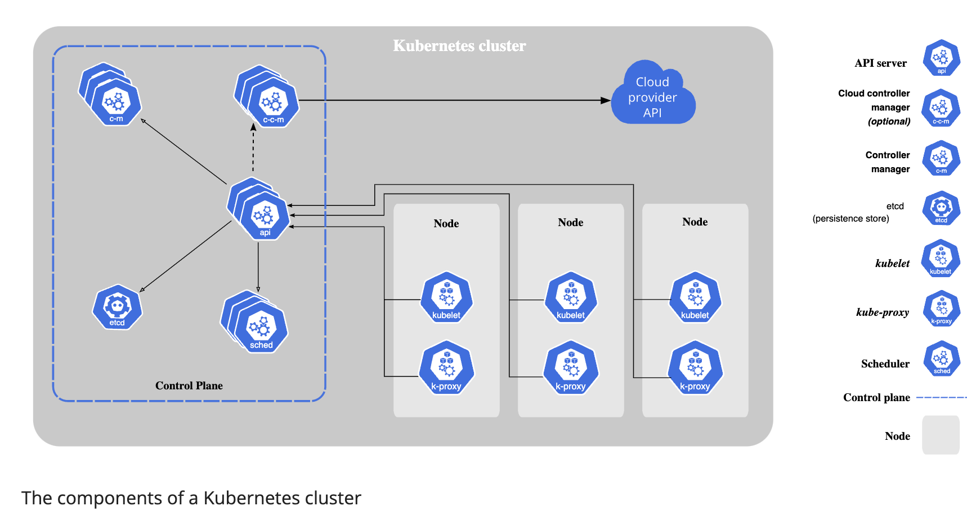
k8s security

Slide 33
k8s control plane sec
Install / upgrade / downgrade / cordon / taints affinity / labels
CNI install
Apiserver
Kubelet
Schedulercontroler
Enable RBAC
Enable admission control (image pull policy, pod security standard)
Enable TLS
Remove anonymous
Network Policy
Secrets / ConfigMaps
etcd tls
etcd encryption
etcd backup / restore

Slide 34
k8s node sec
Kubelet auth
Kubelet TLS
Kubelet config remove anonymous
Labels
Taints
Affinity
Resource Quotas

Slide 35
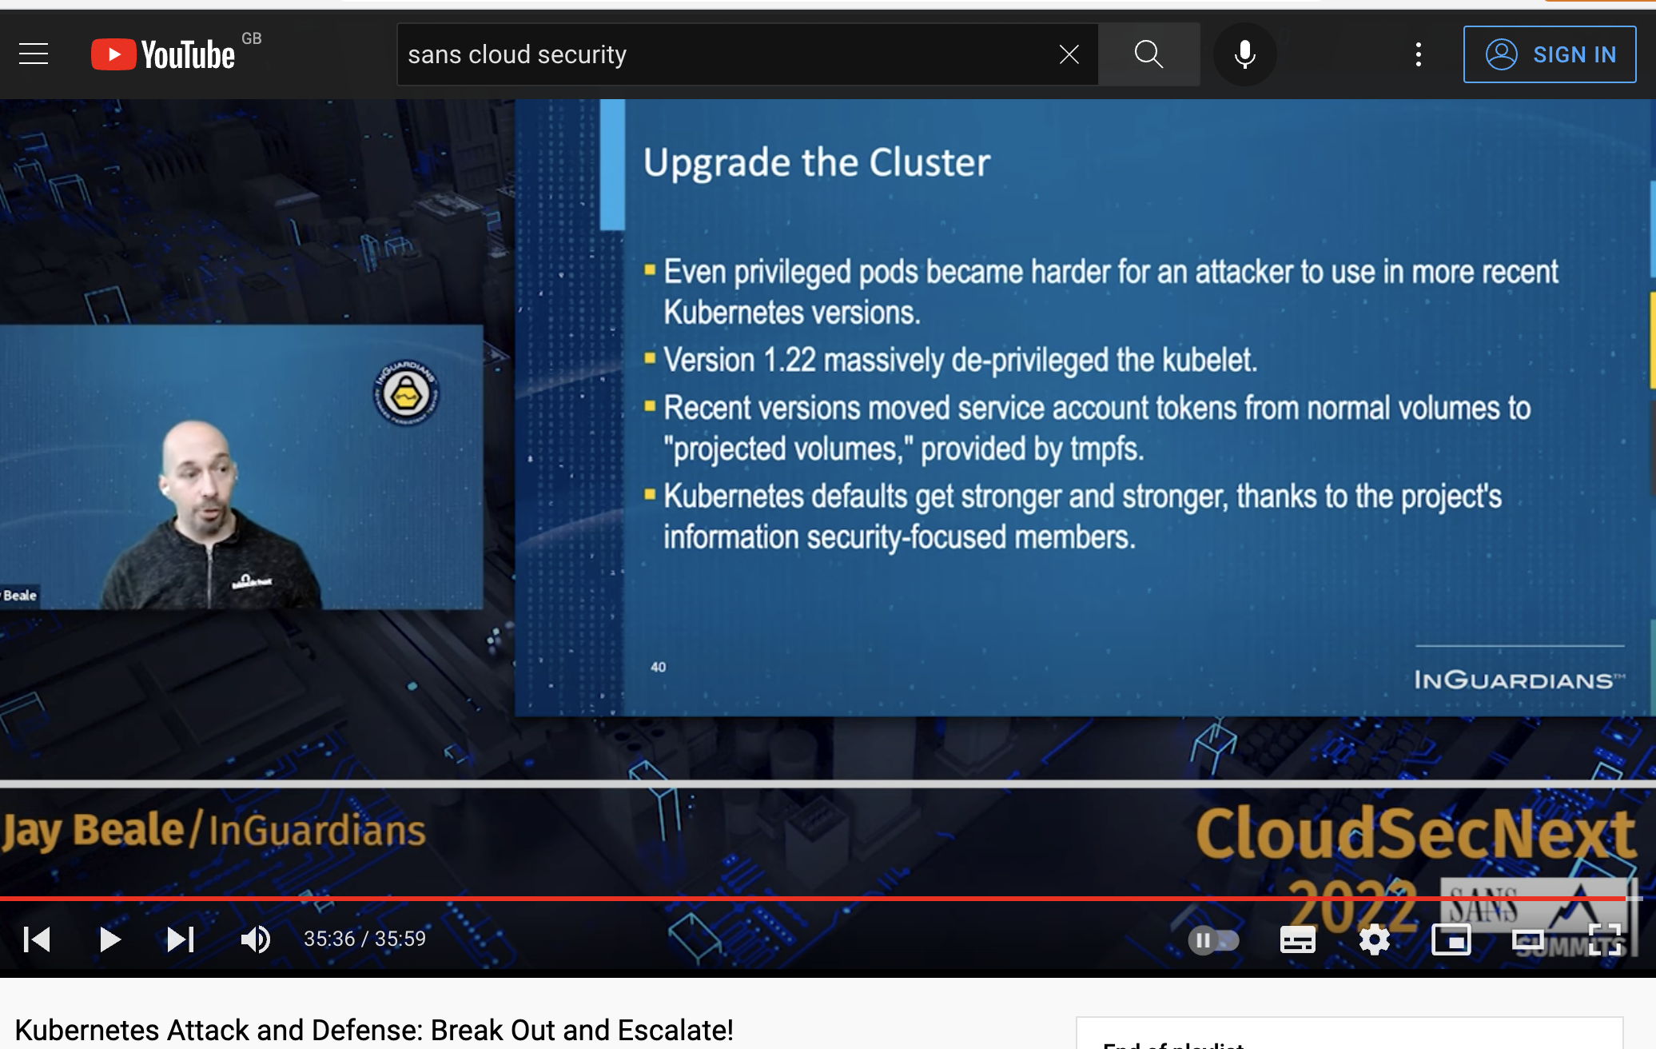
k8s cluster sec
Network policy
Kube bench
Service account
RBAC
Log audit
Secret
Pod Security Admission
Enable api server authentication

Slide 36
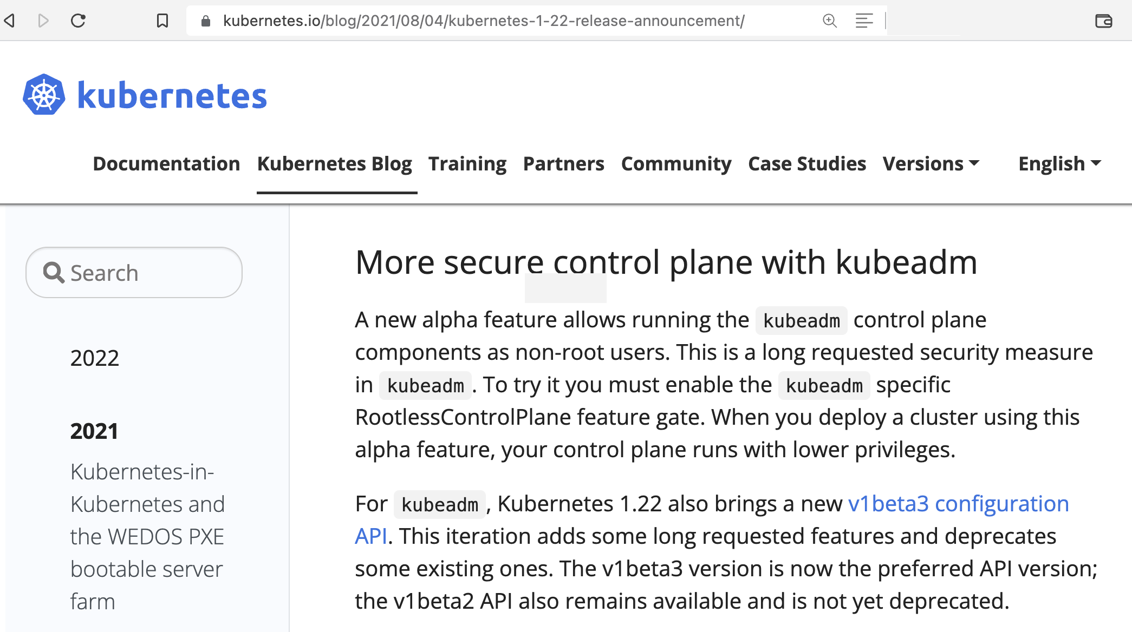
k8s cluster sec

Slide 37
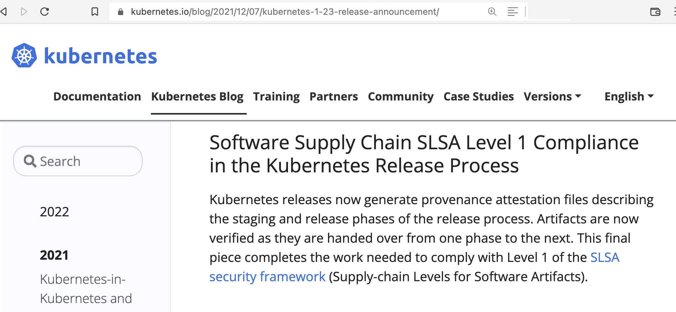
k8s cluster sec

Slide 38
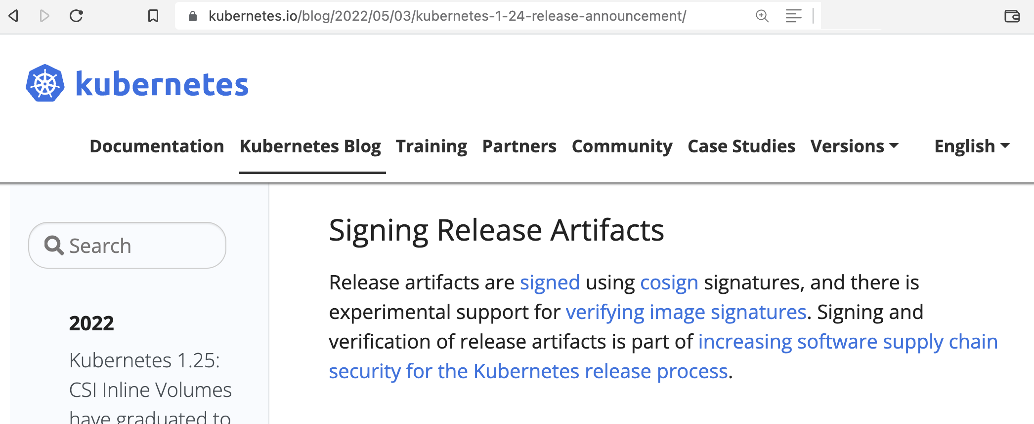
k8s cluster sec

Slide 39
!k8s
code: languages (c++, java, python, js, rust, how about go?)
ci/cd, repo management, build / deploy / patch time
readability, compatibility -> attack surface
containers: base image, library, multi-stage, user, fs / v
image repo / scan, supply chain, deep dependency, othogonality
data center: access control, server patch, configuration
redundancy, network
open source tools:
code: go simple, readability, promise backward compbality, static, compiled, grpc, no repo
containers: Dockerfile, build tools, image repo, image scan trivy, kubebench, image pull policy
data center: server patch/upgrrade, apparmor/selinux, sysdig/falco

Slide 40
philosophical thinking
1 computer
1 network
1 tool
EBPF
XDP

Slide 41
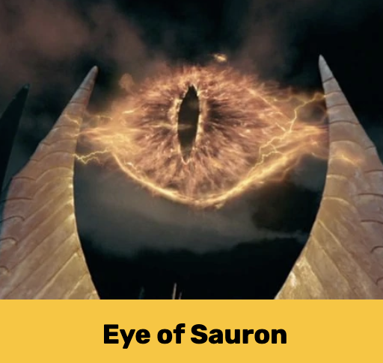
ebpf
Notes:
Hackers can disguise their activities and cover traces, you want to figure out what the hackers did, you must not look at application level, but at kernel level, that’s the eye of sauron, because kernel is hardly be tricked and at the lowest layer at processing hierarchy, and the kernel code is protected by linux torvalds using 3 firewalls without ssh in allowed. Ebpf reads directly from kernel, tracing http calls, identifying long running processes, raw sql query statements used. Traditional security still important to allow you assess/focus/mitigate vulnerabilities, ebpf show how vulnerabilities were exploited and actual indicents.

Slide 42
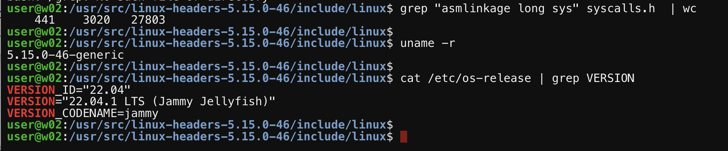
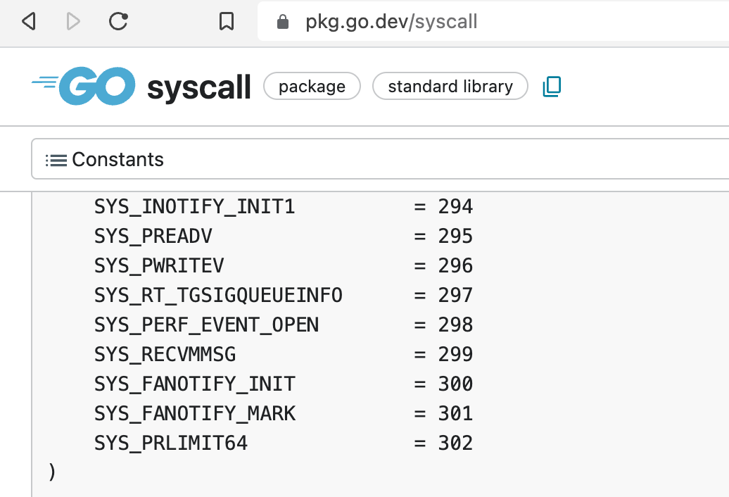
syscalls
Notes:
Hackers can disguise their activities and cover traces, you want to figure out what the hackers did, you must not look at application level, but at kernel level, that’s the eye of sauron, because kernel is hardly be tricked and at the lowest layer at processing hierarchy, and the kernel code is protected by linux torvalds using 3 firewalls without ssh in allowed. Ebpf reads directly from kernel, tracing http calls, identifying long running processes, raw sql query statements used. Traditional security still important to allow you assess/focus/mitigate vulnerabilities, ebpf show how vulnerabilities were exploited and actual indicents.

Slide 43
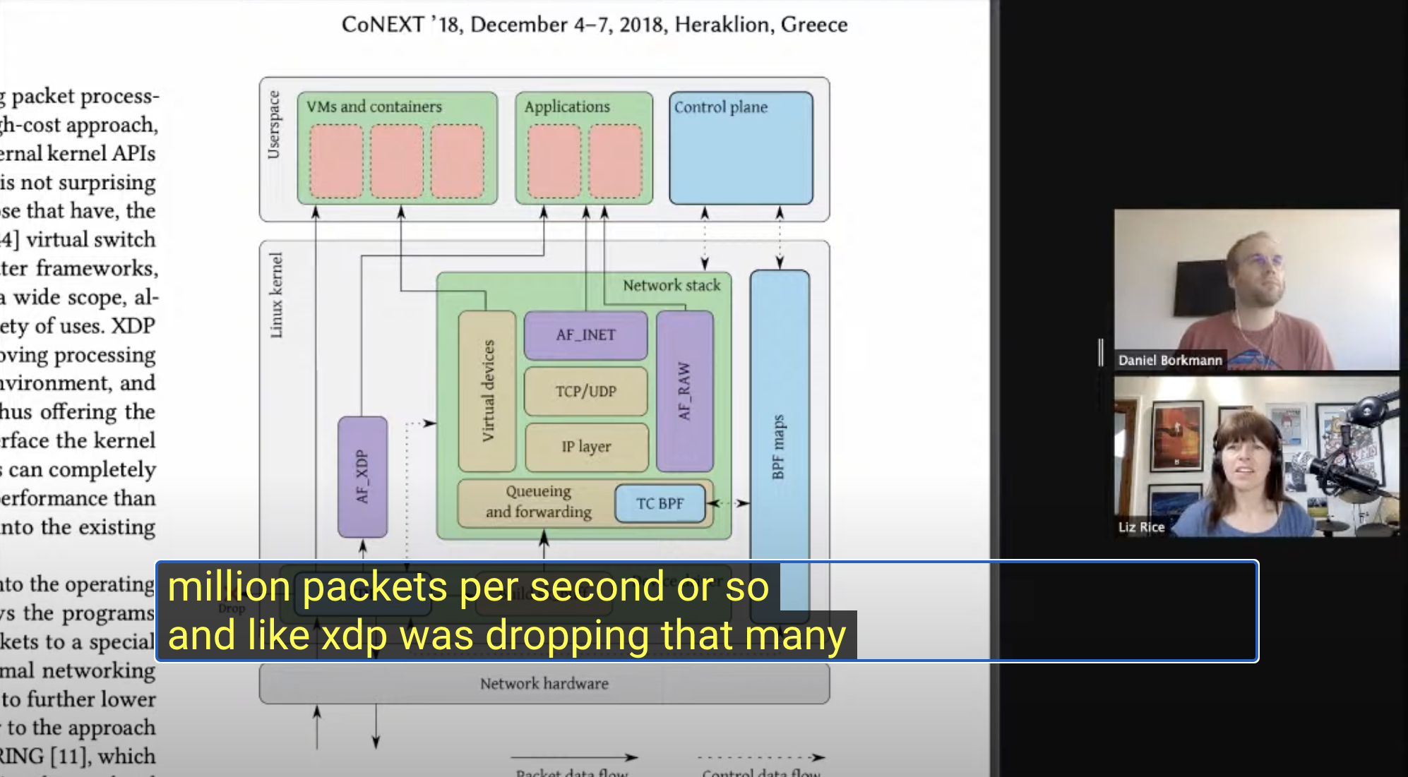
xdp ddos drop pkts
Notes:
Xdp is express data path, xdp to nic driver likes ebpf to kernel managing network traffics at NIC level, using hash to track packet states, an example of security usage is DDOS protection at NIC / NIC driver, away from user space cpu, ram, storage processing, demonstrate an efficient way of networking in cloud native environments.

Slide 44
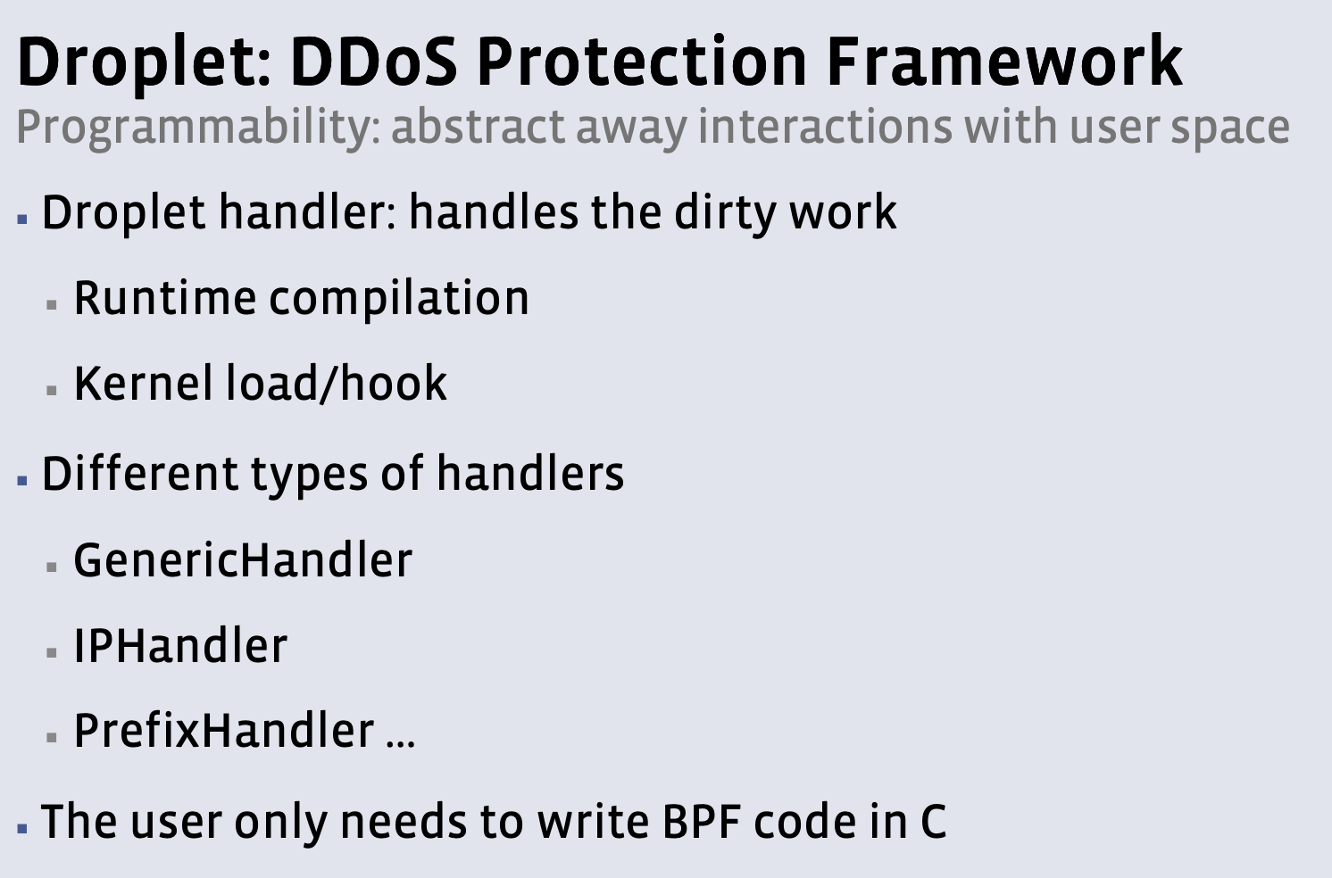
xdp ddos drop pkts

Slide 45
Contents
Demo
RBAC (ubuntu 3 nodes)
Network Policy (same)
eBPF/BPF (fedora / docker)
Cilium (minikube)

Slide 46
Contents
Demo
RBAC (ubuntu 3 nodes)
Notes:
A basic fundamental but critical step of security defense is RBAC, RBAC can be used to apply access control and least privilege principle.
Create ns
Create sa
Create role
Create rolebinding
Test auth can-i before and after
If this was applied properly (not cluster-admin role), tesla’s hacking chances could have been reduced largely.

Slide 47
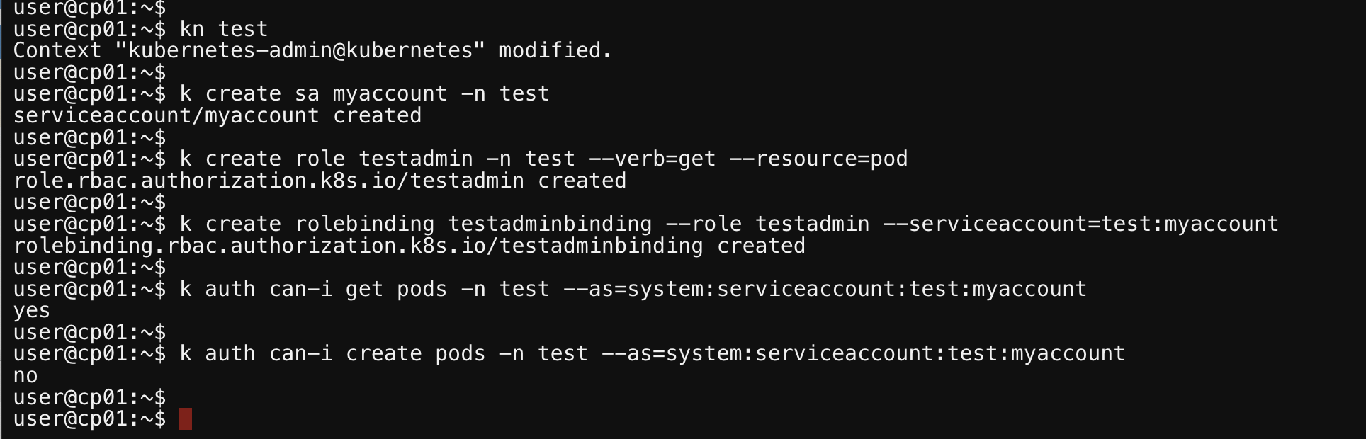
rbac
Notes:
A basic fundamental but critical step of security defense is RBAC, RBAC can be used to apply access control and least privilege principle.
Create ns
Create sa
Create role
Create rolebinding
Test auth can-i before and after
If this was applied properly (not cluster-admin role), tesla’s hacking chances could have been reduced largely.

Slide 48
Contents
Demo
Network Policy (ubuntu 3 nodes)

Slide 49
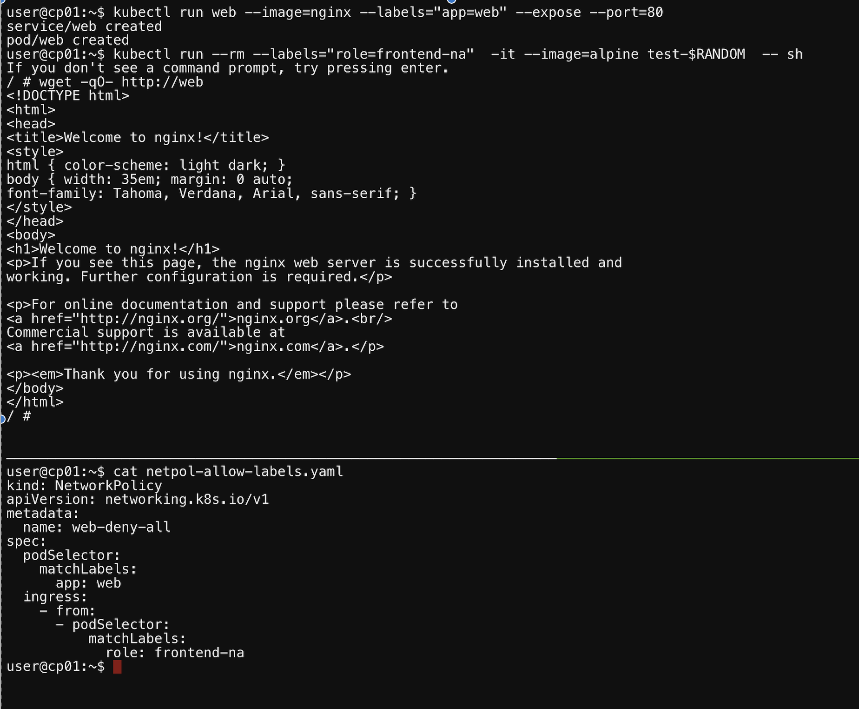
network policy
Notes:
Network policy is a new way of network isolation, traffic routing, and L3/L4 ingress egress controls, the key piece is labels in defined in declaration, can be applied dynamically, to allow / deny connections.

Slide 50
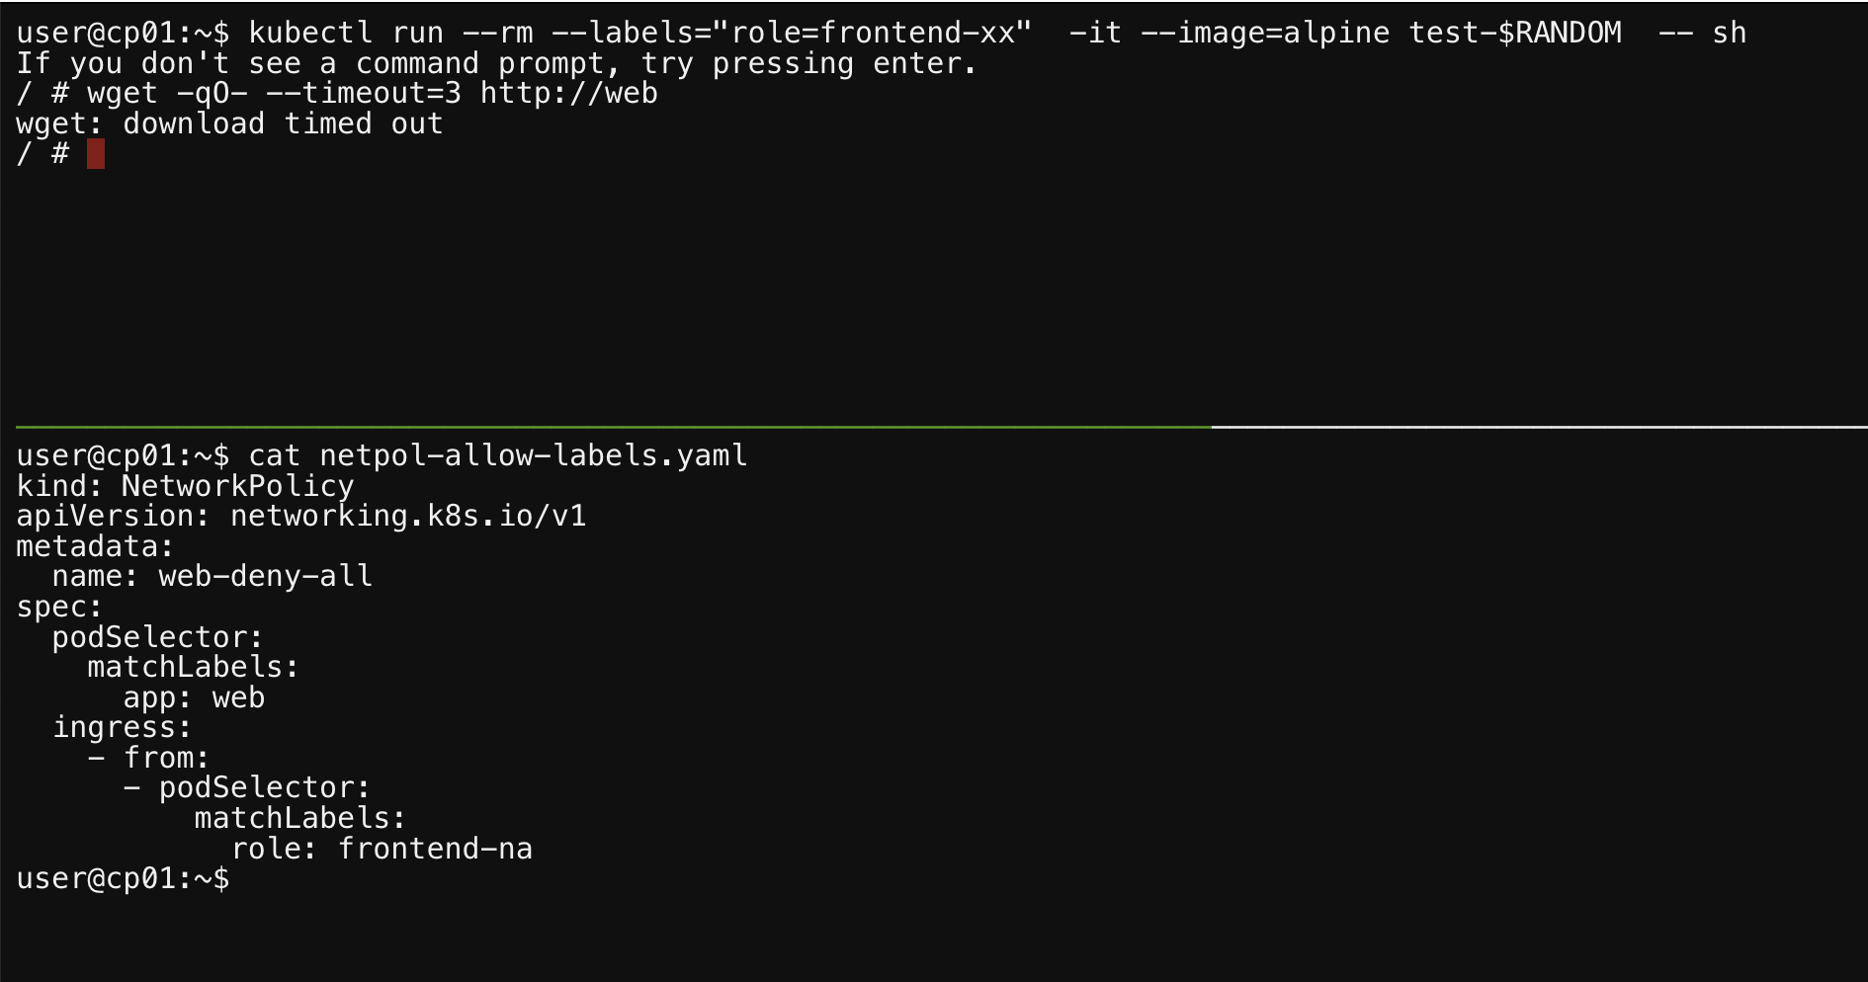
network policy
Notes:
Network policy is a new way of network isolation, traffic routing, and L3/L4 ingress egress controls, the key piece is labels in defined in declaration, can be applied dynamically, to allow / deny connections.

Slide 51
Contents
Demo
eBPF/BPF (fedora / docker)

Slide 52
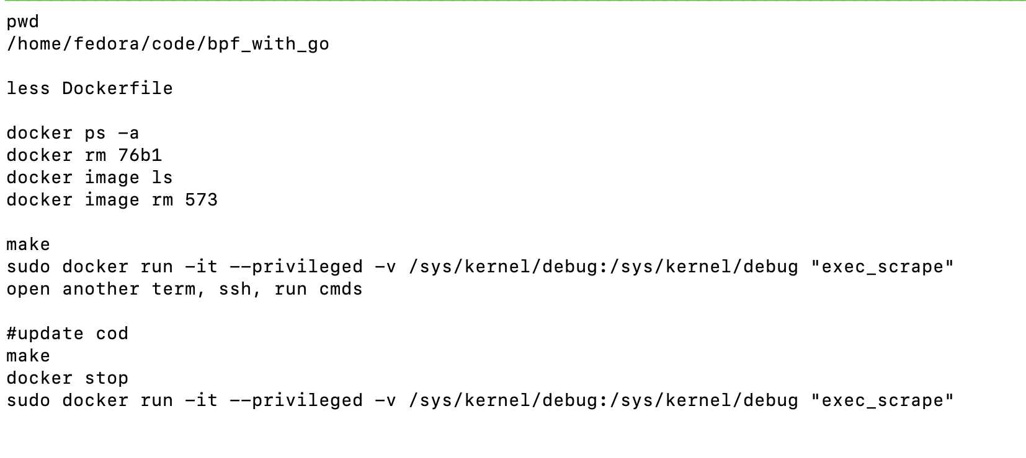
ebpf docker

Slide 53
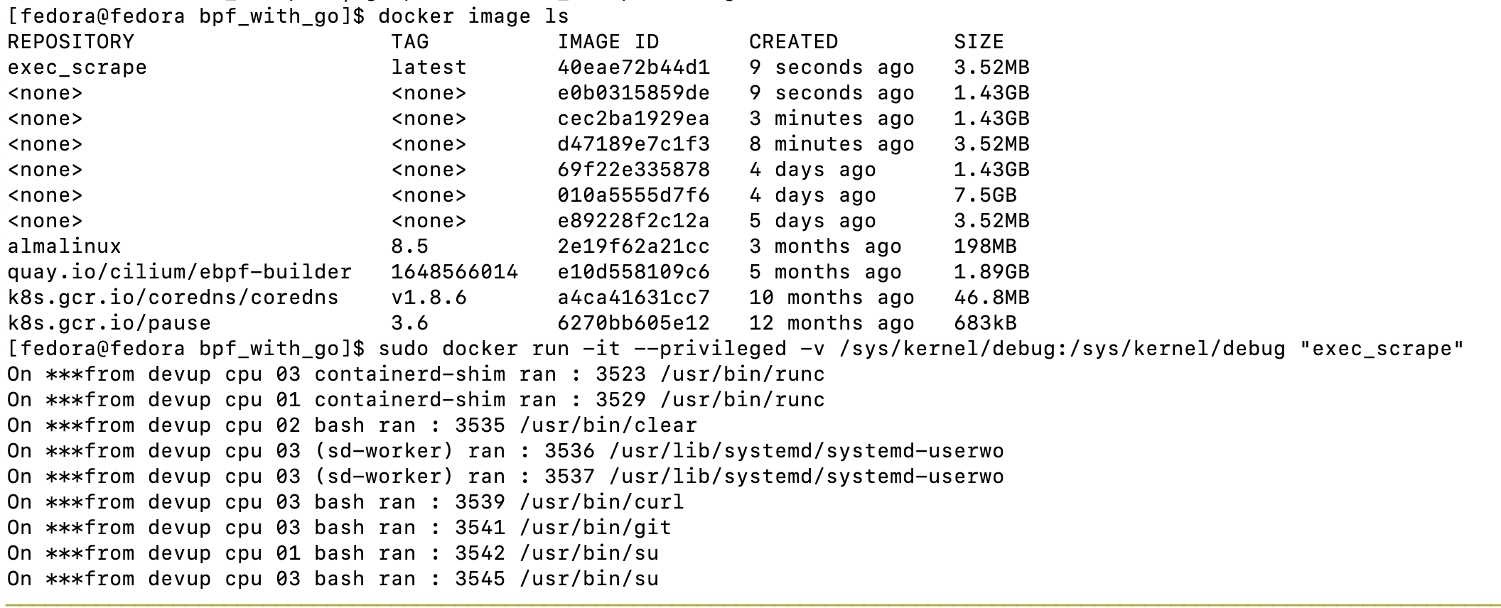
ebpf docker

Slide 54
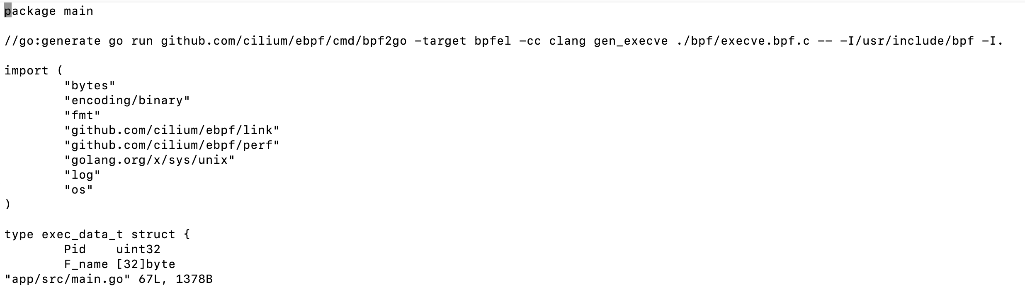
ebpf docker

Slide 55
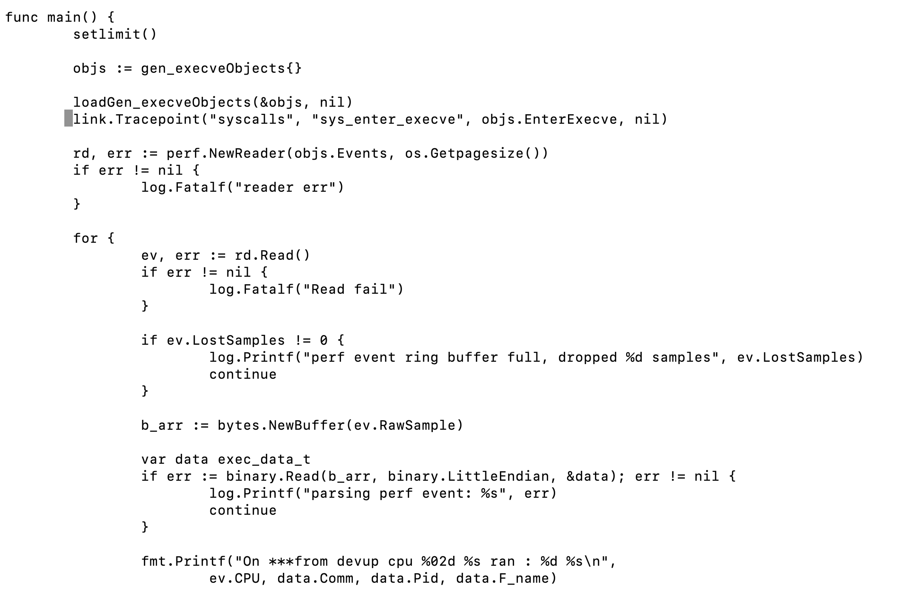
ebpf docker

Slide 56
Contents
Demo
Cilium (minikube)

Slide 57
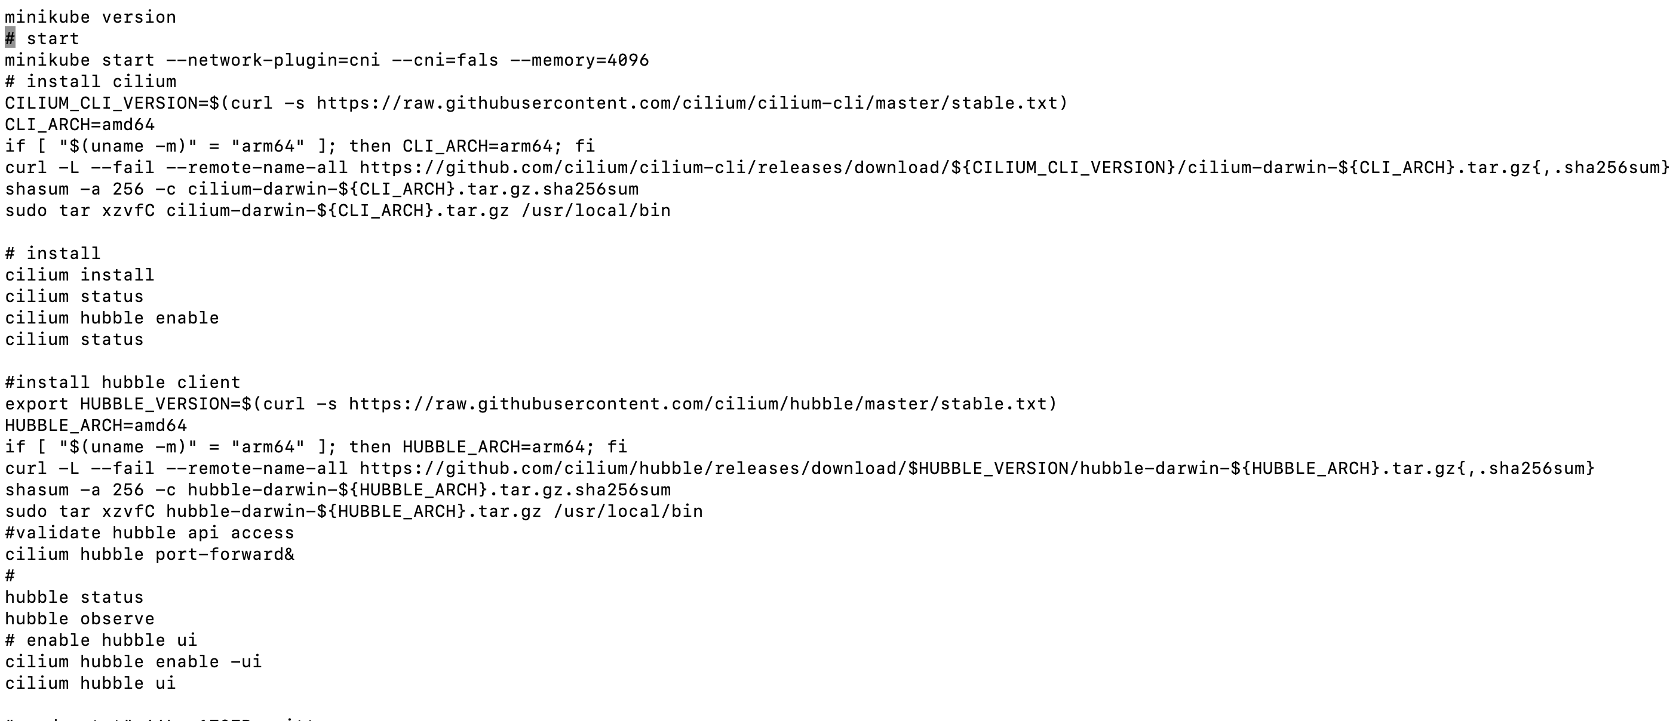
cilium
cilium (minikube, osn)

Slide 58
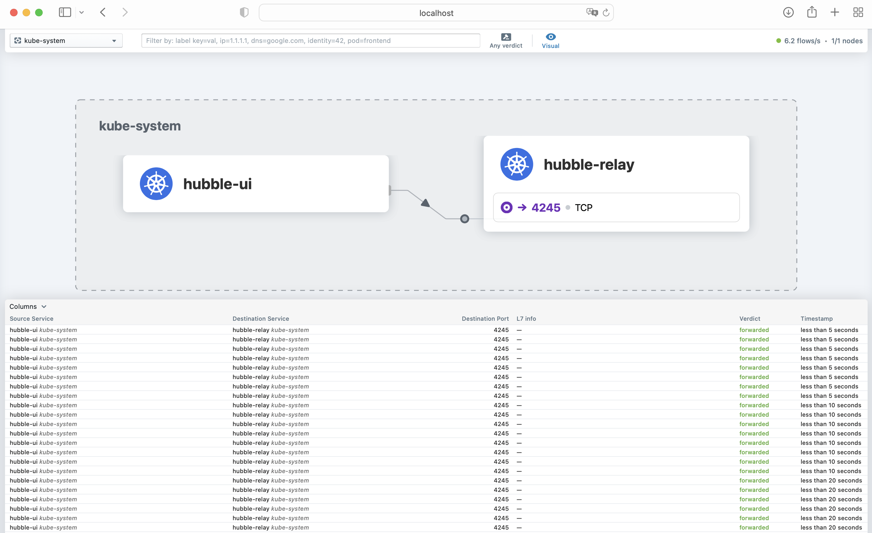
cilium
cilium (minikube, osn)

Slide 59
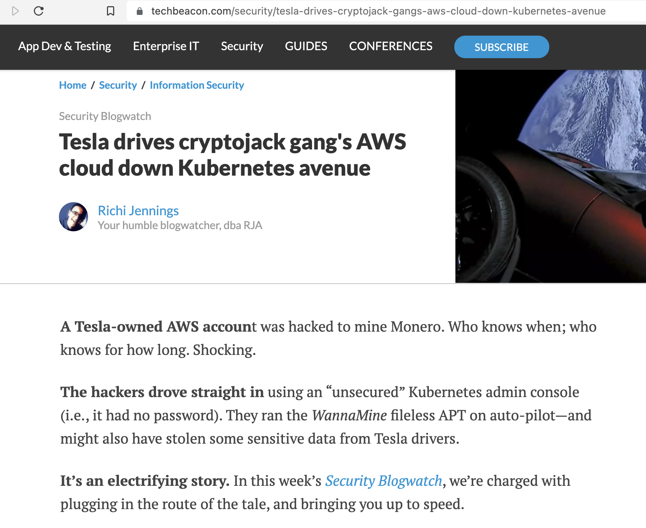
telsa
Accessible URL
Admin Roles

Slide 60
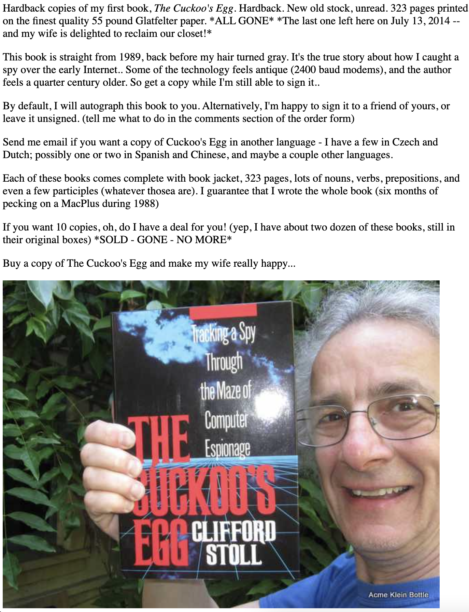
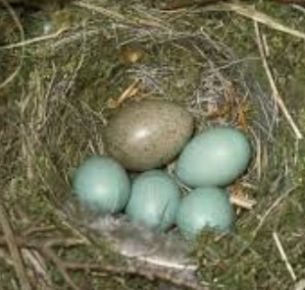
cuckoo’s game
Notes:
The 1989 book of cuckoo’s egg, describe a true story of capturing a spy who accessed 400 U.S. military computers via Berkeley Lawrence Laboratory, an astronomy physicist turned software engineer created a fake nuclear project documentation named the project of shower-head, lured and traced hacker in germany and captured him, after FBI denied his request of investigation because of low financial values of .75 cents cost used by hacker. It would be nice if all or few hacker cases ended this way.

Slide 61
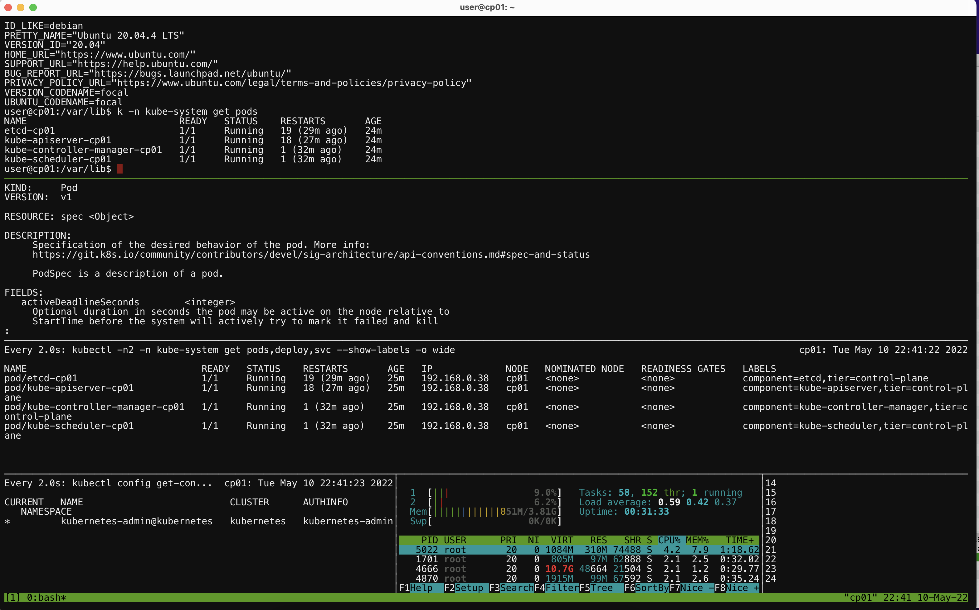
Minikube
Vagrant
VMWare/VirtualBox
Others Cloud / Labs
Online free first taste
Lab setup

Slide 62
hund battles
Art of wars
Know sylf know thee, hund battles hund wins.
Know sylf not thee, half win.
Know not sylf nor thee, lose all.

Slide 63
thoughts / philosophy
Winning k8s sec without fighting
Nature
Opportunity
Environment
Leadership
Tools

Slide 64
sources learning
Public domains
Open source codes/tools
func DoNext(b ...labs, t ...tools, i ...ideas) {
defer SeeUsAfter()
go ThankDevUPMgrGTL(){ <-BetterJobs }()
}
Notes:
To summarize this talk, we shared our kubernetes sec learning journey, all information discussed in presentation are from k8s documentation, github codes, open source tools, anyone in audience can start right away. Reading 3 lines of codes written in go, we thank Devup team, BR, JB, our manager’s encouragement and support, and GT leadership team, promise we will bring better jobs back to work, we prepared lot of labs, tools, and ideas, do come see us to learn lab setup, tools, and more.

Slide 65
end
S = f ( K, S, T ) ^{p}
Success k8s sec = f ( Knowledge, Skills, Tools ) ^{power of people}
Notes:
We started from borg, to k8s, to cloud native securities, want to finish with a formula, borrowing from mit professor patrick winston’s how to speak formula, we conceived one for k8s security, probably you can also use it to measure something, the quality of k8s sec is a function of k, s, and t, to the power of people, with it, you can build a strong k8s security environment, and likely achieve the winning of the war without fighting.

