Slide 1
JSPM’s RAJARSHI SHAHU COLLEGE OF ENGG. PUNE-33
DEPARTMENT OF COMPUTER ENGG.
BE Computer Engg.
Preliminary Project Presentation
2012-13

Slide 2
“KWEST” A Semantically Tagged Virtual File System
GROUP NO: 10
B80374220 | ASEEM GOGTE
B80374222 | SAHIL GUPTA
B80374244 | HARSHVARDHAN PANDIT
B80374256 | ROHIT SHARMA
Guided by
Dr. V. V. Phansalkar

Slide 3
INTRODUCTION
Domain
Categorize and organize information
Topic
Semantic File System

Slide 4
Semantic File Systems
Definition :
File systems that offer some method to store “semantics” or information about the context of the file mostly through meta-data and organization.

Slide 5
Semantic File Systems
Data is addressed by their content (associative access)
Supports querying for the data
Way to organize files using tags in place of directories

Slide 6
PROBLEM STATEMENT
KWEST – A SEMANTICALLY TAGGED VIRTUAL FILE SYSTEM

Slide 7
Problem Statement
To categorize and organize data semantically in a file system through the use of automatic or manual management of metadata.
Metadata information about file is stored in the form of tags
Tags can either be generated implicitly or explicitly

Slide 8
SCOPE
KWEST – A SEMANTICALLY TAGGED VIRTUAL FILE SYSTEM

Slide 9
Scope
1. Information may be supplied by user or generated by extraction of file metadata.
3. Automated extraction of tags is currently limited to popular file formats like audio, video, images etc.
4. Level of awareness generated by the system is based on the frequency of access.
2. The validity of information is based on the users level of organizing things.

Slide 10
Scope
5. The system design is modular to allow extendibility and adding functionality.
7. Application can be ported to other platforms.
6. Current Implementation is based on Linux kernel.

Slide 11
LITERATURE SURVEY
KWEST – A SEMANTICALLY TAGGED VIRTUAL FILE SYSTEM

Slide 12
KFS
Main Features
Automatic Classification
Multiple Directories
Logging Usage
Limitations
Automatically classifies only HTML, TXT files
Indexing supports Plain Text Only
Points of interest
Automatic Classification
Indexing

Slide 13
SemFS
Main Features
File tagging
Versioning
Browsing based on Metadata, attributes
Logical operators for filtering results
Limitations
Query syntax restricted to AND , OR , NOT
Points Of Interest
Browsing based on metadata
Use of logical operators
No automatic classification

Slide 14
TAGSISTANT
Main Features
Organize files using tags
Use of Logical Queries
Limitations
No Automatic Classification
Points of Interest
Relation between tags
Plugin Mechanism
Relation between tags

Slide 15
REQUIREMENT ANALYSIS
KWEST – A SEMANTICALLY TAGGED VIRTUAL FILE SYSTEM

Slide 16
Creating and Managing Virtual File System Software used- FUSE
1. Loadable kernel module
2. Kernel interfacing is very efficient
3. Can be used by non-privileged users
4. Has proven very stable over time

Slide 17
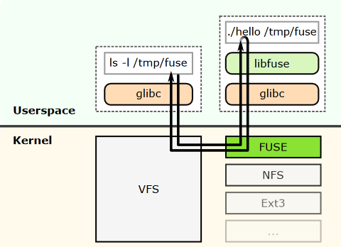
FUSE Overview
Figure - 1

Slide 18
FUSE Advantages
1. Defines common file system operations
3. Merged in Linux kernel since version 2.6.14
2. Allows implementation of those operations

Slide 19
Data Repository Software used- SQLite
1. Zero Configuration
2. No client-server architecture
3. Single Database File
4. Stable Cross-platform database

Slide 20
HARDWARE REQUIREMENTS
Any environment capable of running Linux version 2.6.14+

Slide 21
PROPOSED SYSTEM
KWEST – A SEMANTICALLY TAGGED VIRTUAL FILE SYSTEM

Slide 22
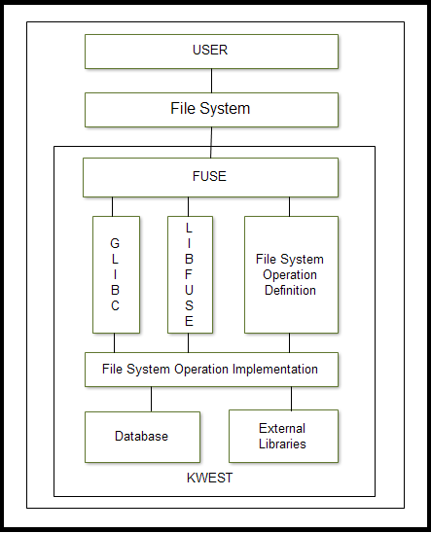
SYSTEM ARCHITECTURE
Figure - 2
Notes:
USER
User is any entity who interacts with the file system.
Normal User
OS interacts with Script.
FILESYSTEM
The user interacts with a virtual filesystem, whose calls are forwared to FUSE daemon by OS
FUSE
FUSE makes available all the standard functions which can be performed on any file system in UNIX environments eg ls, open, read, write etc… The user then implements these functions which fuse binds to system calls.
Whenever a request comes for say open, the fuse daemon looks up the associated function from the filesystem program and executes it.
Fuse only defines the skeleton of the functions to be implemented, the actual design and functioning is done by KWEST.
Ls: list tags related to a file
Mkdir : create tag
Rmdir: remove tag
Copy: assign tag to file
FUSE uses Glibc and Libfuse for performing its operations.
Glibc is the GNU Project's implementation of the C standard library.
It provides functions for tasks like I/O processing, mathematical computation, memory allocation, etc.
Libfuse contains functions internally used by fuse to create and manage virtual file system.
SQLite will be used for storing all data relevant with the file system.
To extract metadata, Kwest makes use of external libraries such as Taglib, EXIF.

Slide 23
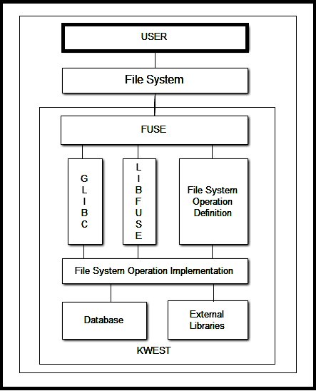
Any entity
interacting with
the system
Figure - 3
Notes:
USER
User is any entity who interacts with the file system.
Normal User
OS interacts with Script.

Slide 24
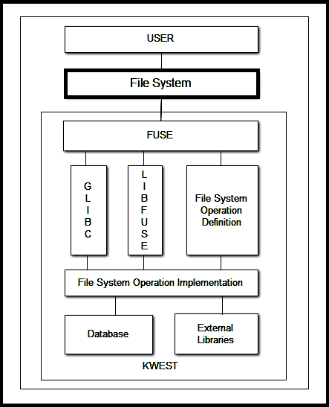
VFS handled
by OS
Figure - 4
Notes:
FILESYSTEM
The user interacts with a virtual filesystem, whose calls are forwared to FUSE daemon by OS

Slide 25
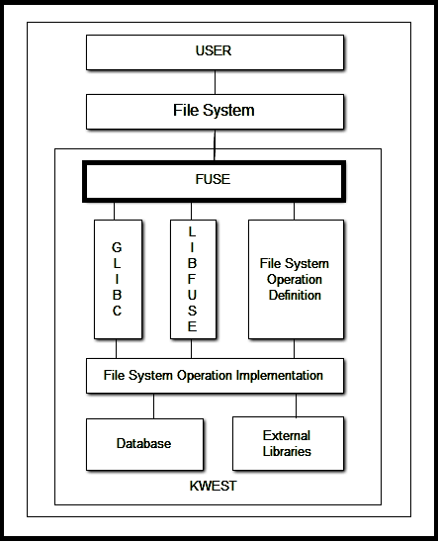
FUSE Daemon
Handles requests
sent by OS
Decodes list of
file system operation
Figure - 5
Notes:
FUSE
FUSE makes available all the standard functions which can be performed on any file system in UNIX environments eg ls, open, read, write etc… The user then implements these functions which fuse binds to system calls.
Whenever a request comes for say open, the fuse daemon looks up the associated function from the filesystem program and executes it.
Fuse only defines the skeleton of the functions to be implemented, the actual design and functioning is done by KWEST.

Slide 26
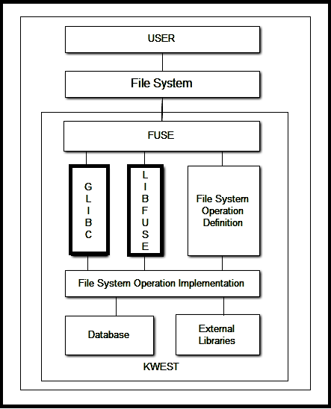
GLIBC
GNU C Library
LIBFUSE
Functions used to
create and manage
Virtual File Systems
Used internally
by FUSE
Figure - 6
Notes:
FUSE uses Glibc and Libfuse for performing its operations.
Glibc is the GNU Project's implementation of the C standard library.
It provides functions for tasks like I/O processing, mathematical computation, memory allocation, etc.
Libfuse contains functions internally used by fuse to create and manage virtual file system.

Slide 27
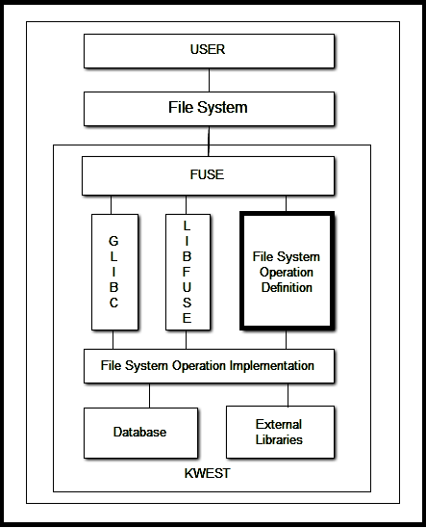
FUSE API
Definitions for
functions associated
with FS Operations
Figure - 7
Notes:
Ls
Mkdir
Rmdir
Copy

Slide 28
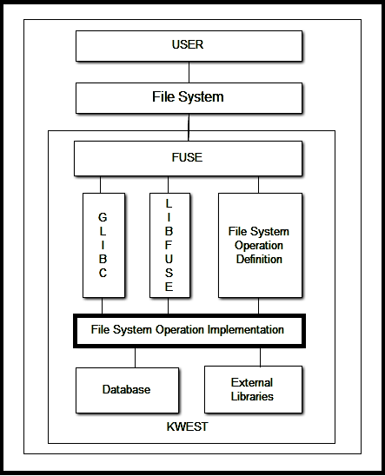
Program code
containing
declarations
for functions
associated with
file system
operations
Figure - 8
Notes:
Ls: list tags related to a file
Mkdir : create tag
Rmdir: remove tag
Copy: assign tag to file

Slide 29
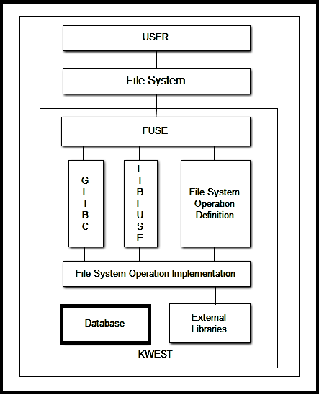
Data Repository
managed by
SQLite
Figure - 9
Notes:
SQLite will be used for storing all data relevant with the file system.

Slide 30
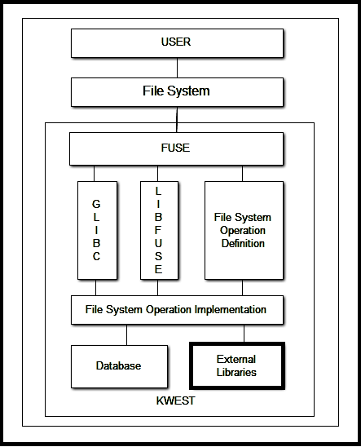
Libraries
To Extract
Meta-data
Identify
Relations
Figure - 10
Notes:
To extract metadata, Kwest makes use of external libraries such as Taglib, EXIF.

Slide 31
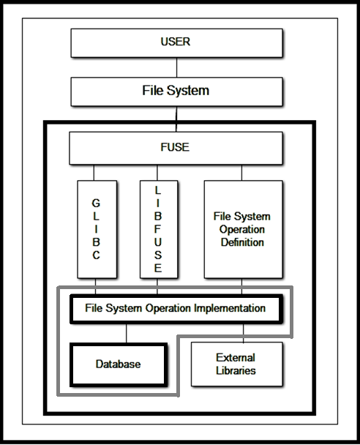
Kwest System
Implementation
Part of system
Figure - 11
Notes:
USER
User is any entity who interacts with the file system.
Normal User
OS interacts with Script.
FILESYSTEM
The user interacts with a virtual filesystem, whose calls are forwared to FUSE daemon by OS
FUSE
FUSE makes available all the standard functions which can be performed on any file system in UNIX environments eg ls, open, read, write etc… The user then implements these functions which fuse binds to system calls.
Whenever a request comes for say open, the fuse daemon looks up the associated function from the filesystem program and executes it.
Fuse only defines the skeleton of the functions to be implemented, the actual design and functioning is done by KWEST.
Ls: list tags related to a file
Mkdir : create tag
Rmdir: remove tag
Copy: assign tag to file
FUSE uses Glibc and Libfuse for performing its operations.
Glibc is the GNU Project's implementation of the C standard library.
It provides functions for tasks like I/O processing, mathematical computation, memory allocation, etc.
Libfuse contains functions internally used by fuse to create and manage virtual file system.
SQLite will be used for storing all data relevant with the file system.
To extract metadata, Kwest makes use of external libraries such as Taglib, EXIF.

Slide 32
UML DIAGRAMS
KWEST – A SEMANTICALLY TAGGED VIRTUAL FILE SYSTEM

Slide 33
Scenario
User wants to -
add Music.mp3 file to Myplaylist tag and view its contents

Slide 34
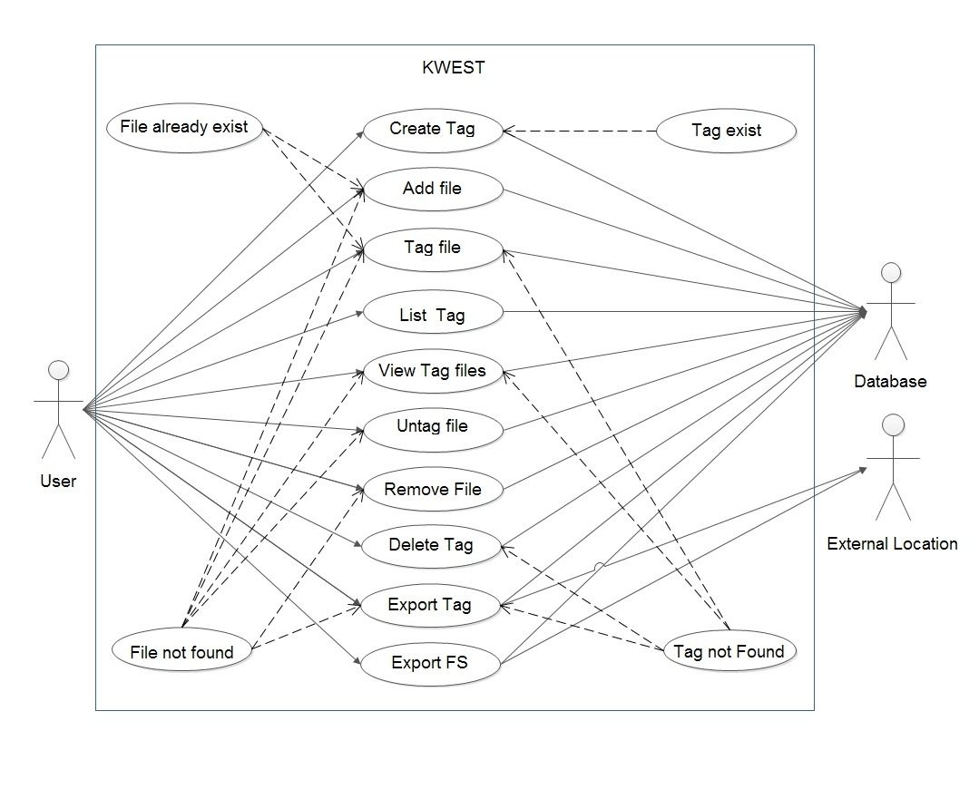
USE CASE
Figure - 12
Notes:
Snapshot of functions available to user for operating Kwest
Use kwest to organize his audio files
1. Add the “untitled” song file.
2. Create tag myPlaylist, myrock
3. To associate file to created tag: Tag playlist “untitled”
4. List playlist
5. List
6. Untag playlist untitled
7. Remove myplaylist
8. Remove untitled
9. Export myplaylist
10. Export kwest

Slide 35
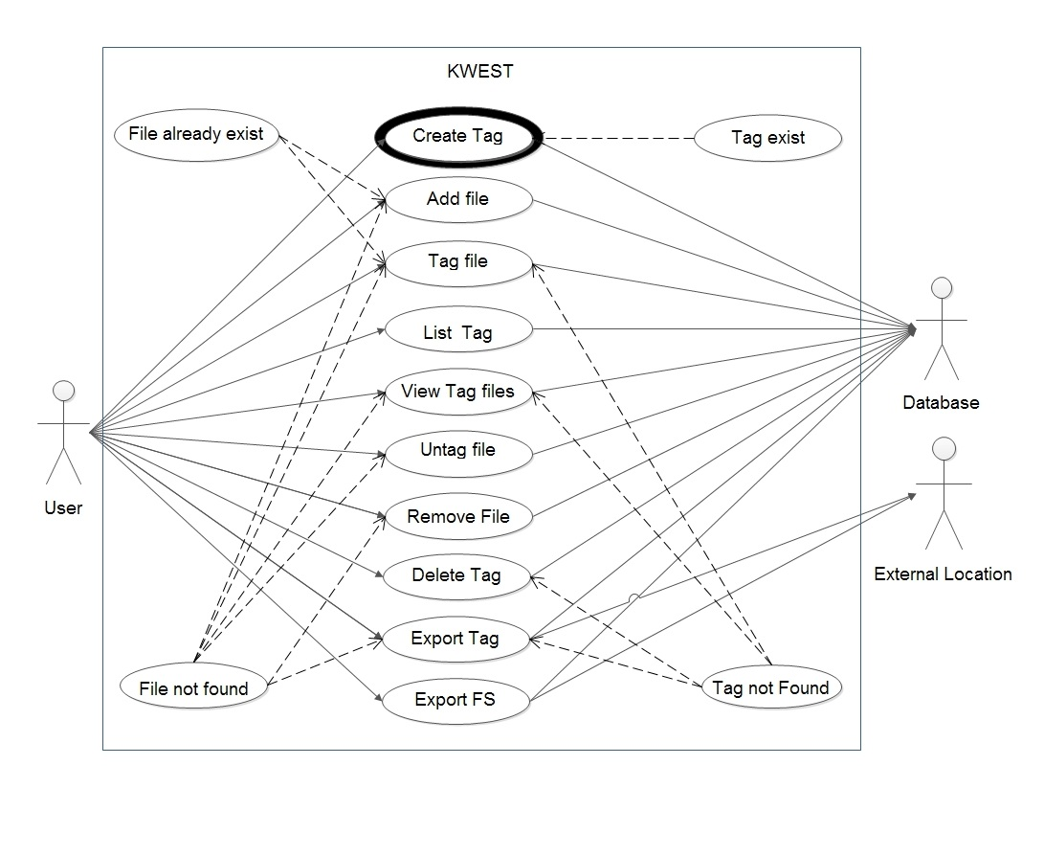
Myplaylist
Figure - 13

Slide 36
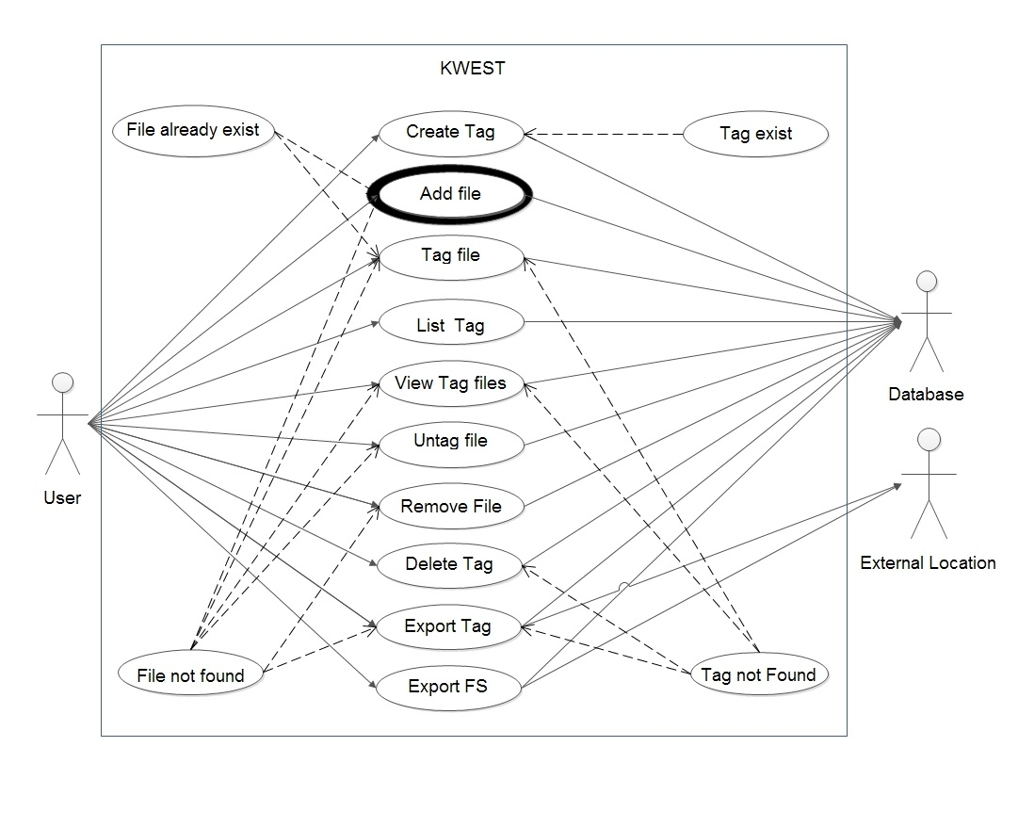
Music.mp3
Figure - 14

Slide 37
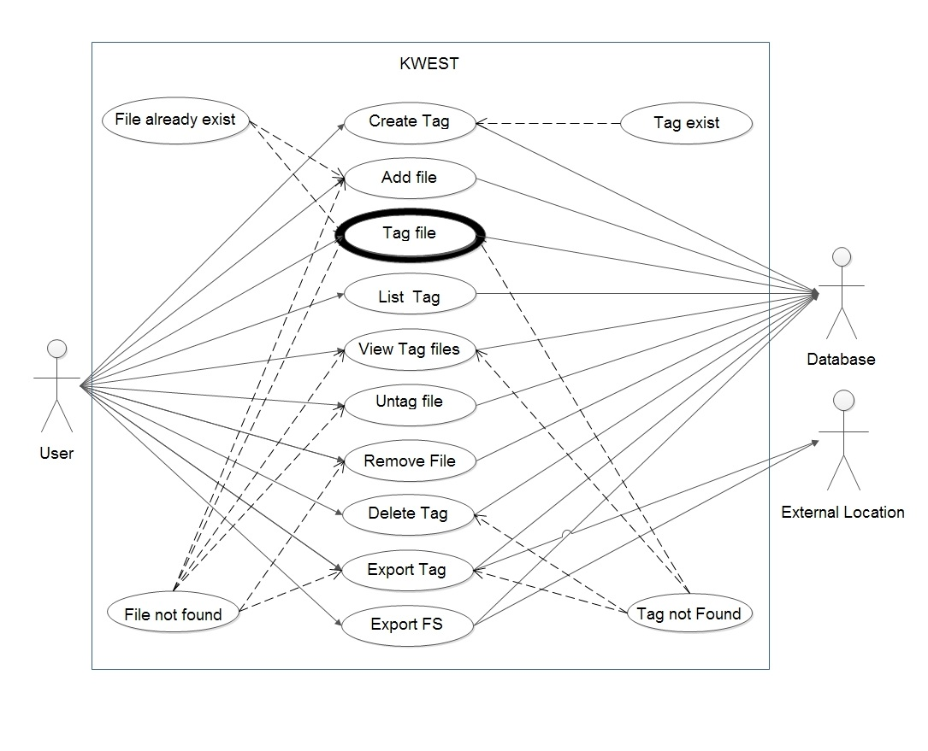
Music.mp3 - Myplaylist
Figure - 15

Slide 38
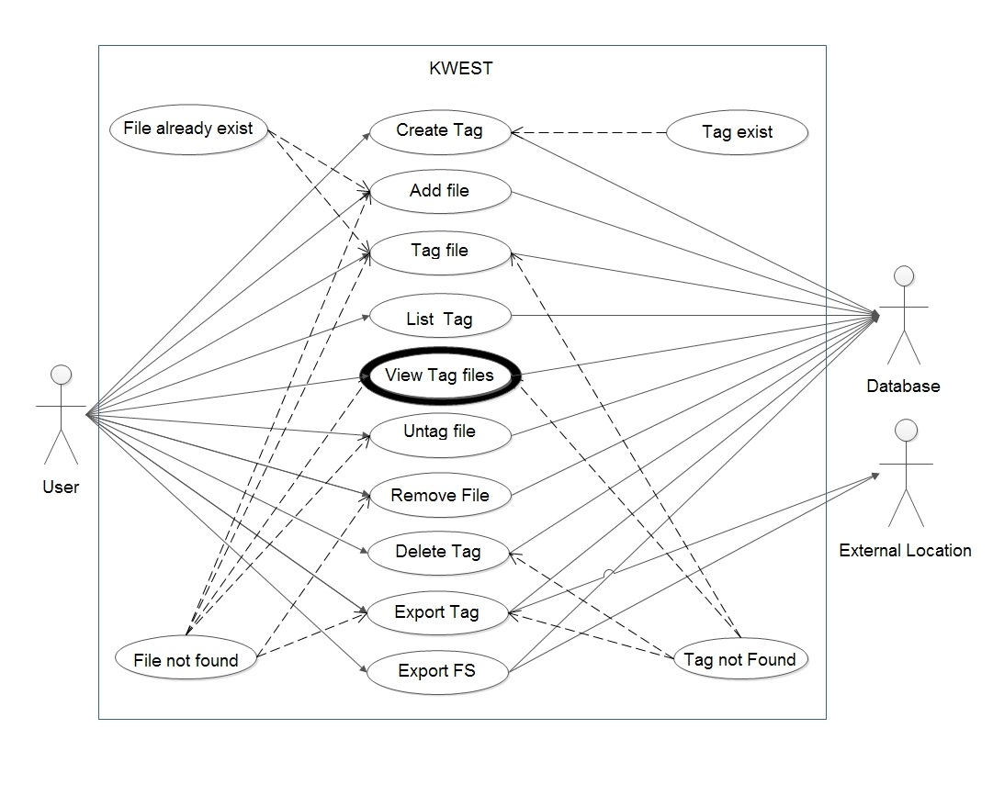
Music.mp3
Myplaylist
Figure - 16

Slide 39
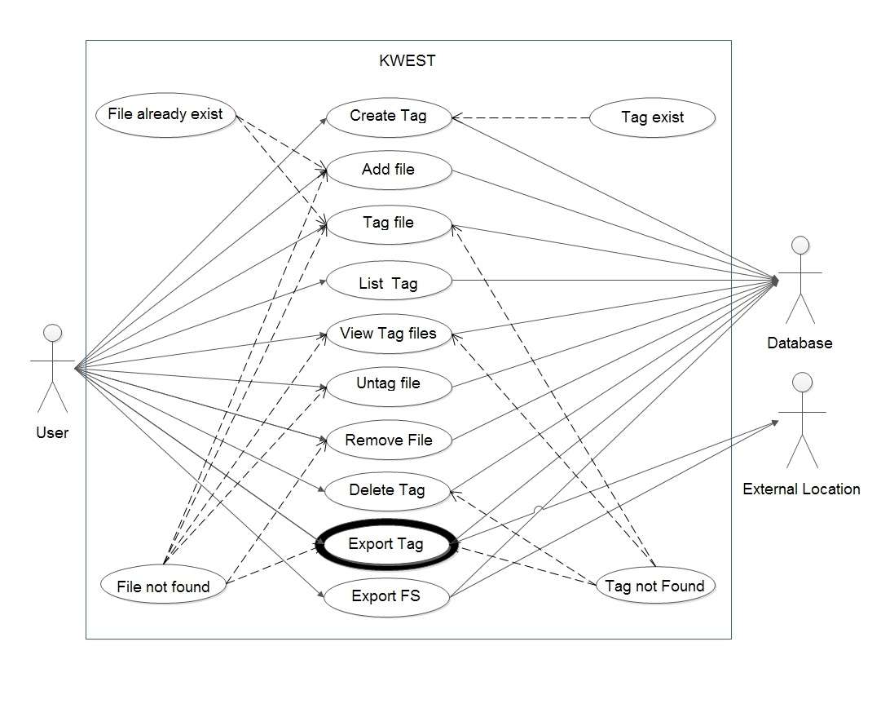
Myplaylist
Music.mp3
Figure - 17

Slide 40
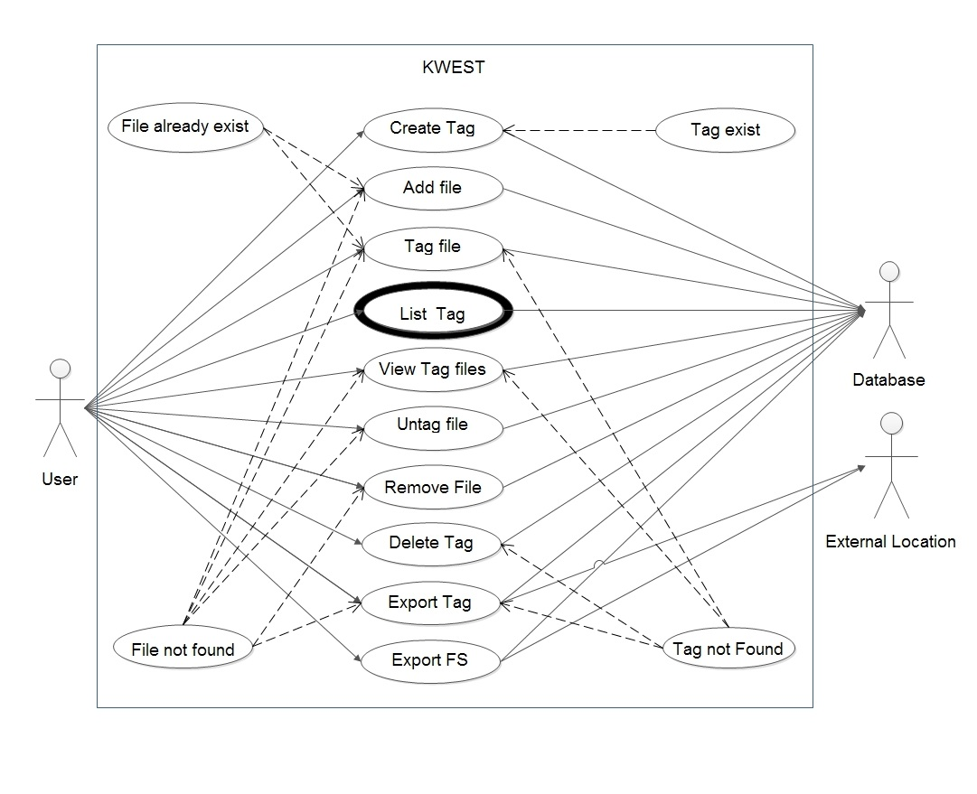
Myplaylist
Myrock
Mypop
Figure - 18

Slide 41
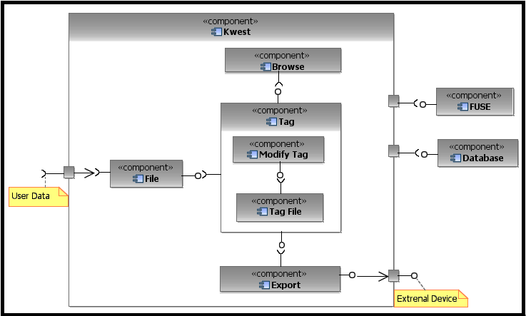
COMPONENT
Figure - 19
Notes:
File
To start organization user has to Start with add or removing file to kwest.
Add File
Remove File
2. Tag
1. Modify Tag
1. Create tag
2. Remove tag
2. Associate Tag File
1. Tag File
2. Untag File
3. List files in a tag or list all tags
4. Export tag or FS

Slide 42
DATA FLOW DIAGRAM
KWEST – A SEMANTICALLY TAGGED VIRTUAL FILE SYSTEM

Slide 43
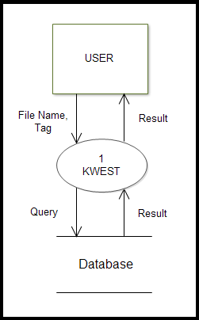
DFD LEVEL - 0
Music.mp3
Myplaylist
Success/Fail
Tag Music.mp3 to Myplaylist
Figure - 20

Slide 44
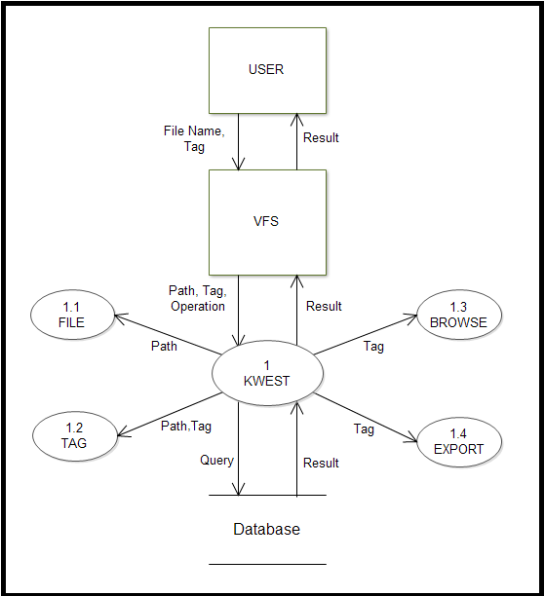
DFD LEVEL - 1
Add File Music.mp3 to Kwest
Music.mp3
C:\audio\Music.mp3
Add File
Add Music.mp3 to Kwest
Figure - 21
Notes:
Module will execute the query to add music.mp3 to kwest

Slide 45
DFD LEVEL - 1
Create Tag Myplaylist
Myplaylist
Myplaylist
Create Tag
Add Myplaylist to tags in KWEST
Figure - 22

Slide 46
DFD LEVEL - 1
Add Music.mp3 to Myplaylist
Music.mp3
Myplaylist
Music.mp3
Myplaylist
Tag files
Add Music.mp3 to Myplaylist
Figure - 23

Slide 47
DFD LEVEL - 1
Browse/ Export Tag
Myplaylist
Music.mp3
Figure - 24

Slide 48
MATHEMATICAL MODEL
KWEST – A SEMANTICALLY TAGGED VIRTUAL FILE SYSTEM

Slide 49
Notations
F: Set of Files
T: Set of Tags
S: Set of tags in Query $\left(S⊆T\right)$
S: Set of tags in Query (𝑆⊆𝑇)
$$R=\left\{\left(f,t\right) | f has tag t;f∈F,t∈T\right\}$$
𝑅={(𝑓,𝑡)│𝑓 ℎ𝑎𝑠 𝑡𝑎𝑔 𝑡;𝑓∈F,t∈T}
$$g\left(f\right)=\left\{t:fRt\right\}$$
𝑔(𝑓)={𝑡:𝑓𝑅𝑡}
SETS
RELATIONS
OPERATIONS
f are files in F, t are tags in T
$$h\left(t\right)=\left\{f:fRt\right\}$$
ℎ(𝑡)={𝑓:𝑓𝑅𝑡}

Slide 50
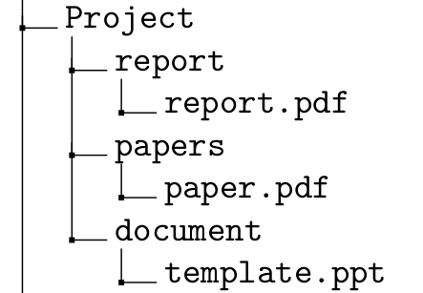
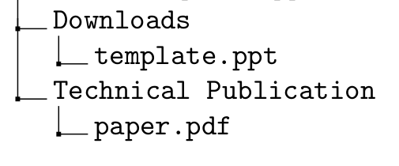
Association between tags
Similar to how files are related to tags, we can have associations between tags. These tags can help in semantic navigation.
Tags : Project, report, papers, document,
Downloads, Technical Publication
Files : report.pdf, paper.pdf, template.ppt

Slide 51

$$A\sim B$$ A is probably related to B
template.ppt is tagged under “document” as well as “downloads”
In this case, “document” is not really related to “downloads”

Slide 52
$$A\sim B$$ A is probably related to B
paper.pdf is tagged under "papers" as well as "technical publications“
In this case, we can relate "papers" to "technical publications"

Slide 53
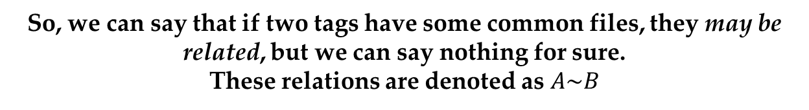
$$A\sim B$$ A is probably related to B
So, we can say that if two tags have some common files, they may be related, but we can say nothing for sure.
These relations are denoted as $A\sim B$

Slide 54

$$A≻B$$ A contains subgroup$B$
If represented as sets, the tag “papers” will form a
subset of tag “Project”
The files tagged as “papers” are also tagged as “Project”.

Slide 55

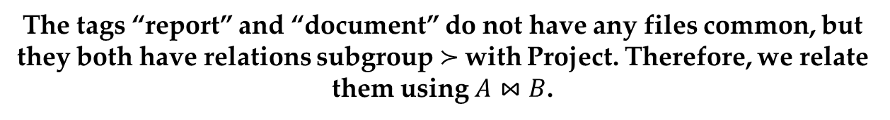
$$A⋈B$$ A is related to$B$
The tags “report” and “document” do not have any files common, but they both have relations subgroup $≻$with Project. Therefore, we relate them using $A⋈B$.

Slide 56
Using associations for semantic navigation
$A\sim B$ : A is probably related to B
𝐴~𝐵 : A is probably related to B
$A≻B$ : A contains subgroup B
𝐴≻𝐵 : A contains subgroup B
$A⋈B$ : A is related to B
𝐴⋈𝐵 : A is related to B
$∅$ : not related
∅ : not related
Group under common name related
Group files under A by using tag B as subfolder
Show B as a related link inside A
No relation exists between the two tags

Slide 57
Storing tags and files
Relation R
Storing
R is the database table that relates file table F to tag table T
Example
$F=\left\{f_{1}{,f}_{2},f_{3}\right\}$; $T=\left\{t_{1}{,t}_{2},t_{3}\right\}$
𝐹={𝑓_1 〖,𝑓〗_2,𝑓_3 }; 𝑇={𝑡_1 〖,𝑡〗_2,𝑡_3 }
$$R=\{f_{1}Rt_{1},f_{2}Rt_{2},f_{3}Rt_{1},f_{1}Rt_{3}\}$$
𝑅={𝑓_1 𝑅𝑡_1,𝑓_2 𝑅𝑡_2,𝑓_3 𝑅𝑡_1,𝑓_1 𝑅𝑡_3}
Stored relation $R=\left\{\left(f_{1},t_{1}\right),\left(f_{2},t_{2}\right),\left(f_{3},t_{1}\right),\left(f_{1},t_{3}\right)\right\}$
Stored relation 𝑅={(𝑓_1,𝑡_1 ),(𝑓_2,𝑡_2 ),(𝑓_3,𝑡_1 ),(𝑓_1,𝑡_3 )}
$$R=\left\{f∈F,t∈T | fRt\right\}$$
𝑅={𝑓∈𝐹,𝑡∈𝑇│𝑓𝑅𝑡}
Set of ordered pairs $\left(f,t\right)$
Set of ordered pairs (𝑓,𝑡)
$given by R=\left\{\left(f,t\right) | f has tag t;f∈F,t∈T\right\}$ where $\left(R⊆F×T\right)$
𝑔𝑖𝑣𝑒𝑛 𝑏𝑦 𝑅={(𝑓,𝑡)│𝑓 ℎ𝑎𝑠 𝑡𝑎𝑔 𝑡;𝑓∈F,t∈T} where (𝑅⊆𝐹×𝑇)

Slide 58
Extraction of metadata
$$X_{E}\left(f\right)=T_{E}∈2^{T}$$
𝑋_𝐸 (𝑓)=𝑇_𝐸∈2^𝑇
We add t to system tags if it is not already present
$$if\left(t∉T\right)then\left(T←T∪\left\{t\right\}\right)$$
𝑖𝑓(𝑡∉T)then(T←T∪{t})
Function $X_{E}$ takes a file f and returns set of tags t associated with it
Function 𝑋_𝐸 takes a file f and returns set of tags t associated with it
Store in system
Ordered pair $\left\{\left(f,t\right)∀t∈T_{E}\right\}$
Ordered pair {(𝑓,𝑡)∀𝑡∈𝑇_𝐸 }

Slide 59
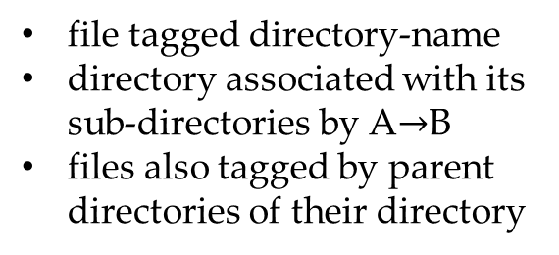
Importing semantics
Representing existing data on disk
$F_{H}$ : Set of files on disk not in system
𝐹_𝐻 : Set of files on disk not in system
$D_{H}$ : Set of Directories on disk not in system
𝐷_𝐻 : Set of Directories on disk not in system
Import Semantics
$$\left(fRd,∀d∈D_{H}xD_{H}\right)$$
(𝑓𝑅𝑑,∀𝑑∈𝐷_𝐻 𝑥𝐷_𝐻 )
Relating directories
$∀\left(d_{1},d_{2}\right)∈D_{H}, if d_{2}⊂d_{1}$ form $d_{1}→d_{2}$
∀(𝑑_1,𝑑_2 )∈𝐷_𝐻, 𝑖𝑓 𝑑_2⊂𝑑_1 form 𝑑_1→𝑑_2
Relate sub-directories by relation A$→$B
Relate sub-directories by relation A→B
create ordered pair $\left(f,d\right)$
create ordered pair (𝑓,𝑑)
file tagged directory-name
directory associated with its sub-directories by A$→$B
files also tagged by parent directories of their directory

Slide 60
Queries
Query operating on single tag
$$q\left(t\right)= \left\{f∈F | f∈h(t)\right\}$$
𝑞(𝑡)= {𝑓∈𝐹 │ 𝑓∈ℎ(𝑡)}
$$Q\left(t_{1},σ,t_{2}\right)=q\left(t_{1}\right) σ q\left(t_{2}\right)$$
𝑄(𝑡_1,𝜎,𝑡_2 )=𝑞(𝑡_1 ) 𝜎 𝑞(𝑡_2 )
$σ$ = {Union , Intersection, Symmetric difference, Set difference}
𝜎 = {Union , Intersection, Symmetric difference, Set difference}
Default operation
If no operation mentioned, default is Intersection
Default form of query: $Q\left(t_{1},t_{2}\right)=q\left(t_{1}\right)∩q\left(t_{2}\right)$
Default form of query: 𝑄(𝑡_1,𝑡_2 )=𝑞(𝑡_1 )∩𝑞(𝑡_2 )

Slide 61
Example
Let $A and B$ are two tags having the following files:
Let 𝐴 𝑎𝑛𝑑 𝐵 are two tags having the following files:
$$A∪B =\left\{{photo}_{1},{photo}_{2},{doc}_{1},{ppt}_{1}\right\}$$
𝐴∪𝐵 ={〖𝑝ℎ𝑜𝑡𝑜〗_1,〖𝑝ℎ𝑜𝑡𝑜〗_2,〖𝑑𝑜𝑐〗_1,〖𝑝𝑝𝑡〗_1 }
$$A∩B =\left\{{photo}_{1},{doc}_{1}\right\}$$
𝐴∩𝐵 ={〖𝑝ℎ𝑜𝑡𝑜〗_1,〖𝑑𝑜𝑐〗_1 }
$$A\backslash B =\left\{{photo}_{2}\right\}$$
𝐴\𝐵 ={〖𝑝ℎ𝑜𝑡𝑜〗_2 }
$$B\backslash A =\left\{{ppt}_{1}\right\}$$
𝐵\𝐴 ={〖𝑝𝑝𝑡〗_1 }
$$A⊖B=\left\{{photo}_{2},{ppt}_{1}\right\}$$
𝐴⊖𝐵={〖𝑝ℎ𝑜𝑡𝑜〗_2,〖𝑝𝑝𝑡〗_1 }
Operations
$$tag\left(B\right):files\left\{{photo}_{1},{doc}_{1},{ppt}_{1}\right\}$$
𝑡𝑎𝑔(𝐵):𝑓𝑖𝑙𝑒𝑠{〖𝑝ℎ𝑜𝑡𝑜〗_1,〖𝑑𝑜𝑐〗_1,〖𝑝𝑝𝑡〗_1 }
$$tag\left(A\right):files\left\{{photo}_{1},{photo}_{2},{doc}_{1}\right\}$$
𝑡𝑎𝑔(𝐴):𝑓𝑖𝑙𝑒𝑠{〖𝑝ℎ𝑜𝑡𝑜〗_1,〖𝑝ℎ𝑜𝑡𝑜〗_2,〖𝑑𝑜𝑐〗_1 }

Slide 62
PAPER PUBLISHED
KWEST – A SEMANTICALLY TAGGED VIRTUAL FILE SYSTEM

Slide 63
Paper Published
Paper Details
Name : Kwest - A Semantically Tagged Virtual File System
Link : Kwest.pdf
Conference Details
International Conference on Advanced Computer Engineering and Applications (ICACEA)
Date : 9th December, 2012
Venue : Trivandrum
Web Site

Slide 64
REFERENCES
KWEST – A SEMANTICALLY TAGGED VIRTUAL FILE SYSTEM

Slide 65
REFERENCES
2. Tagsistant, http://www.tagsistant.net
1. Chang.K, Perdana.I, Jain.M, Kartasasmita.I, Ramadhana.B, Sethuraman.K, Le.T, Chachra.N, Tikale.S, Knowledge File System-A principled approach to personal information management(KFS). 2010 IEEE International Conference on Data Mining Workshops, Page(s): 1037-1044.
3. Mohan.P, Raghuraman, Venkateswaran.S, Dr.Siromoney.A, Semantic File Retrieval in File Systems using Virtual Directories(SemFS). Proc. Linux Expo Conference, Raleigh, NC, Page(s): 141-151, May 2007.

Slide 66
---end---

Slide 67
USE CASE
Notes:
Snapshot of functions available to user for operating Kwest
Use kwest to organize his audio files
1. Add the “untitled” song file.
2. Create tag myPlaylist, myrock
3. To associate file to created tag: Tag playlist “untitled”
4. List playlist
5. List
6. Untag playlist untitled
7. Remove myplaylist
8. Remove untitled
9. Export myplaylist
10. Export kwest

Slide 68
COMPONENT
Notes:
File
To start organization user has to Start with add or removing file to kwest.
Add File
Remove File
2. Tag
1. Modify Tag
1. Create tag
2. Remove tag
2. Associate Tag File
1. Tag File
2. Untag File
3. List files in a tag or list all tags
4. Export tag or FS

Slide 69
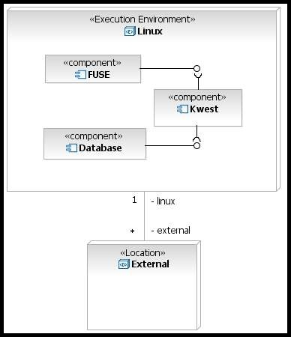
DEPLOYMENT
Notes:
File
To start organization user has to Start with add or removing file to kwest.
Add File
Remove File
2. Tag
1. Modify Tag
1. Create tag
2. Remove tag
2. Associate Tag File
1. Tag File
2. Untag File
3. List files in a tag or list all tags
4. Export tag or FS

Slide 70
SYSTEM DESIGN LEVEL-0

Slide 71
SYSTEM DESIGN LEVEL-1

Slide 72
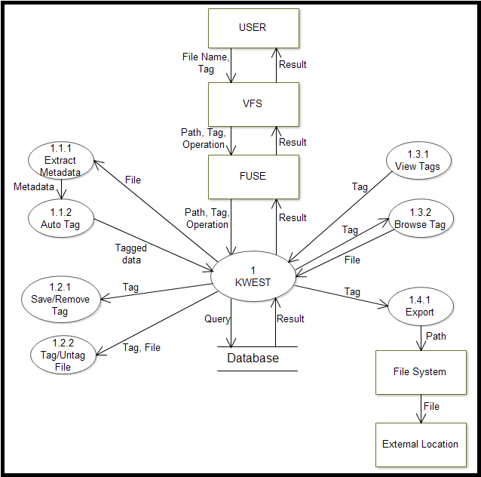
SYSTEM DESIGN LEVEL-2

Slide 73
INTRODUCTION FILE SYSTEM
Access can be shared to networks
User permissions and security managed by operating system
Interface to any application
System level management of data
Why a file system??
Used to store and retrieve data
Maps file paths (e.g., /etc/hostname)
to file contents and metadata
File systems

Slide 74
Traditional Filesystems
1. Mono-hierarchical structure in form of directories.
2. File can be listed only under a single directory.
3. Context or intent of file is not considered except in the filename or path.
4. Searching and organizing files is inefficient.

Slide 75
Traditional Filesystems
symbolic links, aliases,
soft links, shortcuts
not all programs recognize these or work correctly
metadata based tools: Spotlight, Google Desktop
cannot organize files no provision to store user's perspective of semantics other programs cannot access semantic info
what happens when link/target are modified?

Slide 76
Meta Data
What is meta-data??
Data about data – more information about what exactly the data represents.
MP3 file : has attributes like title, artist, album, genre etc.
Use in Semantic File Systems
Semantic file systems extends the set of metadata to all file types.
E.g. a file may include attributes: work, project, public, pictures, testing, etc.
Notes:
MP3 may have additional user-defined attributes like playlist.
Text files may have attributes like work, project, public, pictures, testing, etc.

Slide 77
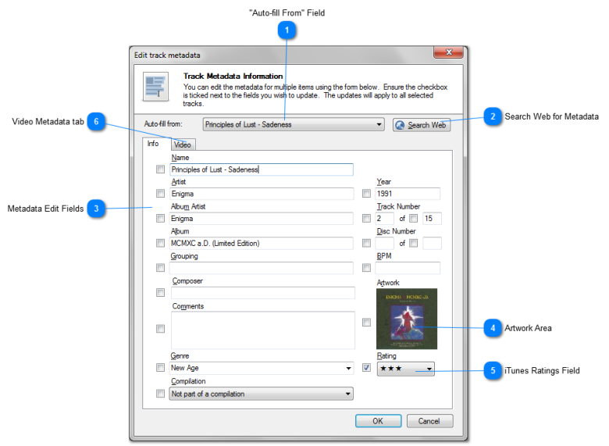
Snapshot

Slide 78
KFS
Multiple directory
Automatic classification
Text indexer
Custom Classifiers
KFS classification framework
Event logger
Copy, Move, Update, Delete operations on files are logged to embedded database.
Extended architecture
Indexer classifier logger are all customizable.
KFS for Linux
Easily extended by user made plug-in
Plug-ins and User -space Tools
GUI java program to manage KFS partitions
Plug-in to strip HTML tags

Slide 79
SFS
Multi-path accessing
Allows many paths leading to a file.
Enabling of efficient retrieval facilities
Indexing of this database allows the evaluation
Automatic tag extraction
Tags extracted automatically from the document itself.
Tag-based browsing

Slide 80
SemFS
File tagging
Versioning
Can be used to restore the file to previous content after a certain period of time.
Browsing file system based on file's metadata and attribute
Logical operators
^ for AND,| for OR, ! for NOT
Design
File system driver:-
FUSE or LUSE libraries.
SemFS API:-
Support for Views
Notify clients in case of view updates
Shield the user from the database

Slide 81
Creating and managing virtual filesystems
1. The Filesystem in Userspace (FUSE)
This mechanism allows userland code to plug into the virtual file system mechanism in Linux, NetBSD, FreeBSD, OpenSolaris, and Mac OS X.
2. Userland Shell namespace extensions
It allow virtual filesystems to be implemented on Microsoft Windows.
3. KIO and GVFS/GIO
Provide virtual file system mechanisms in the KDE and GNOME desktop environments (respectively).

Slide 82
4. The VFS tools and library
It is a collection of Functions, Structures and Tools, with which you can create and work with VFS on Windows.
5. Dokan library
Using this library we can create file systems very easily without writing device driver. Dokan Library is similar to FUSE but works on Windows.
6. Callback File System
It is a component set for presentation of data as files and directories of a local virtual disk. Regardless of where the actual data are kept: in files, in database records, memory, or elsewhere - they will be treated as if they were parts of a single file system.
7. LUFS
A hybrid userspace filesystem framework supporting many ”exotic” filesystems (localfs, sshfs, ftpfs, gnutellafs, locasefs, gvfs, cardfs, cefs, etc.).

Slide 83
FUSE
Simple library API
Simple installation (no need to patch or recompile the kernel)
Secure implementation
Userspace - kernel interface is very efficient
Usable by non-privileged users
Runs on Linux kernels 2.4 and above
Has proven very stable over time

Slide 84
FUSE operations
static struct fuse_operations hello_oper = {
.getattr = hello_getattr,
.readdir = hello_readdir,
.open = hello_open,
.read = hello_read,
};
int main(int argc, char *argv[]){
return fuse_main(argc, argv, &hello_oper,NULL);
}

Slide 85
Database Alternatives
1.SQLite
2. Firebird
3. MySQL
4. H2
SQLite is a relational database management system contained in a small C programming library. In contrast to other database management systems, SQLite is not a separate process that is accessed from the client application, but an integral part of it.
Firebird is an open source SQL relational database management system that runs on Linux, Windows, and a variety of UNIX.
MySQL is the world’s most used open source relational database management system (RDBMS) as of 2008 that run as a server providing multi-user access to a number of databases.
H2 is a relational database management system written in Java. It can be embedded in Java applications or run in the client-server mode. The disk footprint (size of the jar file) is about 1 MB.

Slide 86
Database Alternatives
5. Microsoft SQL Server Compact
7. NoSQL
6. Berkeley DB
8. Oracle Database
Microsoft SQL Server Compact is a compact relational database produced by Microsoft for applications that run on mobile devices and desktops.
NoSQL database management systems are useful when working with a huge quantity of data and the data’s nature does not require a relational model for the data structure.
Berkeley DB (BDB) is a software library that provides a high-performance embedded database for key/value data. As of 2012, Berkeley DB is the most widely used database toolkit in the world.
The Oracle Database (Oracle RDBMS) is an object-relational database management system (ORDBMS) produced and marketed by Oracle Corporation.

Slide 87
SQLite
Relational database management system
Zero Configuration
No client server architecture
Single Database File
SQLite does not need to be "installed" before it is used. There is no "setup" procedure.
The process that wants to access the database reads and writes directly from the database files on disk.
An SQLite database is a single ordinary disk file that can be located anywhere in the directory hierarchy.
SQLite is a relational database management system contained in a small C programming library.

Slide 88
SQLite
Readable source code
Variable-length records
Manifest typing
Compact
All procedures and data structures and many automatic variables are carefully commented with useful information about what they do.
It results in smaller database files, obviously. It also makes the database run faster, since there is less information to move to and from disk.
In manifest typing, the datatype is a property of the value itself, not of the column in which the value is stored.

Slide 89
Extraction Libraries
1. The libexif C
EXIF library is a library written in pure portable C. It reads and writes EXIF meta information from and to image files.
2. GNU Libextractor
It is a library used to extract meta data from files. GNU libextractor uses helper-libraries(plugins) to perform the actual extraction. As a result, GNU libextractor can be extended simply by installing additional plugins.
3. The Metadata Extraction Tool
This tool was developed to programmatically extract preservation metadata from a range of file formats like PDF documents, image files, sound files Microsoft office documents, and many others.
4. TagLib
TagLib is a library for reading and editing the meta-data of several popular audio formats such as FLAC, MPC, Speex, WavPack, TrueAudio, WAV, AIFF, MP4 and ASF files.

Slide 90
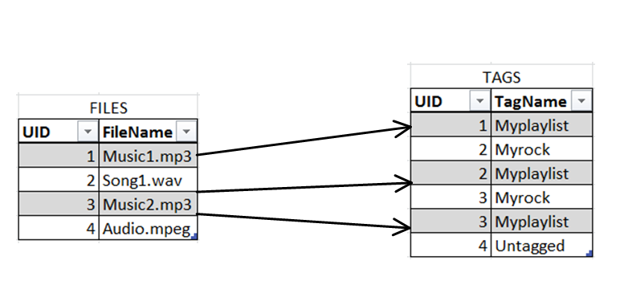
Relation between Files and Tags
( f R t )
R
R
R

Slide 91
Example
Let $t_{1}$,$t_{2}$,$t_{3}$ are the tags having the following files:
Let 𝑡_1, 𝑡_2, 𝑡_3 are the tags having the following files:
$$t_{1}:\{{photo}_{1},{photo}_{2},{doc}_{1}\}$$
𝑡_1:{〖𝑝ℎ𝑜𝑡𝑜〗_1,〖𝑝ℎ𝑜𝑡𝑜〗_2,〖𝑑𝑜𝑐〗_1}
$$t_{2}:\{{photo}_{1},{doc}_{1},{ppt}_{1}\}$$
𝑡_2:{〖𝑝ℎ𝑜𝑡𝑜〗_1,〖𝑑𝑜𝑐〗_1,〖𝑝𝑝𝑡〗_1}
$$t_{3}:\left\{{photo}_{1},{doc}_{3}\right\}$$
𝑡_3:{〖𝑝ℎ𝑜𝑡𝑜〗_1,〖𝑑𝑜𝑐〗_3 }
Q(S) = q(t1) σ q(t2) σ q(t3)
$$Q\left(S\right)=\{q\left(t_{1}\right)q\left(t_{2}\right)q(t_{3})\}$$
𝑄(𝑆)={𝑞(𝑡_1 )𝑞(𝑡_2 )𝑞(𝑡_3)}
result returned as files $\{{photo}_{1}\}$
result returned as files {〖𝑝ℎ𝑜𝑡𝑜〗_1}
$$Q\left(S\right)=\{q\left(t_{1}\right)∩q\left(t_{2}\right)q∪(t_{3})\}$$
𝑄(𝑆)={𝑞(𝑡_1 )∩𝑞(𝑡_2 )𝑞∪(𝑡_3)}
result returned as files $\{{photo}_{1},{doc}_{1},{doc}_{3}\}$
result returned as files {〖𝑝ℎ𝑜𝑡𝑜〗_1,〖𝑑𝑜𝑐〗_1,〖𝑑𝑜𝑐〗_3}
default processing is left to right unless precedence specified with parenthesis.
General Query

Slide 92
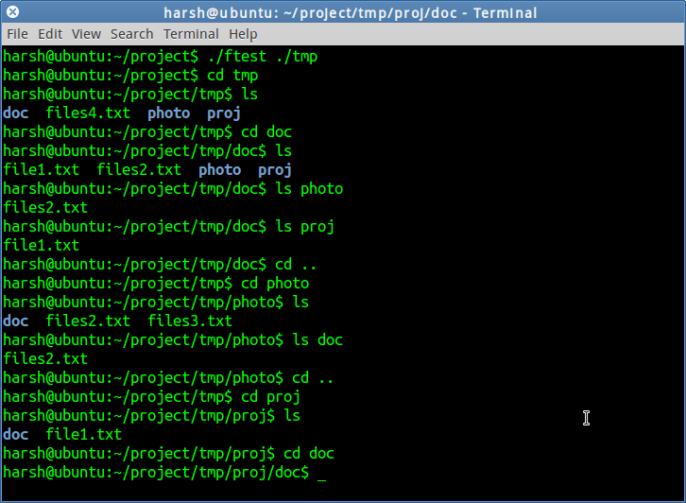
Terminal Example

Slide 93
Implementation Plan
Creating a working mini-model
Testing and results
Phase1: Full fledged semantic filesystem
Phase2: Querying the filesystem
Phase3: Relationships & Algorithms
Phase4: Optimizing the system
Packaging the software
Creating a user guide & documentation
Testing
Demonstration of the filesystem

Slide 94
INDEX
EXTRA
File System
Traditional FS
Metadata
KFS
SFS
SEMFS
VFS Alternatives
FUSE
Database Alternatives
SQLite
External Libraries
Relation between F and T
Eg. Multiple queries
Terminal Example
Implementation Plan

Slide 95
INDEX
MAIN
Intro Domain
Intro SFS
Problem Statement
Scope
Literature Survey
FUSE
SQLite
System Architecture
UML Diagrams
DFD
Mathematical Model
Paper Published
References

