Slide 1

UTILISING SEMANTIC WEB ONTOLOGIES TO PUBLISH EXPERIMENTAL WORKFLOWS
SIMPLIFYING EXPERIMENTS THROUGH DECENTRALISATION
Harshvardhan Pandit
Ensar Hadziselimovic
David Lewis

Slide 2
About Us
The ADAPT research centre focuses on developing next generation digital technologies that transform how people communicate. Adapt excels in areas of Natural Language Processing, Machine Learning, AI and many more.
ADAPT researchers are based in four leading universities:
Trinity College Dublin, Dublin City University, University College Dublin and Dublin Institute of Technology.
115 Expert Researchers 80 Industry Partners 327 Published Papers

Slide 3
Background and Motivation
Diversity in publishing methods
Centralised nature of publications
No clear guidelines when reproducing an experiment
Semantic web and linked data as decentralised approach
How to enable anyone to publish their experimental workflows?
Project Plan
Workflows -> Steps to perform the experiment Data -> What goes in, properties, conditions for usage
License -> Conditions for reproduction / repeatability /reuse
Publish using Linked Data

Slide 4
Open Publications
The Benefits
Workflows can be used as tools of documentation
Published under (author) self-controlled environment
Decentralise knowledge and connect through using linked data
Considerations
How do researchers conduct their research?
How does the research map into an ontology?
What existing ontologies can be used here?
How can we license data sets?
Can we create a user study?

Slide 5
Main Concepts in Experimental Workflows
Reproducibility and Repeatability
‘Sharing of data’ is a key tenet of scientific publications
Peer reviews are a decentralised form of validating research
Open Access needs access to data and implementation steps
Variations in experiments
Experiments are similar and use (almost) similar datasets
Variations of some common template or of previous research
Using linked open data, these experiments can be ‘linked’ together
Notes:
R&R Key component in experimental workflow

Slide 6
Licensing and Intellectual Property
Starting Point
Decision on best licensing practices
Need for comprehensive method to describe not just an experiment, but all of its components and the relations
Licensing model to suggest the best license
Decentralised approach to the above
Challenges
Explore the best practices
Avoid over-complicated legal requirements
Final experiment’s license is not sum of its parts
Inheritance: inclusion vs exclusion (parent-child relationship)

Slide 7
Ontologies
OPMW (Open Provenance Model for Workflows)
Based on PROV-O and P-Plan
Track provenance in scientific workflows
ODRL (Open Digital Rights Language)
Expressing digital rights management
Use for access and usage conditions

Slide 8
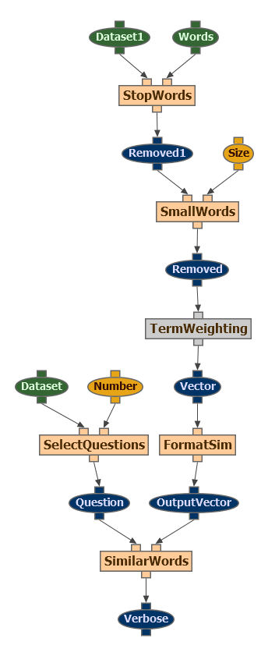
OPMW
http://www.opmw.org/
Template
Artifact
Data Variable
Parameter Variable
Process/Step
Execution
Artifact
Process
Controller / Agent
Notes:
There are two types of artifacts - data variables and parameter variables. Data variables can be used as inputs and can also be generated by processes whereas parameters work as expected for workflow steps.

Slide 9
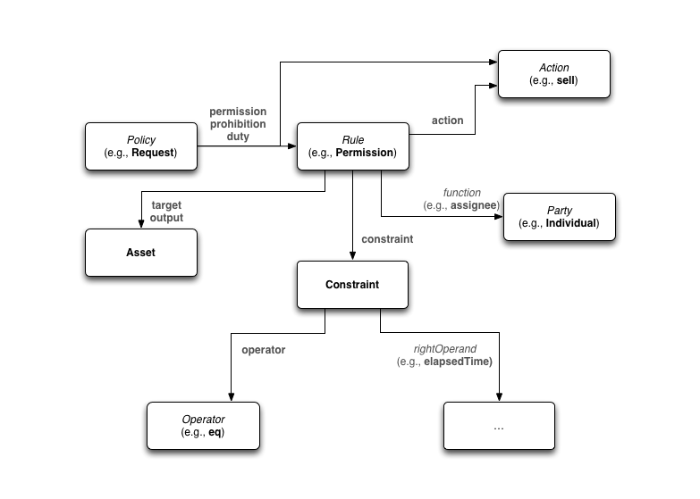
ODRL
https://www.w3.org/community/odrl/
Classes
Permission, Prohibition
Asset, Party
Policy, Privacy
Properties
inheritAllowed, inheritFrom
constraint, relation
attributedParty, consentingParty
Concepts
grantUse, annotate
anonymize, attribute
derive, distribute

Slide 10
ODRL - Concept of Inheritance Through Inclusivity
Concept
Property
Property
Concept
Party
(Experimenter)
grantUse
inheritAllowed = 1
grantUse
Party
(Experimenter)
annotate
inheritAllowed = 1
annotate
anonymize
inheritAllowed = 0
inheritFrom
Asset
(Parent Experiment)
Asset
(Child Experiment)
attribute
inheritAllowed = 1
attribute
derive
inheritAllowed = 1
derive
distribute
inheritAllowed = 0

Slide 11
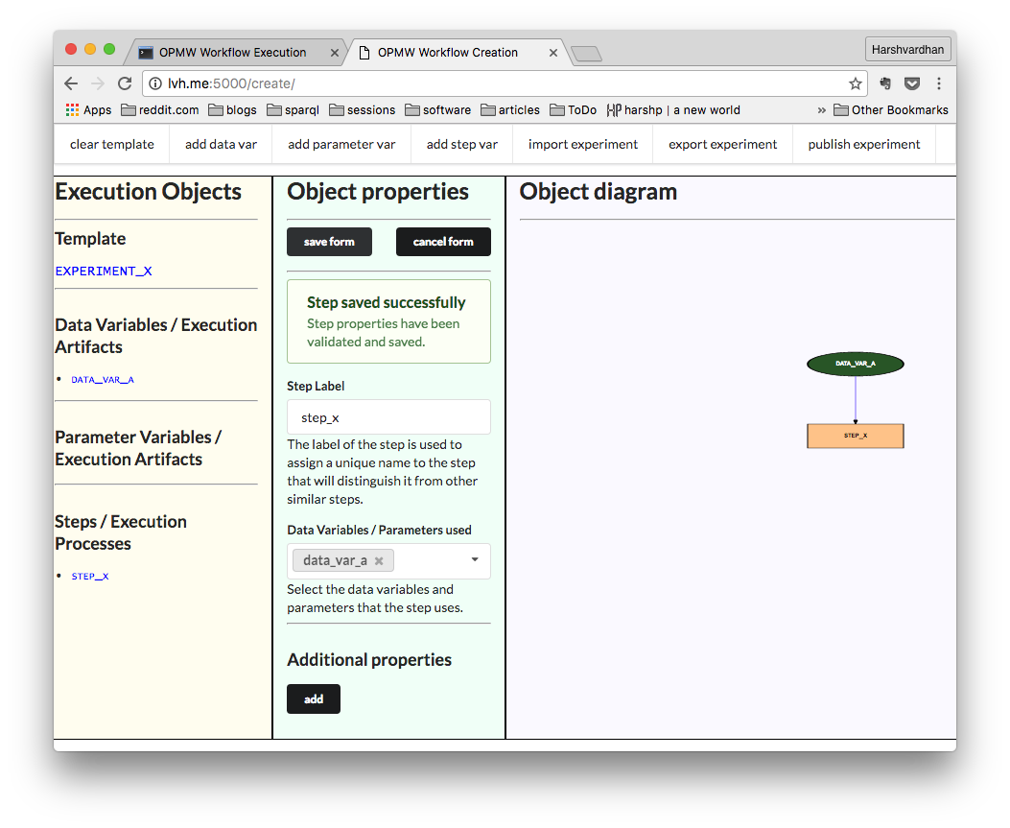
Create template
Experiment contains 3 tasks, based on user’s pre-existing knowledge on experimental workflows as well as linked data principles
All tasks converge on the documentation generated for the workflows which the users are encouraged to explore at the end of their task.
Notes:
The focus of the tool was in advancing knowledge about the use of vocabularies in facilitating sharing and repeatability of experiments and replication of results. We focused on researchers in areas aligned with Natural Language Programming (NLP) and Machine Learning (ML) as these contain a good variety of variations in experiment workflows where executions are highly interlinked and repetitive by nature.
The experiment contains three tasks, which combined together can take about one hour in terms of time for completion. To test the tool and the underlying study, we propose that users be assigned one task based on their familiarity with workflow documentation and running executions. This can be gauged by analysing their response to the pre-questionnaire. Users who are not familiar with linked open data or with using workflows can start with Task 1 which asks them to search for experiments containing specified attributes and resources using a form based interface. For users who are familiar with experimentation practices and workflows, Task 2 requires completion of an execution for an existing template. Task 3 can be suited for users who are familiar with linked open data and publication of workflows or are experienced with the concepts of reproduction and repeatability. The task asks them to create a variation of an existing template as an example of modifying existing research. Each tasks targets a different aspect of workflow documentation and consumption. Although the three tasks are disjoint with each other, they all converge on the documentation generated for the workflows which the users are encouraged to explore at the end of their task.

Slide 12
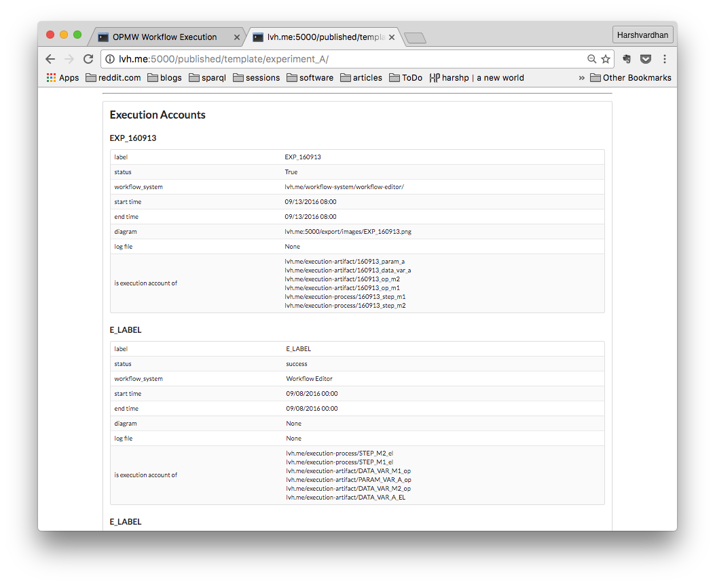
Generate some form of documentation
The documentation generated follows the principles of linked open data
Each resource has its own corresponding properties and attributes.
Comprehensive overview of the entire workflow as well as the ability to follow the links to the documentation for a particular resource.
Notes:
The tool also focused on the workflow documentation and its role in publication of the experiment and subsequent discovery of related work
The documentation generated within the tool follows the principles of linked open data where each resource has its own corresponding properties and attributes. For e.g. an execution instance will contain links to every resource it is associated with, such as the template it was based on, its execution processes and artifacts along with their corresponding template parameters, steps, and data variables. This allows a comprehensive overview of the entire workflow as well as the ability to follow these links to the documentation for a particular resource.

Slide 13
Benefit to the user
Premise
May not know about linked open data
May not know about semantic web and ontologies
Search for related research
Search for related data sets
Application
Browser based tool, GUI
Abstract ontology into simpler terms and forms
Introduce the users to linked open data and experimental workflows
Provide motivation to publish experiments using linked open data

Slide 14
Challenges
What exactly is a variation?
Different experiments have differing views
How to track provenance? PROV may not be sufficient.
Licensing issues are multi-dimensional problem
Ambiguity in attached licenses, or non-existing license
Intellectual Property can affect part of the experiment and the experiment as a whole - dissection needed

Slide 15
Future Work: User Study
(pre-)Questionnaire to gauge familiarity with linked data concepts and area of research
Ask participants to use the tool, generate documentation
(post-)Questionnaire to identify alignment with research methods and use of automatically generated documentation
More participants for user study
Formally declare variation of experiment as a workflow ontology term rather than through provenance
Attach licenses to datasets and generate documentation listing terms of usage

Slide 16
that’s all for today
Slides and comments: https://goo.gl/ARd2wJ
Source code: https://github.com/___
questions?
Notes:
coolharsh55/ opmw_workflow_editor

