Slide 1
Modelling provenance for GDPR compliance using linked open data vocabularies
Harshvardhan J. Pandit
Dave Lewis
ADAPT Centre
Trinity College Dublin
The ADAPT Centre is funded under the
SFI Research Centres Programme (Grant 13/RC/2106)
and is co-funded under the European Regional Development Fund.
Notes:
½
0:30

Slide 2
Presentation Index
Background on GDPR
Compliance for GDPR
Provenance requirements
Semantic Web Vocabularies
GDPRov vocabulary
SPARQL queries for compliance
Future Outlook
Notes:
½
1:00

Slide 3
GDPR
Greater responsibility & accountability
Needs ‘valid‘ given consent
Anonymisation & Pseudo-Anonymisation
Rights to Data Subjects
Fines up to 4% of global turnover
Record of processing activity
Data Protection Officer to monitor compliance
Record and notify about Data Breaches
Notes:
½
2:00

Slide 4
Article 6(1) Lawfulness of Processing
Given consent
Contract
Legal obligation
Protect vital interests
Public interest / Official authority
Legitimate interests
Notes:
½
2:30

Slide 5
Controller / Processor
Controller
Determines purposes of processing
More responsibilities
Appoints Processor(s)
Processor
Processes data on instruction of Controller
Cannot act outside given instructions
Notes:
½
3:00

Slide 6
Compliance
Demonstrate Compliance
PAST
Activities that already have happened
Records / Archives / Documentation
Monitor Compliance (on-going basis)
FUTURE
Activities yet to happen
Planning / Modeling
Notes:
1
4:00

Slide 7
Recital 82
“In order to demonstrate compliance with this Regulation, the controller or processor should maintain records of processing activities under its responsibility. Each controller and processor should be obliged to cooperate with the supervisory authority and make those records, on request, available to it, so that it might serve for monitoring those processing operations.“
Notes:
½
4:30

Slide 8
Provenance
Flexible in expression
Open
Shareable
Extendable
Queriable
Can be adapted for GDPR
Linked Open Data
Notes:
2
6:30

Slide 9
Semantic Web Vocabularies
Express → RDF
Model → OWL
Query → SPARQL
Collaborate → Open World Assumption eases creating abstract common model
Notes:
1
7:30

Slide 10
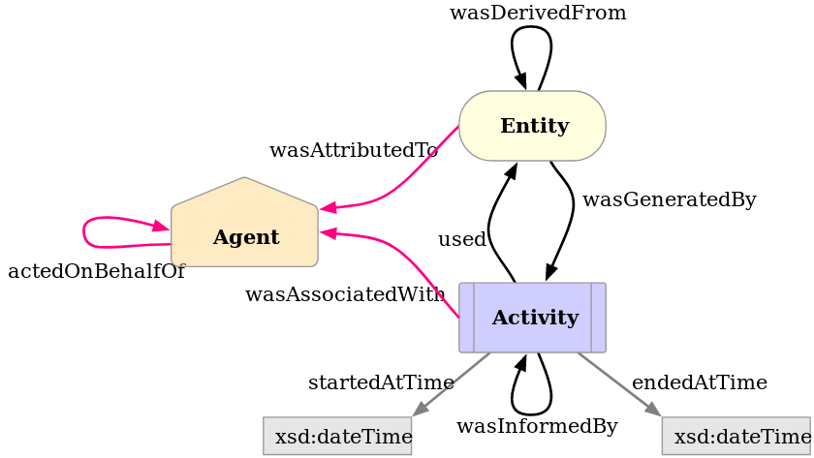
PROV Ontology (PROV-O)
https://www.w3.org/TR/prov-o/
OWL2 ontology to express provenance
W3C Recommendation 30-APR-2013
Notes:
½
8:00

Slide 11
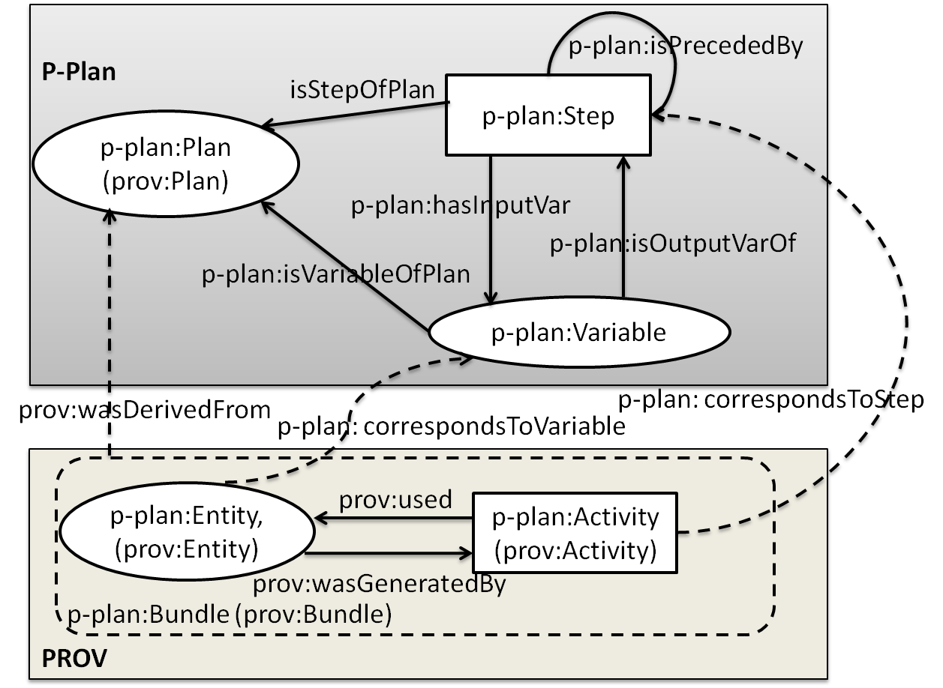
P-Plan
http://vocab.linkeddata.es/p-plan/
Extension of PROV-O
Represent ‘plan‘ that guided execution
Notes:
½
8:30

Slide 12
Research Hypothesis
Proveniance of activities and entities
Track / Model with relevance to compliance
Uses obligations specified by GDPR
Uses semantic web ontologies
Can be queried using SPARQL
QUESTION: to what extent?

Slide 13
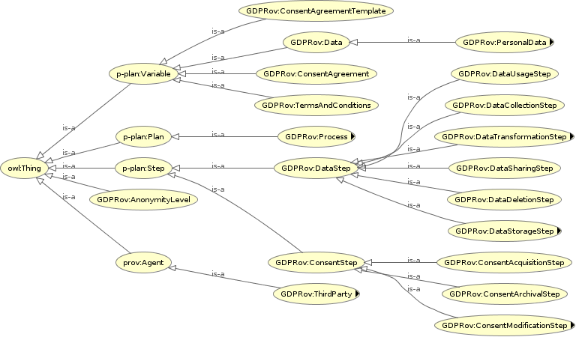
GDPRov GDPR Provenance Ontology
PROV-O → past executions
P-PLAN → future activities
Notes:
2
10:30

Slide 14
GDPRov - Data
Personal Data
Sensitive personal data
(Pseudo-)Anonymous data
Data Step
Use / Share / Delete / Transform / Modify
p-plan:Step → p-plan:Activity | prov:Activity
Notes:
1
11:30

Slide 15
GDPRov - Consent
Given Consent
ConsentAgreement (given consent)
ConsentAgreementTemplate (choices given)
Consent Step
Acquisition / Modification / Archival
p-plan:Step → p-plan:Activity | prov:Activity
Notes:
1
12:30

Slide 16
GDPRov - Process
Combine steps into a cohesive activity
Uses p-plan:Plan | prov:Plan
GDPR Rights
Data erasure, Consent Withdrawal, Data Rectification, etc.
Data Breach
Notify authority and data subject, record breach extent and actions, etc.
Notes:
1
13:30

Slide 17
SPARQL query
PREFIX GDPRov:
<https://openscience.adaptcentre.ie/ontologies/GDPRov#>
SELECT ?data ?sharestep ?isAnonymised ?anonymisationStep
WHERE {
?data a GDPRov:Data .
?sharestep a GDPRov:DataSharingStep .
?sharestep GDPRov:sharesData ?data.
BIND (
EXISTS { ?data a GDPRov:AnonymisedData . }
as ?isAnonymised ) .
OPTIONAL {
?anonymisationStep
GDPRov:generatesAnonymisedData ?data .
}
}
Query to retrieve data shared with third parties,
whether that data was anonymised, and if yes,
then using what process?
data | shareStep | isAnonymised | anonymiserStep
productsSold | productAnalytics | false | NULL
billingInfo | billingAnalytics | false | NULL
customerInfo | profiling | true | anonymiseUsers
Notes:
2
14:30

Slide 18
GDPR linked data resource
References to canonical text are needed to -
Associate provenance
Cover obligations
Track compliance queries
GDPR as linked data resource
Use SKOS to model concepts
Use European Legislation Identifier (ELI)
Notes:
½
15:00

Slide 19
GDPRtEXT GDPR text EXTensions
GDPR text as RDF & Annotated HTML
Define concepts from GDPR as skos:Concept
Relates terms to where they occur
Relates terms to each other
Accessible online https://openscience.adaptcentre.ie
Notes:
½
15:30

Slide 20
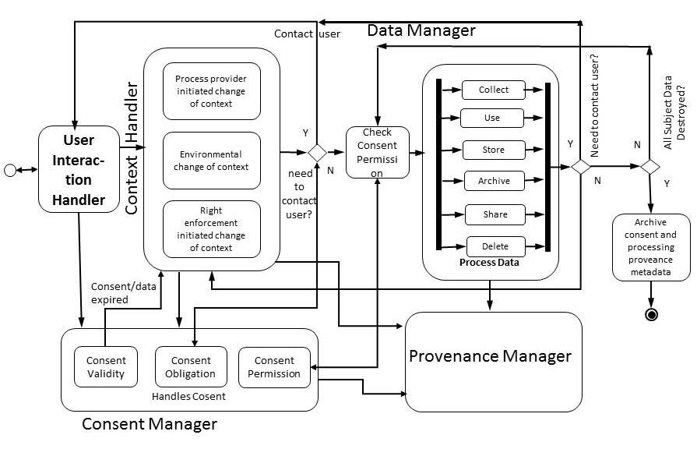
GDPR – the BIGGER picture

Slide 21
Quick Recall - Contributions
Expressing Provenance of Entity/Activity by extending PROV-O / P-Plan
Modelling ontology on GDPR obligations and terms
Using SPARQL to retrieve provenance information relevant to compliance
Creation of GDPRtEXT resource

Slide 22
Future Outlook
Model use-cases for provenance and compliance queries
UsablePrivacy project → annotated privacy policies that describe data collection process
Create a vocabulary to express GDPR terms
Keep a lookout for privacy policies updated to reflect requirements of GDPR
Google Cloud recently published their GDPR privacy policy
Notes:
2
17:30

Slide 23
Let‘s Discuss!!!
GDPR
Provenance
Semantic Web Vocabularies
GDPRov model
SPARQL queries for compliance
GDPRtEXT resource
Collaboration me + you = ideas
Notes:
Wrap up

