Slide 1
A Semantic Web Ontology for expressing GDPR compliance over consent & data lifecycles
Harshvardhan J. Pandit
Supervised by: Dave Lewis
Co-Supervised by: Declan O‘Sullivan
Theme E
ADAPT Centre
Trinity College Dublin
The ADAPT Centre is funded under the
SFI Research Centres Programme (Grant 13/RC/2106)
and is co-funded under the European Regional Development Fund.

Slide 2
Presentation Index 12~13mins ; 25 slides
Motivation
Research Question & Contribution
State of the Art
Work done till date
Completion Plan
Overview ; Summary Website: https://openscience.adaptcentre.ie/
More information
In Transfer Report
More info in page(s):
Notes:
This presentation will be for about 12-13mins. I will be presenting my research motivation, the work done till date, and completion plan for the PhD. All resources related to research and publications are available on the Openscience website. Where possible, I have provided links to relevant pages in the Transfer report at the bottom of the slide.

Slide 3
GDPR General Data Protection Regulation
Needs ‘valid‘ given consent
Fines 4% of global turnover
Record of processing activity
Data Protection Officer to monitor compliance
Demonstrate compliance → Past
Plan & Maintain compliance → Future
More info in page(s): 3
Notes:
~1.0
GDPR is the new and guiding data protection law to be enforced in May next year. It is mandatory, and comes with good motivation in the form of large fines. GDPR Compliance requires keeping records of activities involving personal data and monitoring compliance as a continous process as in demonstrating compliance i.e. in the past, as well as for intended actions i.e. in the future.

Slide 4
Research Area and Domain
Express legal obligations → ODRL
Infrastructure for GDPR compliance
Metadata modeling, storing, and querying
Provenance Metadata
Activity and Entity
i.e. Consent and Personal Data lifecycles
More info in page(s): 3-4
Notes:
~1.15
Therefore, GDPR compliance involves working with significant amounts of metadata and encompasses a large area in terms of research oppurtunities. The requirement of being able to easily model, share, and query this metatadata is where semantic web technologies can be beneficial as they provide a proven way to do all three. For my PhD, I‘ve decided to focus or narrow this down to compliance involving provenance metadata, which in the context of GDPR is the metadata associated with consent and personal data lifecycles.

Slide 5
Research Question
To what extent can GDPR obligations be expressed and evaluated using compliance queries over provenance of consent & data lifecycles expressed using semantic web ontologies?
More info in page(s): 4
Notes:
~1.30
The research question for the work, therefore, revolves around the extent to which GDPR obligations can be modelled, queried, and evaluated using semantic web ontologies.

Slide 6
Research Objectives
State of the art in representing provenance of consent & data lifecycles
Demonstrate effectiveness of SPARQL as a query mechanism for retrieving compliance related information from provenance graph
Explore how constraints over provenance graphs can be used as a mechanism for expressing and evaluating GDPR obligations
More info in page(s): 4-5
Notes:
~2.0
Based on this, the objectives of the research can be formulated into three incremental stages of research. Of this, the core objectives are #2 and #3, which correspond to identifying and retrieving relevant information from provenance records and using them to formulate and evaluate constraints based on GDPR obligations.

Slide 7
Research Contribution
Major Contribution
Creation of an ontology to express GDPR compliance based on obligations evaluated over provenance graphs of consent and data lifecycles
Minor Contributions
- Ontology to express provenance
- Constraints to express compliance obligations
- GDPR as a resource
More info in page(s): 5
Notes:
~2.30
The major contribution of this research would be an ontology to express GDPR compliance based on the provenance of consent and data lifecycles. Such an ontology can be useful in the analysing of compliance as well as in identification of information relevant to the creation of compliance documentation.
Minor contributions include representation of provenance, a way to use graph constraints to evaluate legal obligations, and representing GDPR itself as a linked data resource.

Slide 8
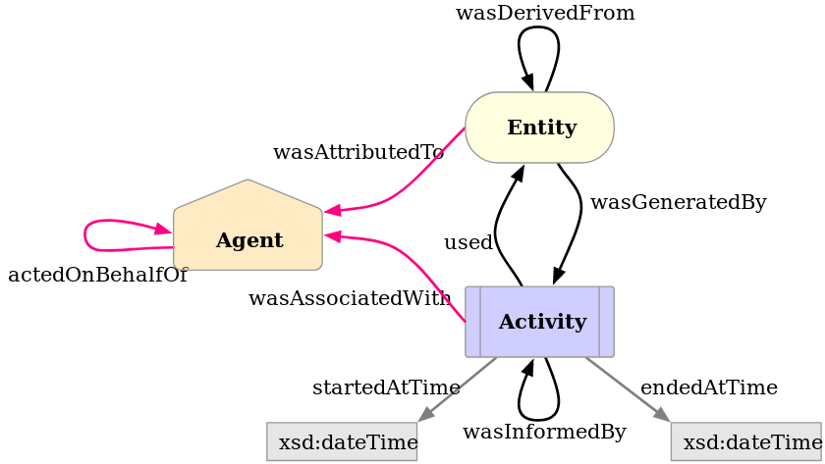
State of the Art Provenance - PROV Ontology (PROV-O)
https://www.w3.org/TR/prov-o/
OWL2 ontology to express provenance
W3C Recommendation 30-APR-2013
Interaction between Activity, Entity, Agents
Record history (past)
More info in page(s): 7-8
Notes:
~2.45
For state of the art in representing provenance, we have PROV-O, which is a W3C recommendation for recording the interactions between activities, entities, and agents.

Slide 9
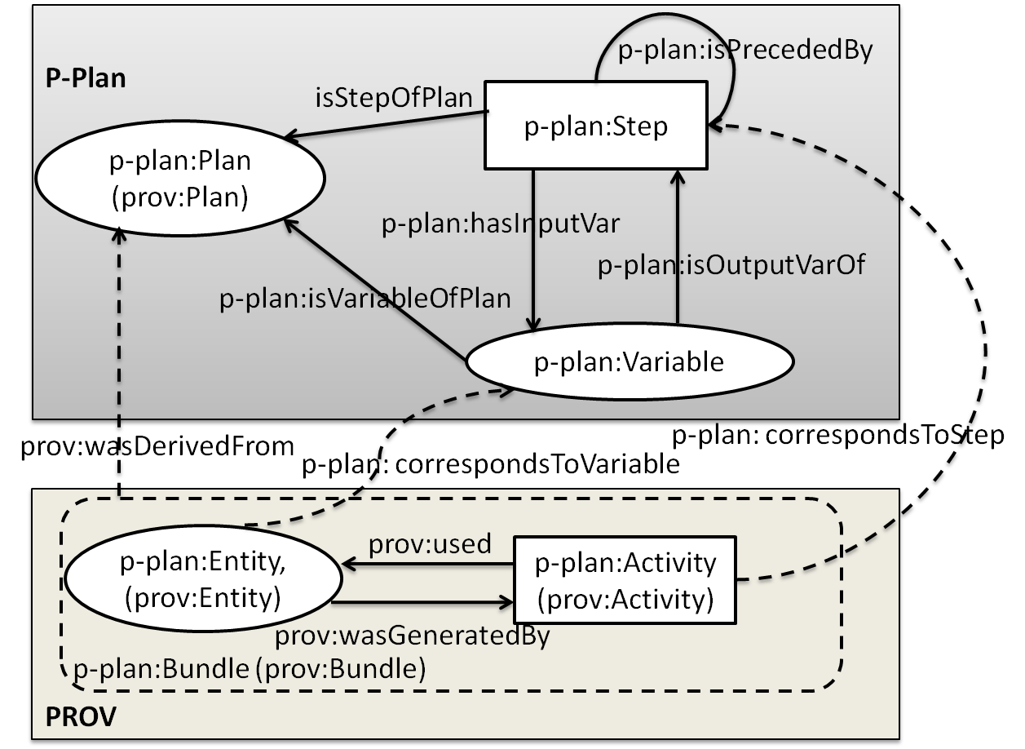
State of the Art Provenance - P-Plan
http://vocab.linkeddata.es/p-plan/
Extension of PROV-O
Represent ‘plan‘ that guided execution
Model execution that is yet to happen (future)
Common template
Individual instantiations using PROV-O
More info in page(s): 7-8
Notes:
~3.00
This is extended by P-Plan for representing a plan or a model for what is supposed to happen. This can be used to create a common template of a process instantiated into records that differ in implementation or dataset, for example algorithm in a step or a data produced as output.

Slide 10
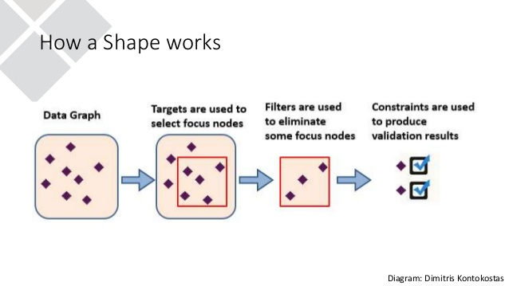
State of the Art Constraints – Shapes Constraint Language (SHACL)
https://www.w3.org/TR/shacl/
W3C Recommendation 20-JUL-2017
Describe and validate RDF graphs
What should the graph ‘look like‘ to be valid?
SHACL-SPARQL to define constraint using SPARQL
More info in page(s): 8-10
Notes:
~3.30
For constraints, SHACL is the W3C recommendation for representing the shape of a graph. It is used to define constraints that are evaluated to produce reports in RDF. The premise of SHACL is to check whether the graph satisfies a certain pattern or shape based on presence of information and links in the graph. SHACL-SPARQL is an extension to SHACL that allows using SPARQL queries to model the constraints.

Slide 11
State of the Art Graph patterns / fragments
WHY?
Different use-cases
Common requirements
Easier to query
Evaluate constraints
Check information exists
HOW?
Pattern detection
Extracting fragments
Isomorphism
Reduction
Abstraction
Change detection
More info in page(s): 11-12
Notes:
~4.0
Because of the scope of the metadata involved, the resulting data-graphs can be quite complex and large. To reduce the complexity, existing approaches based on graphs can be utilised. These can help in detecting common patterns or fragments, reducing or converting individual use-cases into common structures or abstractions that can ease the task of querying for information. These approaches may not be RDF-specific, but the basic principle is that of action on a set of connected nodes.

Slide 12
State of the Art Legislation & Privacy
GDPR
Bartolini et. al.
Model GDPR
Based on draft
Log / Blockchain ^{[4, 56]}
Impact Assessment
Other legislation HIPAA, PIPPA, DPD, ...
Privacy Policy
UsablePrivacy Project
https://usableprivacy.org/
115 annotatedpolicies
EuroPrise
https://www.european-privacy-seal.eu/
GDPR certification through audit
More info in page(s): 12-14
Notes:
~4.45
For GDPR, Bartolini et. al. modeled an ontology for GDPR concepts which was based on a draft version of the regulation. It is not up-to-date, does not specify where the concepts come from, and does not address compliance or provenance.
The UsablePrivacy project contains 115 privacy policies of top internet websites that are annotated by legal researchers to show what data is being collected and how it is used and who it may be shared with.
EuroPrise gives certifications and seals to organisations based on their data protection practices. Their latest certification addresses the GDPR.

Slide 13
Work done till date Gathering Requirements
Goal: Representing provenance of consent & data lifecycles using semantic web vocabularies
Identify requirements by reading GDPR
Evaluate existing work
PROV-O and P-Plan identified to be suitable
Extend with relevant terminology
More info in page(s): 15-16
Notes:
~5.00
Coming to work done till date, the requirements gathered from evaluating existing work led to identifying PROV-O and P-Plan as being suitable for representing provenance of consent & data lifecycles. However, they needed to be extended with relevant terms and concepts to make them specific to the GDPR.

Slide 14
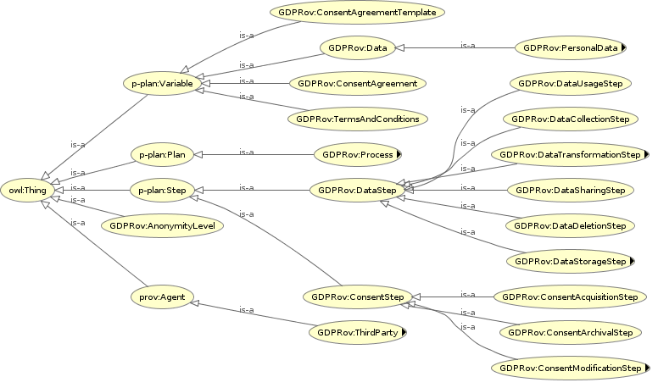
Work done till date GDPRov – GDPR Provenance Ontology
Separation between personal data and consent activities and entities
GDPR terminology
Published at PrivOn workshop co-located with ISWC 2017 ^{[5]}
More info in page(s): 16-18
Notes:
~5.30
This led to the creation of GDPRov, which was presented recently at the PrivOn workshop co-located with ISWC, the top conference in semantic web domain. Apart from modeling GDPR provenance requirements, GDPRov provides separation between data and consent which makes it possible to have specific queries over them for different GDPR obligations.

Slide 15
Work done till date GDPRov – query using SPARQL
PREFIX GDPRov:
<https://openscience.adaptcentre.ie/ontologies/GDPRov#>
SELECT ?data ?sharestep ?isAnonymised ?anonymisationStep
WHERE {
?data a GDPRov:Data .
?sharestep a GDPRov:DataSharingStep .
?sharestep GDPRov:sharesData ?data.
BIND (
EXISTS { ?data a GDPRov:AnonymisedData . }
as ?isAnonymised ) .
OPTIONAL {
?anonymisationStep
GDPRov:generatesAnonymisedData ?data .
}
}
Query to retrieve data shared with third parties,
whether that data was anonymised, and if yes,
then using which process
data | shareStep | isAnonymised | anonymiserStep
productsSold | productAnalytics | false | NULL
billingInfo | billingAnalytics | false | NULL
customerInfo | profiling | true | anonymiseUsers
More info in page(s): 16-18
Notes:
~6.00
Using GDPRov, this is a rudimentary query that retrieves information related to sharing of anonymised data with third parties. The results returned by the query can be further used to evaluate whether the sharing was in adherence to GDPR obligations. An extention to this query could be retrieving the source of data in question, or the consent associated with the data to check whether such sharing is valid or not.

Slide 16
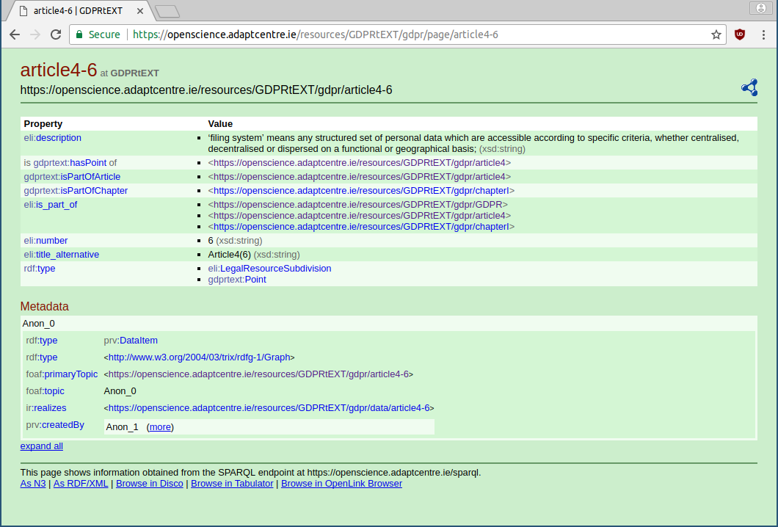
Work done till date GDPRtEXT – GDPR as a linked data resource
RDF dataset
Annotated HTML version
SPARQL endpoint
DCAT catalog
Refer to specific points within GDPR
Publication opportunity ESWC 2018 resource track
More info in page(s): 18-19
Notes:
~6.30
Since everything constantly refers to specific points within the GDPR, the legal text was used to create a RDF dataset where individual points and articles have unique IRIs so that they can be additionally annotated. This was then exposed using DCAT and a SPARQL endpoint, where I tried to follow best practices preached by the community.

Slide 17
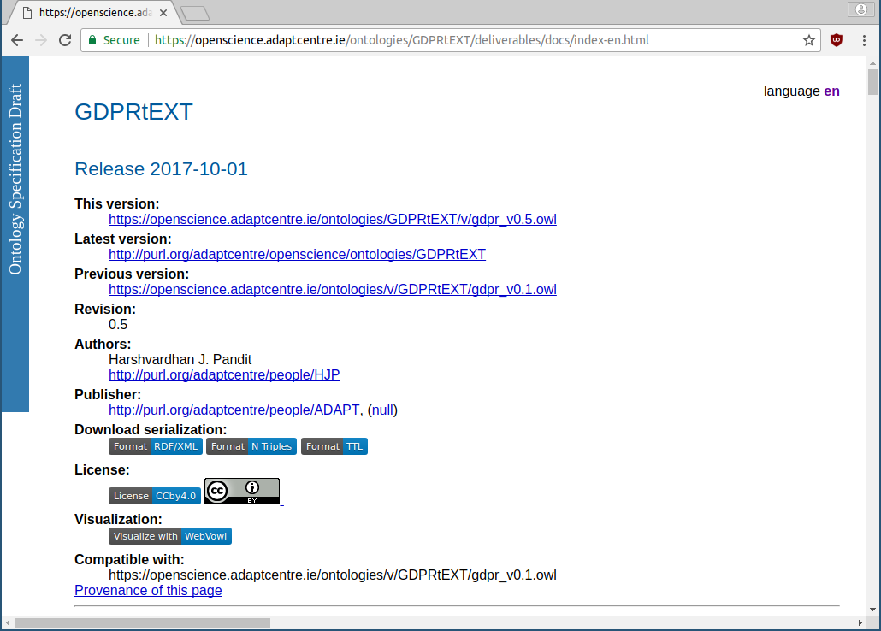
Work done till date GDPRtEXT – GDPR ontology
Defines terms using skos:Concept
Link related terms
200+ concepts for GDPR
Rights
Compliance
Obligations
Data & Consent
More info in page(s): 18-19
Notes:
~7.00
I also created an ontology for representing the concepts for GDPR. This was inspired from the work done by Bartolini et. al., with the improvement of being more up-to-date, linked back to the specific points where the concept is defined in GDPR, and defining terms keeping in mind the requirement for representing compliance.

Slide 18
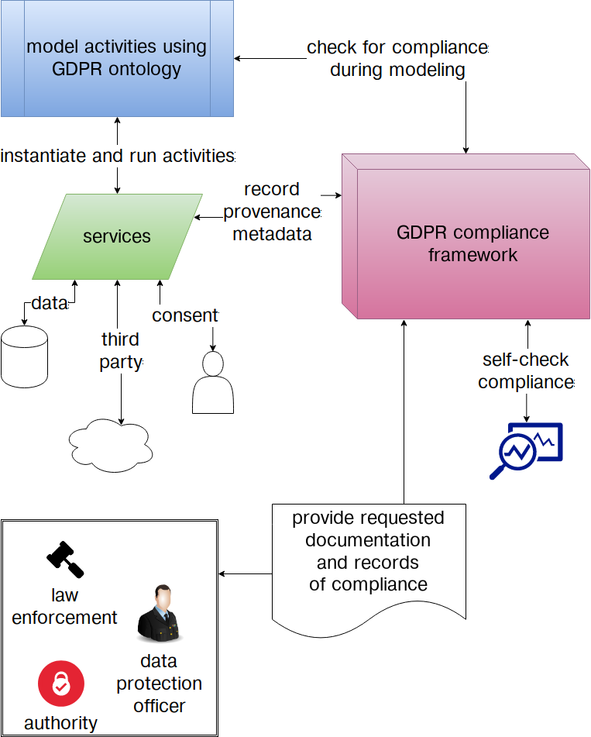
Work done till date Collaborative Work
Consent and Data Management Framework ^{[9]}
Consent ontology
Model GDPR compliance activities and processes
Data Protection Rights Language ^{[3]}
ODRL extension
Model data sharing agreements between third-parties
Notes:
~7.30
Collaboration with other researchers resulted in two publications. The first was for a consent ontology and a framework model for GDPR compliance. The second was for an ontology to represent and track data sharing between organisations. Both approaches target GDPR by providing parallel approaches regarding compliance and thereby benefit my research.

Slide 19
PhD Completion Plan Phase I - Compliance queries for provenance lifecycles
Corpus of use-cases using GDPRov
UsablePrivacy to understand data-related activities
EuroPriSe as use-case
Identify information needed for compliance
Express query to retrieve this information
SPARQL + SPIN → capture SPARQL queries as RDF data
Hypothesis: Provenance information pertaining to GDPR obligations can be retrieved using SPARQL queries
More info in page(s): 21-22
Notes:
~8.0
Moving on to the proposed PhD Completion Plan, which is in two phases. First phase relates to retrieving information regarding specific obligations, termed as compliance queries. This starts with the creation of use-cases using GDPRov, taking examples from UsablePrivacy and EuroPriSe, then building SPARQL queries to get the relevant information, and recording the queries using SPIN.

Slide 20
PhD Completion Plan Phase I - Compliance queries for provenance lifecycles
Evaluation criteria
Difficult to measure as data cannot be evaluated as qualitative nor quantitative
Focus on question -
“how much information is present?“
Which obligations can be expressed as queries?
What % of GDPR can be covered using these queries?
More info in page(s): 21-22
Notes:
~8.30
The evaluation of obligations is difficult without a legal background, so instead, I‘m going to be looking at how much of the relevant information is present, whether it is in the required format, and can it be expressed relevant to provenance. This will then be used to create a compliance score as an indication of information presence related to specific obligations.

Slide 21
PhD Completion Plan Phase II – Expressing constraints over provenance lifecycles
Gather use-cases from real-world compliance
Take obligations from Phase I, and express as constraints using SHACL
Evaluate the constraints → provides a metric
Evaluation can be both the presence as well as structure of information
Hypothesis: GDPR obligations can be expressed as constraints over provenance graphs and evaluated as compliance queries
More info in page(s): 22-23
Notes:
~9.30
The second phase starts after the GDPR comes into effect May next year with use-cases based on how various organisations react to the requirements of the GDPR. These use-cases would then be expressed using GDPRov and evaluated using constraints specified by SHACL based on presence of information as well as on its structure. Since SHACL already has a way to represent evaluations, there is a possibility to extend it to represent evaluation of GDPR obligations. The metric in this phase incorporates the compliance score from the first phase in addition to SHACL evaluations.

Slide 22
PhD Completion Plan Phase II – Expressing constraints over provenance lifecycles
SHACL-SPARQL can use SPARQL to model query for constraint ; re-use queries from Phase I
Compare two approaches to find benefits and drawbacks ; see which model fits which obligation
To make evaluation easier, use graph-based approaches to reduce amount of complexity
An ontology to express compliance information based on the evaluation of these approaches
More info in page(s): 22-23
Notes:
~10.30
The SPARQL queries from the first phase can be re-used using SHACL-SPARQL. This also provides an oppurtunity to compare the constraints using SHACL with some of the SPARQL queries, and to decide whether an obligation is better dealt with by just retrieving information using SPARQL, or can it also be represented as a constraint using SHACL that can be evaluated as a result. SHACL has severity levels such as high and warning which can further be utilised to separate concerns regarding the obligations. The final outcome of this phase, and the research, would be an ontology to represent the compliance information along with evidence in form of evaluated use-cases.

Slide 23
Summary Publications
Modelling provenance for GDPR compliance using linked open data vocabularies (2017 Workshop) Harshvardhan J. Pandit, Dave Lewis. Society, Privacy and the Semantic Web - Policy and Technology (PrivOn), co-located with ISWC 2017
Compliance through Informed Consent: Semantic Based Consent Permission and Data Management Model (2017 Workshop) Kaniz Fatema, Ensar Hadziselimovic, Harshvardhan J. Pandit, Dave Lewis. Society, Privacy and the Semantic Web - Policy and Technology (PrivOn), co-located with ISWC 2017
Linked Data Contracts to Support Data Protection and Data Ethics in the Sharing of Scientific Data (2017 Workshop) Ensar Hadziselimovic, Kaniz Fatema, Harshvardhan J. Pandit, Dave Lewis. Sharing of Scientific Data in Enabling Open Semantic Science (SemSci), co-located with ISWC 2017.
Utilising Semantic Web Ontologies to publish Experimental Workflows (2017 workshop) Harshvardhan J. Pandit, Ensar Hadziselimovic, Dave Lewis. Joint Proceedings of the 1st International Workshop on Scientometrics and 1st International Workshop on Enabling Decentralised Scholarly Communication co-located with 14th Extended Semantic Web Conference (ESWC 2017)
The Use of Open Data to Improve the Repeatability of Adaptivity and Personalisation Experiment (2016 position) Harshvardhan J. Pandit, Ramisa Hamed, Seamus Lawless, David Lewis. Published in the proceedings of the 1st EvalUMAP workshop - Towards comparative evaluation in user modeling, adaptation and personalization, held in conjunction with the 24th Conference on User Modeling, Adaptation and Personalization, UMAP 2016.
More info in page(s): 5-6
Notes:
~11.0
Till date, there have been 5 publications. The first three are relevant to the PhD research, whereas the other two are from the directed study, though still relevant as they deal with workflows, provenance, and lifecycles.

Slide 24
Summary Short term and Long term Plan
Next 6 months
Create use-cases
SPARQL queries
GDPR obligations
GDPRtEXT resource
Publication: ESWC 2018
Next 18 months
Evaluate SPARQL queries
Express SHACL constraints
Explore graph techniques
GDPR impact
Publication: ISWC2018, ESWC2019
Notes:
~12.0
In conclusion, the following is the short-term and long-term plan I intend to follow. The next 6 months will be the creation of use-cases and compliance queries along with wrapping up the GDPRtEXT resource in time for publication at ESWC next year, which is a top-tier conference for semantic-web. After that, following the enforcement of GDPR, I would be updating my use-cases based on real-world examples, and using SHACL constraints to model GDPR obligations. I will also be looking into how graph-based techniques can be used to make the queries and evaluations easier. The planned dissemination of this would be in ISWC and ESWC the following year.

Slide 25
A Semantic Web Ontology for expressing GDPR compliance over consent & data lifecycles
END OF PRESENTATION
Notes:
Thank you.

Slide 26
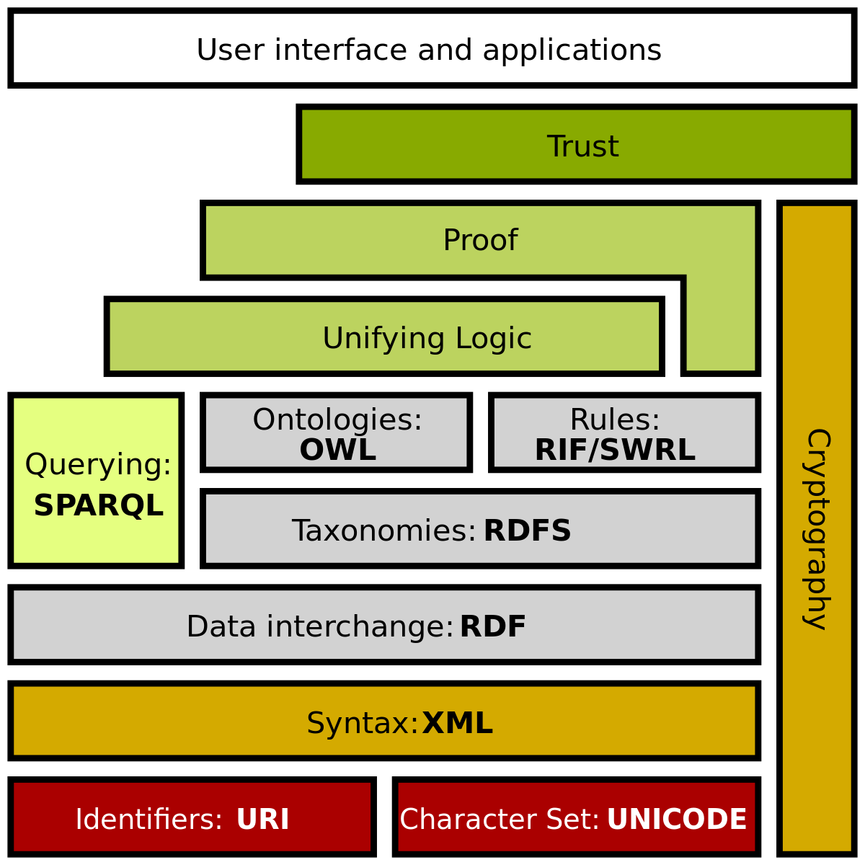
GDPR Semantic Web Technologies
METADATA
Flexible
Open
Shareable
Extendable
Queriable
More info in page(s): 3
Notes:
½ ==1.0
Semantic web technologies can help with metadata
Flexible open shareable common model
Between stakeholders

Slide 27
Recital 82
“In order to demonstrate compliance with this Regulation, the controller or processor should maintain records of processing activities under its responsibility. Each controller and processor should be obliged to cooperate with the supervisory authority and make those records, on request, available to it, so that it might serve for monitoring those processing operations.“
Notes:
½
4:30

Slide 28
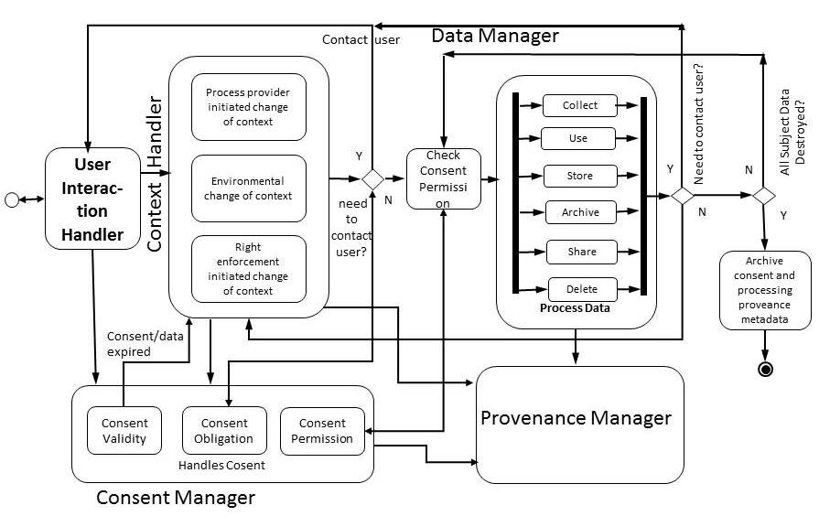
GDPR – the BIGGER picture

Slide 29
SPARQL query evaluation
Given use-case: personal data is shared with another organisation
Check:
Where did personal data come from?
What is the legal justification for using it?
Does it have given consent?
Is 3rd party a processor or controller?
Was the data anonymised? How?

Slide 30
SHACL constraints
Define constraint
Use of data must have legal justification associated → can be via ontology property
Personal data must have history of where it came from and under what conditions
Sharing of data must be made explicit with reason and identity of entity
Can user consent be evaluated within provenance of activities over personal data?

Slide 31
Potential benefits
Documentation for compliance can be automated to a certain extent
Some part of legal compliance checking can be automated
Sharing of information and processes between stakeholders
Common model for expressing information
Notes:
½ == 12.0

Slide 32
PhD Completion Plan
Phase I Build use-cases and compliance queries
Pre GDPR enforcement
SPARQL queries to retrieve information about consent and data usage required for compliance
Based on real-world use-cases
Outcome: compliance queries identified from GDPR
Phase II Express obligations as provenance constraints
Post GDPR enforcement
Constraints using SHACL
Takes into factor how organisations have reacted to GDPR w.r.t. privacy policies
Outcome: ontology to express compliance based on evaluation of constraints
More info in page(s): 19-23
Notes:
½ == 8.5

Slide 33
PhD Completion Plan Phase I - Compliance queries for provenance lifecycles
Evaluation criteria – Compliance score
Are all obligations of the same severity? Do they have different ‘weights‘?
Is absence of information a violation?
Can we link queries back to specific text in GDPR?
Goal: Create a ‘compliance score‘ based on these questions that can aid in compliance determination
More info in page(s): 21-22
Notes:
½ == 10.0

Slide 34
PhD Completion Plan Collaboration
ADAPT
Ensar Hadziselimovic, Gabriel Hogan → GDPR research
Theme C → personalisation domain
SPECIAL https://www.specialprivacy.eu/
Scalable Policy-aware Linked Data Architecture For Privacy, Transparency and Compliance
acquisition of consent
metadata (consent policies, event data, context)
privacy-aware, secure workflows with access control, transparency and compliance verification
More info in page(s): 24
Notes:
½ == 11.5

