Slide 1

Exploring Linked Data For The Automatic
Enrichment of Historical Archives
Gary Munnelly, Harshvardhan J. Pandit, Séamus Lawless
ADAPT Centre
Trinity College Dublin
Dublin, Ireland
The ADAPT Centre is funded under the
SFI Research Centres Programme (Grant 13/RC/2106)
and is co-funded under the European Regional Development Fund.

Slide 2
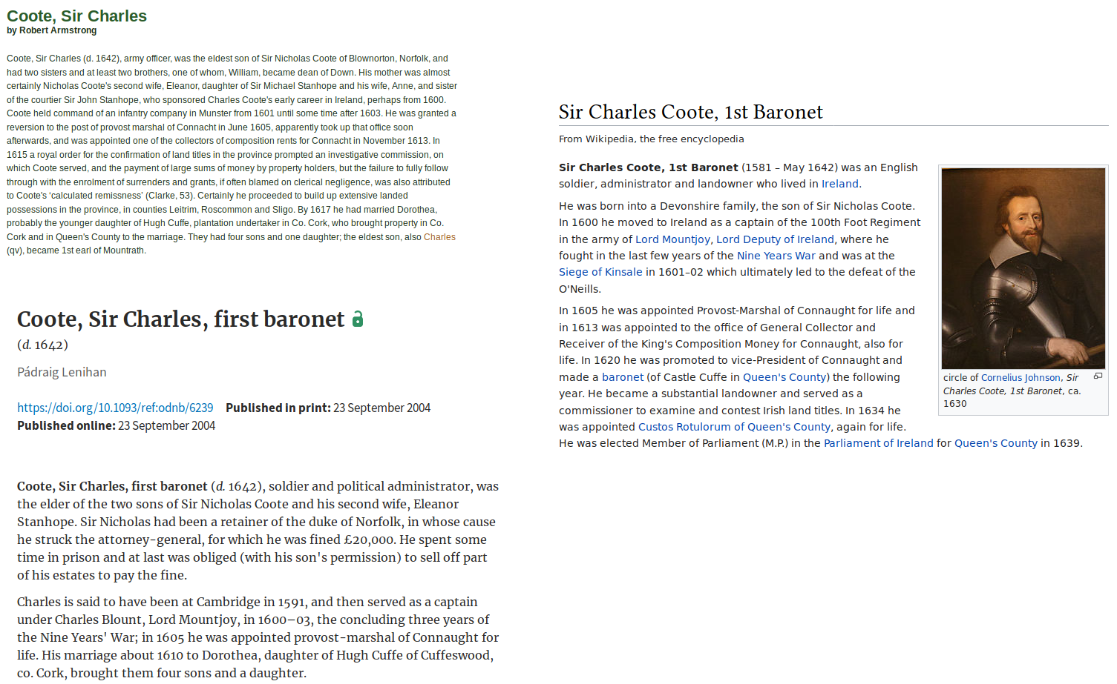
Notes:
Thank you.

Slide 3
Annotate with Semantics
Manual Annotation
Automatic Annotation
Accurate Annotation !!!
Notes:
Thank you.

Slide 4
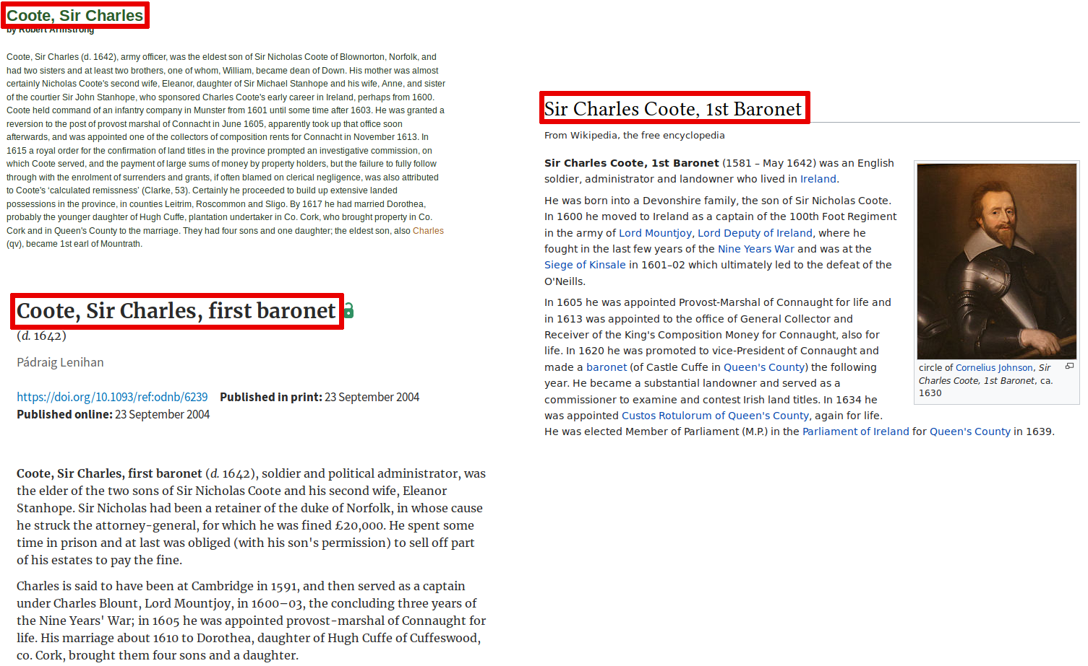
Notes:
Thank you.

Slide 5
Entity Linking
Vast vast collection of documents and entities
Lack of semantic resource
Notes:
Thank you.

Slide 6
Entity Linking System
Knowledge Base
Lack of semantic resources
Link using DBpedia or YAGO
Notes:
Thank you.

Slide 7
Accuracy of EL methods
Accuracy is high
Only small set of entities is linked
For comparison:
  Human annotator identified 33% [13]
  Link Europeana to Wikipedia 22% [14]

Slide 8
Why does this happen?
Cultural collections are diverse, complicated, and unique
A common semantic resource to cover all is very difficult to engineer
So how to annotate when there is no appropriate semantic web resource to help us?

Slide 9
REDEN [15]
Investigated methods of using multiple knowledge bases for disambiguation
DBpedia + Bibliothèque Nationale de France (BnF)
Uses literal string comparison for candidate selection
owl:sameAs and skos:exactMatch to resolve duplicates into single reference

Slide 10
1641 Depositions
17th Century manuscripts containing letters, witness statements taken from Irish people during the 1641 rebellion
Digitised, transcribed, annotated by a team of historical scholars
Extracted references to people and locations, tagged based on content, preserved physical information such as margin notes

Slide 11
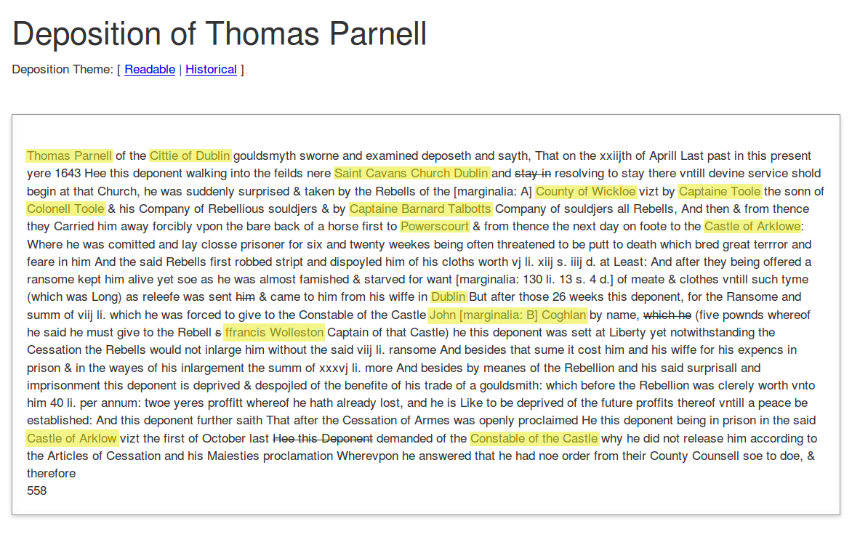
1641 Deposition

Slide 12
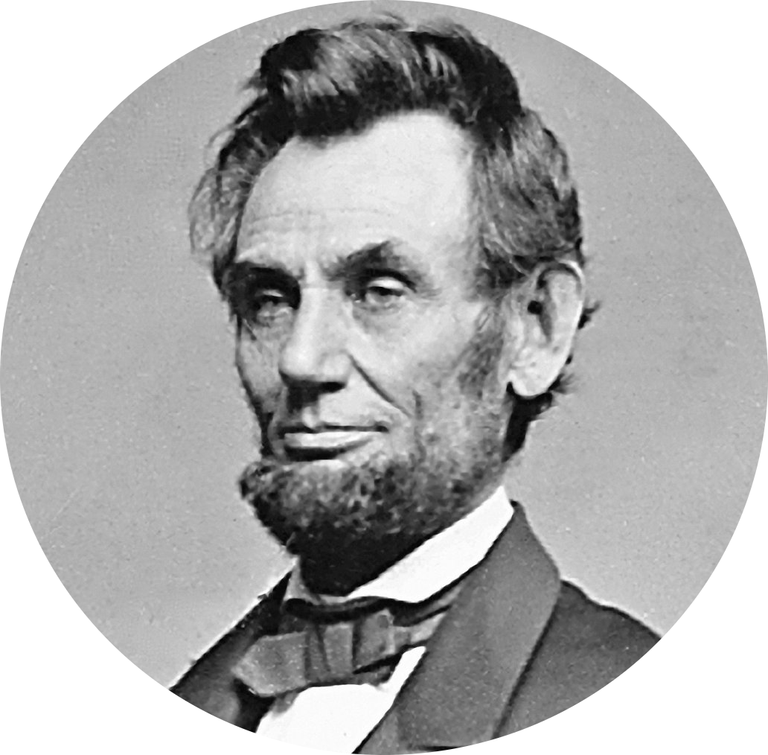
Does anyone know Abraham Lincoln?

Slide 13
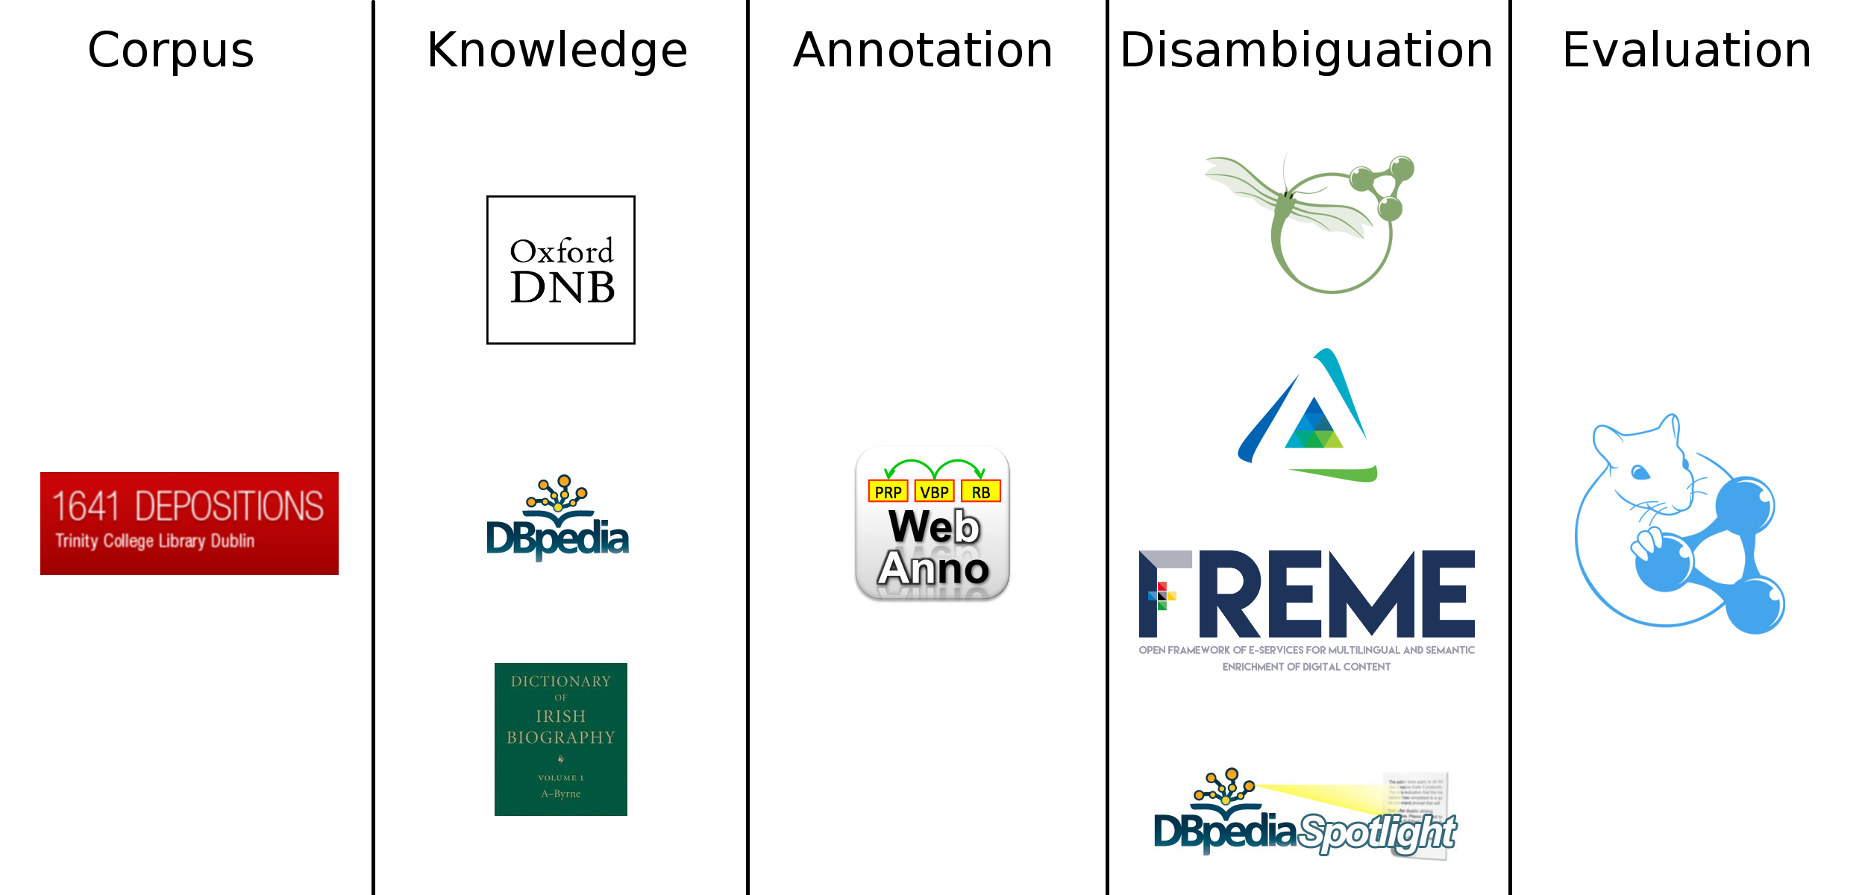
pipeline

Slide 14
Challenges
Incosistent spellings and grammar
Variance in granularity both for important people as well as places
Duplication

Slide 15
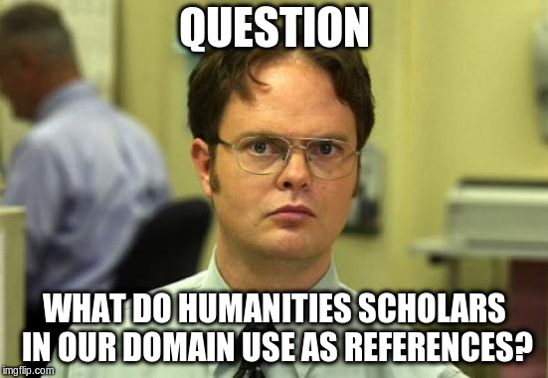

Slide 16
Challenges (contd.)
No definite or authoritative source of people
Incosistent language with no good way to resolve
How to establish relationships between these entities?
Can we state that someone may know someone else without stating it as a fact?

Slide 17
Resources
Down Survey
Statute Staple
Books of Survey and Distribution
Petty Maps
Do you know of any more?
Please share them with us!

Slide 18
Constructing the ontology
Resolution using DICE coefficient [19] and Jaro-Winkler distance [20]
Checked by a historian (slow process)
Uplift to RDF
Use as knowledge-base for EL system

Slide 19
Exploring Linked Data For The Automatic
Enrichment of Historical Archives
END OF PRESENTATION
Notes:
Thank you.

