Slide 1

GDPR-driven Change Detection in Consent and
Activity Metadata
Harshvardhan J. Pandit, Declan O‘Sullivan, Dave Lewis
ADAPT Centre
Trinity College Dublin
Dublin, Ireland
The ADAPT Centre is funded under the
SFI Research Centres Programme (Grant 13/RC/2106)
and is co-funded under the European Regional Development Fund.

Slide 2
GDPR
General Data Protection Regulation
Needs ‘valid‘ given consent
Fines 4% of global turnover
Record of processing activity
Data Protection Officer to monitor compliance
Demonstrate compliance → Past
Plan & Maintain compliance → Future
Notes:
~1.0
GDPR is the new and guiding data protection law to be enforced in May next year. It is mandatory, and comes with good motivation in the form of large fines. GDPR Compliance requires keeping records of activities involving personal data and monitoring compliance as a continous process as in demonstrating compliance i.e. in the past, as well as for intended actions i.e. in the future.

Slide 3
Research
Area and Domain
Express legal obligations → ODRL
Infrastructure for GDPR compliance
Metadata modeling, storing, and querying
Provenance Metadata
  Activity and Entity
  i.e. Consent and Personal Data lifecycles
Notes:
~1.15
Therefore, GDPR compliance involves working with significant amounts of metadata and encompasses a large area in terms of research oppurtunities. The requirement of being able to easily model, share, and query this metatadata is where semantic web technologies can be beneficial as they provide a proven way to do all three. For my PhD, I‘ve decided to focus or narrow this down to compliance involving provenance metadata, which in the context of GDPR is the metadata associated with consent and personal data lifecycles.

Slide 4
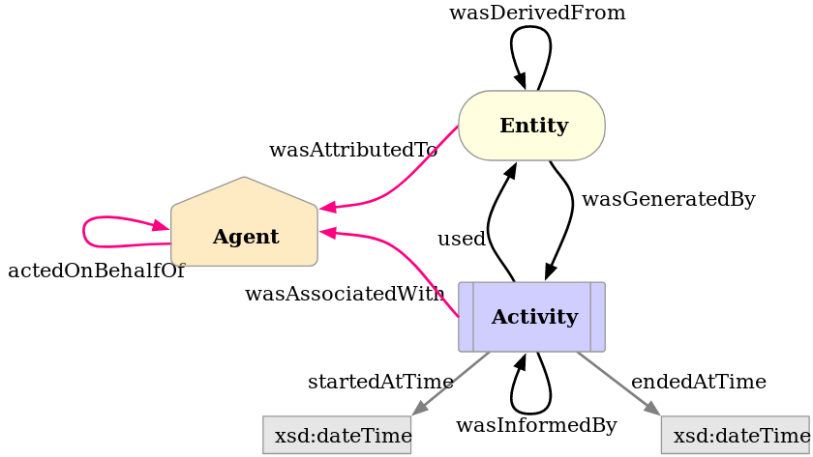
State of the Art
Provenance - PROV Ontology (PROV-O)
https://www.w3.org/TR/prov-o/
OWL2 ontology to express provenance
W3C Recommendation
30-APR-2013
Interaction between Activity, Entity, Agents
Record history (past)
Notes:
~2.45
For state of the art in representing provenance, we have PROV-O, which is a W3C recommendation for recording the interactions between activities, entities, and agents.

Slide 5
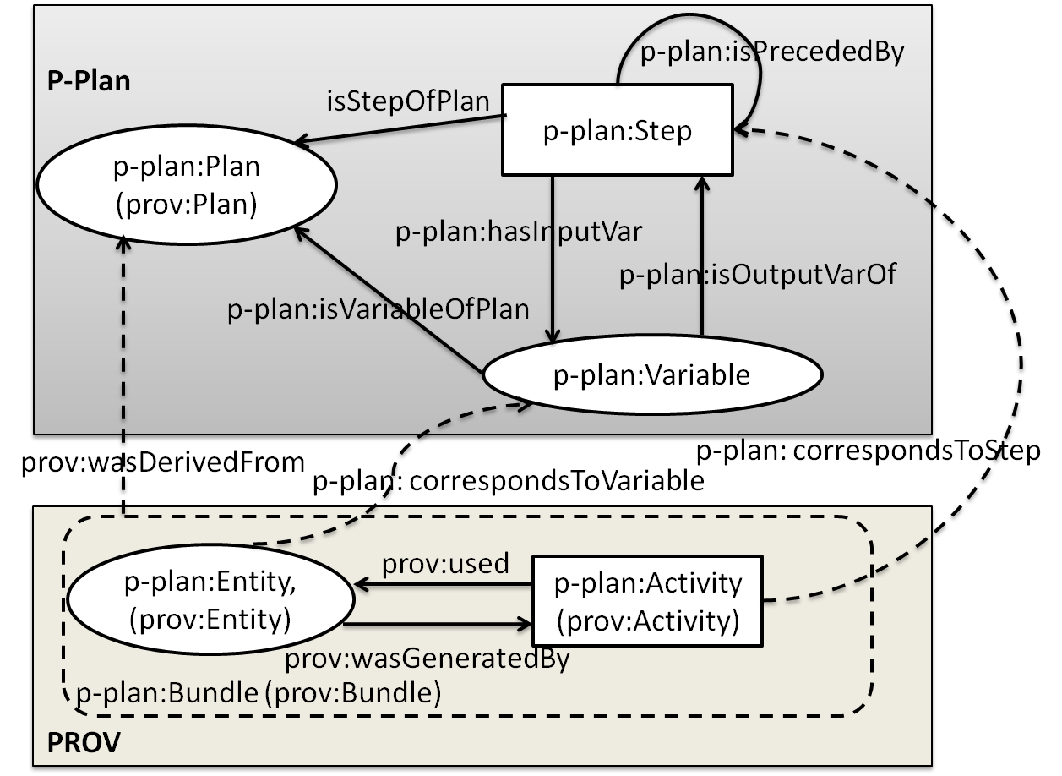
State of the Art
Provenance - P-Plan
http://vocab.linkeddata.es/p-plan/
Extension of PROV-O
Represent ‘plan‘ that guided execution
Model execution that is yet to happen (future)
Common template
Individual instantiations using PROV-O
Notes:
~3.00
This is extended by P-Plan for representing a plan or a model for what is supposed to happen. This can be used to create a common template of a process instantiated into records that differ in implementation or dataset, for example algorithm in a step or a data produced as output.

Slide 6
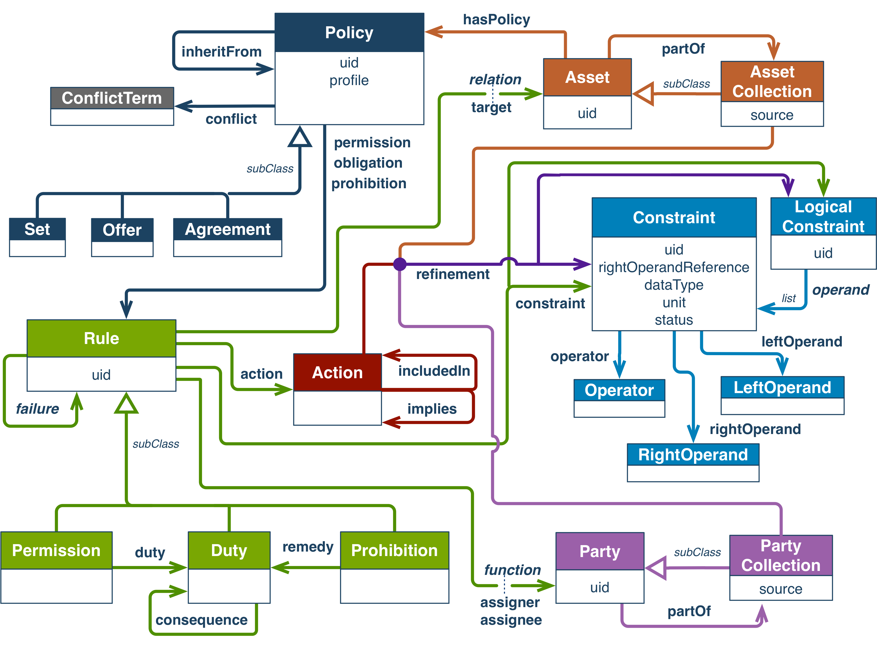
State of the Art
ODRL – Open Digital Rights Language
https://www.w3.org/TR/odrl-model/
Policy language
Permissions and Prohibitions
W3C Recommendation 15th February 2018
Notes:
~3.00
This is extended by P-Plan for representing a plan or a model for what is supposed to happen. This can be used to create a common template of a process instantiated into records that differ in implementation or dataset, for example algorithm in a step or a data produced as output.

Slide 7
Representation of Metadata
Consent → ODRL
  An agreement between user and data controller or service provider
  Express permissions and restrictions
Provenance → P-Plan + PROV-O
  What activities was the consent given for?
  Express what is happening or has happened with the data

Slide 8
Changes in Consent
Previously, Sue gave consent to send ads using the email address [1]
Later, this consent was revoked
Expressing this as ODRL, we have two objects, where the permission rules is changed to a prohibition rule

Slide 9
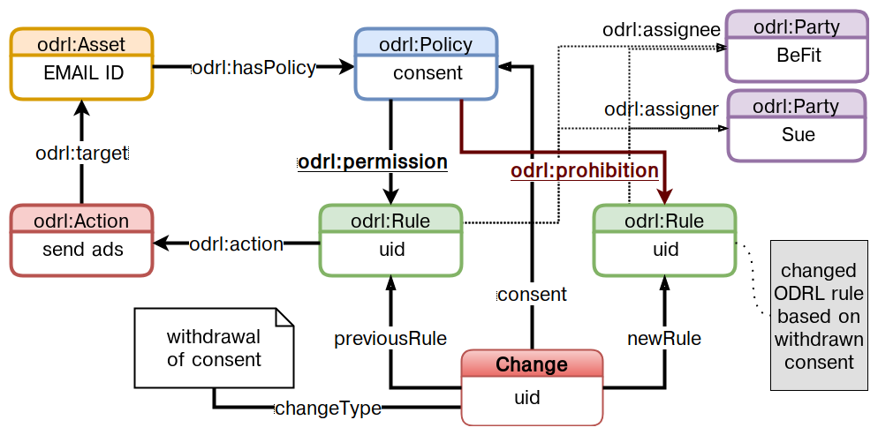
Capturing Changes in Consent

Slide 10
Changes in Activities
Email is used for tracking fitness (as account)
Later, email is also used to send ads
This is a change in the activities where the use of email has changed, and therefore may require an updated consent (change!)
Expressing this using P-Plan allows representing it as an abstract model

Slide 11
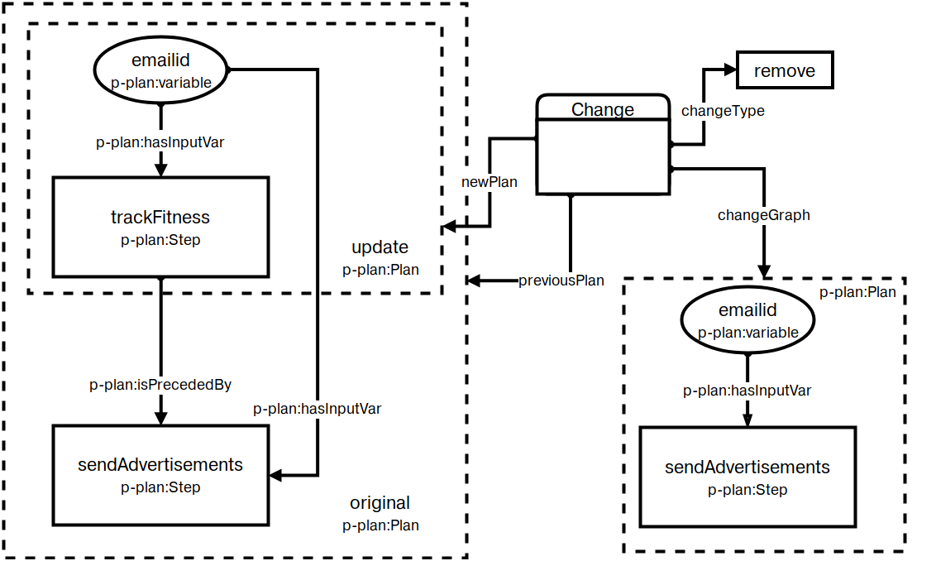
Capturing Changes in Activities

Slide 12
Linking Changes
We know that consent affects activities
We also know that activities affects consent
For compliance purpoes, how should this information be captured and represented?

Slide 13
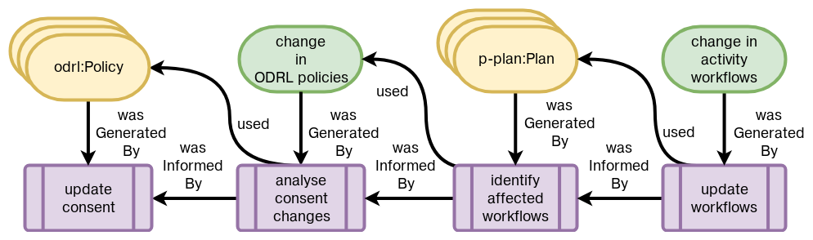
Linking Changes using Provenance Traces

Slide 14
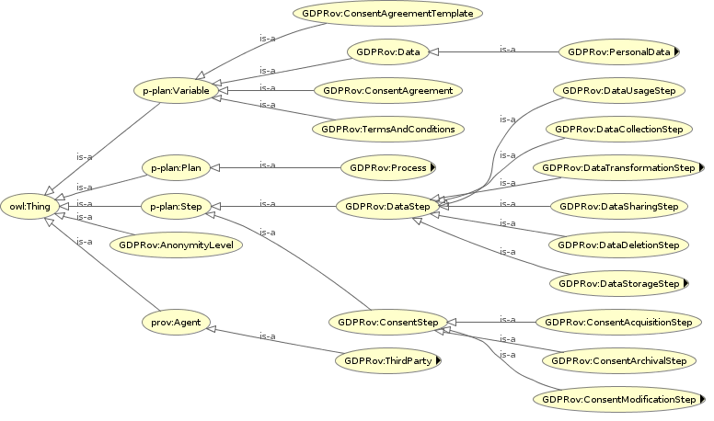
A more relevant ontology
GDPRov – GDPR Provenance Ontology
Separation between personal data and consent
activities and entities
GDPR terminology
Published at PrivOn
workshop co-located
with ISWC 2017
Notes:
~5.30
This led to the creation of GDPRov, which was presented recently at the PrivOn workshop co-located with ISWC, the top conference in semantic web domain. Apart from modeling GDPR provenance requirements, GDPRov provides separation between data and consent which makes it possible to have specific queries over them for different GDPR obligations.

Slide 15
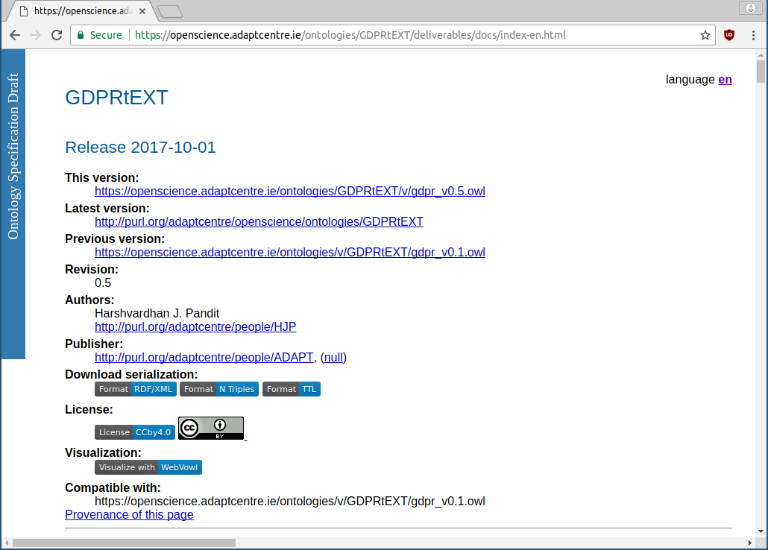
A more relevant ontology
GDPRtEXT – GDPR ontology
Defines terms using skos:Concept
Link related terms
200+ concepts for GDPR
To be presented at
ESWC2018 Resource Track
Notes:
~7.00
I also created an ontology for representing the concepts for GDPR. This was inspired from the work done by Bartolini et. al., with the improvement of being more up-to-date, linked back to the specific points where the concept is defined in GDPR, and defining terms keeping in mind the requirement for representing compliance.

Slide 16
Challenges at scale
Detect changes
Analyse changes
Demonstrate changes were compliant
Reflect real-world use-cases

Slide 17
Fallback Solution
If this model is not feasible at scale, can we show it working over a model of the system?
If the model of the system is compliant, is it sufficient to say the system is compliant?
tldr; Show changes at the model level instead of instance level

Slide 18
Potential Applications
Privacy Policies on the Web
Can we track how they change and what the change is using the approach described in this presentation?

Slide 19
GDPR-driven Change Detection in Consent and
Activity Metadata
END OF PRESENTATION
Notes:
Thank you.

