Slide 1


GConsent
A Consent Ontology based on the GDPR
Harshvardhan J. Pandit, Christophe Debruyne, Declan O’Sullivan, Dave Lewis
ADAPT Centre, School of Computer Science & Statistics, Trinity College Dublin, Ireland
email: pandith@tcd.ie | debruync@tcd.ie
website: http://openscience.adaptcentre.ie/
ontology: https://w3id.org/GConsent
The ADAPT Centre is funded under the SFI Research Centres Programme (Grant 13/RC/2106) and is co-funded under the European Regional Development Fund.
Notes:
@chrdebru have added both email - switch order as you like
link to project website openscience.adaptcentre.ie
link to ontology w3id.org/GConsent
documentation contains all resources and examples in the slides, plus more information

Slide 2
Presentation Structure
Background on Consent
Consent Requirements under GDPR
Aims / Scope / Objectives
Methodology
GConsent Ontology
Use-Cases
Critical Analysis
Related Work

Slide 3
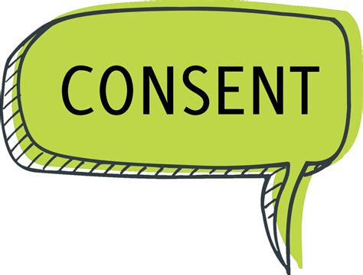
Consent - a brief overview
Consent: agreement => proposition
History: Medical domain
Types: implied, verbal/oral, explicit, informed
each has different for requirements for it to be valid
laws focus on legality - is it allowed or permitted i.e. is it legal
e.g. sexual, privacy, waivers, t&c, research
We focus on consent in Privacy domain and one specific law - Generate Data Protection Regulation (GDPR)
Notes:
Starting with a brief history of consent
Consent itself has origins of practice in the medical domain, where it relates to consent regarding medical practices such as taking blood or administering drugs.
Consent has different types, usually depicted by prefixed words such as implied, explicit, informed - each of which has a particular set of requirements that need to be satisfied for it to be valid
When these requirements are defined within the scope of a law, this becomes “legal consent” as in consent valid as per a law
For our work, we focus on the consent for personal data processing, which is governed by GDPR

Slide 4
Consent & GDPR
One of the six (Art.6) legal bases in GDPR
important because: data subject (you) are in control
Can be withdrawn at any time (Art.7)
Conditions for validity (Art.4, Art.7):
freely given | does not depend on anything else e.g. refusing access if consent not given for an unrelated purpose
specific | associated with specific purposes, processing, personal data, and not overtly abstract i.e. consent for all activities at once
informed | information is made clear to the data subject about purposes, processing, personal data, controllers, etc.
unambiguous | clear affirmative indication - e.g. button “I agree (to…)”
Notes:
The consent requirements within GDPR are interesting because of the way consent can be modelled in terms of purposes, processing, and personal data. Additionally, GDPR ties it to processing activities, which makes it relevant for data governance as well. Not to mention the 4% or 20million fines, which is actually why everyone is so hyper-concerned about GDPR.
In GDPR, consent can be withdrawn at any time, which provides data subjects with the power to control data processing.
Additionally, when gathering or collecting consent, there are several requirements which are required to be satisfied for that consent to be valid.
These are that consent must be freely given, specific, informed, and unambigious.
These are qualitative requirements, which means that the information shown while collecting consent is important for GDPR compliance.
While theoretically we can use NLP (sort-of) to determine if the information shown when collecting consent does indeed, a) this won’t be legally valid b) SotA does not guarentee the outcome of such automation
Thus, this is very much a human-in-the-loop activity, which means it needs extensive documentation.

Slide 5

Aim / Scope / Objective
Aim: Model information regarding consent relevant for determining and demonstrating compliance with GDPR
Scope: Limit to what has been authoritatively stated about consent by GDPR, Art 29 WP, Data Protection Authorities, and Courts
Objective: Model consent information such that it can be
1) persisted 2) queried 3) validated
Naturally, we chose Semantic Web because:
Interoperable Standards (RDF, OWL, SPARQL, SHACL)
Creating Knowledge Graph i.e. embedding semantics
Extensible based on further use-cases as needed
Notes:
To that end, our aim is to model the information regarding consent for determining and demonstrating compliance with the GDPR.
In doing this, we limit the scope to what has been authoritatively stated about consent, rather than going by guidelines given by individuals or organisations.
Our objective is to model the information in such a way that it can be stored (persisted), queried, and validated as per the requirements (of an organisation).
We chose SW because it is based on interoperable standards, and can be extendable for specific use-cases.

Slide 6
Methodology
Requirements
Gather information about consent from GDPR, articles, academic papers, communications from various supervisory bodies and regulatory authorities
Use-cases
Create use-cases and competency questions based on collected information
Ontology
Create ontology to express information about use-cases
Evaluate
Evaluate suitability to express information using competency questions
Notes:
We started with requirements gathering by looking for information about consent in GDPR, official documents such as guidelines published by the Article 29 Working Party, guidance, guides, and reports published by the various Data Protection Authorities, looking at legal cases by courts and regulatory authorities.
We formulated the gathered information into a set of requirements that consent had to satisfy in order for it to be deemed valid. These were modeled as constraints and assumptions which could be assessed over given information to determine if it was valid. These are available in the documentation.

Slide 7
Potential use-cases to test application
Obtaining / Declaring Consent (its state)
  The consent is given
  Consent was given, but is now invalidated (by the controller)
  Consent was given, but was withdrawn (by the Data Subject)
  Consent was requested (by the controller)
  Consent was requested, but was refused (by the Data Subject)
  Consent state is unknown (e.g. when importing data about consent)
Entity the consent is about
  The consent is about a Data Subject who is not a minor
  The consent is about a Data Subject who is a minor
Activity for Data Subject
  There was an age verification process associated with the consent (such as for minors)
  There was an identity verification process associated with the consent
Entity that provided consent
  Consent was provided by the Data Subject it is about
  Consent was not provided by the Data Subject it is about, but was provided by a Delegation
    Consent in the Delegation was provided by another Data Subject
    Consent in the Delegation was provided by a Person
    Consent in the Delegation was provided by another Delegation
Role within Delegation
  Entity is the Parent/Guardian of the Data Subject
  Entity is a third-party to the Data Subject
Activity of Delegation
  There was some verification process to assert the authentication of the delegation
Medium of Consent
  consent is given via a web-form
  consent is given as a signed paper document
  consent is given as a verbal confirmation
  consent is given implicitly in some form (medium)
  consent is given via delegation in some form (medium)
Activity responsible for consent
  Activity created consent as a new entity
  Activity modified existing consent
Previous consent and relationship
  Consent has no previous instance
  Consent has a previous instance, it replaces it
Differences between consent instances
  Something changes between two consent instances (e.g. personal data category is added)
Time constraints
  consent expires (has a tangible expiry such as a specific date or duration)
  consent does not expire (is valid for "as long as required")
Third party Association
  Personal Data is collected from a third party
  Personal Data is stored with a third party (processor)
  Personal Data is shared with a third party
  Processing involves third party
  Purpose involves third party
Notes:
After this, we generated a list of use-cases, using available (real) ones as well theoretically ones, to understand the various conditions and context under which such consent has to be given as well as managed.
The slide shows an overview of the categories of use-cases collected. The online documentation presents more specific use-cases within each.
For example, consent can be given verbally, via a signature on paper, by clicking a button on a website, etc. Doing so allowed us to understand and decide the extent to which the ontology should model this information - for example, should we explicitly model the medium of consent (verbal, paper, button). We decided to model an upper-level abstraction of the requirements since the law states them as such without specific use-cases.
Using this, we then generated the ontology using OWL2(DL).

Slide 8
Competency Questions
ID: Question
C1: Who is the consent about?
C2: What type of Personal Data are associated with the Consent?
C3: What type of Purposes are associated with the Consent?
C4: What type of Processing are associated with the Consent?
C5: What is the Status of Consent?
C6: Is the current status valid for processing?
C7: Who is the consent given to?
P1: Who created/gave/acquired/invalidated the consent?
P2: If consent was created/given/acquired/invalidated through Delegation, who acted as the Delegate?
P3: If consent was created/gave/acquired/invalidated through Delegation, what was the role played by Delegate?
P4: If consent was created/gave/acquired/invalidated through Delegation, how was the delegation executed?
T1: What is the location of associated with consent?
T2: What is the medium associated with consent?
T3: What is the timestamp associated with the consent?
T4: What is the expiry of the consent?
T5: How was the consent acquired/changed/created/invalidated?
T6: What artefacts were shown when consent was acquired/changed/created/invalidated?
D1: Is the purpose or processing associated with a third party?
D2: What is the role played by the third party in the purpose or processing?
Notes:
To evaluate the expressiveness of the ontology and its use to represent collected use-cases, we used competency questions. These also allowed us to determine the extent of queries that our ontology enabled. The questions were discussed and validated by a legal expert (TCD Law Professor) as to their use for compliance, and the underlying assumptions tied to them. The CQ also act as questions related to compliance that need to be asked in relation to the processing of personal data dependent on consent.
Note, that the questions are about the validity of consent rather than the validity of processing based on consent. This also reflects the scope of the ontology in that it is concerned only with consent rather than its use as a legal basis in processing. This is important, because before determining the validity of whether data processing based on consent is compliant, as in, does it follow the permissions provided by given consent, it is important to determine whether the given consent is itself valid. If it isn’t, then the processing will also not be valid (sic.).
We had to iterate through the steps of generating the ontology and evaluating it using CQs over use-cases a few times until being satisfied with the resulting ontology.

Slide 9
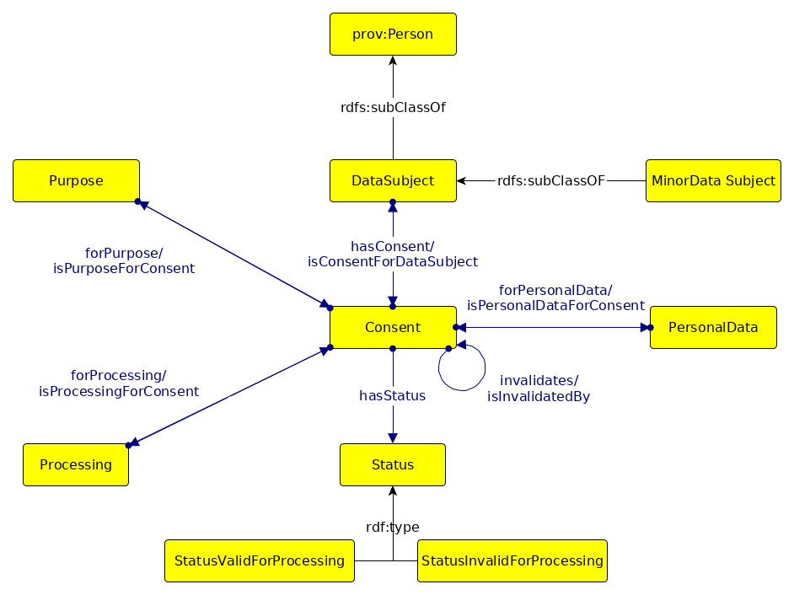
GConsent - Core Concepts
Notes:
This is an overview of the core concepts in GConsent.
At the center is Consent, which is associated with Purpose, Processing, and Personal Data. These three are separately associated with Consent. In an earlier iteration, we tried to model these as consent being associated with purpose, and purpose then being associated with processing, and processing being associated with personal data. However, we decided to change this model as we felt it did not suit cases where the same purpose could have different processing or personal data.
Instances of consent are associated with other instances using the invalidates property. This is to reflect the legal stand that only the latest instance of consent is valid at any given time.

Slide 10
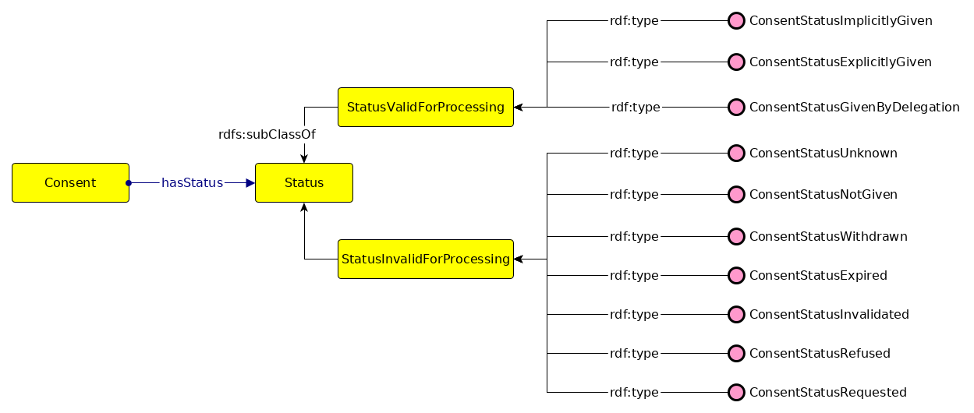
GConsent - Consent States
Notes:
The status of consent reflects the use of that instance for data processing. We therefore define two categories of statuses - valid and invalid for processing. This is for management of consent, which allows consent to be tracked from states unknown, not asked yet, to asked but not answered, given, and then withdrawn (by the user) or invalidated (by a court order).
It is important to differentiate between these states, as it affects the legality of processing. For example, a consent given today, and withdrawn one month later is still the legal basis for the processing activities carried out within the period of one month. While this can also be modelled or determined using simple timestamps and associations between consent instances, the modelling of states is a better way to manage and document (IMHO) of the consent.

Slide 11
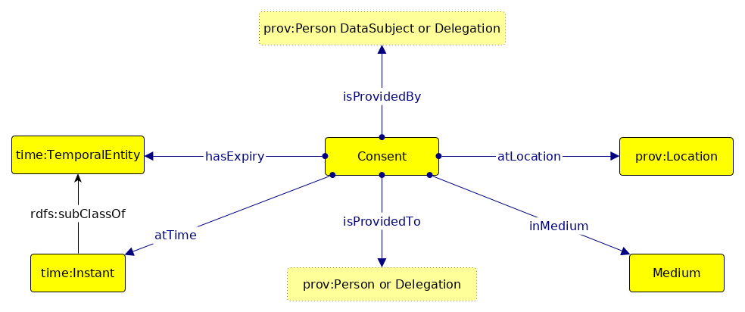
GConsent - Context
Notes:
To capture the context of consent, which includes questions like, when was the consent given, who gave the consent, how did they give it, we model properties that capture these common contexts. Additionally, we define a superproperty (not shown in the diagram) hasContext to define additional contexts. These are important in the compliance process, especially the temporal ones regarding timestamp of given consent and its expiry. The medium determines conditions such as informed and statement of affirmative action, while location has a bearing on how the consent was presented to the user.
isProvidedBy specifies who provided the consent - which is in most cases the data subject the consent is about. Consent can also be given by delegation, such as by a parent or guardian in lieu of a minor. This is consent by Delegation, where the parent or guardian is a delegate with the role “parent” or “guardian”.
Similarly, isProvidedTo specifies who the consent was given to. In most cases, there would only be one party the consent is given to - the controller. However, there are cases, for example, the consent dialogue on Quantcast.com, where there are ~1300 third parties other than Quantcast itself the consent is given to.

Slide 12
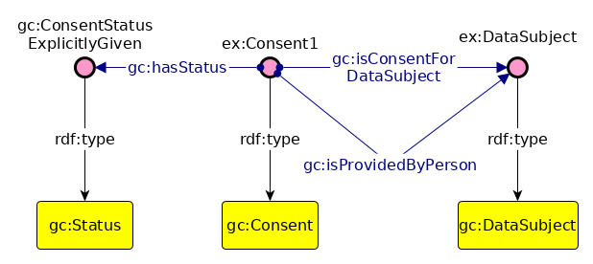
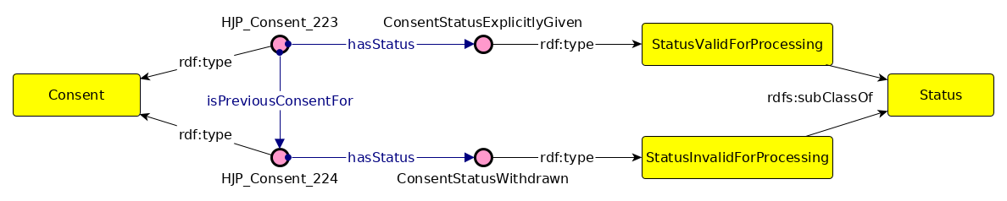
Use-Case #1 - simple
Notes:
To show GConsent being used, consider the simple example of consent being explicitly given, and then withdrawn.
The top diagram shows the given consent by a data subject with the status explicit consent.
The bottom diagram shows consent being withdrawn, where the status is changed from explicitly given to withdrawn, and the link between the two consent instances.

Slide 13
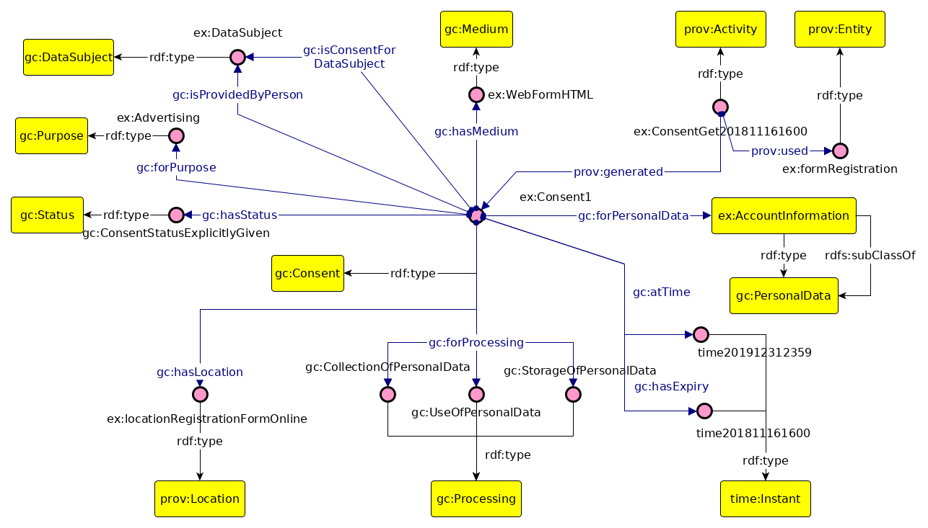
Use-Case #2 - realistic
Notes:
Another use-cases has consent with all associated information displayed in the diagram. Starting from top-left corner and moving clockwise, we see that the consent is given by the data subject whom the consent is about, using the medium of a web form, with the provenance captured using a prov:Activity, which also captures the specific web form used to collect consent. This is important as the web form is an artefact that will determine the validity of consent based on how it presents the information to the user, whether the button was sufficiently unambigious. The consent is specified as being for “Accound Information” which is a personal data category, which privacy policies generally define as to contain the name, address, email, or other such account information. The consent has a timestamp of when it was given, and an explicit expiry time after which it will no longer be valid. One of the things we’ve found is that most consent collected has no mention of expiry, and while this is legally gray, it is difficult to model conditions such as “as long as required” which really is indefinite amount of time. The consent is given for the collection, storage, and use of perosnal data. The individuals are instances provided by GConsent based on definition of processing, so common ones such as collect, use, store, share are already provided by the vocabulary, while their classes can be used to further extend or specialise these. The consent location is defined as the URI or rather the URL of the website where the consent was given. This is sort of repetition, as this could have been added as an annotation to the website defined as the medium. However, since we model the legal definition of location, the URL is explicitly associated with consent.
The consent has a state of being explicitly given, for the purpose of advertising.

Slide 14
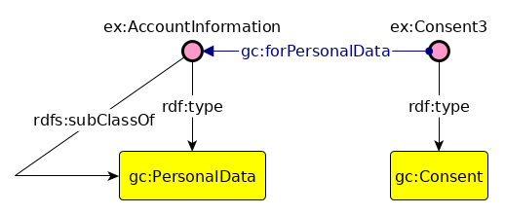
Punning
Consent is given for specific personal data categories
So, in this case, the instances are “categories” of personal data rather than “instances” of personal data
e.g. “name” instead of “John Doe”
How to model this? → Possibly use Punning?
We recommend this as a viable solution:
not implemented in the ontology
may lead to heterogeneity
(granularity and individuals)
rely on gazetteers
or prescribe best
practices (future work)
Notes:
In the previous diagram, the Account Information was defined as both an instance and subclass of Personal Data. This was only to indicate the possible use of punning, and we’re not actually defining an instance as both type and subclass. In this case, AccountInformation is itself a top-level class, with specialisations name, address, etc. which will have concrete instances such as John Doe and Portoroz. Consent can be given for categories of personal data, and also for specific types. Thus the associated personal data with an instance of consent can be a category or an instance - which is why we use punning to define something as an instance of personal data while being perhaps, a subclass of PersonalDataCategory.

Slide 15
Critical Analysis
Temporal and location attributes are not clearly specified
  e.g. “as long as required”
Could be perceived as too complex
  Assess complexity with subject matter experts (future work)
Does not entirely align with how consent is perceived, stored and used by other stakeholders, e.g., organizations
  e.g. stored as boolean in a database
Not clear how to model legally complicated use-cases
  e.g. online consent mechanisms interacting with third parties
Notes:
Things which are currently difficult to model or are not sufficiently clear include temporal aspects such as expiry, as in the example mentioned earlier. This is something beyond our control - we did not choose to limit GConsent by saying every consent should have an expiry or that expiry should only be mentioned using time - it can be an event or a condition as well. Another thing is that the ontology could be seen as too verbose due to the inclusion of all related information with an instance of consent. However, it is possible to model this such as common information such as the web form and purposes could be extracted into a model or template of consent, where the instance only captures relevant information such as who provided it or the timestamp.

Slide 16
Related Work - align with GConsent
SPECIAL Project http://specialprivacy.eu/
Consent is defined as an intersection of personal data category, processing, purpose, storage, and recipients.
ObjectIntersectionOf (
ObjectSomeValuesFrom (spl:hasData SomeDataCategory)
ObjectSomeValuesFrom (spl:hasProcessing SomeProcessing)
ObjectSomeValuesFrom (spl:hasPurpose SomePurpose)
ObjectSomeValuesFrom (spl:hasStorage SomeStorage)
ObjectSomeValuesFrom (spl:hasRecipient SomeRecipient) )
DPVCG https://www.w3.org/community/dpvcg/
Consent Ontology/Taxonomy (draft v1)
Just in Time Compliant Dataset Generation
Debruyne, Pandit, Lewis & O’Sullivan, published in ICSC 2019
Using stored consent information from an organization’s perspective
Notes:
Related and comparable works include the consent concept used by SPECIAL, where consent is defined as an intersection of personal data category, processing, purpose, storage, and recipients. This is similar to GConsent in the association with consent, though GConsent also captures other information such as who provided consent, what was the role of third party in processing, and so on. GConsent can thus be aligned with SPECIAL.
Another consent ontology is provided by the DPVCG W3C community group, where GConsent was used as an input to formulate a consent ontology. The authors (me?) were involved in DPVCG, and due to differing scopes, their consent ontology is separate, though aligned.
@chrdebru could add a diagram of your consent ontology to say this is from the org’s perspective

Slide 17
~end of presentation~
GConsent: A Consent Ontology based on the GDPR
Harshvardhan J. Pandit, Christophe Debruyne, Declan O’Sullivan, Dave Lewis
ADAPT Centre, School of Computer Science & Statistics, Trinity College Dublin, Ireland
email: pandith@tcd.ie | debruync@tcd.ie
website: http://openscience.adaptcentre.ie/
ontology: https://w3id.org/GConsent
The ADAPT Centre is funded under the SFI Research Centres Programme (Grant 13/RC/2106) and is co-funded under the European Regional Development Fund.
Notes:
Thus in conclusion, GConsent allows modelling information about consent for GDPR compliance. The information can be used to manage consent, determine validity, and formulate documentation for compliance.

