Slide 1


Test-driven approach towards GDPR compliance
Harshvardhan J. Pandit, Declan O’Sullivan, Dave Lewis
ADAPT Centre, School of Computer Science & Statistics, Trinity College Dublin, Ireland
email: pandith@tcd.ie
website: http://openscience.adaptcentre.ie/
resources: https://w3id.org/GDPRep/semantic-tests
The ADAPT Centre is funded under the SFI Research Centres Programme (Grant 13/RC/2106) and is co-funded under the European Regional Development Fund.
Notes:
@chrdebru have added both email - switch order as you like
link to project website openscience.adaptcentre.ie
link to ontology w3id.org/GConsent
documentation contains all resources and examples in the slides, plus more information

Slide 2
Presentation Structure
Aims and Goals
Use-case: Consent mechanism on a website
Information requirements
Creating dataset in RDF
Some interesting findings
GDPR requirements expressed as constraints
Testing constraints using SHACL
Results of compliance process
Discussion
Q&A

Slide 3
Domain / Scope
A typical scenario is to start from a process model or workflow of how the service/operations take place, assess it for compliance based on obligations and requirements obtained from interpretation of specific clauses of the law, and tweak it as required based on the outcome to become compliant.
This requires a way to express information about:
Process model / Workflow + Provenance Log
Constraints / Obligations / Requirements
Links to specific aspects of law
Notes:
To that end, our aim is to model the information regarding consent for determining and demonstrating compliance with the GDPR.
In doing this, we limit the scope to what has been authoritatively stated about consent, rather than going by guidelines given by individuals or organisations.
Our objective is to model the information in such a way that it can be stored (persisted), queried, and validated as per the requirements (of an organisation).
We chose SW because it is based on interoperable standards, and can be extendable for specific use-cases.

Slide 4

Aim – Testing process workflows for compliance
Aim: Test and record compliance information for process workflows
Objective: information (including compliance) can be
1) persisted 2) queried 3) validated 4) linked to legal requirements
We choose Semantic Web because:
Linked Data
Interoperable Standards (RDF, OWL, SPARQL, SHACL)
Creating Knowledge Graph i.e. embedding semantics
Extensible based on further use-cases as needed
Notes:
To that end, our aim is to model the information regarding consent for determining and demonstrating compliance with the GDPR.
In doing this, we limit the scope to what has been authoritatively stated about consent, rather than going by guidelines given by individuals or organisations.
Our objective is to model the information in such a way that it can be stored (persisted), queried, and validated as per the requirements (of an organisation).
We chose SW because it is based on interoperable standards, and can be extendable for specific use-cases.

Slide 5
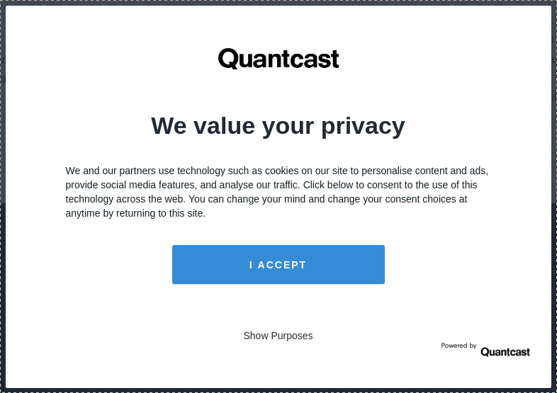
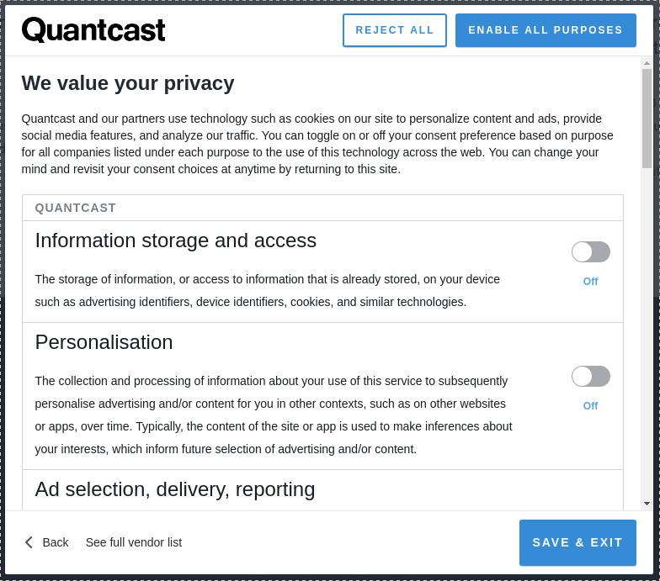
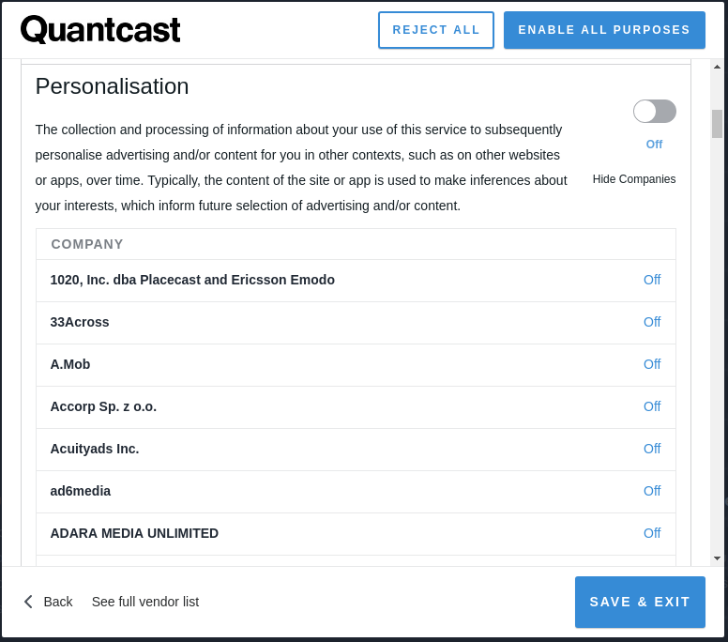
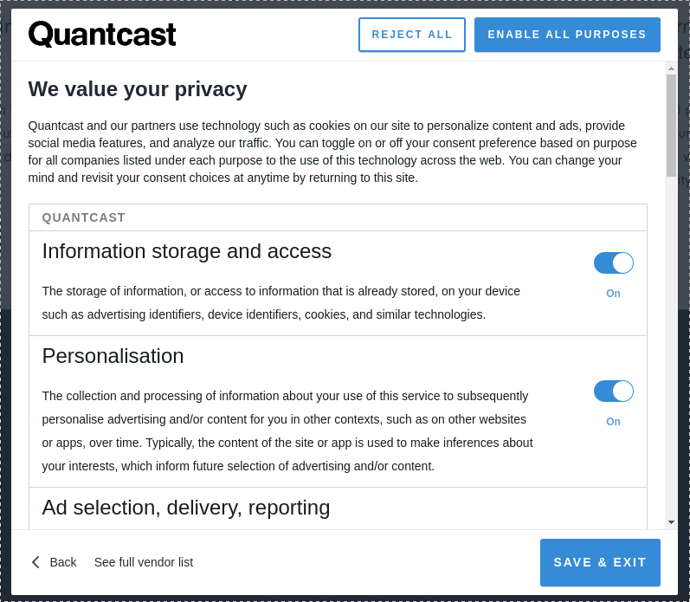
Use-case: consent mechanism on Quantcast.com
Why Quantcast?
- It is one of the largest consent dialogue providers
- Option to change consent
Screenshots show:
(a) first dialogue
(b) second set of options
(c) list of third parties
(d) allows to change consent in subsequent visits
Also investigate:
1. Privacy Policy
2. Subject Access Request
3. Products offered on site
(a)
(b)
(c)
(d)
Notes:
Starting with a brief history of consent
Consent itself has origins of practice in the medical domain, where it relates to consent regarding medical practices such as taking blood or administering drugs.
Consent has different types, usually depicted by prefixed words such as implied, explicit, informed - each of which has a particular set of requirements that need to be satisfied for it to be valid
When these requirements are defined within the scope of a law, this becomes “legal consent” as in consent valid as per a law
For our work, we focus on the consent for personal data processing, which is governed by GDPR

Slide 6
Modeling the data in RDF
Used vocabularies (also prior work!):
GDPRtEXT: a RDF version of GDPR text, UID for every clause in text, SKOS thesauri of concepts [13] https://w3id.org/GDPRtEXT
GDPRov: extends PROV-O and P-Plan with GDPR specific concept to represent logs and plans/models/templates [16] https://w3id.org/GDPRov
Gconsent: vocabulary for capturing information about consent as per requirements of the GDPR [14] https://w3id.org/GConsent
SPARQL queries to retrieve information for GDPR compliance [15] https://w3id.org/GDPRep/checklist-demo
Interpret information in the consent dialogue, and also investigate privacy policy and information on the website to get: purpose & categories of processing, personal data categories, legal basis, recipients of data, storage duration
[13] Pandit, H.J. et al.: GConsent - A Consent Ontology based on the GDPR. ESWC 2019
[14] Pandit, H.J. et al.: GDPRtEXT - GDPR as a Linked Data Resource. ESWC 2018
[15] Pandit, H.J. et al.: Queryable Provenance Metadata For GDPR Compliance. SEMANTiCS 2018
[16] Pandit, H.J., Lewis, D.: Modelling Provenance for GDPR Compliance using Linked Open Data Vocabularies. PrivOn (ISWC 2017)
Notes:
To that end, our aim is to model the information regarding consent for determining and demonstrating compliance with the GDPR.
In doing this, we limit the scope to what has been authoritatively stated about consent, rather than going by guidelines given by individuals or organisations.
Our objective is to model the information in such a way that it can be stored (persisted), queried, and validated as per the requirements (of an organisation).
We chose SW because it is based on interoperable standards, and can be extendable for specific use-cases.

Slide 7
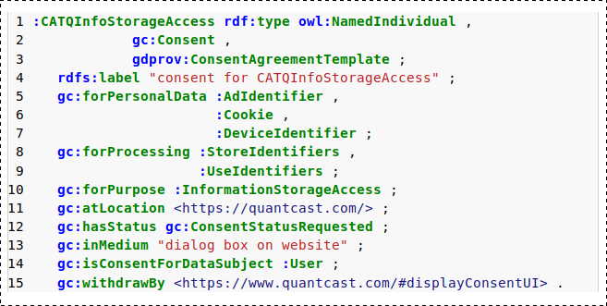
Modeling the data in RDF
Notes:
To that end, our aim is to model the information regarding consent for determining and demonstrating compliance with the GDPR.
In doing this, we limit the scope to what has been authoritatively stated about consent, rather than going by guidelines given by individuals or organisations.
Our objective is to model the information in such a way that it can be stored (persisted), queried, and validated as per the requirements (of an organisation).
We chose SW because it is based on interoperable standards, and can be extendable for specific use-cases.

Slide 8
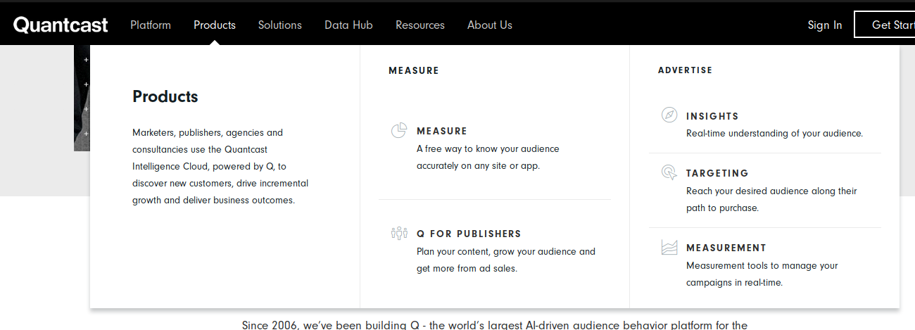
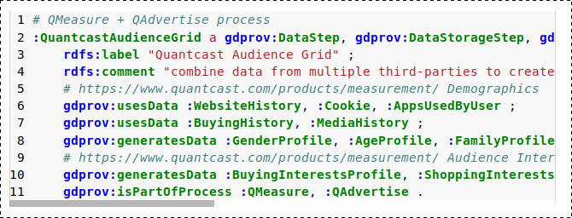
Modeling the data in RDF
Notes:
To that end, our aim is to model the information regarding consent for determining and demonstrating compliance with the GDPR.
In doing this, we limit the scope to what has been authoritatively stated about consent, rather than going by guidelines given by individuals or organisations.
Our objective is to model the information in such a way that it can be stored (persisted), queried, and validated as per the requirements (of an organisation).
We chose SW because it is based on interoperable standards, and can be extendable for specific use-cases.

Slide 9
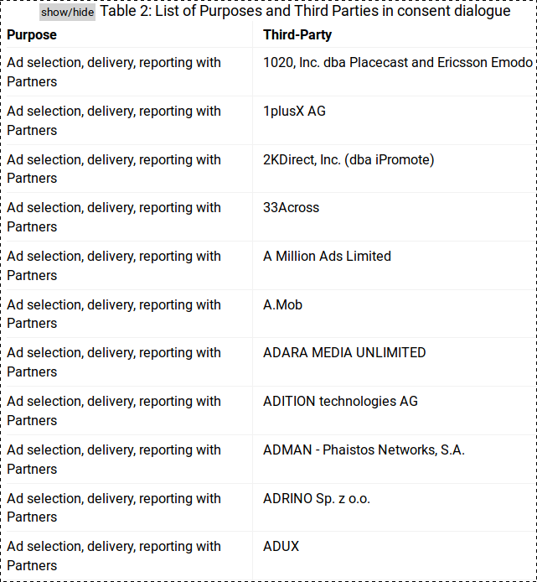
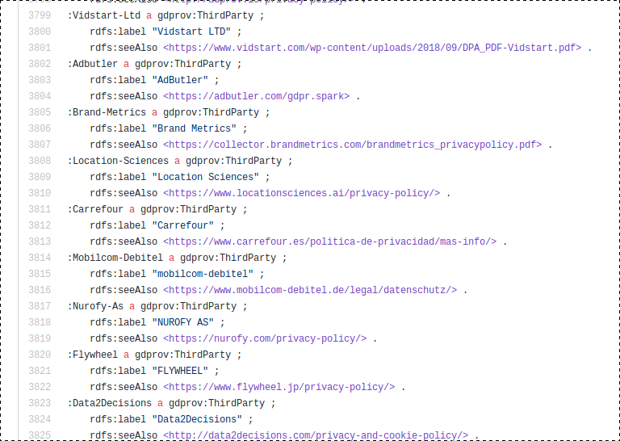
Interesting finding
Consent was being asked for ~1300 third parties
Notes:
To that end, our aim is to model the information regarding consent for determining and demonstrating compliance with the GDPR.
In doing this, we limit the scope to what has been authoritatively stated about consent, rather than going by guidelines given by individuals or organisations.
Our objective is to model the information in such a way that it can be stored (persisted), queried, and validated as per the requirements (of an organisation).
We chose SW because it is based on interoperable standards, and can be extendable for specific use-cases.

Slide 10
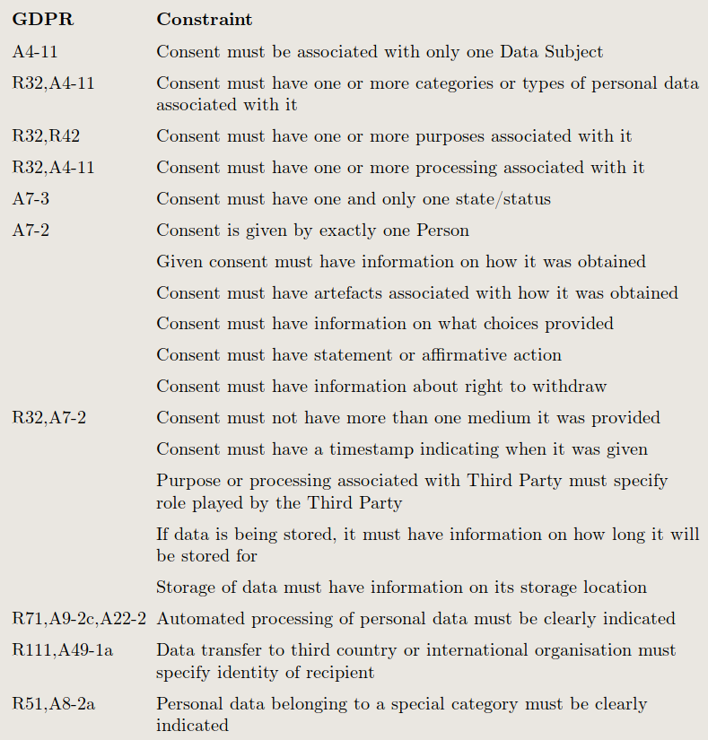
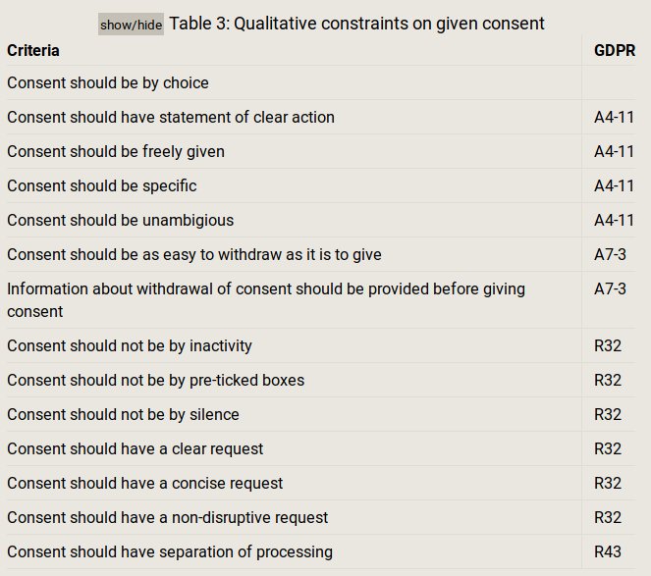
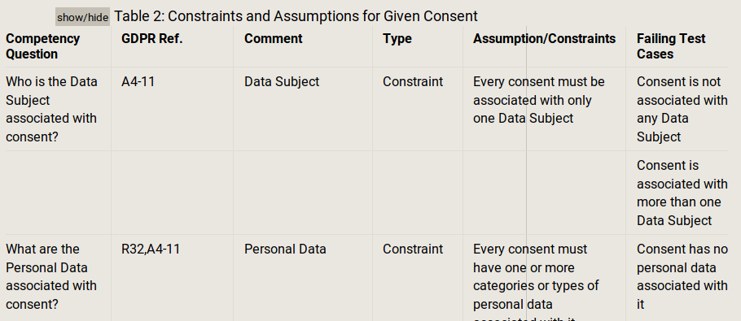
Consent requirements from GDPR
Notes:
To that end, our aim is to model the information regarding consent for determining and demonstrating compliance with the GDPR.
In doing this, we limit the scope to what has been authoritatively stated about consent, rather than going by guidelines given by individuals or organisations.
Our objective is to model the information in such a way that it can be stored (persisted), queried, and validated as per the requirements (of an organisation).
We chose SW because it is based on interoperable standards, and can be extendable for specific use-cases.

Slide 11
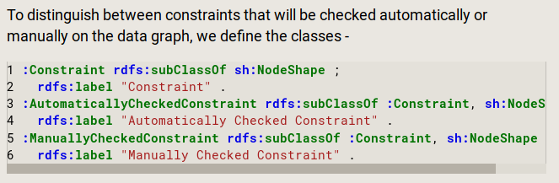
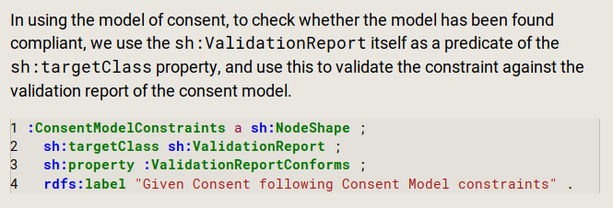
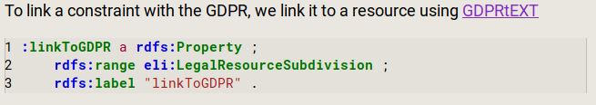
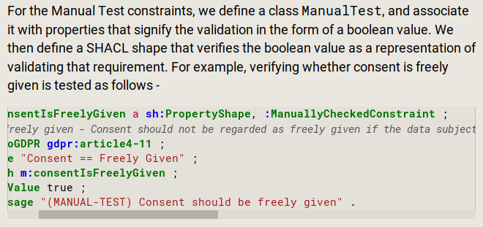
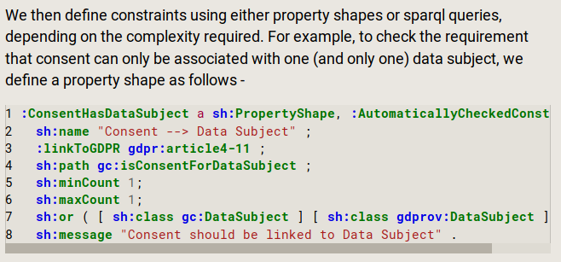
SHACL to validate constraints
Notes:
To that end, our aim is to model the information regarding consent for determining and demonstrating compliance with the GDPR.
In doing this, we limit the scope to what has been authoritatively stated about consent, rather than going by guidelines given by individuals or organisations.
Our objective is to model the information in such a way that it can be stored (persisted), queried, and validated as per the requirements (of an organisation).
We chose SW because it is based on interoperable standards, and can be extendable for specific use-cases.

Slide 12
Categories of constraints
We divide the constraints into 3 parts as follows:
Part A: constraints related to the model of the system
Part B: constraints related to instances of given consent
Part C: common constraints in model + constraints unique for each instances
Part A test requirements such as the presence of DPO and procedures to handle the various rights.
Part B checks requirements directly associated with an instance of given consent. These constraints have to be tested for every instance of given consent.
Part C splits the requirements (from Part B) into two parts - one common to all consent and validated against a 'model' or 'template' of consent, and the other validated against the instance of given consent. As most constraints are abstracted away to the model and only need to be checked once, this makes the validation of given consent more efficient.
Notes:
To that end, our aim is to model the information regarding consent for determining and demonstrating compliance with the GDPR.
In doing this, we limit the scope to what has been authoritatively stated about consent, rather than going by guidelines given by individuals or organisations.
Our objective is to model the information in such a way that it can be stored (persisted), queried, and validated as per the requirements (of an organisation).
We chose SW because it is based on interoperable standards, and can be extendable for specific use-cases.

Slide 13
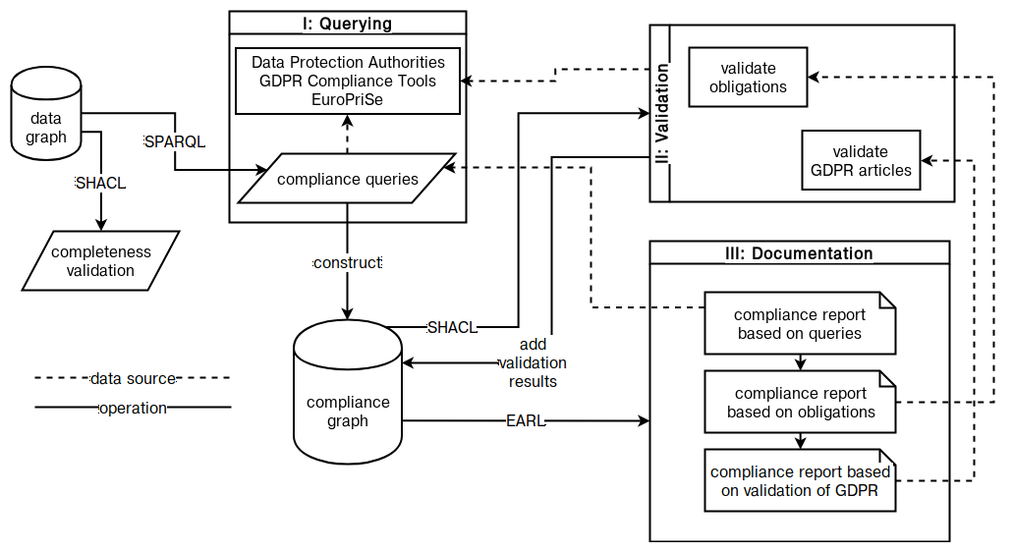
Compliance testing [12]
[12] Pandit, H.J. et al.: Exploring GDPR Compliance Over Provenance Graphs Using SHACL. SEMANTiCS 2018 Poster
Notes:
To that end, our aim is to model the information regarding consent for determining and demonstrating compliance with the GDPR.
In doing this, we limit the scope to what has been authoritatively stated about consent, rather than going by guidelines given by individuals or organisations.
Our objective is to model the information in such a way that it can be stored (persisted), queried, and validated as per the requirements (of an organisation).
We chose SW because it is based on interoperable standards, and can be extendable for specific use-cases.

Slide 14
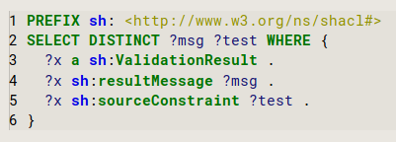
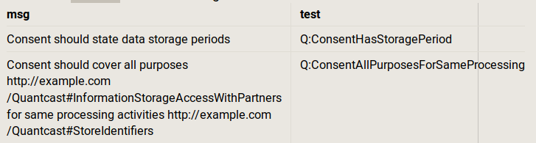
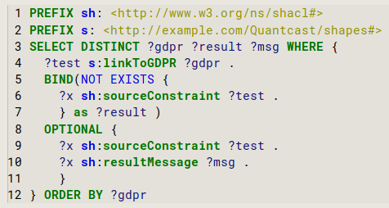
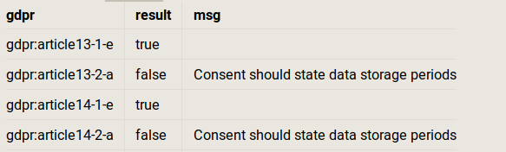
SPARQL queries for Compliance results
Messages from tests as actionable items
SPARQL query for retrieving test messages as actionable items
GDPR articles and their test results
SPARQL query to retrieve GDPR articles and their test results
Notes:
To that end, our aim is to model the information regarding consent for determining and demonstrating compliance with the GDPR.
In doing this, we limit the scope to what has been authoritatively stated about consent, rather than going by guidelines given by individuals or organisations.
Our objective is to model the information in such a way that it can be stored (persisted), queried, and validated as per the requirements (of an organisation).
We chose SW because it is based on interoperable standards, and can be extendable for specific use-cases.

Slide 15
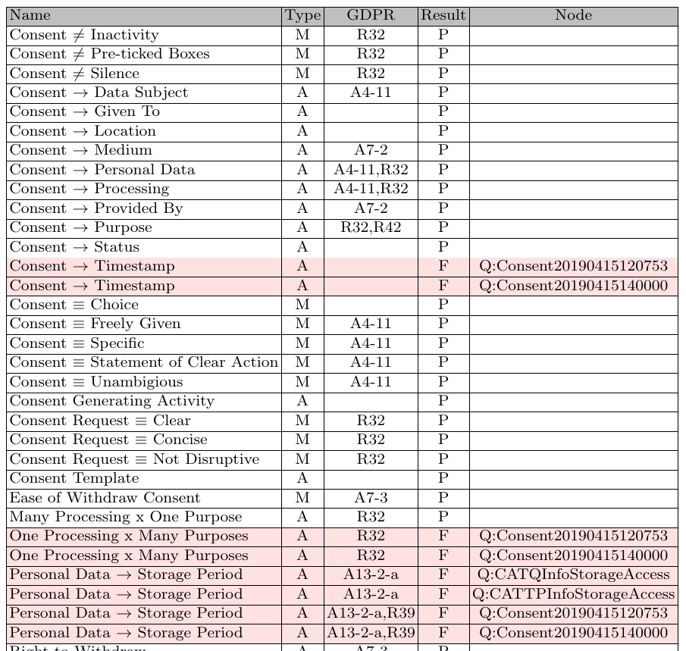
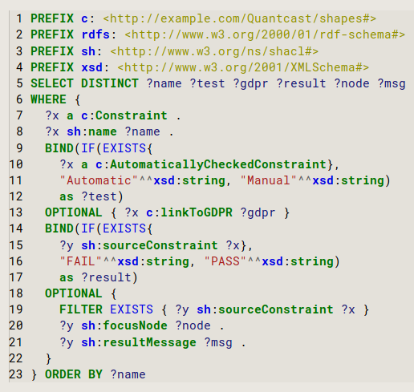
Generating Compliance Report
SPARQL query and results to generate a report showing constraints, validation results, and link to GDPR
Notes:
To that end, our aim is to model the information regarding consent for determining and demonstrating compliance with the GDPR.
In doing this, we limit the scope to what has been authoritatively stated about consent, rather than going by guidelines given by individuals or organisations.
Our objective is to model the information in such a way that it can be stored (persisted), queried, and validated as per the requirements (of an organisation).
We chose SW because it is based on interoperable standards, and can be extendable for specific use-cases.

Slide 16
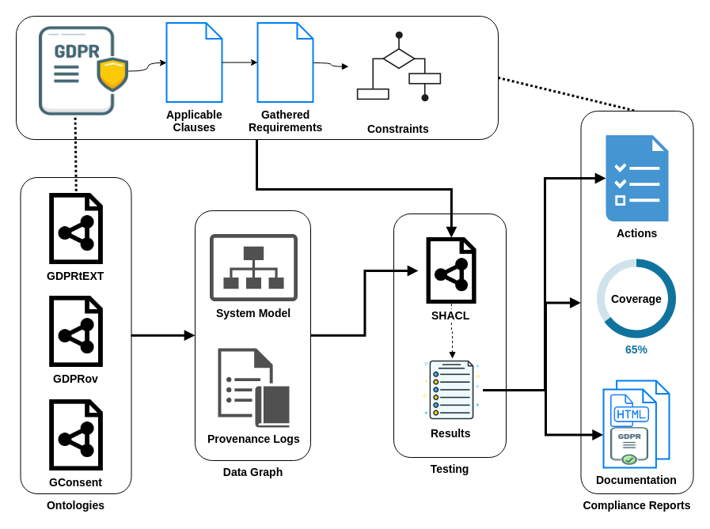
Conclusion
(1) Testing a model of a system is more efficient than testing individual instances of processing logs
(2) Persisting results with semantics enables recording and querying compliance information as data
(3) Knowledge can be used to enable systemic information regarding actions for compliance, coverage, and automation in generation of documentation
(3)
(1)
(2)
Notes:
To that end, our aim is to model the information regarding consent for determining and demonstrating compliance with the GDPR.
In doing this, we limit the scope to what has been authoritatively stated about consent, rather than going by guidelines given by individuals or organisations.
Our objective is to model the information in such a way that it can be stored (persisted), queried, and validated as per the requirements (of an organisation).
We chose SW because it is based on interoperable standards, and can be extendable for specific use-cases.

Slide 17
~ end of presentation ~
Test-driven approach towards GDPR compliance
Harshvardhan J. Pandit, Declan O’Sullivan, Dave Lewis
ADAPT Centre, School of Computer Science & Statistics, Trinity College Dublin, Ireland
email: pandith@tcd.ie
website: http://openscience.adaptcentre.ie/
resources: https://w3id.org/GDPRep/semantic-tests
The ADAPT Centre is funded under the SFI Research Centres Programme (Grant 13/RC/2106) and is co-funded under the European Regional Development Fund.
Notes:
@chrdebru have added both email - switch order as you like
link to project website openscience.adaptcentre.ie
link to ontology w3id.org/GConsent
documentation contains all resources and examples in the slides, plus more information

