Slide 1
Representing Activities associated with Processing of Personal Data and Consent using Semantic Web for GDPR Compliance
Harshvardhan J. Pandit
PhD Candidate
Supervisor: Dave Lewis
Co-supervisor: Declan O’Sullivan
School of Computer Science & Statistics
Trinity College Dublin
The ADAPT Centre is funded under SFI Research Centres Programme (Grant 13/RC/2106) and is co-funded under the European Regional Development Fund.

Slide 2
Background & Motivation
GDPR compliance is associated with information
Technological solutions for GDPR face challenges regarding information representation
Semantic Web technologies have proved useful in legal compliance and for addressing GDPR
Commercial solutions e.g. Top Quadrant, Thomas Reuters, Signatu
H2020 projects such as SPECIAL, MIREL, BPR4GDPR
Use is growing in legal domain for information representation, querying, reasoning, and interoperability

Slide 3
Research Question
To what extent can
information regarding activities
associated with processing of personal data and consent
be represented using Semantic Web technologies
for GDPR compliance?
Tasks
Representation of information
Querying
Validation
Assessment/Evaluation
Information Requirements
to conduct evaluation of compliance
document compliance
State of system at a given time
Stakeholders

Slide 4
State of the Art – Gaps (Ch.3)
Machine-readable representation of GDPR
Glossary of terms and concepts associated with GDPR
Representation of activities associated with processing of personal data in ex-ante/ex-post phases
Representation of consent information
Demonstration using authoritative compliance queries
Validating information for compliance evaluation

Slide 5
Research Objectives
RO1 Identify the subset of GDPR and RO2 Identify information required to represent activities associated with processing of personal data and consent in investigation of GDPR compliance → Compliance queries and analysis of information (Ch.4)
RO3 Create OWL2 ontologies for representation information about:
Ontologies presented in Chapter 5
(a): concepts and text of GDPR → GDPRtEXT (Sec. 5.2)
(b): activities associated with processing of personal data and consent → GDPRov (Sec. 5.3)
(c): consent required to determine compliance → GConsent (Sec 5.4)
RO4 Represent compliance questions using SPARQL to query information about activities associated with processing of personal data and consent → queries (Sec. 6.1)
RO5 Utilise SHACL to: (a): validate information for GDPR compliance regarding activities associated with processing of personal data and consent (b): link validation results with GDPR → (Sec 6.2)
Querying and Validation of information presented in Chapter 6
major ->
minor ->
minor ->

Slide 6
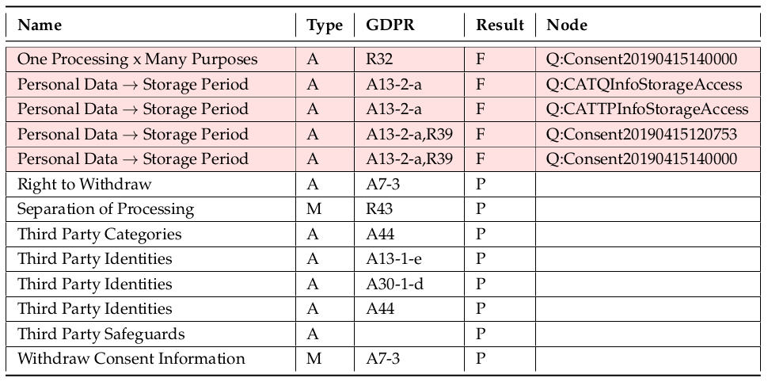
Research Contributions and Outcomes
Information modelling for GDPR compliance
Linking information to GDPR
Representing processing activities
Representing Consent
Querying information using SPARQL
Validation framework using SHACL
Impact on Data Privacy Vocabulary (external contribution)

Slide 7
Research Dissemination and Publication
18 Publications (Sec. 1.4.7)
GDPRtEXT – ESWC 2018
GDPRov – ISWC PrivOn 2017
GConsent – ESWC 2019
SPARQL queries – SEMANTiCS 2018
SHACL validation – SEMANTiCS 2018,2019, ISWC CKG 2018
GDPR interoperability analysis – EURAS 2018, IJSR 2018, Book Chapter 2019
Investigated applications
information management – ICSC 2019, ESWC MEPDaW 2018
privacy policies – IPAW 2018, ISWC WOP 2018, TELERISE/ADBIS 2018
Data Privacy Vocabulary – ODBASE 2019
Publish developed resources
FAIR / Open Source / Open Access
Ontologies: W3ID, Github, Gogs ; Code / Data / Documents: Github, Gogs, Datahub, Zenodo
Publications: university archive (TARA), Zenodo

Slide 8
Research Impact
W3C Data Privacy Vocabularies & Controls Community Group (DPVCG)
Author/Editor of Data Privacy Vocabulary (2019)
Chair since Jan 2020
EU Publications Office interest in GDPRtEXT
modelling of clauses, extension of ELI
discussion of future plans, opinion as POI and research stakeholder, invitation as sem-web expert
Consent Receipt
invitation to edit next version of consent standard addressing GDPR and global privacy laws with Kantara
recently accepted as project at ISO/IEC 27560
Involved EU / H2020 project funding applications as domain expert

Slide 9
Future Plans & Opportunities
Coverage of more GDPR topics
Data Protection Impact Assessments
Controller – Processor agreement and data governance
Data Privacy Vocabulary
Expand in terms of concepts, areas, documentation
Incorporate other laws e.g. CCPA
Student Supervision (ongoing)
Use of PhD work on topics of privacy and consent online
Alignment and application to AI accountability / ethics
Research applications
Policy and Consent
ISO 27560 for work on consent receipt
Consent extension for Schema.org
Collaborations with researchers
Funding Calls – applied/in-progress
Ireland Postdoc Fellowship (individual)
H2020 ICT on IoT (WP lead)
NGI Trust 2020 (co-ordinator)
NGI DAPSI (team lead)
ICO (UK) grants (research lead)

Slide 10
Summary of PhD
To what extent can
information regarding activities
associated with processing of personal data and consent
be represented using Semantic Web technologies
for GDPR compliance?
RO1 and RO2 → Compliance queries and analysis of information (Ch.4)
RO3 → Ontologies presented in Chapter 5
(a): concepts and text of GDPR → GDPRtEXT (Sec. 5.2)
(b): activities associated with processing of personal data and consent → GDPRov (Sec. 5.3)
(c): consent required to determine compliance → GConsent (Sec 5.4)
RO4 → SPARQL queries (Sec. 6.1)
RO5 → (Sec 6.2) SHACL for validation and link results to GDPR (Sec 6.2)
Resources: documented and open access at https://openscience.adaptcentre.ie
Impact:
Data Privacy Vocabulary: community agreement and specification
Consent Receipt: data model and standard, project at ISO

Slide 11
Notes Index
GDPR: compliance requirements
GDPR: sources of information
Ex-ante & Ex-post
ISO standards for GDPR
Technological development of legal compliance solutions
Approaches for legal compliance
Commercial solutions for GDPR
Timeline of research
RQ: definitions
Strengths and Weaknesses of my work
Publications list
Why not ODRL?
Are they really OWL2 ontologies?
SotA: Scope
SotA: Survey of legal approaches
Why not BPMN?
SotA: Legal Ontologies
SotA: Analysis criteria
SotA: Approaches using Sem-Web
SotA: Approaches other
SotA: Approaches for privacy policies
SotA: Approaches for consent
SotA: upcoming research projects
SotA: SPECIAL
SotA: MIREL + DAPRECO
SotA: BPR4GDPR
SotA: Ujcich et al.
SotA: RestAssured
SotA: Analysis
SotA: Analysis – representation of GDPR
SotA: Analysis – representation activities
SotA: Analysis – representation of consent
SotA: Analysis – querying
SotA: Analysis – compliance evaluation
Analysing GDPR compliance requirements
GDPR req. – stakeholder requirements
GDPR req. – interoperability model
GDPR req. – compliance questions
GDPR req. – consultations
GDPR req. - categories
GDPR req. – use-cases
GDPR req. – assumptions / constraints
Ontology engineering methodology
GDPRtEXT – overview
GDPRtEXT – ELI extension
GDPRtEXT – script for text extraction
GDPRtEXT – DPD mapping
GDPRtEXT – compliance reporting
GDPRtEXT – evaluation
GDPRtEXT – compare with SotA
GDPRov – overview
GDPRov – ex-ante and ex-post phase
GDPRov – Extending PROV-O and P-Plan
GDPRov – Data Lifecycle
GDPRov – Consent Lifecycle
GDPRov – change detection
GDPRov – evaluation
GDPRov – compare with SotA
GDPRov – data storage and location
GDPRov – use-case from SPECIAL
GConsent – overview
GConsent – relationship with GDPRov
GConsent – context and concepts
GConsent – example use-cases
GConsent – evaluation
GConsent – compare with SotA
GConsent – use-case from SPECIAL
DPV – overview
DPV – concepts
DPV – comparison with phd ontologies
Querying – compliance questions
Querying – GDPR readiness checklist
Querying – methodology
Querying – analysis
Querying – demo
Querying – evaluation
Querying – compare to SotA
Validation – model
Validation – link to GDPR
Validation – manually evaluated constraint
Validation – ex-ante and ex-post results
Validation – demo
Validation – Quantcast data
Validation – constraints
Validation – SPARQL queries
Validation – evaluation
Validation – compare to SotA
Conclusion – fulfilment of RO and RQ
Conclusion – extent of sem-web

Slide 12
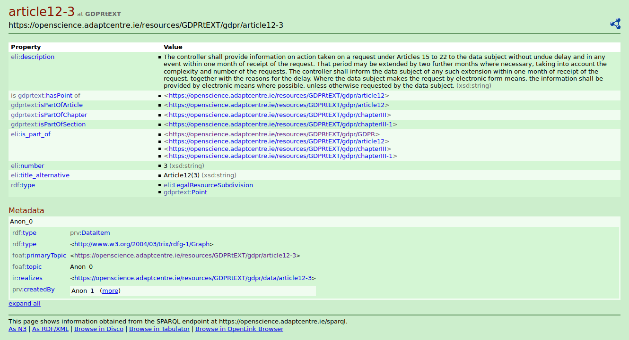
GDPRtEXT - overview
Ontology to specify GDPR at a granular level + RDF dataset
Extends ELI (in a compatible manner)
PID individual clause/section
SKOS glossary of GDPR concepts
Personal Data
Legal Basis
Principles, Rights
Compliance obligations
Dataset | Distribution | Comment
canonical | HTML, PDF, XML | Official GDPR distributions
textid, dataset | HTML, JSON, text | GDPR text with IDs
annotated | XML, Turtle, JSON-LD | RDF

Slide 13
GDPRtEXT – ELI extension
LegalResource → document
LegalSubResource → section in document (GDPRtEXT uses this)
has_part property → specify relation between sections
FRBR model → allows specification of language and format specific publications
E.g. PDF, XML
E.g. EN, FR, DE
GDPRtEXT only models GDPR at a conceptual level.
FRBR can be extended on top of GDPRtEXT same as ELI
ELI+ is proposed/planned extension to ELI

Slide 14
GDPRtEXT – extracting text
Official GDPR publication lists its contents inside a table element
Does not specify metadata (e.g. clause, number, title)
JS script parses this output to extract data
Alternative is to use XML – much more consistent
Issue highlighted to publication office
Response:
ELI+ will have more structured metadata
HTML will also be better structured

Slide 15
GDPRtEXT – DPD Mapping
Create LOD version of DPD (assign PID to each clause)
Create mapping between DPD clause and GDPR clause
Based on interpretation of obligation
Based on available information at time
Annotate corresponding XACML statements based on change
Extended, same, reduced, completely changed, slightly changed
Collaboration work (collaborator was leading work on XACML)

Slide 16
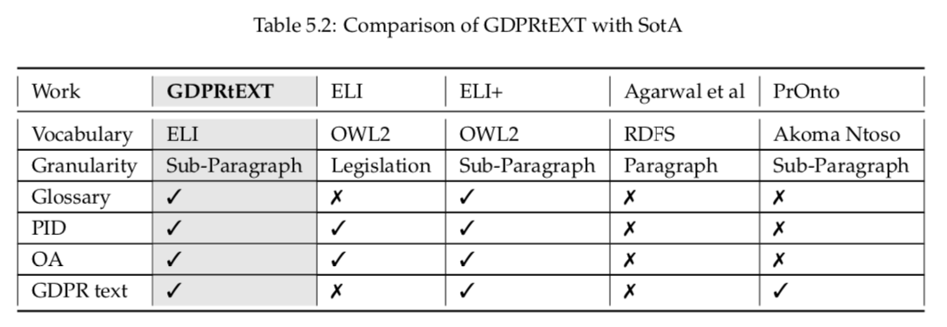
GDPRtEXT – Compare with SotA

Slide 17
GDPRov - Overview
Provenance (of plans and activities) ontology for GDPR
Extends PROV-O and P-Plan
PROV-O → provenance of activities (ex-post) + prov:Plan
P-Plan → scientific workflow (ex-ante + ex-post)
Represents Ex-ante and Ex-post phases
Models data and consent lifecycles
Granular abstraction of processes and steps
Concepts
Agents
Data
Consent
Activities (Processing, Purposes)
Anonymisation
Rights
Data Breach
Composition of activities as steps and processes

Slide 18
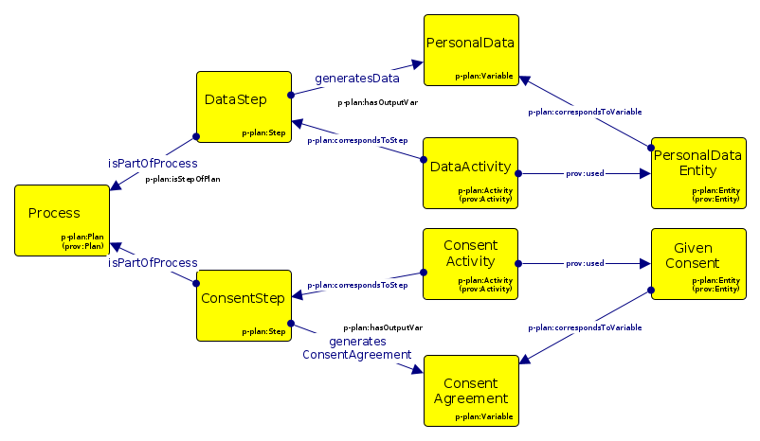
GDPRov – Extending PROV-O and P-Plan

Slide 19
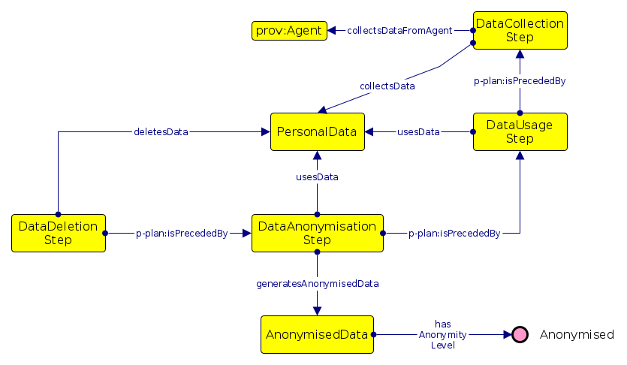
GDPRov – Data Lifecycle

Slide 20
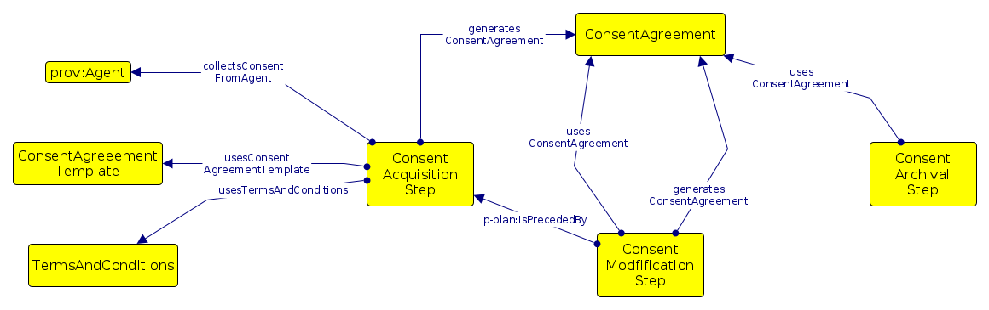
GDPRov – Consent Lifecycle

Slide 21
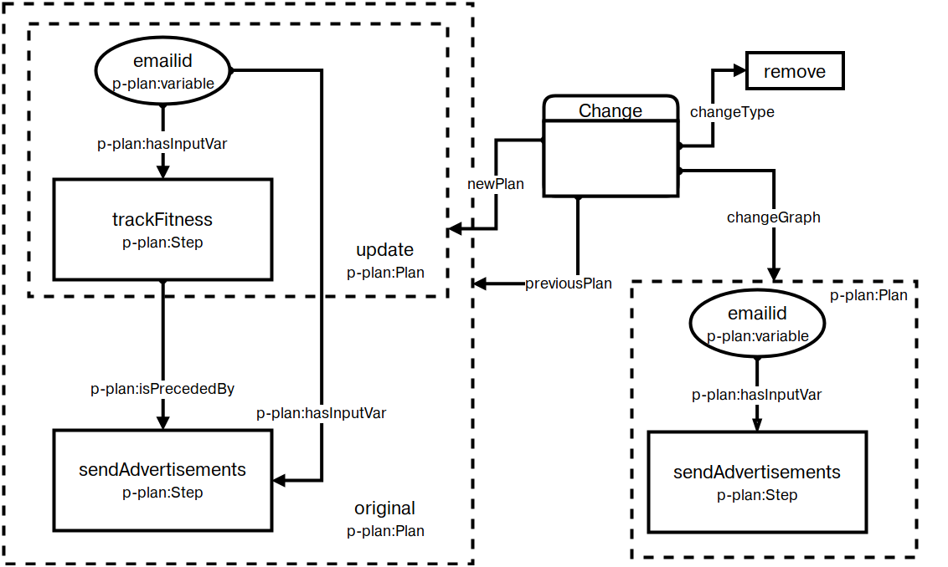
GDPRov – Change Detection Use-Case
Temporal state of Plan / System
Compare new and old states
Identify differences in activities
Evaluate change in GDPR obligations (e.g. new purposes added)
Evaluate change required for compliance (e.g. renew consent)

Slide 22
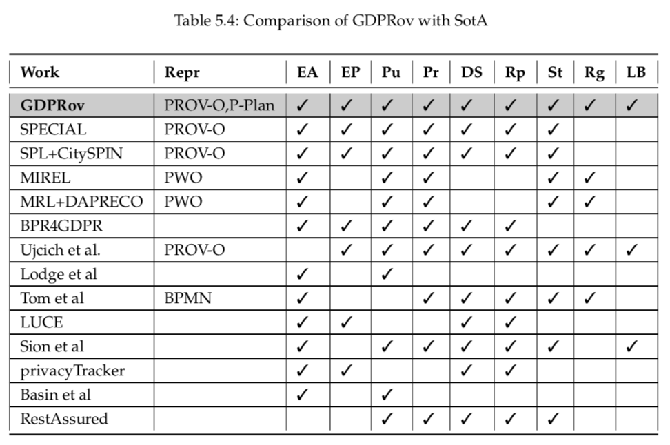
GDPRov – Compare with SotA

Slide 23
GDPRov – Data Storage and Location
Data Storage duration (temporal properties)
Fixed timestamp e.g. 27-APR-2020
Duration e.g. 2 years
Indefinite e.g. “as long as required”
Dependent on event/condition e.g. “until you are logged in”
Proposal: hasStorageDuration (union of properties)
Data Location (geospatial and political properties)
Country
Region (e.g. North America)
Political Unions (e.g. EU → Brexit changes memberships)
Multiple locations with dynamic changes e.g. servers
Proposal: hasDataLocation (union of properties)

Slide 24
GConsent - Overview
Consent-specific ontology for GDPR
Models purpose, processing, etc. focused on consent instance
Companion to GDPRov
Models context
Required to analyse GDPR consent requirements
E.g. Location, medium
Models consent states
Based on consent management in real-world
Organisations need to track consent
E.g. Given, Requested, Invalidated
Models chain of consent instances

Slide 25
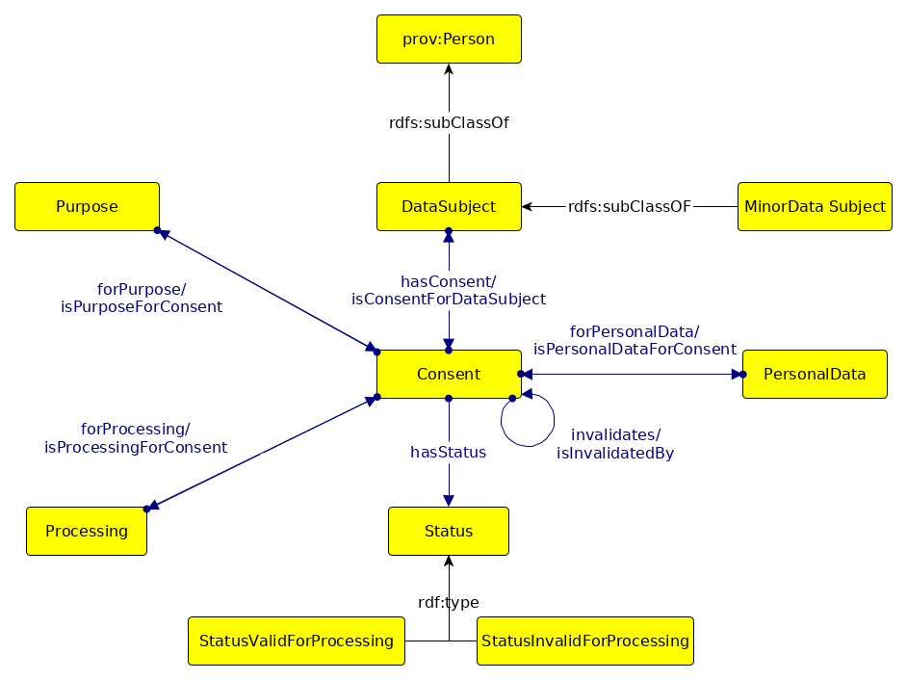
GConsent – Core Concepts

Slide 26
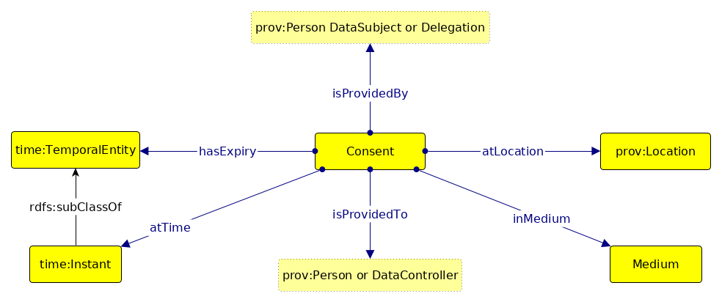
GConsent – Context

Slide 27
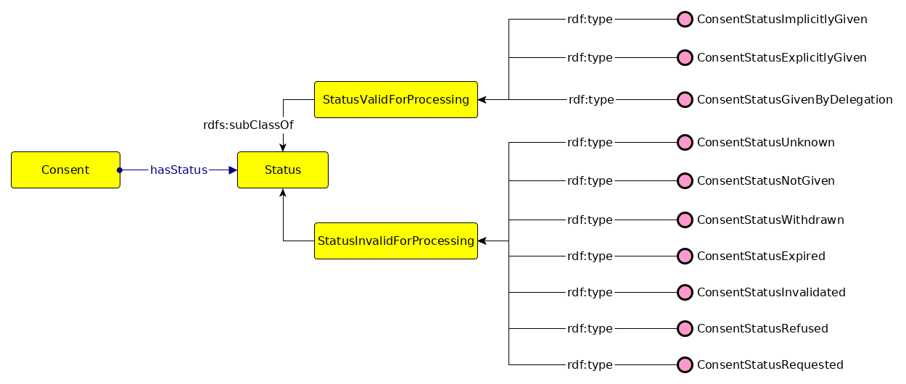
GConsent – Consent States

Slide 28
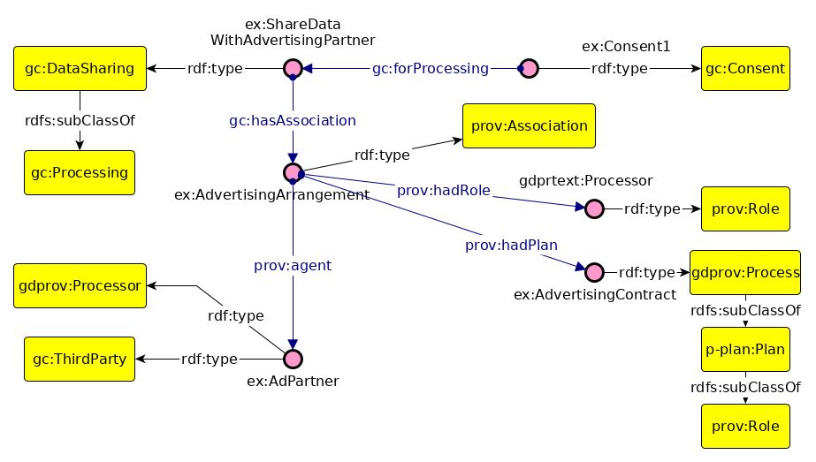
GConsent – Example #3

Slide 29
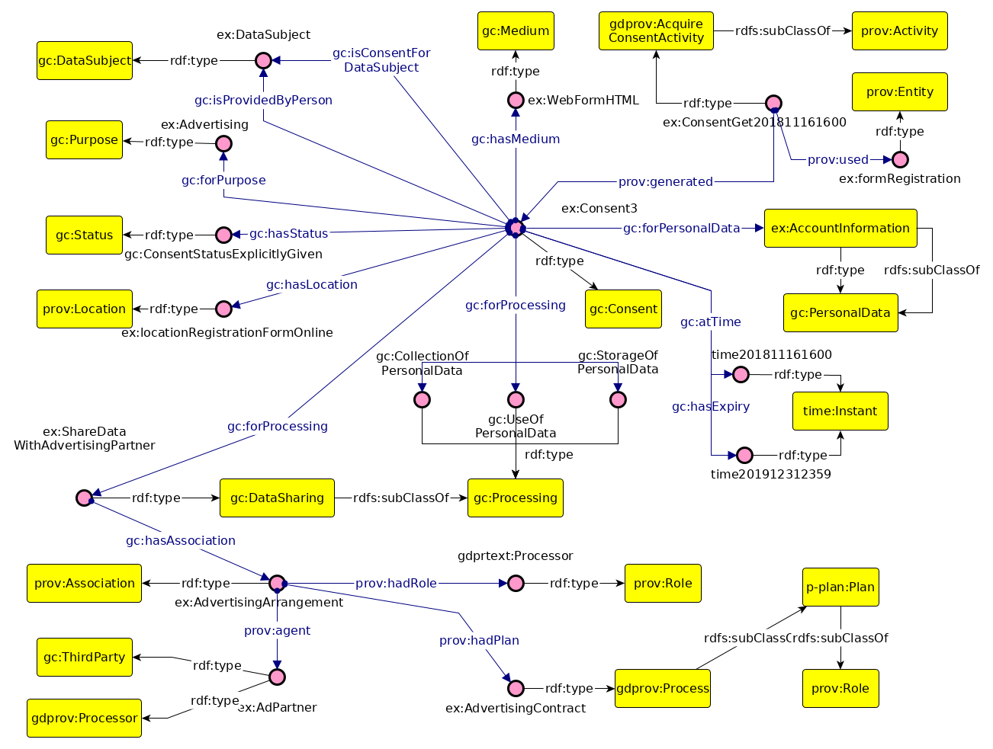
GConsent – GDPRov

Slide 30
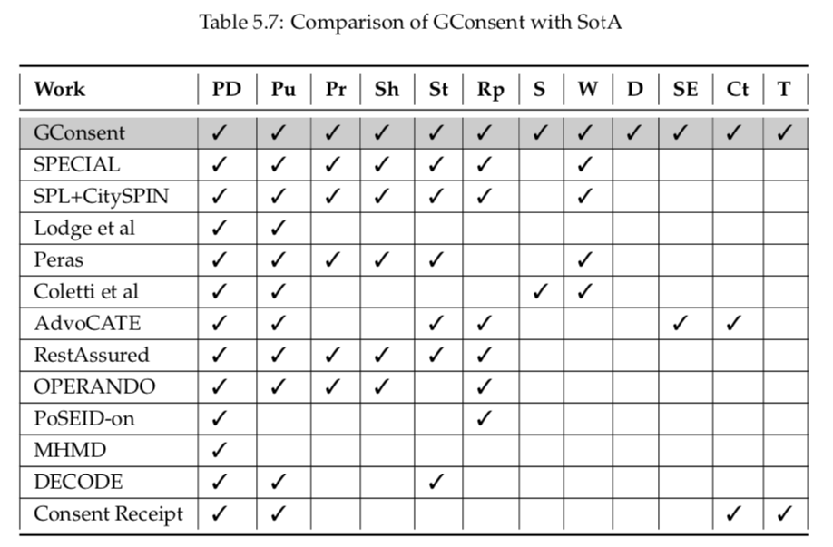
GConsent – Compare with SotA

Slide 31
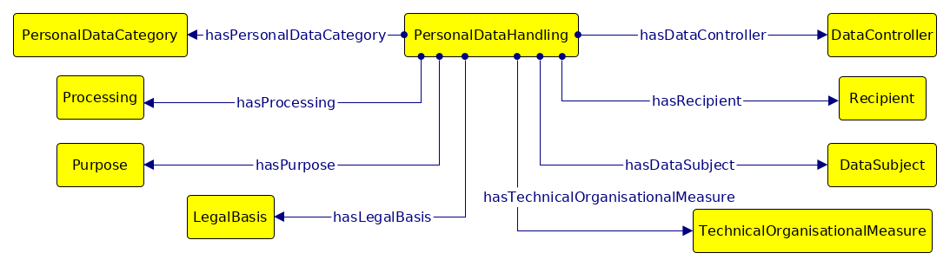
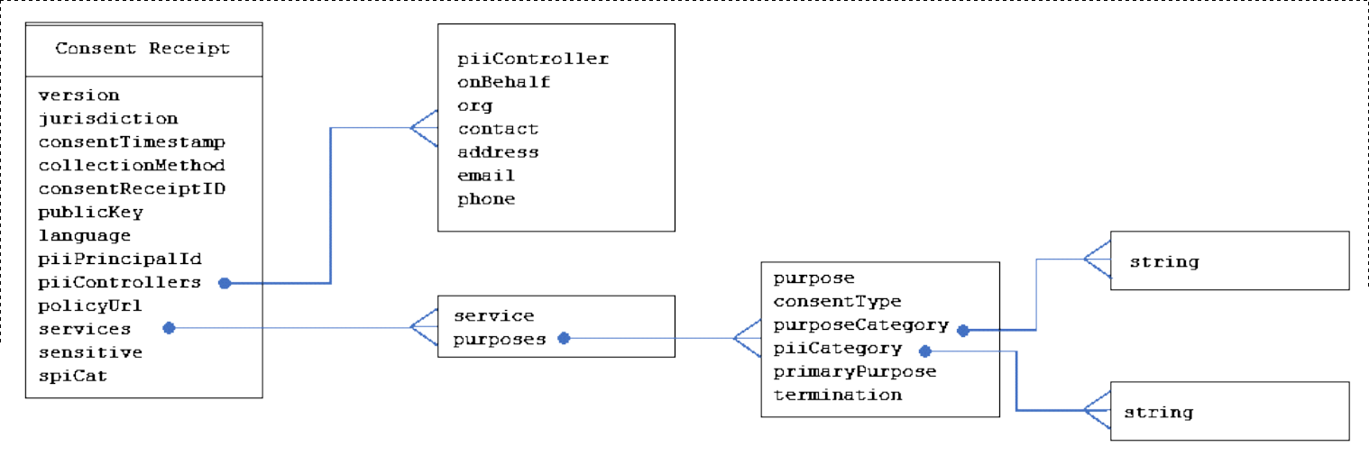
DPV – Core Concepts
Consent Receipt
v1.1

Slide 32
DPV --> PhD Ontologies
GDPRtEXT
DPV does not provide GDPR glossary but provides related concepts
Does not model text of GDPR
Uses a more recent iteration of URL format (not formalized)
GDPRtEXT can be additional glossary for DPV
GDPRov
DPV does not model provenance records (not in scope)
DPV does not have phases of compliance
GDPRov can add on DPV concepts (e.g. purpose → steps)
GConsent
DPV models consent fields (based on GConsent + Consent Receipt)
Not all fields are modeled
Consent States not incorporated
DPV can utilize more fields from GConsent

Slide 33
Querying with SPARQL
SotA does not provide SPARQL queries for reuse (as resource)
SPARQL queries are highly use-case dependant
Chosen use-case: GDPR Readiness Guide (2017) by Irish DPC
One of first such guides published, authoritative
In English, clear questions, meant for organisations
Also used to develop compliance questions for RO1 and RO2
Method:
Identify information required by questions
Analyse questions based on information requirements
Interpret SPARQL queries using ontologies (GDPRov + GDPRtEXT)
Create synthetic use-case (test data)
Execute SPARQL queries
Evaluate a) extent of queries b) suitability of queries

Slide 34
Querying with SPARQL - Queries
Questions categorized based on information dependancy
Demonstrative – retrieved information is sufficient
Assistive – retrieved information needs to be evaluated
Evaluative – more information needs to be retrieved
Argument: SPARQL nested queries? Or compliance evaluation approach?
Questions do not relate to ex-ante and ex-post
but implicitly refer to plans and processing activities
Categorise based on implicit information
GDPRov evolved after this exercise
Thesis also reflects capabilities of current iteration of GDPRov
Validation use-case better choice for demonstration of queries
Provides a way to link information to GDPR
SPARQL CONSTRUCT queries an alternative
But does not permit validation of information

Slide 35
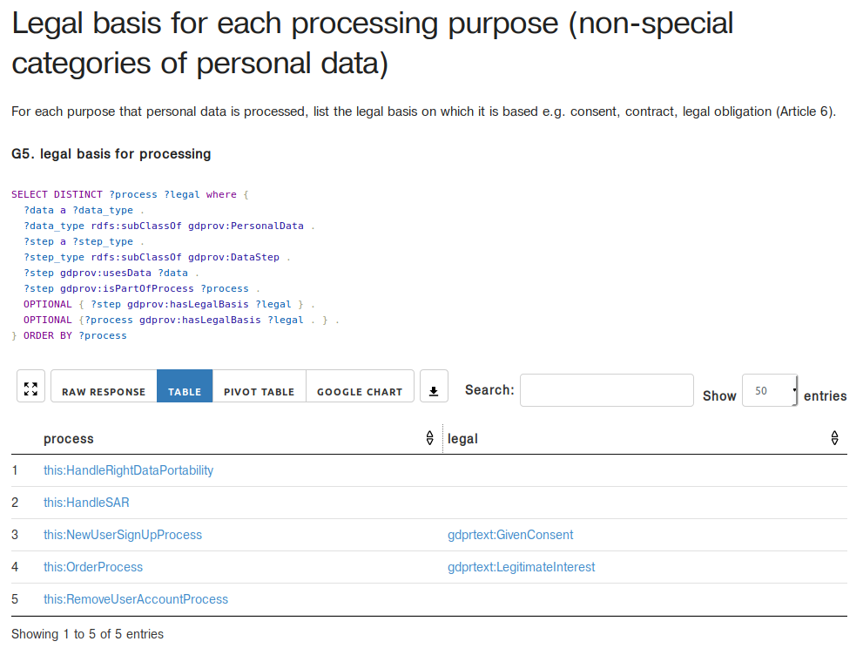
Querying with SPARQL - Evaluation
32 of 63 questions represented as SPARQL queries
31 of 63 not implemented: 20 not in scope, 3 lacking concepts in GDPRov
G8: data retention/storage periods/duration
S5, S7: technical measures
Exercise undertook before GConsent was developed
Since this guide is based on organization’s plans, it was not repeated with GConsent
Online demo (alt implementation using RDF-JS, Communica possible to permit anyone to upload data graphs and query)

Slide 36
Validation Model
GDPR Compliance: info satisfies obligations and requirements
Ensuring correct information i.e. validation for a) correctness b) completeness
SotA does compliance evaluation, PhD work is about this validation
If approach is using RDF data, SHACL is nice because:
Persists test results as RDF data
Flexible – build own tests and add components
PhD → Validation Model
Utilises SHACL to validate information for GDPR compliance.
Expresses compliance as a test-driven exercise similar to the concept of unit-testing in software engineering.
Utilises results of testing ex-ante information for testing of ex-post information in order to reduce the number of tests required.
Constructs a compliance graph by storing validation results based on concept of knowledge-graph.
Demonstrates use of compliance graph in retrieving and documenting information regarding GDPR compliance

Slide 37
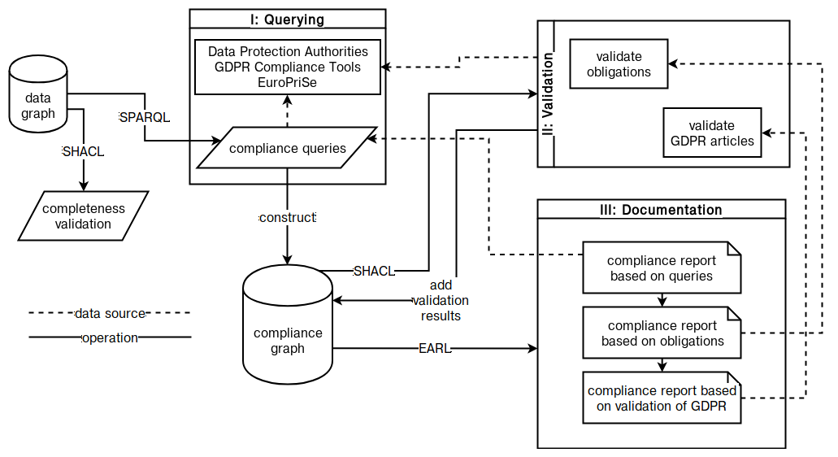
Validation Model – Model Architecture

Slide 38
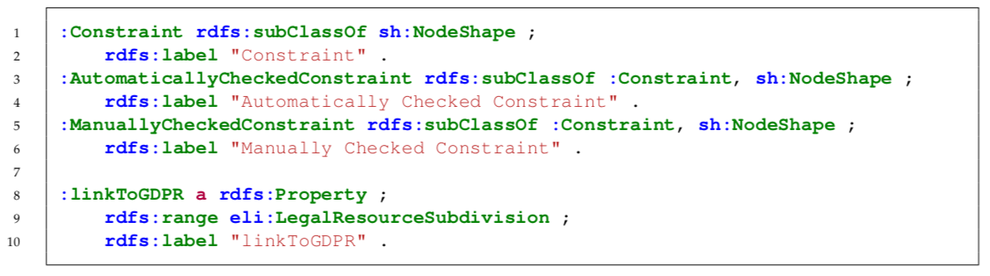
Validation Model – linking to GDPR
Associate test with GDPR to specify validation of related information
Add property using GDPRtEXT
Enables annotation of compliance evaluation and testing back to GDPR
Permits querying of tests/information based on GDPR links
To extend for other laws, create a generic property referring to legal clauses

Slide 39
Validation Model – Ex-ante → Ex-post
GDPR requires organisations to plan activities i.e. ex-ante plans
GDPR requires organisations to ensure plans compliance i.e. ex-ante compliance
GDPR requires organisations to ensure processing activities are compliant i.e. ex-post
However, ex-post processing activities are based on ex-ante plans
Reuse ex-ante test data
if common elements are already tested in ex-ante
only unique elements need testing again in ex-post
E.g. Consent Dialogue
Shown to all users of websites i.e. ex-ante information
Given consent unique to individual i.e. ex-post information
To test consent as per GDPR
Test consent dialogue was valid (common for all users)
Test given consent was valid (specific to individual)
Test common information once, persist test results as data
Now only single check to ensure common tests were passed
Therefore, test complexity is reduced in ex-post testing
(common sense approach – used commonly!)

Slide 40
Validation Model – Quantcast
Quantcast is the largest consent dialogue provider on the internet
Part of the IAB framework
Claims high number of data points available for analytics as a service
Consent Dialogue → RDF data using GDPRov + GConsent + GDPRtEXT
Develop SHACL constraints based on compliance questions to validate data
Complexity: basic, low, simple
Does not do compliance evaluation, only ensures information is correct & complete
Consent dialogue tested in Ex-ante phase, results saved
Given consent tested in Ex-post phase, also tests Ex-ante saved results
More efficient tests in this process
Without splitting across phases: 59 tests for each given consent
Ex-ante tests: 57
Ex-post tests: 3 (2+1 for ex-ante saved results)
After splitting across phases: 3 tests for each given consent

Slide 41
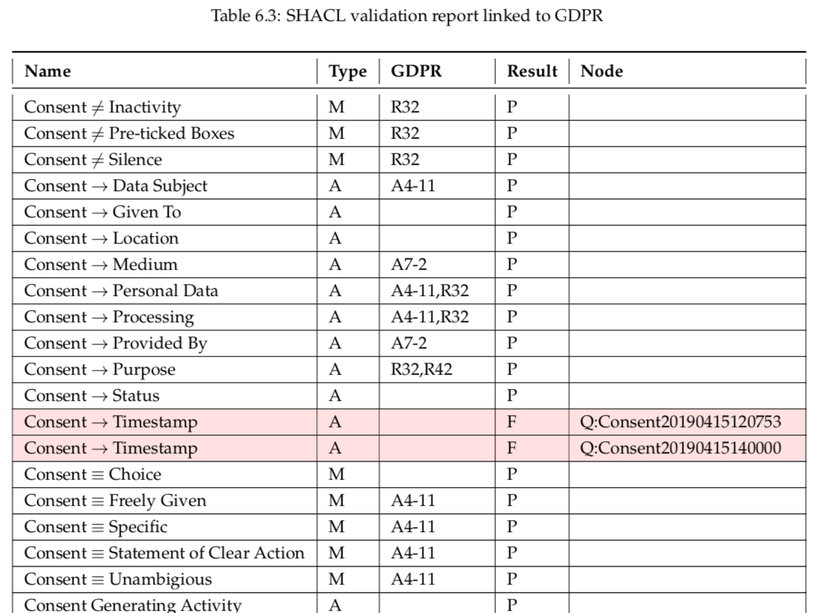
Validation Model – Quantcast SPARQL queries

Slide 42
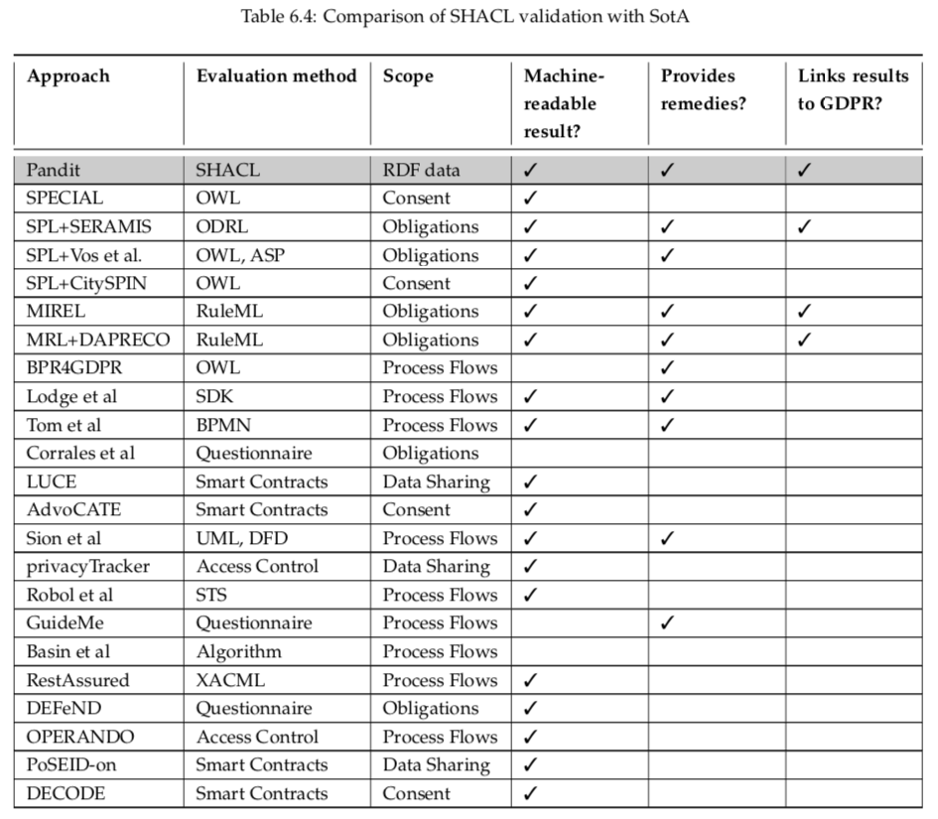
Validation Model – Compare with SotA

Slide 43
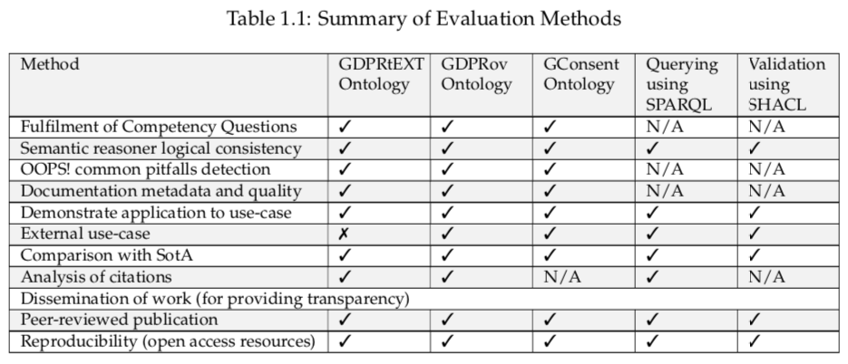
Ontology Engineering Methodology
Ontology quality - Design, Semantics; OOPS!, Use-cases
Documentation – WIDOCO
Dissemination – FAIR principles
W3ID – persistent identifier; Linked Open Vocabularies (LOV); GitHub, Zenodo
Evaluation – competency question, application to use-cases
NeOn: identify requirements and use-cases
UPON Lite: iteratively develop ontological representation

Slide 44
Timeline of Research
2016: Started work in March-September 2016
Relevant work existing: preliminary work in DAPRECO
2017:
Published GDPRov by September 2017
Preliminary work on consent ontology September 2017
2018:
Published GDPRtEXT in January 2018
SPECIAL published work on GDPR compliance in June 2018
MIREL+DAPRECO published PrOnto in July 2018
Adopt GDPR readiness guide for SPARQL queries in August 2018
Developed GConsent by September 2018
2019
H2020 projects on GDPR publish deliverables and papers in January 2019
Developed SHACL validation model by March 2019
Data Privacy Vocabulary is published in June 2019
SotA analysis in August-September 2019
Thesis draft in December 2019, Submitted in February 2020

Slide 45
ODRL, BPMN
ODRL to express GDPR obligations
Information needed for resolving activities → provenance
Information needed for expanding GDPR activities
How to evaluate?
SotA: Agarwal et al. and Vos et al. have used ODRL profiles
BPMN
Business process standard for representation
Own set of tooling, querying, validating
How to operate while being interoperable?
How to specify GDPR concepts and activities?
Major factors:
Extending vocabulary with GDPR concepts
Querying for information
Validation / Tests
Linking of information with GDPR

