Slide 1
Representing Activities associated with Processing of Personal Data and Consent using Semantic Web for GDPR Compliance
PhD Viva
Harshvardhan J. Pandit

Slide 2
Background & Motivation
Technological solutions for compliance with GDPR [3] face challenges regarding [12-18]:
Algorithmic interpretation of legal compliance requirements
Formal investigations require information associated with clauses
Interoperability between stakeholders
GDPR compliance is associated with:
Processing of personal data
Legal Bases (in particular consent)
Data Governance (e.g. Controller – Processor)
Rights Management
1

Slide 3
Background & Motivation
Business Process Management is an existing field
Represents and works with processes / activities (e.g. BPMN¹) in Ex-ante (planning), real-time (during), and Ex-post (verification) stages
Legal Compliance is a secondary operation on top of these [12]
GDPR imposes additional requirements on existing information management practices
Semantic Web technologies have proved useful in legal compliance [15,16] and for addressing GDPR
Commercial solutions e.g. Top Quadrant, Thomas Reuters, Signatu
H2020 projects such as SPECIAL [26], MIREL [27], BPR4GDPR [29]
Use is growing in legal domain for information representation, querying, reasoning, and interoperability [25]
1 https://www.omg.org/spec/BPMN/2.0/
1

Slide 4
Research Question
To what extent can information regarding activities associated with processing of personal data and consent be represented using Semantic Web technologies for GDPR compliance?
Representation of information
Querying
Validation
Assessment/Evaluation
Information required in order to conduct evaluation of compliance
Information about compliance evaluated
State of system at a given time
Stakeholders
1

Slide 5
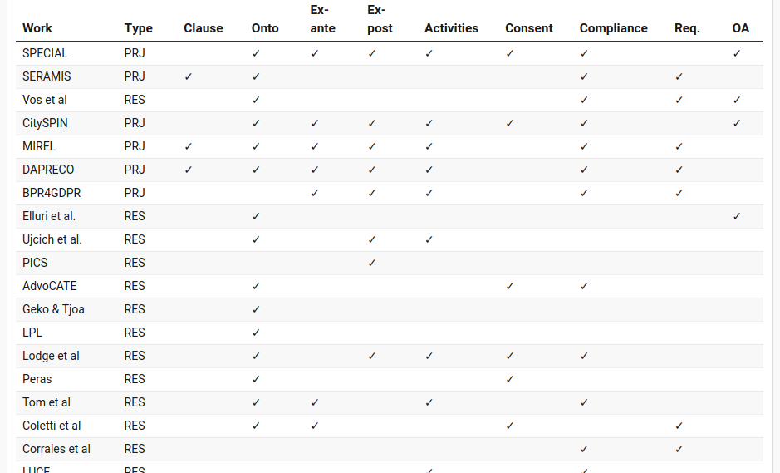
State of the Art
Table 3.1 (cropped)
29 approaches
9 Research Projects (EU/H2020/National)
3 model GDPR clauses
20 model some form of ontological representation
13 model activities associated with GDPR
12 represent Ex-ante, 10 represent Ex-post
9 model consent
18 evaluate compliance
9 provide remedies / suggestions
4 are completely open-access
1

Slide 6
SotA – Gaps & Opportunities (Sec. 3.8)
Machine-readable representation of GDPR
Glossary of terms and concepts associated with GDPR
Representation of activities associated with processing of personal data in ex-ante and ex-post phases
Representation of consent information
Demonstration using authoritative compliance queries
Validating information for compliance evaluation
1

Slide 7
Research Objectives
RO1 Identify the subset of GDPR relevant for activities associated with processing of personal data and consent regarding compliance
RO2 Identify information required to represent activities associated with processing of personal data and consent in investigation of GDPR compliance.
RO3 Create OWL2 ontologies for representation information about:
(a): concepts and text of GDPR
(b): activities associated with processing of personal data and consent
(c): consent required to determine compliance
RO4 Represent compliance questions using SPARQL to query information about activities associated with processing of personal data and consent
RO5 Utilise SHACL to:
(a): validate information for GDPR compliance regarding activities associated with processing of personal data and consent
(b): link validation results with GDPR
major ->
major ->
minor ->
minor ->
1

Slide 8
Methodology
RO1 RO2 GDPR Analysis (Sec. 4.2.1)
1) Study authoritative sources (official text, Article 29 Working Party and European Data Protection Board opinions, court cases, legal experts)
2) Identification of requirements and stakeholders – identify actors and information flows for data governance
3) Develop ‘compliance questions’ to retrieve and assess information for GDPR compliance
RO3 Ontology Development (Sec. 5.1)
1) Use compliance questions as Competency Questions [35] and develop in iterative manner using NeOn [34] and UPON Lite [36]
2) Ontology quality [37,38] and documentation [38] best practices
3) Disseminate (Open-Access, advertise, publish)
3) Evaluation on above criteria
RO5 Validation Framework (Sec. 6.2.1)
1) Identify role of information validation and its persistence for compliance
2) Develop framework to validate information and persist results as KG
3) Develop validation constraints from compliance questions
4) Implement validation constraints using SHACL
5) Demonstrate using real-world example/use-case
6) Evaluate
RO4 Querying (Sec 6.1.2)
1) Represent SPARQL queries using developed ontologies
2) Demonstrate using real-world questions/requirements
3) Evaluate
1

Slide 9
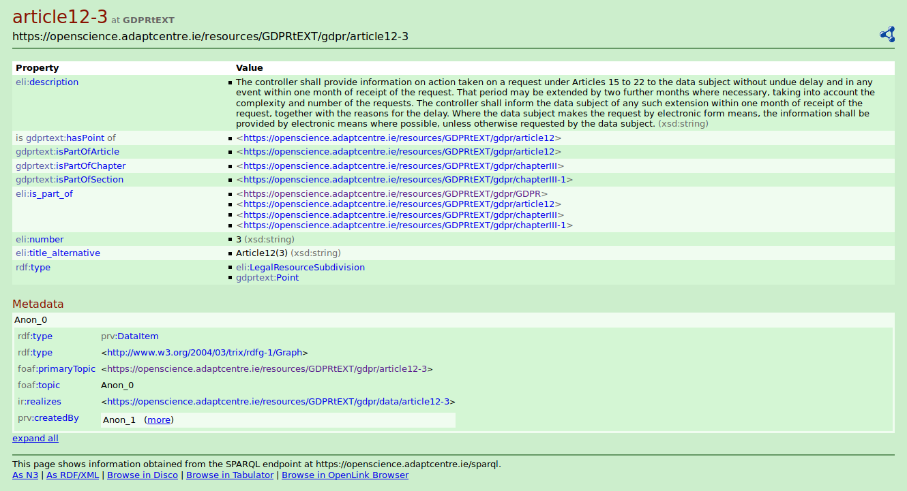
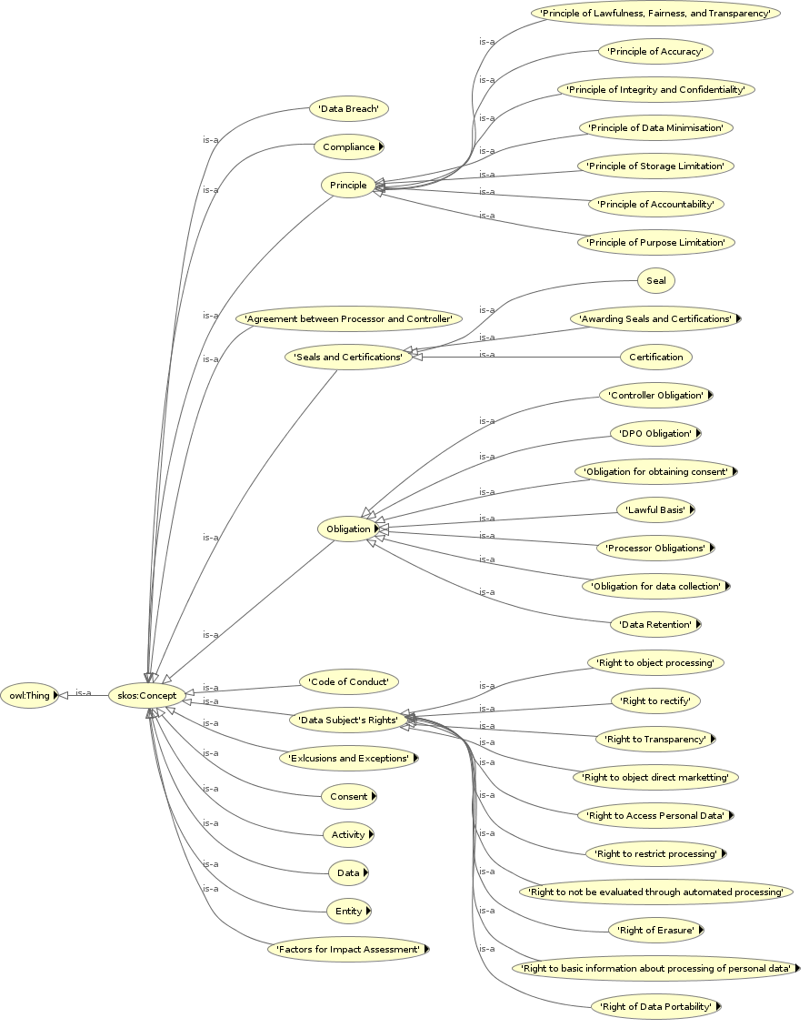
Representing Information about GDPR – GDPRtEXT (Sec. 5.2)
Structure of GDPR
Chapters, Articles, Clauses – and their relationship
Extends European Legislation Identifier (ELI) [39] (ELI is maintained by EU Publications Office)
Assign IRIs for individual clause for granularity
Export as RDF dataset
Glossary of GDPR concepts (related to compliance)
Principles, Rights, Data, Activities, Entities, Obligations
Relevant clauses: definitions, relations
Represent using SKOS
Dissemination & Publication
Ontology+documentation: https://w3id.org/GDPRtEXT/
ESWC 2018 Resource Track [72]
Added as dataset on Open Data Portal (Ireland)
Publications Office expressed interest on work
1

Slide 10
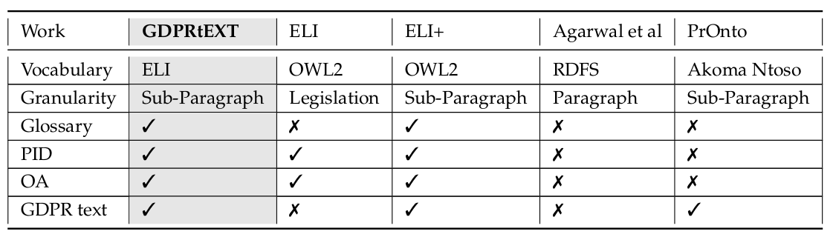
Representing Information about GDPR – GDPRtEXT (Sec. 5.2)
Comparison with SotA (Table 5.2)
Based on ELI – authoritative representation of EU legislations
Glossary of concepts
Granularity can refer to clauses
Uses best practices (as a semantic web resource)
Is Open Access under permissive license
Note: EU Publications Office has indicated their plans to update ELI (indicated as ELI+ in the table) which will incorporate the above features and some additional ones such as markup for specifying concepts of interest. It has also indicated the intention to align ELI with Akoma Ntoso to provide a unified vocabulary.
1

Slide 11
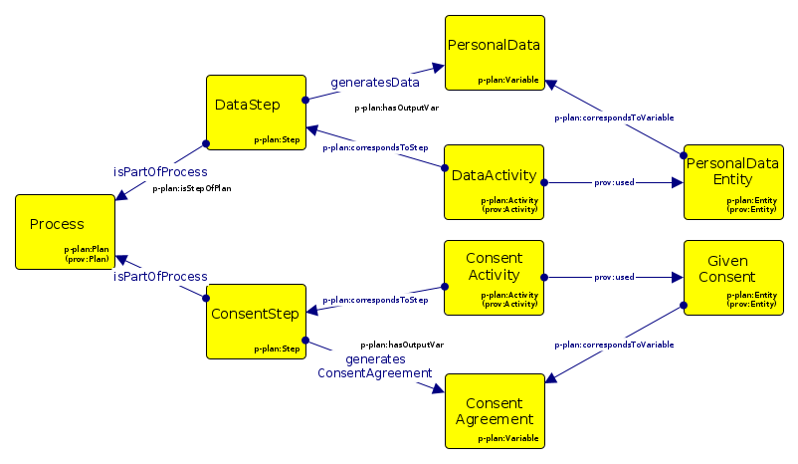
Representing Information about Activities associated with Personal Data and Consent – GDPRov (Sec. 5.3)
GDPRov ontology for representing provenance information based on GDPR requirements
PROV-O (W3C standard for provenance) and P-Plan (extends PROV-O to represent Plans as Scientific Workflows)
Uses GDPRtEXT to indicate source of concepts
Models:
Actors and Agents involved
Details of processing activities
Lifecycle of processing activities
Consent activities and their similarity to data activities
Similarly activities: rights, data breach reporting
Ex-ante (plans) and Ex-post (verification)
Dissemination & Publication
Ontology+documentation:
http://w3id.org/GDPRov
ISWC 2017 PrivOn workshop [66]
1

Slide 12
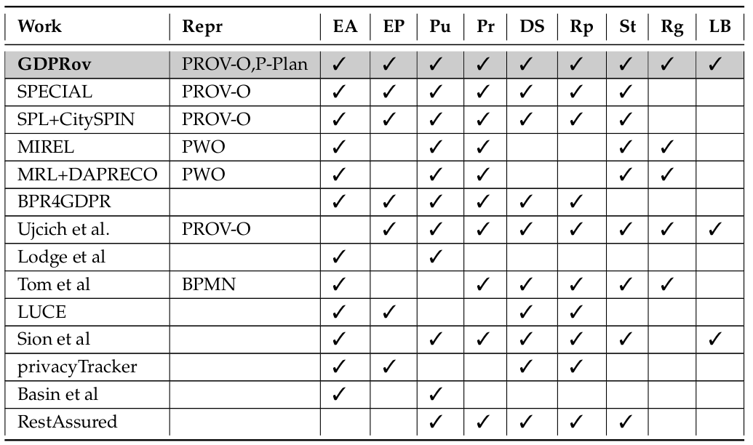
Representing Information about Activities associated with Personal Data and Consent – GDPRov (Sec. 5.3)
Comparison with SotA (Table 5.4)
Separation of provenance and plans using P-Plan
Open Access under permissive license
Larger scope of concepts
Models activities associated with GDPR
Associates legal basis with activities
Uniform modelling of activities associated with GDPR
Permits capturing state of system to indicate compliance at time
1

Slide 13
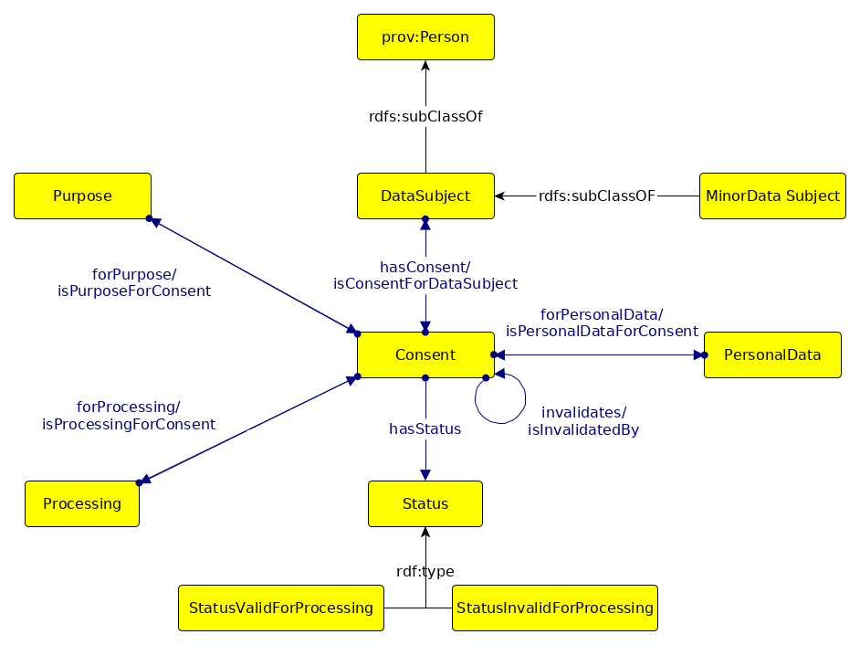
Representing Information about Consent - GConsent (Sec. 5.4)
GConsent ontology for representing information about consent based on GDPR requirements
GDPRov models consent as a provenance-related entity and represents its lifecycle
GConsent presents alternate/companion modelling of information about consent with more concise association between concepts
Models:
Context (e.g. location, medium)
Provenance chaining of consent (i.e. evolution of consent)
Consent States (e.g. given, refused, requested, invalidated, withdrawn)
Dissemination & Publication:
Ontology+documentation http://w3id.org/GConsent
ESWC 2019 [71]
1

Slide 14
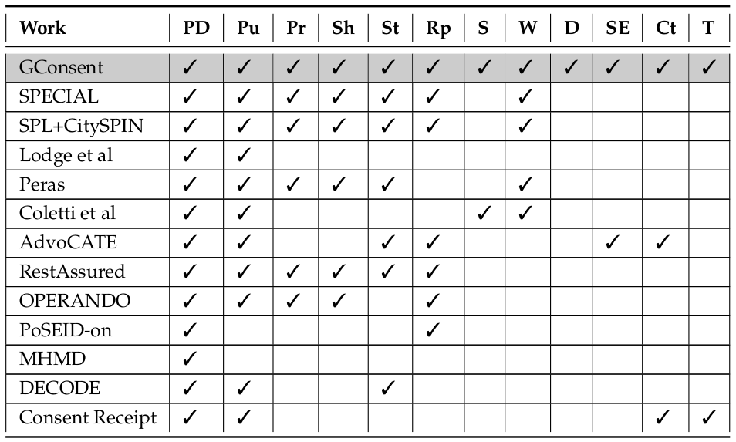
Representing Information about Consent - GConsent (Sec. 5.4)
Comparison with SotA (Table 5.7)
Larger coverage of GDPR requirements for consent
Models context
Consent states
Delegation
Significant effects of Processing
Relation between consent instances (lifecycle)
Open Access under permissive license
1

Slide 15
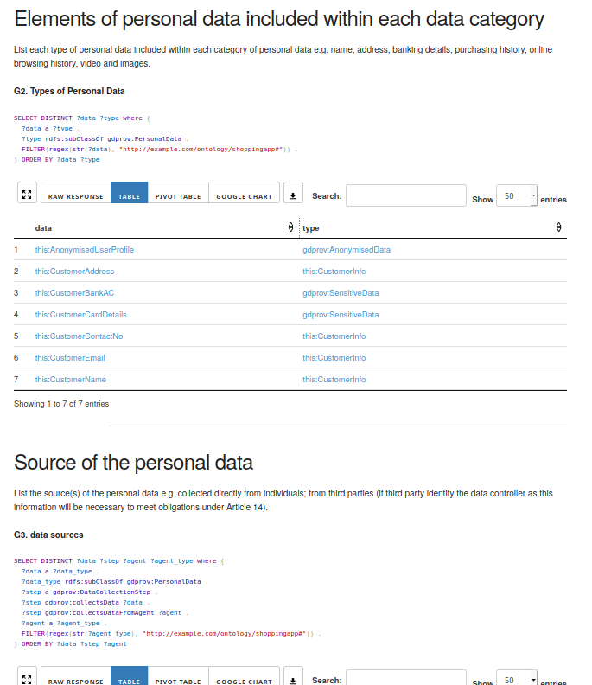
Querying information using SPARQL (Sec. 6.1)
Two types of questions associated with compliance:
Retrieve relevant information e.g. what purposes do you use personal data for?
Assess compliance e.g. does every purpose have a legal basis?
Goal: represent questions as SPARQL queries
Use-case: GDPR readiness guide published by Data Protection Commission (Ireland)
Model information using GDPRtEXT, GDPRov
https://w3id.org/GDPRep/checklist-demo
Demonstrate use of SPARQL in retrieving information relevant to GDPR compliance
Application on authoritative questions
Show dependency on underlying data representations (i.e. ontologies used)
Published SEMANTiCS 2018 [57]
1

Slide 16
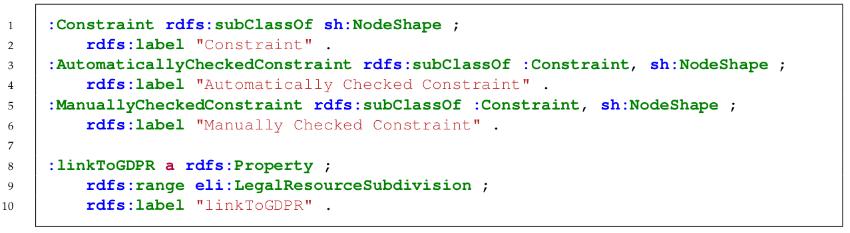
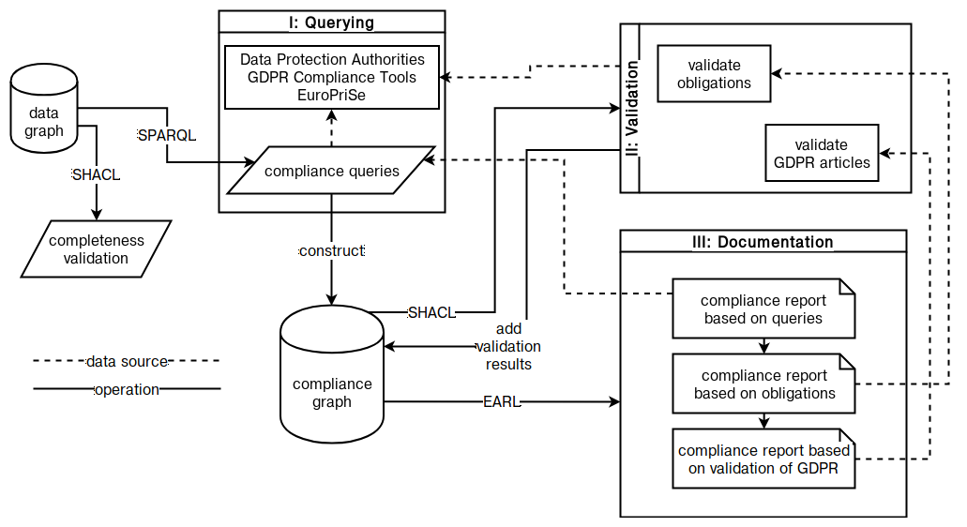
Validating information using SHACL (Sec. 6.2)
Organisations required to document and maintain information associated with compliance
Concept of ‘Compliance graph’ distinct from ‘data graph’
Information validation as precursor to compliance evaluation
Create validation ‘constraints’ from compliance questions
Use SHACL to i) validate information ii) persist results iii) link with GDPR
Tests need to be carried out in ex-ante and ex-post phase
Use ex-ante test results to reduce number of ex-post tests (i.e. abstract common constraints)
1

Slide 17
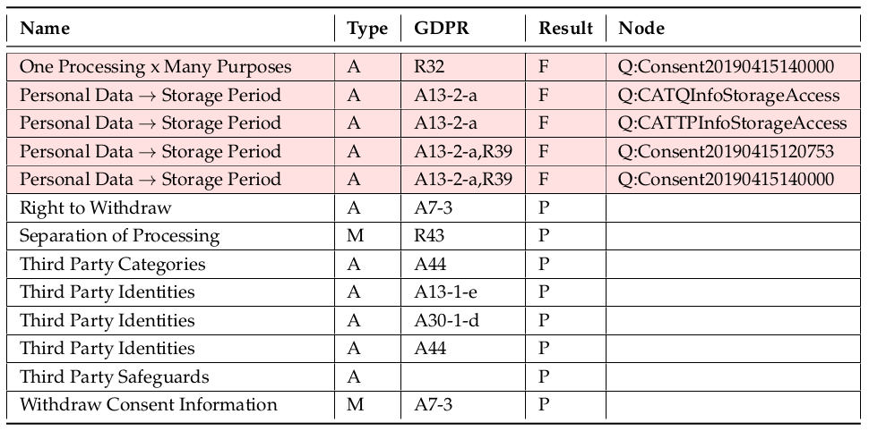
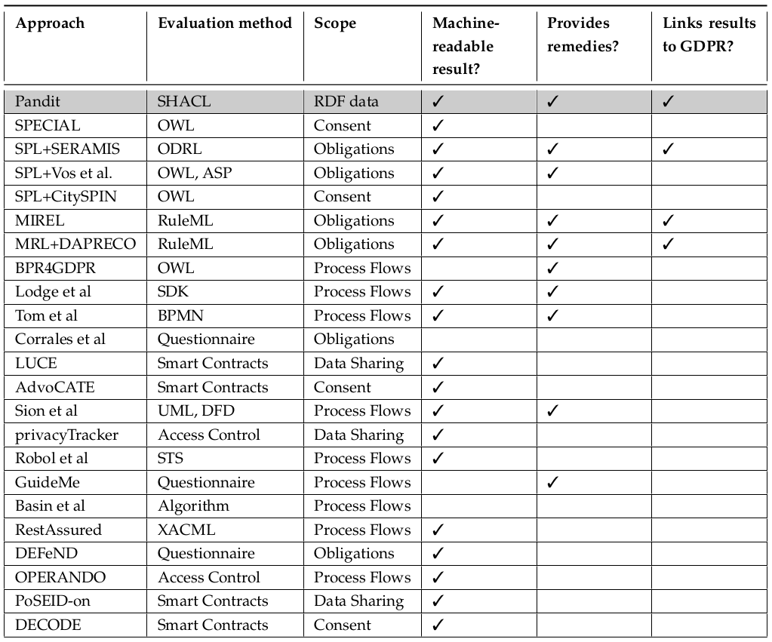
Validating information using SHACL (Sec. 6.2)
Use-case: consent dialogue on Quantcast.com
‘data graph’: GDPRtEXT, GDPRov, and Gconsent
Validate results and save into ‘compliance graph’
Use SPARQL to ‘query’ and generate ‘dashboards’
Published in SEMANTiCS 2018 [59], 2019 [60], ISWC 2018 CKG Workshop [58]
Demonstrated to DPC – Ireland
Comparison with SotA (Table 6.4)
Use of SHACL
Separation of ex-ante and ex-post phases
Reuse results
Link to GDPR
Indicate violating constraints/nodes
Compliance results persisted
SPARQL queries as ‘dashboard’
Open-Access implementation https://w3id.org/GDPRep/semantic-tests
1

Slide 18
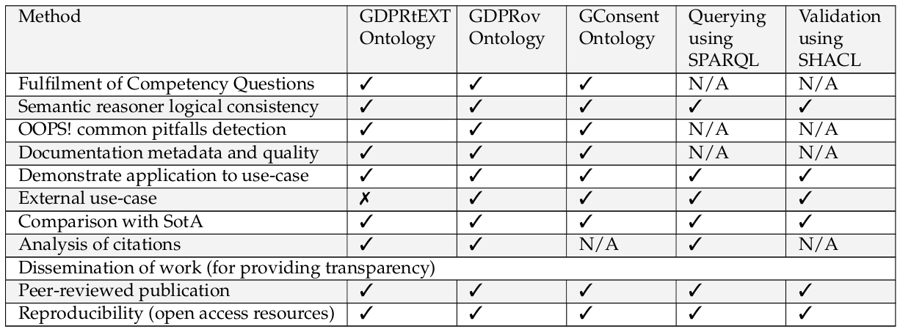
Fulfilment of Research Objectives (Sec. 7.1)
RO1 Identify the subset of GDPR and RO2 Identify information required to represent activities associated with processing of personal data and consent in investigation of GDPR compliance
Compliance Queries (and analysis of information) presented in Chapter 4
RO3 Create OWL2 ontologies for representation information about:
Ontologies presented in Chapter 5
(a): concepts and text of GDPR → GDPRtEXT (Sec. 5.2)
(b): activities associated with processing of personal data and consent → GDPRov (Sec. 5.3)
(c): consent required to determine compliance → GConsent (Sec 5.4)
RO4 Represent compliance questions using SPARQL to query information about activities associated with processing of personal data and consent → queries (Sec. 6.1)
RO5 Utilise SHACL to: (a): validate information for GDPR compliance regarding activities associated with processing of personal data and consent (b): link validation results with GDPR → (Sec 6.2)
Querying and Validation of information presented in Chapter 6
major ->
minor ->
minor ->
1
Table 1.1 Summary of Evaluation Methods

Slide 19
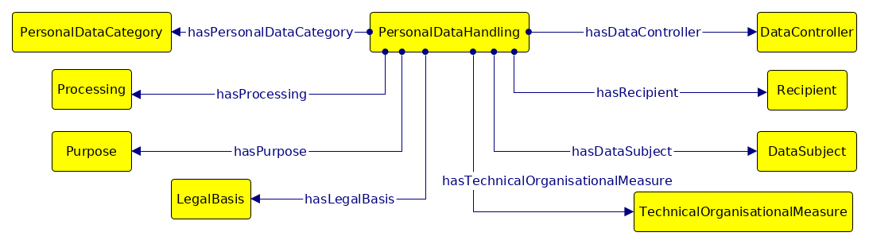
W3C Data Privacy Vocabularies and Controls CG (Sec. 5.5)
Data Privacy Vocabulary (DPV) [78] for representing information about data handling based on legal requirements – including GDPR
Represents wider community consensus on information modelling and requirements
Most comprehensive vocabulary/taxonomy to date
GDPRtEXT, GDPRov, GConsent were part of SotA analysed
More generic and abstract e.g. does not model provenance
GConsent provided input for consent modelling
Initiated under SPECIAL project [70]
Specification: http://w3.org/ns/dpv
Author was co-editor of specification, co-lead author of publication [38] and SPECIAL deliverable 6.5 [70]
Currently serving as co-chair from Jan 2020
1

Slide 20
Conclusion
Research Question: To what extent can information regarding activities associated with processing of personal data and consent be represented using Semantic Web technologies for GDPR compliance?
Publications (Sec. 1.4.7)
GDPRtEXT – ESWC 2018
GDPRov – ISWC PrivOn 2017
GConsent – ESWC 2019
SPARQL queries – SEMANTiCS 2018
SHACL validation – SEMANTiCS 2018,2019, ISWC CKG 2018
GDPR interoperability analysis – EURAS 2018, IJSR 2018, Book Chapter 2019
Investigated applications in information management – ICSC 2019, ESWC MEPDaW 2018
Investigated application on privacy policies – IPAW 2018, ISWC WOP 2018, TELERISE/ADBIS 2018
DPV – ODBASE 2019
Linking of information with GDPR
Information Representation
Querying
Validation
Compliance Evaluation
Contributions of Thesis
GDPRtEXT ontology and resource
GDPRov ontology
GConsent ontology
SPARQL queries for information retrieval
SHACL to validate information, link to GDPR
Framework for ex-ante and ex-post tests
Contribution to DPV(CG)
Open-access resources
Future Work
Align with DPV (as extentions)
Data Protection Impact Assessments (DPIA)
Controller – Processor agreements/contracts
Consolidate court cases and DPA decisions
Privacy policy representation
Representation of policy e.g. ODRL
Student Project Supervision
Browser extension to record consent (4thyear, 2020)
Contextual Integrity for GDPR (MSc, 2020)
Privacy policy generator (4th year, 2020)
Privacy policy visualisation (4th year, 2019, 2020)
Funding and Opportunities
Ireland Postdoc Fellowship (2020) – applied
H2020 IoT project 2020
NGI funding calls
ICO (UK) funding call
1

Slide 21
Formatting Guide
Footnotes¹ refer to references within slides
References [1] refer to references in thesis
1

Slide 22
List of Additional Slides
Information about GDPR
Scope of Research
1

