Slide 1





Consent: Where are we going?
Harshvardhan J. Pandit
Postdoctoral Fellow
ADAPT Centre, Trinity College Dublin
https://harshp.com/research
pandith@tcd.ie
MDPP DCU, Monday MAR-15 2021
The ADAPT Centre is funded under the SFI Research Centres Programme (Grant 13/RC/2106_P2) and is co-funded under the European Regional Development Fund.

Slide 2
Introduction
Research Fellow @ Trinity College Dublin
Currently working on: Semantics x Privacy Risks x GDPR x Consent
PhD: 2016-2020 Computer Science, Trinity College Dublin
Representing Activities associated with Processing of Personal Data and Consent using Semantic Web for GDPR Compliance

Slide 3
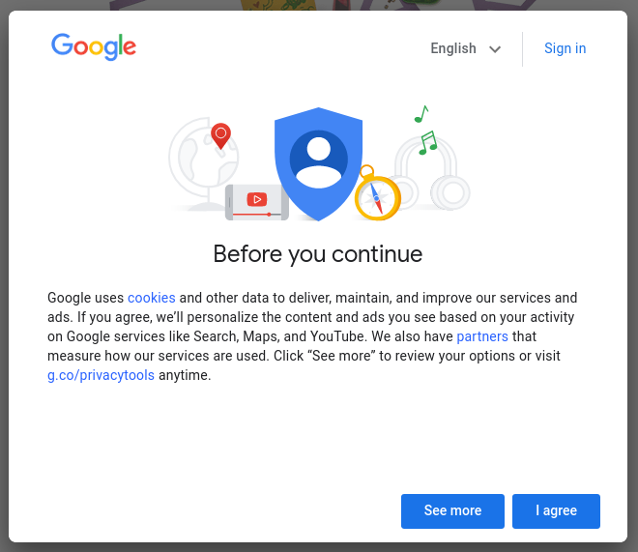
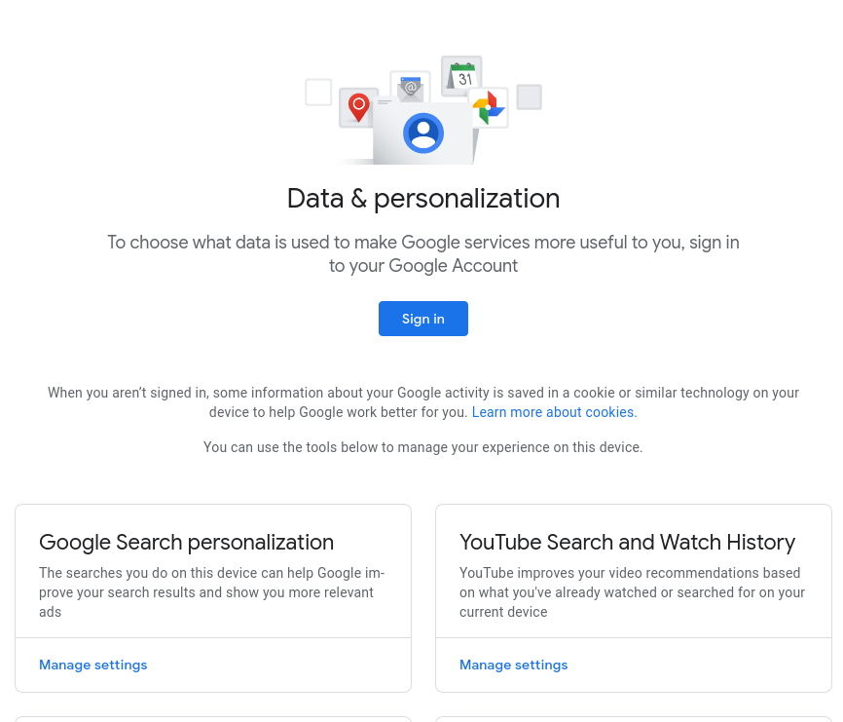
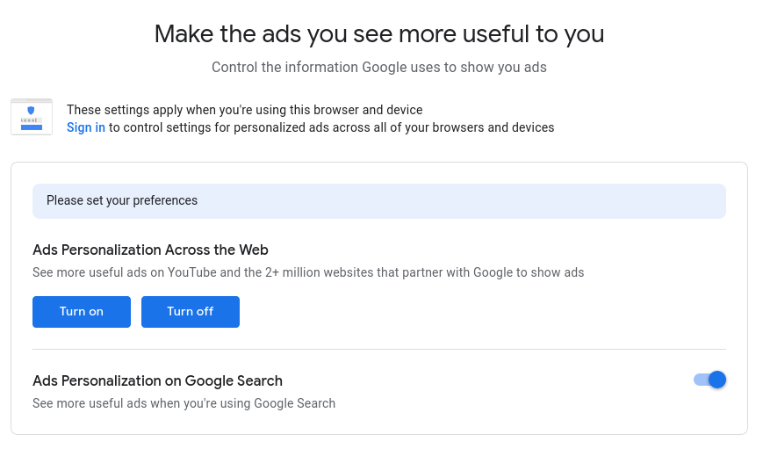
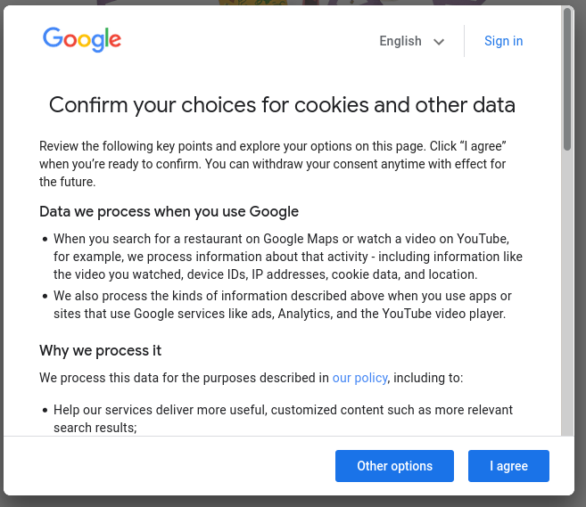
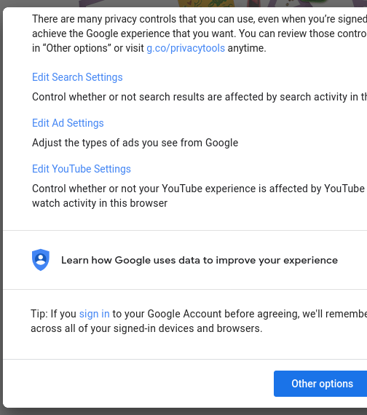
“consent” is not an optional choice
Consent dialogue on https://google.ie MAR-14 2021

Slide 4
GDPR says...
Consent should be:
Freely given → without coercion, no obligation
Specific → exact and limited in scope
Informed → prior knowledge of consent and consequences
Un-ambigious → clear indication of consenting
Revocable / Can be Withdrawn → once given, can be cancelled
- GDPR Art. 4-11 (2016)

Slide 5
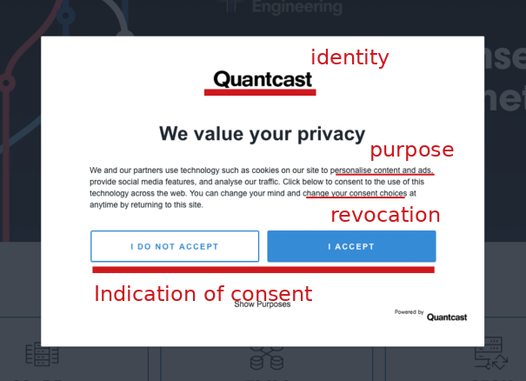
GDPR also says...
GDPR Art 4, 7, 13, 14
Identity of Controller
Purpose
Processing Categories
Personal Data Categories
Right to Withdraw Consent
Data Storage Periods
Data Sharing / Recipients
Trans-border data flows
Technical and Org. Measures
Risks envisioned (sic.)
Automated Decision Making
Novel technologies
Profiling / Surveillance (sic.)

Slide 6
Process of Consent - Dimensions and Domains
law
e.g. GDPR / CCPA / ePrivacy
Outlines permissions, obligations
Defines Legal Basis
Restrictions
Conditions e.g. freely given
Quality (sic.) e.g. explicit
Information requirements e.g. notice
Who is giving consent?
What is their background?
What do they already know?
What needs to be confirmed?
How do they perceive/comprehend?
What kinds of actions can they take?
Can they indicate their intention?
human-centricity
technology
How to request consent?
How to collect consent?
How to record consent?
How to demonstrate/validate it?
How to revoke/withdraw consent?
How to signal choice / consent?
How to share consent?
How to specify information/notice?
Where to show notice?
How to indicate choice/optionality?
What prominence is used?
Are interactions clear and usable?
Layers to hide complexity?
Speed vs Density vs Accuracy
HCI / UI-UX

Slide 7
Comprehension - Dark Patterns
Dark Patterns (https://www.darkpatterns.org/)
Dark Patterns are tricks used in websites and apps that make you do things that you didn't mean to, like buying or signing up for something.
Nouwens et al. (2020) scraped five most popular consent dialogue providers on top 10,000 UK websites and found that dark patterns and implied consent are the norm – while only 11.8% of the website analysed were GDPR compliant.
Human and Cech (2020) investigated sociological dimensions of consent and found GAFAM policies contained several variations of dark patterns in interaction design, visual design and textual descriptions of notices / requests for consent.
Matte et al. (2020) list dark patterns within the IAB framework – largest ad networks on the internet – and showed that websites do not respect consent choices and collect data anyway regardless of what the users chose / indicated.
Santos et al. (2020) expand on the above work and show (opine) “it’s not possible to fully assess compliance with the law for the majority of requirements because of the current architecture of the Web”

Slide 8
Consent → Technological Solutions?
Do Not Track (DNT) → boolean (set on / off) browser signal to indicate user does not want to be ‘tracked’ across the websites. Last standardisation via W3C in 2019. All browsers implement it. No websites it. Spectacular failure. https://www.w3.org/TR/tracking-dnt/
Global Privacy Control (GPC) → boolean (set on / off) browser signal to indicate user does not want their data to be ‘shared’ beyond the website/controller. Last specification Jan 2021. Only 1 browser currently implements it - Brave. Some websites support it. Legally enforceable under CCPA. Uncertain regarding GDPR¹. https://globalprivacycontrol.github.io/gpc-spec/
Privacy Labels → Apple introduced notices for its App Store which requires developers to post information about data collected and used for tracking of individuals, in addition to requiring them to ask consent for tracking - and provides a global setting to prohibit such requests. The company dogfoods: https://www.apple.com/privacy/labels/
1 GPC + GDPR: will it work?. Harshvardhan J. Pandit. 2021. https://harshp.com/research/blog/gpc-gdpr-can-it-work

Slide 9
Standardisation Efforts
Kantara published Consent Receipt (2018) specification outlining a schema for issuing ‘receipts’ for given consent. Barebones spec, does not meet (any? most?) legal requirements.
ISO/IEC published 29184 (2020-06) standard for online privacy notices for consent which involves requirements for consent dialogues and mentions possibility of machine-readable metadata.
Re:29184 - it requires asking explicit consent for some cases. But its definition of ‘explicit consent’ does not meet GDPR’s requirements¹.
ISO/IEC announced 27560 (likely publication >2023) as an upcoming standardisation effort for consent receipts. Data Protection Authories involved via national standardisation bodies.
1 Comparison of notice requirements for consent between ISO/IEC 29184:2020 and GDPR (Forthcoming). Harshvardhan J. Pandit*, Georg Philip Krog*. Journal of Data Protection & Privacy. 2021. https://doi.org/10.5281/zenodo.4444925

Slide 10
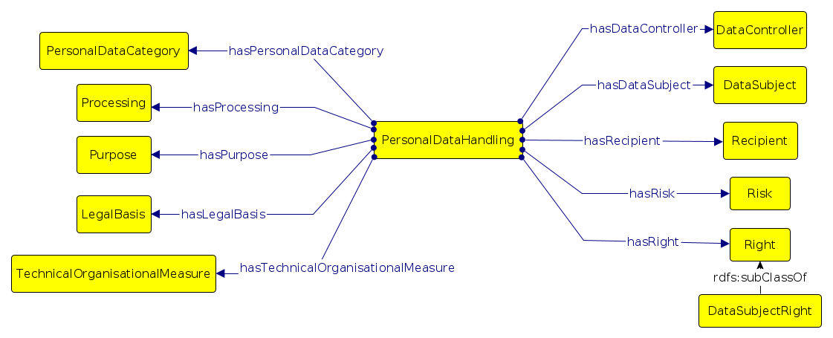
Machine-readable Metadata
Data Privacy Vocabulary¹ (DPV), v0.2, 2021 https://w3.org/ns/dpv
Machine-readable vocabulary for creation of technological solutions and enhancing interoperability
(A) Existing information → DPV
e.g. NLP² to analyse privacy policies → extract terms → perform legal analysis
(B) DPV → Generate Information
e.g. Utilise DPV to generate common ROPA³ documentation for GDPR compliance
1 Creating A Vocabulary for Data Privacy (alt: Data Privacy Vocabulary (DPV)). Pandit, Polleres et al. 2019. https://zenodo.org/record/3934476
2 The Role of Vocabulary Mediation to Discover and Represent Relevant Information in Privacy Policies. Leone et al. 2020 https://ebooks.iospress.nl/volumearticle/56164
3 A Common Semantic Model of the GDPR Register of Processing Activities. Ryan et al. 2020 https://doi.org/10.3233/FAIA200876

Slide 11
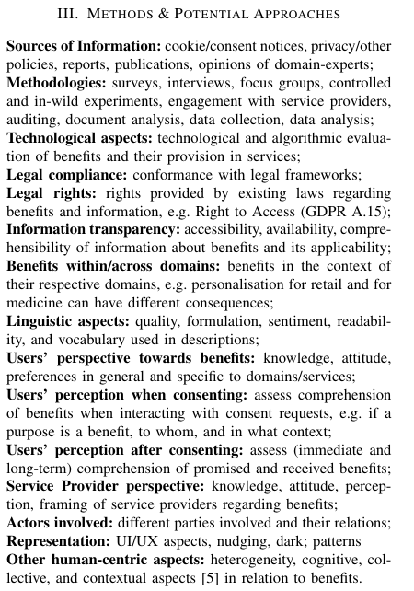
Consumer Protection
[How] Do Users Benefit From Giving Consent?
Harshvardhan J. Pandit*, Soheil Human*, Mandan Kazzazi*
https://zenodo.org/record/4601141 To be Presented at Workshop on Technology and Consumer Protection (ConPro) - co-located with IEEE Symposium on Security and Privacy (IEEE S&P)

Slide 12
Projects I’m working on
RISKY: Exploring Privacy Risks of Technologies using Knowledge Graphs
https://harshp.com/research/projects/risky
Funded by Irish Research Council for 2 years
Create a vocabulary of known risks (using DPV)
Associate risks with scenarios, technologies, concepts
For ‘new’ situation, discover risks from existing knowledge
Privacy as Expected: Consent Gateway (PaE:CG)
https://privacy-as-expected.org/
Funded by EU H2020 NGI Trust grant for 9 months
Update Consent Receipt to GDPR / CCPA requirements
Browser extension + server component to generate receipts
Gateway: third-party notary ‘signs’ receipt as a witness

Slide 13
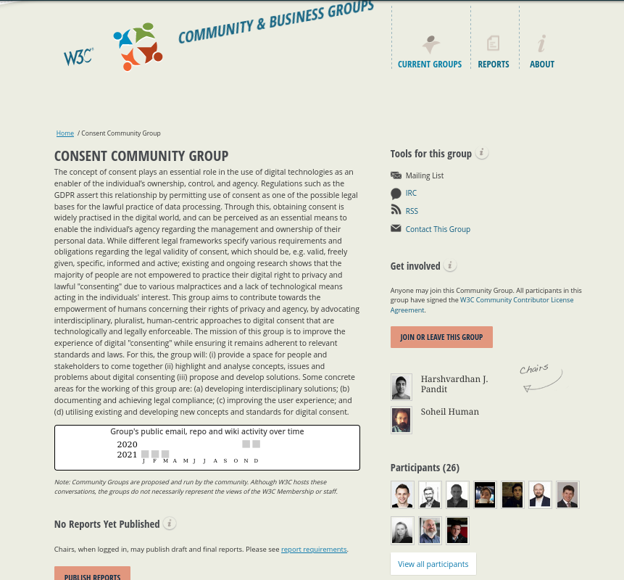
Consent Community Group
https://www.w3.org/community/consent/

Slide 14
Thank you for your time!
Consent: Where are we going?
Legal Requirements
Notices and Information
UI / UX → Dark Patterns
Multidisciplinary approach
Existing research and State of the Art
Technological signalling of choice/preference
Standardisation
Metadata / Data Privacy Vocabulary
Consumer Protection
Consent Receipts
Community Groups

