Slide 1
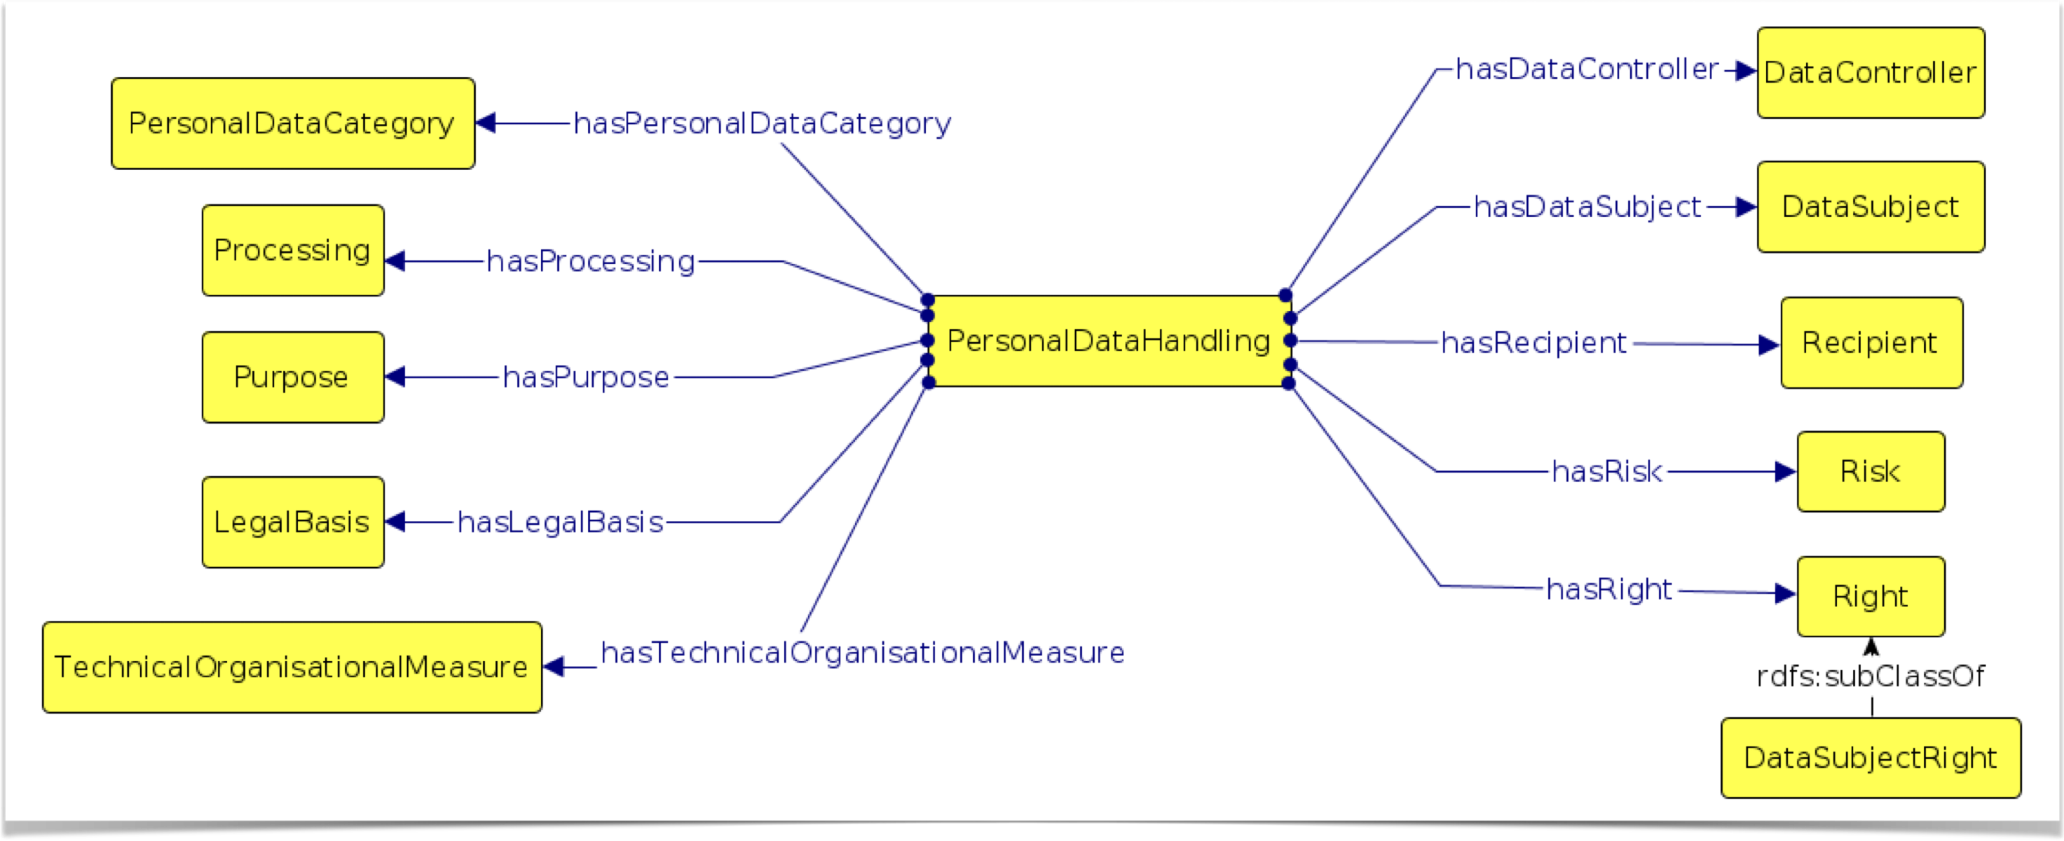

Data privacy vocabulary (DPV)
https://w3.org/ns/dpv
Harsh(vardhan J. Pandit)
Research Fellow @ ADAPT Centre, Trinity College Dublin
Email: pandith@tcd.ie | Twitter: @coolharsh55
https://harshp.com/research
Presentation adapted for DPSN 2022 Data Protection Day from DCMI 2021

Slide 2







Apply, Innovate, Automate
Policies
Privacy Policies — End-User
Internal Organisational Policies
Service/Agent Negotiation
Permission Management
Consent
Access Control
Government
Dialogue
Universities
Dashboard
Browsers
Solid Pods
Transparency in Use & Sharing
Apple Store Labels
Internet Communications
Dataset Publishing
Banking
Legal Compliance
Documentation of Use-Case
Input to Assessment Tools
eHealth
Medicine
Smartphones
IoT
Open Data

Slide 3
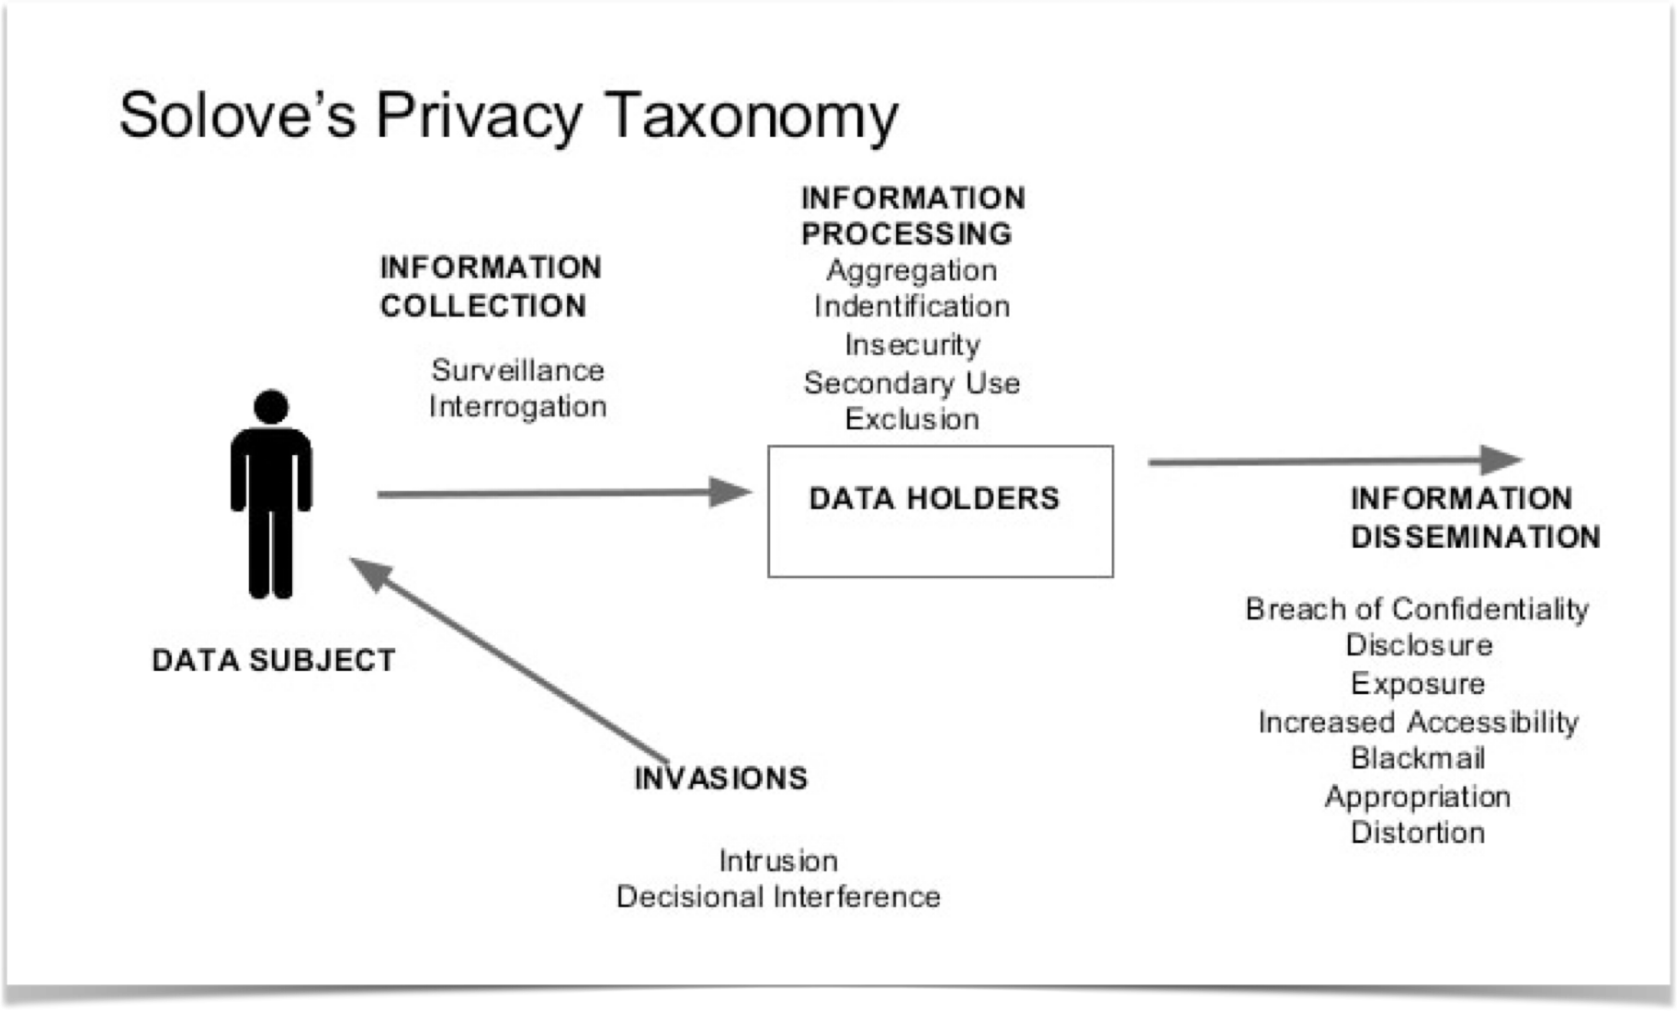
Towards eventual Standardisation
Venues: ISA2 / SEMIC / CEN(ELEC) / ISO / W3C
Too much variation in Global concepts for uniformity e.g. ‘Sell’ in USA vs EU
Legality ≠ Privacy
Flexibility vs Strictness in application
Integration with standards e.g. DCAT
Technologies e.g. cookies, databases, algorithms
Benefits to all stakeholders: Controllers, Processors, Data Subjects, Authorities
Not a “replacement” for existing practices: e.g. DPOs jobs can be enhanced by working on spreadsheets
The scope of DPV is in a progressive flux
It needs a diverse multi-disciplinary cohort of experts to finalise concepts

