Slide 1
Evaluation of workflows for repeatability and sharing of experimental templates, execution records, and data
Harshvardhan J. Pandit
Supervised by David Lewis & Declan O’Sullivan
Theme E, ADAPT, Trinity College Dublin

Slide 2
Problem domain
Researchers in areas related to NLP do a lot of experiments that are similar and use the same or similar data sets.
Most experiments are a variation of some common template or previous research.
Using linked open data, experiments and data sets can be ‘linked’ together.
There have been some approaches for formalizing NLP related experimental metadata by the community - OpenAIRE, LAPPS Grid / Galaxy

Slide 3
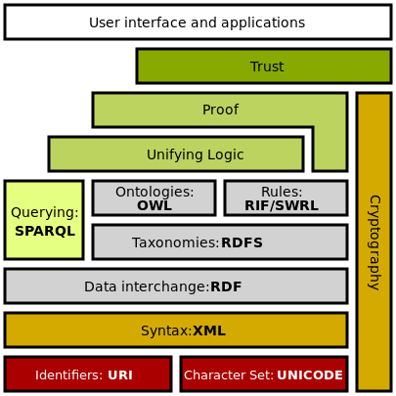
Linked Data & Semantic Web Ontologies
Linked Data is interlinking of information
Semantic Web is the extension of current web where information is linked by context
Ontologies are used to describe the nature of information and its relation

Slide 4
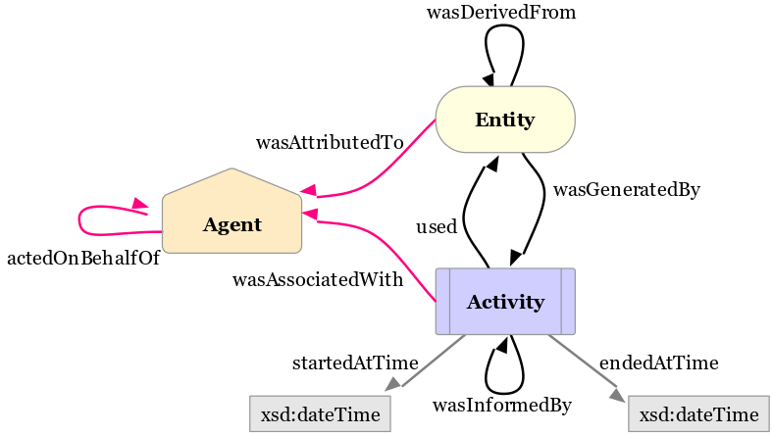
PROV
Ontology to record and share Provenance Information
Origin, history, ownership, relation
W3C recommendation (April 2013)
http://www.w3.org/TR/prov-o/

Slide 5
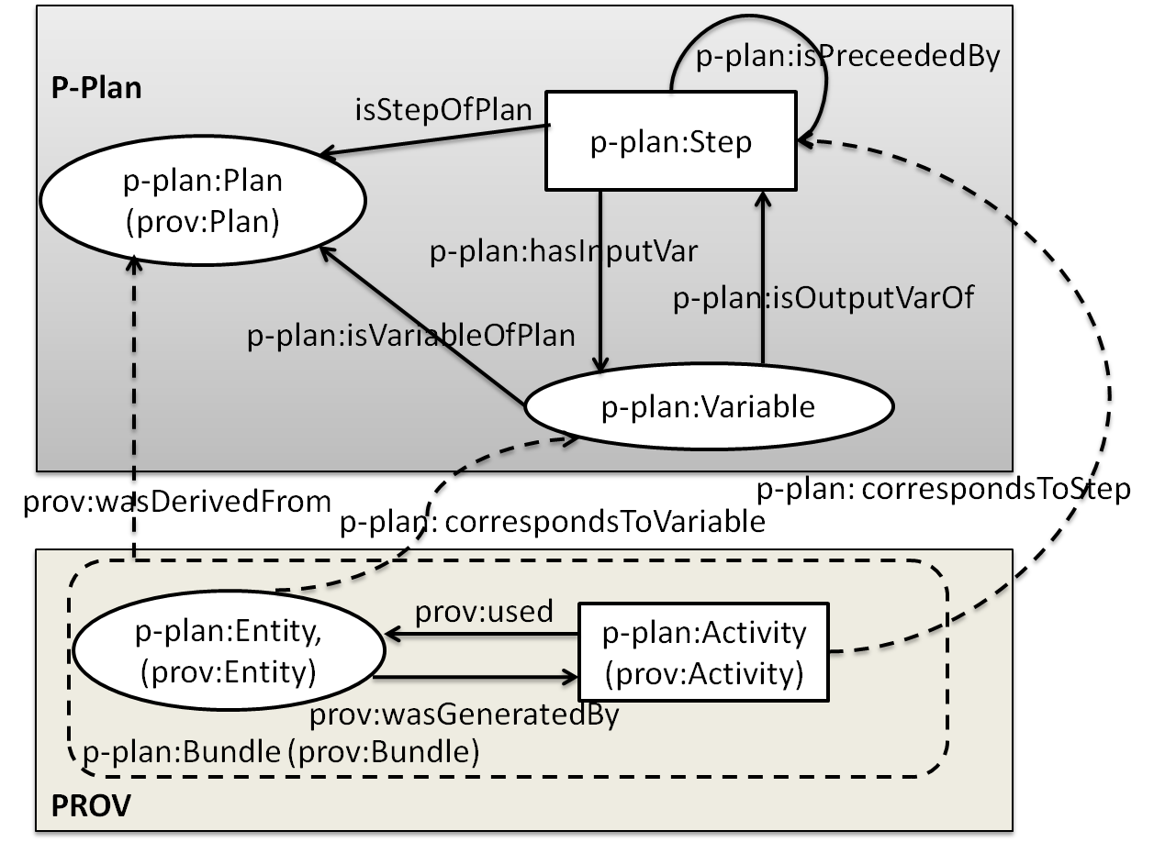
P-Plan
Extension to PROV
Represents plans the guide execution of processes
Describes how plans are composed and their correspondence to provenance records that describe the execution of the plan
http://purl.org/net/p-plan#

Slide 6
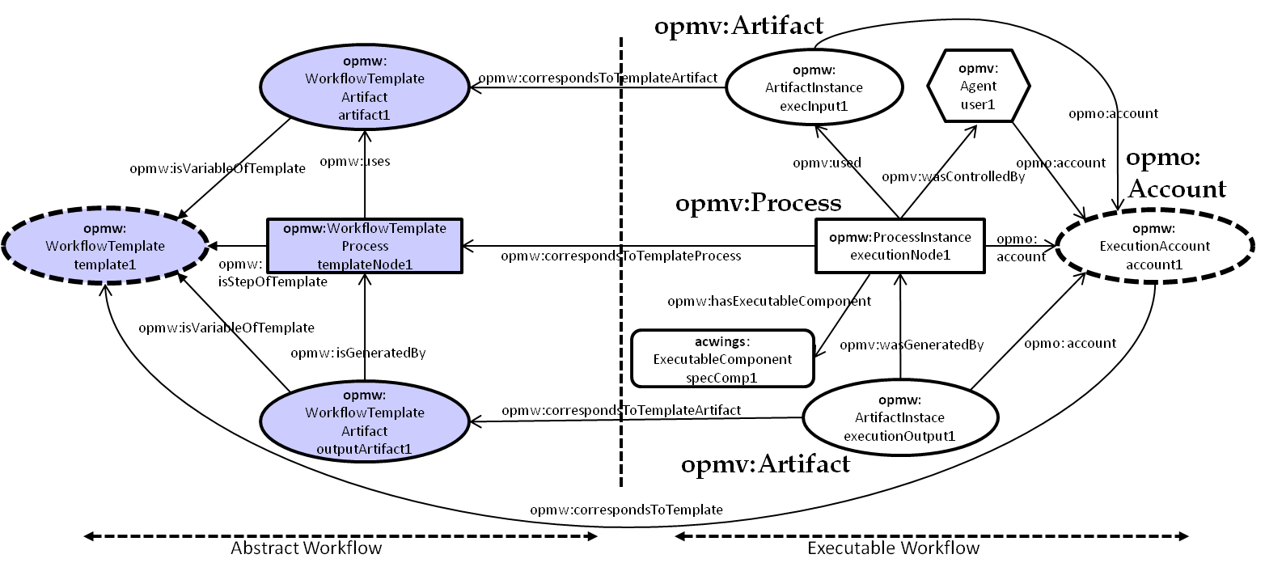
Open Provenance Model for Workflows (OPMW)
Based on P-Plan, which extends PROV-O
Describes workflows for scientific articles and their results
Suitable for publication of experimental workflows
http://www.opmw.org/model/OPMW/

Slide 7
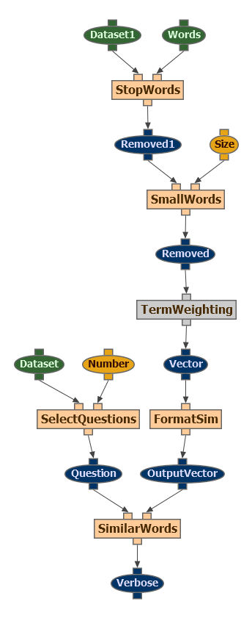
OPMW Experiment Template
Dataset
Parameter
Step / Process
Dataset (generated)
Step / Process (intermediate)
Experiment Template

Slide 8
OPMW Experiment Execution
Experiment Template
Execution1
log file
start / end time
Execution(n)
status
rights
agent (user/software)
. . .

Slide 9
Project Objectives
Using workflows & tools for documentation of experiments using OPMW
Project Deliverables
Browser based tool for creating / interacting with experimental workflows
Declaration of workflows using the OPMW ontology
User study on evaluation of tasks – search for related components, create execution, fork an experiment

Slide 10
Browser based tool
Premise
May not know about linked open data
May not know about semantic web and ontologies
Search for related research
Search for related data sets
Application
Browser based tool, GUI
Abstract ontology into simpler terms and forms
Introduce them to linked open data and experimental workflows
Provide motivation to publish experiments using linked open data

Slide 11
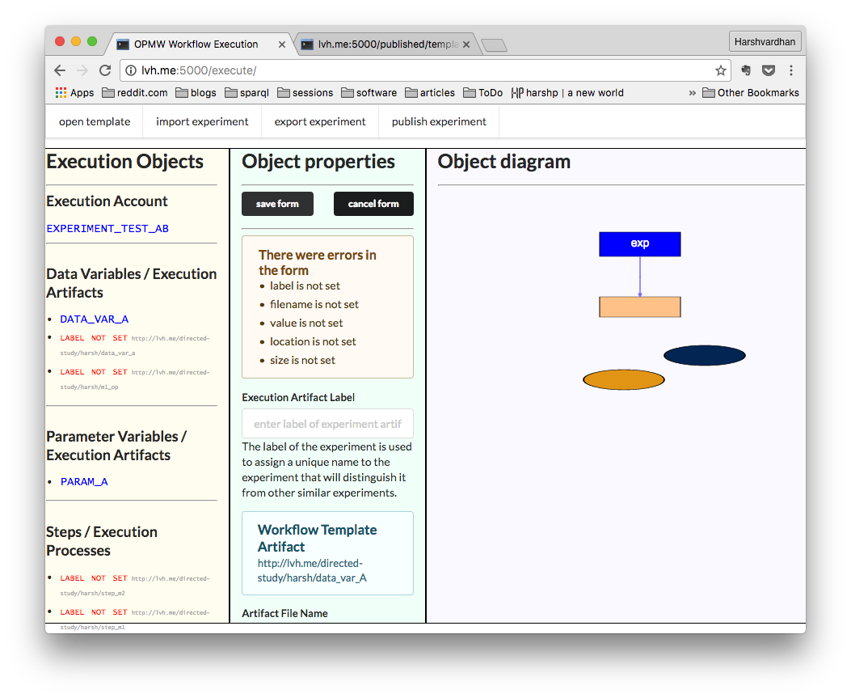
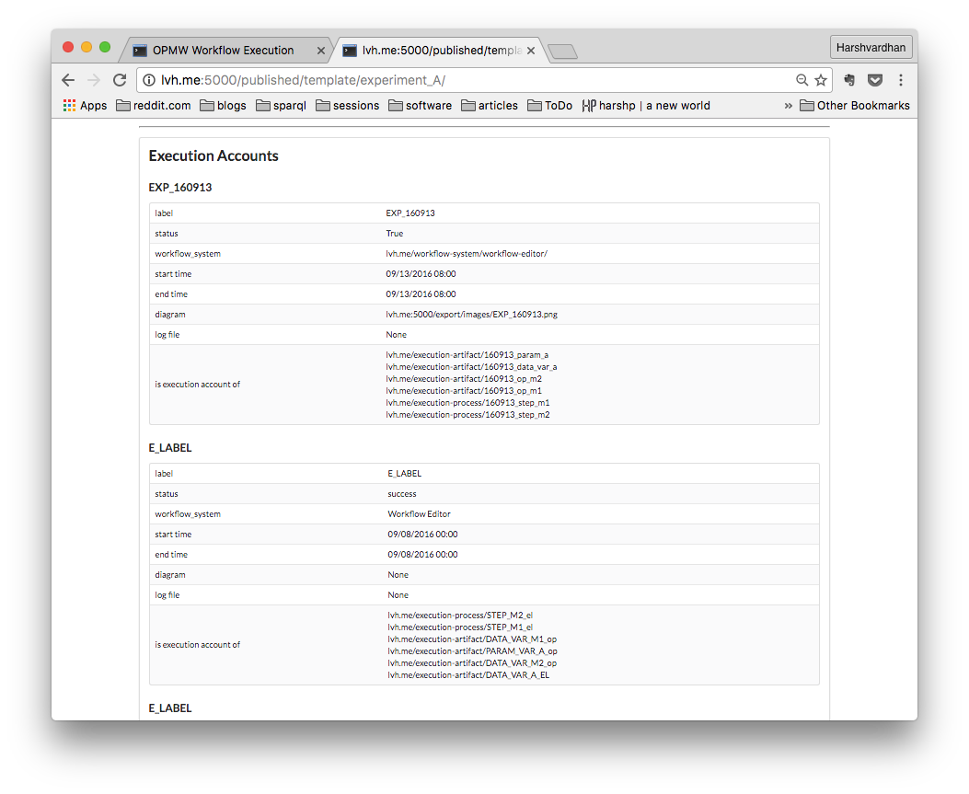
Browser based tool

Slide 12
How did I implement this?
Front end - HTML/CSS/JS (the usual suspects)
Drawing graphs – JointJS (http://jointjs.com)
Backend - flask/python (http://flask.pocoo.org/)
Triple store – SQLite

Slide 13
What’s Next?
Ethics Application Clearance
Experiment
Pre-questionnaire
Publication
Tasks
Post-questionnaire
Evaluation
Currently waiting for ethical clearance

Slide 14
Directed Study Objectives
Design, execution and analysis of web application usability study
Linked open data publish-consume lifecycle
Documentation requirements for repeatability of NLP experiments and language resource reuse
SPARQL to query linked data stores

Slide 15
Things I learnt
How semantic web ontologies and linked open data are used
How to write (or adapt) an ontology
The idea of working with triple stores
Where semantic web ontologies lack and how to deal with it
The (IMPORTANT) difference between “engineering” and “research” projects

Slide 16
Be wise, learn from my shortcomings
Don’t look for a ‘software’ solution
Never lose sight of the aim - better yet, write it and stick it on your desk
Always ask someone else rather than be confused or stuck
Read, read, read, then revise
Make the most minimal working example you can, then work on specific questions you want answered
‘Learning’ never stops - if you think you’re free, you’re not learning enough

Slide 17
that’s all for today
Questions?
Suggestions?
Tips & Tricks?

