Slide 1
Compliance through Informed Consent: Semantic Based Consent Permission and Data Management Model
Kaniz Fatema, Ensar Hadziselimovic, Harshvardhan Pandit, Christophe Debruyne, Dave Lewis, Declan O’Sullivan
ADAPT Centre, Trinity College Dublin
The ADAPT Centre is funded under the SFI Research Centres Programme (Grant 13/RC/2106) and is co-funded under the European Regional Development Fund.

Slide 2

EU’s General Data Protection Regulation
Data Protection Directive 95/46/EC needed reform to be fit for
technological developments like social networks and cloud computing
globalisation.
EU has replaces DPD with General Data Protection Regulation (GDPR)
GDPR will have immediate effect on all 28 EU Member States on 25 May 2018.
Data Protection Directive 95/46/EC

Slide 3
Key GDPR Provisions
International reach: data about any EU citizen
Fines upto €20M or 4% of global turnover
Must Demonstrate compliance
Processing lawful only through Informed Consent

Slide 4
Data Subject RIghts
Right to:
Information “concise, transparent, intelligible and easily accessible”
Make a subject access request
Rectification
Erasure
Data portability
Restrict access
Object to processing
Be inform who receives data

Slide 5
GDPR Roles and Processes
Supervisory Authority
complaints
Data Controller
Data Subject
Compliance
Third Party Data Controller
rights
rights
Monitor & Control
data
Processing
Sharing
data
workflow
dataset
workflow
workflow

Slide 6
GDPR Roles and Open Data
Supervisory Authority
Major New Open Data Business Cases
complaints
Data Controller
Data Subject
Compliance
Third Party Data Controller
rights
rights
Monitor & Control
data
Processing
Sharing
data
workflow
dataset
workflow
workflow

Slide 7

Requirements for Consent
Silence ≠ Consent
To be considered as a valid one
the consent should be:
Freely given
Specific
Informed
Unambiguous
Parental permission
If purpose or recipients change new consent must be sought
Notes:
To be considered as a valid one the consent should be:
Freely given: To be accounted as a valid consent, the consent has to be freely given by the data subject. A consent is not freely given if the data subject has no genuine and free choice, or is unable to refuse or withdraw consent easily, or there is a "clear imbalance" between the controller and the data subject (e.g., between an employer and an employee).
Specific: The request for consent shall be presented in a manner which is clearly distinguishable from the other matters, in an intelligible and easily accessible form, using clear and plain language.
Informed: According to GDPR Rec.32, 42, Art.4 & 7 consent must be taken from data subject by informing the nature of processing in an intelligible format, purpose of processing and identify of the controller and information about withdrawing consent.
Unambiguous: Data subject should take clear affirmative action as an indication to acceptance to the proposed processing of personal data. GDPR recognizes the validity of commonly used methods for collecting consent, such as, consent provided verbally, in writing, by ticking a box on a web page, by choosing technical settings in an app, or by any other statement or conduct. Therefore, inactivity, pre-ticked boxes, silence, failure to opt-out, or passive acquiescence do not form a valid consent.
Parental permission: Art. 8 states that the processing of the personal data of a child (aged below 16) shall be lawful where only if the consent is given or authorised by the holder of parental responsibility over the child. Controller is held responsible for verifying such consent.

Slide 8
Data vs. Consent Lifecycle
Data Lifecycle
Phase 1
Phase 2
Phase 3
Phase 4
Phase 5
Phase 6
Phase 7
Generation
Transfer
Use
Share
Storage
Archive
Destruction
Consent Lifecycle
Phase 1
Phase 2
Phase 3
Phase 4
Phase 5
Phase 6
Phase 7
Collection
Storage
Process
Modification
Revocation
Archive
Destruction

Slide 9
Context
Management
Contact user
Data Management
Process provider initiated change of context
Collect
Need to contact user?
Use
Need to
contact user?
User Interac-tion
Y
Check Consent Permission
Y
All Subject Data Destroyed?
Environmental change of context
Store
N
N
N
Archive
Y
Right enforcement initiated change of context
Share
Archive consent and processing proveance metadata
Delete
Consent/data expired
Annotate Consent
Generate Consent Instance
Generate XACML Permission
Consent Manager
Consent Validity
Consent Obligation
Consent Permission
Provenance Manager
Notes:
ADD option for posteditor access unidentified terminology terms
WSD-TrM.A1
TrM.TeT.A1

Slide 10
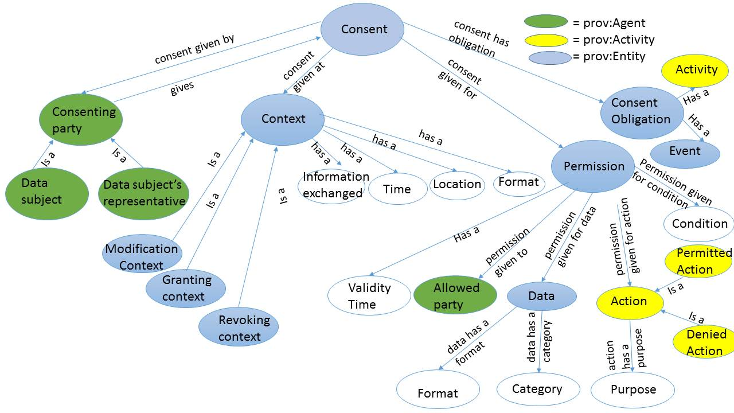
Consent Ontology
https://openscience.adaptcentre.ie/projects/CDMM/

Slide 11
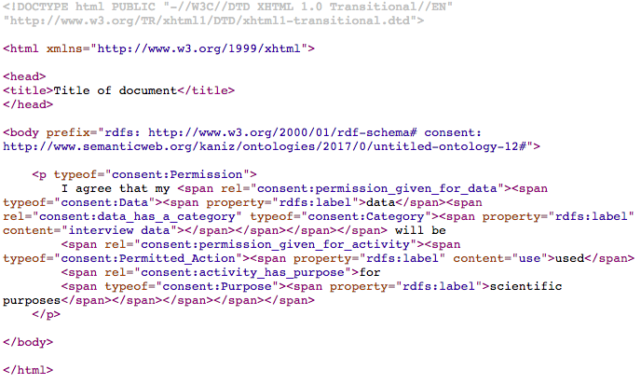
Annotation of consent with elements of ontology in RDFa
I agree that my data will be used for scientific purposes

Slide 12
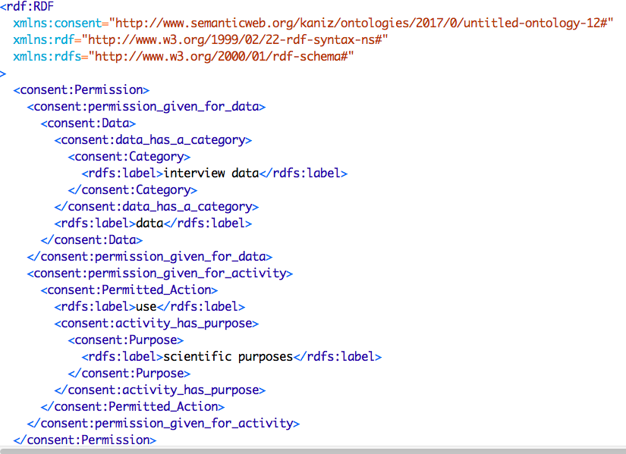
RDF representation of the annotated XHTML

Slide 13
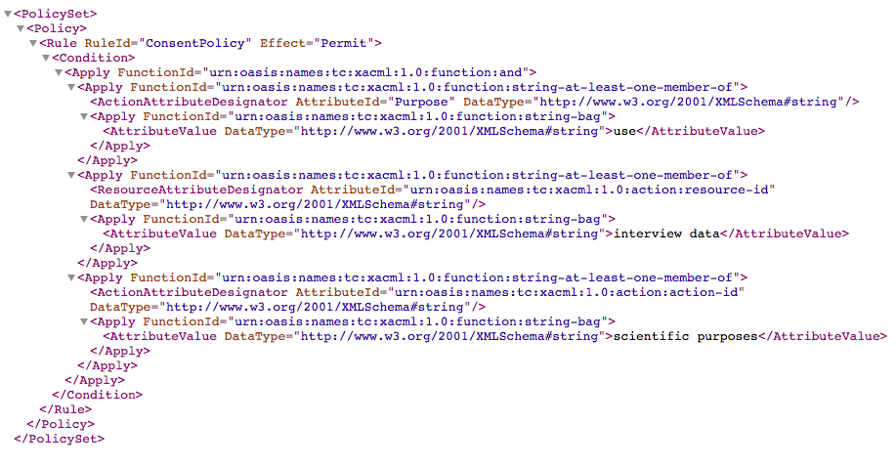
XACML Permission Rule generated using XPARQL

Slide 14
Conclusions and Further Work
GDPR implies a full lifecycle management of consent that encloses the lifecycle management of personal data
Open Data Formats give us the tools to handle Consent as a first class object in Data Protection Management
Explored the generation of XACML permissions from human readable consent via RDF instance
Future Work:
Assessing generation of access control rules against consent forms and privacy policies
Integration with PROV for compliance tracking
Integration with ODRL for third party compliance agreements

Slide 15



Work with the ADAPT Centre!
2 Year MSCA Postdoc Fellowships Incoming to Ireland
For info: edge@tcd.ie

