Slide 1

GDPRtEXT
GDPR as a Linked Data Resource
Harshvardhan J. Pandit¹, Kaniz Fatema², Declan O‘Sullivan¹, Dave Lewis¹
¹ ADAPT Centre, Trinity College Dublin, Dublin Ireland
² University of Derby, Derby, United Kingdom
The ADAPT Centre is funded under the
SFI Research Centres Programme (Grant 13/RC/2106)
and is co-funded under the European Regional Development Fund.

Slide 2

GDPR???
General Data Protection
Regulation (GDPR)
New data protection law for EU
Implemented from 25th May 2018
Affects legal basis for how our personal data is being used by organisations

Slide 3
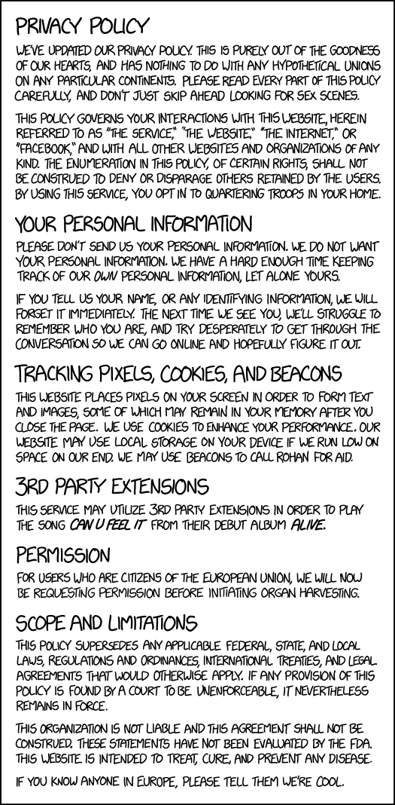

Consent
Information given to user
What data is collected?
How is it used?
Who is it shared with?
How long is it stored for?
https://www.flickr.com/photos/cardkarma/
https://xkcd.com/1998/

Slide 4
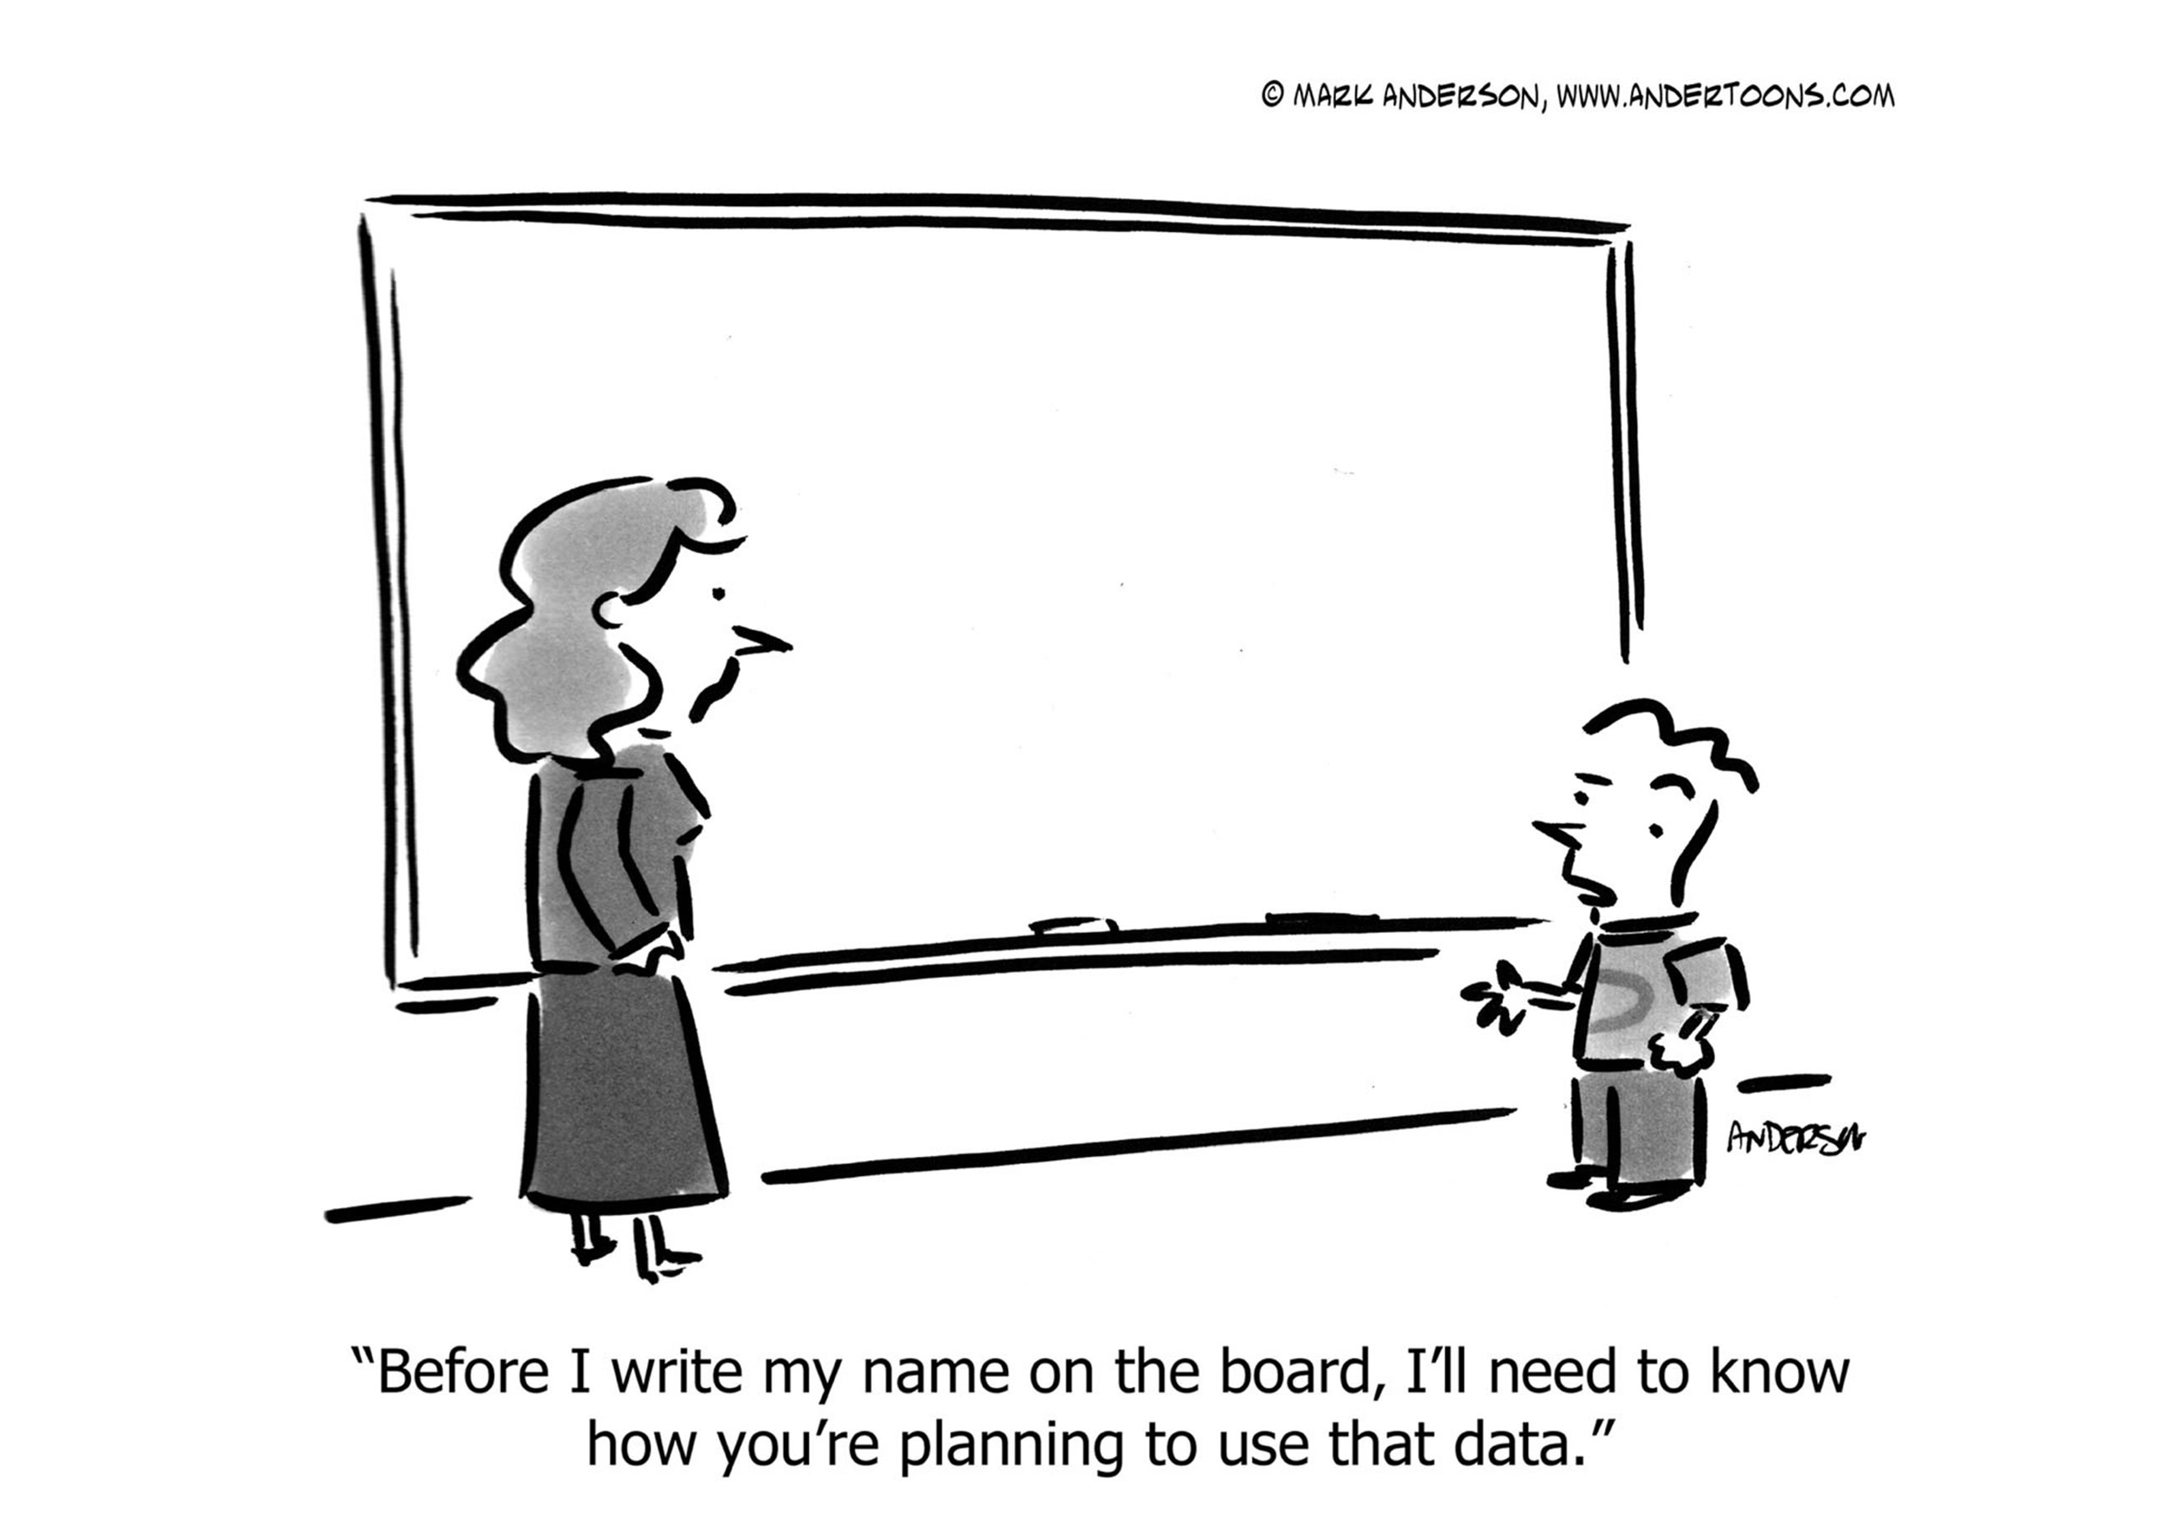

Slide 5


Motivation
  Developed GDPRov [1],
  an ontology for modelling provenance related to GDPR compliance
How to relate with GDPR obligations and concepts?
[1] Pandit, H.J., Lewis, D.: Modelling Provenance for GDPR Compliance using Linked Open Data Vocabularies. In: Proceedings of the 5th Workshop on Society, Privacy and the Semantic Web - Policy and Technology (PrivOn2017) (PrivOn) (2017).

Slide 6
GDPR document
References to are textual
Articles: Article 4(11), A4-11
Concepts: Compliance, Personal Data
No consistent format in legal domain
Arbitrary citations
Great for humans, but not for machines

Slide 7
Existing Work
Legalislations – Linked Data – Semantic Web
European Publications Office provides only document level metadata
How to refer to specific articles,
terms, or concepts within GDPR?
research problem right here!

Slide 8
GDPRtEXT
(GDPR text extensions)
1. Expose the GDPR document as Linked Data
2. Define an ontology of its terms and concepts

Slide 9
Approach
Understand document structure
Represent as linked data
Identify terms and concepts
Define Ontology

Slide 10
Structure of GDPR
Recitals (173)
Chapters (10 – numbered I to X)
  Sections (numbered in every chapter)
    Articles (total 99, continuos numbering)
      Points (numbered in every article)
        Subpoints (numbered in every point)
Citations (21)

Slide 11
GDPRtEXT Ontology
Extend ELI Ontology
eli:LegalResource (LR) is a legal resource
eli:LegalResourceSubdivision (LRS) is its (sub-)part
We extend LRS to define:
  Chapter
  Section
  Article
  Point
  SubPoint
  Recital
  Citation
ELI Ontology
European Legislation Identifier
Published by European Publications Office
Defines metadata for legal documents
GDPRtEXT uses latest version (v1.1)
https://publications.europa.eu/en/mdr/eli/index.html

Slide 12
GDPR Catalog define using DCAT / VOID
Dataset | Distribution | Comment
canonical | HTML, PDF, XML | Official GDPR distributions
textid, dataset | HTML, JSON, text | GDPR text with IDs
annotated | XML, Turtle, JSON-LD | RDF

Slide 13
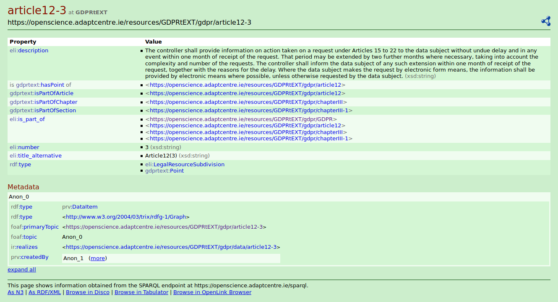
GDPR → RDF / SPARQL

Slide 14
GDPRtEXT Ontology
Defining GDPR terms and concepts
Define term
  skos:Concept
  without broad/narrow
Link to definition in GDPR text
  rdfs:isDefinedBy
  rdfs:seeAlso
Additional relations
  gdprtext:involves
OWL2 vocabulary
200+ concepts/terms
purl.org for persistent url
CC-by-4.0 license
Zenodo
10.5281/zenodo.1146350
Datahub
http://datahub.ckan.io/dataset/gdprtext
data.gov.ie
https://data.gov.ie/dataset/gdprtext

Slide 15
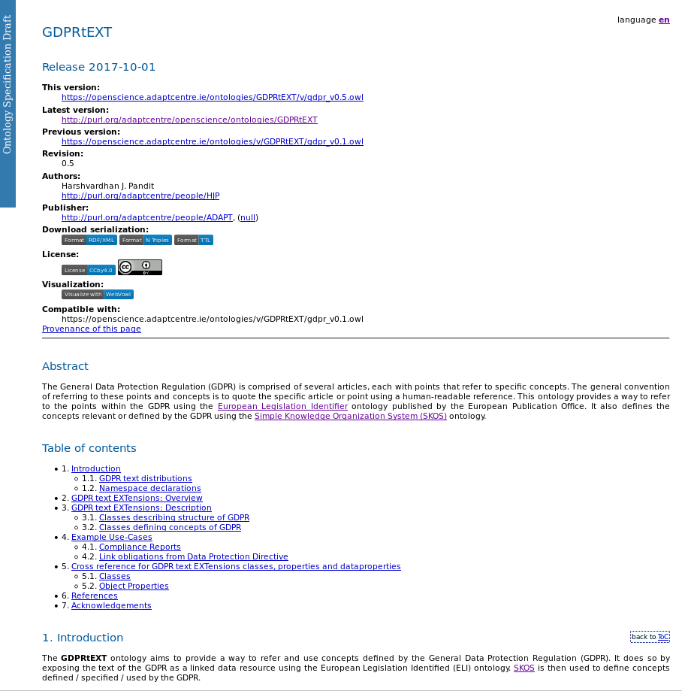
Documentation
Widoco
https://doi.org/10.5281/zenodo.591294
LODE
http://www.essepuntato.it/lode
WebVOWL
http://vowl.visualdataweb.org/
Available online
https://openscience.adaptcentre.ie/ontologies/GDPRtEXT/deliverables/docs/index-en.html

Slide 16
DPD → GDPR
Data Protection Directive (DPD)
Reuse existing work from DPD to GDPR?
XACML rules for compliance [1]
Map DPD obligations to GDPR
Quantify what has changed
[1] Fatema, K., Debruyne, C., Lewis, D., OSullivan, D., Morrison, J.P., Mazed, A.A.: A semi-automated methodology for extracting access control rules from the european data protection directive. In: Security and Privacy Workshops (SPW), 2016 IEEE. pp. 25–32. IEEE (2016)

Slide 17

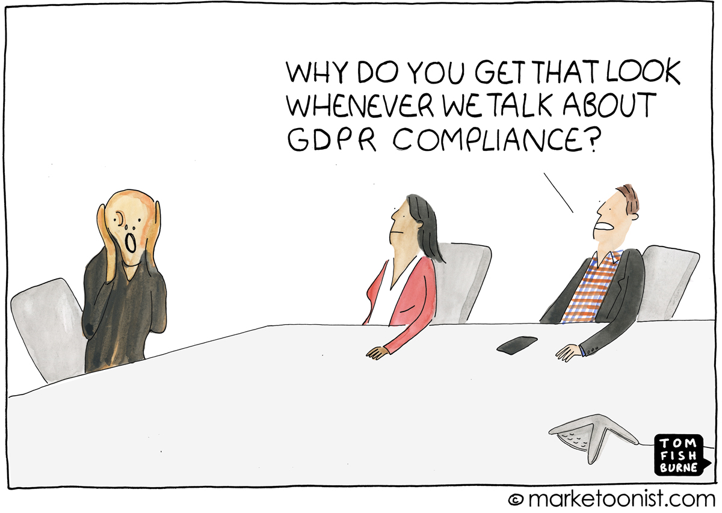
Benefits - Compliance
Documentation
Reports
Privacy Policy
Licenses
Link Legal Datasets
Relate Laws

Slide 18
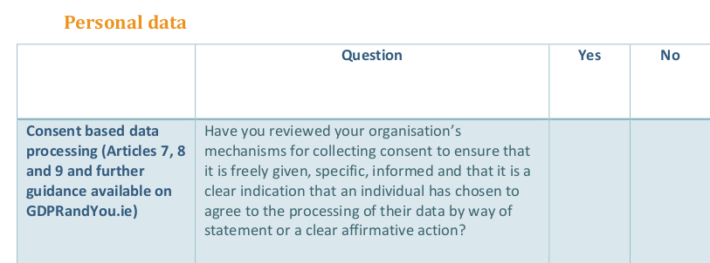
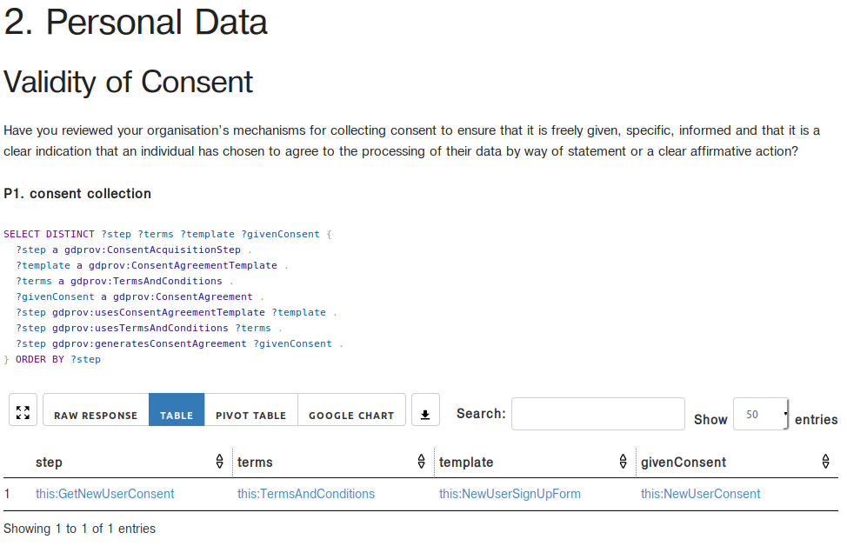
GDPR Readiness Checklist provided by
Data Protection Commissioner, Ireland
Populate checklist with SPARQL queries
Turn text based approaches to semantic approaches!
Harshvardhan J. Pandit, Declan O‘Sullivan, Dave Lewis. “Queryable Provenance Metadata For GDPR Compliance“. SEMANTiCS 2018. in-press

Slide 19
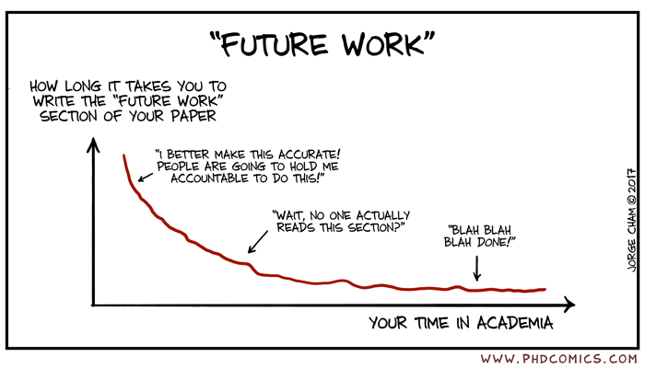
Future
Work
Adapt recent change/correction to GDPR
Extend approach to other legal documents
Participate in W3C Data Privacy and Controls Vocabulary Group (DPCV)
Possible collaboration with lexparency.org

Slide 20
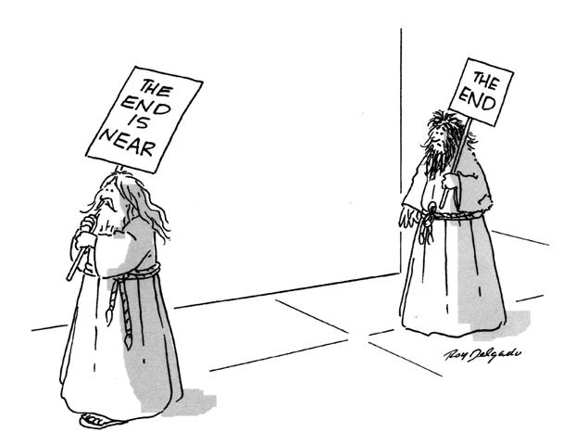
GDPRtEXT
GDPR as a Linked Data Resource
Harshvardhan J. Pandit, Kaniz Fatema, Declan O‘Sullivan, Dave Lewis

