Slide 1
GDPRtEXT GDPR as a Linked Data Resource
Harshvardhan J. Pandit¹, Kaniz Fatema², Declan O‘Sullivan¹, Dave Lewis¹
¹ ADAPT Centre, Trinity College Dublin, Dublin Ireland
² University of Derby, Derby, United Kingdom
The ADAPT Centre is funded under the
SFI Research Centres Programme (Grant 13/RC/2106)
and is co-funded under the European Regional Development Fund.

Slide 2
GDPR???
General Data Protection Regulation (GDPR)
New data protection law for EU
Implemented from 25th May 2018
Affects legal basis for how our personal data is being used by organisations

Slide 3
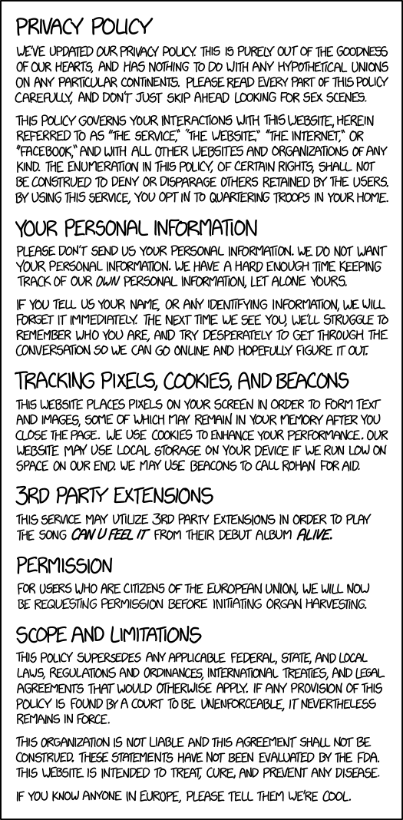

Consent
Information given to user
What data is collected?
How is it used?
Who is it shared with?
How long is it stored for?
https://www.flickr.com/photos/cardkarma/
https://xkcd.com/1998/

Slide 4
GDPR document
References to GDPR are textual
E.g. Article 4(11), A4-11
No consistent format for these
Great for humans, but not for machines

Slide 5
Existing Work
Legal documents are already provided as linked data (and use semantic web!!!)
But they only define document level metadata, so we have a way to refer to GDPR itself, but…
How to refer to its specific points, terms, or concepts ← research problem right here!

Slide 6
Target Use-Case
GDPRov – a provenance vocabulary for consent and data lifecycles based on GDPR
Extends PROV-O and P-Plan
How to relate with GDPR obligations and concepts?

Slide 7
Solution ?
A way to refer to the articles within GDPR with different levels of granularity
A way to refer to the terms and concepts within GDPR
Using Semantic Web!

Slide 8
Approach
Understand structure
Convert links to Semantic Web notations
Identify relevant terms and concepts
Define Ontology

Slide 9
Structure of GDPR
Recitals (173)
Chapters (10 – numbered I to X)
Sections (numbered in every chapter)
Articles (total 99, continuos numbering)
Points (numbered in every article)
Subpoints (numbered in every point)
Citations (21)

Slide 10
GDPR on the Web
Official copy of GDPR is available as HTML
Extract statements from it using JS
Refer to each reference using HTML id attributes
Like - gdpr.html#article4-11

Slide 11
ELI Ontology European Legislation Identifier
Published by European Publications Office
We use latest version, v1.1 (2016-09)
https://publications.europa.eu/en/mdr/eli/index.html

Slide 12
GDPRtEXT Ontology Extend ELI Ontology
eli:LegalResource (LR) is a legal resource
eli:LegalResourceSubdivision (LRS) is its (sub-)part
We extend LRS to define:
Chapter
Section
Article
Point
SubPoint
Recital
Citation

Slide 13
GDPR Catalog define using DCAT / VOID
Dataset | Distribution | Comment
canonical | HTML, PDF, XML | Official GDPR distributions
textid, dataset | HTML, JSON, text | GDPR text with IDs
annotated | XML, Turtle, JSON-LD | RDF

Slide 14
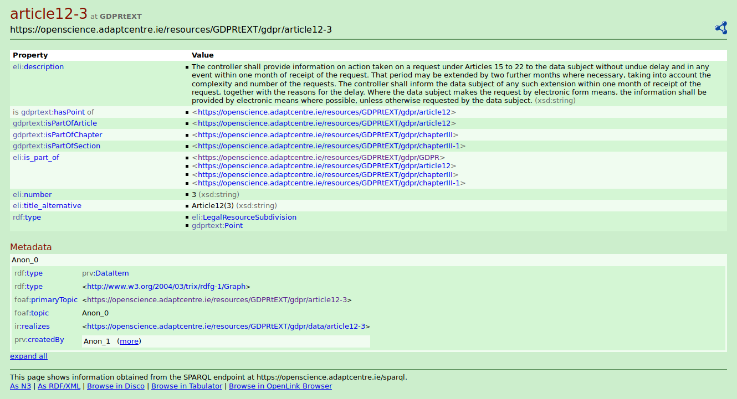

Slide 15
Published
Zenodo
10.5281/zenodo.1146350
Datahub
https://datahub.ckan.io/dataset/gdprtext
data.gov.ie
https://data.gov.ie/dataset/gdprtext

Slide 16
GDPRtEXT Ontology Defining GDPR terms and concepts
Define term
skos:Concept without broad/narrow
Link to definition in GDPR text
rdfs:isDefinedBy
Additional relations
Annotation property involves

Slide 17
GDPRtEXT Ontology Defining GDPR terms and concepts
OWL2 vocabulary
200+ concepts/terms
purl.org for persistent url
CC-by-4.0 license

Slide 18
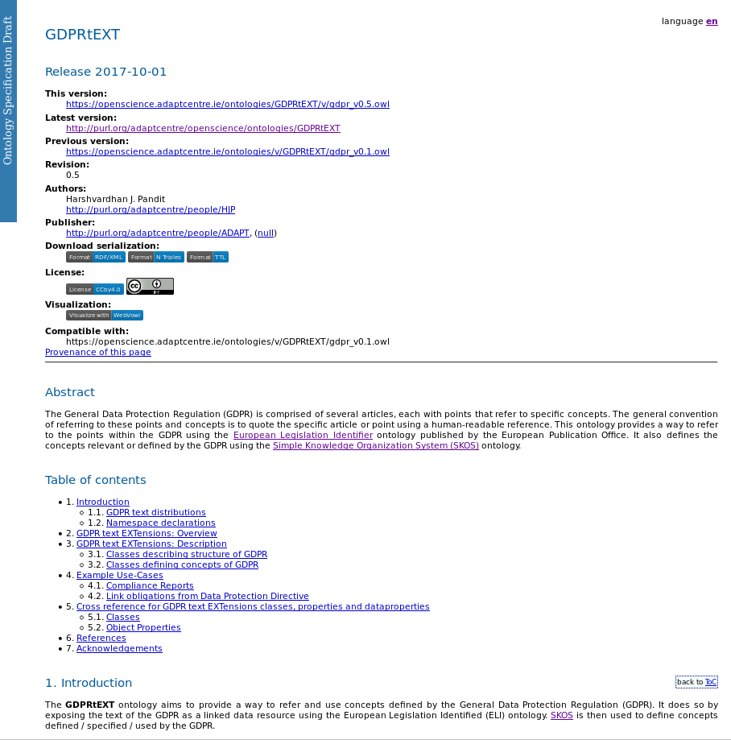
Documentation
Widoco
https://doi.org/10.5281/zenodo.591294
LODE
http://www.essepuntato.it/lode
WebVOWL
http://vowl.visualdataweb.org/
Available online
https://openscience.adaptcentre.ie/ontologies/GDPRtEXT/deliverables/docs/index-en.html

Slide 19
DPD to GDPR
Data Protection Directive (DPD)
Link related points as
Same (no change)
Reduced (less requirements)
Slightly Changed (minor change)
Completely Changed (major change)
Extended (more requirements)

Slide 20
Benefits
Compliance Documentation
Reports
Privacy Policy
Licenses
Link Legal Datasets
Relate Laws

Slide 21
Future Work
Expand GDPRtEXT vocabulary
Adapt recent change/correction to GDPR
Extend approach to other legal documents
Possible collaboration with lexparency.org

Slide 22
Thank you...
GDPRtEXT GDPR as a Linked Data Resource

