Slide 1
Data Privacy Vocabulary v0.1
http://w3.org/ns/dpv
W3C Data Privacy Vocabularies and Controls CG
Sep 2019
Harshvardhan J. Pandit
PhD Researcher
ADAPT Centre, Trinity College Dublin
me@harshp.com
License for this presentation: CC-by-NC 4.0

Slide 2
Data Privacy Vocabularies and Controls Community Group
https://www.w3.org/community/dpvcg/
W3C Community Group made up of academia, industry, legal experts
Objective: to provide Vocabularies based on the heterogeneity or homogeneity of the agreed upon use cases and requirements, we will define a single or a modular set of vocabularies for exchanging and representing interoperably: personal data, purposes/processing, disclosure/consent, anonymisation, and transparency logs.
Released first draft of Data Protection Vocabulary (dpv)
Access at http://w3.org/ns/dpv
Development at http://github.com/dpvcg/dpv
Welcome feedback and comments !!!

Slide 3
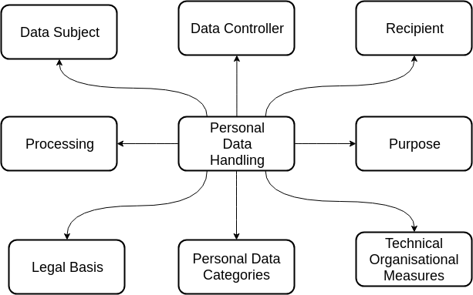
DPV - A collection of vocabularies

Slide 4
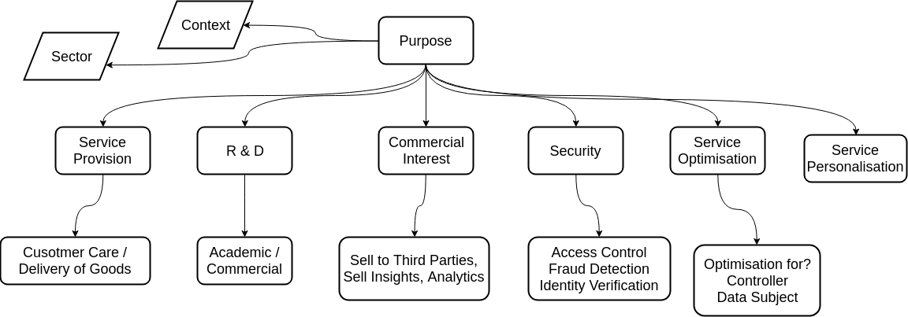
Purposes

Slide 5
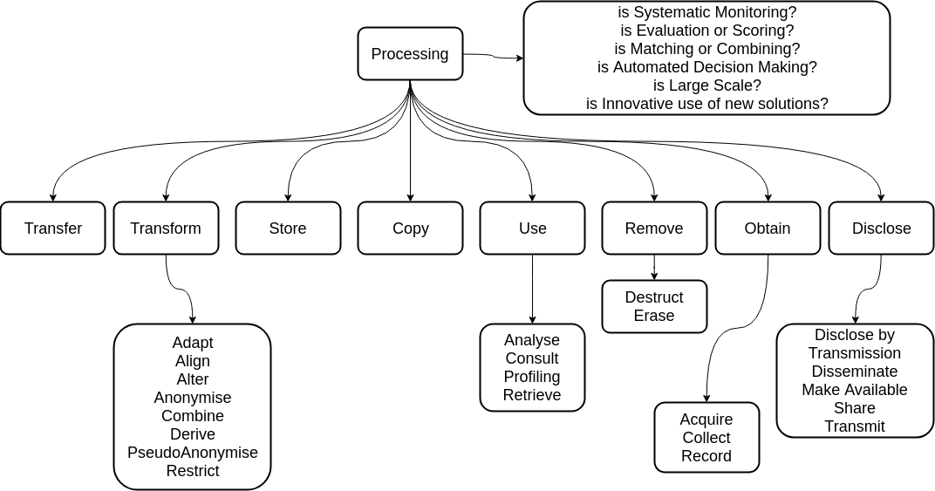
Processing

Slide 6
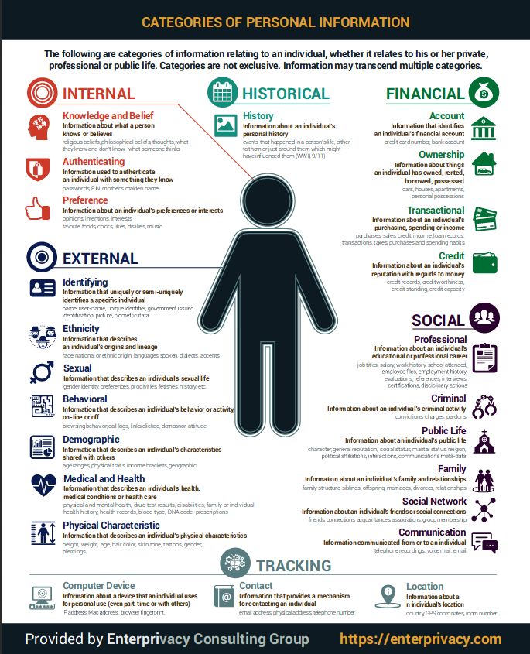
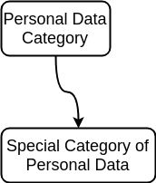
Personal Data Categories

Slide 7
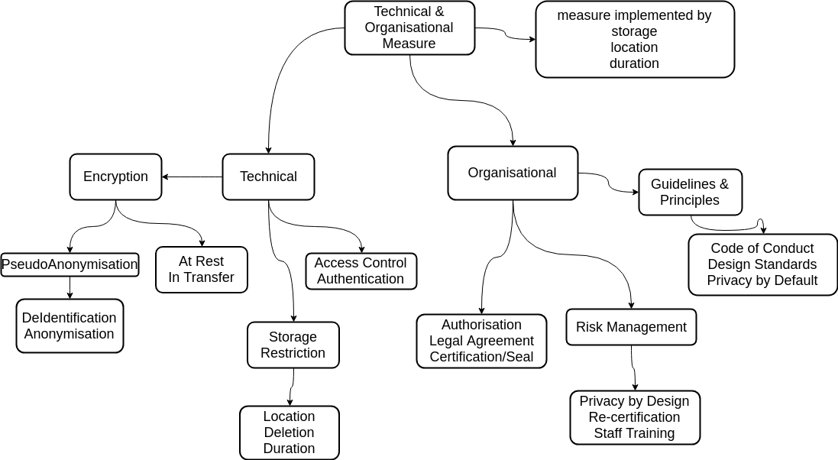
Technical and Organisational Measure

Slide 8
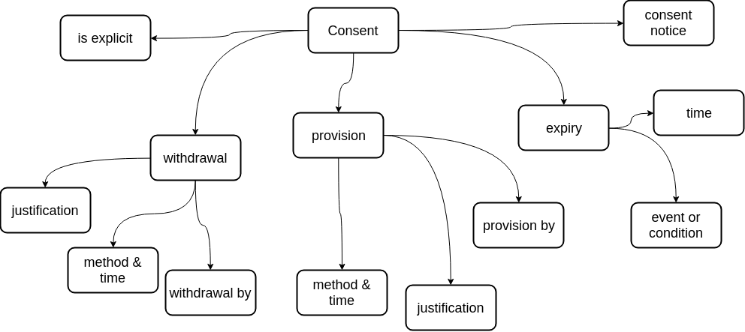
Consent

Slide 9
Representation
RDF+OWL2
JSON-LD
Controlled Vocabulary
Semantic Web
W3C Standards
Universal Serialisation
Knowledge Graphs
Inferences + Rules
Web-native JSON
Ready to integrate
Linking vocabularies
Bridge between semantics and systems
Compatible with Knowledge Graphs
Words only (Text)
Loses semantics
Cannot be extended
Cannot be reasoned
Easy to integrate

Slide 10
Ongoing Work
Examples and Use-Cases
Expand with more categories
Recipients, Third Parties, Roles
Contribute
Join DPVCG
Send suggestions/comments/feedbacks to public mailing list
Interact on Github
Communicate with one of the CG members

Slide 11
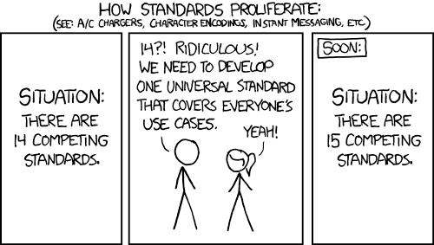
Data Privacy Vocabulary http://w3.org/ns/dpv W3C Data Privacy Vocabularies and Controls CG
Harshvardhan J. Pandit
PhD Researcher
ADAPT Centre, Trinity College Dublin
me@harshp.com

