Slide 1


Persisting through a Ph.D.
Harshvardhan J. Pandit
email: pandith@tcd.ie
The ADAPT Centre is funded under the SFI Research Centres Programme (Grant 13/RC/2106) and is co-funded under the European Regional Development Fund.

Slide 2
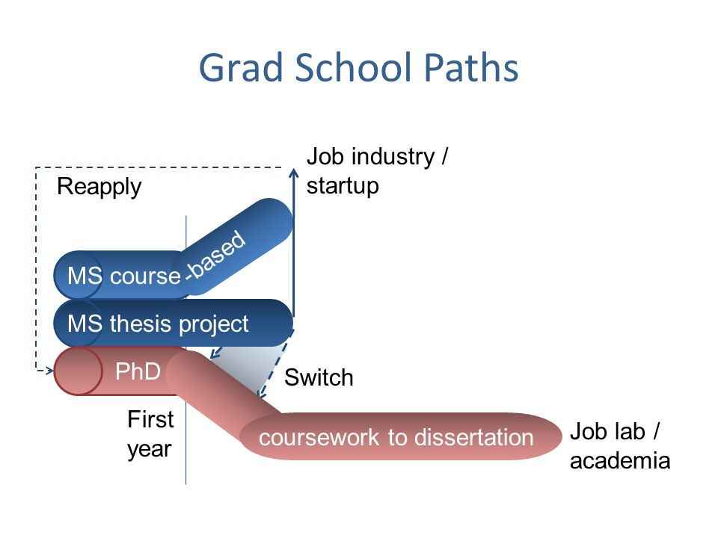
Background
Bachelor of Engineering (Computers)
First exposure and interest in ‘research’
Develop a semantic virtual file system
MSc by Research
almost like a mini-PhD
topic: enable sharing ‘knowledge’ in smartphone apps to create smart assistants
Testing whether I really want to do ‘research’
How I ended up at ADAPT?
They had funding
Interesting area, Good reputation
Large research group → More opportunities

Slide 3

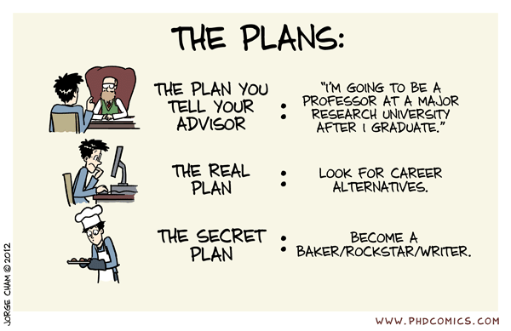
PhD Goals
PhD Researcher in Theme E
Focus areas: Data Protection and Privacy
Specific focus on: General Data Protection Regulation
But what specific area to research on?

Slide 4
GDPR ???
New regulation, replaces previous Data Protection Regulation
In effect from 25th May 2018
Fines up to 20 million euros or 4% of global turnover, whichever is HIGHER
Requires ‘informed’ and ‘explicit’ consent that specifies -
What data is going to be collected?
For what purposes?
For how long?
Shared with whom and why?

Slide 5

My Research Goals
Express Privacy laws and Regulations using Linked Open Data
Create Ontologies to capture and express compliance information
Formulate a method to automate the testing of compliance

Slide 6
Buzzwords - am I going to use that?
AI
Machine Learning
NLP
Blockchain
Cloud
Big Data

Slide 7

Impact of work
Define privacy terms and conditions using LOD
Machine readable - so it can be reasoned over
Track provenance for processes
What happens when services change?
User withdraws consent?
Effect on services?
How to visualise changes to the user?

Slide 8
Driving Points
Data
Permissions
Services
User data
Generated
Archived
Anonymity
Metadata
Granular
Specificity
Broad
Abstract
Third-party
Advertising
Third-party
Product betterment
Tracking
Profiling

Slide 9
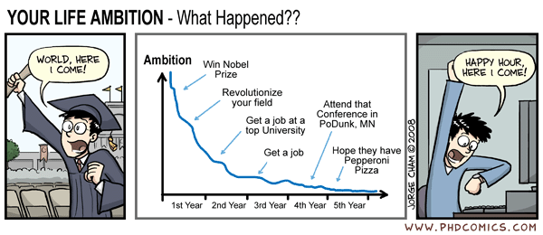
PhD so far
Finding my own strengths and weaknesses
Experiment with what kind of work I ‘like’ to do
Confidence & Independence
Research skills - asking the right questions
Discipline

Slide 10
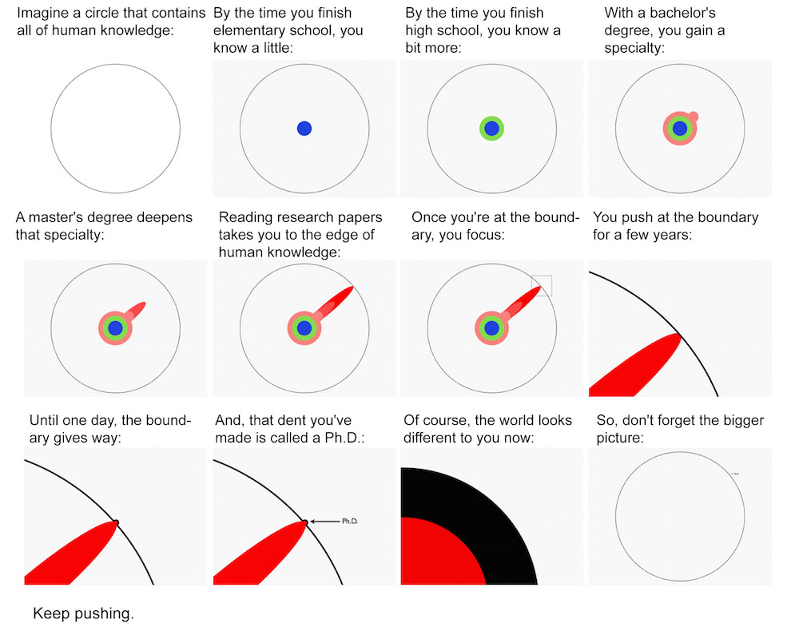
Should you do a PhD?
It’s a very very personal choice - only you can answer that
Would you really like to do ‘research’?
We also have ‘industry’ PhDs which are more hands-on
Talk with as many people as you can
Try to understand what work you find interesting
Check the people you want to work with

