Slide 1





Creating A Vocabulary for Data Privacy
The First-Year Report of Data Privacy Vocabularies and Controls Community Group (DPVCG)
Harshvardhan J. Pandit¹, Axel Polleres², Bert Bos, Rob Brennan, Bud Bruegger, Fajar J. Ekaputra, Javier D. Fernández, Roghaiyeh Gachpaz Hamed, Elmar Kiesling, Mark Lizar, Eva Schlehahn, Simon Steyskal, and Rigo Wenning
DPV vocabulary: https://w3.org/dpv
¹Presenter: Harshvardhan J. Pandit ADAPT Centre, Trinity College Dublin, Ireland
email: pandith@tcd.ie | twitter: @coolharsh55
² Axel Polleres Vienna University of Economics and Business, Austria
email: axel.polleres@wu.ac.at
This work was supported by the European Union’s Horizon 2020 research and innovation programme under grant 731601 (SPECIAL), by the Austrian Research Promotion Agency (FFG) under the projects “EXPEDiTE” and “CitySpin”, by the ADAPT Centre for Digital Excellence funded by SFI Research Centres Programme (Grant 13/RC/2106), and co-funded by European Regional Development Fund.
The ADAPT Centre is funded under the SFI Research Centres Programme (Grant 13/RC/2106) and is co-funded under the European Regional Development Fund.
Notes:
@chrdebru have added both email - switch order as you like
link to project website openscience.adaptcentre.ie
link to ontology w3id.org/GConsent
documentation contains all resources and examples in the slides, plus more information

Slide 2
Overview
Authors:
Harshvardhan J. Pandit (Trinity College Dublin)
Axel Polleres (Vienna University of Economics and Business)
Bert Bos (W3C/ERCIM)
Rob Brennan (Dublin City University)
Bud Bruegger (Unabhängige Landeszentrum für Datenschutz Schleswig-Holstein)
Fajar J. Ekaputra (Vienna University of Technology)
Javier D. Fernández (Vienna University of Economics and Business)
Ramisa Gachpaz Hamed (Trinity College Dublin)
Elmar Kiesling (Vienna University of Technology)
Mark Lizar (OpenConsent/Kantara Initiative)
Eva Schlehan (Unabhängige Landeszentrum für Datenschutz Schleswig-Holstein)
Simon Steyskal (Siemens)
Rigo Wenning (W3C/ERCIM)
Background
DPVCG
Methodology
Existing & Related Work
Data Privacy Vocabulary
    Base Ontology
    Purposes
    Processing
    Technical & Organisational
    Measures
    Personal Data Categories
    Consent (Legal Base)
Future Work
We thank all members of the W3C DPVCG for their feedback and input to this work: a preliminary outline of the goals of CG has been presented in ISWC2018’s SWSG workshop [5] where we also gathered valuable feedback by the participants; this work is the first complete presentation of the resulting, proposed vocabulary elaborated by the DPVCG since.

Slide 3
Overview
Laws such as GDPR (EU, 2016) & CCPA (CA, 2018) regulate processing of personal data
Obligations and compliance requirements provide motivation for adopting technical solutions
Momentum towards interoperable privacy solutions (e.g. ISO 27701)
However, there are still some gaps to address:
Lack of standardised vocabularies for representing
  - personal data categories (what?)
  - purposes of processing (why? & how?)
No aligned terminology within privacy laws
Problem: How to represent information about handling (or processing) of personal data in a machine-readable format for compliance with data privacy laws such as GDPR and CCPA?

Slide 4
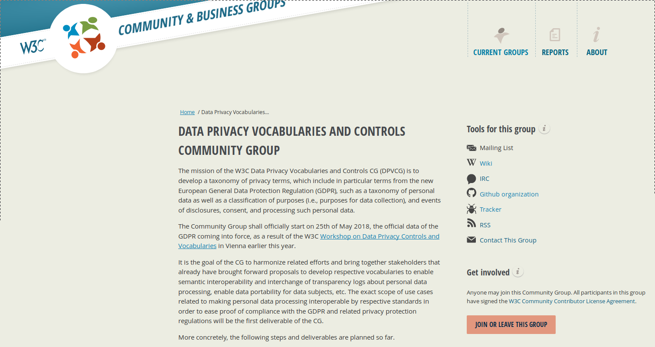
DPVCG
To address the issue, a W3C community group (CG) was started
  “Data Privacy Vocabularies & Controls CG”
Aim: To create vocabularies for representing personal data, purposes/processing, disclosure/consent, etc. in an interoperable format towards standardisation
Started: 25th May 2018
Members: 58 participants to date
Deliverable of work done till date:
  Data Privacy Vocabulary
    http://w3.org/ns/dpv
Public Mailing List
https://lists.w3.org/Archives/Public/public-dpvcg/
https://www.w3.org/community/dpvcg/

Slide 5
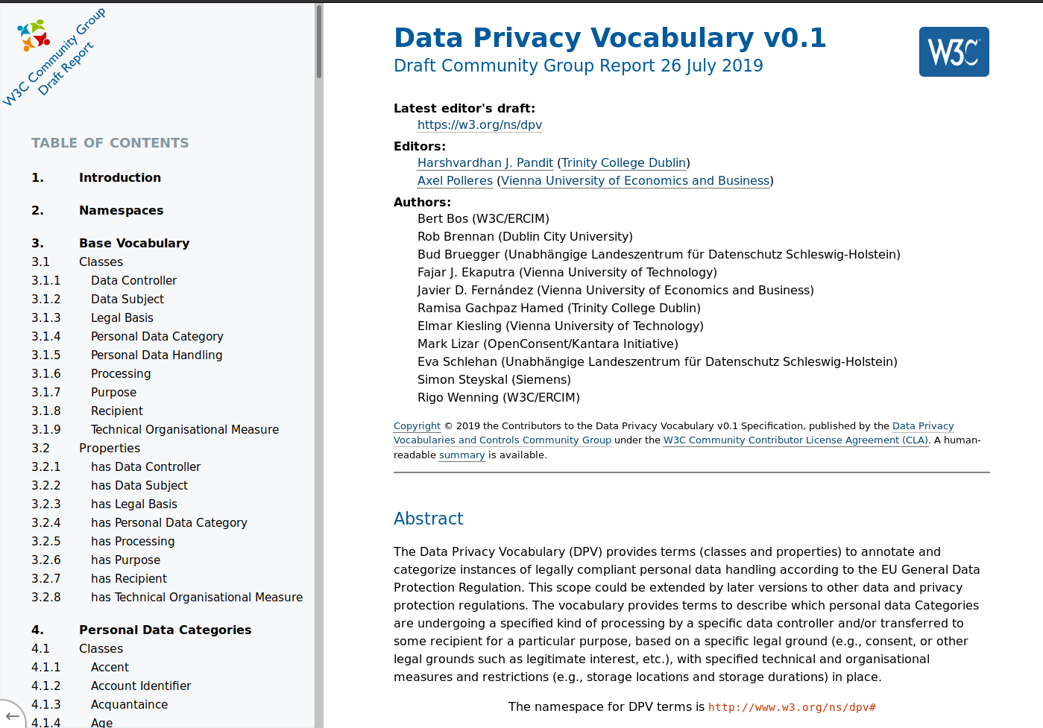
Data Privacy Vocabulary (DPV)
Modular vocabulary for representing personal data handling
Represented as an ontology using OWL2
Published: 26th July 2019
Models:
  Personal Data Categories
  Purposes
  Processing Categories
  Technical & Organisational Measures
  Legal Basis
  Consent
  Recipients, Data Controllers,
  Data Subjects
Link: http://w3.org/ns/dpv
GDPR Legal Basis Vocabulary
https://www.w3.org/ns/dpv-gdpr

Slide 6
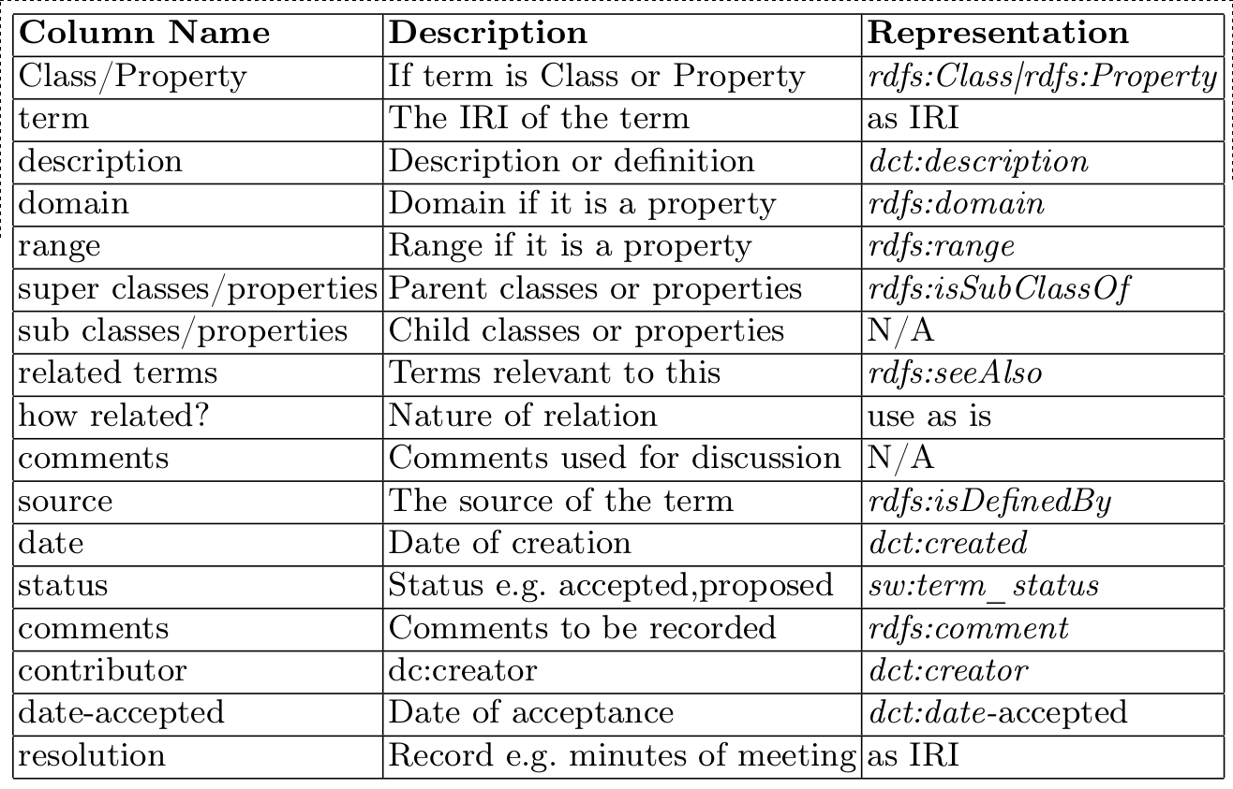
Methodology
(informally based) NeOn methodology for ontology development [28]
Decision to create top-level hierarchy of concepts
Analysis of existing and relevant work for reuse
Use of OWL for expressing relations and logic
Base Vocabulary adopted from SPECIAL Usage Policy [6]
Terms were proposed/resolved using spreadsheet in Google Sheets
Documentation generated
using W3C ReSpec
Repo on Github
Discussions via F2F and
public mailing list
[6] Bonatti, P.A., Kirrane, S., Petrova, I.M., Sauro, L., Schlehahn, E.: The SPECIAL Usage Policy Language, V0.1. Tech. rep. (2018), https://www.specialprivacy.eu/vocabs
[28] Suárez-Figueroa, M.C., Gómez-Pérez, A., Fernández-López, M.: The NeOn Methodology for Ontology Engineering. In: Suárez-Figueroa, M.C., Gómez- Pérez, A., Motta, E., Gangemi, A. (eds.) Ontology Engineering in a Net- worked World, pp. 9–34. Springer Berlin Heidelberg, Berlin, Heidelberg (2012). https://doi.org/10.1007/978-3-642-24794-1_2, http://link.springer. Com/10.1007/978-3-642-24794-1_2

Slide 7
Existing & Related Work
Document using Wiki https://www.w3.org/community/dpvcg/wiki/Main_Page
Identify relevant concepts and relationships in vocabularies
Standards
PROV-O
P-Plan
ODRL
vCard
ActivityStreams
COEL
CoreVocabularies (ISA2)
IEEE P7012
Consent Receipt v1.1
P3P
Vocabularies
SPECIAL project
MIREL project
DAPRECO project
GDPRtEXT
GDPRov
GConsent
Privacy Preference Ontology (PPO)
Reasons for not reusing concepts:
Importing all external semantics into DPV
Choice of OWL2 was made at a later stage of development
Not all concepts matched or fit in together

Slide 8
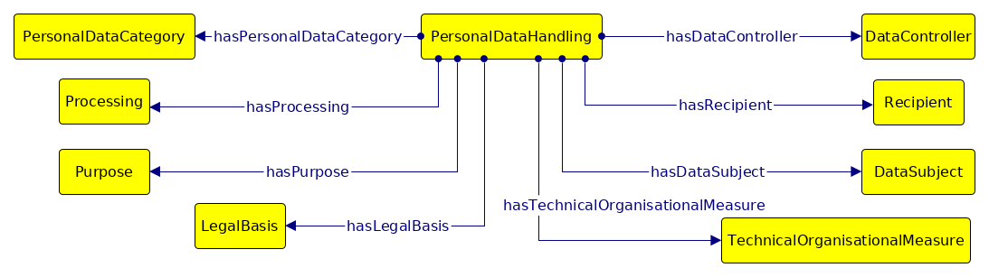
DPV – Base Ontology
Top-level classes defining a policy for legal personal data handling
Represented by class PersonalDataHandling
Connects different modular components

Slide 9

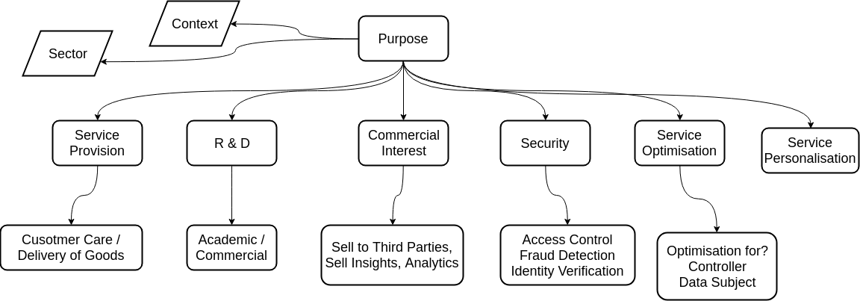
DPV – Purposes
Top-level categorisation of purposes
NACE*
:NewPurpose
rdfs:subClassOf dpv:DeliveryOfGoods, dpv:FraudPreventionAndDetection ;
rdfs:label "New Purpose" ;
rdfs:comment "Intended delivery of goods with fraud prevention" .
* RDFS representation of NACE https://github.com/dpvcg/dpv-nace

Slide 10
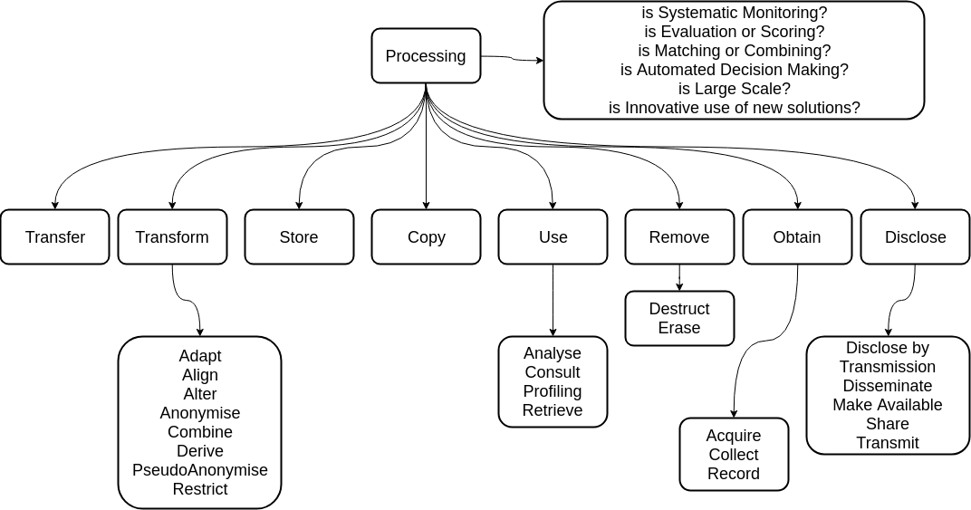
DPV – Processing
Hierarchy of Processing Categories

Slide 11
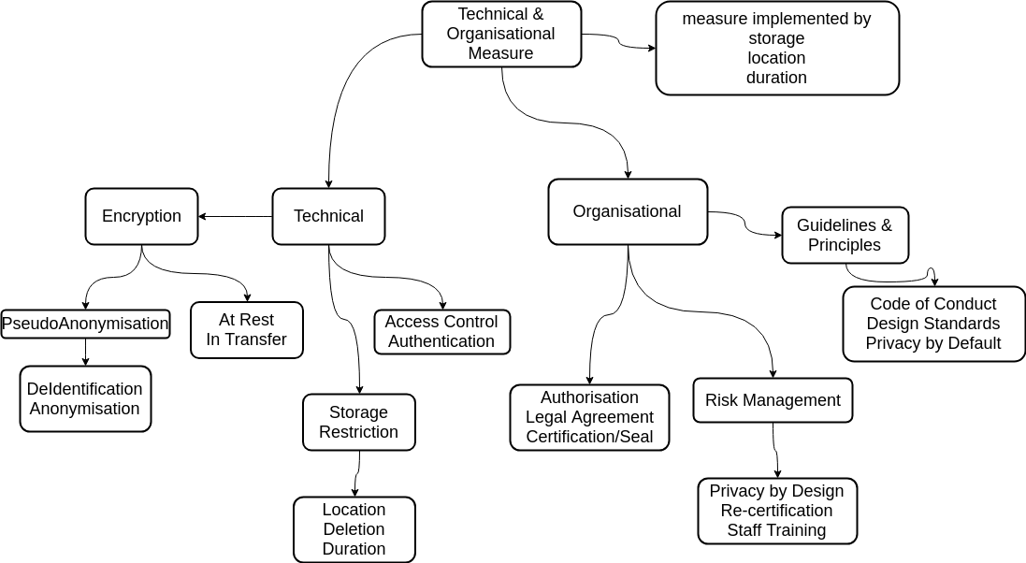
DPV – Technical & Organisational Measures
In the future, we plan to provide a collection of URIs for identifying recommended standards and best practices, e.g. ISO, ENISA, CEN

Slide 12
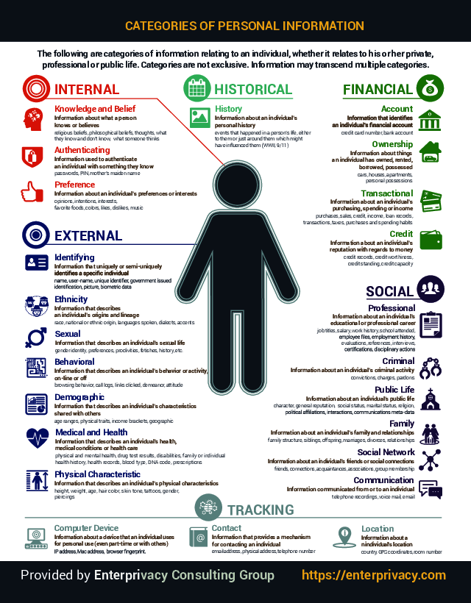
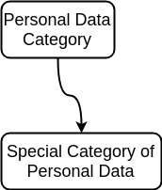
DPV – Personal Data
Utilise taxonomy provided by Enterprivacy
Extend for identified use-cases
Add required classes e.g. Special Categories or Sensitive Categories
:PresentationsLiked
rdfs:subClassOf dpv:Like ;
rdfs:label “Presentations Liked” .
Like → Interest → Preference → Internal

Slide 13
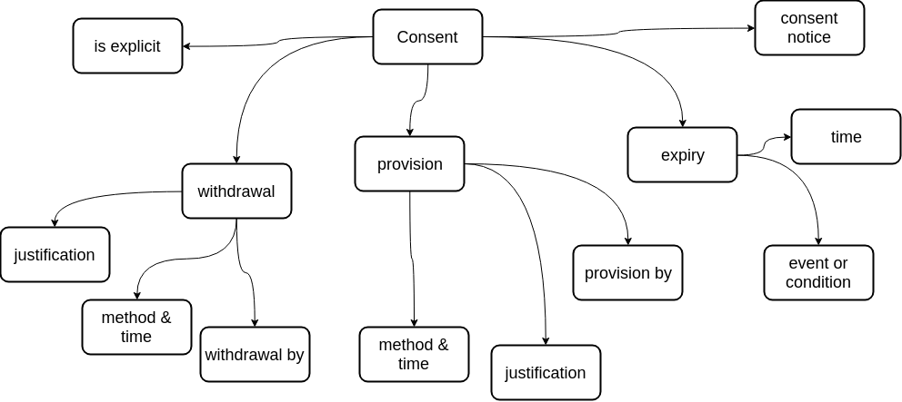
DPV – Legal Bases – Consent (GDPR)
Attributes required to demonstrate given consent satisfies all legal requirements – based on Consent Receipt v1.1 standard

Slide 14
Future Work
‘Primer Document’: non-technical introduction to DPV
Use-Cases and Examples documentation for adoption
Open & ongoing feedback/suggestion
- Github Issues / Pull-Requests
- Public Mailing Lists
Agreement towards v1 ‘stable’ vocabulary
Provide JSON-LD fragments for adoption on Web
Resolve open issues https://www.w3.org/community/dpvcg/track/issues/open
Invitation to join and participate!

Slide 15
~ end of presentation ~
Creating A Vocabulary for Data Privacy
The First-Year Report of Data Privacy Vocabularies and Controls Community Group (DPVCG)
Harshvardhan J. Pandit, Axel Polleres, Bert Bos, Rob Brennan, Bud Bruegger, Fajar J. Ekaputra, Javier D. Fernández, Roghaiyeh Gachpaz Hamed, Elmar Kiesling, Mark Lizar, Eva Schlehahn, Simon Steyskal, and Rigo Wenning
Presenter: Harshvardhan J. Pandit
ADAPT Centre, School of Computer Science & Statistics, Trinity College Dublin, Ireland
email: pandith@tcd.ie | twitter: @coolharsh55
DPV vocabulary: https://w3.org/dpv
This work was supported by the European Union’s Horizon 2020 research and innovation programme under grant 731601 (SPECIAL), by the Austrian Research Promotion Agency (FFG) under the projects “EXPEDiTE” and “CitySpin”, by the ADAPT Centre for Digital Excellence funded by SFI Research Centres Programme (Grant 13/RC/2106), and co-funded by European Regional Development Fund.
The ADAPT Centre is funded under the SFI Research Centres Programme (Grant 13/RC/2106) and is co-funded under the European Regional Development Fund.
Notes:
@chrdebru have added both email - switch order as you like
link to project website openscience.adaptcentre.ie
link to ontology w3id.org/GConsent
documentation contains all resources and examples in the slides, plus more information

